Slide 1
IPv6
Geoff Huston
APNIC

Slide 2
Why?

Slide 3
Because we’ve run out of addresses

Slide 4
again

Slide 5
We’ve been here before ...
The original ARPAnet design from 1969 used the NCP protocol, which used 8 bit addresses
  Maximum network of 256 nodes
  Enough, yes?

Slide 6
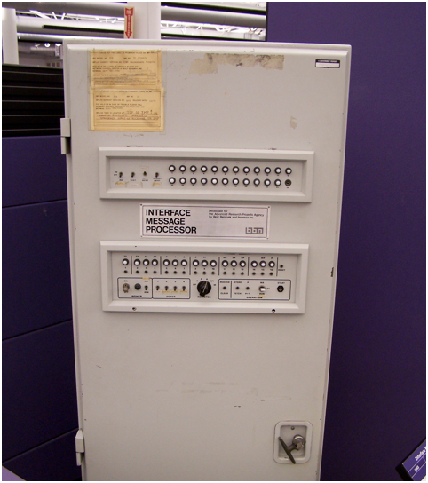
ARPAnet IMP

Slide 7
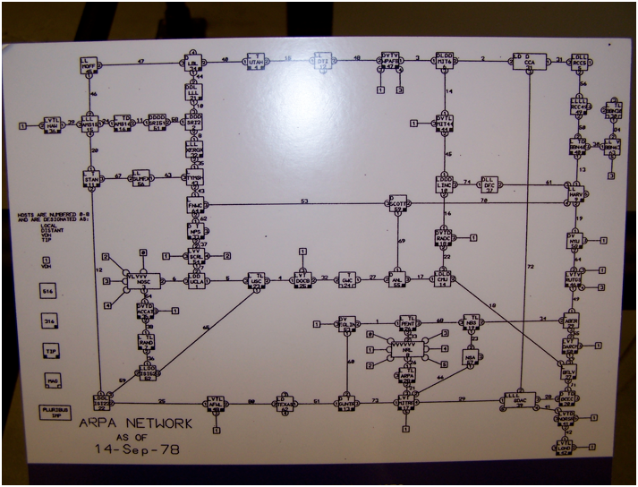
ARPAnet - September 1978

Slide 8
Transition V1.0
Turns out that 8 bits of addresses was not enough for the next generation of mini computers
ARPAnet undertook a transition from NCP to a new protocol: TCP/IP
  Expansion from 8 to 32 bit addresses
  Flag Day: 1 January 1983
  Shutdown and reboot every node into the new protocol

Slide 9
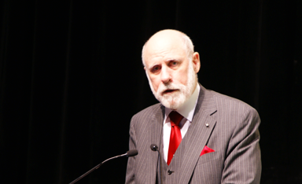
“This time, for sure!” *
* Actually Vint didn’t say this!

Slide 10
IP Version 4
32 bit address field
  That’s 4,294,967,296 addresses
We’ve used this to build today’s Internet:
  Some 400,000 networks
  Around 900 million connected devices
Some 29 years later, we’ve run out of addresses - again!

Slide 11
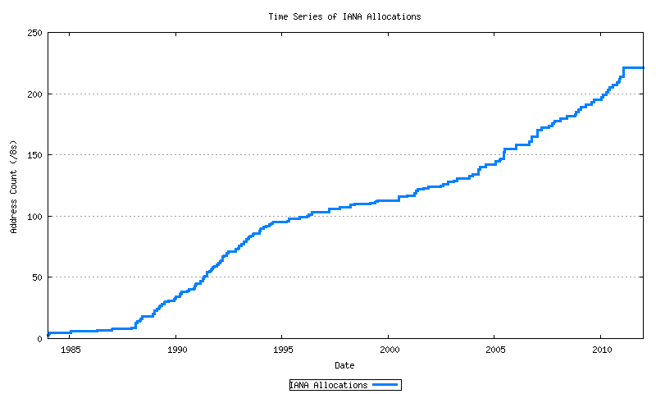
IPv4 Address Allocations

Slide 12
IPv4 Address Allocations
Exhaustion!
Mobiles
GFC
Broadband
Boom & Bust
CIDR
A&R networks
NSFNET

Slide 13

IPocalypse?

Slide 14

So we’ll hit the wall – right?

Slide 15
Maybe not
Many ISPs have been stockpiling IPv4 addresses
Address “recovery” programs are underway
So it’s not a sudden halt
But the addressed part of the network grew by more than 250 million services in 2010
  Which was the largest year so far for the Internet

Slide 16
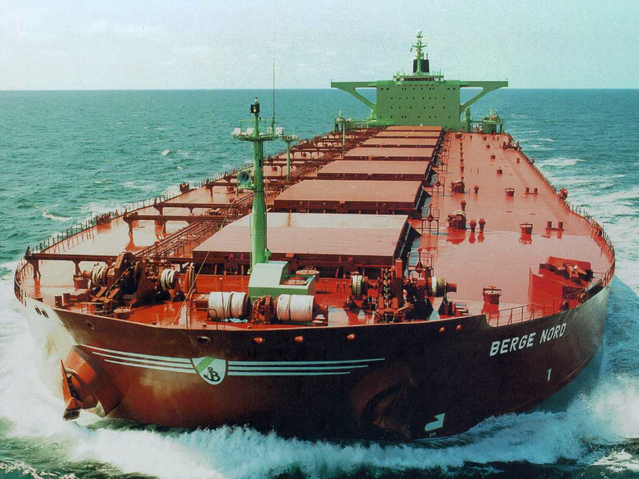
It’s more like this!

Slide 17
What are we transitioning to?

Slide 18
IPv6

Slide 19
Layer-3 Protocol Surgery
5
Application
4
TCP
UDP
ICMP
3
IPv4
2
Data Link
1
Physical
Notes:
Physical layer and data link layer stay the same: We keep using Ethernet, PPP, etc to carry our packets. Layer-4 protocols like TCP and UDP stay the same too, and applications interact with them in more or less the same way. But they’re carried by a new layer-3 protocol.
That’s all. That’s it. Not hard, is it?

Slide 20

Layer-3 Protocol Surgery
5
Application
Application
4
TCP
UDP
ICMP
TCP
UDP
ICMP
3
IPv4
IPv6
2
Data Link
Data Link
1
Physical
Physical
Only the IP layer changes – nothing else!
Notes:
Physical layer and data link layer stay the same: We keep using Ethernet, PPP, etc to carry our packets. Layer-4 protocols like TCP and UDP stay the same too, and applications interact with them in more or less the same way. But they’re carried by a new layer-3 protocol.
That’s all. That’s it. Not hard, is it?

Slide 21
What changes with IPv6?

Slide 22
What changes?
  128 bit address fields
  Fixed host/network boundary
  Replaced Broadcast and ARP with Multicast and SLAAC
  Removed on-the-fly fragmentation with ICMP6 notification to source
  No NATS!
  Multi-Addressing
  Scoped Addresses

Slide 23
What’s giving us grief?
  128 bit address fields
  Fixed host/network boundary
  Replaced Broadcast and ARP with Multicast and SLAAC
    But we need to retain DHCP for DNS auto-config
  Removed on-the-fly fragmentation with ICMP6 notification to source
  No NATS!
  Multi-Addressing
  Scoped Addresses
  No Backwards Compatibility

Slide 24
Technology Considerations
For simple LANs it is possible to “just turn it on”
  Although the lack of a NAT may be an issue
For more complex networks IPv6 requires careful engineering
  Particularly around prefix delegation
  And firewall configuration
And the dual stack environment introduces a whole new set of application problems

Slide 25
Transition V2.0
A “Flag Day” switchover is impossible
Piecemeal replacement won’t work either as IPv6 is not backward compatible with IPv4
So we need to run both protocols in tandem “for a while”
But bear in mind that one protocol has already run out of addresses
And network growth continues at record levels

Slide 26
Transition V2.0
We need to :
deploy IPv6 in parallel with IPv4
deploy ever more stringent IPv4 address conservation measures within the network
allow the network to expand at an ever increasing rate
All at the same time!

Slide 27
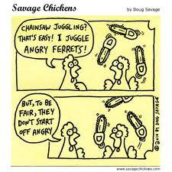
Maybe it’s like this!

Slide 28
Why is this so hard?

Slide 29
The IPv6 Transition Plan
Size of the Internet
IPv6 Deployment
IPv6 Transition – Dual Stack
IPv4 Pool Size
Time

Slide 30
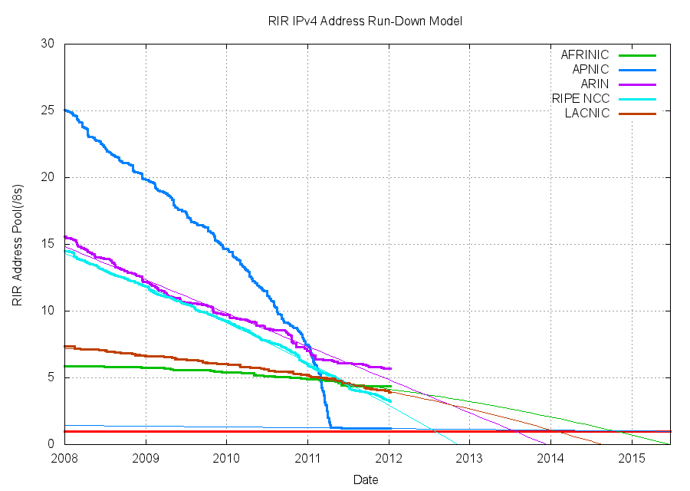
IPv4 Depletion

Slide 31
A Rough Census of the Network Edge
Counting IPv6 in client devices:
  Some 45% of devices run Windows Vista or Windows 7 - with IPv6 turned on
  Some 8% of devices run Mac OS X - with IPv6 turned on
  Some 35% of devices run Windows XP
About half of the devices out there have IPv6 installed and active
  And a large proportion of the other half are probably running Windows XP
http://en.wikipedia.org/wiki/Usage_share_of_operating_systems

Slide 32
A Rough Census of the Network Core
4,882 ASNs originate IPv6 prefixes (out of a total of 39,535 ASNs in the IPv4 routing table)
But 33,909 ASNs are stubs and 5,626 ASNs are transit
  49% of the IPv4 transit ASNs in routing space originate IPv6 prefixes
http://bgp.potaroo.net/v6/as2.0/

Slide 33
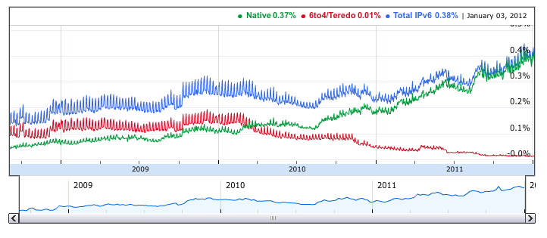
IPv6 capability, as seen by Google
http://www.google.com/intl/en/ipv6/statistics/

Slide 34
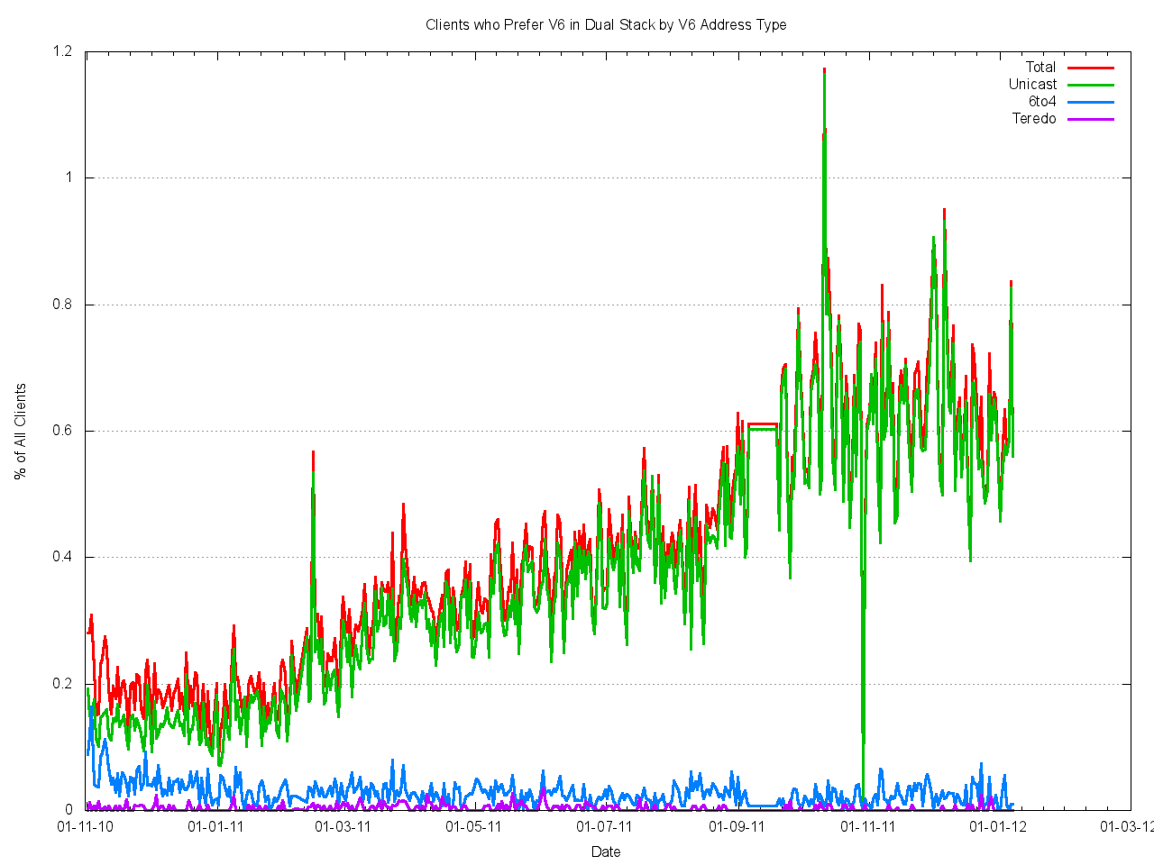
IPv6 capability, as seen by APNIC, 2011
1.2%
0.8%
0.4%
0.0%
Nov
Jan
Mar
May
Jul
Sep
Nov
Jan
http://www.potaroo.net/stats/1x1/sitec/

Slide 35
Ooops!
Access – 0.6% of end clients are served with an IPv6 access service that provides the client with a native IPv6 unicast address
Services – 0.7% of the Alexa top 1M web sites have AAAA records

Slide 36
The IPv6 Transition Plan - V2.0
Size of the Internet
IPv6 Deployment?
IPv6 Transition – Dual Stack
IPv4 Pool Size
2006
2008
2010
2012
2014
Date

Slide 37
What’s gone wrong?
It seems that we’ve managed to achieve only 2 out of 3 objectives for IPv6 deployment
And now the access industry has to deploy (and fund) IPv4 address extension mechanisms in addition to funding an IPv6 deployment
What’s going wrong in this gap between core and edge?
  Why has the access service sector been disinterested in any meaningful levels of IPv6 deployment so far?
  Why is the content industry lagging on IPv6 deployment?

Slide 38
Lessons from the Past
If this transition to IPv6 is proving challenging, then how did we ever get the IPv4 Internet up and running in the first place?

Slide 39
IPv4 Deployment Lessons
Technology: packet switching vs circuit switching
  lower network costs though pushing of functionality and cost to end systems exposed a new demand schedule for communications services
i.e. packet switching was far cheaper than circuit switching. This drop in cost exposed new market opportunities for emergent ISPs

Slide 40
Circuits to Packets:
The Demand Schedule Shift
d(IP)
Price
d(C)
s(C)
reduced cost of
supply, and increased
perception of value,
resulting in a new
equilibrium point with
higher quantity and
lower unit price
p(Circuits)
p(IP)
s(IP)
q(Circuits)
q(IP)
Quantity

Slide 41
IPv4 Deployment
Business: exposed new market opportunity in a market that was actively shedding many regulatory constraints
  exposed new market opportunities via arbitrage of circuits
    buy a circuit, resell it as packets
  presence of agile high-risk entrepreneur capital willing to exploit short term market opportunities exposed through this form of arbitrage
  volume-based suppliers initially unable to redeploy capital and process to meet new demand
    unable to cannibalize existing markets
    unwilling to make high risk investments

Slide 42
IPv4 Deployment
Small ISP
(Entrepreneur Sector)
Size of the Internet
High Volume Provider Industry
(Telco Sector)
~1990
~1995
~2000
Time

Slide 43
IPv4 Deployment
Business: exposed new market opportunity in a market that was actively shedding many regulatory constraints
  exposed new market opportunities via arbitrage of circuits
    buy a circuit, resell it as packets
  presence of agile high-risk entrepreneur capital willing to exploit short term market opportunities exposed through this form of arbitrage
  volume-based suppliers initially unable to redeploy capital and process to meet new demand
    unable to cannibalize existing markets
    unwilling to make high risk investments
  the maturing market represented an opportunity for large scale investment that could operate on even lower cost bases through economies of scale

Slide 44
IPv4 Deployment
Small ISP
(Entrepreneur Sector)
Size of the Internet
High Volume Provider Industry
(Telco Sector)
~1990
Time
~2005

Slide 45
What about IPv6 Transition?
Will the same technology, cost and regulatory factors that drove the deployment of the IPv4 Internet also drive this industry through the transition from IPv4 to IPv6?

Slide 46
IPv6 vs IPv4
Are there competitive differentiators?
no cost differential
no functionality differential
no inherent consumer-visible difference
no visible consumer demand
no visible competitive differentiators other
than future risk

Slide 47
IPv4 to Dual Stack:
The Demand Schedule Shift
Price
D_{V4 / DualStack}
No change in perception of value, so demand schedule is unaltered
Supply side cost increase due to Dual Stack operation
S_{DualStack}
P_{DualStack}
S_{V4}
P_{V4}
Q_{DualStack}
Q_{V4}
Quantity
Equilibrium point is at a lower quantity if Dual Stack supply costs are passed on to customers

Slide 48
The Transition to IPv6
Given that we’ve left it so late in terms of the scale of the transition and the degree of difficultly with IPv4 exhaustion, and given that there appears to be little motivation from some critical industry segments to embark on this transition --- will it happen at all?

Slide 49
The Transition to IPv6
Alternatively, is this transition an instance of a market failure?

Slide 50
“Market Failure”
Wikinomics:
“In economics, a market failure exists when the production or use of goods and services by the market is not efficient. That is, there exists another outcome where market participants' overall gains from the new outcome outweigh their losses (even if some participants lose under the new arrangement). Market failures can be viewed as scenarios where individuals' pursuit of pure self-interest leads to results that are not efficient – that can be improved upon from the societal point-of-view. The first known use of the term by economists was in 1958, but the concept has been traced back to the Victorian philosopher Henry Sidgwick.”
http://en.wikipedia.org/wiki/Market_failure

Slide 51
The Transition to IPv6
Alternatively, is this transition an instance of a market failure?
Individual self-interest leads to inefficient supply outcomes, as self-interest does not lead the installed based of consumers and suppliers to underwrite the cost of dual stack operation within the transition

Slide 52
IPv6 Transition as a “Public Good?”
Is the transition to IPv6 is non-excludable and non-rivalrous?
In which case this transition issue parallels that of a public good
With an implication that conventional market dynamics in a deregulated environment will not lead to this transition being undertaken
And a corollary that if this transition is considered to be necessary or essential then some form of public good solution needs to be considered

Slide 53
Public Good “solutions”
There are a number of conventional approaches to the distribution of a public good:
  Assurance contracts
  Coasian solutions
  Government enterprise provisioning
  Tariffs
  Subsidies
  Taxation remedies
  Regulatory impost

Slide 54
Regulatory Impost
A regulatory constraint is placed on the ISP carrier licence holders that IPv6 services are to be provided by a given deadline
  as has happened with digital television in many regulatory regimes.
This regulatory constraint acts a form of a assurance contract, where all providers are in effect bound to produce a particular solution

Slide 55
Government Purchase Contracts
Where the public sector collectively require the provision in IPv6 in all their service contracts.
This is a form of a coasian solution where a group of potential beneficiaries pool together their willingness to pay for the public good.
  We have seen this approach in the past with the Government OSI Profiles (GOSIP) of the late 1980's when the approach proved ineffectual.
  There is no assurance that such collective actions on the part of the public sector have sufficient mass and momentum to create a broader sustainable market that will impel the private sector to undertake the transition.

Slide 56
Subsidies and Incentives
Where the production of the good is subsidised in some fashion by public funds
  This can be in the form of direct payments to service providers, or in the form of vouchers to consumers which can be redeemed only in exchange for the supply of a specified service.
Related incentive measures include the use of taxation incentives related to infrastructure investment, where the investment in a certain class of infrastructure or in a certain sector can be provided with advantaged taxation treatment.

Slide 57
Public Provision
Where the service is provided by a publically-owned enterprise.
The funding for such an enterprise can be provided by government-backed investment bonds, or directly from public revenues, and operating losses are underwritten by the public purse.
  This measure was used for most national telephone service providers for a significant part of the twentieth century, so it is not exactly a completely foreign concept for this industry.

Slide 58
What About IPv4 Exhaustion?
Does IPv4 address exhaustion change this picture?
What are the economic implications of service providers adding CGNs to the current service offering based on IPv4?
Are CGNs and IPv6 mutually exclusive investment options for access providers?

Slide 59
Adding CGNs to IPv4:
The Demand Schedule Shift
D_{V4}
Price
D_{CGNs}
CGNs reduce functionality and
impair the performance of some applications
Supply side cost increase due to Dual Stack operation
S_{CGNs}
P_{CGNs}
S_{V4}
P_{V4}
Q_{CGNs}
Q_{V4}
Quantity
CGNs represent higher cost and lower value for customers

Slide 60
But is this all there is to CGNs?
Will CGN’s alter the user’s experience of services?
Does this alter the role (and location) of CDNs?
  Or has the CDN model already evolved to accommodate this evolution?
Do CGNs alter the leverage of the access provider with respect to service deployment?
  Is this an instance of a forced carriage toll gate that allows the carriage sector to renegotiate their relationship with the content access model

Slide 61
Further musing...
Do we really understand the dynamics and inter-relationships of the components of this industry?
Mobility Providers
Content
Providers
Users
Devices
Data Service
Aggregators
Access Providers
Transit Providers
Advertisers
Infrastructure Service
Providers

Slide 62
Further musing...
What drives the carriage sector?
What drives the content sector?
Is the open network architecture being offered by IPv6 fundamental to the objectives of either of these sectors?
Will they invest in IPv6 infrastructure and service provision?
If so, then why?
If not, then why not?

Slide 63
Your Thoughts?
Carriage vs Content
  Currently IT and the Internet has allowed content to shed carriage mediation and negotiate directly with the end consumer
  Will scarcity in the carriage activity enable carriage players to re-enter the content distribution function in a mediation (toll gate) role?

Slide 64
Thank You

