Slide 1
Tomorrow’s Internet
A highly personal (and somewhat opinionated) view by
Geoff Huston,
APNIC

Slide 2

The most profound technologies are those that disappear. They weave themselves into the fabric of everyday life until they are indistinguishable from it...
- Mark Weiser 1991

Slide 3
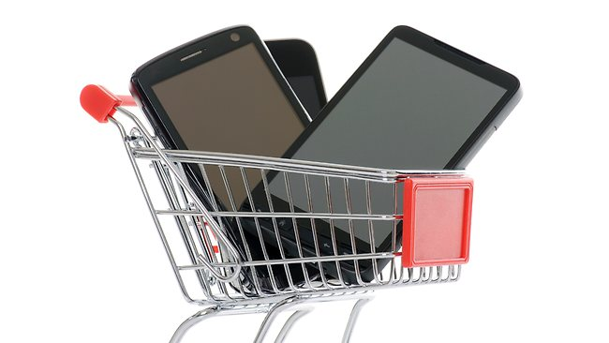
So how should we look at today’s Internet?
Is the fascination with mobile devices merely a temporary consumer fad, destined to be replaced by the next cool technology item?
Or is this an instance of a profound technology change that will bed down to be a part of our everyday life for many years to come?

Slide 4
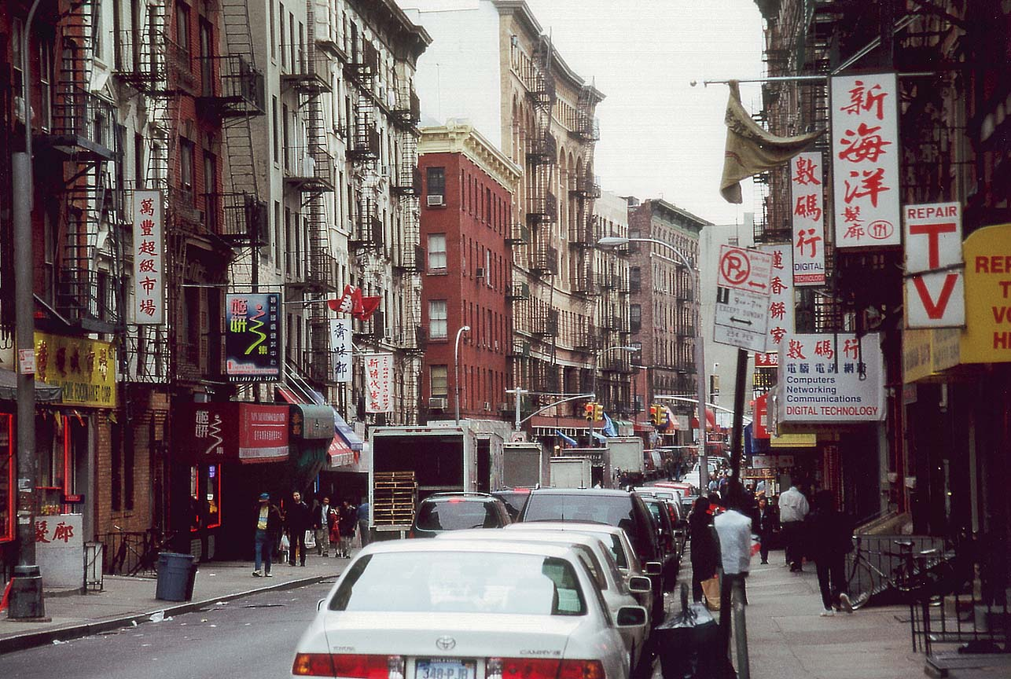
To try and answer this, lets try and put this question into some broader context of the evolution the computer and communications enterprise

Slide 5

The Computing and Comms Evolutionary Path
1946 – Eniac – a numeric calculator

Slide 6
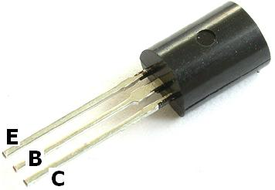
The Computing and Comms Evolutionary Path
1947– The Transistor

Slide 7
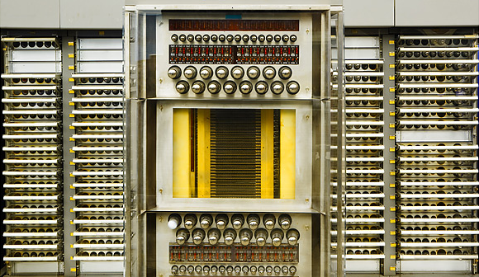
The Computing and Comms Evolutionary Path
1946 – Eniac – a numeric calculator
1954 SAGE – a programmable computer

Slide 8

The Computing and Comms Evolutionary Path
1964 IBM 360 – commercial computing
1964: IBM 360

Slide 9
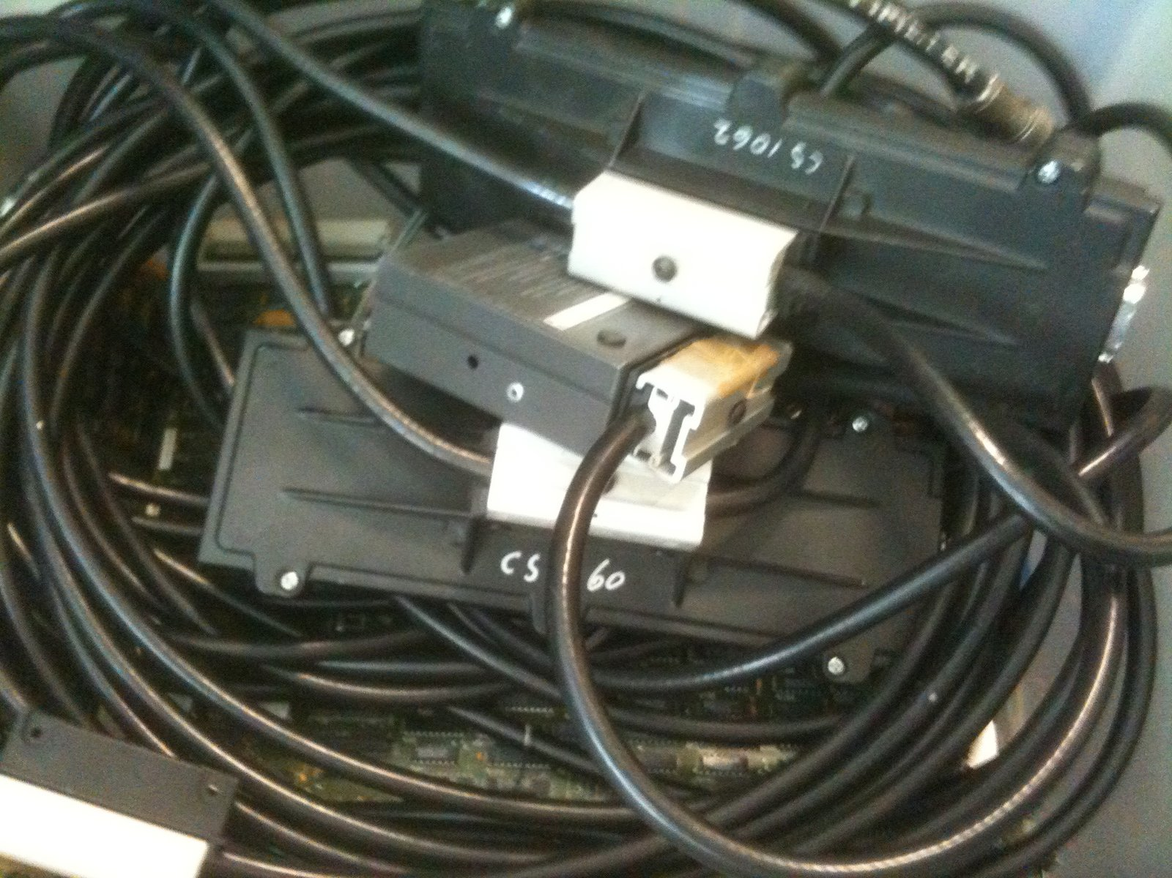
The Computing and Comms Evolutionary Path
1976 Ethernet

Slide 10

The Computing Evolutionary Path
The Computing and Comms Evolutionary Path
1976 CRAY-1 – “super” computing

Slide 11

The Computing Evolutionary Path
The Computing and Comms Evolutionary Path
A fork in the road:
1976 – Apple-1 “personal” computing
1976: Apple I

Slide 12
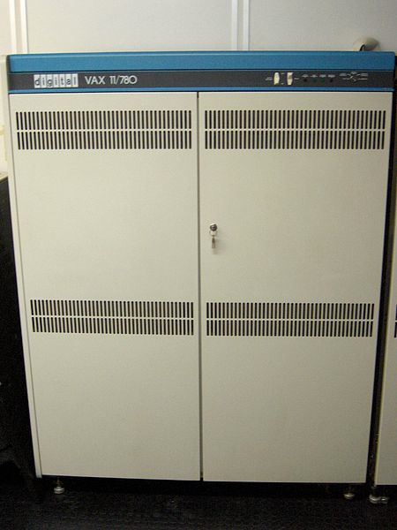
The Computing Evolutionary Path
The Computing and Comms Evolutionary Path
Wide Area Packet Networks
1982 – DECnet Phase IV

Slide 13

The Computing and Comms Evolutionary Path
1984 – Mac - visual computing

Slide 14
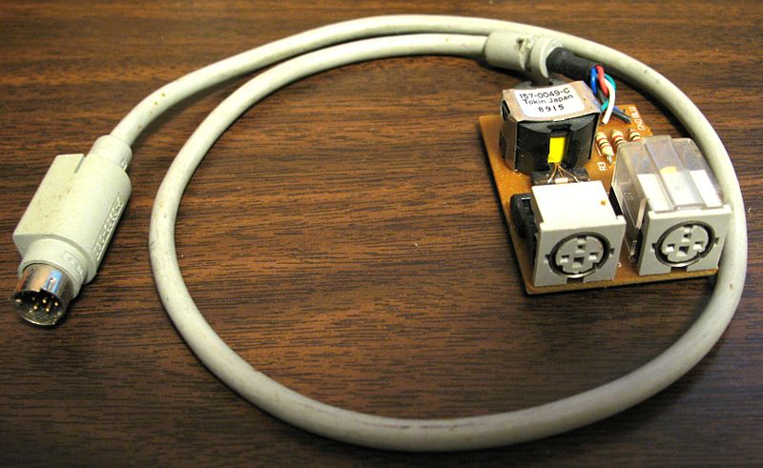
The Computing and Comms Evolutionary Path
1985 – Appletalk

Slide 15
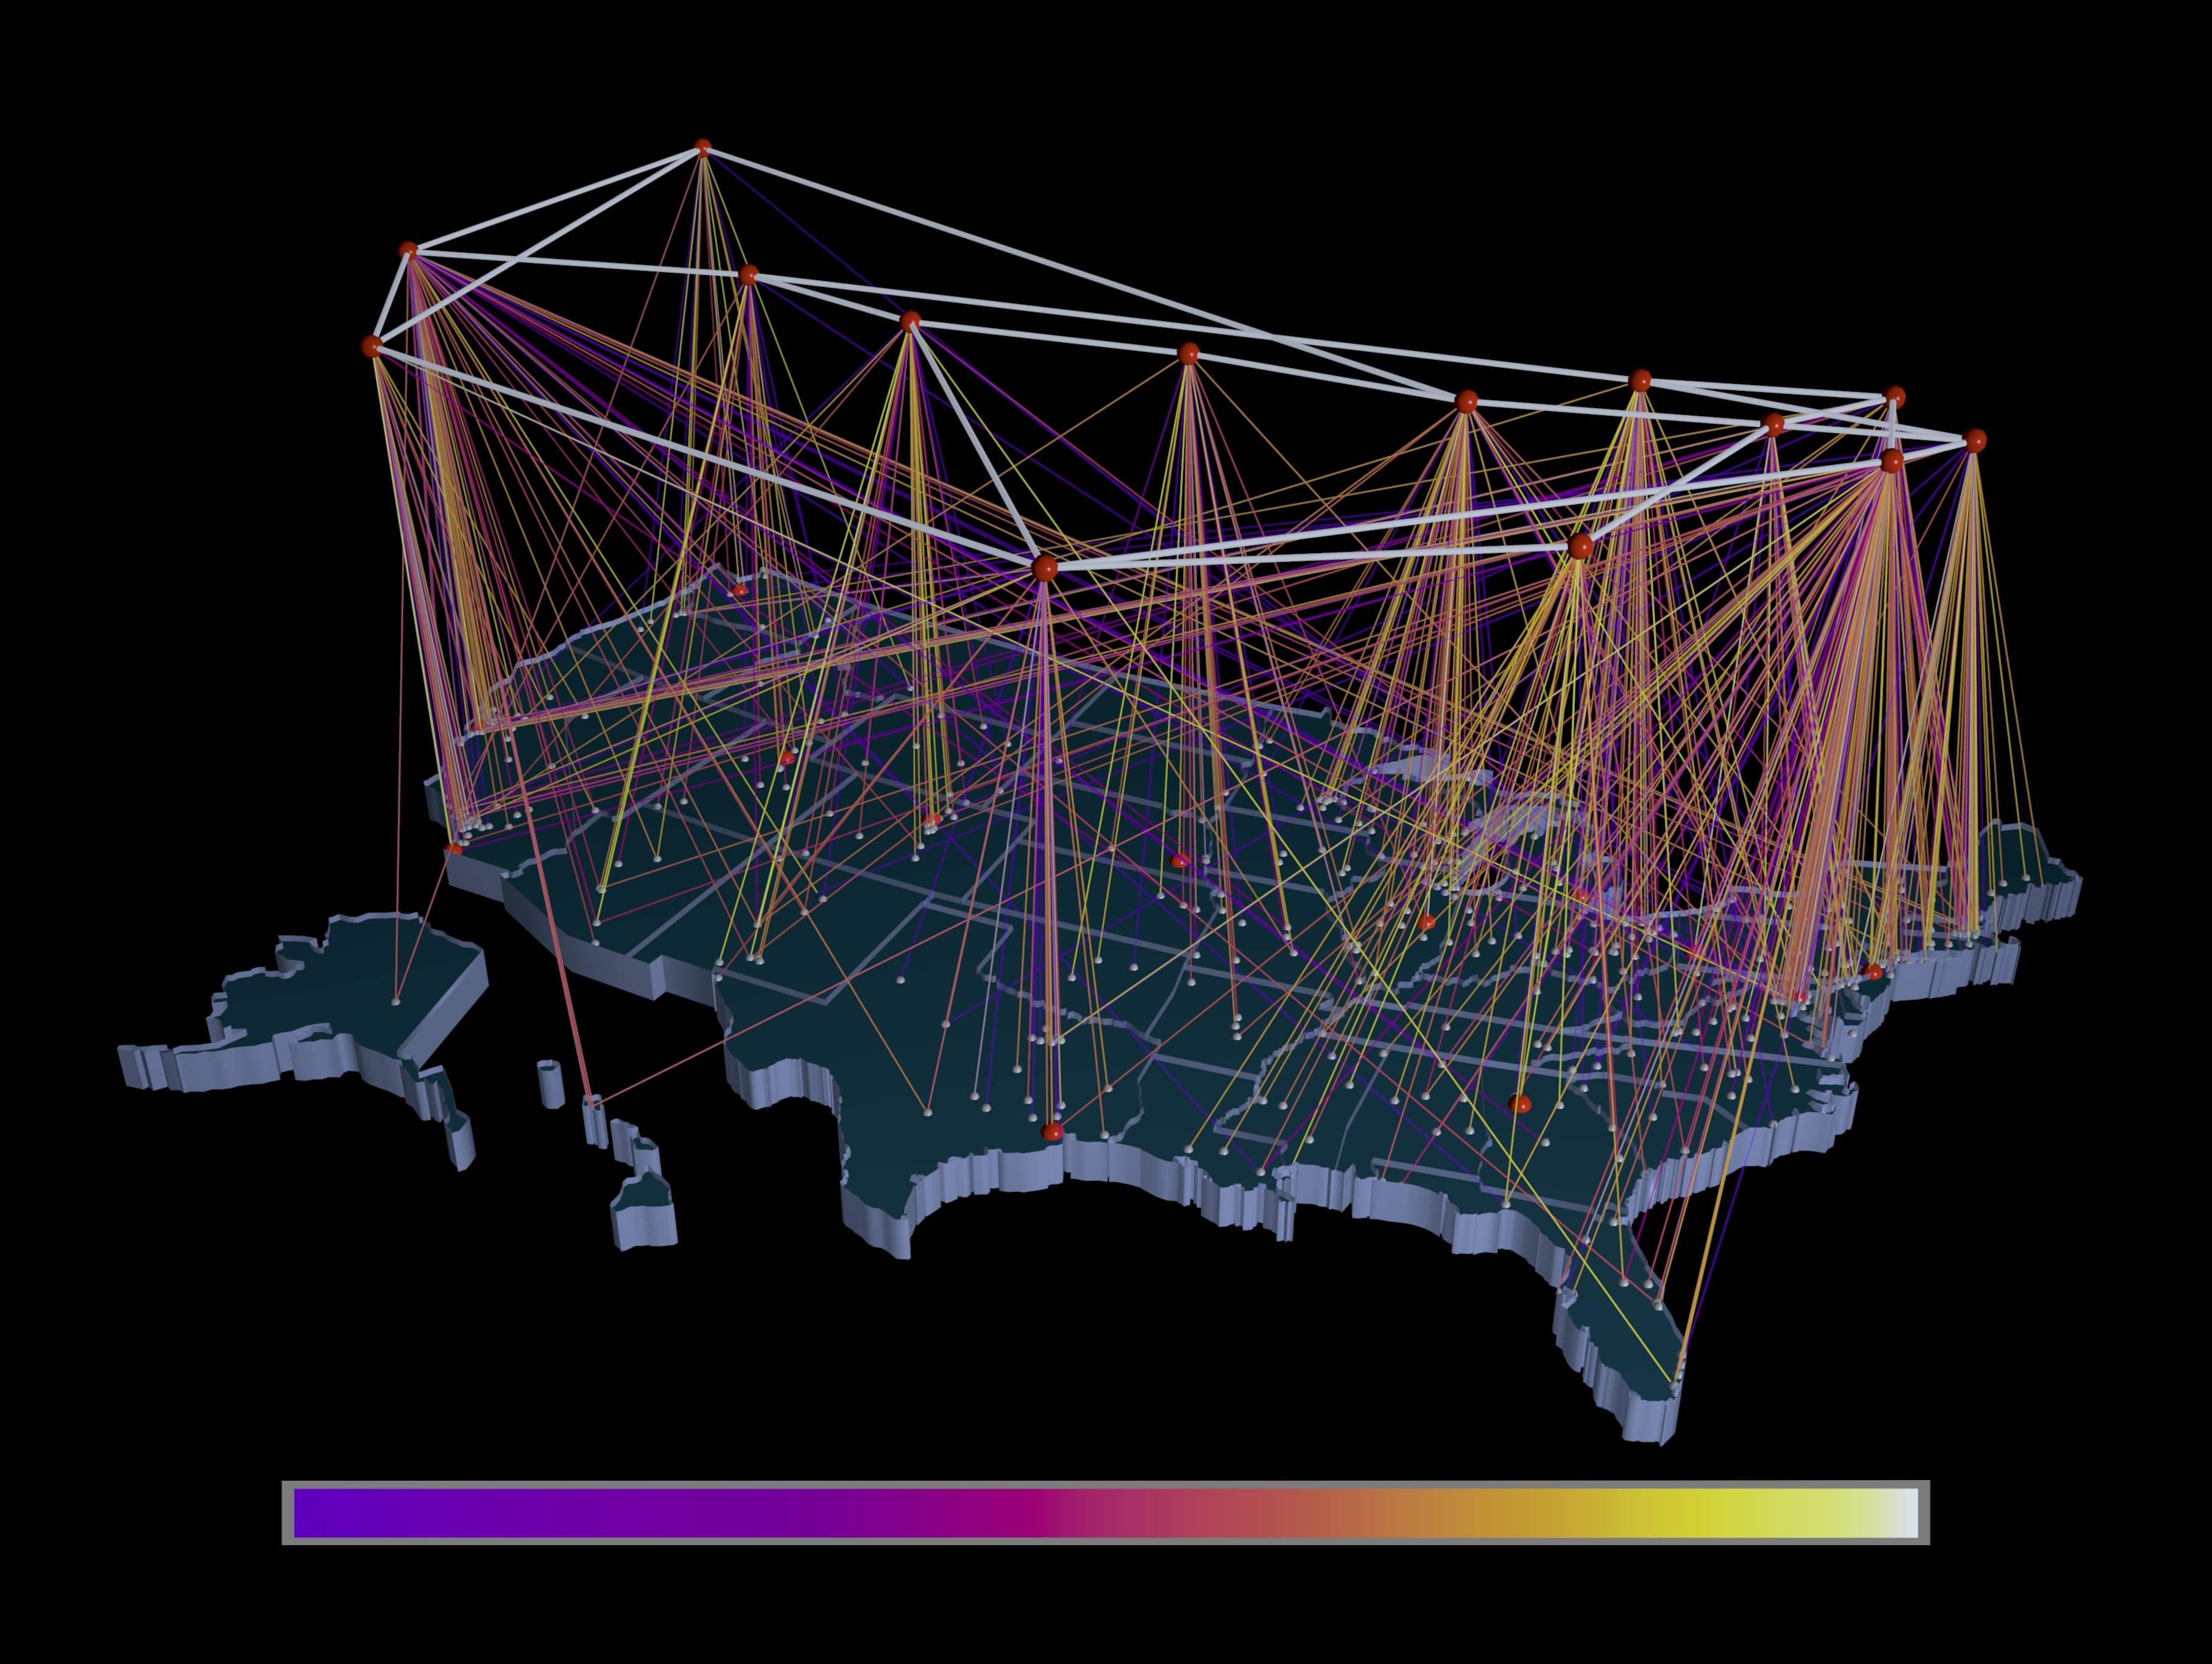
The Computing and Comms Evolutionary Path
1988 – TCP/IP and the NSFNET

Slide 16
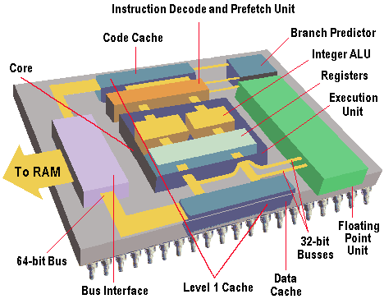
The Computing and Comms Evolutionary Path
1993 – Intel - Pentium processor

Slide 17
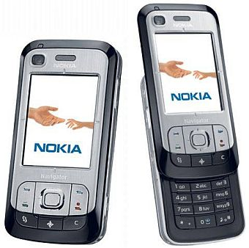
The Computing and Comms Evolutionary Path
1993 – GSM

Slide 18
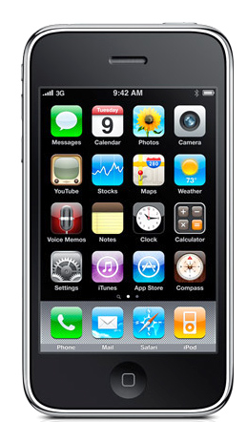
The Computing and Comms Evolutionary Path
2007 – Apple’s iPhone

Slide 19
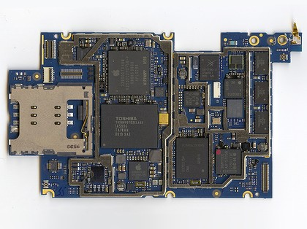
Today’s mobile device is a digital device that has the computing capability of a laptop device, with the form function of a mobile phone or small tablet.
It is an Internet-connected device with a general purpose browser* and a full** set of media capabilities
* Yes, WAP was a hideous mistake. Hopefully we’re over it now!
** Depending on whether you buy into Apple’s denial of Flash for iOS or not!

Slide 20
Today’s mobile device is a digital device that has the computing capability of a laptop device, with the form function of a mobile phone or small tablet.
And they are transforming the Internet!
It is an Internet-connected device with a general purpose browser* and a full** set of media capabilities
* Yes, WAP was a hideous mistake. Hopefully we’re over it now!
** Depending on whether you buy into Apple’s denial of Flash for iOS or not!

Slide 21
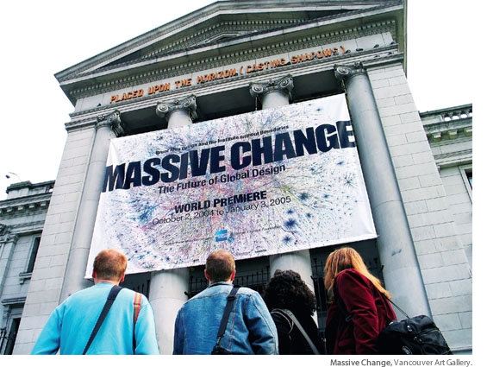

Slide 22
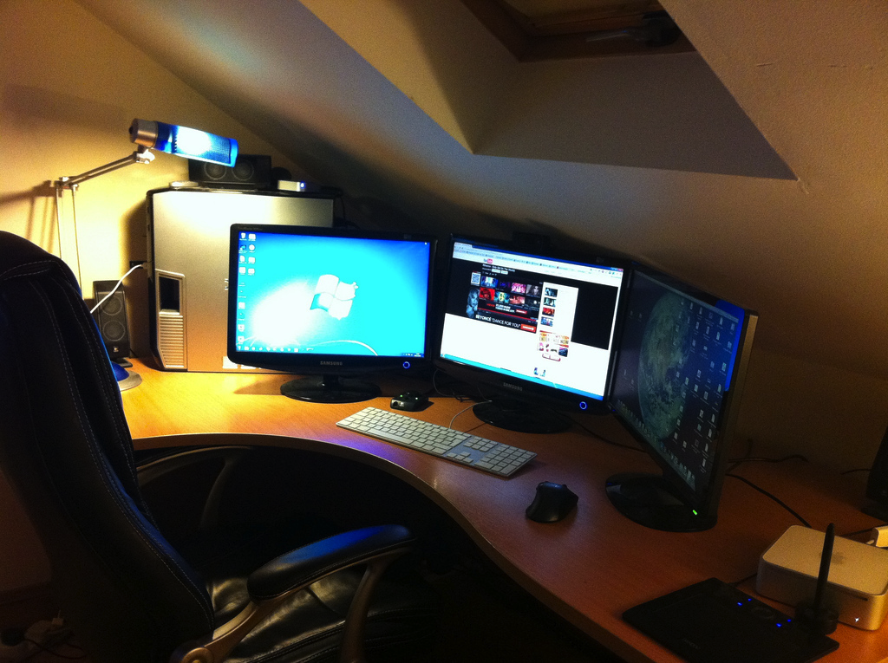
With desktop devices the Internet was a dedicated activity
lighting
privacy
reliable power
large view screens
dedicated worktop
wired bandwidth
dedicated chair

Slide 23

The Internet is now anywhere and everywhere
radio connectivity
Thumb
operated
hand sized
battery power
Its trivial, commonplace and blends into all our activities

Slide 24

Telephony Networking

Slide 25
Telephony Networking
Microphone
Speaker
Network Magic *
Bell
Pulse Generator
The Network defines the Service

Slide 26
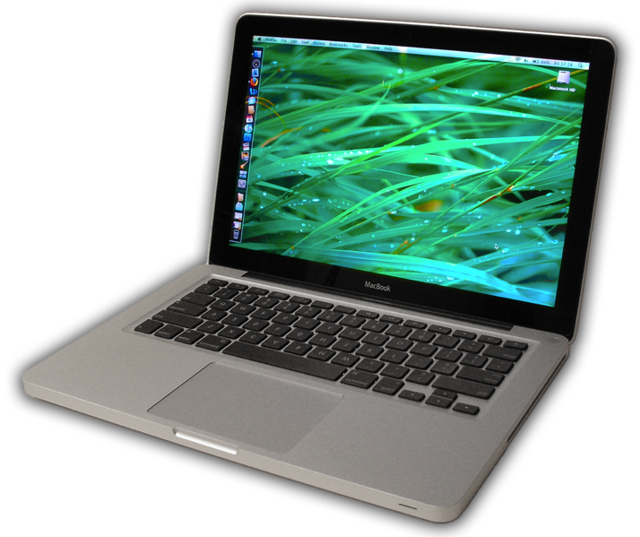
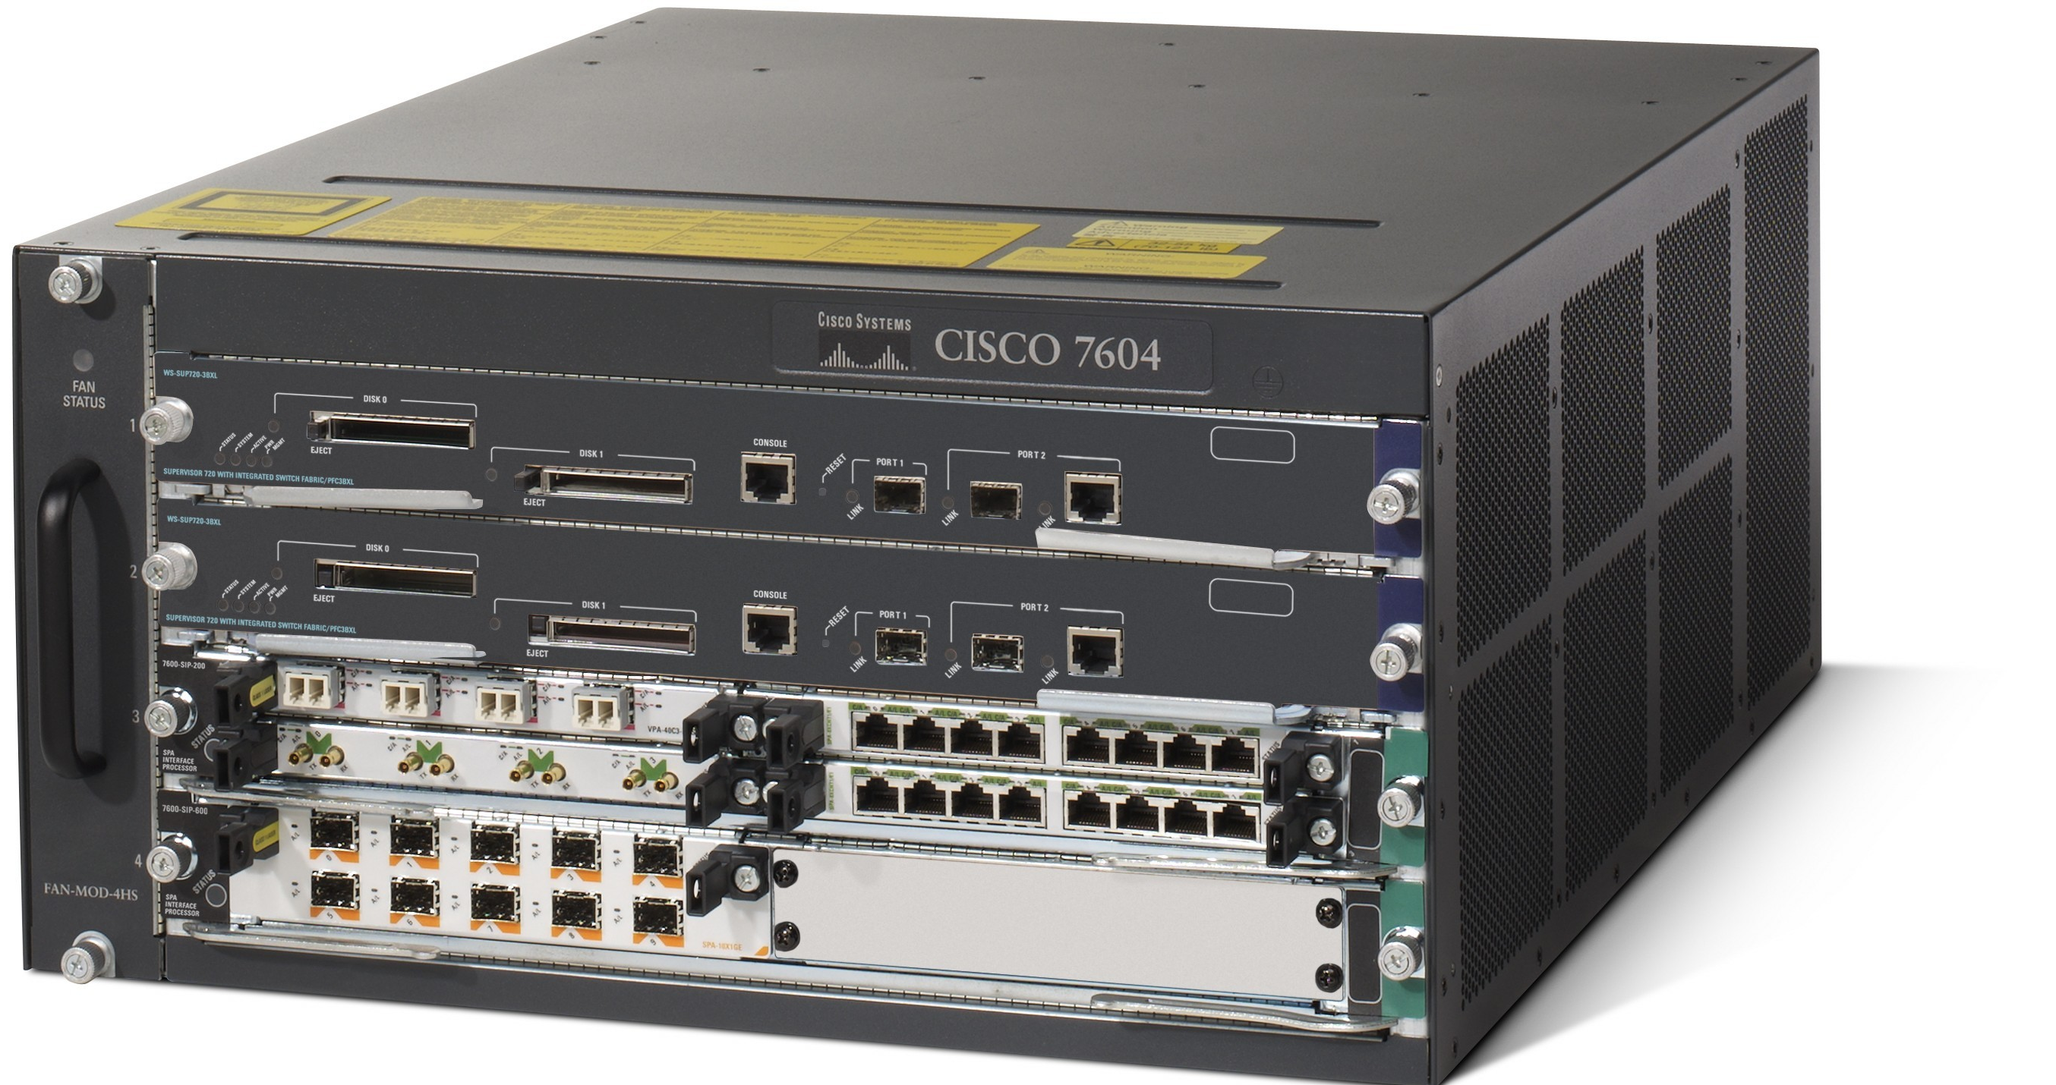
IP Networking

Slide 27
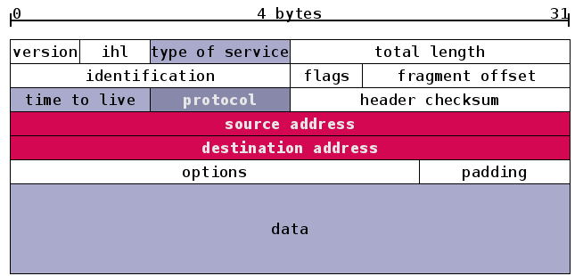
IP Networking
Packet Switch
Application Magic *
IP Packet
The Applications define
the Services

Slide 28
IP: Occam’s Razor applied to Networking
Why has IP been so effective?

Slide 29
IP: Occam’s Razor applied to Networking
Why has IP been so effective?
Because it’s cheap!

Slide 30
IP: Occam’s Razor applied to Networking
Why has IP been so effective?
Because it’s cheap!
Why is IP cheap?

Slide 31
IP: Occam’s Razor applied to Networking
Why has IP been so effective?
Because it’s cheap!
Why is IP cheap?
Becuase its minimal
in what it does!
Version
IHL
Type of Service
Total Length
Identification
Flags
Fragment Offset
Time To Live
Protocol
Header Checksum
Source Address
Destination Address
Options
Padding

Slide 32
IP: Occam’s Razor applied to Networking
Why has IP been so effective?
Because it’s cheap!
Why is IP cheap?
Becuase its minimal
in what it does!
Version
IHL
Type of Service
Total Length
Identification
Flags
Fragment Offset
Time To Live
Protocol
Header Checksum
Source Address
Destination Address
Options
Padding
What about all the other “network” functions?

Slide 33
IP: Occam’s Razor applied to Networking
Why has IP been so effective?
Because it’s cheap!
Why is IP cheap?
Becuase its minimal
in what it does!
Version
IHL
Type of Service
Total Length
Identification
Flags
Fragment Offset
Time To Live
Protocol
Header Checksum
Source Address
Destination Address
Options
Padding
What about all the other “network” functions?
They are now part of the upper levels at edge, not part of the network!

Slide 34
But – is minimalism sustainable?

Slide 35
Drilling down…
So far this is all rather abstract

Slide 36
Drilling down…
So far this is all rather abstract
Lets take a more detailed look at some specific technologies

Slide 37
Drilling down…
This is all rather abstract
And bear in mind that the shape of the future can often be found in the mistakes of the past!
Lets take a more detailed look at some specific technologies

Slide 38
IP was just so simple…
Version
IHL
Type of Service
Total Length
Identification
Flags
Fragment Offset
Time To Live
Protocol
Header Checksum
Source Address
Destination Address
Options
Padding
Hop-by-Hop stateless forwarding
Datagram transmission
End-To-End data integrity
Decoupled resource management, topology management

Slide 39
What could possibly go wrong?

Slide 40
What’s not working…

Slide 41
What’s not working…
Multicast

Slide 42
What’s not working…
Multicast
MPLS

Slide 43
What’s not working…
Multicast
MPLS
Congestion Control

Slide 44
What’s not working…
Multicast
Buffering and Queues
MPLS
Congestion Control

Slide 45
What’s not working…
Multicast
Buffering and Queues
MPLS
Congestion Control
QoS

Slide 46
What’s not working…
Multicast
Buffering and Queues
MPLS
Congestion Control
Consistent Speed
QoS

Slide 47
What’s not working…
Multicast
Buffering and Queues
High Speed
MPLS
Congestion Control
Consistent Speed
QoS

Slide 48
What’s not working…
Multicast
Buffering and Queues
Ultra High Speed
MPLS
High Speed
Congestion Control
Consistent Speed
QoS

Slide 49
What’s not working…
Multicast
Delay
Buffering and Queues
Ultra High Speed
MPLS
High Speed
Congestion Control
Consistent Speed
QoS

Slide 50
What’s not working…
Multicast
Delay
Buffering and Queues
Ultra High Speed
MPLS
High Speed
Congestion Control
Consistent Speed
QoS
Load Management

Slide 51
What’s not working…
Multicast
Delay
Buffering and Queues
Ultra High Speed
MPLS
Routing
High Speed
Congestion Control
Consistent Speed
QoS
Load Management

Slide 52
What’s not working…
Multicast
Identity and location overloading
Delay
Buffering and Queues
Ultra High Speed
MPLS
Routing
High Speed
Congestion Control
Consistent Speed
QoS
Load Management

Slide 53
What’s not working…
Identity and location overloading
Multicast
Packet quantization and fragmentation
Delay
Buffering and Queues
Ultra High Speed
MPLS
Routing
High Speed
Congestion Control
Consistent Speed
QoS
Load Management

Slide 54
What’s not working…
Identity and location overloading
Multicast
Packet quantization and fragmentation
Delay
IPv6
Buffering and Queues
Ultra High Speed
MPLS
Routing
High Speed
Congestion Control
Consistent Speed
QoS
Load Management

Slide 55
What’s not working…
Identity and location overloading
Multicast
Packet quantization and fragmentation
Delay
IPv6
Buffering and Queues
Tunnels
Ultra High Speed
MPLS
Routing
High Speed
Congestion Control
Consistent Speed
QoS
Load Management

Slide 56
What’s not working…
Identity and location overloading
Multicast
Packet quantization and fragmentation
Delay
IPv6
IPv6 Transition
Buffering and Queues
Tunnels
Ultra High Speed
MPLS
Routing
High Speed
Congestion Control
Consistent Speed
QoS
Load Management

Slide 57
What’s not working…
Identity and location overloading
Multicast
Packet quantization and fragmentation
Jitter
Delay
IPv6
IPv6 Transition
Buffering and Queues
Tunnels
Ultra High Speed
MPLS
Routing
High Speed
Congestion Control
Consistent Speed
QoS
Load Management

Slide 58
What’s not working…
Identity and location overloading
Multicast
Packet quantization and fragmentation
Delay
IPv6
Jitter
IPv6 Transition
Buffering and Queues
Tunnels
Wireless
Ultra High Speed
MPLS
Routing
High Speed
Congestion Control
Consistent Speed
QoS
Load Management

Slide 59
What’s not working…
Identity and location overloading
Multicast
Packet quantization and fragmentation
(in)security
Delay
IPv6
Jitter
IPv6 Transition
Buffering and Queues
Tunnels
Wireless
Ultra High Speed
MPLS
Routing
High Speed
Congestion Control
Consistent Speed
QoS
Load Management

Slide 60
What’s not working…
Network Management
Identity and location overloading
Multicast
Packet quantization and fragmentation
(in)security
Delay
IPv6
Jitter
IPv6 Transition
Buffering and Queues
Tunnels
Wireless
Ultra High Speed
MPLS
Routing
High Speed
Congestion Control
Consistent Speed
QoS
Load Management

Slide 61
What really needs to work…
Network Management
Identity and location overloading
Multicast
Packet quantization and fragmentation
Scaling
(in)security
Delay
IPv6
Jitter
IPv6 Transition
Buffering and Queues
Tunnels
Wireless
Ultra High Speed
MPLS
Routing
High Speed
Congestion Control
Consistent Speed
QoS
Load Management

Slide 62
Where to from here?

Slide 63
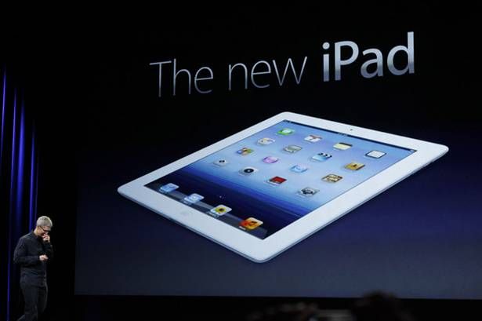
Today!

Slide 64
“We are now living in a post-PC world”
Apple’s Tim Cook, March 2012

Slide 65
The metrics of success

Slide 66

Counting Users...
There are 2.5 billion Internet users today
http://www.itu.int/ITU-D/ict/statistics/

Slide 67
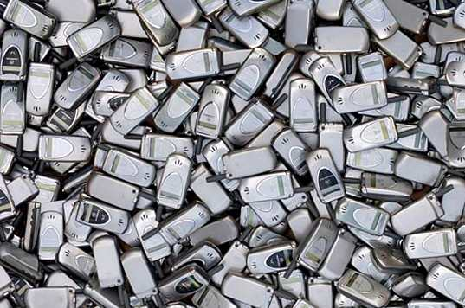
Counting Users...
And 5 billion mobile phone users!
There are 2 billion Internet users today
http://www.itu.int/ITU-D/ict/statistics/

Slide 68

Counting Users...
And 5 billion mobile phones!
There are 2 billion Internet users today
And 750 million mobile Internet users!
Source: Generator Research

Slide 69
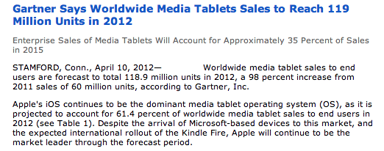
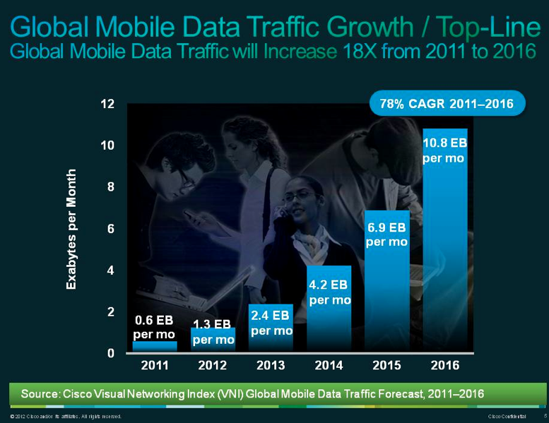

Tomorrow’s Users and Usage

Slide 70

Where to from here?

Slide 71
5 Years Out
2017

Slide 72
It’s a mobile world!
  2011: 270 million mobile units shipped
  Factors:
    Production volumes are bringing down component unit cost
    Android is bringing down software unit cost
    No need for new content - leverage off the the existing web universe of content
    Shift away from the desktop and the laptop by the production industry seeking new markets for their production capability
    Assumes an abundant minimal common network substrate

Slide 73

Apple’s Numbers
iPhones:
Q3 2010 : Apple shipped 8.4M iPhones
Q3 2011 : Apple shipped 20.3M iPhones
  Added 42 carriers and 15 countries in the quarter!
iPads:
Q3 2010 : Apple shipped 3.3M iPads
Q3 2011 : Apple shipped 9.2M iPads
  “every iPad we could make has been sold”
Q3 2011 profit: $US 7.3B

Slide 74
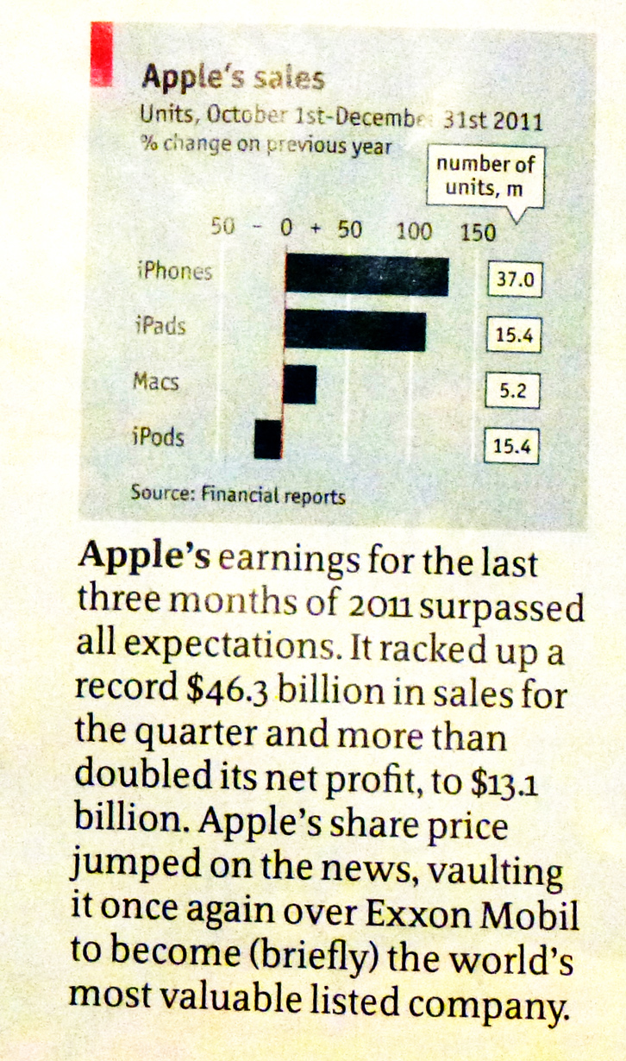
Apple’s Numbers
iPhones:
Q3 2010 : Apple shipped 8.4M iPhones
Q3 2011 : Apple shipped 20.3M iPhones
  Added 42 carriers and 15 countries in the quarter!
iPads:
Q3 2010 : Apple shipped 3.3M iPads
Q3 2011 : Apple shipped 9.2M iPads
  “every iPad we could make has been sold”
Q3 2011 profit: $US 7.3B
And Q4 2011 was even bigger!

Slide 75
Apple’s Numbers
iPhones:
Q3 2010 : Apple shipped 8.4M iPhones
Q3 2011 : Apple shipped 20.3M iPhones
  Added 42 carriers and 15 countries in the quarter!
iPads:
Q3 2010 : Apple shipped 3.3M iPads
Q3 2011 : Apple shipped 9.2M iPads
  “every iPad we could make has been sold”
Q3 2011 profit: $US 7.3B
37M iPhones
15M iPads
And Q4 2011 was even bigger!
$13.1B profit!

Slide 76
Coping with Demand
Global IPv4 supply shortfall is predicted to reach 800m addresses by 2014

Slide 77
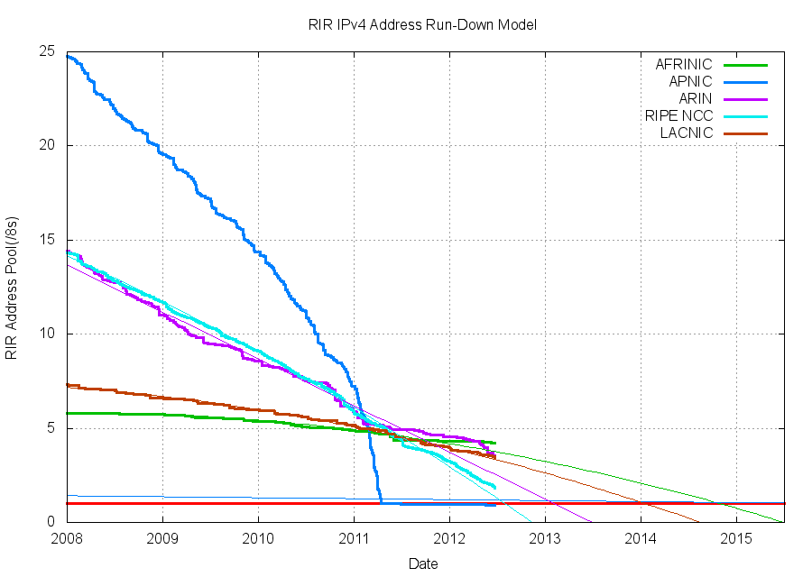
Coping with IPv4 Address Exhaustion

Slide 78
Coping with IPv4 Address Exhaustion
Hopefully, we’ve figured out this
transition to IPv6 by 2017!!
2017

Slide 79

In the next five years...
we have a choice

Slide 80
In the next five years...
Everything gets squashed into HTTP, IPv4 and the network becomes
the bottleneck
IPv6

Slide 81
And its not yet clear which path the Internet will take!

Slide 82
And its not yet clear which path the Internet will take!
market forces

Slide 83
Can we look further out?

Slide 84
10 Years Out?
2022

Slide 85
My personal view...by 2022
The Internet will be all IPv6 by 2022!
  There is no extended afterlife in store for IPv4
    CGNs also have near term limits under intense scaling pressure and ALGs break just about everything!
    There is no room for more than one protocol - Look at what happened to DECnet, SNA, Appletalk, X.25,...
  There is no afterlife for MPLS, VPNs, QoS, NGNs, Multicast or SDNs either
    IP is a minimal value add to raw bandwidth:
      Packet quantization of the bandwidth resource
      Routing to maintain simple shortest path topology
    Everything else is an overhead

Slide 86
My personal view...by 2022
Or there will be no more Internet by then
  because all the CGNs, ALGs, CDNs in the world will not hold the Internet together for 10 years of intense growth pressure
  And because one common protocol platform, one common address space, one common name space is a brittle state, it will fracture and splinter under adornment pressure from both vendors and operators

Slide 87
My personal view...by 2022
If we still have one Internet, radio spectrum will become even more of a scarce and highly valuable asset
  well it is already, but the competition for spectrum in highly populous areas will continue
  Fewer wide area services - more cellular / femtocell services backed by fibre backhaul to improve spectrum efficiency

Slide 88
My personal view...by 2022
Cloud / Data Centre services may well be at or after their peak by 2022
  Innovative competitive pressure at this time may well come from highly distributed systems that do not rely on intense concentrations of computation and information storage

Slide 89
20 Years Out?
2032

Slide 90
My personal view...by 2032
This is extremely tough!
  very little from the world of 1992 is still with us today
  very little of today’s environment will be persistent for the next two decades
  Why?

Slide 91
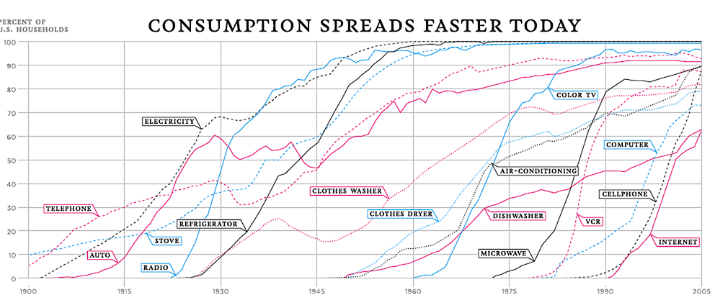
As the pace of technology adoption gets faster we cycle through successive generations of technologies at ever faster rates
http://visualecon.wpengine.netdna-cdn.com/wp-content/uploads/2008/02/history-of-products.gif

Slide 92
What’s shaping our future?
We need to think about a post-PC world where computation, storage and communications are all abundant commodities. It’s innovative services and applications that will shape much of the Internet’s future. And the most effective innovative force in such an environment is open technologies, and open software in particular. This allows innovators to assume the entirety of the current state of the art and build from there. This is truly a powerful model!

Slide 93
In thinking about a future Internet

Slide 94
There’s no need to clean the slate

Slide 95
There’s no need to clean the slate
Nor to forget everything we’ve learned about packet networks so far

Slide 96
There’s no need to clean the slate
Nor to forget everything we’ve learned about packet networks so far
But we need to think about a future that is way beyond today’s Internet

Slide 97
And as we look at the evolution of the technology there are probably two important design principles to bear in mind …

Slide 98
Focus

Slide 99
Simplicity

Slide 100
Thank You!
Questions?

