Slide 1
IPv6 Transition:
A Progress Report
Geoff Huston
Chief Scientist
APNIC

Slide 2
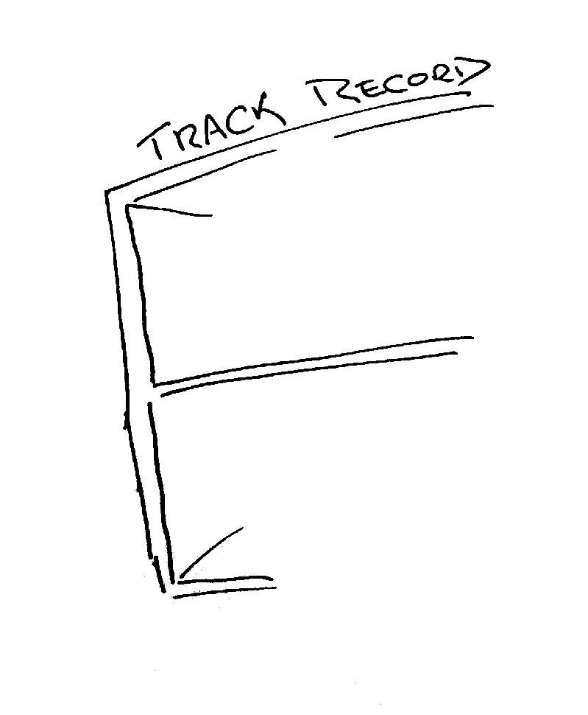
The mainstream telecommunications industry has a rich history

Slide 3


The mainstream telecommunications industry has a rich history
…of making very poor
technology choices

Slide 4


The mainstream telecommunications industry has a rich history
…of making very poor
technology guesses
and regularly being
taken by
surprise!

Slide 5
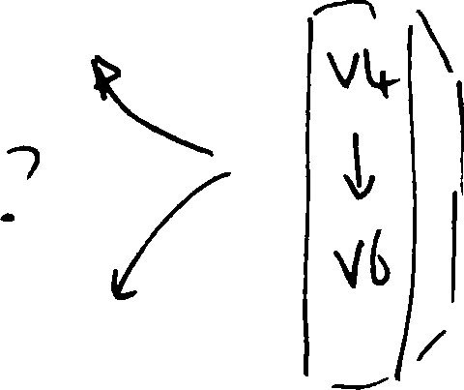
So, how are we going with the IPv4 to IPv6 transition?

Slide 6
But maybe there’s an initial question here:
Do we really need to worry about this?

Slide 7
Do we really need to worry about this?
Surely IPv6 will just happen – its just a matter
of waiting for the pressure of Ipv4 address
exhaustion to get to sufficient levels of intensity.

Slide 8
Do we really need to worry about this?
Surely IPv6 will just happen – its just a matter
of waiting for the pressure of Ipv4 address
exhaustion to get to sufficient levels of intensity.
Or maybe not – let’s look a bit closer at the situation

Slide 9
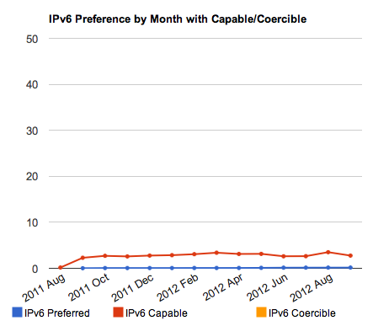
IPv6 Uptake
Measured at the level of client capability, the amount of the Internet’s user base that currently displays IPv6 capability is less than 1%
More worryingly, the overall trend curves for the entire Internet for Ipv6 adoption have pretty flat for some years now
IPv6 uptake: Dual Stack Preferred and V6 Capable

Slide 10
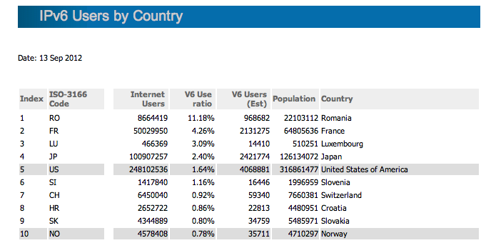
IPv6 Uptake
There is fair amount of variance here: some countries appear to be well ahead of others in IPv6 deployment:...

Slide 11
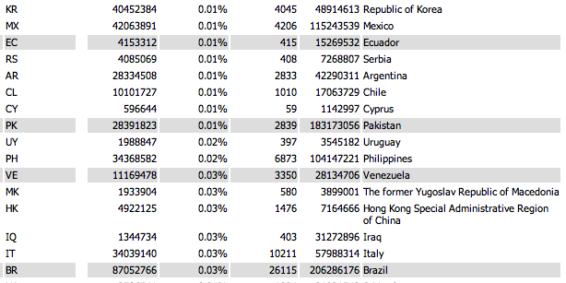
IPv6 Uptake
There is fair amount of variance here: while others are not as well positioned

Slide 12
IPv6 Uptake
There is a LOT of uncertainty in the IPv6 transition process at present
Some countries and some sectors are progressing quickly, but much of the Internet appears to be still in a “wait and see” mode
Some actors feel that V6 deployment is something that they should respond to now
Others are still waiting...

Slide 13
IPv6 Uptake
Currently its looking like this transition is becoming an extended hiatus for the Internet
There is no overnight “quick fix” for IPv6 adoption
That implies that EVERYONE will need to support Ipv4 access for some years to come
But how we are going to do this, and for how long, is a really tough question

Slide 14
IPv6 Uptake
...But how we are going to support dual stacks, and for how long, is a really tough question
And there are a number of factors that make so much harder, rather than easier...

Slide 15

The “inevitability” of technological evolution

Slide 16
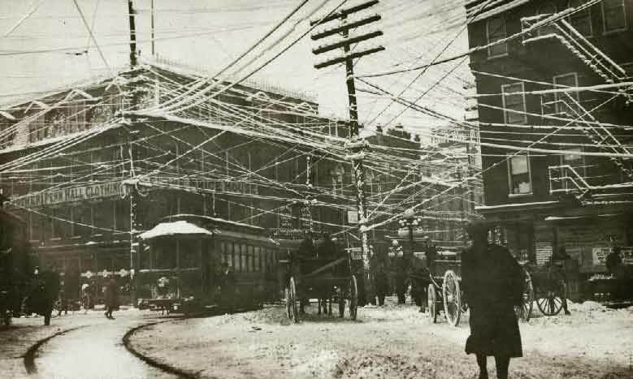

Slide 17

The “inevitability” of technological evolution

Slide 18

The “inevitability” of technological evolution

Slide 19
The “inevitability” of technological evolution
Now lets look at something a little more topical to today!

Slide 20

The “inevitability” of technological evolution?

Slide 21

The “inevitability” of technological evolution?

Slide 22


The challenge often lies in managing the transition from one technology to another

Slide 23

To get from “here” to “there” requires an excursion through an environment of CGNs, CDNs, ALGs and similar middleware ‘solutions’ to IPv4 address exhaustion
The challenge often lies in managing the transition from one technology to another
IPv6
Transition
plus
Exhaustion!
CGNs
IPv4
ALGs
CDNs

Slide 24
To get from “here” to “there” requires an excursion through an environment of CGNs, CDNs, ALGs and similar middleware ‘solutions’ to IPv4 address exhaustion
The challenge often lies in managing the transition from one technology to another
IPv6
Transition requires the network owner to undertake capital investment in network service infrastructure. What lengths will the network owner then go to to protect the value of this additional investment by locking itself into this “transitional” service model for an extended/indefinite period?
CGNs
IPv4
ALGs
CDNs

Slide 25

The challenge often lies in managing the transition from one technology to another
IPv6
CGNs
IPv4
ALGs
CDNs
The risk in this transition phase is that the Internet heads off in a completely different direction!

Slide 26
Can we “manage” this transition?

Slide 27
Can we “manage” this transition?
To ensure that the industry maintains a collective focus on IPv6 as the objective of this exercise!

Slide 28
How can we “manage” this transition?
To ensure that the industry maintains a collective focus on IPv6 as the objective of this exercise!
And to ensure that we do not get distracted by attempting to optimize what were intended to be temporary measures

Slide 29
Challenges:
This is a deregulated and highly
competitive environment

Slide 30

Challenges:
This is a deregulated and highly
competitive environment
It is NOT a case of a single
“either/or” decision
?

Slide 31

Challenges:
This is a deregulated and highly
competitive environment
There are many different players
Each with their own perspective
?
?
?
?
?
?
?
?
?
?
?
?
?
?
?
?
?
?
?
?
?

Slide 32

Challenges:
This is a deregulated and highly
competitive environment
There are many different players
Each with their own perspective
?
And all potential approaches will be explored!

Slide 33
Challenges:
This is a deregulated and highly
competitive environment
There is no plan!

Slide 34
Challenges:
This is a deregulated and highly
competitive environment
There is no plan, just the interplay of
various market pressures

Slide 35
Challenges:
This is a deregulated and highly
competitive environment
There is no plan, just the interplay of
various market pressures
2. Varying IPv4 Address Exhaustion Timelines

Slide 36
IPv4 Address Exhaustion – APNIC

Slide 37
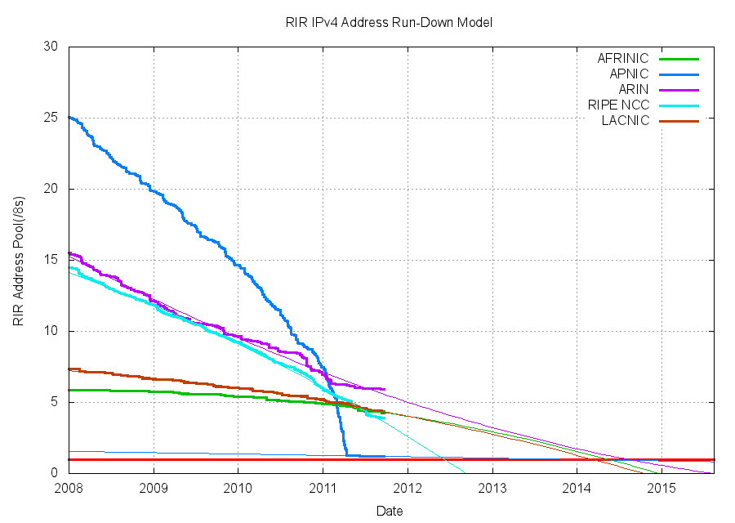
Remaining IPv4 Address
Pools–All RIRs
Sep 2011

Slide 38
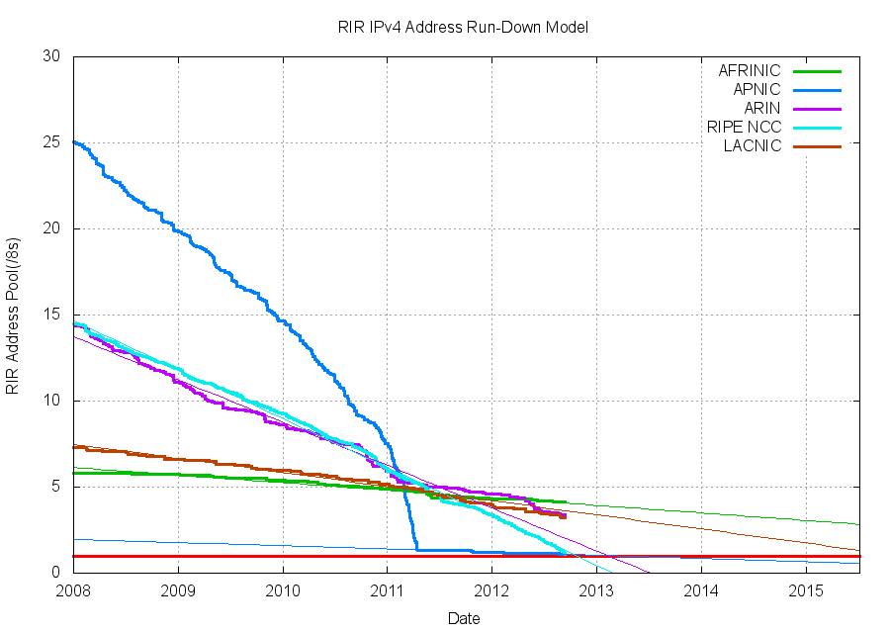
Remaining IPv4 Address
Pools–All RIRs
Sep 2012

Slide 39
Address Exhaustion Projections
RIPE Exhaustion – 14 September 2012
ARIN Exhaustion – 2013 – 2014?

Slide 40
Exhaustion Predictions
RIR | Predicted Exhaustion Date * | Remaining Address Pool (14 Sep 2012)
APNIC | 19 April 2011 (actual) | 0.91
RIPE NCC | 14 September 2012 (actual) | 1.05 /8s
ARIN | 24 August 2013 | 3.36 /8s
LACNIC | 16 May 2014 | 3.22 /8s
AFRINIC | 8 Aug 2014 | 4.14 /8s
* Here “exhaustion” is defined as the point when the RIR’s remaining pool falls to 1 /8

Slide 41
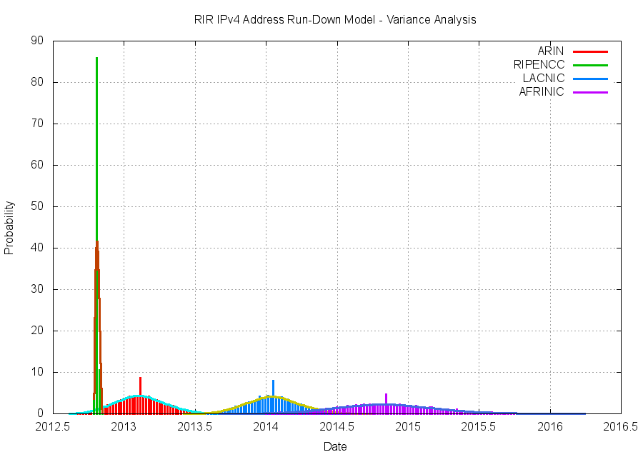

Slide 42
Challenges:
This is a deregulated and highly
competitive environment
There is no plan, just the interplay of
various market pressures
2. Varying IPv4 Address Exhaustion Timelines
Differing time lines create differing
pressures in the market

Slide 43
Challenges:
This is a deregulated and highly
competitive environment
There is no plan, just the interplay of
various market pressures
2. Varying IPv4 Address Exhaustion Timelines
Differing time lines create differing
pressures in the market
3. Regional Diversity

Slide 44
Today
IPv6
RIPE NCC
APNIC
IPv4
CGNs
ARIN
LACNIC
AFRINIC
ALGs
CDNs

Slide 45
Late 2012
IPv6
RIPE NCC
CGNs
ARIN
LACNIC
IPv4
APNIC
AFRINIC
ALGs
CDNs

Slide 46
2013
IPv6
RIPE NCC
ARIN
CGNs
LACNIC
IPv4
ALGs
CDNs
APNIC
AFRINIC

Slide 47
By 2014 it is possible that different regions of the world will be experiencing very different market pressures for the provision of Internet services, due to differing transitional pressures from IPv4 exhaustion

Slide 48
By 2014 it is possible that different regions of the world will be experiencing very different market pressures for the provision of Internet services, due to differing transitional pressures from IPv4 exhaustion
What’s the level of risk that the differing environments of transition lead to significantly different outcomes in each region?

Slide 49
By 2013 it is possible that different regions of the world will be experiencing very different market pressures for the provision of Internet services, due to differing transitional pressures from IPv4 exhaustion
Will we continue to maintain coherency of a single Internet through this transition?
What’s the level of risk that the differing environments of transition lead to significantly different outcomes in each region?

Slide 50
The Risk of the Long Term Plan
The longer the period of transition, the higher the risk of completely losing the plot and heading into other directions!

Slide 51
201x?
IPv6
ARIN
LACNIC
AFRINIC
CGNs
IPv4
RIPE NCC
ALGs
CDNs
APNIC

Slide 52
Challenges:
This is a deregulated and highly
competitive environment
There is no plan, just the interplay of
various market pressures
2. Varying IPv4 Address Exhaustion Timelines
Differing time lines create differing
pressures in the market
3. Regional Diversity
One network architecture is not an
assured outcome!

Slide 53
What does this mean for the Internet?

Slide 54
What does this mean for the Internet?
We are going to see a LOT of transition middleware being deployed!

Slide 55
What does this mean for LEAs?
We are going to see a LOT of transition middleware being deployed!
And we are going to see a significant diversity in what that middleware does

Slide 56
What does this mean for LEAs?
LEAs have traditionally focused on the NETWORK as the point of interception and tracing:
They are used to a consistent model to trace activity:
get an IP address and a time range
trace back based on these two values to uncover a set of network transactions

Slide 57
What does this mean for LEAs?
In a world of densely deployed CGNs and ALGS then the IP address loses coherent meaning in terms of end party identification.
These traceback approaches won’t work any more!

Slide 58
What does this mean for LEAs?
In a world of densely deployed CGNs and ALGS then the IP address loses coherent meaning in terms of end party identification
And instead of shifting to a single “new” model of IP address use, we are going to see widespread diversity in the use of transition mechanisms and NATs in carrier networks

Slide 59
What does this mean for LEAs?
The risk we are running at the moment is that in the near future there will no longer be a single consistent model of how an IP network manages IPv4 and IPv6 addresses
Which implies that there will no longer be a useful single model of how to perform traceback on the network

Slide 60
What does this mean for LEAs?
What’s the likely response from LEAs and regulators?
One likely response is to augment the record keeping rules for ISPs:
“record _absolutely everything_, and keep the records for decades”

Slide 61
What does this mean for ISPs?
What are the new record keeping rules?
In order to map a “external” IP address and time to a subscriber as part of a traceback exercise then:
  * for every active middleware element you now need to hold the _precise_ time and the _precise_ tranforms that were applied to a packet flow
  and you need to be able to cross-match these records accurately

Slide 62
What does this mean for ISPs?
What are the new record keeping rules?
How many different sets of rules are required for each CGN / dual stack transition model being used?
And are these record keeping practices affordable?
  (granularity of the records is shifting from “session” records to “transition” and even individual packet records in this diverse model)
Are they even practical within today’s technology capability?
Is this scaleable?
Is it even useful any more?

Slide 63
Traceback in tommorrow’s Internet?
The traceback toolkit:
  precise time, source and dest IP addrs, protocol and port information
  Access to all ISP middleware logs
  CDN SP logs
  Network and Middleware deployment maps
  V6 Transition technology map used by the ISP
  A thorough understanding of vendor’s equipment behaviour for various applications
  A thorough understanding of application behaviours

Slide 64
Making it hard...
The V6 transition was challenging enough
The combination of V4 exhaustion and V6 transition is far harder
The combination of varying exhaustion times, widespread confusion, diverse agendas, diverse pressures, V4 exhaustion and V6 transition is now amazingly challenging

Slide 65
Making it very hard...
The problem we are facing is that we are heading away from a single service architecture in our IP networks
Different providers are seeing different pressures and opportunities, and are using different technology solutions in their networks
And the longer we sit in this “exhaustion + transitioning” world, the greater the diversity and internal complexity of service networks that will be deployed

Slide 66
Even harder?
All this will make the entire record and trace problem for ISPs and LEAs far harder than it is at present!
At some point along this path of escalating network complexity and diversity its likely that our networks will be simply be unable to track individual use in any coherent manner
If this is where the Internet is heading, then from an LEA perspective the tracking and tracing story is looking pretty bad
In which case we really need to understand if there is a Plan B becuase what we are doing now may simply not work any longer!

Slide 67
In which case we really need to understand if there is a Plan B because what we are doing now may simply not work any longer!

Slide 68
Thank You

