Slide 1
What’s so special about the number 512?
Geoff Huston
Chief Scientist, APNIC Labs
1 September 2014

Slide 2


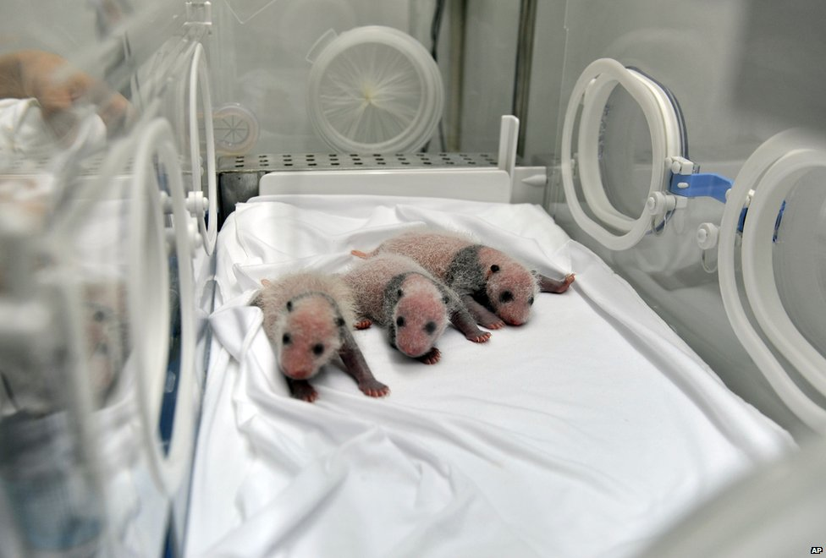

12 August 2014
Rosetta closes in on comet 67P/Churyumov-Gerasimenko
World Elephant Day
Violence continues in the Gaza Strip
Newborn Panda Triplets in China

Slide 3
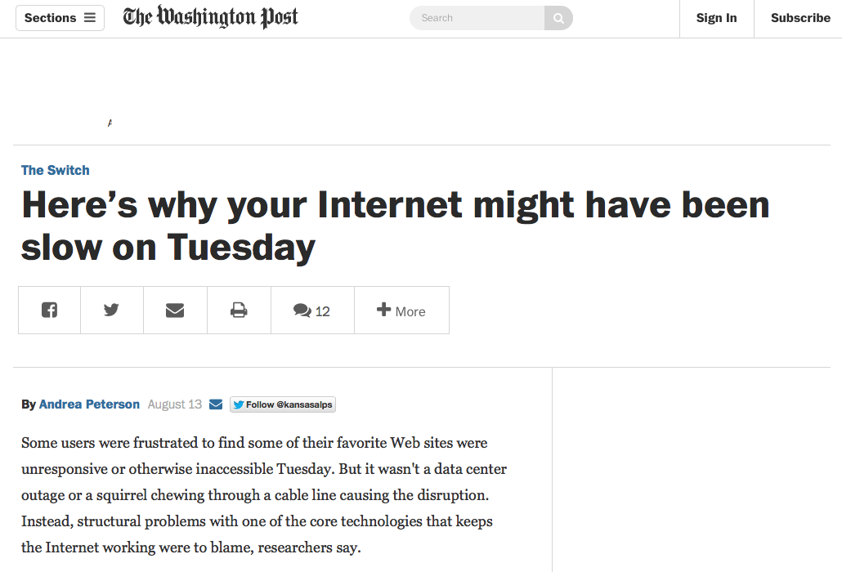


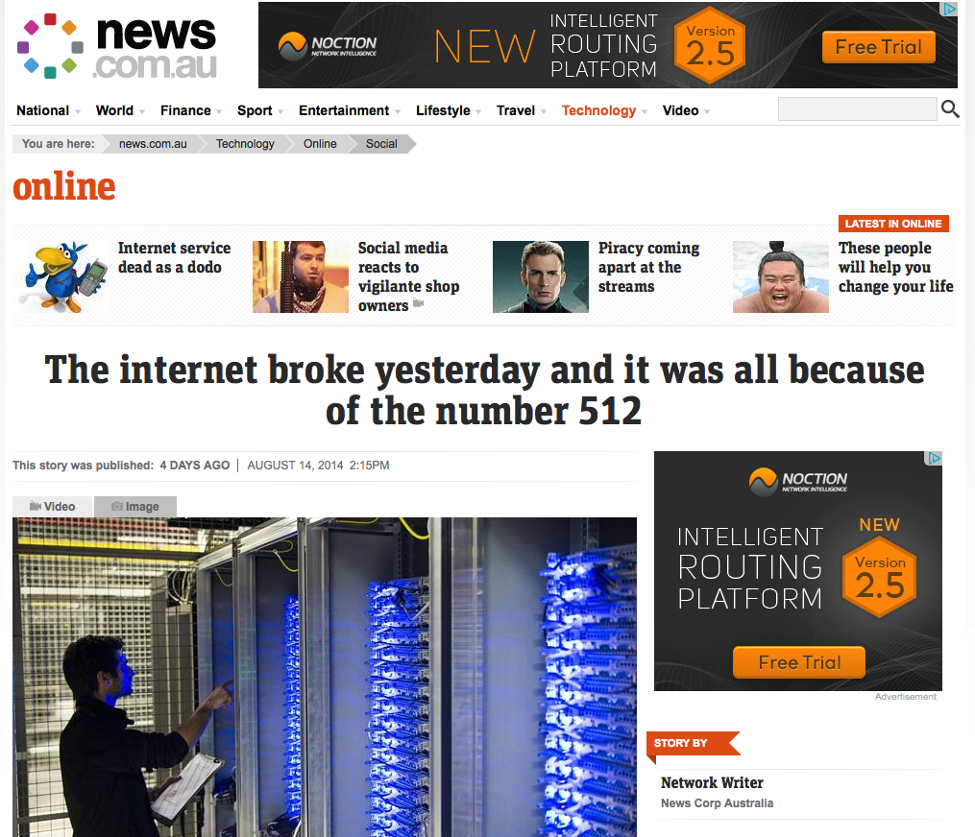
The Internet apparently has a bad hair day

Slide 4
What happened?
Did we all sneeze at once and cause the routing system to fail?

Slide 5
12 August 2014
BGP update log for 12 August

Slide 6
12 August 2014
Verizon Route Leak (AS701)
Total IPv4 FIB size passes 512K

Slide 7
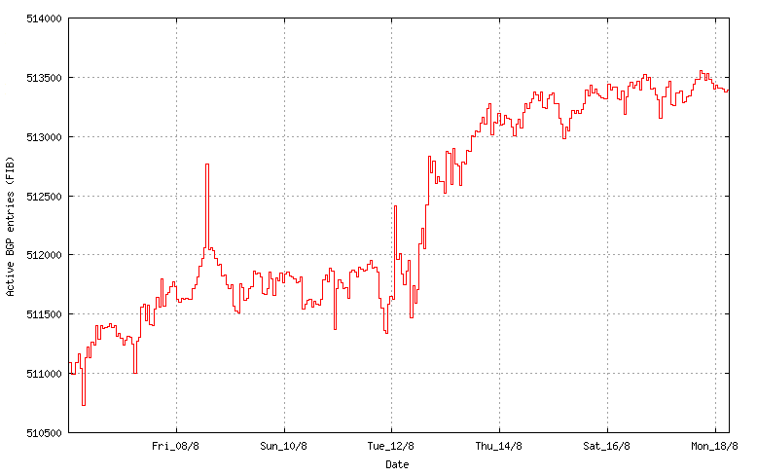
12 August 2014
BGP FIB Size

Slide 8
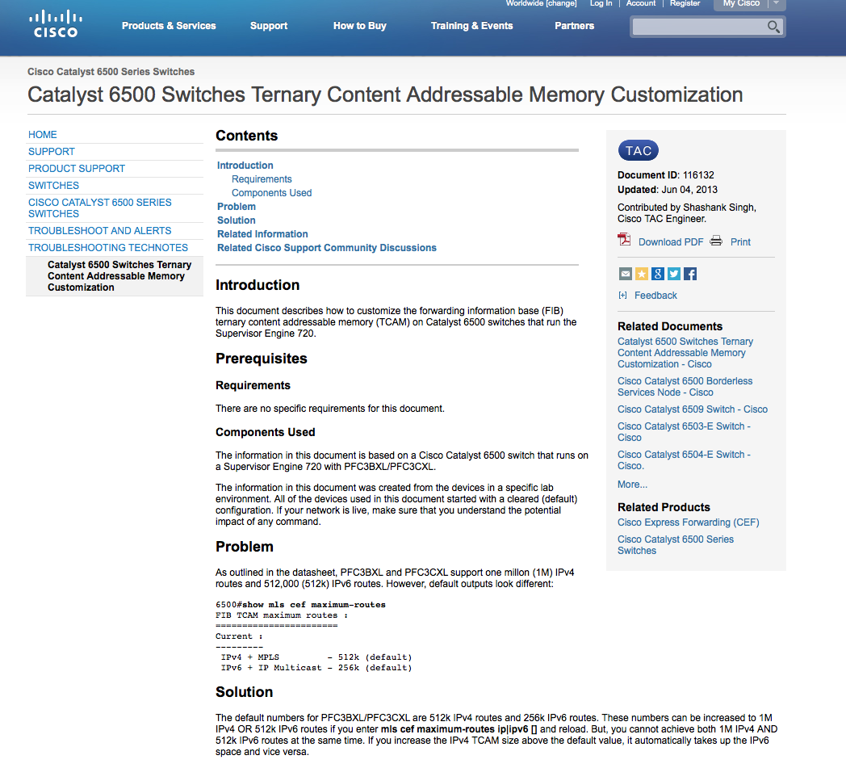
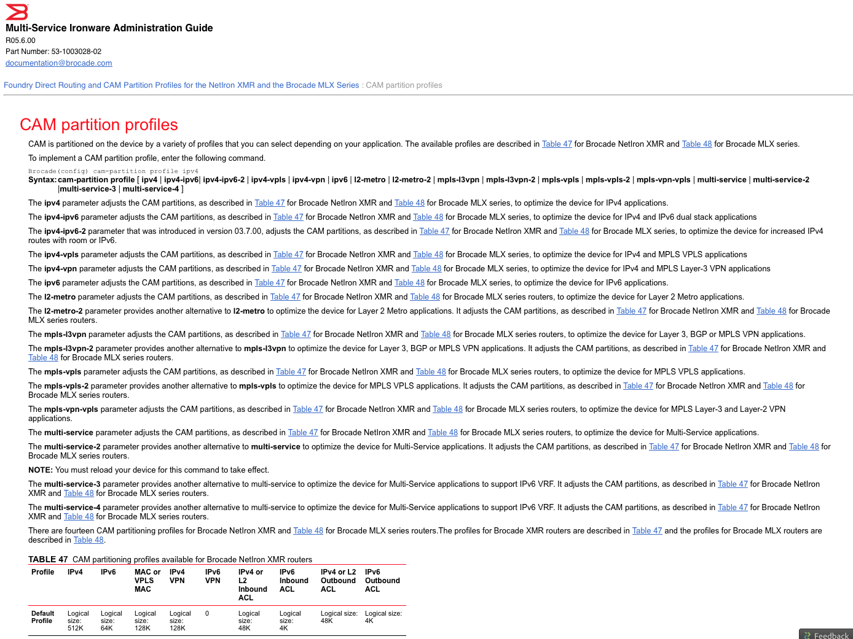

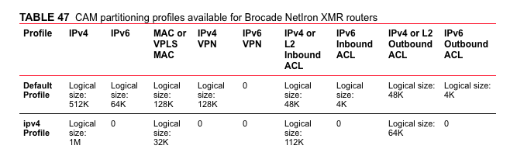
http://www.cisco.com/c/en/us/support/docs/switches/catalyst-6500-series-switches/116132-problem-catalyst6500-00.html
512K is a default constant
in some Cisco and Brocade
products
Brocade NetIron XMR
http://www.brocade.com/downloads/documents/html_product_manuals/NI_05600_ADMIN/wwhelp/wwhimpl/common/html/wwhelp.htm#context=Admin_Guide&file=CAM_part.11.2.html
Cisco Cat 6500

Slide 9
Routing Behaviour
Was the AS701 Route Leak the problem?
Or was the FIB growth passing 512K entries the problem?
What does routing growth look like anyway?

Slide 10
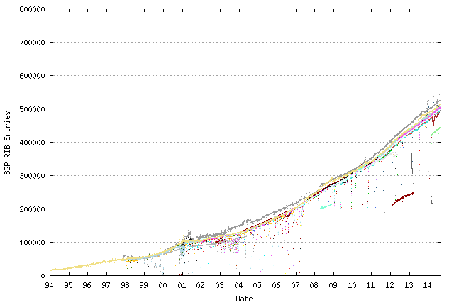
20 years of routing the Internet
2011: Address Exhaustion
2009: The GFC hits the Internet
2005: Broadband to the Masses
2001: The Great Internet Boom and Bust
1994: Introduction of CIDR

Slide 11
IPv4 BGP Prefix Count 2011 - 2014
550,000
450,000
350,000
Jan
2011
Jan
2012
Jan
2013
Jan
2014
Jan
2015

Slide 12
IPv4 2013- 2014 BGP Vital Statistics
Jan-13 Aug-14
Prefix Count 440,000 512,000 + 11% p.a.
Roots 216,000 249,000 + 9%
More Specifics 224,000 264,000 + 11%
Address Span 156/8s 162/8s + 2%
AS Count 43,000 48,000 + 7%
Transit 6,100 7,000 + 9%
Stub 36,900 41,000 + 7%

Slide 13
IPv4 in 2014 – Growth is Slowing (slightly)
Overall IPv4 Internet growth in terms of BGP is at a rate of some ~9%-10% p.a.
Address span growing far more slowly than the table size (although the LACNIC runout in May caused a visible blip in the address rate)
The rate of growth of the IPv4 Internet is slowing down (slightly)
  Address shortages?
  Masking by NAT deployments?
  Saturation of critical market sectors?

Slide 14
IPv6 BGP Prefix Count
20,000
World IPv6 Day
10,000
0
2,000
Jan
2011
Jan
2012
Jan
2013
Jan
2014

Slide 15
IPv6 2013-2014 BGP Vital Statistics
Jan-13 Aug-14 p.a. rate
Prefix Count 11,500 19,036 + 39%
Roots 8,451 12,998 + 32%
More Specifics 3,049 6,038 + 59%
Address Span (/32s) 65,127 73,153 + 7%
AS Count 6,560 8,684 + 19%
Transit 1,260 1,676 + 20%
Stub 5,300 7,008 + 19%

Slide 16
IPv6 in 2013
Overall IPv6 Internet growth in terms of BGP is 20% - 40 % p.a.
  2012 growth rate was ~ 90%.
(Looking at the AS count, if these relative growth rates persist then the IPv6 network would span the same network domain as IPv4 in ~16 years time -- 2030!)

Slide 17
IPv6 in 2013 – Growth is Slowing?
Overall Internet growth in terms of BGP is at a rate of some ~20-40% p.a.
AS growth sub-linear
The rate of growth of the IPv6 Internet is also slowing down
  Lack of critical momentum behind IPv6?
  Saturation of critical market sectors by IPv4?
  <some other factor>?

Slide 18
What to expect

Slide 19
BGP Size Projections
Generate a projection of the IPv4 routing table using a quadratic (O(2) polynomial) over the historic data
  For IPv4 this is a time of extreme uncertainty
    Registry IPv4 address run out
    Uncertainty over the impacts of any after-market in IPv4 on the routing table
  which makes this projection even more
  speculative than normal!

Slide 20
IPv4 Table Size
600,000
Linear: Y = -169638 + (t * 1517.584)
Quadratic: Y = -4973214 + (6484.294 * t) + (-1.837814* 10⁻¹² * t²)
Exponential: Y = 10**(3.540416 + (year * 1.547426e-09))
400,000
200,000
0
2004
2006
2008
2010
2012
2014

Slide 21
V4 - Daily Growth Rates

Slide 22
V4 - Relative Daily Growth Rates

Slide 23
V4 - Relative Daily Growth Rates

Slide 24
IPv4 BGP Table Size predictions
Linear Model
Exponential Model
Jan 2013 441,172 entries
2014 488,011 entries
2015 540,000 entries 559,000
2016 590,000 entries 630,000
2017 640,000 entries 710,000
2018 690,000 entries 801,000
2019 740,000 entries 902,000
These numbers are dubious due to uncertainties introduced by IPv4 address exhaustion pressures.

Slide 25
IPv6 Table Size
25,000
20,000
15,000
10,000
5,000
0
2004
2006
2008
2010
2012
2014

Slide 26
V6 - Daily Growth Rates

Slide 27
V6 - Relative Growth Rates

Slide 28
V6 - Relative Growth Rates

Slide 29
V6 - Relative Growth Rates

Slide 30
IPv6 BGP Table Size predictions
Exponential Model
LinearModel
Jan 2013 11,600 entries
2014 16,200 entries
2015 24,600 entries 19,000
2016 36,400 entries 23,000
2017 54,000 entries 27,000
2018 80,000 entries 30,000
2019 119,000 entries 35,000

Slide 31
Up and to the Right
Most Internet curves are “up and to the right”
But what makes this curve painful?
  The pain threshold is approximated by Moore’s Law

Slide 32
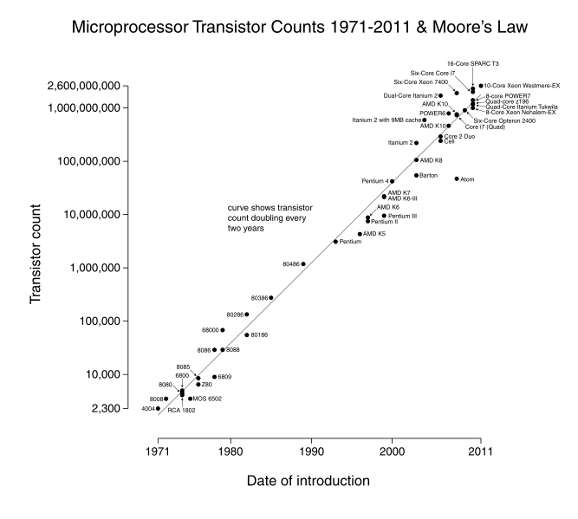

Slide 33
IPv4 BGP Table size and Moore’s Law
Moore’s Law
BGP Table Size Predictions

Slide 34
IPv6 Projections and Moore’s Law
Moore’s Law
BGP Table Size Predictions

Slide 35
BGP Table Growth
Nothing in these figures suggests that there is cause for urgent alarm -- at present
The overall eBGP growth rates for IPv4 are holding at a modest level, and the IPv6 table, although it is growing rapidly, is still relatively small in size in absolute terms
As long as we are prepared to live within the technical constraints of the current routing paradigm it will continue to be viable for some time yet

Slide 36
Table Size vs Updates

Slide 37
BGP Updates
What about the level of updates in BGP?
Let’s look at the update load from a single eBGP feed in a DFZ context

Slide 38
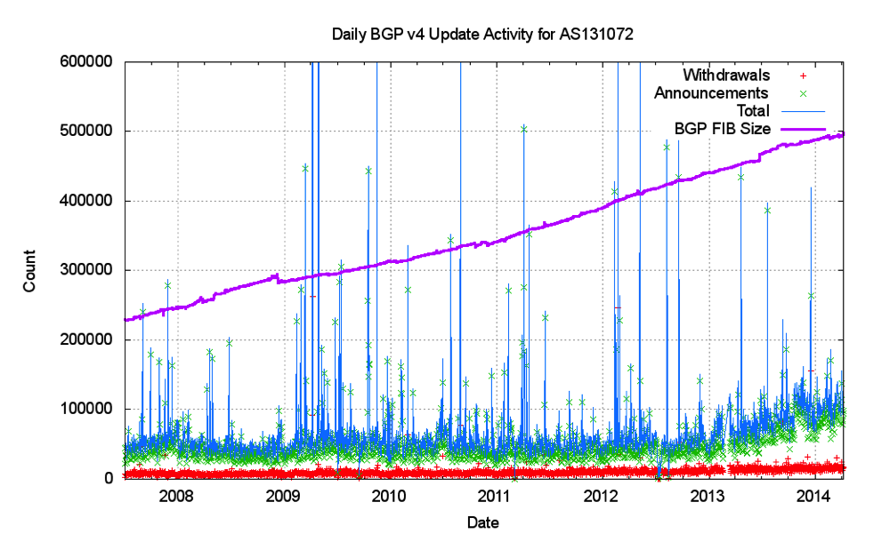
Announcements and Withdrawals

Slide 39
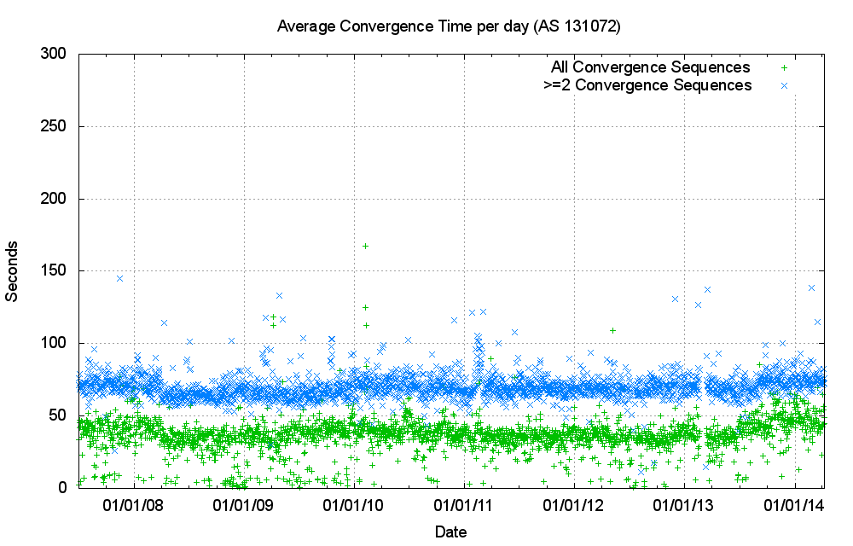
Convergence Performance

Slide 40
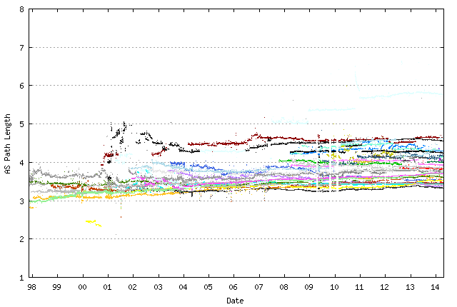
IPv4 Average AS Path Length
Data from Route Views

Slide 41
Updates in IPv4 BGP
Nothing in these figures is cause for any great level of concern …
  The number of updates per instability event has been constant, due to the damping effect of the MRAI interval, and the relatively constant AS Path length over this interval
What about IPv6?

Slide 42
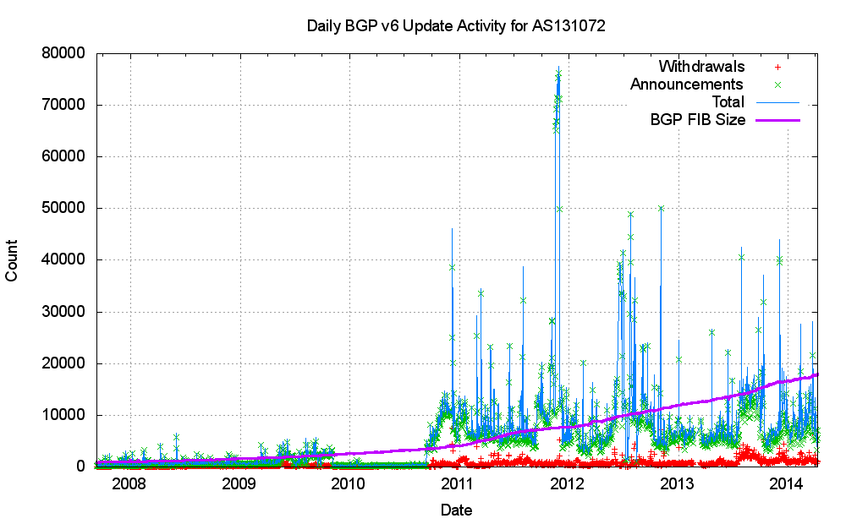
V6 Announcements and Withdrawals

Slide 43
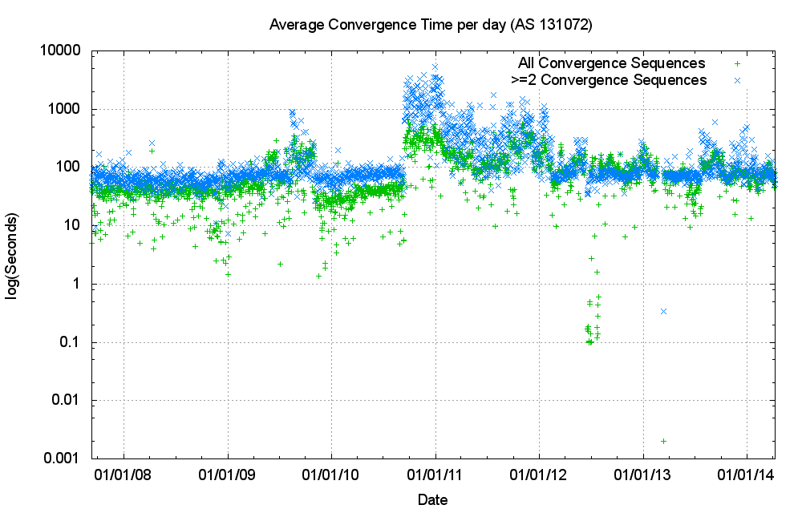
V6 Convergence Performance

Slide 44
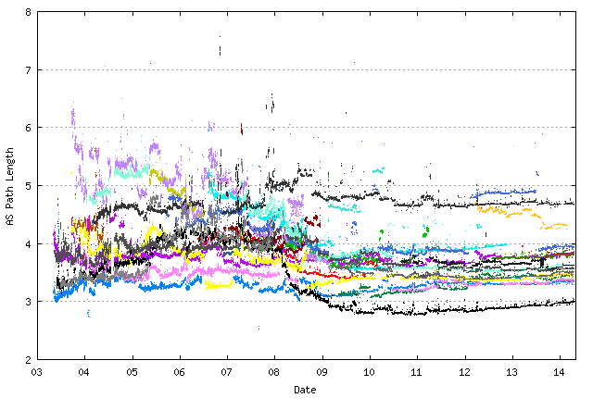
V6 Average AS Path Length
Data from Route Views

Slide 45
BGP Convergence
The long term average convergence time for the IPv4 BGP network is some 70 seconds, or 2.3 updates given a 30 second MRAI timer
The long term average convergence time for the IPv6 BGP network is some 80 seconds, or 2.6 updates

Slide 46
Problem? Not a Problem?
It’s evident that the global BGP routing environment suffers from a certain amount of neglect and inattention
But whether this is a problem or not depends on the way in which routers handle the routing table.
So lets take a quick look at routers…

Slide 47
Inside a router
Backplane
Line Interface Card
Switch Fabric Card
Management Card
Thanks to Greg Hankins

Slide 48
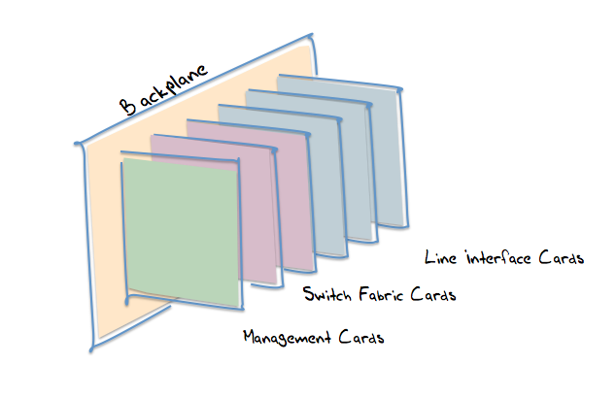
Inside a line card
FIB Lookup Bank
Packet Buffer
DRAM
TCAM
*DRAM
Backplane
Media
Packet Manager
PHY
Network
CPU
Thanks to Greg Hankins

Slide 49
Inside a line card
FIB Lookup Bank
Packet Buffer
DRAM
TCAM
*DRAM
Backplane
Media
Packet Manager
PHY
Network
CPU
Thanks to Greg Hankins

Slide 50
FIB Lookup Memory
The interface card’s network processor passes the packet’s destination address to the FIB module.
The FIB module returns with an outbound interface index

Slide 51
FIB Lookup
This can be achieved by:
  Loading the entire routing table into a Ternary Content Addressable Memory bank (TCAM)
or
  Using an ASIC implementation of a TRIE representation of the routing table with DRAM memory to hold the routing table
Either way, this needs fast memory

Slide 52
TCAM Memory
Address
11000000 00000000 00000010 00000001
192.0.2.1
TCAM width depends on the chip set in use. One popular TCAM config is 72 bits wide. IPv4 addresses consume a single 72 bit slot, IPv6 consumes two 72 bit slots. If instead you use TCAM with a slot width of 32 bits then IPv6 entries consume 4 times the equivalent slot count of IPv4 entries.
192.0.0.0/16 11000000 00000000 xxxxxxxx xxxxxxxx 3/0
192.0.2.0/24 11000000 00000000 00000010 xxxxxxxx 3/1
Longest Match
The entire FIB is loaded into TCAM. Every destination address is passed through the TCAM, and within one TCAM cycle the TCAM returns the interface index of the longest match. Each TCAM bank needs to be large enough to hold the entire FIB. TTCAM cycle time needs to be fast enough to support the max packet rate of the line card.
I/F 3/1
Outbound Interface identifier

Slide 53
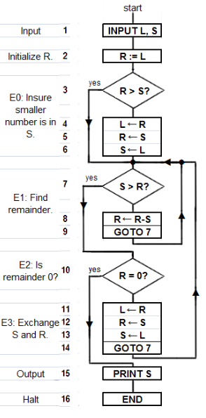
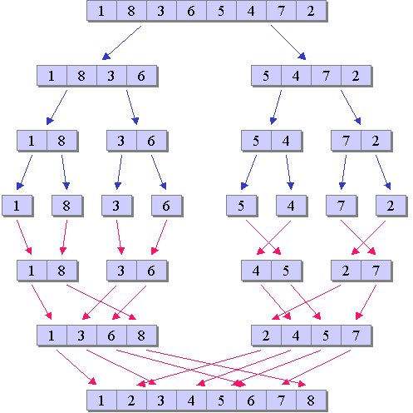
TRIE Lookup
Address
11000000 00000000 00000010 00000001
192.0.2.1
1/0
ASIC
1/0
?
?
1/0
?
1/0
?
1/0
DRAM
?
x/0000
…
The entire FIB is converted into a serial decision tree. The size of decision tree depends on the distribution of prefix values in the FIB. The performance of the TRIE depends on the algorithm used in the ASIC and the number of serial decisions used to reach a decision
?
I/F 3/1
Outbound Interface identifier

Slide 54
Memory Tradeoffs
ASIC +
RLDRAM 3
Higher
Lower
Lower
Lower
Smaller
1Gbit
TCAM
Lower
Higher
Higher
Higher
Larger
80Mbit
Access Speed
$ per bit
Power
Density
Physical Size
Capacity
Thanks to Greg Hankins

Slide 55
Memory Tradeoffs
TCAMs are higher cost, but operate with a fixed search latency and a fixed add/delete time. TCAMs scale linearly with the size of the FIB
ASICs implement a TRIE in memory. The cost is lower, but the search and add/delete times are variable. The performance of the lookup depends on the chosen algorithm. The memory efficiency of the TRIE depends on the prefix distribution and the particular algorithm used to manage the data structure

Slide 56
Size
What memory size do we need for 10 years of FIB growth from today?
TCAM
Trie
V4: 2M entries (1Gt)
plus
V6: 1M entries (2Gt)
V4: 100Mbit memory (500Mt)
plus
V6: 200Mbit memory (1Gt)
2014
2019
2024
V4 FIB
512K
768K
1M
V6 FIB
25K
125K
512K
“The Impact of Address Allocation and Routing on the Structure and
Implementation of Routing Tables”, Narayn, Govindan & Varghese, SIGCOMM ‘03

Slide 57
Scaling the FIB
BGP table growth is slow enough that we can continue to use simple FIB lookup in linecards without straining the state of the art in memory capacity
However, if it all turns horrible, there are alternatives to using a complete FIB in memory, which are at the moment variously robust and variously viable:
  FIB compression
  MPLS
  Locator/ID Separation (LISP)
  OpenFlow/Software Defined Networking (SDN)

Slide 58
Speed
1Tb
400Gb/1Tb 2017?
1.5Gpps
100Gb
40Gb/100Gb 2010 / 150Mpps
10Gb
10Gb 2002 / 15Mpps
1Gb 1999 / 1.5Mpps
1Gb
100Mb
100Mb 1995 / 150Kpps
10Mb
10Mb 1982/15Kpps
1980
1990
2000
2010
2020

Slide 59
Speed, Speed, Speed
What memory speeds are necessary to sustain a maximal packet rate?
100GE 150Mpps 6.7ns per packet
400Ge 600Mpps 1.6ns per packet
1Te 1.5Gpps 0.67ns per packet
0ns
10ns
20ns
30ns
40ns
50ns
1Te
400Ge
100Ge

Slide 60
Speed, Speed, Speed
What memory speeds do we HAVE?
1Te
400Ge
100Ge
DDR3DRAM
Commodity DRAM
0ns
10ns
20ns
30ns
40ns
50ns
RLDRAM
Thanks to Greg Hankins

Slide 61
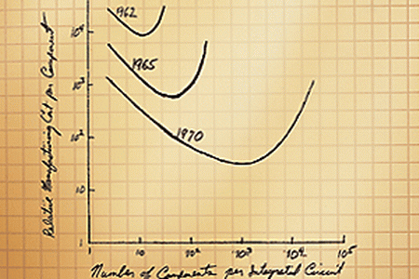
Scaling Speed
Scaling speed is going to be tougher over time
Moore’s Law talks about the number of gates per circuit, but not circuit clocking speeds
Speed and capacity could be the major design challenge for network equipment in the coming years
If we want to exploit parallelism as an alternative to wireline speed for terrabit networks, then is the use of best path routing protocols, coupled with destination-based hop-based forwarding going to scale?
Or are we going to need to look at path-pinned routing architectures to provide stable flow-level parallelism within the network?
http://www.startupinnovation.org/research/moores-law/

Slide 62

Thank You
Questions?

