Slide 1
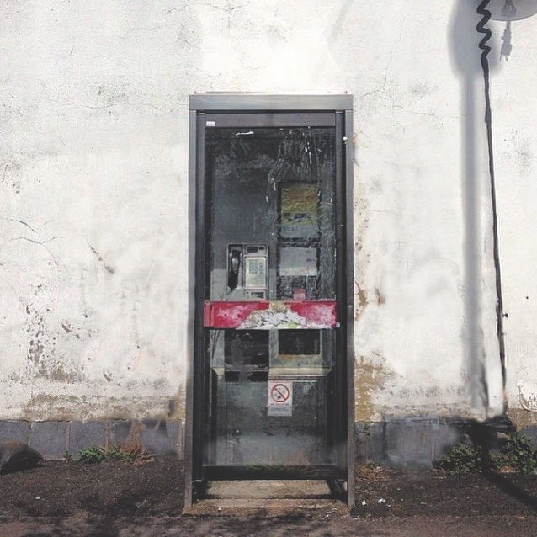
Who’s Watching?
Geoff Huston, APNIC
Street Art: Banksy

Slide 2
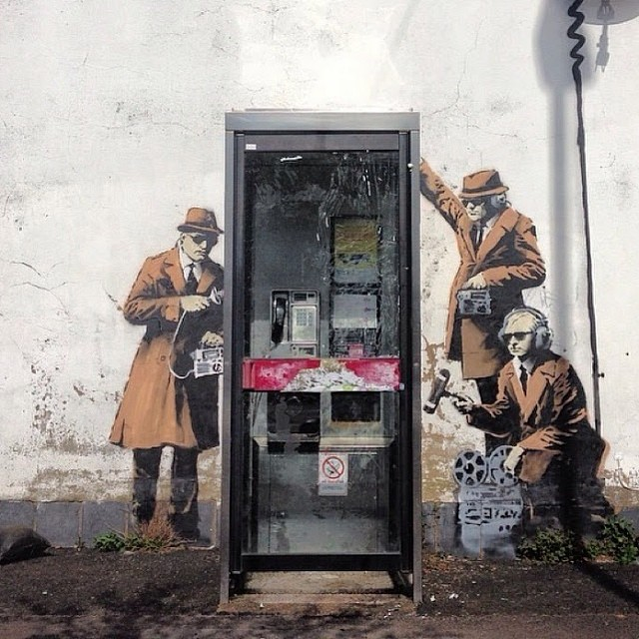
7
Who’s Watching?
Geoff Huston, APNIC
Street Art: Banksy

Slide 3
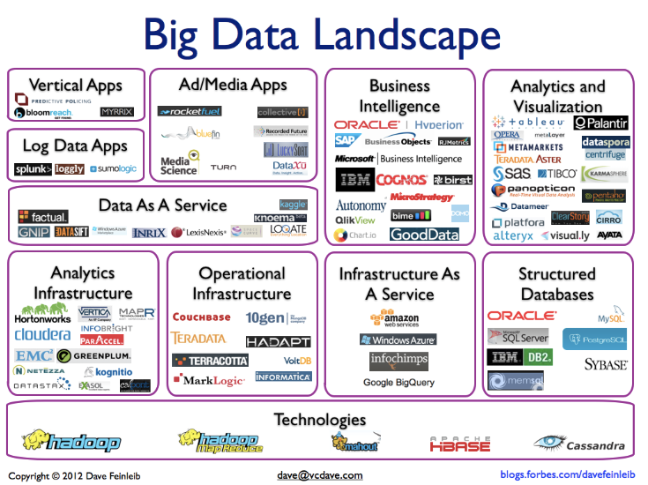
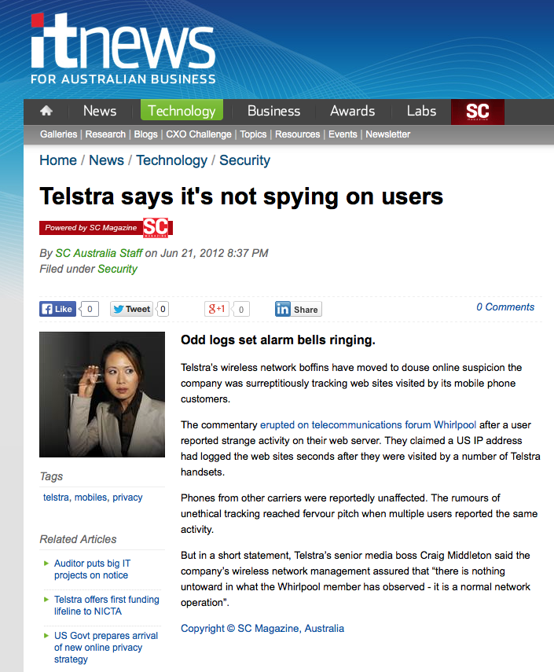
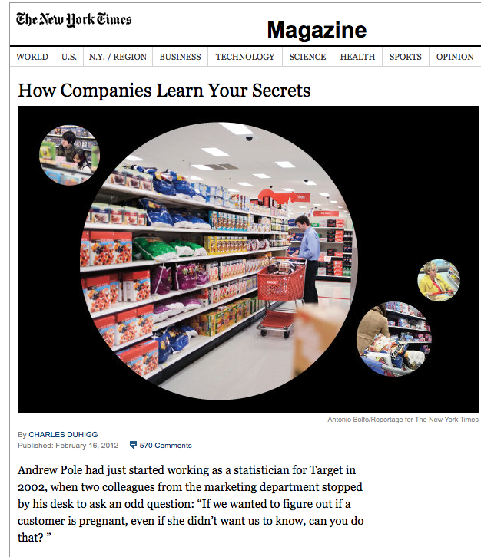

Slide 4

It’s all about YOU
These days technology has managed to create a mass market of customized individual markets - the market of one is now achievable, where each individual can be identified and targeted with products tailored to the individual’s perceived needs
And much of this intelligence is gathered by observing your online activities.
And it appears that online data gathering is a widespread practice involving businesses, finance organizations, internet service providers and government agencies
Some of this intelligence gathering is explicit, while other forms are more covert.
Can we observe this activity?

Slide 5
The Theory
At APNIC we measurement aspects of technology deployment by using Google Ads to deliver a test script to a very large profile of users
  We measure penetration of DNSSEC and IPv6, and many other aspects of the end user’s view of the Internet through these scripts
  We have some 500,000 tests executed per day
  And each of them use uniquely generated URLs
  And the URLs direct the end user back to our servers
  So, in theory we should see each unique URL retrieved from our server exactly once

Slide 6
The Theory
At APNIC we measurement aspects of technology deployment by using Google Ads to deliver a test script to a very large profile of users
  We measure penetration of DNSSEC and IPv6, and many other aspects of the end user’s view of the Internet through these scripts
  We have some 500,000 tests executed per day
  And each of them use uniquely generated URLs
  And the URLs direct the end user back to our servers
  So, in theory we should see each unique URL retrieved from our server exactly once
Right?

Slide 7
Here’s what we see in the web logs…
[22/Jan/2014:00:10:21 +0000]
  120.194.53.xxx
  "GET /1x1.png?t10000.u3697062917.s1390349413.i333.v1794.rd.td

Slide 8
Here’s what we see in the web logs…
[22/Jan/2014:00:10:21 +0000]
  120.194.53.0
  "GET /1x1.png?t10000.u3697062917.s1390349413.i333.v1794.rd.td
10:21 120.194.53.0 – Origin AS = 24445
CMNET-V4HENAN-AS-AP Henan Mobile Communications Co.,Ltd

Slide 9
Here’s what we see in the web logs…
[22/Jan/2014:00:10:21 +0000]
  120.194.53.0
  "GET /1x1.png?t10000.u3697062917.s1390349413.i333.v1794.rd.td
[22/Jan/2014:00:11:29 +0000]
  221.176.4.0
  "GET /1x1.png?t10000.u3697062917.s1390349413.i333.v1794.rd.td

Slide 10
Here’s what we see in the web logs…
[22/Jan/2014:00:10:21 +0000]
  120.194.53.xxx
  "GET /1x1.png?t10000.u3697062917.s1390349413.i333.v1794.rd.td
[22/Jan/2014:00:11:29 +0000]
  221.176.4.xxx
  "GET /1x1.png?t10000.u3697062917.s1390349413.i333.v1794.rd.td
10:21 120.194.53.0 – Origin AS = 24445
CMNET-V4HENAN-AS-AP Henan Mobile Communications Co.,Ltd
68 seconds later -- SAME URL, different IP!
11:29 221.176.4.0 – Origin AS = 9808
CMNET-GD Guangdong Mobile Communication Co.Ltd.

Slide 11
Searching for Stalkers
We’ve combed over our collected data since the start of 2014 to see what evidence we can gather about URL stalking…

Slide 12
Some Stalker Numbers
In the first 248 days of 2014 we saw:
  123,110,633 unique end-user IP addresses presented to our servers from these test scripts
  317,309 of these end-user IP addresses presented HTTP GET strings to us that were subsequently presented to us from a different client IP address!
That’s some 1 in 400* users that seem to have attracted some kind of digital stalker!
* Or maybe a bit more, due to NATs hiding multiple end users behind a single public IP address

Slide 13


Slide 14
Online Privacy? Really?
It’s hard to believe that today’s Internet respects personal privacy when it seems that around 1 in 400 users have attracted some kind of digital stalker that tracks the URLs they visit.

Slide 15
Stalking Rates by Country
CC Samples Stalked Rate/1,000,000 Country
IR 674 111 164,688 Iran (Islamic Republic of)
LA 28,506 2,875 100,855 Lao People's Democratic Republic
MO 38,761 2,954 76,210 Macao Special Administrative Region of China
SG 240,188 17,406 72,468 Singapore
HK 486,101 22,136 45,537 Hong Kong Special Administrative Region of China
CN 10,419,638 435,040 41,751 China
GB 872,124 28,845 33,074 United Kingdom of Great Britain and Northern Ireland
TW 1,769,367 36,823 20,811 Taiwan
JP 1,500,779 23,971 15,972 Japan
AU 293,193 4,620 15,757 Australia
US 4,491,711 53,370 11,881 United States of America
MY 1,035,434 10,214 9,864 Malaysia
AL 437,399 4,043 9,243 Albania
CA 947,922 6,244 6,587 Canada
KH 143,886 897 6,234 Cambodia
MM 16,411 97 5,910 Myanmar
MK 458,820 2,214 4,825 The former Yugoslav Republic of Macedonia
BZ 8,139 35 4,300 Belize
MN 57,622 233 4,043 Mongolia
NZ 344,951 1,385 4,015 New Zealand
CV 3,742 14 3,741 Cape Verde
ME 223,005 775 3,475 Montenegro
FJ 14,892 47 3,156 Fiji
SR 44,116 136 3,082 Suriname
AW 11,123 34 3,056 Aruba
The top 25 countries in terms
of observed URL stalking rates

Slide 16
Counting Stalkers
431,749,774 unique URLs were presented back to us in this experiment, and we saw some 776,243 URLS that were presented to us more than once, from different source IP addresses
The subsequent presentations came from 8,309 distinct source networks (/24s)

Slide 17
Top Stalker Subnets
Rank IP Net Count AVG Delay AS Description
1 119.147.146.0 339,855 122.6 4134 CHINANET-BACKBONE No.31,Jin-rong Street,CN
2 101.226.33.0 53,181 1,502.2 4812 CHINANET-SH-AP China Telecom (Group),CN
3 180.153.206.0 51,592 1,528.0 4812 CHINANET-SH-AP China Telecom (Group),CN
4 112.64.235.0 33,067 1,470.8 17621 CNCGROUP-SH China Unicom Shanghai network,CN
5 180.153.214.0 32,954 1,468.4 4812 CHINANET-SH-AP China Telecom (Group),CN
6 101.226.66.0 30,863 1,499.3 4812 CHINANET-SH-AP China Telecom (Group),CN
7 180.153.163.0 23,941 1,515.0 4812 CHINANET-SH-AP China Telecom (Group),CN
8 180.153.201.0 22,673 1,562.2 4812 CHINANET-SH-AP China Telecom (Group),CN
9 101.226.89.0 19,337 1,426.4 4812 CHINANET-SH-AP China Telecom (Group),CN
10 221.176.4.0 14,019 855.7 9808 CMNET-GD Guangdong Mobile Communication Co.Ltd.,CN
11 101.226.65.0 13,604 1,519.9 4812 CHINANET-SH-AP China Telecom (Group),CN
12 101.226.51.0 10,226 1,490.8 4812 CHINANET-SH-AP China Telecom (Group),CN
13 112.65.193.0 8,619 1,555.5 17621 CNCGROUP-SH China Unicom Shanghai network,CN
14 66.249.93.0 8,306 31,355.1 15169 GOOGLE - Google Inc.,US
15 180.153.205.0 6,816 1,557.0 4812 CHINANET-SH-AP China Telecom (Group),CN
16 180.153.114.0 6,796 1,550.6 4812 CHINANET-SH-AP China Telecom (Group),CN
17 69.41.14.0 5,724 810.0 47018 CE-BGPAC - Covenant Eyes, Inc.,US
18 66.249.81.0 5,218 38,095.9 15169 GOOGLE - Google Inc.,US
19 66.249.88.0 4,817 31,119.7 15169 GOOGLE - Google Inc.,US
20 66.249.80.0 4,685 24,641.1 15169 GOOGLE - Google Inc.,US
21 222.73.77.0 4,471 1,398.5 4812 CHINANET-SH-AP China Telecom (Group),CN
22 180.153.161.0 4,352 1,470.3 4812 CHINANET-SH-AP China Telecom (Group),CN
23 180.153.211.0 4,271 1,520.9 4812 CHINANET-SH-AP China Telecom (Group),CN
24 66.249.85.0 3,774 23,607.7 15169 GOOGLE - Google Inc.,US
25 93.186.23.0 3,707 37.3 18705 RIMBLACKBERRY - Research In Motion Limited,CA

Slide 18
Is it me … or you?
A short delay stalking would point to local scriptware on users’ browsers that feeds visited URL streams to a third party once the load script has completed
Extended stalking delays of 15, 30 and 60 minutes would indicates that there is some amount of intercepting middleware that feeds proxy web caches

Slide 19
Stalking Delay
The 15, 30 and 60 minute local peaks are likely to be local web proxy refresh cycles
This local peak matches a result timer in the test script

Slide 20
Web Proxies
Could this be a variant of a web proxy or active middleware content service that is harvesting URLs off the wire?
  A strong indicator of a local proxy device is that it is located in the same AS as the end client.
  Let’s filter that list of URL stalkers and look at those stalkers that use a different Origin AS from the original request
  Here’s what we see…

Slide 21
Different Origin AS Stalkers
Rank IP NeT # Avg Delay AS Description
1 119.147.146.0 255,121 128.1 4134 CHINANET-BACKBONE No.31,Jin-rong Street,CN
2 101.226.33.0 50,257 1,543.3 4812 CHINANET-SH-AP China Telecom (Group),CN
3 180.153.206.0 48,808 1,574.6 4812 CHINANET-SH-AP China Telecom (Group),CN
4 112.64.235.0 32,800 1,507.1 17621 CNCGROUP-SH China Unicom Shanghai network,CN
5 180.153.214.0 31,225 1,519.5 4812 CHINANET-SH-AP China Telecom (Group),CN
6 101.226.66.0 29,188 1,548.2 4812 CHINANET-SH-AP China Telecom (Group),CN
7 180.153.163.0 22,666 1,558.8 4812 CHINANET-SH-AP China Telecom (Group),CN
8 180.153.201.0 21,470 1,609.0 4812 CHINANET-SH-AP China Telecom (Group),CN
9 101.226.89.0 18,233 1,613.2 4812 CHINANET-SH-AP China Telecom (Group),CN
10 101.226.65.0 12,889 1,573.4 4812 CHINANET-SH-AP China Telecom (Group),CN
11 101.226.51.0 9,640 1,542.9 4812 CHINANET-SH-AP China Telecom (Group),CN
12 112.65.193.0 8,531 1,588.3 17621 CNCGROUP-SH China Unicom Shanghai network,CN
13 221.176.4.0 8,324 749.6 9808 CMNET-GD Guangdong Mobile Communication Co.Ltd.,CN
14 180.153.205.0 6,432 1,597.0 4812 CHINANET-SH-AP China Telecom (Group),CN
15 180.153.114.0 6,431 1,591.4 4812 CHINANET-SH-AP China Telecom (Group),CN
16 69.41.14.0 5,685 825.7 47018 CE-BGPAC - Covenant Eyes, Inc.,US
17 222.73.77.0 4,190 1,442.7 4812 CHINANET-SH-AP China Telecom (Group),CN
18 180.153.161.0 4,120 1,524.6 4812 CHINANET-SH-AP China Telecom (Group),CN
19 180.153.211.0 4,064 1,566.9 4812 CHINANET-SH-AP China Telecom (Group),CN
20 223.27.200.0 2,740 1.8 45796 BBCONNECT-TH-AS-AP BB Connect Co., Ltd.,TH
21 60.190.138.0 2,341 3,600.2 4134 CHINANET-BACKBONE No.31,Jin-rong Street,CN
22 64.125.188.0 2,286 1,517.2 6461 ABOVENET - Abovenet Communications, Inc,US
23 222.73.76.0 2,144 1,595.6 4812 CHINANET-SH-AP China Telecom (Group),CN
24 101.226.102.0 2,022 1,554.1 4812 CHINANET-SH-AP China Telecom (Group),CN
25 180.153.212.0 2,003 1,450.5 4812 CHINANET-SH-AP China Telecom (Group),CN

Slide 22
Maybe it’s ISP and/or National Infrastructure
We’ve all heard about the Great Firewall of China
  And other countries may be doing similar things
Possibly this URL stalking is the result of some form of ISP or national content cache program
Let’s filter this list further by using geo-location information to find those cases where the original end client’s IP address and the stalker’s IP address locate to different countries

Slide 23
Different Country Stalkers
Rank IP Net # AVG Delay AS Description
1 119.147.146.0 205,033 130.7 4134 CHINANET-BACKBONE No.31,Jin-rong Street,CN
2 101.226.33.0 6,198 1,576.1 4812 CHINANET-SH-AP China Telecom (Group),CN
3 180.153.206.0 6,120 1,608.3 4812 CHINANET-SH-AP China Telecom (Group),CN
4 180.153.214.0 3,827 1,561.0 4812 CHINANET-SH-AP China Telecom (Group),CN
5 112.64.235.0 3,819 1,544.9 17621 CNCGROUP-SH China Unicom Shanghai network,CN
6 101.226.66.0 3,603 1,577.3 4812 CHINANET-SH-AP China Telecom (Group),CN
7 180.153.163.0 2,742 1,540.1 4812 CHINANET-SH-AP China Telecom (Group),CN
8 223.27.200.0 2,740 1.8 45796 BBCONNECT-TH-AS-AP BB Connect Co., Ltd.,TH
9 101.226.89.0 2,658 2,230.2 4812 CHINANET-SH-AP China Telecom (Group),CN
10 180.153.201.0 2,628 1,549.4 4812 CHINANET-SH-AP China Telecom (Group),CN
11 101.226.65.0 1,528 1,573.3 4812 CHINANET-SH-AP China Telecom (Group),CN
12 69.41.14.0 1,243 1,127.4 47018 CE-BGPAC - Covenant Eyes, Inc.,US
13 101.226.51.0 1,195 1,627.6 4812 CHINANET-SH-AP China Telecom (Group),CN
14 112.65.193.0 1,038 1,623.9 17621 CNCGROUP-SH China Unicom Shanghai network,CN
15 64.124.98.0 906 1,288.9 6461 ABOVENET - Abovenet Communications, Inc,US
16 180.153.114.0 819 1,632.6 4812 CHINANET-SH-AP China Telecom (Group),CN
17 180.153.205.0 765 1,497.7 4812 CHINANET-SH-AP China Telecom (Group),CN
18 208.184.77.0 649 1,419.5 6461 ABOVENET - Abovenet Communications, Inc,US
19 222.73.77.0 535 1,373.8 4812 CHINANET-SH-AP China Telecom (Group),CN
20 180.153.211.0 517 1,450.6 4812 CHINANET-SH-AP China Telecom (Group),CN
21 180.153.161.0 504 1,675.7 4812 CHINANET-SH-AP China Telecom (Group),CN
22 183.60.153.0 262 451.3 4134 CHINANET-BACKBONE No.31,Jin-rong Street,CN
23 222.73.76.0 255 1,512.7 4812 CHINANET-SH-AP China Telecom (Group),CN
24 101.226.102.0 235 2,012.7 4812 CHINANET-SH-AP China Telecom (Group),CN
25 208.80.194.0 227 10,731.5 13448 WEBSENSE - Websense, Inc,US

Slide 24
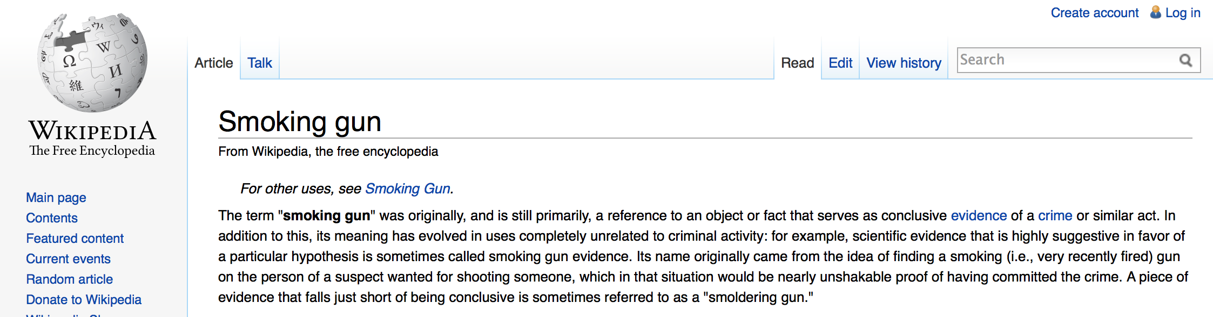
Different Country Stalkers
Rank IP Net # AVG Delay AS Description
1 119.147.146.0 205,033 130.7 4134 CHINANET-BACKBONE No.31,Jin-rong Street,CN
2 101.226.33.0 6,198 1,576.1 4812 CHINANET-SH-AP China Telecom (Group),CN
3 180.153.206.0 6,120 1,608.3 4812 CHINANET-SH-AP China Telecom (Group),CN
4 180.153.214.0 3,827 1,561.0 4812 CHINANET-SH-AP China Telecom (Group),CN
5 112.64.235.0 3,819 1,544.9 17621 CNCGROUP-SH China Unicom Shanghai network,CN
6 101.226.66.0 3,603 1,577.3 4812 CHINANET-SH-AP China Telecom (Group),CN
7 180.153.163.0 2,742 1,540.1 4812 CHINANET-SH-AP China Telecom (Group),CN
8 223.27.200.0 2,740 1.8 45796 BBCONNECT-TH-AS-AP BB Connect Co., Ltd.,TH
9 101.226.89.0 2,658 2,230.2 4812 CHINANET-SH-AP China Telecom (Group),CN
10 180.153.201.0 2,628 1,549.4 4812 CHINANET-SH-AP China Telecom (Group),CN
11 101.226.65.0 1,528 1,573.3 4812 CHINANET-SH-AP China Telecom (Group),CN
12 69.41.14.0 1,243 1,127.4 47018 CE-BGPAC - Covenant Eyes, Inc.,US
13 101.226.51.0 1,195 1,627.6 4812 CHINANET-SH-AP China Telecom (Group),CN
14 112.65.193.0 1,038 1,623.9 17621 CNCGROUP-SH China Unicom Shanghai network,CN
15 64.124.98.0 906 1,288.9 6461 ABOVENET - Abovenet Communications, Inc,US
16 180.153.114.0 819 1,632.6 4812 CHINANET-SH-AP China Telecom (Group),CN
17 180.153.205.0 765 1,497.7 4812 CHINANET-SH-AP China Telecom (Group),CN
18 208.184.77.0 649 1,419.5 6461 ABOVENET - Abovenet Communications, Inc,US
19 222.73.77.0 535 1,373.8 4812 CHINANET-SH-AP China Telecom (Group),CN
20 180.153.211.0 517 1,450.6 4812 CHINANET-SH-AP China Telecom (Group),CN
21 180.153.161.0 504 1,675.7 4812 CHINANET-SH-AP China Telecom (Group),CN
22 183.60.153.0 262 451.3 4134 CHINANET-BACKBONE No.31,Jin-rong Street,CN
23 222.73.76.0 255 1,512.7 4812 CHINANET-SH-AP China Telecom (Group),CN
24 101.226.102.0 235 2,012.7 4812 CHINANET-SH-AP China Telecom (Group),CN
25 208.80.194.0 227 10,731.5 13448 WEBSENSE - Websense, Inc,US

Slide 25
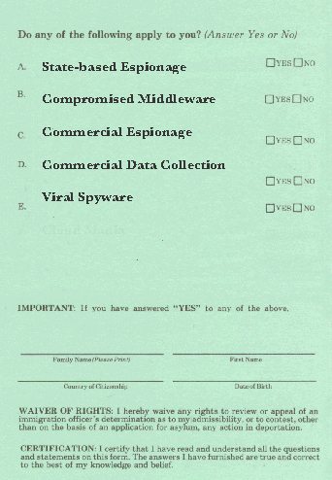
What are we seeing here?

Slide 26

119.147.146.27
Street Art: Banksy

Slide 27
Where are the Stalked?
CC Stalk Country
Count
AD 2 Andorra
AE 434 United Arab Emirates
AF 2 Afghanistan
AG 20 Antigua and Barbuda
AL 4032 Albania
AM 161 Armenia
AO 12 Angola
AR 734 Argentina
AT 154 Austria
AU 3463 Australia
AW 15 Aruba
AZ 96 Azerbaijan
BA 969 Bosnia and Herzegovina
BB 40 Barbados
BD 128 Bangladesh
BE 199 Belgium
BF 5 Burkina Faso
BG 2544 Bulgaria
BH 77 Bahrain
BJ 11 Benin
BN 20 Brunei Darussalam
BO 44 Bolivia
BR 995 Brazil
BS 5 Bahamas
BT 4 Bhutan
BW 10 Botswana
BY 58 Belarus
BZ 16 Belize
CA 3164 Canada
CD 5 DR Congo
CG 3 Congo
CH 125 Switzerland
CI 30 Cote d'Ivoire
CL 228 Chile
CM 9 Cameroon
CN 136402 China
CO 945 Colombia
CR 38 Costa Rica
CV 10 Cape Verde
CY 217 Cyprus
CZ 162 Czech Republic
DE 867 Germany
DJ 1 Djibouti
DK 73 Denmark
DO 109 Dominican Republic
DZ 2288 Algeria
EC 232 Ecuador
EE 58 Estonia
EG 1216 Egypt
ES 557 Spain
ET 9 Ethiopia
EU 8 European Union
FI 121 Finland
FJ 25 Fiji
FR 1124 France
GA 7 Gabon
GB 16056 United Kingdom
GE 200 Georgia
GF 1 French Guiana
GH 54 Ghana
GL 4 Greenland
GN 1 Guinea
GQ 10 Equatorial Guinea
GR 965 Greece
GT 18 Guatemala
GU 49 Guam
GY 17 Guyana
HK 17105 Hong Kong
HN 65 Honduras
HR 191 Croatia
HT 6 Haiti
HU 847 Hungary
ID 2103 Indonesia
IE 138 Ireland
IL 548 Israel
IN 1162 India
IQ 1089 Iraq
IR 103 Iran (Islamic Republic of)
IT 958 Italy
JM 54 Jamaica
JO 94 Jordan
JP 23174 Japan
KE 45 Kenya
KG 31 Kyrgyzstan
KH 712 Cambodia
KR 701 Republic of Korea
KW 55 Kuwait
KZ 1048 Kazakhstan
LA 95 Lao People's Democratic Republic
LB 25 Lebanon

Slide 28
Where are the Stalked?
LK 110 Sri Lanka
LR 2 Liberia
LT 302 Lithuania
LU 10 Luxembourg
LV 84 Latvia
LY 52 Libya
MA 3111 Morocco
MD 103 Republic of Moldova
ME 762 Montenegro
MG 14 Madagascar
MK 2210 FYR Macedonia
ML 11 Mali
MM 62 Myanmar
MN 134 Mongolia
MO 2323 Macao
MP 192 Northern Mariana Islands
MR 14 Mauritania
MT 110 Malta
MU 66 Mauritius
MW 2 Malawi
MX 1928 Mexico
MY 9077 Malaysia
MZ 6 Mozambique
NA 11 Namibia
NC 10 New Caledonia
NE 7 Niger
NG 43 Nigeria
NI 19 Nicaragua
NL 334 Netherlands
NO 55 Norway
NP 138 Nepal
NZ 1012 New Zealand
OM 59 Oman
PA 151 Panama
PE 832 Peru
PG 4 Papua New Guinea
PH 3281 Philippines
PK 1126 Pakistan
PL 4114 Poland
PM 2 Saint Pierre and Miquelon
PR 58 Puerto Rico
PS 379 Occupied Palestinian Territory
PT 233 Portugal
PY 36 Paraguay
QA 207 Qatar
RO 2990 Romania
RS 2672 Serbia
RU 811 Russian Federation
RW 9 Rwanda
SA 685 Saudi Arabia
SD 22 Sudan
SE 135 Sweden
SG 16350 Singapore
SI 293 Slovenia
SK 95 Slovakia
SM 1 San Marino
SN 74 Senegal
SR 114 Suriname
ST 10 Sao Tome and Principe
SV 45 El Salvador
SY 22 Syrian Arab Republic
TG 6 Togo
TH 4529 Thailand
TJ 10 Tajikistan
TN 356 Tunisia
TR 3465 Turkey
TT 48 Trinidad and Tobago
TW 29247 Taiwan
TZ 14 Tanzania
UA 486 Ukraine
UG 16 Uganda
US 8524 United States of America
UY 62 Uruguay
VE 400 Venezuela
VN 9191 Vietnam
VU 1 Vanuatu
WS 2 Samoa
YE 55 Yemen
ZA 91 South Africa
ZM 4 Zambia
ZW 7 Zimbabwe

Slide 29
Where are the Stalked?
This is an impressive list of countries
  Which says a lot about the ubiquity of Google Ads!
  But it also says a lot about the reach of the particular stalking activity we are seeing here
Is this list skewed towards any particular country?

Slide 30
Where are the stalked?
CN 136402 China
TW 29247 Taiwan
JP 23174 Japan
HK 17105 Hong Kong Special Administrative Region of China
SG 16350 Singapore
GB 16056 United Kingdom of Great Britain and Northern Ireland
VN 9191 Vietnam
MY 9077 Malaysia
US 8524 United States of America
TH 4529 Thailand
PL 4114 Poland
AL 4032 Albania
TR 3465 Turkey
AU 3463 Australia
PH 3281 Philippines
CA 3164 Canada
MA 3111 Morocco
RO 2990 Romania
RS 2672 Serbia
BG 2544 Bulgaria
MO 2323 Macao Special Administrative Region of China
DZ 2288 Algeria
MK 2210 The former Yugoslav Republic of Macedonia
ID 2103 Indonesia
MX 1928 Mexico
This is the top 25 countries where we have observed end systems that appear to have attracted this particular stalker

Slide 31
Where are the stalked?
CC Stalked URLs Rate/100000 Country
MO 2,323 131,601 1,765 Macao
HK 17,105 1,949,495 877 Hong Kong
MP 192 24,549 782 Northern Mariana Islands
CN 136,402 23,949,516 569 China
ST 10 2,081 480 Sao Tome and Principe
TW 29,247 6,176,517 473 Taiwan
JP 23,174 5,165,103 448 Japan
GQ 10 4,039 247 Equatorial Guinea
AL 4,032 1,674,691 240 Albania
GL 4 1,746 229 Greenland
MY 9,077 3,979,009 228 Malaysia
MK 2,210 1,121,630 197 The former Yugoslav Republic of Macedonia
SG 16,350 9,452,589 172 Singapore
KH 712 417,028 170 Cambodia
NE 7 4,913 142 Niger
ME 762 589,540 129 Montenegro
WS 2 1,635 122 Samoa
IR 103 86,224 119 Iran (Islamic Republic of)
LA 95 87,071 109 Lao People's Democratic Republic
SR 114 119,539 95 Suriname
CA 3,164 3,550,951 89 Canada
MA 3,111 3,779,870 82 Morocco
PG 4 4,901 81 Papua New Guinea
BJ 11 13,459 81 Benin
GB 16,056 20,069,870 80 United Kingdom of Great Britain and Northern Ireland
This is the top 25 countries with the highest relative rate of stalking
from this particular stalker

Slide 32
Stalking Delay Distribution
Is this stalking instant, or delayed?
  The average interval between the initial URL fetch and the second fetch from this net is 74 seconds. What’s the distribution in delay times?

Slide 33
Distribution of Stalking Delay
Most of these stalking fetches happen with 3 seconds of the initial fetch
(But a small set extend this delay to hours)

Slide 34
User Agent strings
What User Agent string is used by the stalker?
What User Agent strings are used by the stalked?

Slide 35
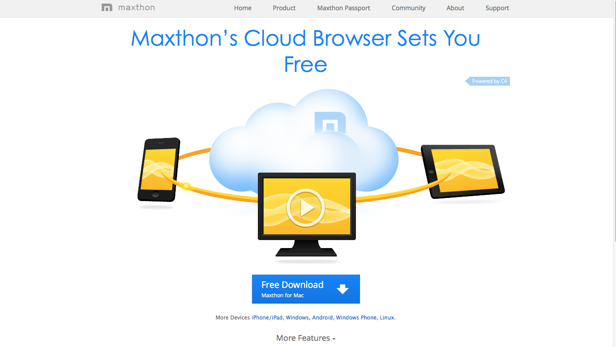
The Stalker’s User Agent String
Mozilla/4.0 (compatible; MSIE 6.0; Windows NT 5.1; SV1; .NET CLR 2.0.50727; MAXTHON 2.0)

Slide 36
Top 25 User Agent Strings of the stalked systems
6,068 Mozilla/5.0 (Windows NT 5.1) AppleWebKit/537.36 (KHTML, like Gecko) Chrome/28.0.1500.95 Safari/537.36 SE 2.X MetaSr 1.0
5,458 Mozilla/5.0 (Windows NT 6.1; WOW64) AppleWebKit/537.36 (KHTML, like Gecko) Chrome/28.0.1500.95 Safari/537.36 SE 2.X MetaSr 1.0
5,389 Mozilla/5.0 (Windows NT 6.1; WOW64) AppleWebKit/537.36 (KHTML, like Gecko) Chrome/33.0.1750.154 Safari/537.36
5,029 Mozilla/5.0 (Windows NT 6.1; WOW64) AppleWebKit/537.36 (KHTML, like Gecko) Chrome/32.0.1700.107 Safari/537.36
4,669 Mozilla/5.0 (Windows NT 6.1) AppleWebKit/537.36 (KHTML, like Gecko) Chrome/28.0.1500.95 Safari/537.36 SE 2.X MetaSr 1.0
4,641 Mozilla/5.0 (Windows NT 6.1; WOW64) AppleWebKit/537.36 (KHTML, like Gecko) Chrome/31.0.1650.63 Safari/537.36
3,382 Mozilla/5.0 (Windows NT 6.1) AppleWebKit/537.36 (KHTML, like Gecko) Chrome/31.0.1650.63 Safari/537.36
3,265 Mozilla/5.0 (Windows NT 6.1; WOW64; rv:26.0) Gecko/20100101 Firefox/26.0
3,084 Mozilla/5.0 (Windows NT 6.1) AppleWebKit/537.36 (KHTML, like Gecko) Chrome/32.0.1700.107 Safari/537.36
2,915 Mozilla/5.0 (Windows NT 6.1; WOW64) AppleWebKit/537.36 (KHTML, like Gecko) Chrome/32.0.1700.76 Safari/537.36
2,813 Mozilla/5.0 (Windows NT 6.1) AppleWebKit/537.36 (KHTML, like Gecko) Chrome/33.0.1750.154 Safari/537.36
2,813 Mozilla/5.0 (Windows NT 6.1; WOW64; rv:27.0) Gecko/20100101 Firefox/27.0
2,765 Mozilla/5.0 (Windows NT 6.1; WOW64) AppleWebKit/537.1 (KHTML, like Gecko) Chrome/21.0.1180.89 Safari/537.1
2,653 Mozilla/5.0 (Windows NT 6.1; WOW64) AppleWebKit/537.36 (KHTML, like Gecko) Chrome/33.0.1750.117 Safari/537.36
2,651 Mozilla/5.0 (Windows NT 6.1; WOW64) AppleWebKit/537.36 (KHTML, like Gecko) Chrome/34.0.1847.131 Safari/537.36
2,416 Mozilla/5.0 (Windows NT 6.1; WOW64) AppleWebKit/537.36 (KHTML, like Gecko) Chrome/34.0.1847.116 Safari/537.36
2,238 Mozilla/5.0 (Windows NT 6.1; rv:26.0) Gecko/20100101 Firefox/26.0
2,222 Mozilla/5.0 (Windows NT 5.1; rv:26.0) Gecko/20100101 Firefox/26.0
2,142 Mozilla/5.0 (Windows NT 5.1) AppleWebKit/537.36 (KHTML, like Gecko) Chrome/32.0.1700.107 Safari/537.36
2,043 Mozilla/5.0 (Windows NT 6.1; WOW64; rv:28.0) Gecko/20100101 Firefox/28.0
2,028 Mozilla/5.0 (Windows NT 5.1) AppleWebKit/537.36 (KHTML, like Gecko) Chrome/31.0.1650.63 Safari/537.36
1,965 Mozilla/5.0 (Windows NT 6.1) AppleWebKit/537.36 (KHTML, like Gecko) Chrome/32.0.1700.76 Safari/537.36
1,876 Mozilla/5.0 (Windows NT 6.1; rv:27.0) Gecko/20100101 Firefox/27.0
1,846 Mozilla/5.0 (Windows NT 6.1) AppleWebKit/537.36 (KHTML, like Gecko) Chrome/34.0.1847.131 Safari/537.36
1,813 Mozilla/5.0 (Windows NT 6.1; WOW64) AppleWebKit/537.36 (KHTML, like Gecko) Chrome/32.0.1700.102 Safari/537.36

Slide 37
Top 25 User Agent Strings of the stalked systems
6,068 Mozilla/5.0 (Windows NT 5.1) AppleWebKit/537.36 (KHTML, like Gecko) Chrome/28.0.1500.95 Safari/537.36 SE 2.X MetaSr 1.0
5,458 Mozilla/5.0 (Windows NT 6.1; WOW64) AppleWebKit/537.36 (KHTML, like Gecko) Chrome/28.0.1500.95 Safari/537.36 SE 2.X MetaSr 1.0
5,389 Mozilla/5.0 (Windows NT 6.1; WOW64) AppleWebKit/537.36 (KHTML, like Gecko) Chrome/33.0.1750.154 Safari/537.36
5,029 Mozilla/5.0 (Windows NT 6.1; WOW64) AppleWebKit/537.36 (KHTML, like Gecko) Chrome/32.0.1700.107 Safari/537.36
4,669 Mozilla/5.0 (Windows NT 6.1) AppleWebKit/537.36 (KHTML, like Gecko) Chrome/28.0.1500.95 Safari/537.36 SE 2.X MetaSr 1.0
4,641 Mozilla/5.0 (Windows NT 6.1; WOW64) AppleWebKit/537.36 (KHTML, like Gecko) Chrome/31.0.1650.63 Safari/537.36
3,382 Mozilla/5.0 (Windows NT 6.1) AppleWebKit/537.36 (KHTML, like Gecko) Chrome/31.0.1650.63 Safari/537.36
3,265 Mozilla/5.0 (Windows NT 6.1; WOW64; rv:26.0) Gecko/20100101 Firefox/26.0
3,084 Mozilla/5.0 (Windows NT 6.1) AppleWebKit/537.36 (KHTML, like Gecko) Chrome/32.0.1700.107 Safari/537.36
2,915 Mozilla/5.0 (Windows NT 6.1; WOW64) AppleWebKit/537.36 (KHTML, like Gecko) Chrome/32.0.1700.76 Safari/537.36
2,813 Mozilla/5.0 (Windows NT 6.1) AppleWebKit/537.36 (KHTML, like Gecko) Chrome/33.0.1750.154 Safari/537.36
2,813 Mozilla/5.0 (Windows NT 6.1; WOW64; rv:27.0) Gecko/20100101 Firefox/27.0
2,765 Mozilla/5.0 (Windows NT 6.1; WOW64) AppleWebKit/537.1 (KHTML, like Gecko) Chrome/21.0.1180.89 Safari/537.1
2,653 Mozilla/5.0 (Windows NT 6.1; WOW64) AppleWebKit/537.36 (KHTML, like Gecko) Chrome/33.0.1750.117 Safari/537.36
2,651 Mozilla/5.0 (Windows NT 6.1; WOW64) AppleWebKit/537.36 (KHTML, like Gecko) Chrome/34.0.1847.131 Safari/537.36
2,416 Mozilla/5.0 (Windows NT 6.1; WOW64) AppleWebKit/537.36 (KHTML, like Gecko) Chrome/34.0.1847.116 Safari/537.36
2,238 Mozilla/5.0 (Windows NT 6.1; rv:26.0) Gecko/20100101 Firefox/26.0
2,222 Mozilla/5.0 (Windows NT 5.1; rv:26.0) Gecko/20100101 Firefox/26.0
2,142 Mozilla/5.0 (Windows NT 5.1) AppleWebKit/537.36 (KHTML, like Gecko) Chrome/32.0.1700.107 Safari/537.36
2,043 Mozilla/5.0 (Windows NT 6.1; WOW64; rv:28.0) Gecko/20100101 Firefox/28.0
2,028 Mozilla/5.0 (Windows NT 5.1) AppleWebKit/537.36 (KHTML, like Gecko) Chrome/31.0.1650.63 Safari/537.36
1,965 Mozilla/5.0 (Windows NT 6.1) AppleWebKit/537.36 (KHTML, like Gecko) Chrome/32.0.1700.76 Safari/537.36
1,876 Mozilla/5.0 (Windows NT 6.1; rv:27.0) Gecko/20100101 Firefox/27.0
1,846 Mozilla/5.0 (Windows NT 6.1) AppleWebKit/537.36 (KHTML, like Gecko) Chrome/34.0.1847.131 Safari/537.36
1,813 Mozilla/5.0 (Windows NT 6.1; WOW64) AppleWebKit/537.36 (KHTML, like Gecko) Chrome/32.0.1700.102 Safari/537.36
Many of the stalked end systems appear to be using Windows OS platforms!

Slide 38
Top 25 User Agent Strings of the stalked systems
6,068 Mozilla/5.0 (Windows NT 5.1) AppleWebKit/537.36 (KHTML, like Gecko) Chrome/28.0.1500.95 Safari/537.36 SE 2.X MetaSr 1.0
5,458 Mozilla/5.0 (Windows NT 6.1; WOW64) AppleWebKit/537.36 (KHTML, like Gecko) Chrome/28.0.1500.95 Safari/537.36 SE 2.X MetaSr 1.0
5,389 Mozilla/5.0 (Windows NT 6.1; WOW64) AppleWebKit/537.36 (KHTML, like Gecko) Chrome/33.0.1750.154 Safari/537.36
5,029 Mozilla/5.0 (Windows NT 6.1; WOW64) AppleWebKit/537.36 (KHTML, like Gecko) Chrome/32.0.1700.107 Safari/537.36
4,669 Mozilla/5.0 (Windows NT 6.1) AppleWebKit/537.36 (KHTML, like Gecko) Chrome/28.0.1500.95 Safari/537.36 SE 2.X MetaSr 1.0
4,641 Mozilla/5.0 (Windows NT 6.1; WOW64) AppleWebKit/537.36 (KHTML, like Gecko) Chrome/31.0.1650.63 Safari/537.36
3,382 Mozilla/5.0 (Windows NT 6.1) AppleWebKit/537.36 (KHTML, like Gecko) Chrome/31.0.1650.63 Safari/537.36
3,265 Mozilla/5.0 (Windows NT 6.1; WOW64; rv:26.0) Gecko/20100101 Firefox/26.0
3,084 Mozilla/5.0 (Windows NT 6.1) AppleWebKit/537.36 (KHTML, like Gecko) Chrome/32.0.1700.107 Safari/537.36
2,915 Mozilla/5.0 (Windows NT 6.1; WOW64) AppleWebKit/537.36 (KHTML, like Gecko) Chrome/32.0.1700.76 Safari/537.36
2,813 Mozilla/5.0 (Windows NT 6.1) AppleWebKit/537.36 (KHTML, like Gecko) Chrome/33.0.1750.154 Safari/537.36
2,813 Mozilla/5.0 (Windows NT 6.1; WOW64; rv:27.0) Gecko/20100101 Firefox/27.0
2,765 Mozilla/5.0 (Windows NT 6.1; WOW64) AppleWebKit/537.1 (KHTML, like Gecko) Chrome/21.0.1180.89 Safari/537.1
2,653 Mozilla/5.0 (Windows NT 6.1; WOW64) AppleWebKit/537.36 (KHTML, like Gecko) Chrome/33.0.1750.117 Safari/537.36
2,651 Mozilla/5.0 (Windows NT 6.1; WOW64) AppleWebKit/537.36 (KHTML, like Gecko) Chrome/34.0.1847.131 Safari/537.36
2,416 Mozilla/5.0 (Windows NT 6.1; WOW64) AppleWebKit/537.36 (KHTML, like Gecko) Chrome/34.0.1847.116 Safari/537.36
2,238 Mozilla/5.0 (Windows NT 6.1; rv:26.0) Gecko/20100101 Firefox/26.0
2,222 Mozilla/5.0 (Windows NT 5.1; rv:26.0) Gecko/20100101 Firefox/26.0
2,142 Mozilla/5.0 (Windows NT 5.1) AppleWebKit/537.36 (KHTML, like Gecko) Chrome/32.0.1700.107 Safari/537.36
2,043 Mozilla/5.0 (Windows NT 6.1; WOW64; rv:28.0) Gecko/20100101 Firefox/28.0
2,028 Mozilla/5.0 (Windows NT 5.1) AppleWebKit/537.36 (KHTML, like Gecko) Chrome/31.0.1650.63 Safari/537.36
1,965 Mozilla/5.0 (Windows NT 6.1) AppleWebKit/537.36 (KHTML, like Gecko) Chrome/32.0.1700.76 Safari/537.36
1,876 Mozilla/5.0 (Windows NT 6.1; rv:27.0) Gecko/20100101 Firefox/27.0
1,846 Mozilla/5.0 (Windows NT 6.1) AppleWebKit/537.36 (KHTML, like Gecko) Chrome/34.0.1847.131 Safari/537.36
1,813 Mozilla/5.0 (Windows NT 6.1; WOW64) AppleWebKit/537.36 (KHTML, like Gecko) Chrome/32.0.1700.102 Safari/537.36
Many of the stalked users browser appears to be Chrome!

Slide 39


Chrome/Windows Virus?
Are we seeing some viral spyware virus in Chrome & Windows?

Slide 40
Chrome/Windows Virus?
Are we seeing some viral spyware virus in Chrome & Windows?
I don’t think that’s the case
Let’s look at those browser User Agent strings again…

Slide 41
Top 25 User Agent Strings of the stalked systems
6,068 Mozilla/5.0 (Windows NT 5.1) AppleWebKit/537.36 (KHTML, like Gecko) Chrome/28.0.1500.95 Safari/537.36 SE 2.X MetaSr 1.0
5,458 Mozilla/5.0 (Windows NT 6.1; WOW64) AppleWebKit/537.36 (KHTML, like Gecko) Chrome/28.0.1500.95 Safari/537.36 SE 2.X MetaSr 1.0
5,389 Mozilla/5.0 (Windows NT 6.1; WOW64) AppleWebKit/537.36 (KHTML, like Gecko) Chrome/33.0.1750.154 Safari/537.36
5,029 Mozilla/5.0 (Windows NT 6.1; WOW64) AppleWebKit/537.36 (KHTML, like Gecko) Chrome/32.0.1700.107 Safari/537.36
4,669 Mozilla/5.0 (Windows NT 6.1) AppleWebKit/537.36 (KHTML, like Gecko) Chrome/28.0.1500.95 Safari/537.36 SE 2.X MetaSr 1.0

Slide 42
Top 25 User Agent Strings of the stalked systems
6,068 Mozilla/5.0 (Windows NT 5.1) AppleWebKit/537.36 (KHTML, like Gecko) Chrome/28.0.1500.95 Safari/537.36 SE 2.X MetaSr 1.0
5,458 Mozilla/5.0 (Windows NT 6.1; WOW64) AppleWebKit/537.36 (KHTML, like Gecko) Chrome/28.0.1500.95 Safari/537.36 SE 2.X MetaSr 1.0
5,389 Mozilla/5.0 (Windows NT 6.1; WOW64) AppleWebKit/537.36 (KHTML, like Gecko) Chrome/33.0.1750.154 Safari/537.36
5,029 Mozilla/5.0 (Windows NT 6.1; WOW64) AppleWebKit/537.36 (KHTML, like Gecko) Chrome/32.0.1700.107 Safari/537.36
4,669 Mozilla/5.0 (Windows NT 6.1) AppleWebKit/537.36 (KHTML, like Gecko) Chrome/28.0.1500.95 Safari/537.36 SE 2.X MetaSr 1.0
User Agent = “MetaSR”

Slide 43
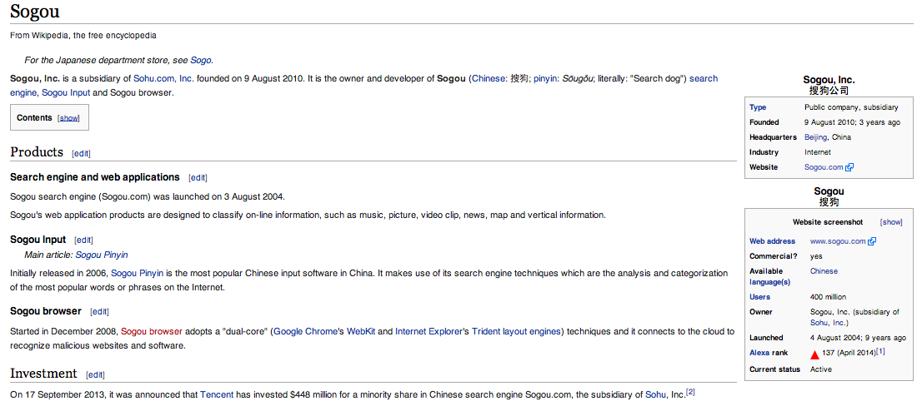
Top 25 User Agent Strings of the stalked systems
6,068 Mozilla/5.0 (Windows NT 5.1) AppleWebKit/537.36 (KHTML, like Gecko) Chrome/28.0.1500.95 Safari/537.36 SE 2.X MetaSr 1.0
5,458 Mozilla/5.0 (Windows NT 6.1; WOW64) AppleWebKit/537.36 (KHTML, like Gecko) Chrome/28.0.1500.95 Safari/537.36 SE 2.X MetaSr 1.0
5,389 Mozilla/5.0 (Windows NT 6.1; WOW64) AppleWebKit/537.36 (KHTML, like Gecko) Chrome/33.0.1750.154 Safari/537.36
5,029 Mozilla/5.0 (Windows NT 6.1; WOW64) AppleWebKit/537.36 (KHTML, like Gecko) Chrome/32.0.1700.107 Safari/537.36
4,669 Mozilla/5.0 (Windows NT 6.1) AppleWebKit/537.36 (KHTML, like Gecko) Chrome/28.0.1500.95 Safari/537.36 SE 2.X MetaSr 1.0
User Agent = “MetaSR”
Sogou Explorer 2.X

Slide 44
Top 25 User Agent Strings of the stalked systems
6,068 Mozilla/5.0 (Windows NT 5.1) AppleWebKit/537.36 (KHTML, like Gecko) Chrome/28.0.1500.95 Safari/537.36 SE 2.X MetaSr 1.0
5,458 Mozilla/5.0 (Windows NT 6.1; WOW64) AppleWebKit/537.36 (KHTML, like Gecko) Chrome/28.0.1500.95 Safari/537.36 SE 2.X MetaSr 1.0
5,389 Mozilla/5.0 (Windows NT 6.1; WOW64) AppleWebKit/537.36 (KHTML, like Gecko) Chrome/33.0.1750.154 Safari/537.36
5,029 Mozilla/5.0 (Windows NT 6.1; WOW64) AppleWebKit/537.36 (KHTML, like Gecko) Chrome/32.0.1700.107 Safari/537.36
4,669 Mozilla/5.0 (Windows NT 6.1) AppleWebKit/537.36 (KHTML, like Gecko) Chrome/28.0.1500.95 Safari/537.36 SE 2.X MetaSr 1.0
User Agent = “MetaSR”
Sogou Explorer 2.X
“It connects to the cloud to recognize malicious websites and software”

Slide 45
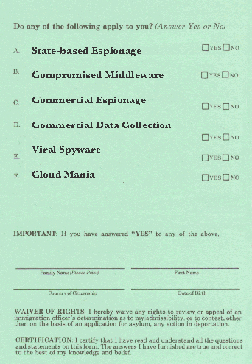
What are we seeing for stalking from 119.147.146.0/24?
✔

Slide 46
What are we seeing for stalking from 119.147.146.0/24?
✔
✔
✔
✔

Slide 47
This data set is just a tiny glimpse into the overall pattern of web activity

Slide 48

What’s happening in the larger world of various forms of tracking users’ behaviour on the Internet?
Street Art: Banksy

Slide 49
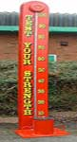
In today’s Internet users’ browsing history is being siphoned off to third parties as a commonplace activity.
Who gets to see this data of user browsing behaviour? Within which national regime? Within which constraints of privacy?
Is this form of digital stalking something that we are comfortable with?
Or are we even aware that it is happening at all?
TEST
YOUR
COMFORT

Slide 50
Thanks to:
George Michaelson and Byron Ellacot of APNIC for developing the Ad Measurement Experiment
Warren Kumari, of Google, who spent some time looking through user agent strings to identify a pointer to the Sogou browser in the collected data.

Slide 51

Thanks!
Street Art: Banksy

