Slide 1
What have we done?
Geoff Huston

Slide 2


Slide 3
25 Years Ago…
In 1990, Peter Elford and I turned on the Australian Academic and Research Network for every University and CSIRO site in Australia
The Internet had arrived for the national higher education and research sector
So what were the issues then and how much have things changed…?

Slide 4
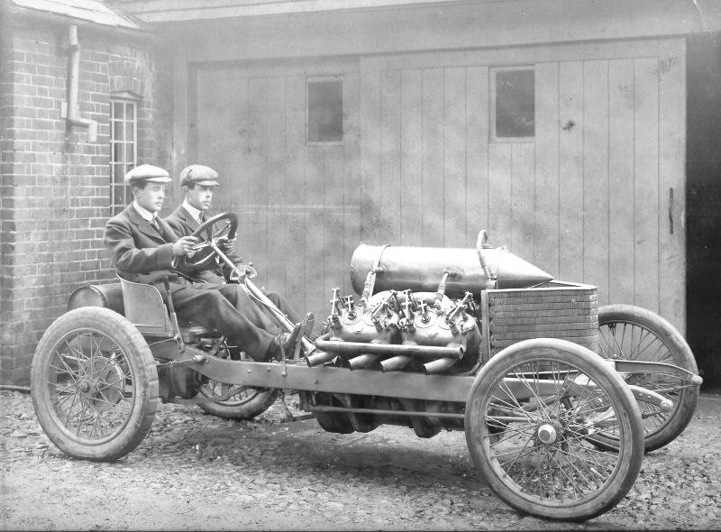
The past is a foreign land – they do things differently there!

Slide 5
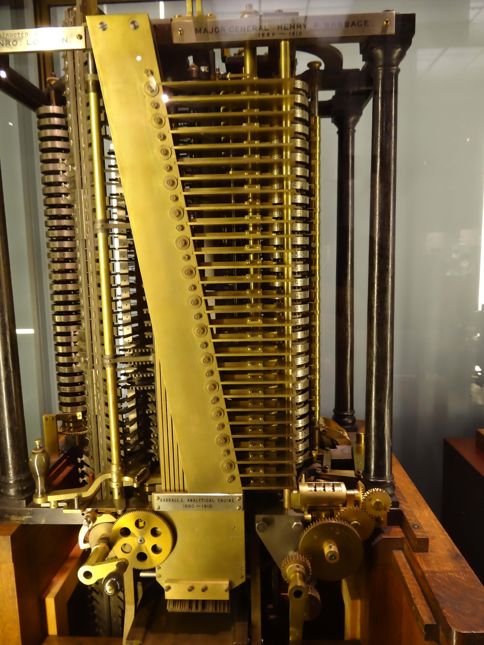
The Computing Evolutionary Path
1837 – Babbage’s Analytical Engine

Slide 6
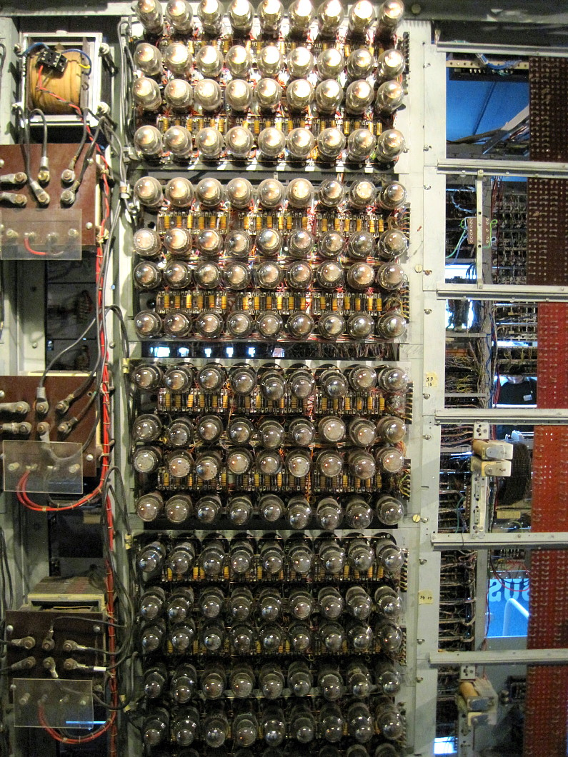
The Computing Evolutionary Path
1943 – Colossus Computer

Slide 7

The Computing Evolutionary Path
1946 – Eniac – a numeric calculator

Slide 8
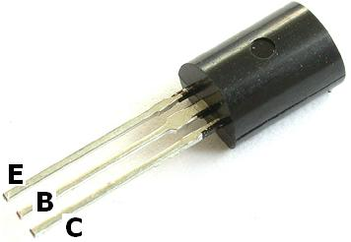
The Computing Evolutionary Path
1947– The Transistor

Slide 9

The Computing Evolutionary Path
1964 IBM 360 – commercial computing
1964: IBM 360

Slide 10
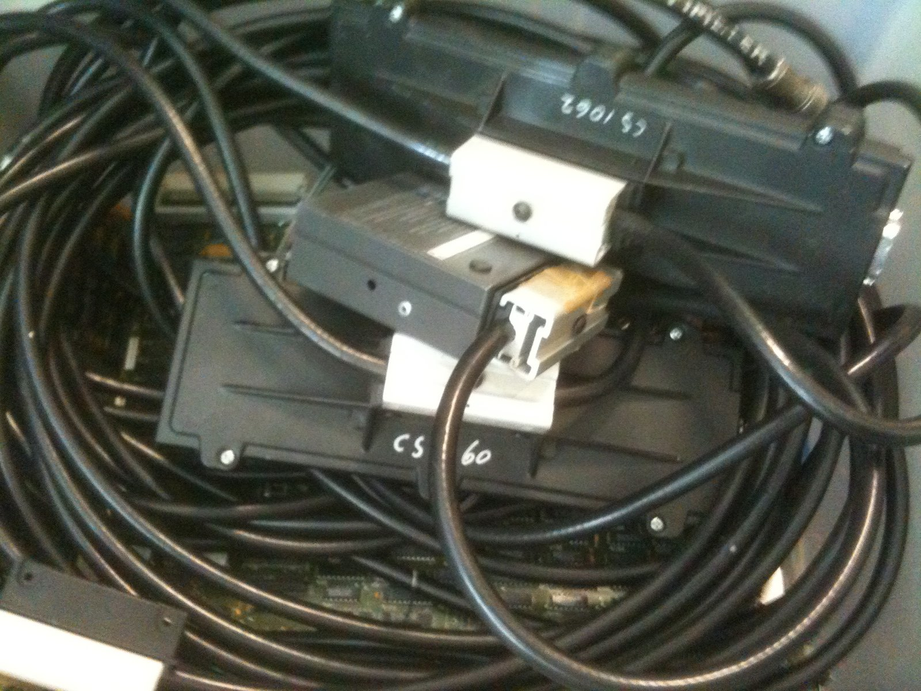
The Computing Evolutionary Path
1976 Ethernet

Slide 11

The Computing Evolutionary Path
The Computing Evolutionary Path
1976 CRAY-1 – “super” computing

Slide 12

The Computing Evolutionary Path
The Computing Evolutionary Path
A fork in the road:
1976 – Apple-1 “personal” computing
1976: Apple I

Slide 13
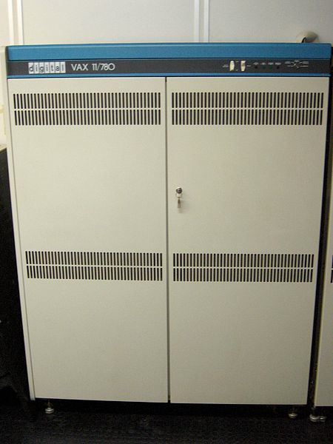
The Computing Evolutionary Path
The Computing Evolutionary Path
Wide Area Packet Networks
1982 – DECnet Phase IV

Slide 14

The Computing Evolutionary Path
1984 – Mac - visual computing

Slide 15
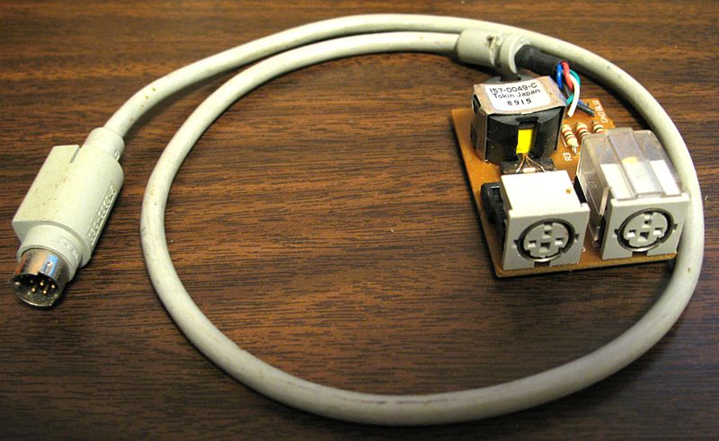
The Computing Evolutionary Path
1985 – Appletalk

Slide 16
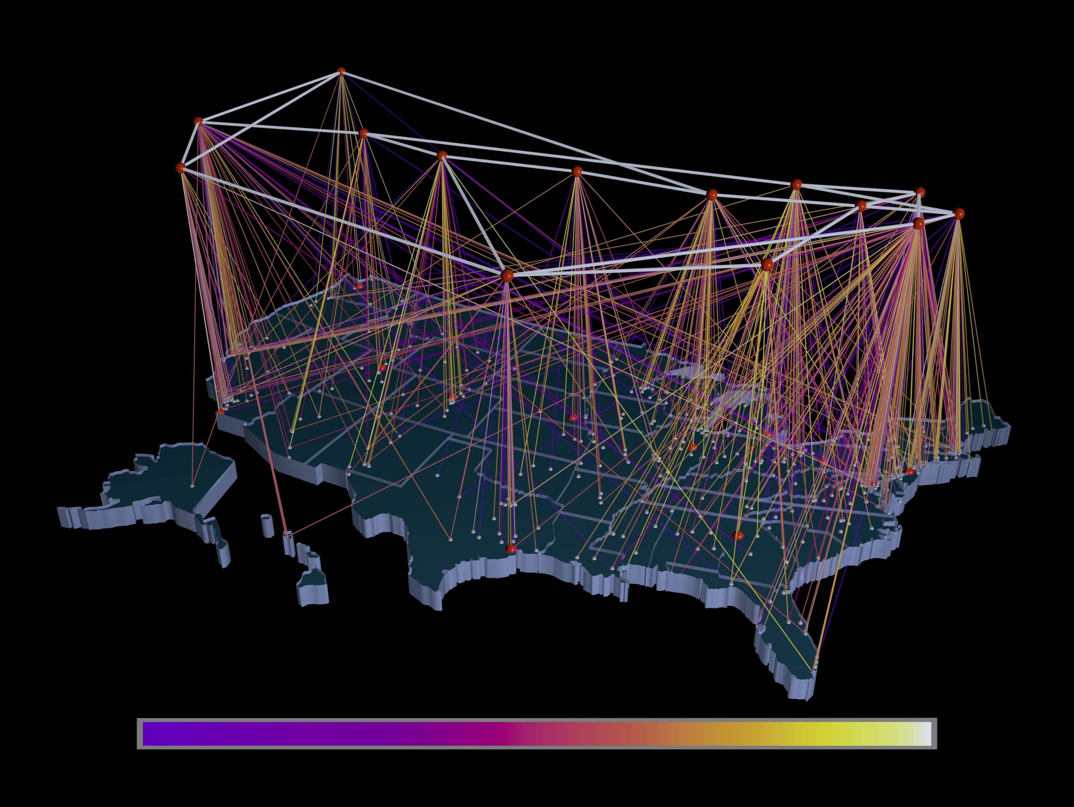
The Computing Evolutionary Path
1988 – TCP/IP and the NSFNET

Slide 17
Which brings us to 1990
(Or thereabouts)

Slide 18
What were we talking about then?

Slide 19
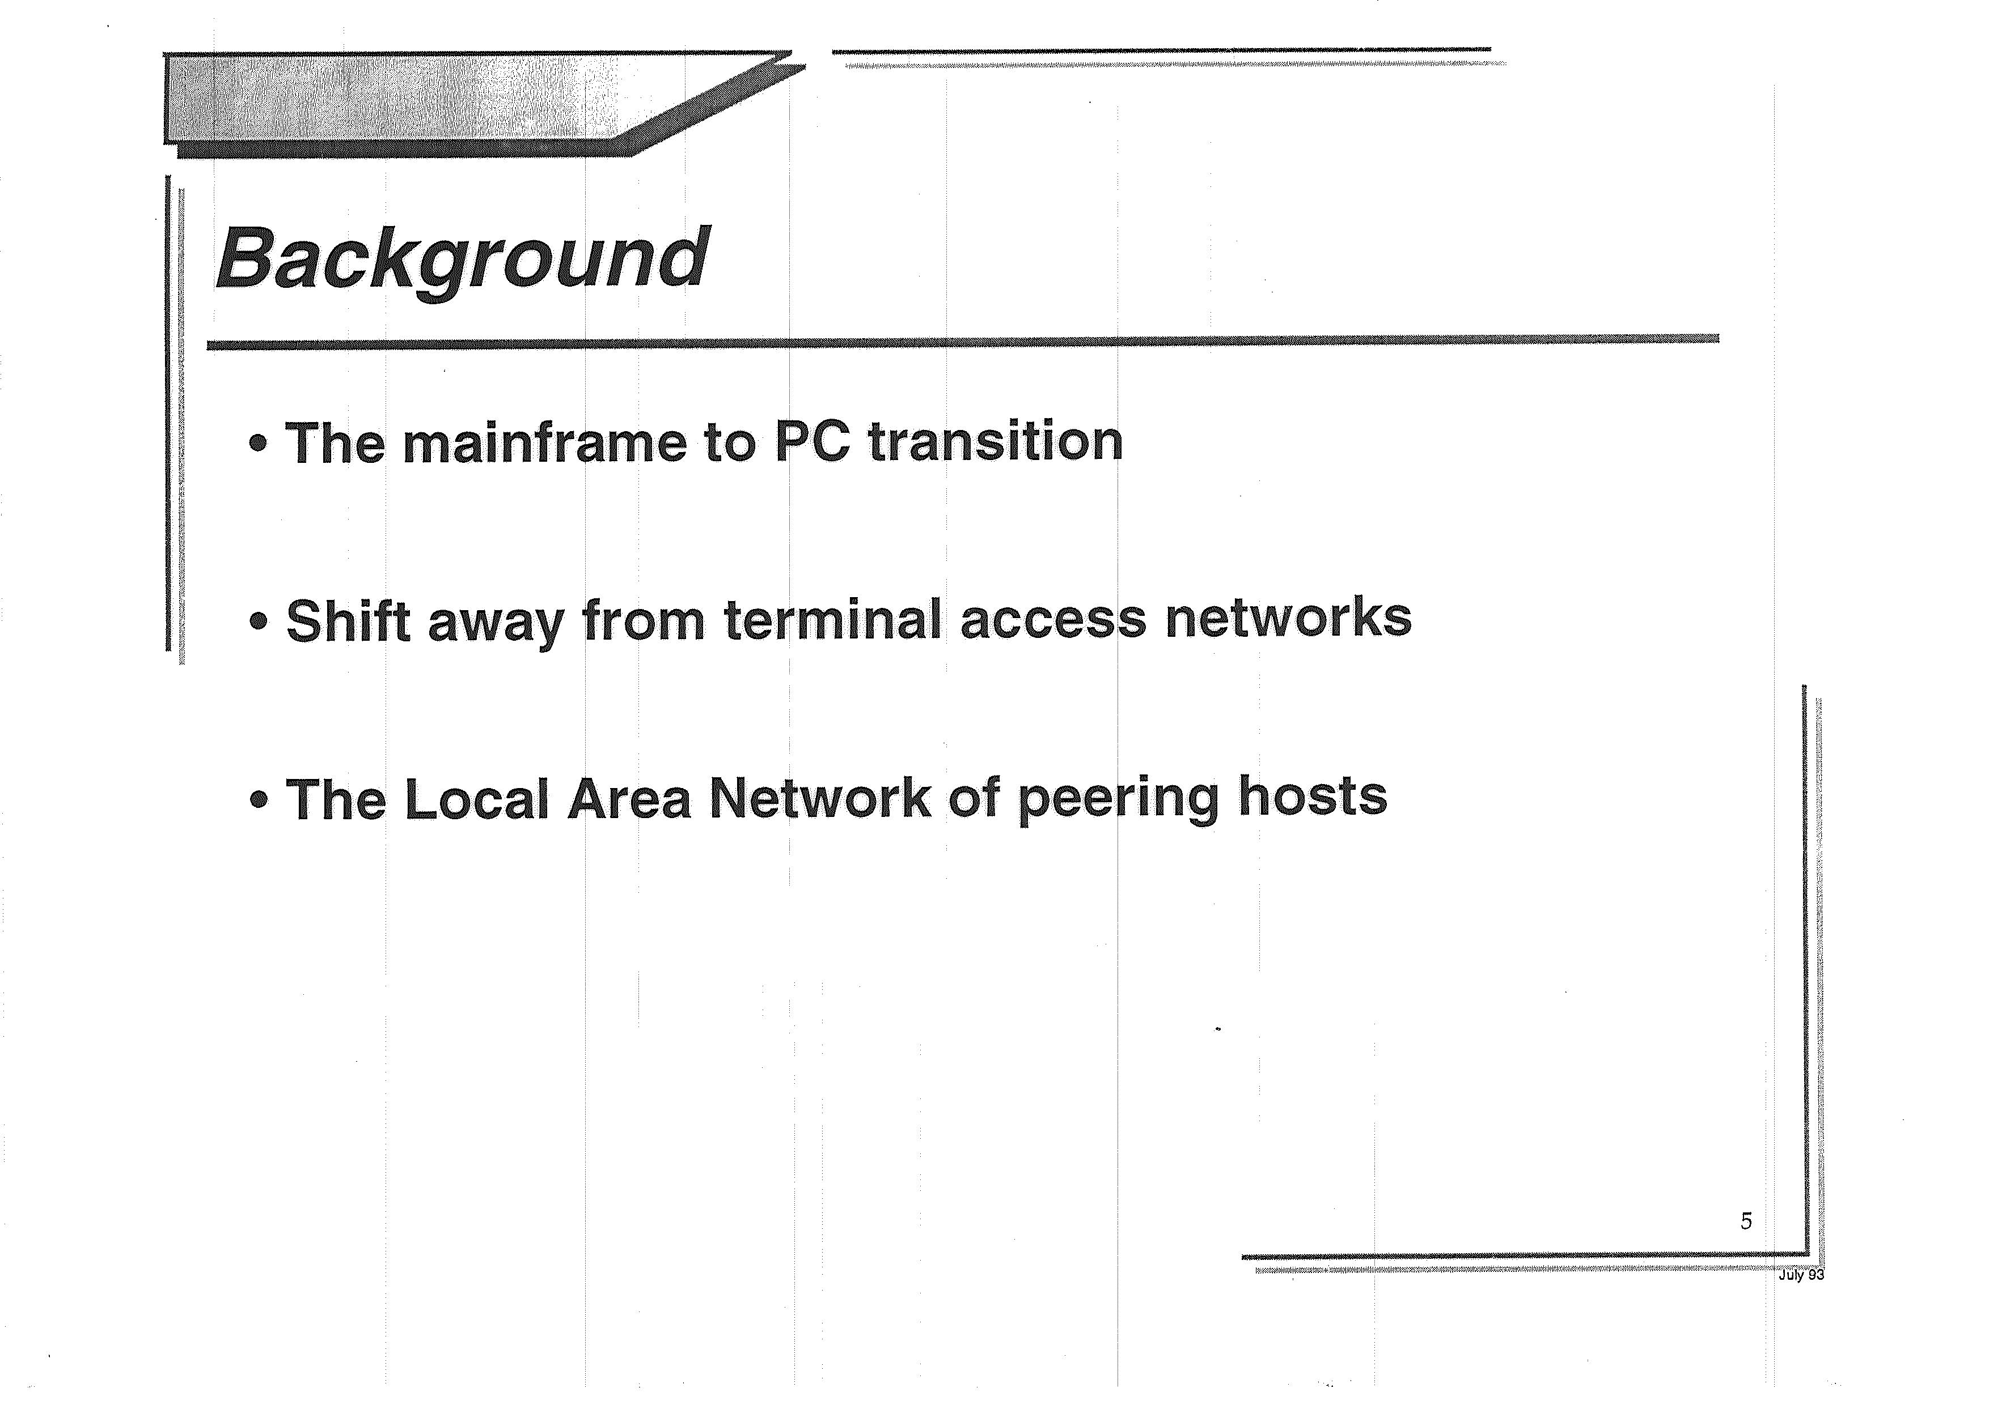

Slide 20
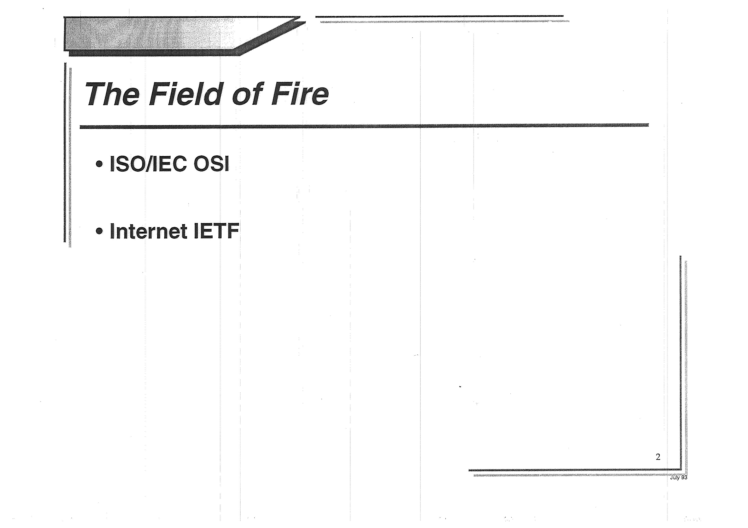

Slide 21
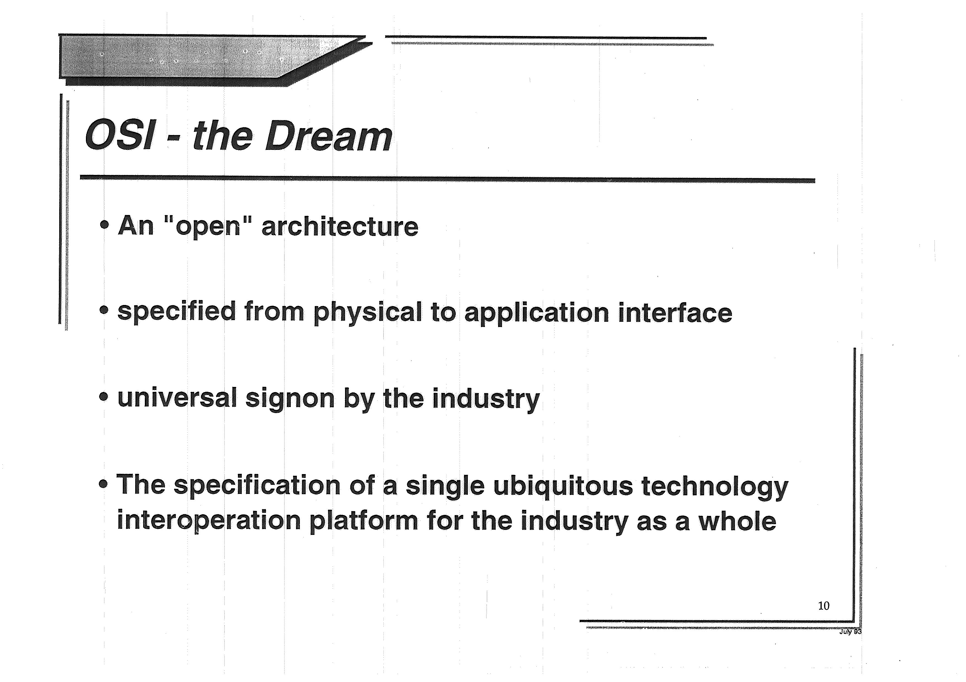

Slide 22
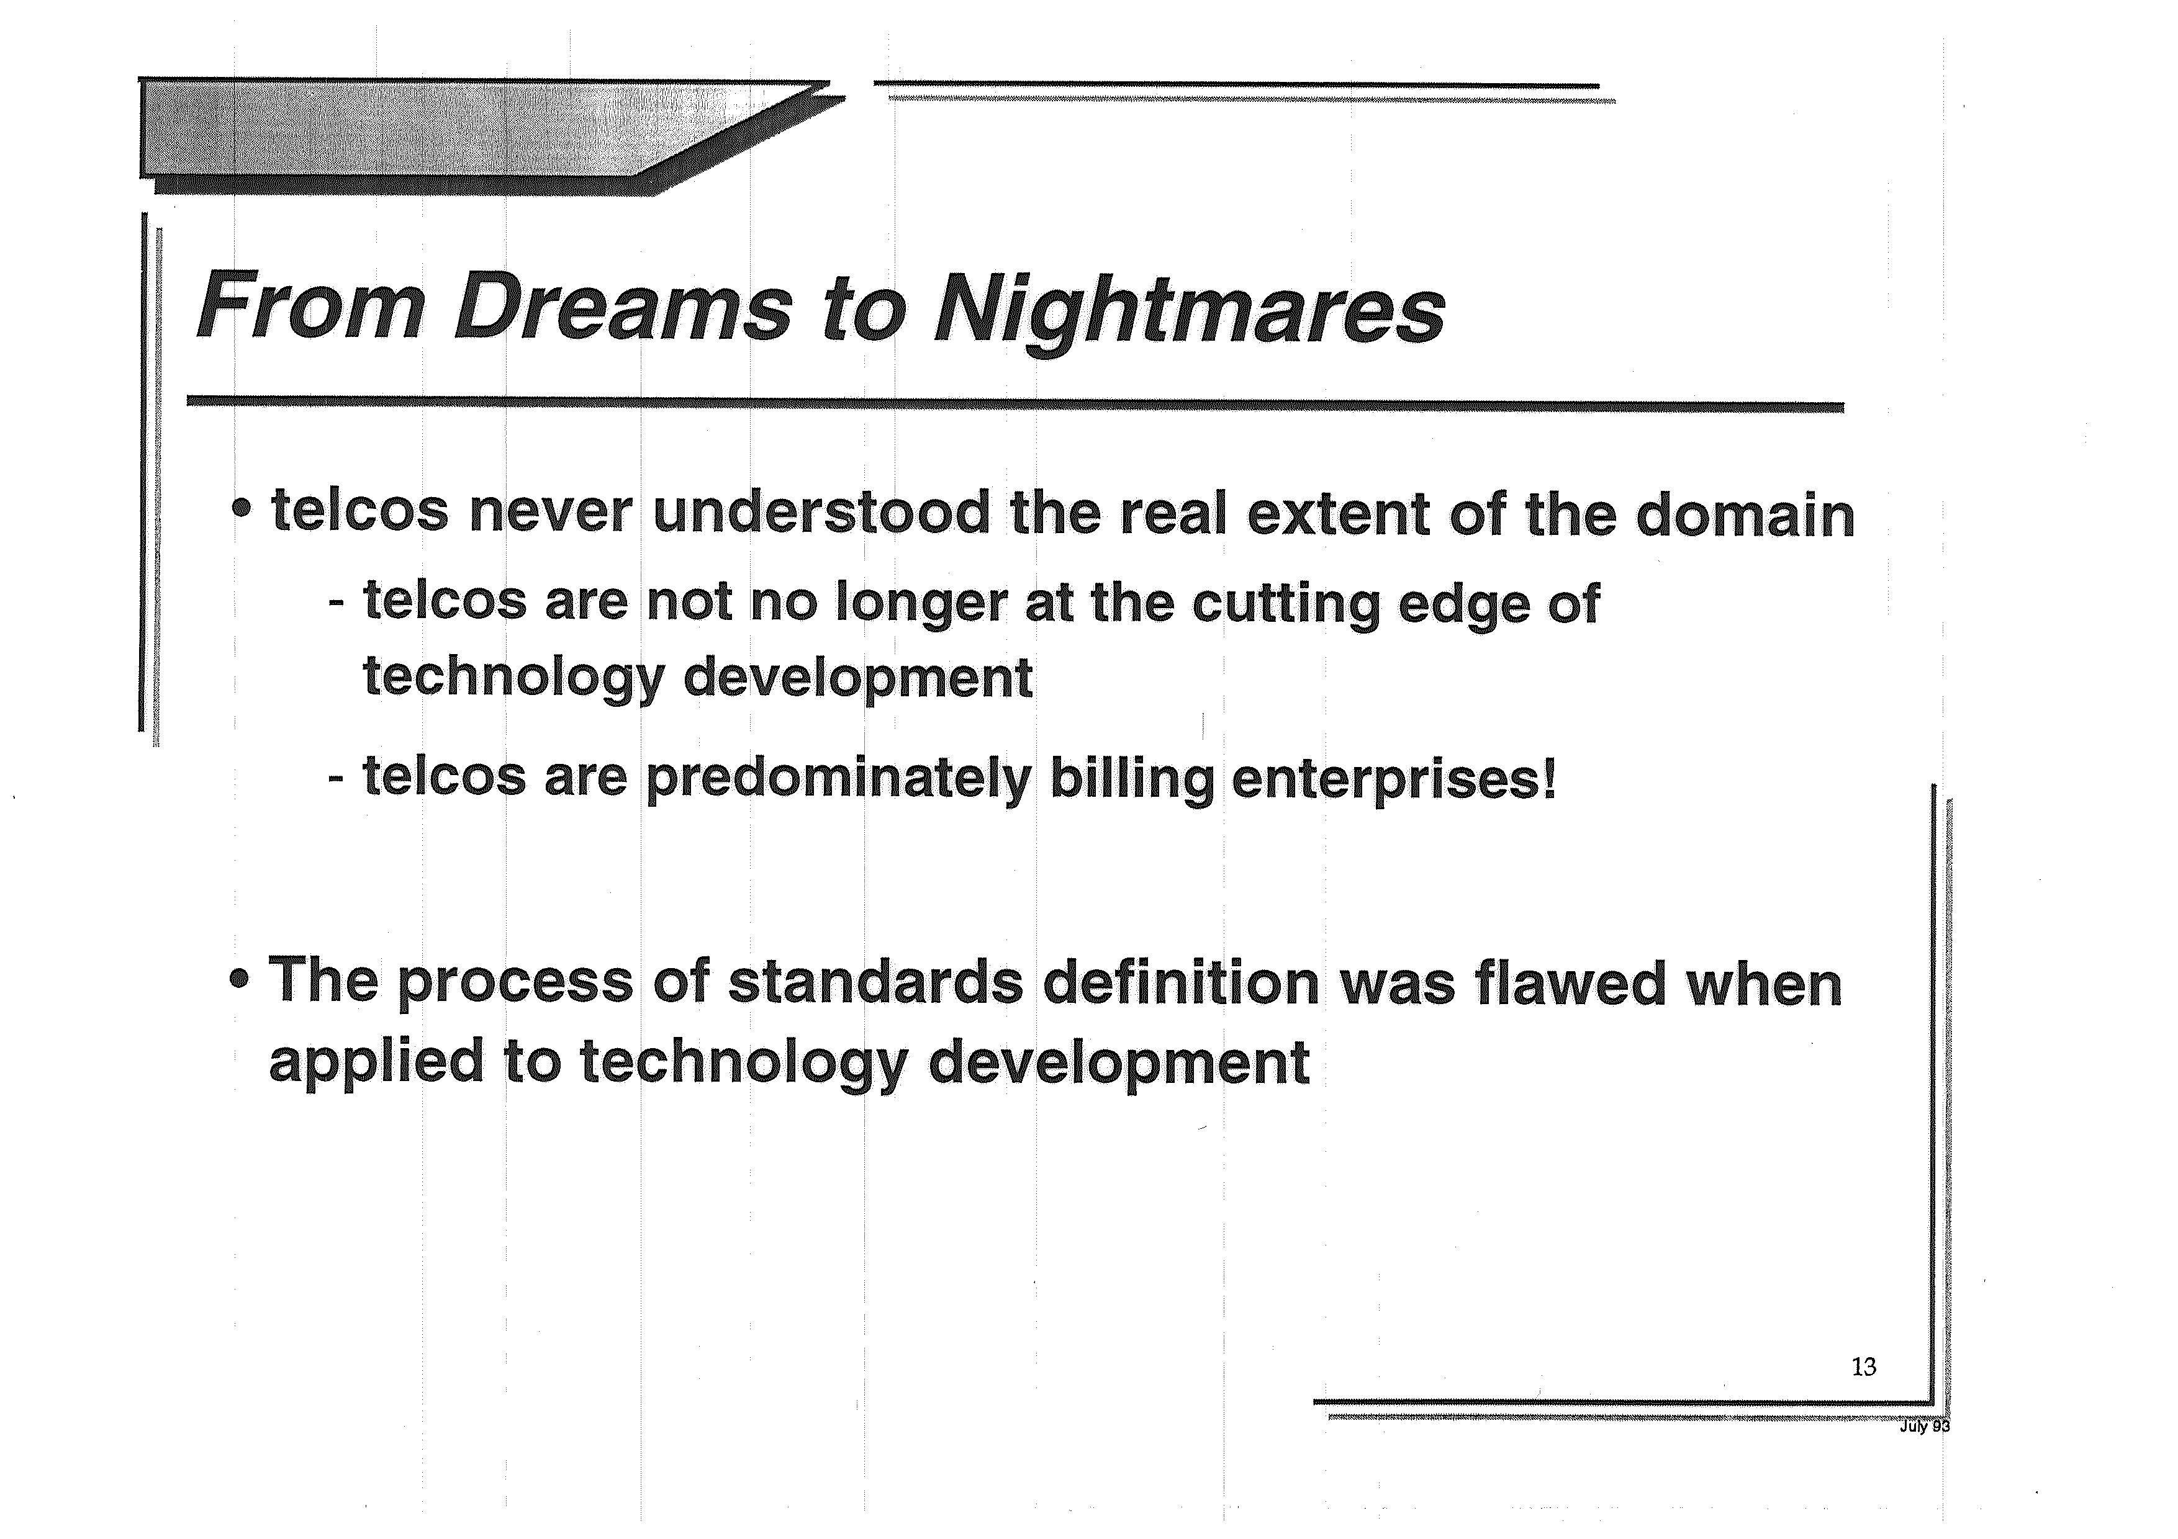

Slide 23
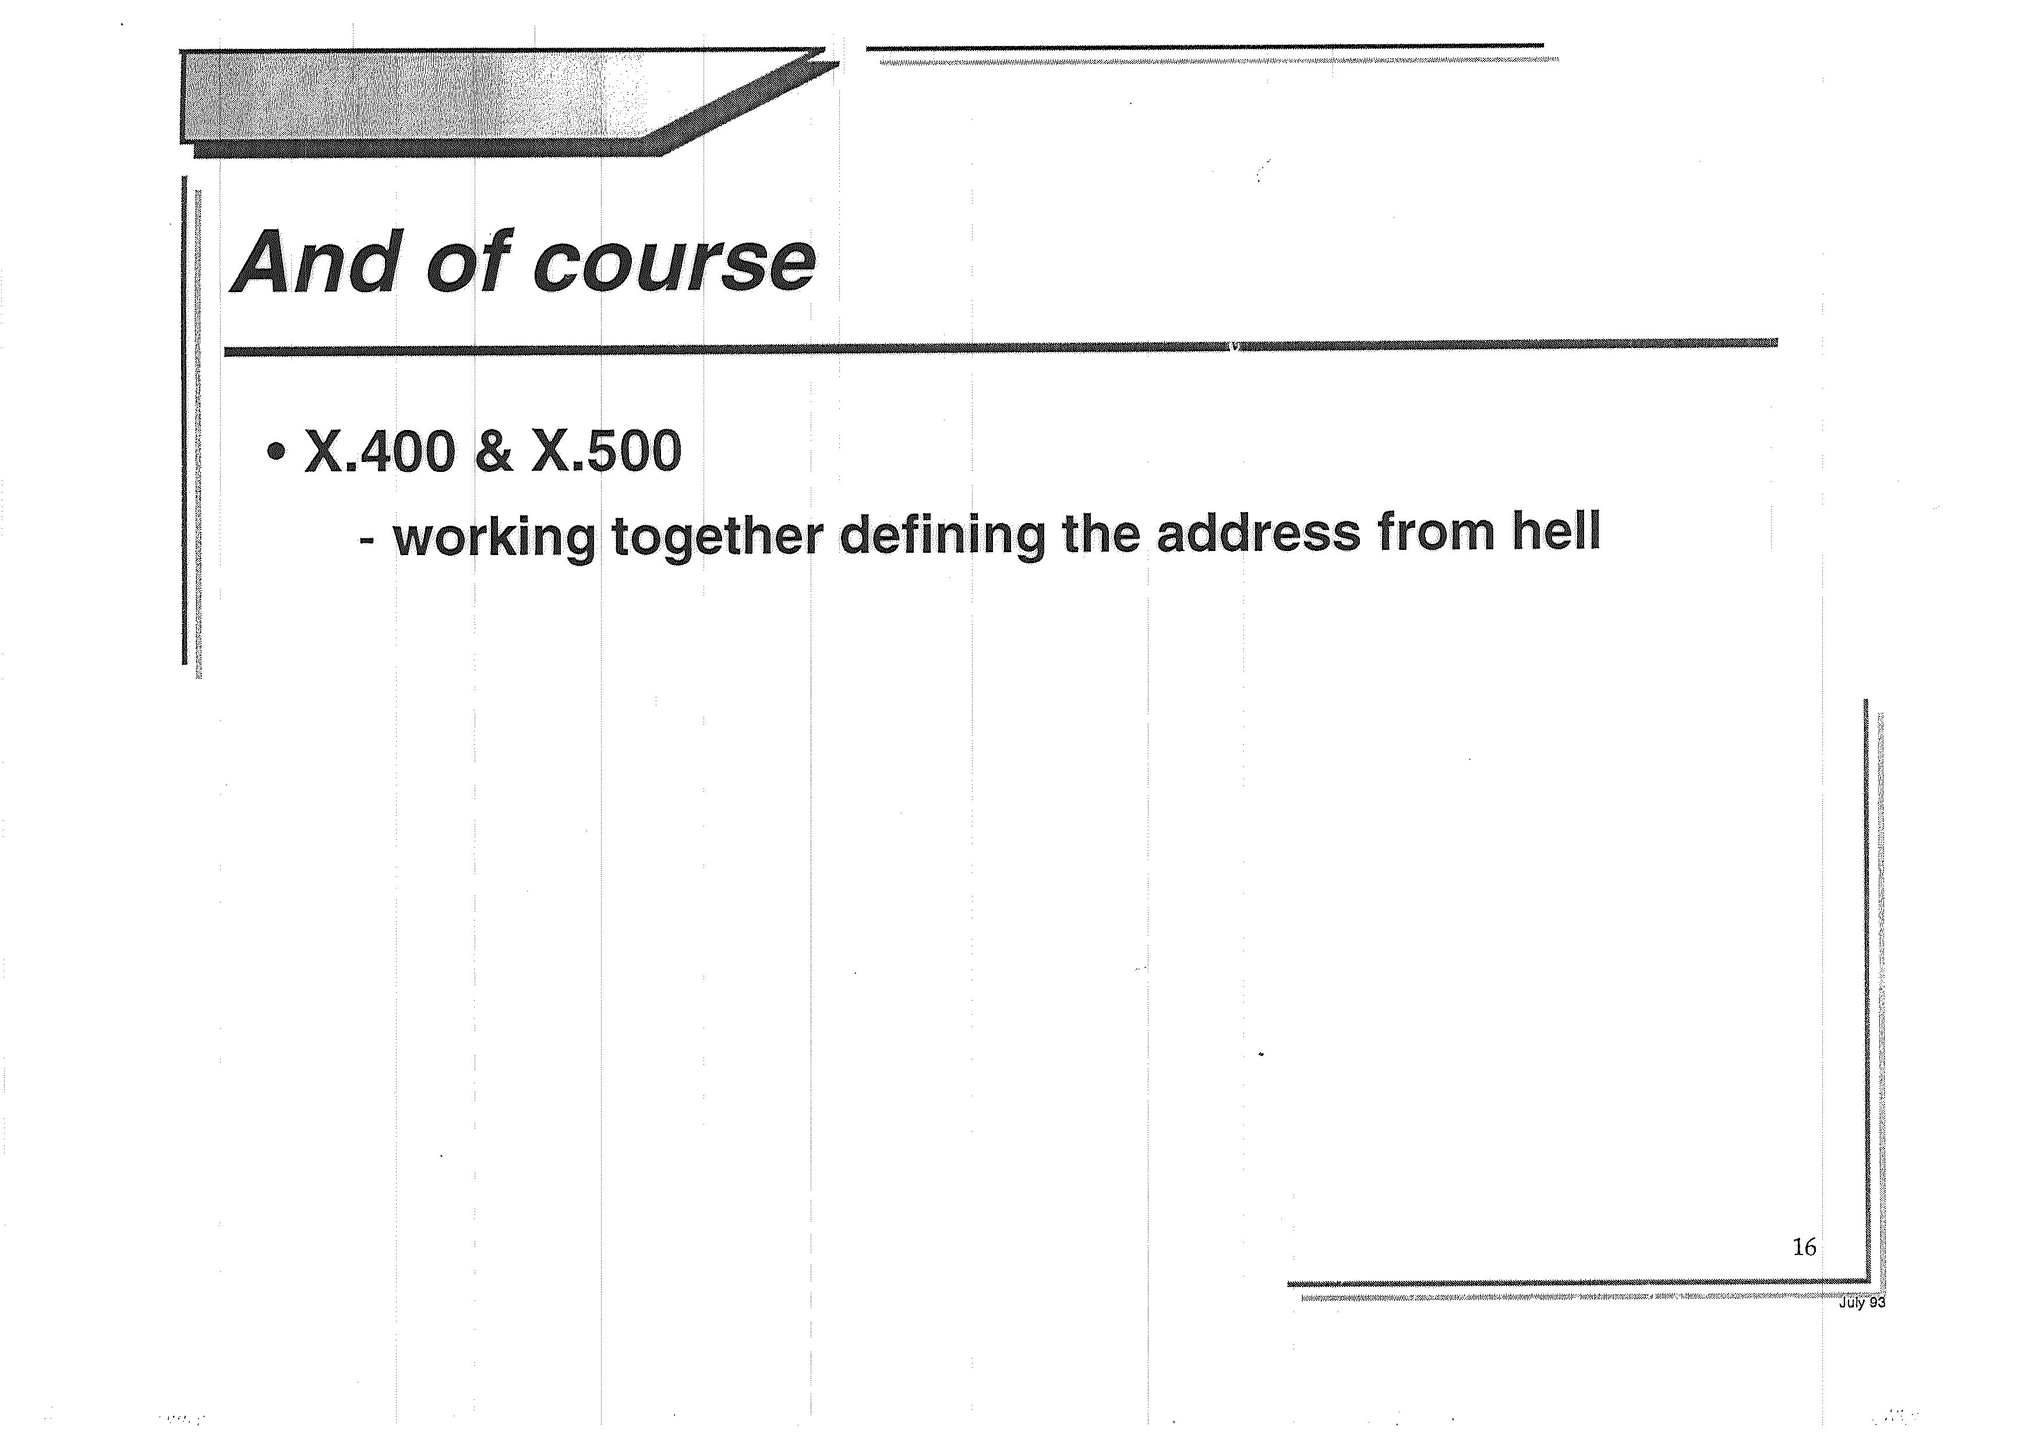

Slide 24
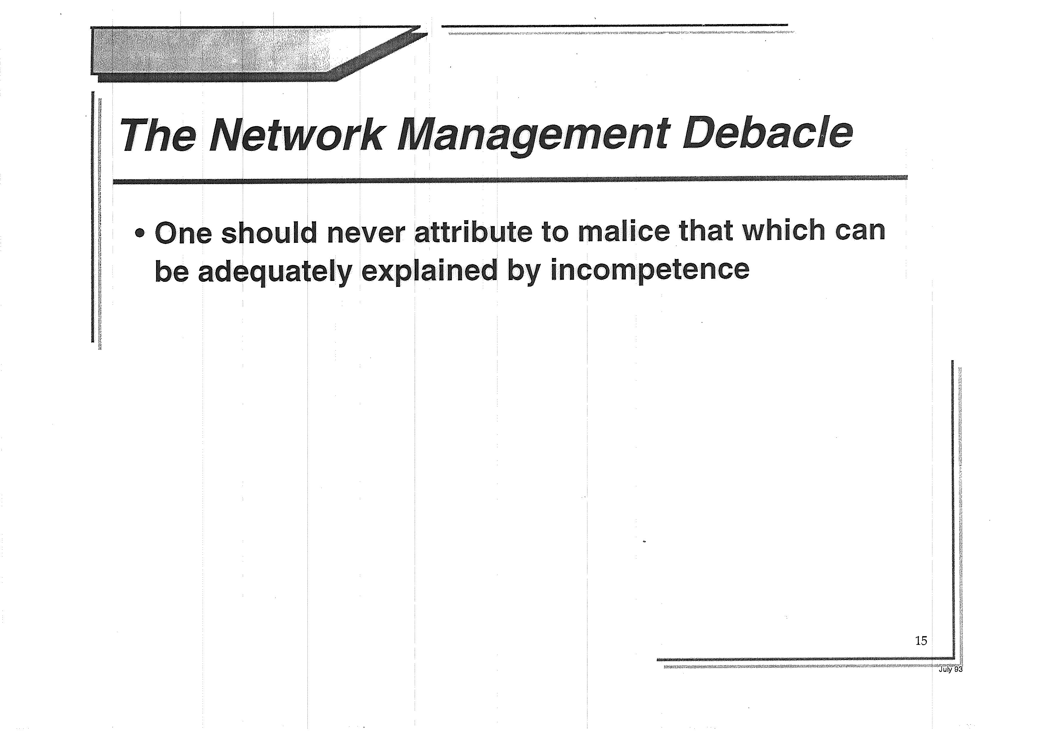

Slide 25
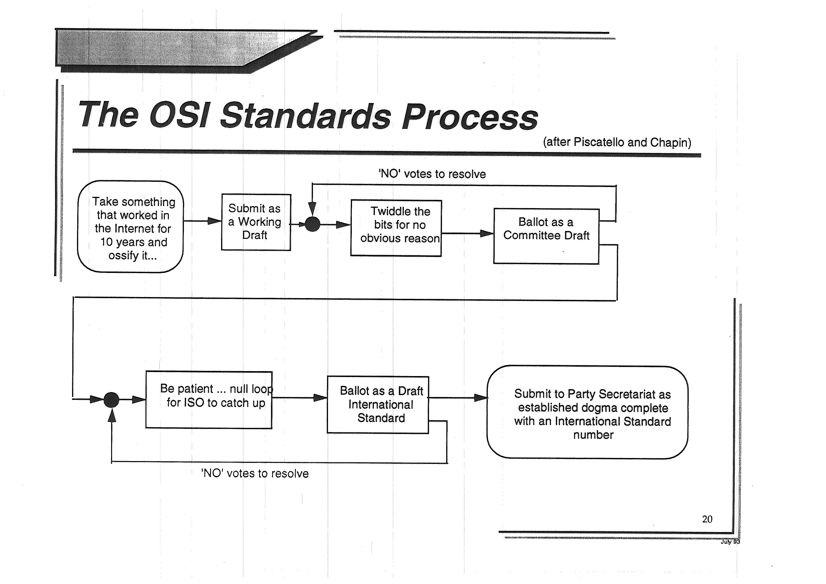

Slide 26
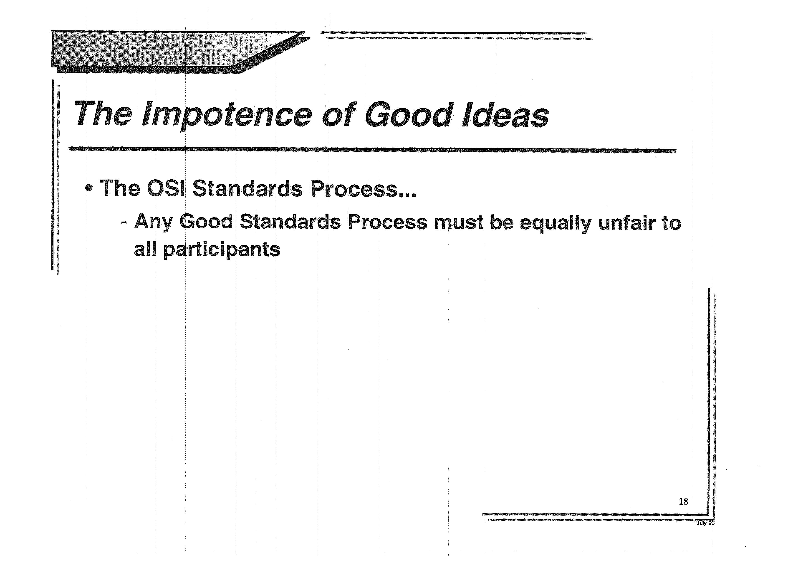

Slide 27
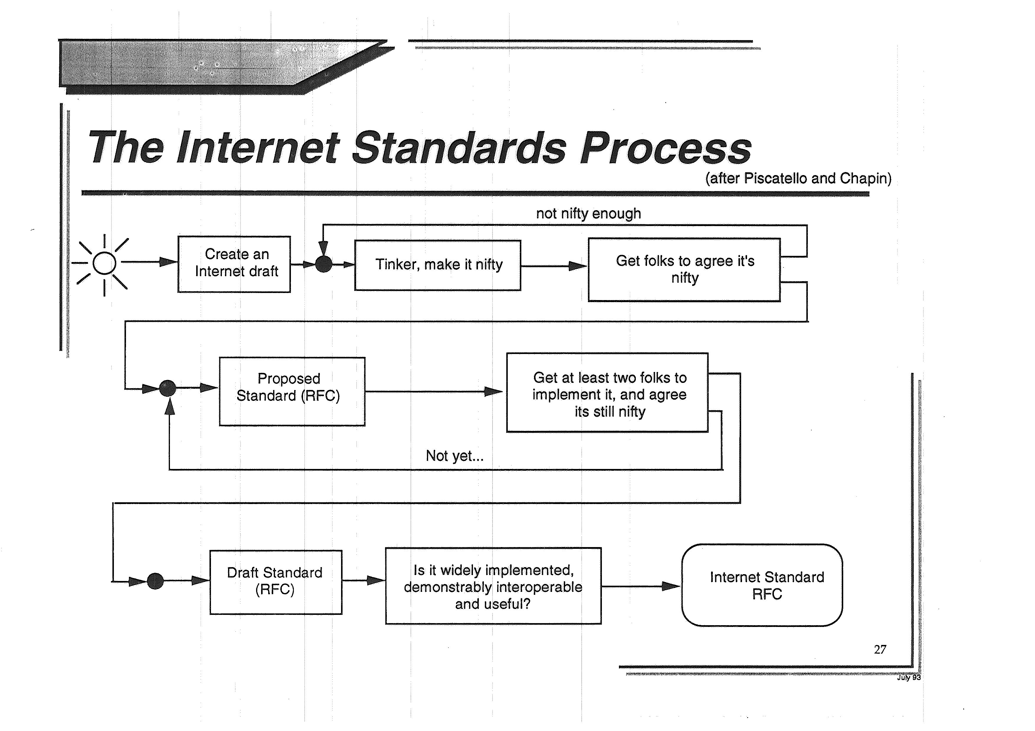

Slide 28
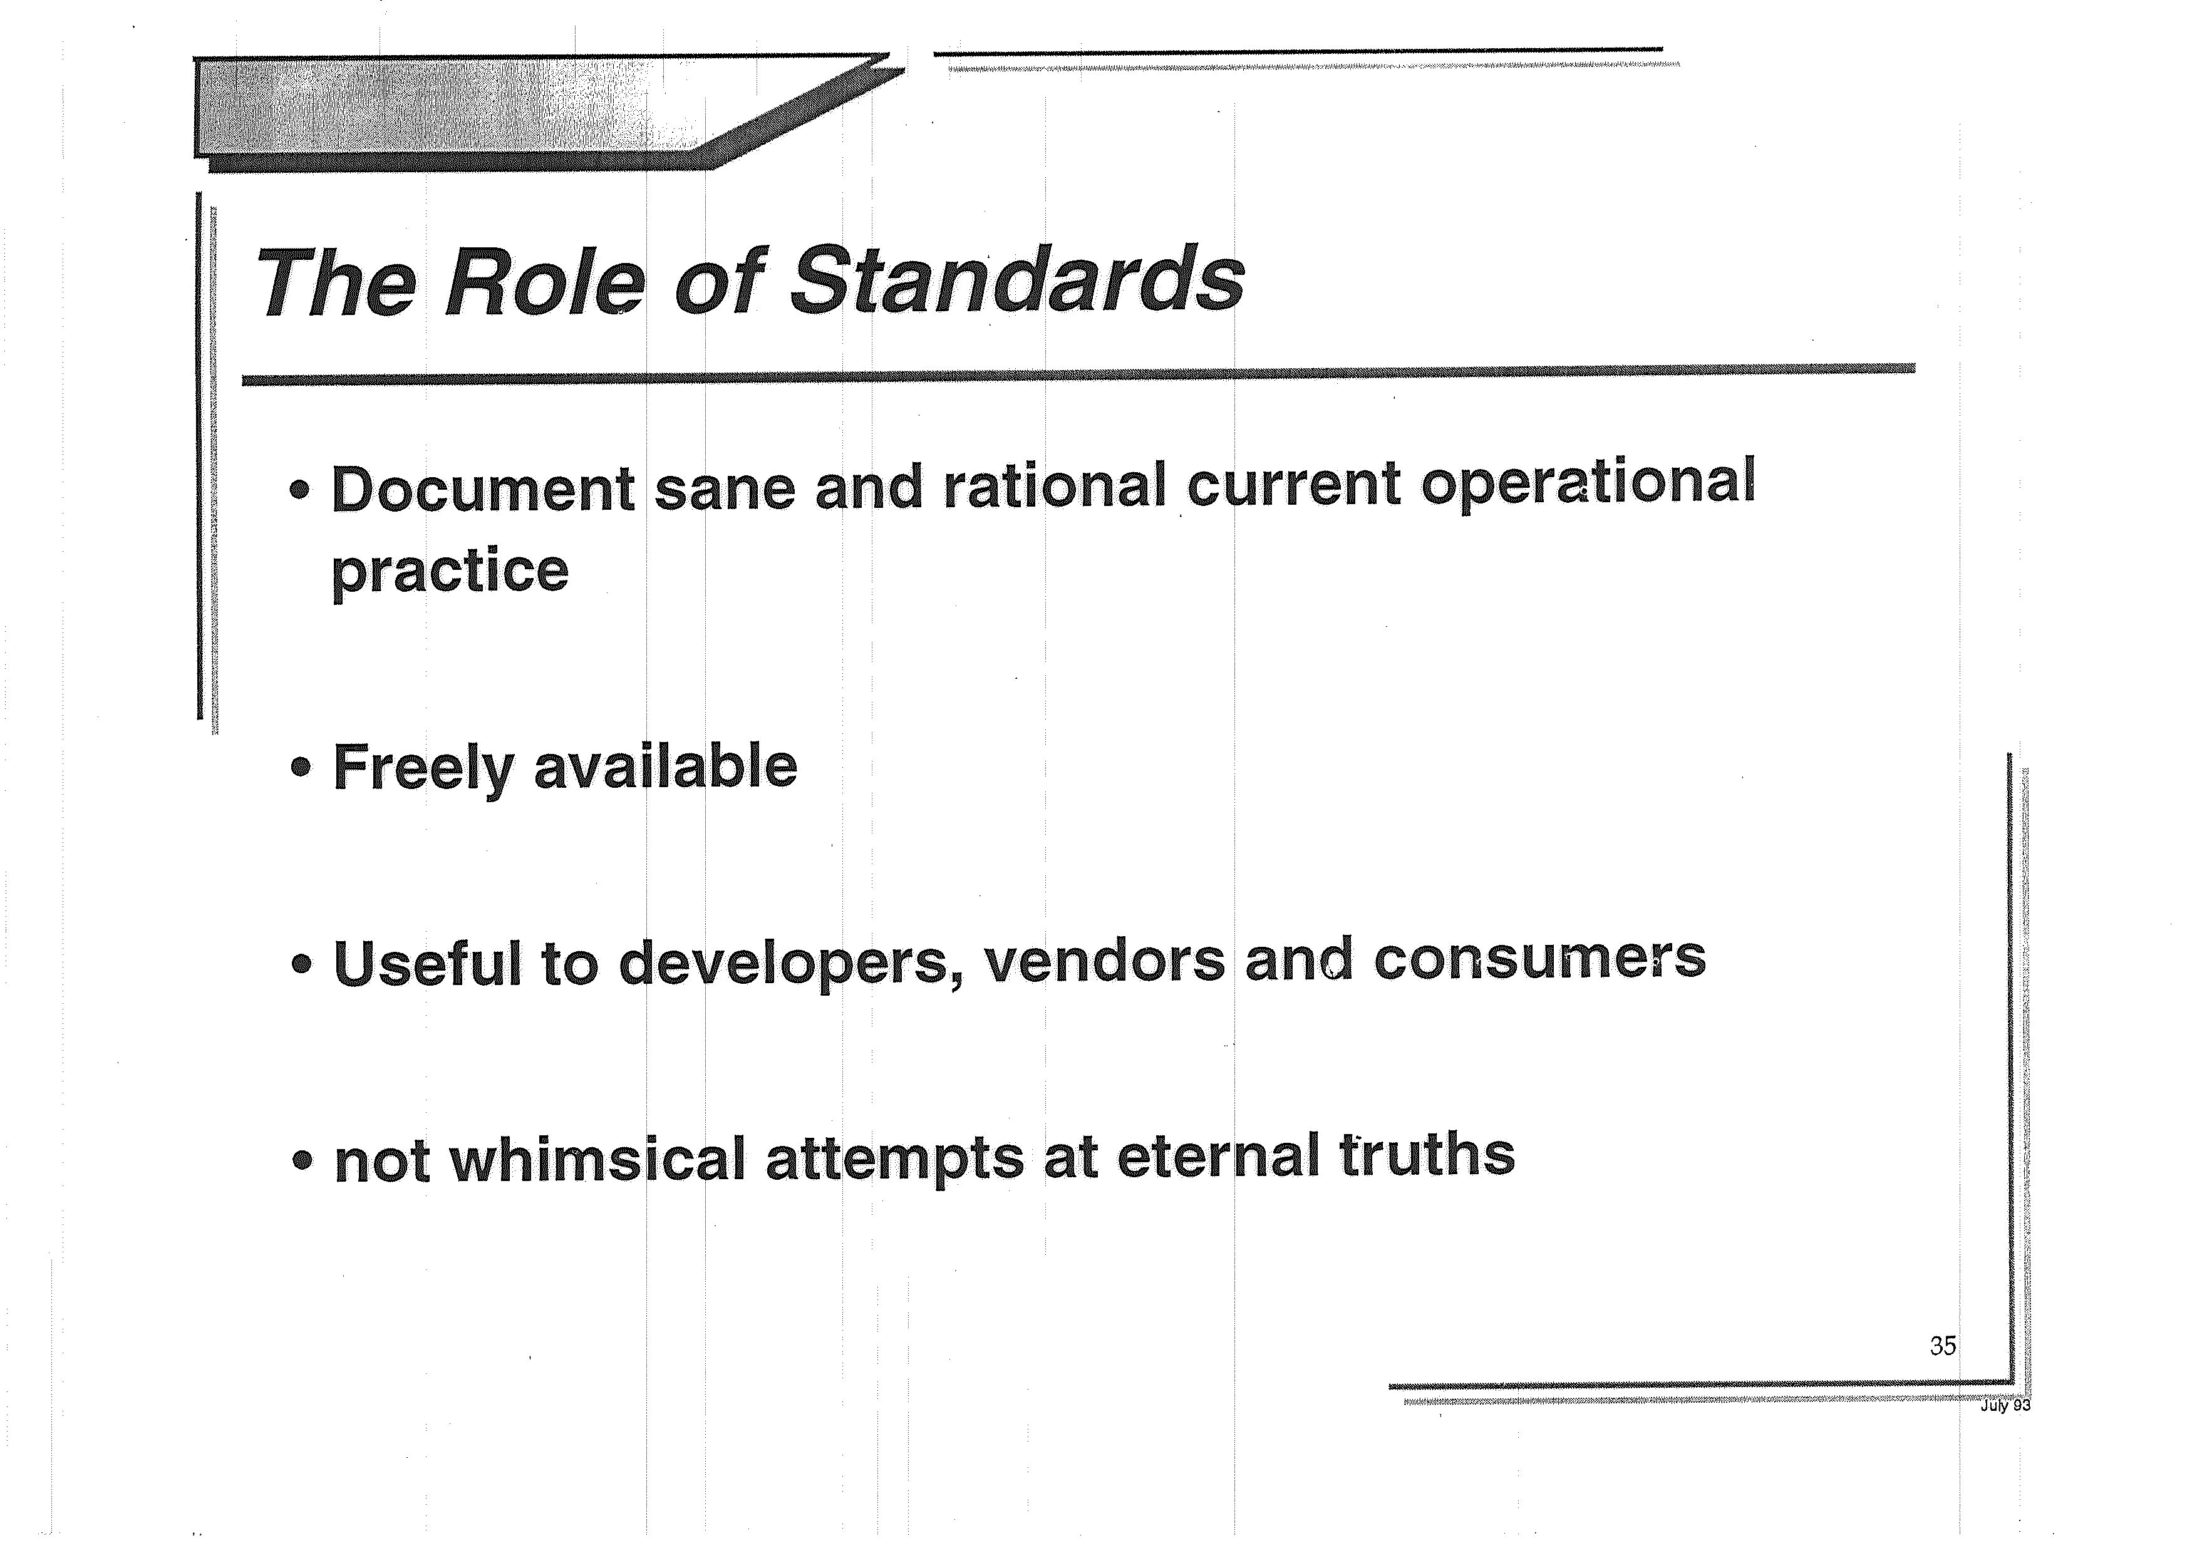

Slide 29
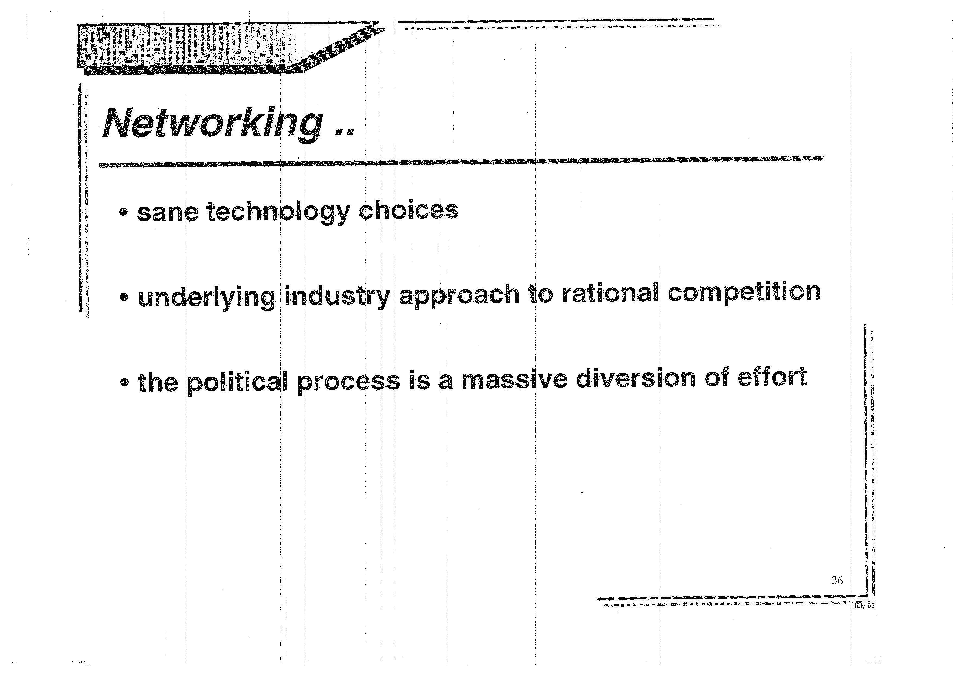

Slide 30
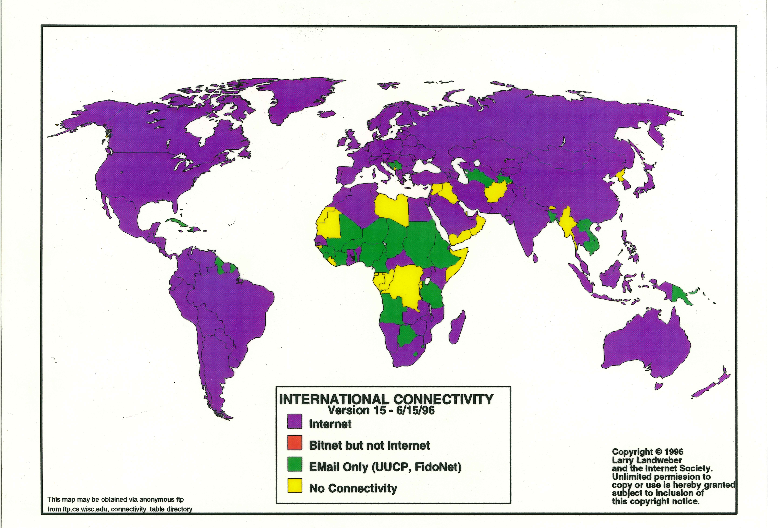
We had high hopes for the Internet

Slide 31
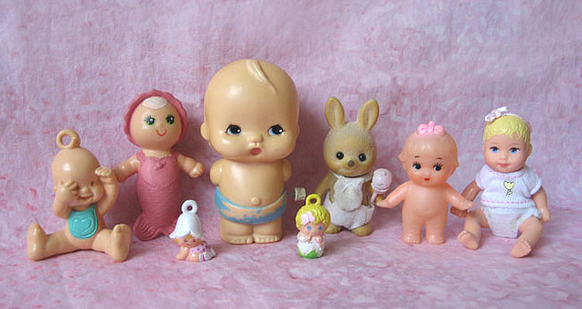
But we were a lot younger then
Photo Credit: Aimee Ray https://www.flickr.com/photos/merwing/516164481

Slide 32

And we were the underdog
Photo Credit: https://www.flickr.com/photos/barrielynn/1817195121

Slide 33
Things are different now

Slide 34
Things are different now
We won

Slide 35
Things are different now
We won:
We won the protocol wars with OSI
We won the voice wars with telephony
We won the content wars with television
Computers and the Internet are now everywhere…

Slide 36
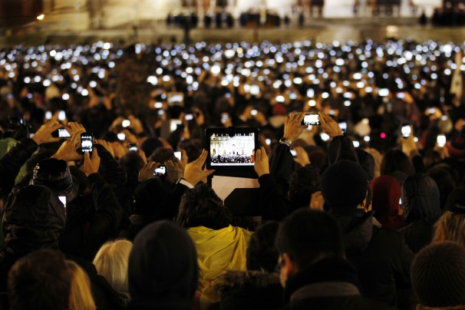
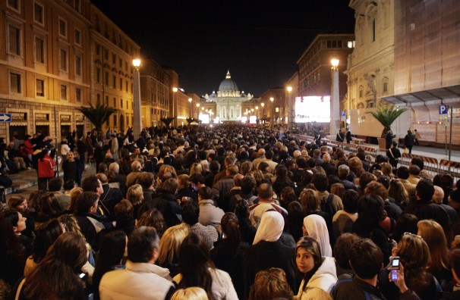
Recording everything
2005
2013

Slide 37
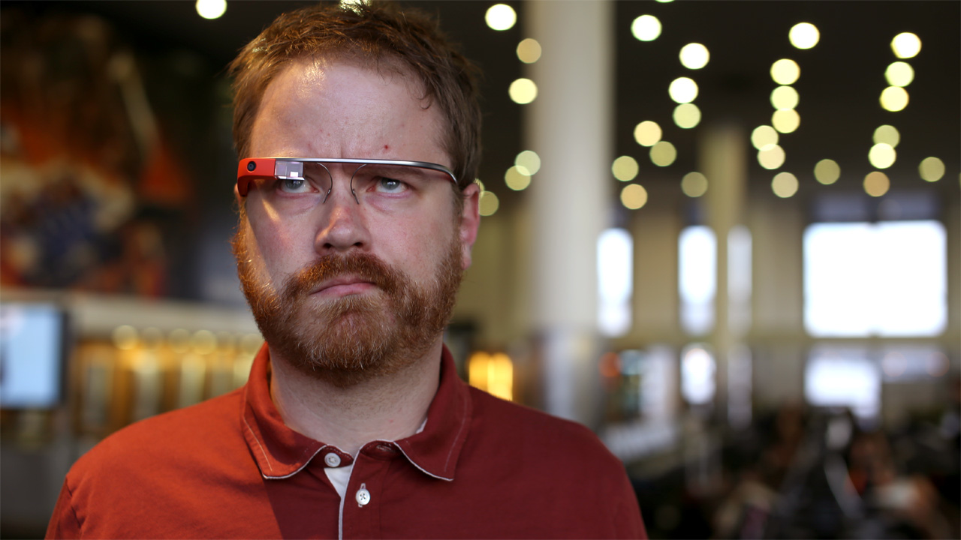
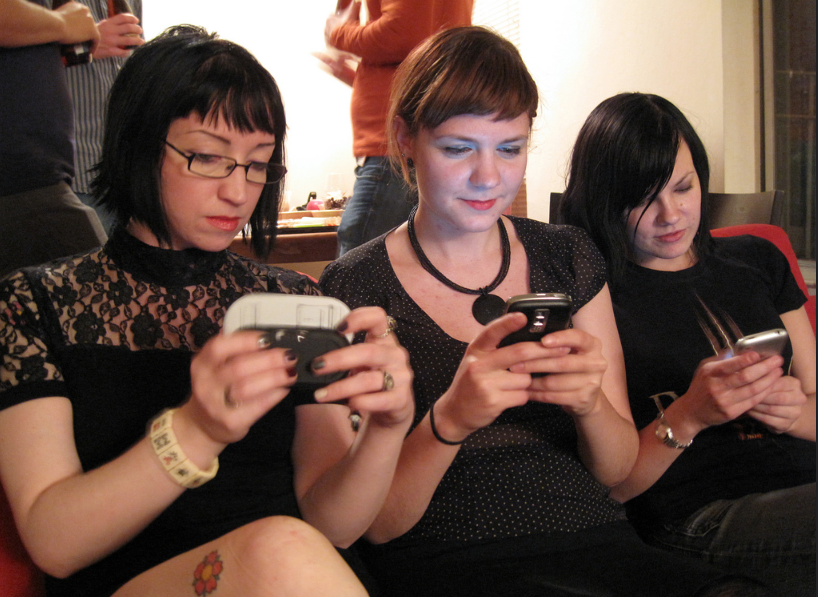
Always with us

Slide 38
And it sure looks like…

Slide 39
And it sure looks like…
WE are now the problem!

Slide 40
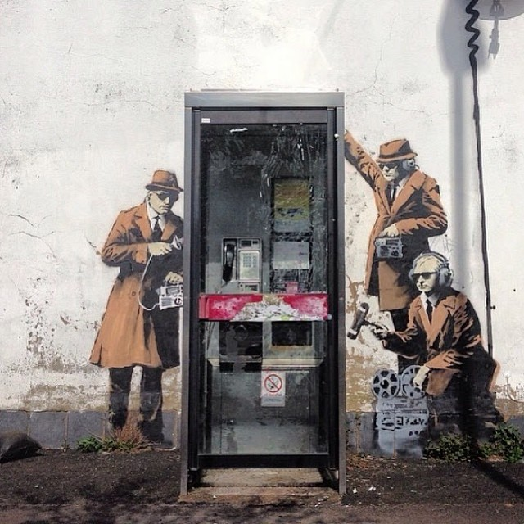
Street Art: Banksy

Slide 41
How did we get to this unexpected point?

Slide 42
How did we get to this point?
What happened over the past 25 years to get us here?
The commercialisation of the electronic messaging Internet
  The expansion from the academic and research stable to a public venture based largely on entrepreneurial activity
  The proliferation of Dial-up ISPs

Slide 43
How did we get to this point?
What happened over the past 25 years to get us here?
The internal re-building of the telco industry
  Active effort to engage with the Internet and integrate it into the telco service portfolio
    The Internet was not originally seen as a threat to voice – but it was seen as a threat to their services
  Active effort of the ISPs at the time to keep em out!
  Regulatory confusion

Slide 44
How did we get to this point?
What happened over the past 25 years to get us here?
The Web and the DSL world
  Listing access capacity by the first orders of magnitude (Kilobits to Megabits)
  First wave of ISP rationalisation
  Web content revolution
  The rise of search
  The emergence of VOIP as a threat to the telco core

Slide 45
Then what?
Broadband Capacity meets Broadband content – the rise of the streamers
  Noone truly expected that the Internet would take on broadcast television at the pace and volume that it has played out
  All of the capacity planning models for infrastructure engineering need to change
  New business relationships between CDNs and IAPs had to be forged

Slide 46
Then what?
Further ISP culling as volume economics places ever greater control over the access industry
  Profitability is no longer based on aggressive market expansion, but on cost management
  Volume wins in such a market, so the ISP industry aggregates up to a small (3 – 4) number of large providers in each national market
The assumptions of ubiquity and the “cloud”

Slide 47
Closer to home - some thoughts on the Australian NBN Experiment
Early efforts to underwrite large scale cable infrastructure blocked by political resistance to Telstra and Foxtel union – Telstra walks away from initial HFC program
Telstra and its capital investment program heads into mobile services to seek higher returns from capital investment, leaving wired consumers on the DSL infrastructure
As part of a Keynesian style response to the GFC Canberra tries to replace the country’s aging copper distribution infrastructure through public capital injection, and weaken Telstra’s stranglehold over access to urban distribution infrastructure – the NBN
Political interference, poor execution, changing commercial models, shifting consumer desires all add to the subsequent confusion
  No current clear idea of timetable, cost, deployment schedules, technology model, service outcome …

Slide 48
So what are the issues?
The wired internet is being handed back to the telcos and telco wannabes
And that’s disappointing in every possible way:
  Conservative business model
  Conservative technology model
  Massive political clout
  And the brain stem of an unreconstructed monopolist

Slide 49
So what are the issues?
The security folk are acting like this is a phone network – when it’s the opposite!
So you can expect more inspired idiocy following Data Retention regulation
TICSA anyone?

Slide 50
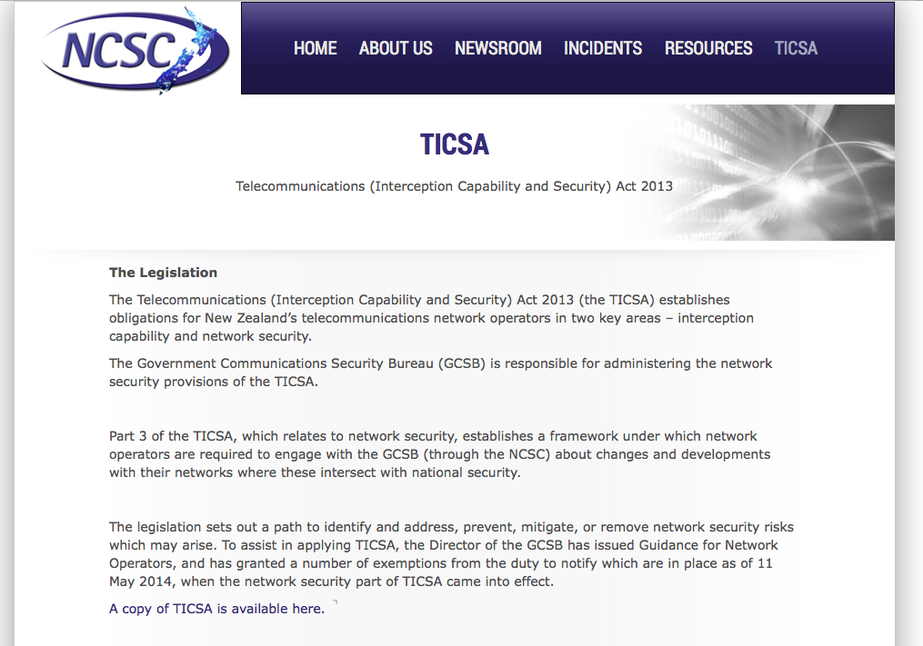

Slide 51
So what are the issues?
The “new” Internet is now all mobile:
1.5 BILLION devices shipped in 2014
50% of all visible devices on the Internet
75% of all access service ARPU is mobiles
So mobile access networks are the focus of “new” competition in the “new Internet”– right?

Slide 52

But the “new” mobile provider is just the same as the “old” telco
Won’t get fooled again…

Slide 53
But the “new” mobile provider is just the same as the “old” telco
Exclusive Use Spectrum has blessed a tiny number of operators
  and everyone else is shunted through “wholesale channels”
The data margins and caps are truly awesome revenue generators

Slide 54
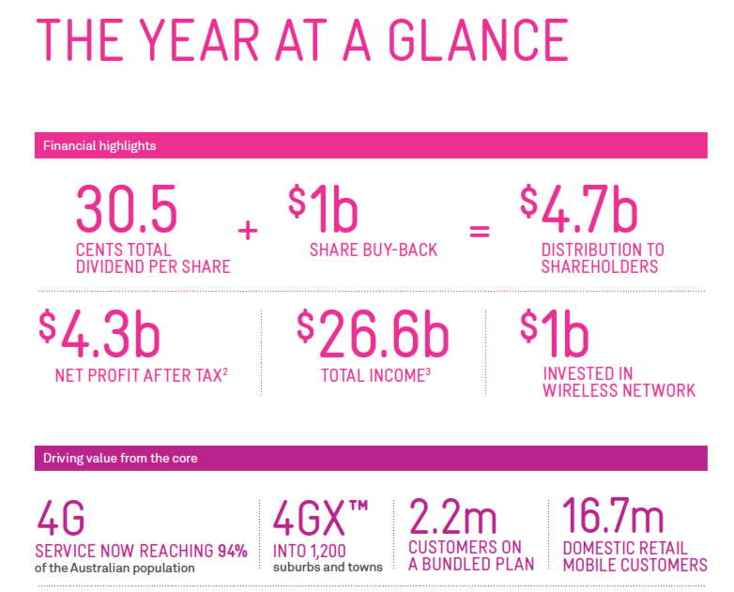
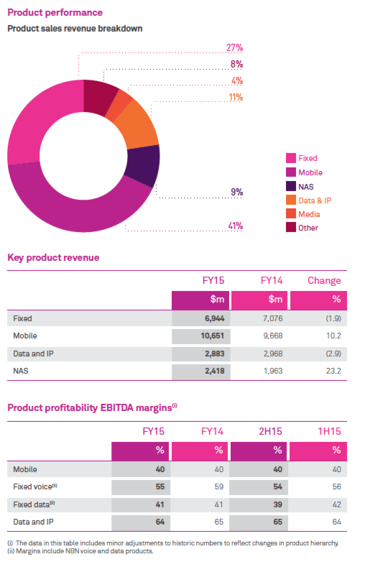
The “old” telco

Slide 55
The “new” competitors

Slide 56
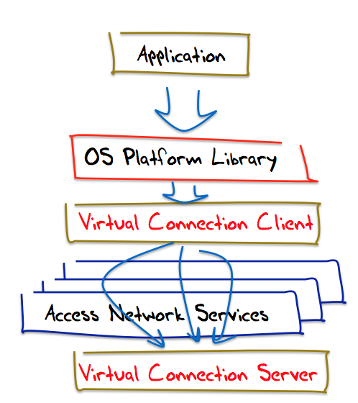
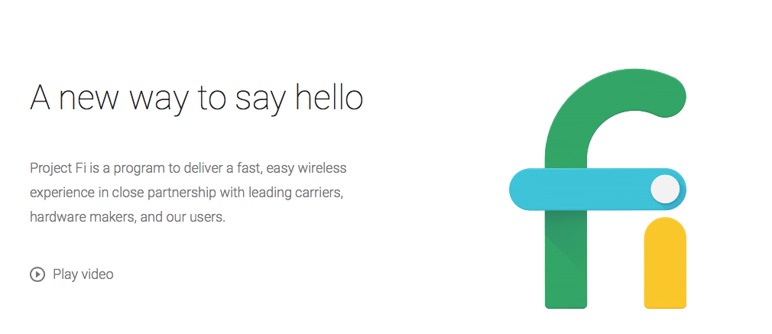
The “new” competitors

Slide 57
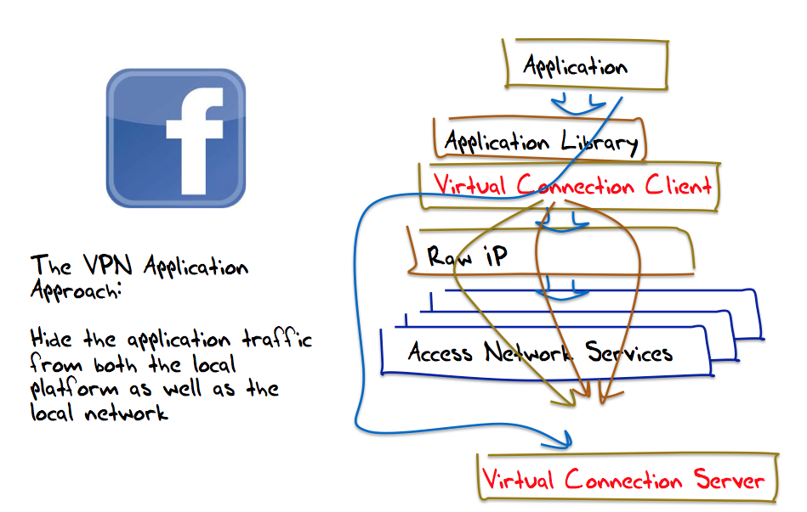
The new “new” competitors

Slide 58
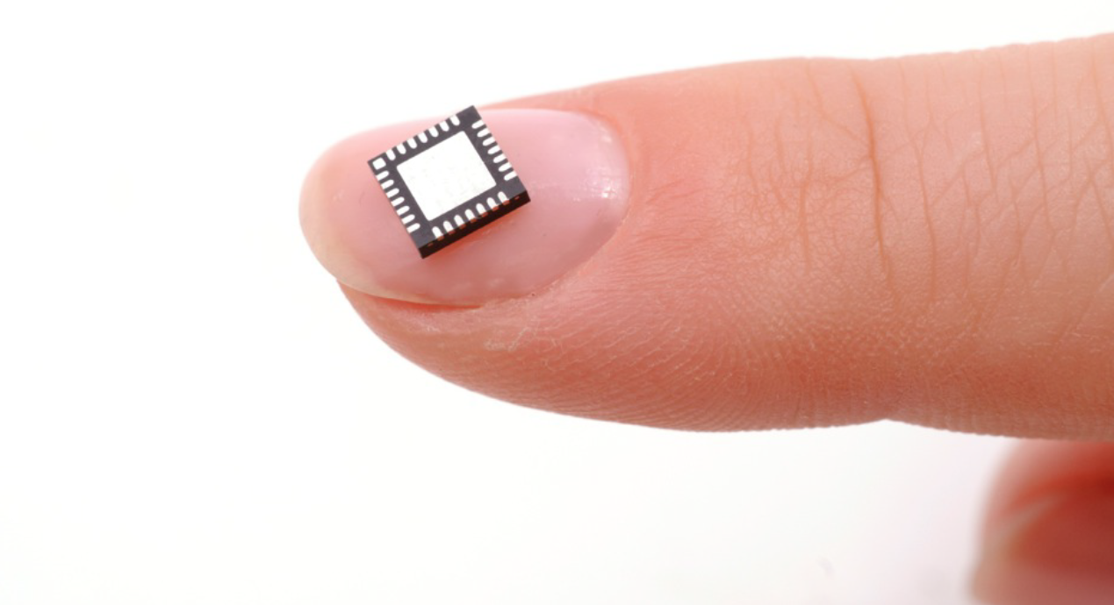
So what are the issues?

Slide 59

Silicon Ubiquity

Slide 60
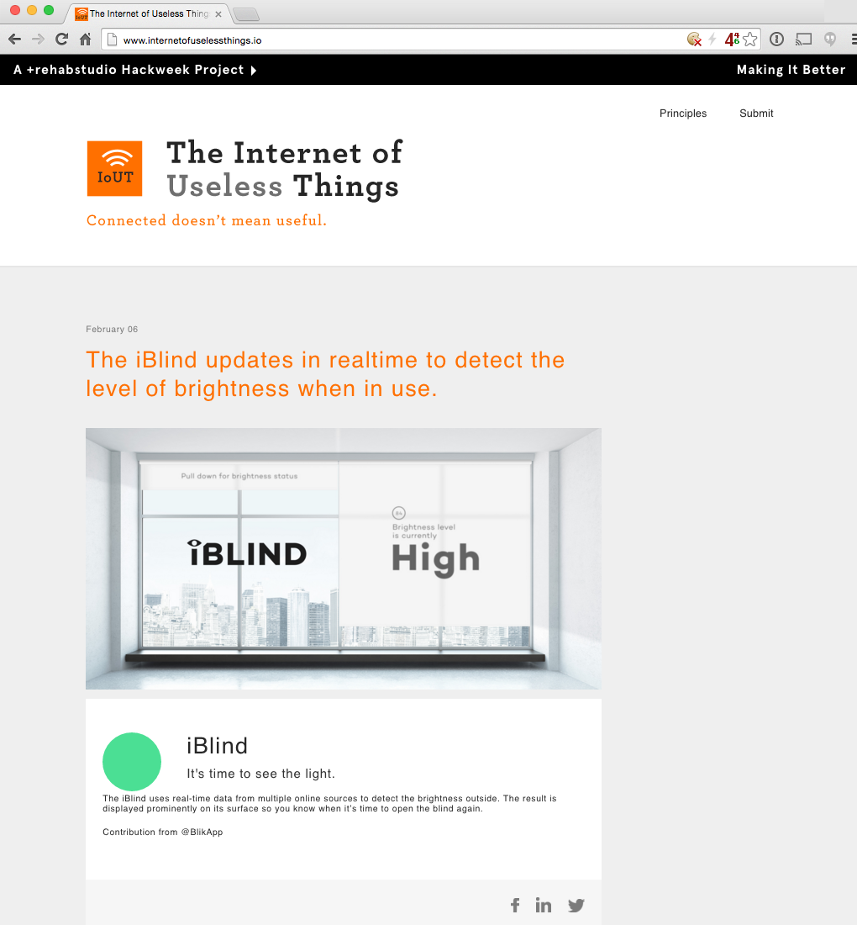
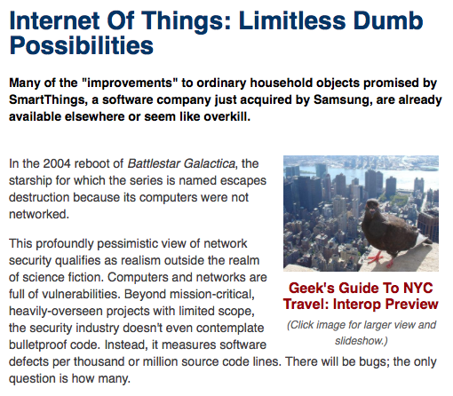
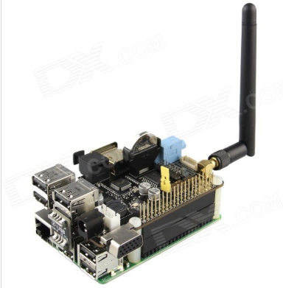
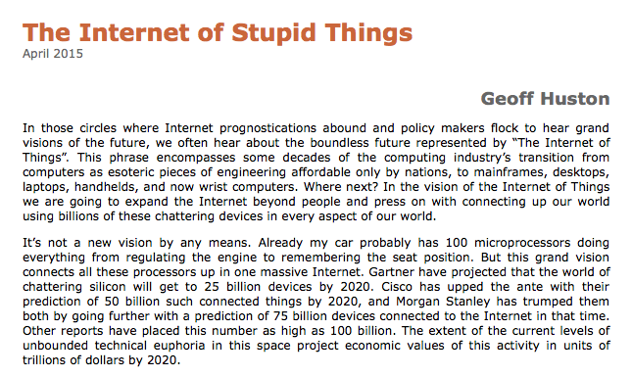
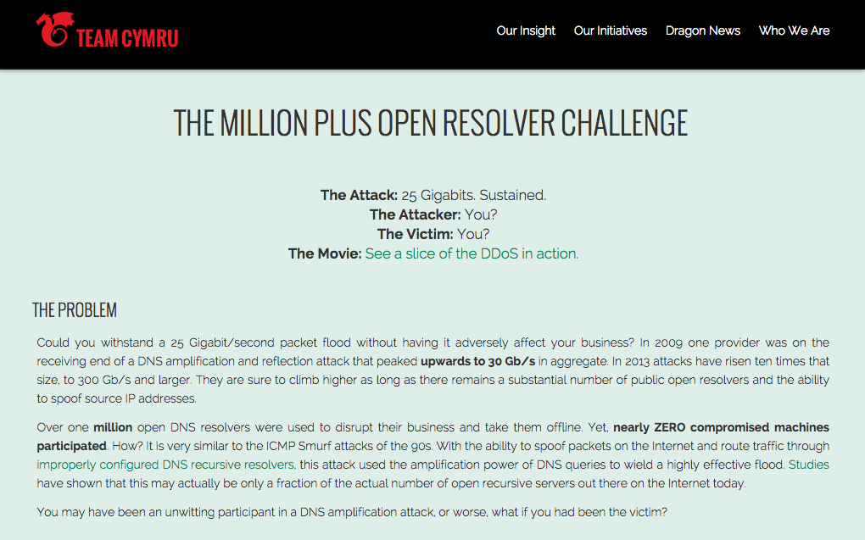
Silicon Stupidity

Slide 61
So where does it head?
In 1990, when Pete and I were connecting up campuses in Australia, our world had:
  mobile phones the size of briefcases
  “portable” computers that weren’t even luggable!
  cameras that loaded film
  “real” computers that were multi-million dollar investments with cluster of work bees to tend them
  “technology” as a skilled occupation undertaken by a small cadre of educated professional engineers
  And it may have had Microsoft and Apple, but it had no Google!
Much of that world has vanished!
“Technology” is now a consumer-driven commodity

Slide 62
So where does it head?
What has replaced it is both oddly familiar and strangely alien at the same time
Which is about the best one say say about the next 25 years!

Slide 63
Thanks!

