Slide 1
A quick review of
DNSSEC Validation in today’s Internet
Geoff Huston
APNIC
June 2016

Slide 2
What is being measured?
Clients who will perform DNSSEC validation of a domain name
  Using RSA/SHA-1 as the crypto algorithm
  Who will not resolve a badly-signed domain name
We are NOT measuring:
  Validating resolvers
  Signed domains

Slide 3
What is not being measured?
We are NOT measuring:
  Validating resolvers
    Its actually quite a challenge to isolate the DNSSEC validation behaviour of a recursive resolver from query logs.
    And if the aim is to measure the user impact here, then it makes more sense to measure the number of users who use DNSSEC validating resolvers rather than the resolvers themselves
  Signed domains
    This has its own challenges relating to zone enumeration in the DNS, and we are not undertaking that here!

Slide 4
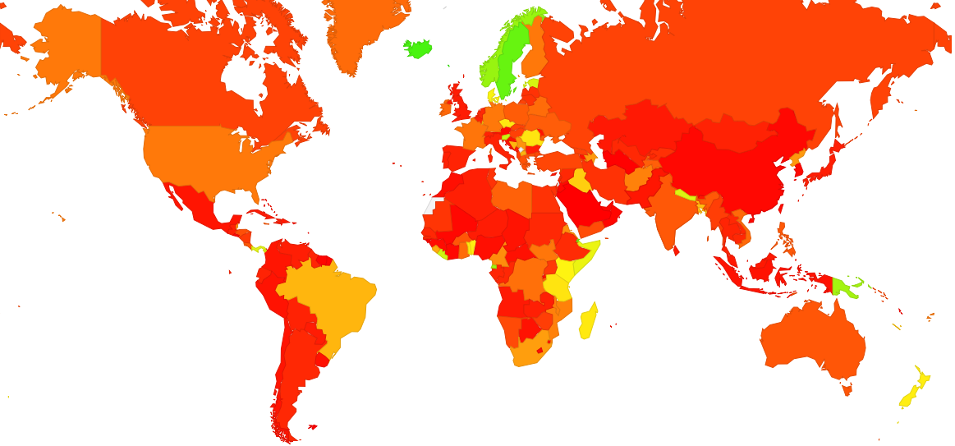
The Global Validation Picture
0%
50%
100%
http://stats.labs.apnic.net/dnssec

Slide 5
The Global Validation Picture
Nordic concentration of DNSSEC!
?
Use of Google’s PDNS
0%
50%
100%
% of users in a country that use DNSSEC validating resolvers
http://stats.labs.apnic.net/dnssec

Slide 6
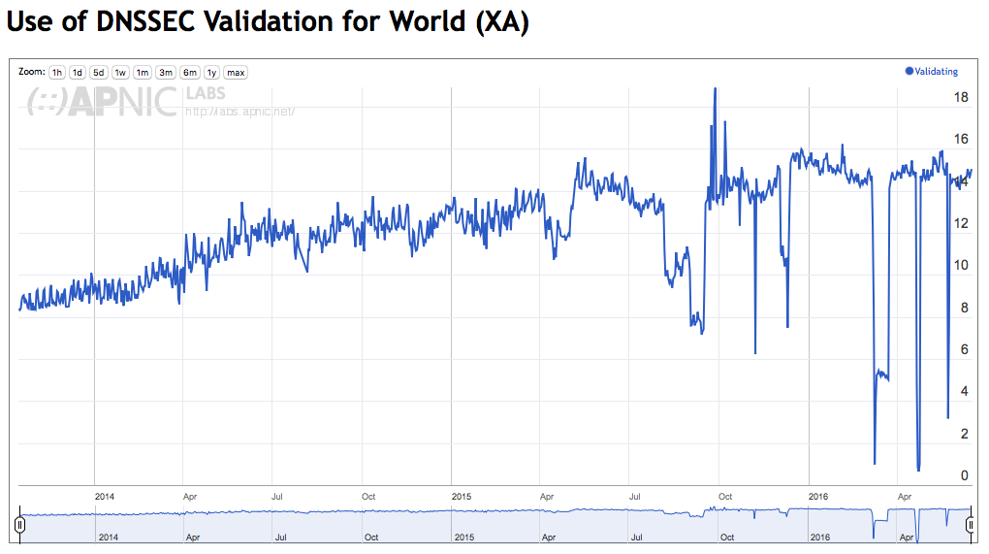
The Global Picture

Slide 7
The Global Picture
2014
2015
2016

Slide 8
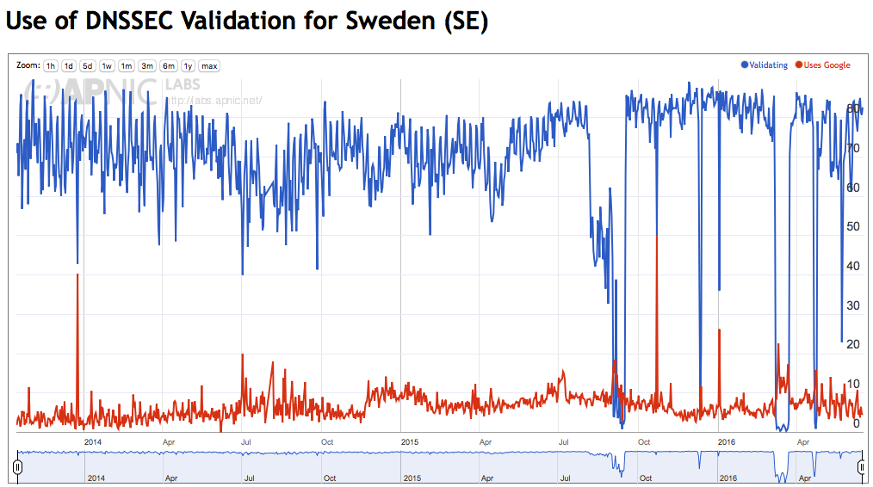
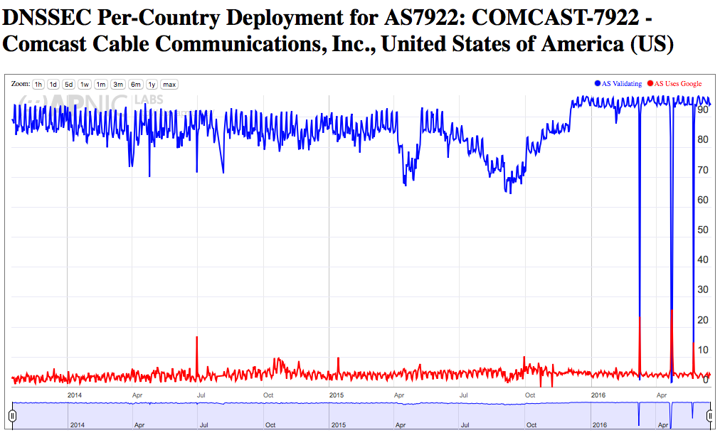
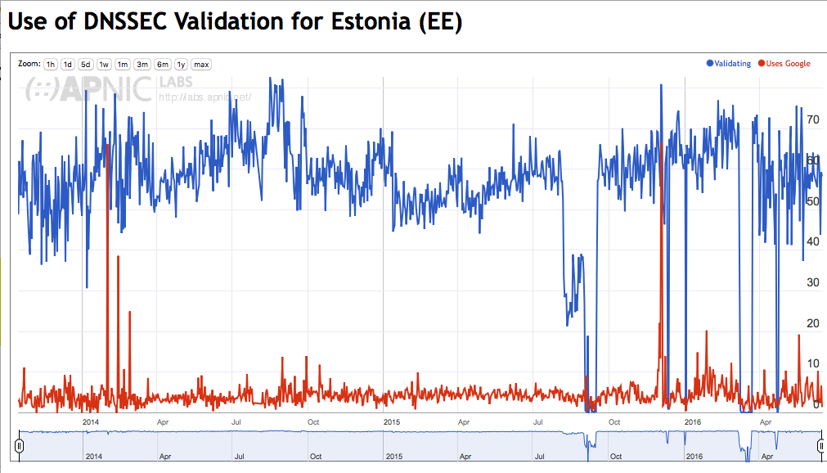
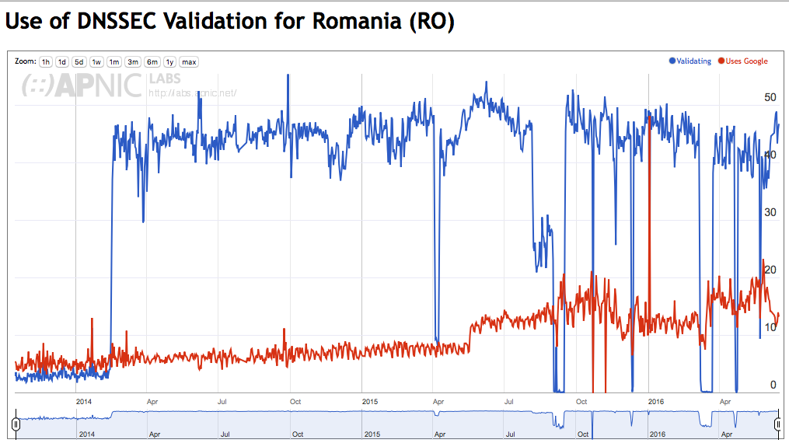
Some have been Validating for many years
Sweden – 80 %
Comcast – 90%
Romania – 45 %
Estonia – 60 %

Slide 9
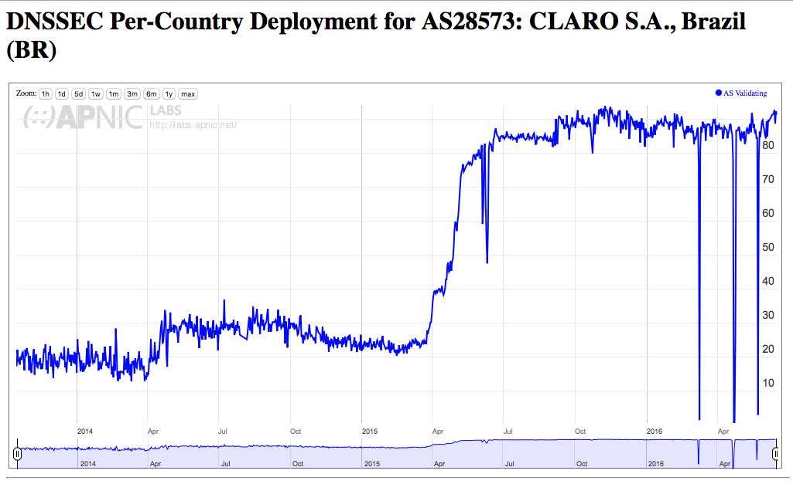
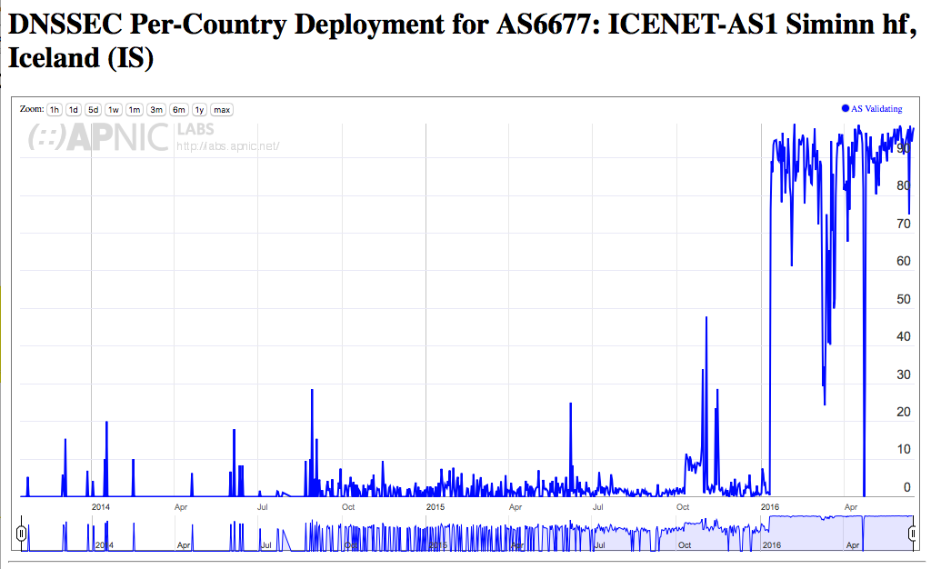
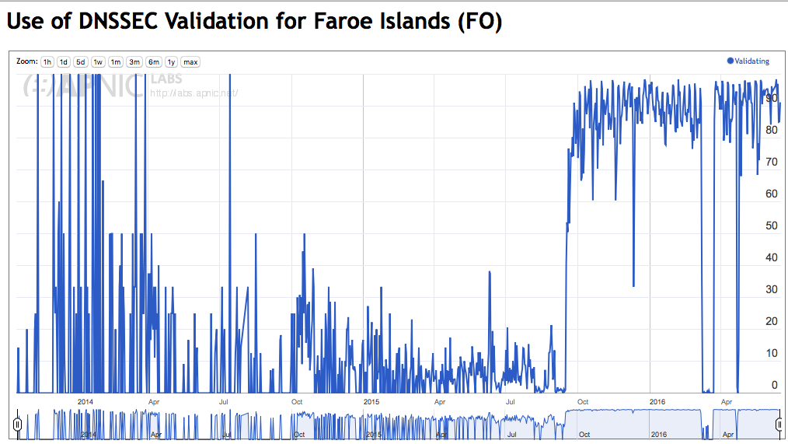
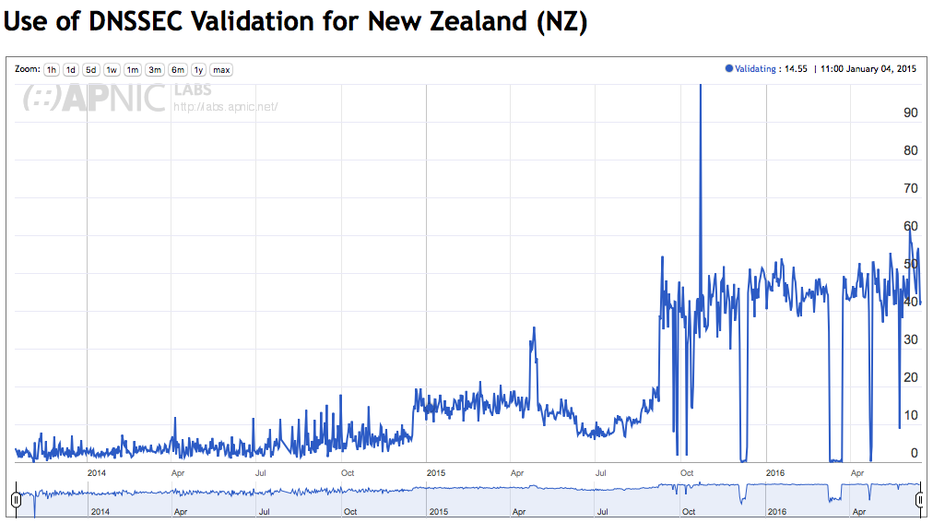
Recent DNSSEC Validation
Claro, BR – 90%
ICENET, IS – 90%
Faroe Islands - 90%
New Zealand - 50%

Slide 10
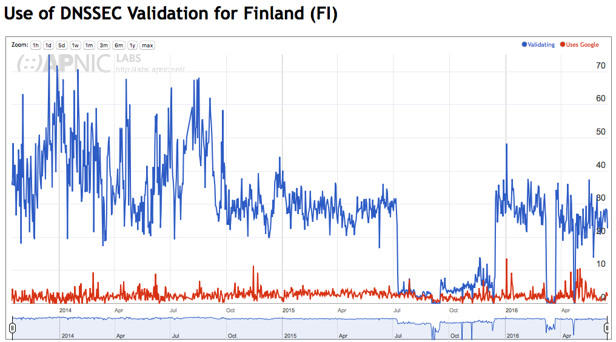
Finland

Slide 11
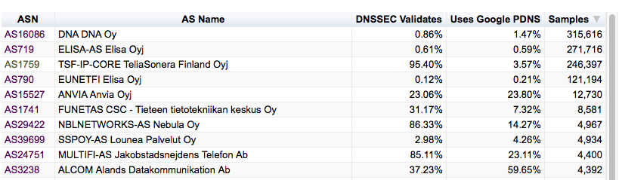
Finland – Top 10 ISPs

Slide 12
The Bigger Picture
Much of the African continent and parts of Asia still show high DNSSEC validation rates due to their use of Google’s Public DNS service (which currently receives 12% of the Internet’s query load)
Comcast resolvers are a major validation system in North America and this resolver collection performs the second highest volume of validation
Recent areas of switching on DNSSEC validation in DNS resolvers are in Iceland, Norway, Brazil, Nepal, New Zealand and Papua New Guinea

Slide 13
But
Growth of validation deployment has slowed
  80% of all current queries request DNSSEC credentials
  26% of all current queries perform DNSSEC validation
  11% of current queries turn to a non-validating resolver upon SERVFAIL
  15% of current queries will perform validation and live with the outcome

Slide 14
Thanks!
DNSSEC Reports: http://stats.labs.apnic.net/dnssec

