Slide 1
Why Dane?
Geoff Huston
Chief Scientist, APNIC

Slide 2
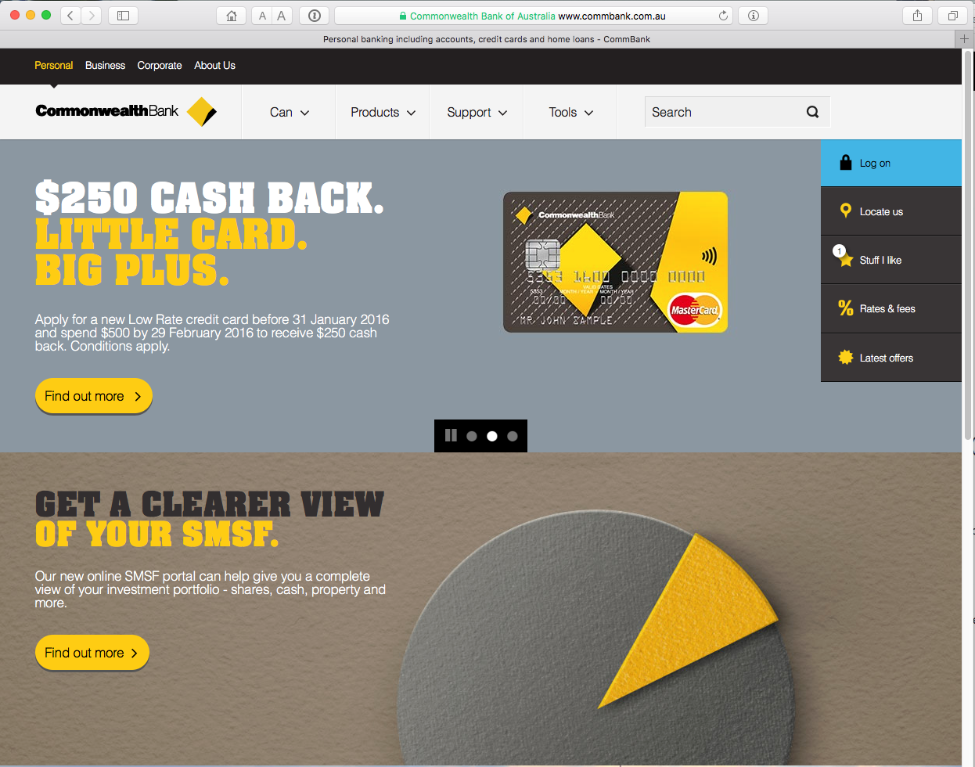
Security on the Internet
How do you know that you are going to where you thought you were going to?

Slide 3
Security on the Internet
How do you know that you are going to where you thought you were going to?
My Bank’s web site
Or at least I think its my
bank because it looks a bit
familiar and there is a
green icon of a lock
So it HAS to be my
bank – hasn’t it?

Slide 4


Connection Steps
Me:
DNS Query:
www.commbank.com.au?
DNS Response:
104.97.235.12
TCP Session:
TCP Connect 104.97.235.12, port 443

Slide 5
Hang on…
$ dig -x 104.97.235.12 +short
a104-97-235-12.deploy.static.akamaitechnologies.com.
That’s not an IP addresses that was allocated to the Commonwealth Bank!
The Commonwealth Bank of Australia has 140.168.0.0 - 140.168.255.255 and 203.17.185.0 - 203.17.185.255
So why should my browser trust that 104.97.235.12 is really the “proper” web site for the Commonwealth Bank of Australia and not some dastardly evil scam?
How can my browser tell the difference between an intended truth and a lie?

Slide 6
It’s all about cryptography
https://www.flickr.com/photos/130418531@N02/16782188377/in/photolist-ryZ6Vt-Qbdz2s-xBDAPD-osGvgu-odevZf-osVbe3-
b2F4k-osR1qv-rG1BcF-ot8gpv-xjqvRQ-wEavwc-xjqD3o-xB2Zk6-xjqoVA-xyHzRm-xBDnyF-xjqBou-wE1UH1-xyHr6L-osVboS-xjqwbh-
wE1XvW-xBDvxg-xjwNyK-wEavWR-wEax2g-wE28Ss-xB38Vx-wEat5i-ot6Muw-wEamXZ-wE1Unb-xjqBuU-xjwQqa-ouT45p-xjwM8i-
osQZSM-ot8g2M-ouT4SB-ouT4zH-or6o99-wEaxH6-xjwYpr-xjqBPS-xyHxUA-xB36sM-xjwTvD-xAdeTN-xjqyrC

Slide 7
The Basic Challenge
Pick a pair of keys such that:
  Messages encoded with one key can only be decoded with the other key
  Knowledge of the value of one key does not infer the value of the other key
https://www.flickr.com/photos/matthew_lancaster_2/16236820919/in/photolist-qJMXbg-k2DdCg-bzq2E4-pMr5jw-6dqcYA-dA2qD7-hQia7n-rKbWt5-8cGJjp-4LF4GB-aFRdWK-ozhoRq-crZRwJ-oxSYk7-8cGBVH-8cKWKQ-oRt26z-k2GHfS-pTut5d-8cGG9n-nkNjxY-diYG5E-pMAb9Q-dePaJq-cNyBTL-q9gPnG-qJqEK8-8cGCbT-8cGCjt-e19ouA-hvDKJv-otkJrQ-rPCDtZ-dzVTon-oo9QU2-bvEeLd-QdhGwY-pJGKSU-ommZQ5-ozgY5v-cy1Wiy-yoTFCD-y6zvq9-ovkUxR-y6EPqD-8cKVxw-yobvEZ-8cGDVV-xr9Zmo-y6yrNo

Slide 8
RSA
Select two large (> 256 bit) prime numbers, p and q, then:
  n = p.q
  ⏀(n) = (p-1).(q-1) (the number of numbers that are relatively prime to n)
  Pick an e that is relatively prime to ⏀(n)
  The PUBLIC KEY is <e,n>
Pick a value for d such that d.e = 1 mod ⏀(n)
  The PRIVATE KEY is <d,n>
For any x, x^{de} ≡ x (mod n)

Slide 9
The Power of Primes
(m^{e})^{d} = (m^{d})^{e} ≡ m (mod n)
As long as d and n are relatively large, and n is the product of two large prime numbers, then finding the value of d when you already know the values of e and n is computationally expensive
Now d.e = 1 mod ⏀(n)
So if you know ⏀(n), then you can calculate d
But ⏀(n) = (p-1).(q-1), where p.q = n
You need to find the prime factors of n, a very large composite number that is the product of two primes

Slide 10
TLS Connections
https://rhsecurity.wordpress.com/tag/tls/

Slide 11
TLS Connections
https://rhsecurity.wordpress.com/tag/tls/

Slide 12
TLS Connections
https://rhsecurity.wordpress.com/tag/tls/

Slide 13
TLS Connections
How does the client
“recognise” this certificate
as valid?
https://rhsecurity.wordpress.com/tag/tls/

Slide 14
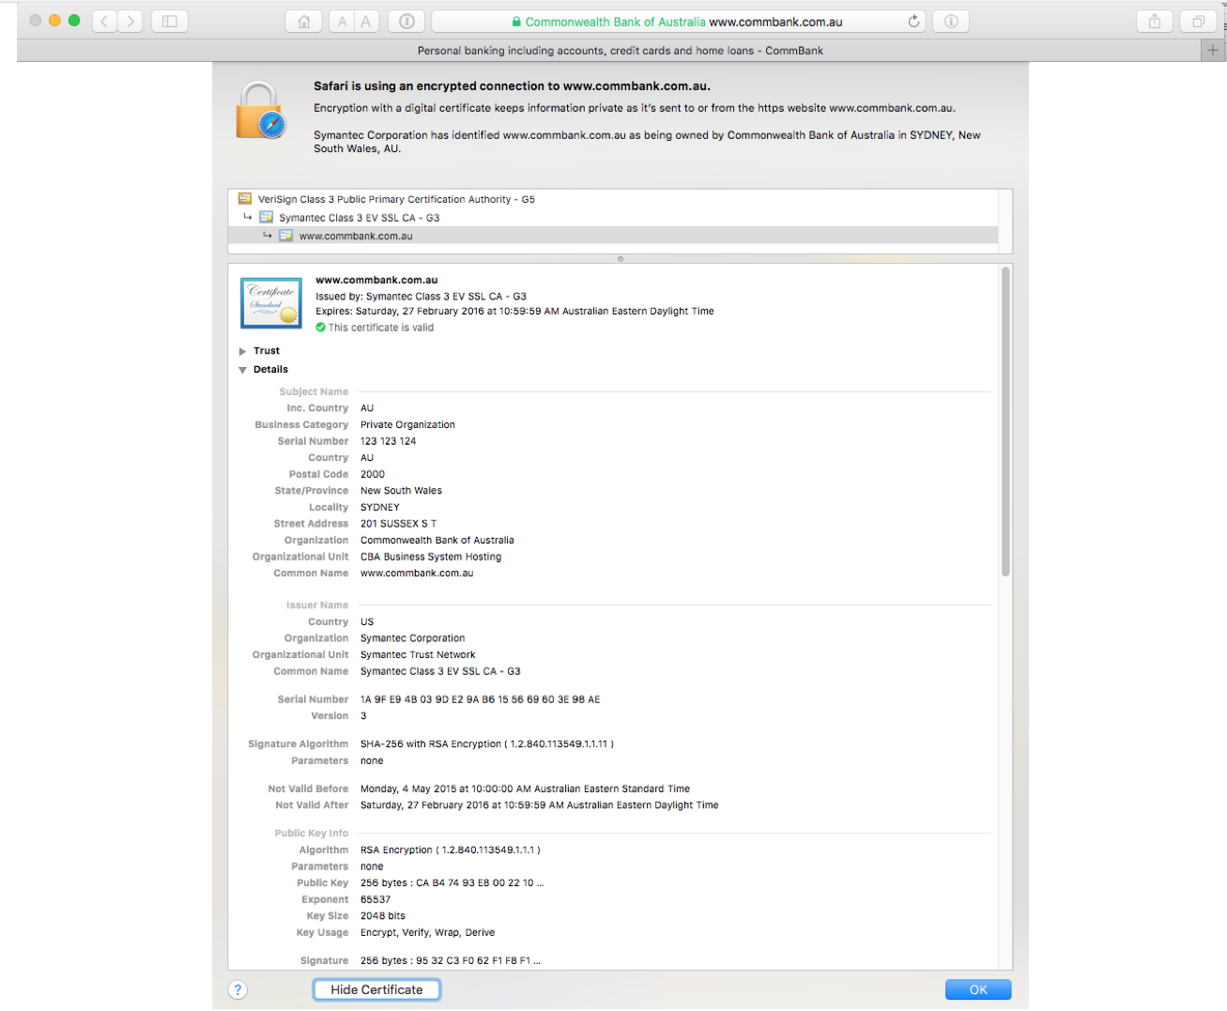

Slide 15
How did my browser know that this is a valid cert?

Slide 16
Domain Name Certification
The Commonwealth Bank of Australia has generated a key pair
And they passed a Certificate Signing Request to a company called “Symantec” (together with money)
Symantec is willing to vouch (in a certificate) that the entity who goes by the domain name of www.commbank.com.au also has a certain public key value (because it has been paid to do this!)
So if I can associate this public key with a connection then I have a high degree of confidence that I’ve connected to the “real” www.commbank.com.au, as long as I am also prepared to trust Symantec, and their certificate issuance processes, and that the certificates that they issue are always genuine

Slide 17
Domain Name Certification
The Commonwealth Bank of Australia has generated a key pair
And they passed a Certificate Signing Request to a company called “Symantec” (together with money)
Symantec is willing to vouch (in a certificate) that the entity who goes by the domain name of www.commbank.com.au also has a certain public key value (because it has been paid to do this!)
So if I can associate this public key with a connection then I have a high degree of confidence that I’ve connected to the “real” www.commbank.com.au, as long as I am also prepared to trust Symantec, and their certificate issuance processes, and that the certificates that they issue are always genuine
Why should I trust them?

Slide 18
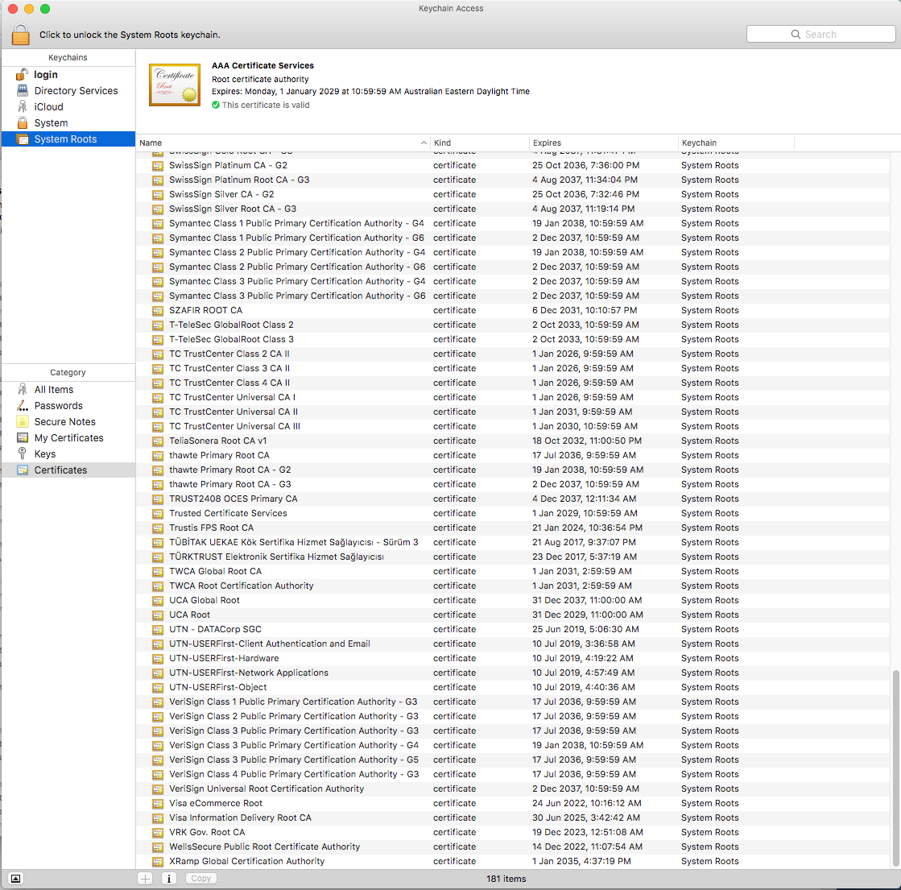
Local Trust
The cert I’m being asked to trust was issued by a certification authority that my browser already trusts – so I trust that cert!

Slide 19
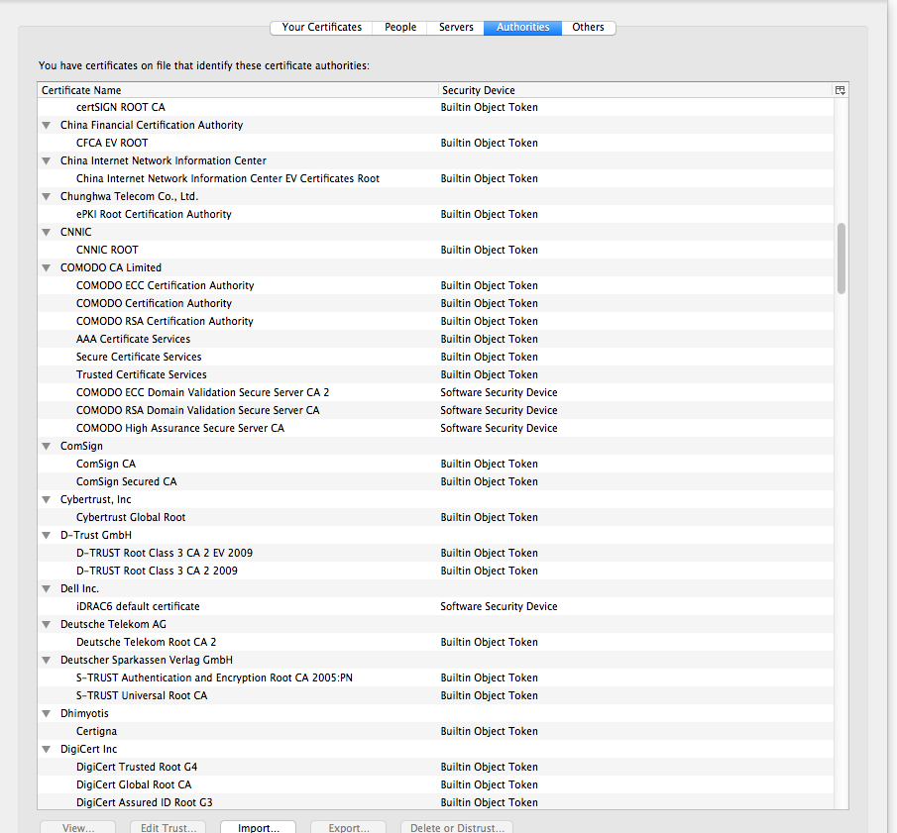
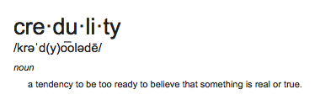
Local Trust or Local Credulity*?
That’s a big list of people to
Trust
Are they all trustable?
*

Slide 20
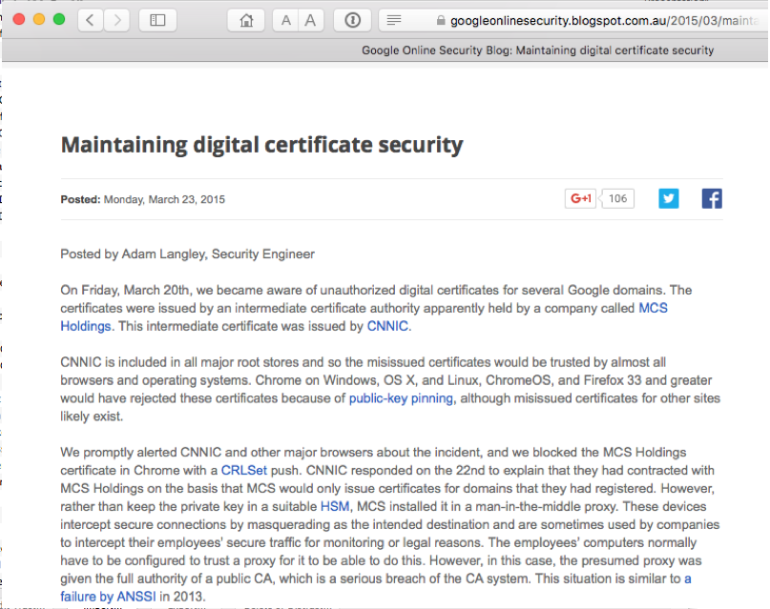
Local Credulity
That’s a big list of people to
Trust
Are they all trustable?
Evidently Not!

Slide 21
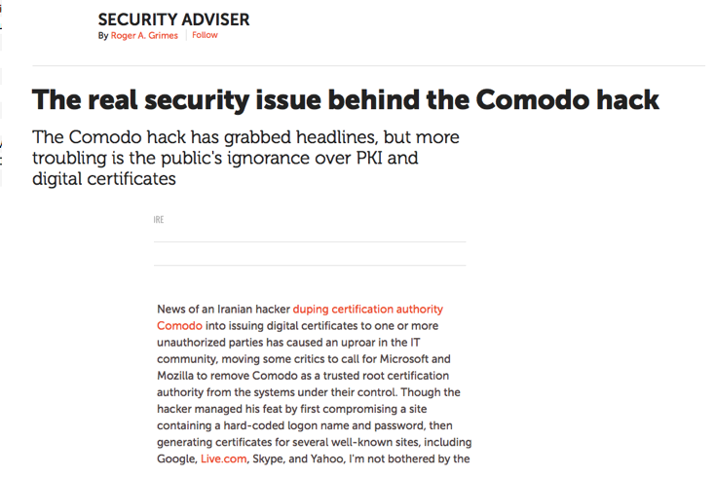
Local Credulity
That’s a big list of people to
Trust
Are they all trustable?
Evidently Not!

Slide 22
But my bank uses Symantec
as their Certificate Authority
And Symantec NEVER lie in the certificates they issue

Slide 23
Never?

Slide 24
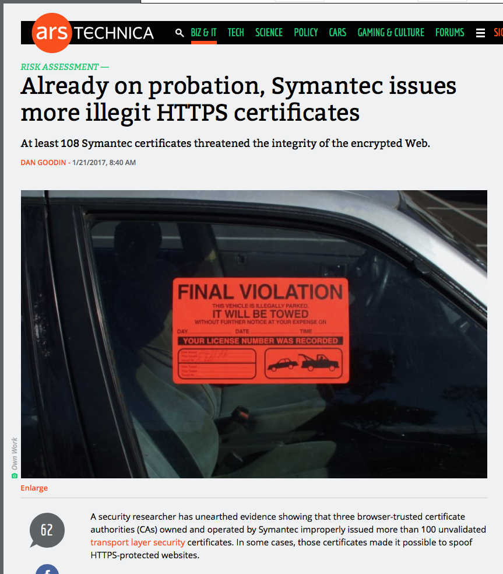
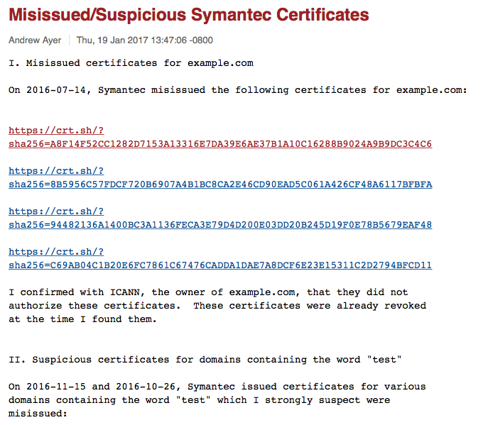
Well, hardly ever
http://arstechnica.com/security/2017/01/already-on-probation-symantec-issues-more-illegit-https-certificates/

Slide 25
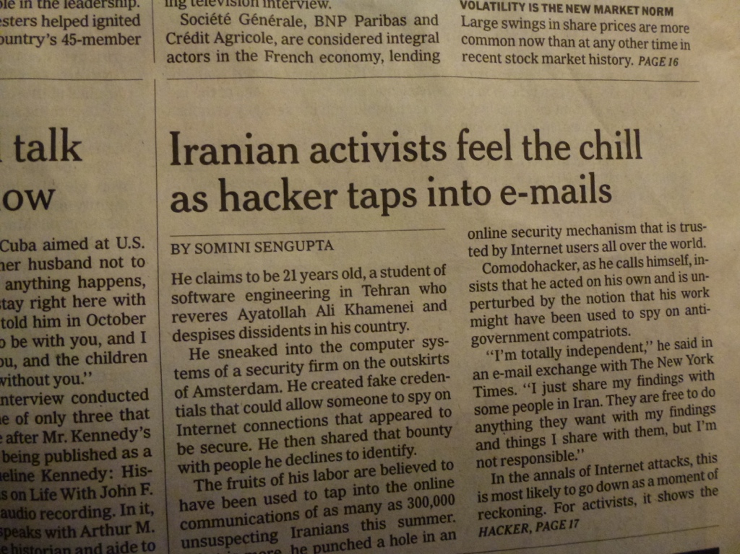
With unpleasant consequences when it all goes wrong
International Herald Tribune
Sep 13, 2011 Front Page

Slide 26
What’s going wrong here?
The TLS handshake cannot specify WHICH CA should be used to validate the digital certificate
That means that your browser may allow ANY CA to be used to validate a certificate

Slide 27
What’s going wrong here?
The TLS handshake cannot specify WHICH CA should be used to validate the digital certificate
That means that your browser may allow ANY CA to be used to validate a certificate
WOW! That’s awesomely bad!

Slide 28
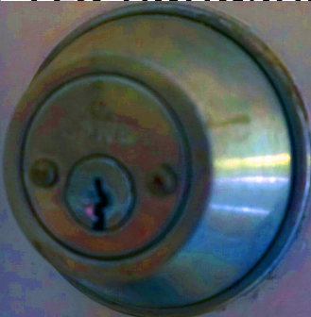
What’s going wrong here?
WOW! That’s awesomely bad!
Here’s a lock – it might be the lock on your front door for all I know.
The lock might LOOK secure, but don’t worry – literally ANY key will open it!

Slide 29
What’s going wrong here?
There is no incentive for quality in the CA marketplace
Why pay more for any certificate when the entire CA structure is only as strong as the weakest CA
And you browser trusts a LOT of CAs!
  About 60 – 100 CA’s
  About 1,500 Subordinate RA’s
  Operated by 650 different organisations
See the EFF SSL observatory
http://www.eff.org/files/DefconSSLiverse.pdf

Slide 30
In a commercial environment
Where CA’s compete with each other for market share
And quality offers no protection
Than what ‘wins’ in the market?
Sustainable
?
Resilient
Secure
Privacy
Trusted

Slide 31
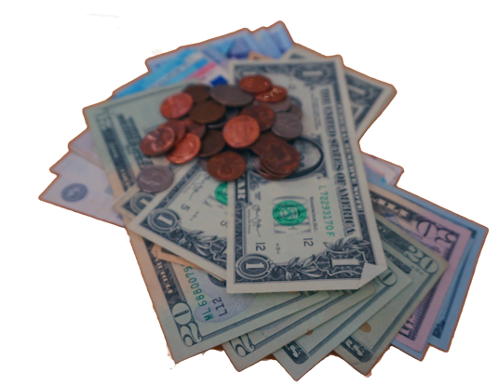
In a commercial environment
Where CA’s compete with each other for market share
And quality offers no protection
Than what ‘wins’ in the market?
Sustainable
Resilient
Cheap!
Secure
Privacy
Trusted

Slide 32
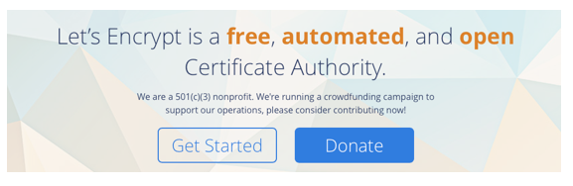
Where now?
Option A: Take all the money out of the system!
www.letsencrypt.org

Slide 33
Where now?
Option A: Take all the money out of the system!
Will the automation of the Cert Issuance coupled with a totally free service make the overall environment more or less secure?
We’re probably going to find out real soon!
www.letsencrypt.org

Slide 34
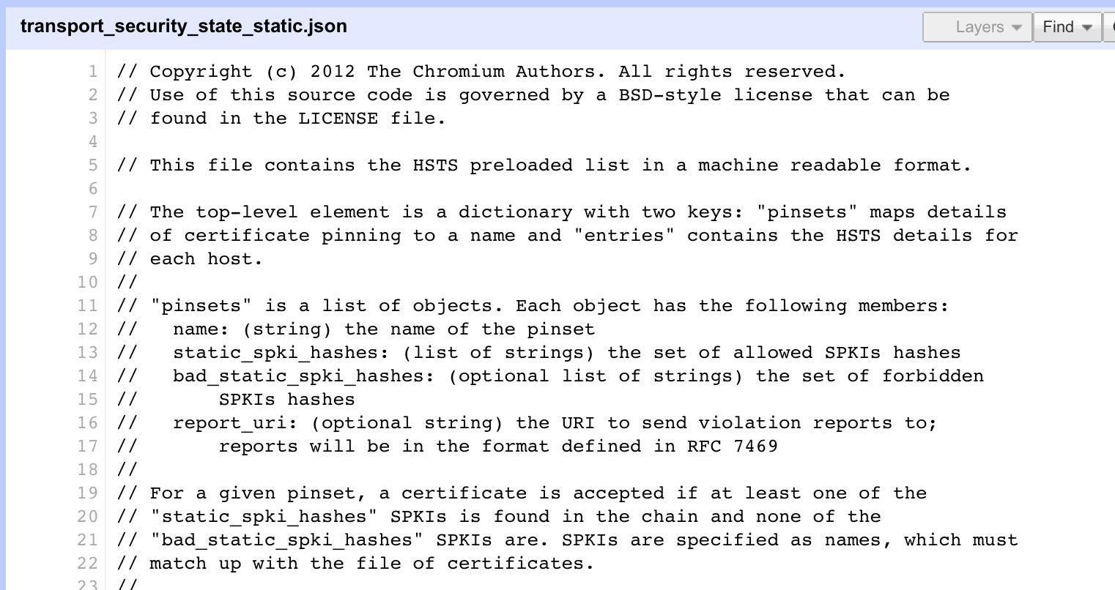
Where now?
Option B: White Listing and Pinning with HSTS
https://code.google.com/p/chromium/codesearch#chromium/src/net/http/transport_security_state_static.json

Slide 35
Where now?
Option B: White Listing and Pinning with HSTS
https://code.google.com/p/chromium/codesearch#chromium/src/net/http/transport_security_state_static.json
Its not a totally insane idea -- until you realise that it appears to be completely unscaleable!

Slide 36
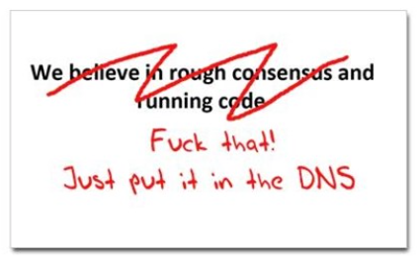
Where now?
Option C: Use the DNS!
cafepress.com/nxdomain

Slide 37
Seriously … just use the DNS Luke!*
Where better to find out the public key associated with a DNS name than to look it up in the DNS?
* Ok, that was a cheap shot – my apologies to the Star Wars franchise!

Slide 38
Seriously
Where better to find out the public key associated with a DNS name than to look it up in the DNS?
  Why not query the DNS for the HSTS record (pinning record)?

Slide 39
Seriously
Where better to find out the public key associated with a DNS name than to look it up in the DNS?
  Why not query the DNS for the HSTS record?
  Why not query the DNS for the issuer CA?

Slide 40
Seriously
Where better to find out the public key associated with a DNS name than to look it up in the DNS?
  Why not query the DNS for the HSTS record?
  Why not query the DNS for the issuer CA?
  Why not query the DNS for the hash of the domain name cert?

Slide 41
Seriously
Where better to find out the public key associated with a DNS name than to look it up in the DNS?
  Why not query the DNS for the HSTS record?
  Why not query the DNS for the issuer CA?
  Why not query the DNS for the hash of the domain name cert?
  Why not query the DNS for the hash of the domain name public key?

Slide 42
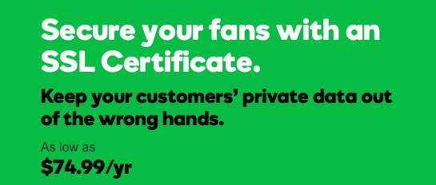
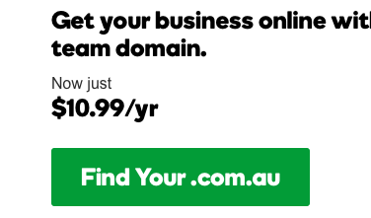
Seriously
Where better to find out the public key associated with a DNS name than to look it up in the DNS?
  Why not query the DNS for the HSTS record?
  Why not query the DNS for the issuer CA?
  Why not query the DNS for the hash of the domain name cert?
  Why not query the DNS for the hash of the domain name subject public key info?
Who needs CA’s anyway?

Slide 43
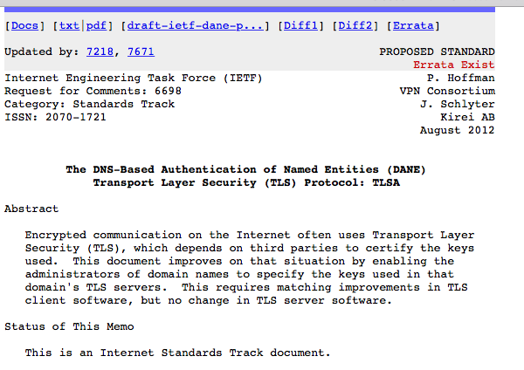
DANE
Using the DNS to associated domain name public key certificates with domain name
RFC6698 -- You should read this!

Slide 44
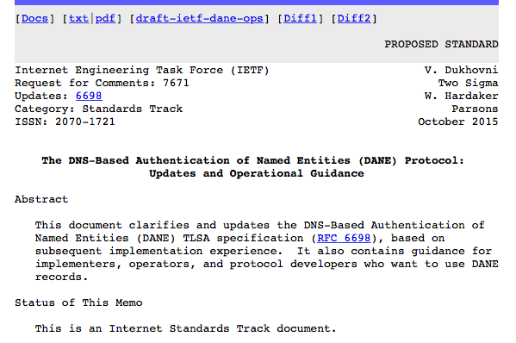
DANE
Using the DNS to associated domain name public key certificates with domain name
You probably should read RFC7671 as well!

Slide 45
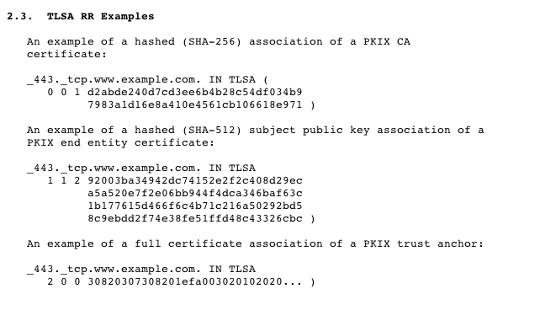
DANE
TLSA RR
CA Cert Hash
EE Cert Hash
Trust Anchor

Slide 46
EECert TLSA record generation
; Convert the public key certificate to DER format
; Generate the SHA256 hash
; Add DNS gunk!
$ /usr/bin/openssl x509 -in /usr/local/etc/letsencrypt/live/www.dotnxdomain.net/cert.pem -outform DER |
/usr/bin/openssl sha256 |
cut -d ' ' -f 2 |
awk '{print ”_443._tcp.www.dotnxdomain.net IN TLSA 3 0 1 " $1}'
_443._tcp.www.dotnxdomain.net. 899 IN TLSA 3 0 1 D42101BCCE941D22E8E467C5D75E77EC4A7B8B7C9366C6A878CB4E15 7E602F17
$ dig +dnssec TLSA _443._tcp.www.dotnxdomain.net.
_443._tcp.www.dotnxdomain.net. 899 IN TLSA 3 0 1 D42101BCCE941D22E8E467C5D75E77EC4A7B8B7C9366C6A878CB4E15 7E602F17
_443._tcp.www.dotnxdomain.net. 899 IN RRSIG TLSA 13 5 900 20200724235900 20170122043100 56797 www.dotnxdomain.net. dUYD1sMIpBc6RsUhturFzz5G8qX6oaDGRzaD/q6n+YJi2kqzDfWZls6F 3X1mXdpeQQYz52yOUOcdWvFRO9TQZQ==

Slide 47
SPKI TLSA record generation
; Generate the public key
; Convert it to DER format
; Generate the SHA256 hash
; Add DNS gunk!
$ /usr/bin/openssl x509 -in /usr/local/etc/letsencrypt/live/www.dotnxdomain.net/cert.pem -pubkey -noout |
openssl rsa -pubin -outform der |
/usr/bin/openssl sha256 |
cut -d ' ' -f 2 |
awk '{ print "_443._tcp.www.ndotnxdomain.net IN TLSA 3 1 1 " $1}’
_443._tcp.www.ndotnxdomain.net IN TLSA 3 1 1 df3a810d998cfddf8fa935ed33065ee27a67747366e2da40ddefef2b3a2032eb

Slide 48
TLS with DANE
Client receives server cert in Server Hello
  Client queries the DNS for the TLSA Resource Record of the domain name
  Client validates the public key information in the presented certificate against the TLSA RR
Client performs Client Key exchange

Slide 49
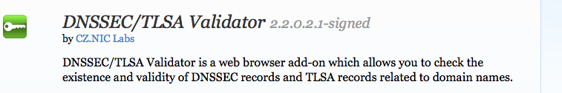
TLS Connections
DNS Name
TLSA query
Public Key
Cert
https://rhsecurity.wordpress.com/tag/tls/

Slide 50
Just one problem…
The DNS is full of liars and lies!
And this can compromise the integrity of public key information embedded in the DNS
Unless we fix the DNS we are no better off than before with these TLSA records!

Slide 51
Just one response…
We need to allow users to validate DNS responses for themselves
And for this we need a Secure DNS framework
Which we have – and its called DNSSEC!

Slide 52
DNSSEC Interlocking Signatures
. (root)
. Key-Signing Key – signs over
. Zone-Signing Key – signs over
DS for .com (Key-Signing Key)
.com
.com Key-Signing Key – signs over
.com Zone-Signing Key – signs over
DS for example .com (Key-Signing Key)
.example.com
example.com Key-Signing Key – signs over
example.com Zone-Signing Key – signs over
www.example.com
www.example.com

Slide 53
DNSSEC Interlocking Signatures
. (root)
. Key-Signing Key – signs over
. Zone-Signing Key – signs over
DS for .com (Key-Signing Key)
.com
.com Key-Signing Key – signs over
.com Zone-Signing Key – signs over
DS for example .com (Key-Signing Key)
.example.com
example.com Key-Signing Key – signs over
example.com Zone-Signing Key – signs over
www.example.com
www.example.com IN A 192.0.1

Slide 54
DNSSEC Interlocking Signatures
Is the KSK for . valid?
. (root)
. Key-Signing Key – signs over
Is the ZSK for . valid?
. Zone-Signing Key – signs over
Is this DS equal to the hash of the KSK?
Is the signature for this record valid?
DS for .com (Key-Signing Key)
.com
Is the KSK for .com valid?
.com Key-Signing Key – signs over
.com Zone-Signing Key – signs over
Is the ZSK for .com valid?
DS for example .com (Key-Signing Key)
Is this DS equal to the hash of the KSK?
Is the signature for this record valid?
.example.com
example.com Key-Signing Key – signs over
Is the KSK for example.com valid?
example.com Zone-Signing Key – signs over
Is the ZSK for example.com valid?
www.example.com
Is the signature for this record valid?
www.example.com IN A 192.0.1

Slide 55
DNSSEC Interlocking Signatures
Is the KSK for . valid?
. (root)
As long as you have a valid local trust anchor for the root zone then you can validate a signed DNS response by constructing this backward path to the local root trust anchor
Is the ZSK for . valid?
. Key-Signing Key – signs over
. Zone-Signing Key – signs over
Is this DS equal to the hash of the KSK?
Is the signature for this record valid?
DS for .com (Key-Signing Key)
.com
Is the KSK for .com valid?
.com Key-Signing Key – signs over
.com Zone-Signing Key – signs over
Is the ZSK for .com valid?
DS for example .com (Key-Signing Key)
Is this DS equal to the hash of the KSK?
Is the signature for this record valid?
.example.com
example.com Key-Signing Key – signs over
Is the KSK for example.com valid?
example.com Zone-Signing Key – signs over
Is the ZSK for example.com valid?
www.example.com
Is the signature for this record valid?
www.example.com IN A 192.0.1

Slide 56
DANE + DNSSEC
Query the DNS for the TLSA record of the domain name and ask for the DNSSEC signature to be included in the response
Validate the signature to ensure that you have an unbroken signature chain to the root trust point
At this point you can accept the TLSA record as the authentic record, and set up a TLS session based on this data

Slide 57
But I can’t see DANE in my browser!
Browser vendors appear to be dragging the chain on DANE support, often citing lack of DNSSEC deployment as the excuse de jour
DANE exists today as plug-ins rather than a core functionality
Cynically, one could observe that fast but insecure is the browser vendors’ current preference!
But is it really the case that DNSSEC deployment is lagging?

Slide 58
We need DNSSEC as well as DANE…
How much DNSSEC Validation is out there?

Slide 59
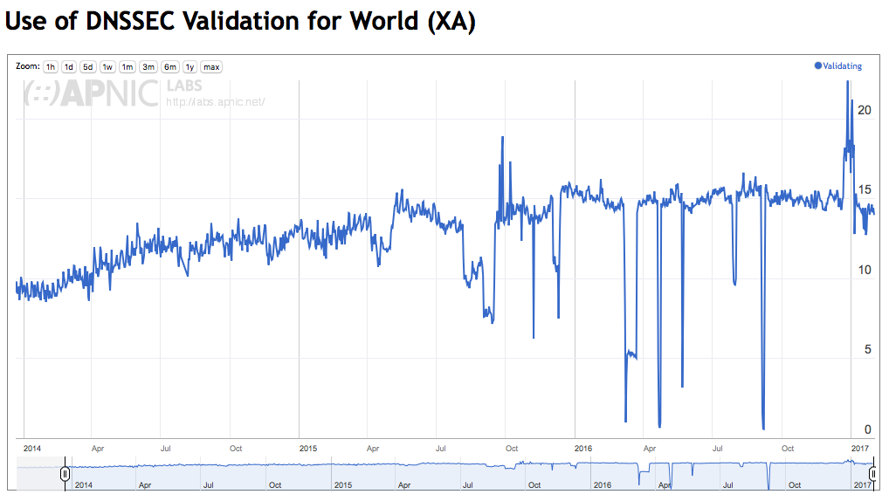
Do we do DNSSEC Validation?
stats.labs.apnic.net/dnssec/XA

Slide 60
Or…

Slide 61
Look! No DNS!
Server packages the server cert, TLSA record and the DNSSEC credential chain in a single bundle *
Client receives bundle in Server Hello
  Client performs validation of TLSA Resource Record using the supplied DNSEC signatures plus the local DNS Root Trust Anchor without performing any additional DNS queries
  Client validates the presented certificate against the TLSA RR
Client performs Client Key exchange
* draft-shore-tls-dnssec-chain-extension

Slide 62
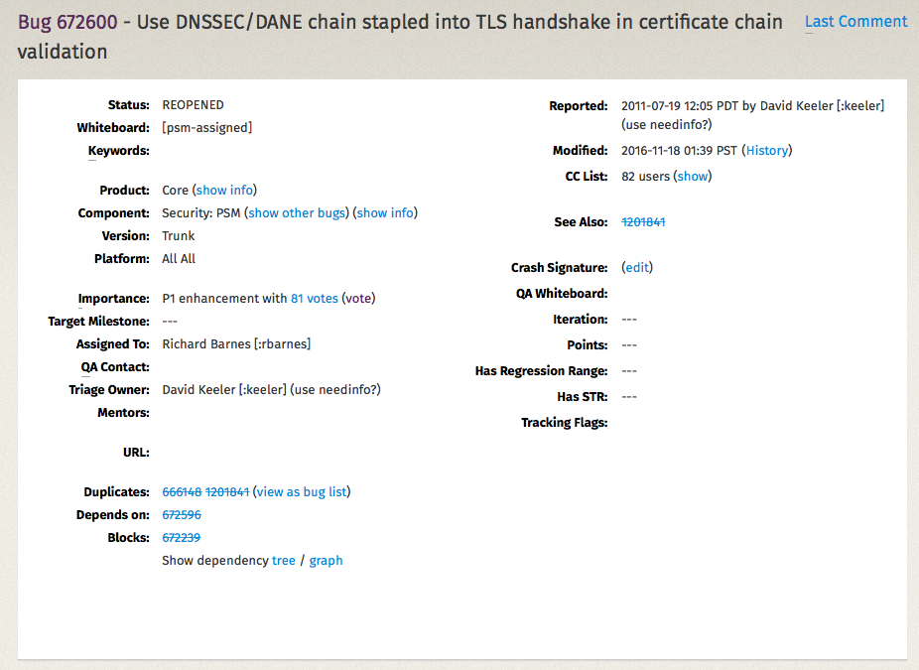
Maybe browsers are ready adopt this approach to TLS + DANE
Mozilla Bug Report 672600

Slide 63
Where now?
We could do a far better job at Internet Security:
Publishing DNSSEC-signed zones
Publishing DANE TLSA records
Using DNSSEC-validating resolution
Using TLSA records to guide Key Exchange for TLS

Slide 64
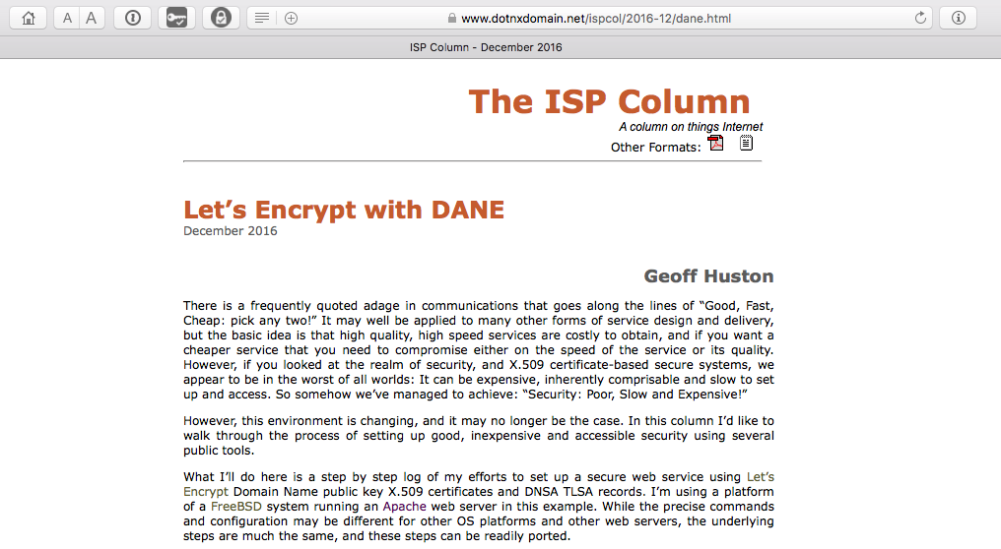
Let’s Do it!
What Let’s Encrypt and DNSSEC offers is robust, affordable, accessible security without the current overheads of high priced vanity CA offerings

Slide 65
That’s it!
Questions?

