Slide 1
Securing BGP:
The current state of RPKI
Geoff Huston
Chief Scientist, APNIC
Notes:
Abstract : Route Leakages and Prefixes Hijacking are very common and operators need to deal with it very often. Route leaks are similar in structure and effect to route hijacks, BGP hijacks and BGP man-in-the-middle attacks. However, while hijacks typically connote malicious attacks, route leaks instead are usually inadvertent and due to filter misconfigurations. There are lot of tools and techniques; RPS & SIDR are two working groups in IETF which are very instrumental to make routing infrastructure secure. It's been a while RPSL is there; we are also taking about RPKI for couple of years. But how operators are adopting & implementing these technologies? What issues they are facing? In this presentation I try to figure out those issues, analyze some data and see how it looks like in operational network.

Slide 2
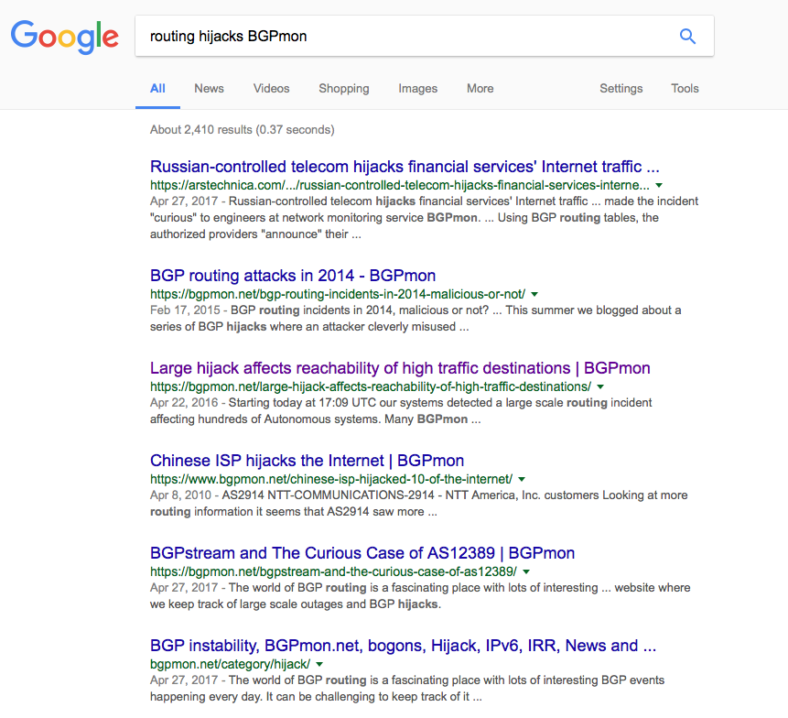
Incidents

Slide 3

What happens when I announce your addresses in BGP?
All the traffic that used to go to you will now come to me
I can disrupt your service
I can inspect unencrypted traffic that was heading towards you
I can send out traffic as if it was you
I can emit spam, mount bot attacks, or misbehave
I can get a certificate in your name
I can inspect encrypted traffic heading to your servers
I can mount pernicious man-in-the-middle attacks
Notes:
RADB and several other IRR databases allow any user to create any route object for any prefix. Given the wide usage of RADB and is recognition as an authoritative source for IRR data, it is the ideal place for adversaries to register route objects.

Slide 4

If I were evil
I’d announce your routes
Use an automated cert issuer to get a certificate issued for your domain name
Attract all secure traffic intended for your service and pass it on (man-in-the-middle)
  But I use _MY_ encryption to the end user, so I can see everything the end users does with your service, including their passwords
  And its not clear that they will notice anything amiss

Slide 5
If I were evil
I’d announce your routes
Use an automated cert issuer to get a certificate issued for your domain name
Attract all secure traffic intended for your service and pass it on (man-in-the-middle)
  But I use _MY_ encryption to the end user, so I can see everything the end users does with your service, including their passwords
  And its not clear that they will notice anything amiss
This form of attack is challenging to prevent once the route hijack is installed
So a useful defence is to ensure that the routing system resists attempts to install route hijacks

Slide 6
If I were evil
I’d announce your routes
Use an automated cert issuer to get a certificate issued for your domain name
Attract all secure traffic intended for your service and pass it on (man-in-the-middle)
  But I use _MY_ encryption to the end user, so I can see everything the end users does with your service, including their passwords
  And its not clear that they will notice anything amiss
This form of attack is challenging to prevent once the route hijack is installed
So a useful defence is to ensure that the routing system resists attempts to install route hijacks
How can we counter route hijacks?
How can we tell what is a “genuine” route update and what’s a fake?

Slide 7
What do we do today?

Slide 8
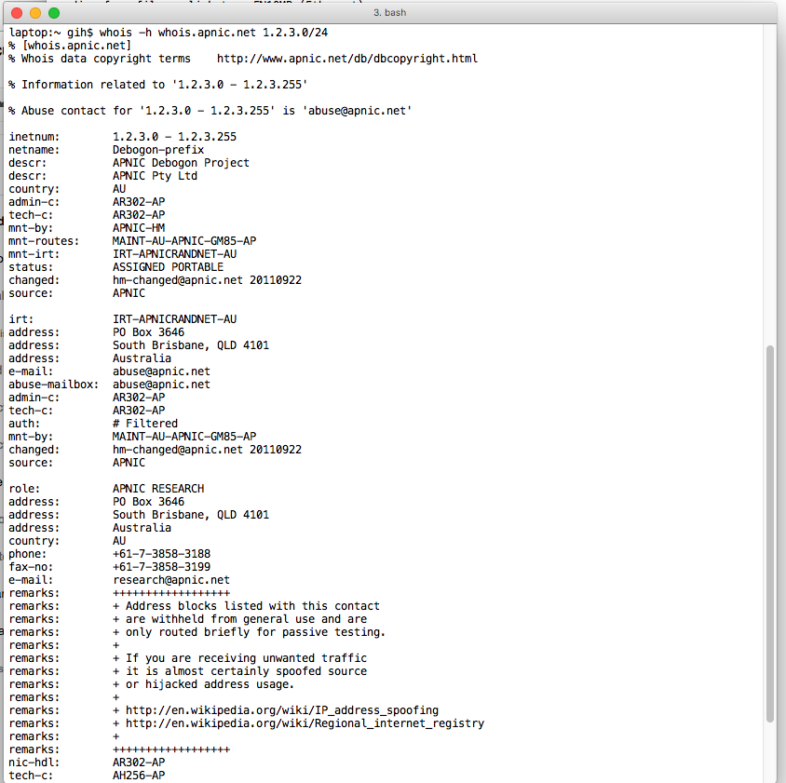
What do we do today?
I ask you to route my net:
You look the net up on whois
If it all seems to match then accept
the request and add it to the
network filters for this customer

Slide 9
What do we do today?
I ask you to route my net:
You look the net up on whois
If it all seems to match then accept
the request and add it to the
network filters for this customer
The awesome power of whois!

Slide 10
What do we do today?
I ask you to route my net
You ask for me to provide a “Letter of Authority”
Which is an effort to absolve you of all liability that may arise from announcing this route
You then add the to the network filters for this customer

Slide 11
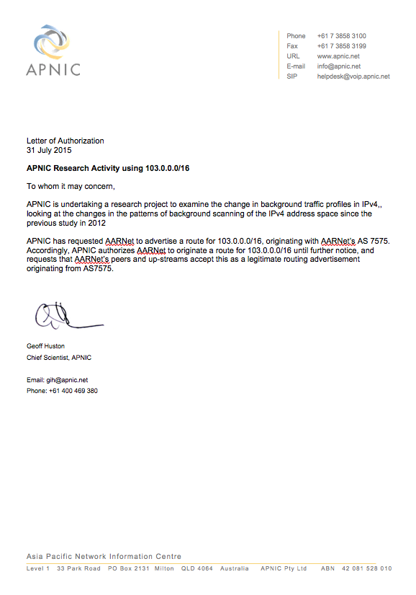
What do we do today?
I ask you to route my net
You ask for me to provide a “Letter of Authority”
Which is an effort to absolve you of all liability that may arise from announcing this route
You then add the to the network filters for this customer

Slide 12
What do we do today?
I ask you to route my net
You ask for me to provide a “Letter of Authority”
Which is an effort to absolve you of all liability that may arise from announcing this route
You then add the to the network filters for this customer
At least you are off the hook
when the network police
come knocking!!

Slide 13
What do we do today?
I ask you to route my net
You ask for me to enter the details in a route registry
Access filters may be automatically generated from route registry data

Slide 14
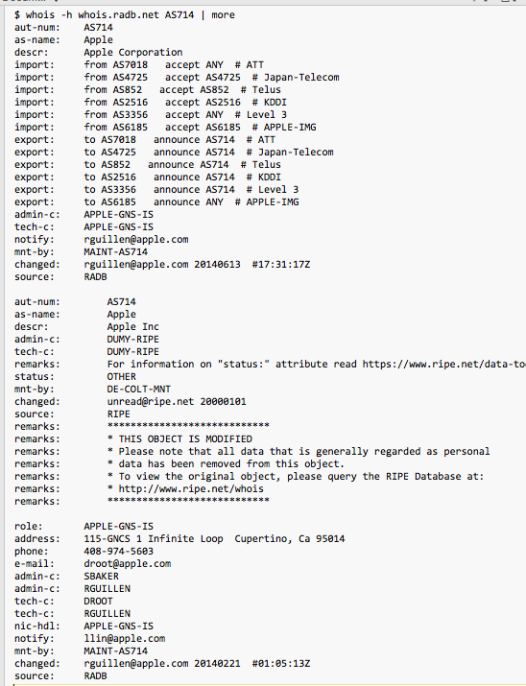
What do we do today?
I ask you to route my net
You ask for me to enter the details in a route registry
Access filters may be automatically generated from route registry data

Slide 15
What do we do today?
I ask you to route my net
You ask for me to enter the details in a route registry
Access filters may be automatically generated from route registry data
- How current is this data?
- Is it complete?
- Can I trust it to use as an automatic filter generator for my routers?

Slide 16
What do we do today?
I ask you to route my net
You ask for me to enter the details in a route registry
Access filters may be automatically generated from route registry data
- How current is this data?
- Is it complete?
- Can I trust it to use as an automatic filter generator for my routers?
A publicly accessible description of every import and export policy to every transit, peer, and customer, is difficult to maintain, and is not in the best business interests of many ISPs

Slide 17
What’s the problem here?
Whois lookups typically require manual processing.
  This information is also somewhat informal so it often requires some level of interpretation and judgment
  Whois lookups are an admission process, not a means to maintain route filters
Letters of Authority are just a way to try and avoid liabilities – they are not a useful tool to manage routing
Routing Registries come in all shapes and sizes!
  Which is itself a problem – there is no single authoritative source
  The expression of routing policies quickly becomes complex and error prone
  Is this a case of attempting to harness too much information?

Slide 18
The RPKI Approach
None of these approaches are very satisfactory as a complete solution to this problem
Let’s take a step back and see if we can use digital signature technology to assist here.
If we can, then we can construct automated systems that will recognise validly signed attestations about addresses and their use

Slide 19
Using Cryptography to tell “Good” from “Bad”
This looks a lot like an application of public/private key cryptography, with “authority to use” conveyed by a digital signature
  Using a private key to sign the authority, and the public key to validate the authority
  If the private key was held by the address holder then we have the notion of binding the control over an address to holding the private key
  We can use a conventional certificate infrastructure to support public key validation at the scale of the Internet
  But how can we inject trustable authority into this framework?

Slide 20
Trustable Credentials
How can we inject trustable authority into this framework?

Slide 21
Trustable Credentials
How can we inject trustable authority into this framework?
Bind the Registry and the key structure together:
Use the existing address allocation hierarchy
  IANA, RIRs, NIRs & LIRs, End holders
Describe this address allocation structure using digital certificates
The certificates do not introduce additional data – they are a representation of registry information in a particular digital format

Slide 22
Resource Certificates
A resource certificate is a digital document that binds together an IP address block with the IP address holder’s public key, signed by the certification authority’s private key
The certificate set can be used to validate that the holder of a particular private key is held by the current legitimate holder of a particular number resource – or not!
Community driven approach
  Collaboration between the RIRs since 2006
  Based on open IETF standards
    Based on work undertaken in the Public Key Infrastructure (PKIX) and Secure Inter-Domain Routing (SIDR) Working Groups of the IETF

Slide 23

The RPKI Certificate Service
Enhancement to the RIR Registry
  Offers verifiable proof of the number holdings described in the RIR registry
Resource Certification is an opt-in service
  Number Holders choose to request a certificate
    Derived from registration data

Slide 24
What Can we Sign?
One approach is to look at the process of “permissions” that add an advertised address prefix to the routing system:
  The address holder is “authorising” a network to “originate” a route advertisement into the routing system
The ‘ROA’ is a digitally signed version of this authority. It contains
  An address prefix (and range of ‘allowed’ prefix sixes
  An ‘originating address’
This allows others to check the validity of a BGP route announcement:
  If there is a valid ROA, and the origin AS matches the AS in the ROA, and the prefix length is within the bounds of the ROA, then the announcement has been entered into the routing system with the appropriate permissions

Slide 25
So ROAs can help
An automated solution that checks the validity of a route announcement against a local repository of digital certificates:
  Which can be used to feed a BGP routing filter that can isolate certain instances of what looks like attempted route hijack

Slide 26
Are we using RPKI and ROAS
Two questions:
  What proportion of existing route advertisements have associated published ROAs?
  What proportion of network operators will reject a route if the associated ROA set indicates an invalid route advertisement (possible route hijack)

Slide 27
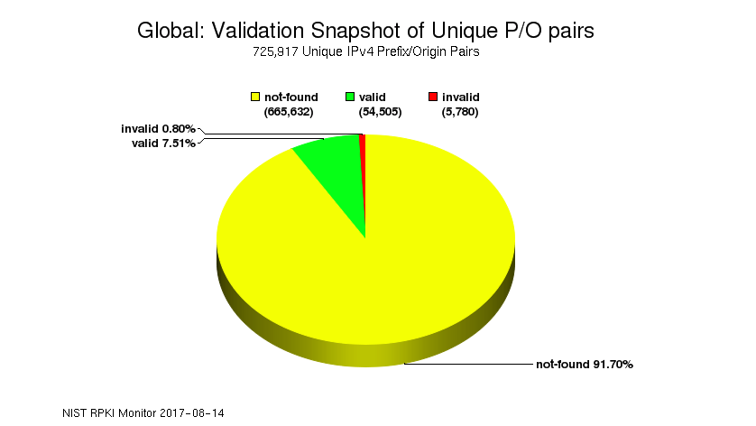
ROA publication
https://rpki-monitor.antd.nist.gov

Slide 28
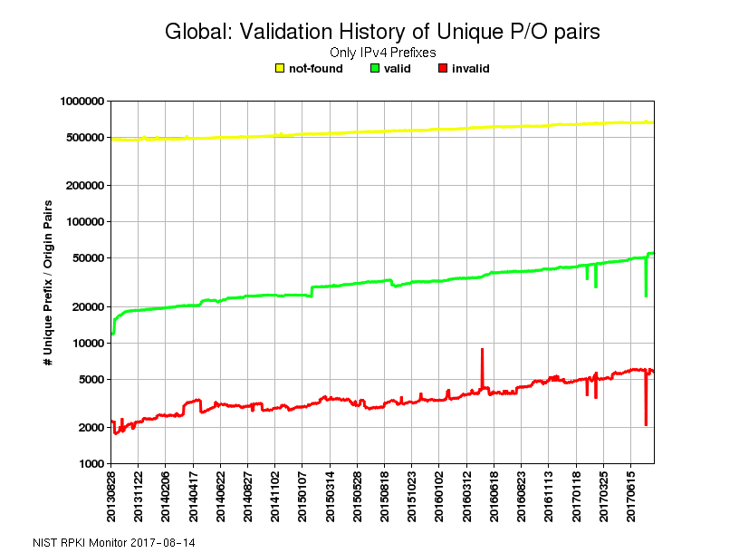
ROA publication
https://rpki-monitor.antd.nist.gov

Slide 29
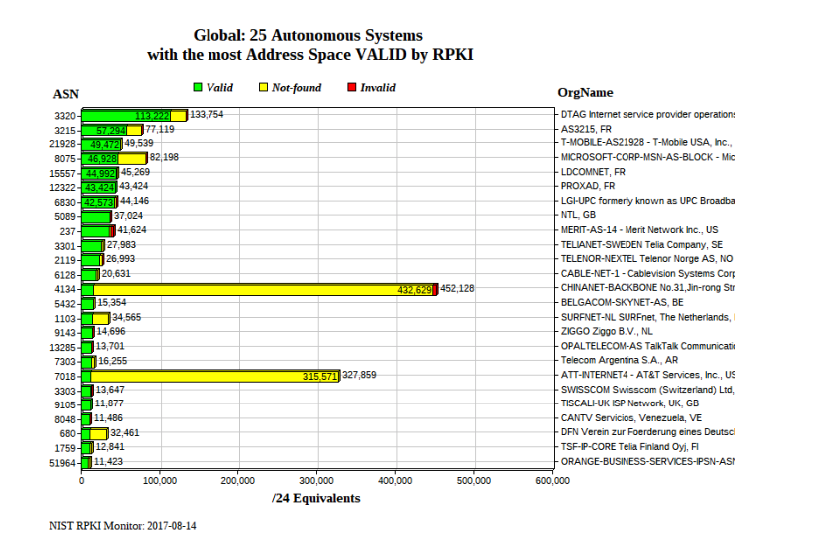
ROA publication
https://rpki-monitor.antd.nist.gov

Slide 30
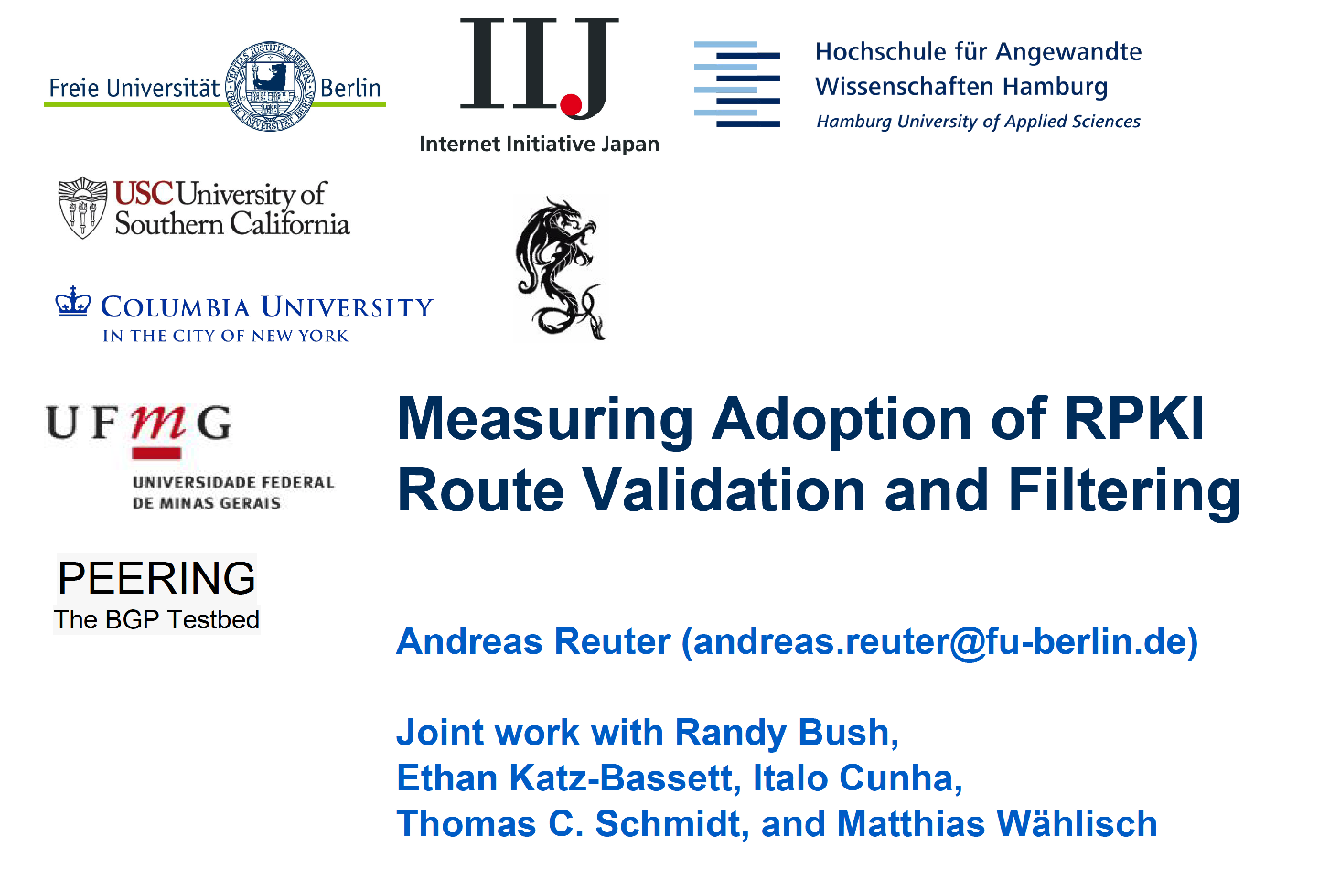
ROA Use
https://ripe74.ripe.net/presentations/43-ovs-study-ripe74-plen-final.pdf

Slide 31
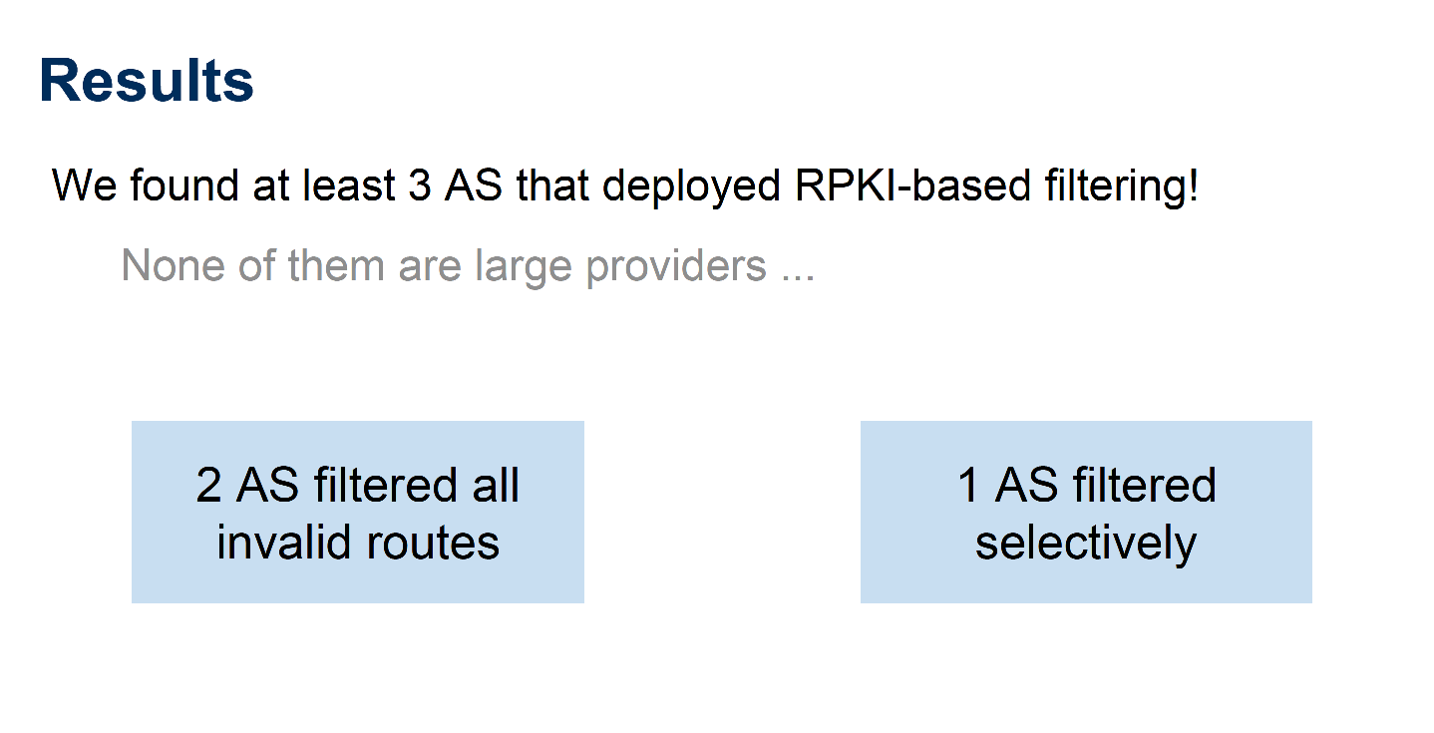
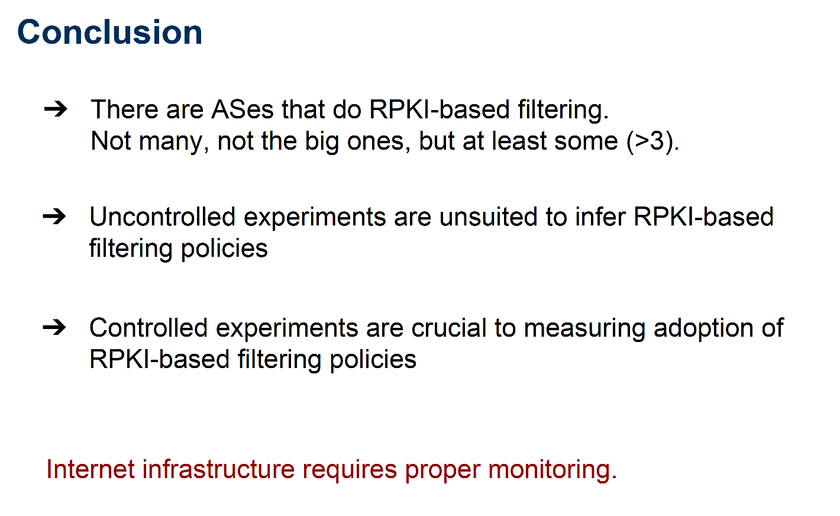
ROA Use
https://ripe74.ripe.net/presentations/43-ovs-study-ripe74-plen-final.pdf

Slide 32
Errrr
If route hijacking is such a problem then why aren’t we all publishing ROAs and running ROA filters on our routers?
Cryptography and Certificate management operationally challenging
  which is often seen as one more thing to go wrong!
Without everybody running BGPsec that it is not a very robust defence
  As long as a hijacker includes your ROA-described originating AS in the faked AS PATH the hijacker can still inject a false route
If ROAs are challenging for operators, then BGPsec is far more so!

Slide 33
The Perfect can be the enemy of the Good
Maybe there are some “Good” things we can do right now instead of just waiting for BGPsec to work!

Slide 34
More Ideas?
Waiting for everyone to adopt a complex and challenging technology solution is probably not going to happen anytime soon
Are that other things we can do that leverage the RPKI in ways that improve upon existing measures?
  Use ROAs to digitally sign a LOA?
  Digitally sign whois entries?
  Digitally sign Routing Policy descriptions in IRRs
  Signed data could help a user to determine if the information is current and genuine
  This would not directly impact routing infrastructure, but instead would improve the operators’ route admission process to automatically identify routing requests that do not match signed registry / routing database information

Slide 35
Thanks!

