Slide 1
Surviving IPv6 Fragmentation
October 2017
Geoff Huston
APNIC Labs

Slide 2
IPv6 and Packet Fragmentation
IPv6 made two major changes to IP’s handling of packet fragmentation:
The fragmentation control header has been moved out of the IP header to become an extension header
  In other words the UDP / TCP protocol header is pushed further into the packet and to find it you need to follow the header chain
The IPv4 ‘Don’t Fragment’ bit is jammed on
  In the case of path MTU issues IPv6 routers should not perform fragmentation on the fly, but are required to pass an ICMPv6 PTB message back to the packet’s sender

Slide 3
IPv4 and IPv6 handling of Path MTU issues
IPv4 “Forward Fragmentation”
IPv4 header
2
IPv4 header
1
TCP/UDP header
TCP/UDP header
Payload
Payload
IPv4 Router

Slide 4
IPv4 and IPv6 handling of Path MTU issues
IPv4 “Forward Fragmentation”
IPv4 header
2
IPv4 header
1
TCP/UDP header
TCP/UDP header
Payload
Payload
Source
IPv4 Router
IPv6 header
TCP/UDP xtn header
IPv6 “Source Fragmentation”
1
Payload
IPv6 Router
Source
ICMPv6 PTB
IPv6 header
2
TCP/UDP xtn header
Payload
IPv6 header
Fragmentation xtn header
3
TCP/UDP xtn header
Payload

Slide 5
New Dependencies
For IP fragmentation to work in IPv6 then:
all ICMPv6 messages have to be passed backwards from the interior of the network to the sender
and
IPv6 packets containing a IPv6 Fragmentation Extension header should not be dropped

Slide 6
ICMPv6 PTB handling
Only the sending host now has control of fragmentation
A received ICMPv6 message needs to alter the sender’s state to that destination:
  For TCP, if the ICMP payload contains the TCP header, then you can pass this to the TCP control block. TCP can alter the session MSS and resend the dropped data, or you can just alter the local per-destination MSS and hope that TCP will be prompted to resend

Slide 7
ICMPv6 PTB handling
Only the sending host now has control of fragmentation
A received ICMPv6 message needs to alter the sender’s state to that destination:
  For UDP – um, err, um well

Slide 8
ICMPv6 PTB handling
Only the sending host now has control of fragmentation
A received ICMPv6 message needs to alter the sender’s state to that destination:
  For UDP – um, err, um well
Maybe you should store the revised path MTU in a per-host forwarding table cache for a while
If you ever need to send another UDP packet to this host you can use this cache entry to guide your fragmentation behaviour

Slide 9
ICMPv6 PTB and Anycast
Anycast Constellation
Sender Instance
Sender Instance
Client
Sender Instance
Sender Instance
Sender Instance
It is not obvious (or even assured) that every router on the path from an anycast instance to a client host will necessarily be part of the same anycast instance “cloud”
The implication is that in anycast, the reverse ICMPv6 PTB messages will not necessarily head back to the original sender!

Slide 10
IPv6 Fragmentation Extension Header
The extension header sits between the IPv6 packet header and the upper level protocol header for the leading fragged packet, and sits between the header and the trailing payload frags for the trailing packets
Practically, this means that transport-protocol aware packet processors/switches need to decode the extension header chain, if its present, which can consume additional cycles to process/switch a packet – and the additional time is not predictable. For trailing frags there is no transport header!
Or the unit can simply discard all IPv6 packets that contain extension headers - which is what a lot of transport protocol sensitive IPv6 deployed switching equipment appears to do!
IPv6 header
Fragmentation xtn header
TCP/UDP xtn header
Payload

Slide 11
Who uses Fragmentation anyway?
Well, the DNS is a good place to start looking!

Slide 12
Who uses Fragmentation anyway?
Well, the DNS is a good place to start looking!
$ dig +dnssec DNSKEY org
; <<>> DiG 9.8.3-P1 <<>> +dnssec DNSKEY org
;; global options: +cmd
;; Got answer:
;; ->>HEADER<<- opcode: QUERY, status: NOERROR, id: 21353
;; flags: qr rd ra ad; QUERY: 1, ANSWER: 7, AUTHORITY: 0, ADDITIONAL: 1
;; OPT PSEUDOSECTION:
; EDNS: version: 0, flags: do; udp: 512;
; QUESTION SECTION:
;org. IN DNSKEY
;; ANSWER SECTION:
org. 861 IN DNSKEY 256 3 7 AwEAAXxsMmN/JgpEE9Y4uFNRJm7Q9GBwmEYUCsCxuKlg
org. 861 IN DNSKEY 256 3 7 AwEAAayiVbuM+ehlsKsuAL1CI3mA+5JM7ti3VeY8ysmo
org. 861 IN DNSKEY 257 3 7 AwEAAZTjbIO5kIpxWUtyXc8avsKyHIIZ+LjC2Dv8naO+
org. 861 IN DNSKEY 257 3 7 AwEAAcMnWBKLuvG/LwnPVykcmpvnntwxfshHlHRhlY0F
org. 861 IN RRSIG DNSKEY 7 1 900 20170815152632 20170725142632 3947
org. 861 IN RRSIG DNSKEY 7 1 900 20170815152632 20170725142632 9795
org. 861 IN RRSIG DNSKEY 7 1 900 20170815152632 20170725142632 17883
;; Query time: 134 msec
;; SERVER: 8.8.8.8#53(8.8.8.8)
;; WHEN: Mon Jul 31 12:07:16 2017
;; MSG SIZE rcvd: 1625
The response to a DNSKEY query for .org uses a response of 1,625 octets!

Slide 13
What can happen to a “large” DNS response?
The only authoritative name server for this zone is via IPv6
$ dig +bufsize=4096 +dnssec question.dotnxdomain.net. @8.8.8.8
; <<>> DiG 9.9.5-9+deb8u10-Debian <<>> +bufsize=4096 +dnssec question.dotnxdomain.net. @8.8.8.8
;; global options: +cmd
;; Got answer:
;; ->>HEADER<<- opcode: QUERY, status: SERVFAIL, id: 34058
;; flags: qr rd ra; QUERY: 1, ANSWER: 0, AUTHORITY: 0, ADDITIONAL: 1
;; OPT PSEUDOSECTION:
; EDNS: version: 0, flags: do; udp: 512
;; QUESTION SECTION:
;question.ap2.dotnxdomain.net. IN A
;; Query time: 3477 msec
;; SERVER: 8.8.8.8#53(8.8.8.8)
;; WHEN: Thu Jul 06 04:57:41 UTC 2017
;; MSG SIZE rcvd: 104
Oops!
Yes, I’m asking Google’s public
DNS resolver service over IPv4, and getting Googles PDNS to query the authoritative server over IPv6

Slide 14
What can happen to a “large” DNS response?
The only authoritative name server for this zone is via IPv6
$ dig +bufsize=4096 +dnssec question.dotnxdomain.net. @8.8.8.8
; <<>> DiG 9.9.5-9+deb8u10-Debian <<>> +bufsize=4096 +dnssec question.dotnxdomain.net. @8.8.8.8
;; global options: +cmd
;; Got answer:
;; ->>HEADER<<- opcode: QUERY, status: SERVFAIL, id: 34058
;; flags: qr rd ra; QUERY: 1, ANSWER: 0, AUTHORITY: 0, ADDITIONAL: 1
;; OPT PSEUDOSECTION:
; EDNS: version: 0, flags: do; udp: 512
;; QUESTION SECTION:
;question.ap2.dotnxdomain.net. IN A
;; Query time: 3477 msec
;; SERVER: 8.8.8.8#53(8.8.8.8)
;; WHEN: Thu Jul 06 04:57:41 UTC 2017
;; MSG SIZE rcvd: 104
If the IPv6-only response from the authoritative name server to Google’s name server exceeds 1500 octets the Google resolver returns SERVFAIL, despite providing a large UDP Buffer size option to the authoritative name server
Oops!
Yes, I’m asking Google’s public
DNS resolver service over IPv4, and getting Googles PDNS to query the authoritative server over IPv6

Slide 15
The DNS expects Fragmentation to just work!
When a resolver offers no EDNS(0) UDP buffer size then the server offers a truncated UDP response no larger than 512 octet of DNS payload
  The resolver should be capable of interpreting this truncated response as a signal to re-query using TCP
When a resolver offers a large EDNS(0) UDP buffer size then this denotes a capability of the resolver to process a large response – the server may then send a large UDP response, which may involve UDP fragmentation

Slide 16
However…
UDP Fragmentation has its problems
  UDP trailing fragments in IPv4 and IPv6 may encounter fragment filtering rules on firewalls in front of resolvers

Slide 17
However…
UDP Fragmentation has its problems
  UDP trailing fragments in IPv4 and IPv6 may encounter fragment filtering rules on firewalls in front of resolvers
  Large UDP packets in IPv6 may encounter path MTU mismatch problems, and the ICMP6 Packet Too Big diagnostic message may be filtered.
  Even if it is delivered, the host may not process the message due to the lack of verification of the authenticity of the ICMP6 message.
  Because the protocol is UDP, receipt of an ICMP6 message will not cause retransmission of a re-framed packet.

Slide 18
However…
UDP Fragmentation has its problems
  UDP trailing fragments in IPv4 and IPv6 may encounter fragment filtering rules on firewalls in front of resolvers
  Large UDP packets in IPv6 may encounter path MTU mismatch problems, and the ICMP6 Packet Too Big diagnostic message may be filtered.
  Even if it is delivered, the host may not process the message due to the lack of verification of the authenticity of the ICMP6 message. Because the protocol is UDP, receipt of an ICMP6 message will not cause retransmission of a re-framed packet.
  UDP fragments in IPv6 are implemented by Extension Headers. There is some evidence of deployment of IPv6 switching equipment that unilaterally discards IPv6 packets with extension headers

Slide 19
However…
UDP Fragmentation has its problems
  UDP trailing fragments in IPv4 and IPv6 may encounter fragment filtering rules on firewalls in front of resolvers
  Large UDP packets in IPv6 may encounter path MTU mismatch problems, and the ICMP6 Packet Too Big diagnostic message may be filtered.
  Even if it is delivered, the host may not process the message due to the lack of verification of the authenticity of the ICMP6 message. Because the protocol is UDP, receipt of an ICMP6 message will not cause retransmission of a re-framed packet.
  UDP fragments in IPv6 are implemented by Extension Headers. There is some evidence of deployment of IPv6 switching equipment that unilaterally discards IPv6 packets with extension headers
DNS over TCP is not always available
  TCP over DNS may be blocked by firewall filtering rules even when the resolver re-queries using a smaller EDNS0 buffer size to generate a truncated response (*)
* http://www.potaroo.net/presentations/2013-10-05-dns-protocol.pdf
DNS OARC, October 2013

Slide 20
TCP may not help the DNS here
If the fragmented response is lost (firewalls having issues with trailing fragments, PMTU signal loss, or network switches discarding IPv6 packets with Extension Headers) then the client gets no response at all, which is a signal of server failure
A non-responsive server may prompt a client to repeat the UDP query, which won’t help in this case.
This repeated unresponsive behaviour is not necessarily an invitation to re-query using TCP unless the client persists and re-issues the query with a small (or no) EDNS(0) UDP Buffer size option

Slide 21
Is this a problem for today’s IPv6 Internet?
Can we measure the extent to which users might be affected with this scenario of large DNS responses, DNS resolvers and IPv6?

Slide 22
IPv6 Fragmentation Handling
There is a lot of “drop” behaviour in the Ipv6 Internet for Fragmentation Extension headers
  RFC7872 – recorded EH packet drop rates of 30% - 40%
  This experiment sent fragmented packets towards well-known servers and observed whether the server received and reconstructed the fragmented packet
But sending fragmented queries to servers is not all that common – the reverse situation of big responses is more common
So what about sending fragmented packets BACK from servers – what’s the drop rate of the reverse case?

Slide 23
Our Measurement Approach
We use an Online Ad platform to enroll endpoints to attempt to resolve a set of DNS names:
  Each endpoint is provided with a unique name string (to eliminate the effects of DNS caching)
  The DNS name is served from our authoritative servers
  Resolving the DNS name requires the user’s DNS resolvers to receive a fragmented IPv6 packet

Slide 24
“Glueless” Delegation to detect IPv6 Fragmentation Handling
“Parent” name server
Secondary objective: resolve these
name server names to their IP addresses
Reply with the DNS names of the name servers, but not their IP addresses
“Sibling” name server
Resume the original name resolution task
“Child” name server
Use a modified DNS server that fragments all DNS responses
The “child” name server will only be queried if the resolver could receive the response from the sibling name server

Slide 25
V6, the DNS and Fragmented UDP
Total number of tests: 10,851,323
Failure Rate in receiving a large response: 4,064,356
IPv6 Fragmentation Failure Rate: 38%

Slide 26
Which Resolvers?
10,115 IPv6 seen resolvers
3,592 resolvers were consistently unable to resolve the target name (likely due to failure to receive the fragmented response)
Which is too large a list to display here
But we can show the top 20…

Slide 27
Which Resolvers?
All these resolvers appears to be unable to receive fragmented UDP
DNS responses – This is the Top 20, as measured by the query count
per resolver address

Slide 28
Resolvers in Which Networks?
This is the total per origin AS of those resolvers that appear to be unable to receive fragmented UDP DNS responses. This is the Top 20, as measured by the query count per origin AS

Slide 29
What about TCP and Fragmentation?
Let’s try the same approach:
  Set up an ad-based measurement using a customised IPv6 packet handler
  Pass all TCP responses through a packet fragmenter
  Use a packet capture to see if the fragmented TCP segment was ACKed or not

Slide 30
What about TCP and Fragmentation?
1,961,561 distinct IPv6 end point addresses
434,971 failed to receive Fragmented IPv6 packets
22% failure rate

Slide 31
Where are TCP e-2-e drops?
Top 15 networks with highest Fragmented IPv6 Drop Rates

Slide 32
Why do we see these high packet drop rates?
Two major factors appear to lie behind this failure rate:
  Network equipment dropping IPv6 packets with Extension Headers
  Firewalls dropping Fragmented packets

Slide 33
Why do we see these high packet drop rates?
Two major factors appear to lie behind this failure rate:
  Network equipment dropping IPv6 packets with Extension Headers
  Firewalls dropping Fragmented packets
the underlying large packet response failure rate could be higher than the numbers presented here – our experiment gratuitously fragmented the IPv6 packet and did not rely on receipt of an ICMP6 PTB message to trigger this action – so these numbers don’t factor in the potential for additional failures caused by ICMP6 PTB message filtering

Slide 34
What to do?
Accepting a future IPv6-only Internet means we are going to have to take the problem of IPv6 Fragmentation seriously
  Because relying on IPv4 as a backup is a hack with an indeterminate future!
Which means that we need to figure out how to change the appalling drop rate for fragmented IPv6 packets both in the DNS and in end-to-end paths in the net
  Should we try and fix the network problem or try to work around it?

Slide 35

What can we do about it?
Fix it!
Get all the deployed routers, switches and firewalls and related network middleware to accept packets with IPv6 Fragmentation Headers

Slide 36

What can we do about it?
Change it!
Change the way in which IPv6 manages IP fragmentation and the use of Extension Headers as Fragmentation Control fields

Slide 37
What can we do about it?
Avoid it!
Change application behaviour so as to avoid the use of packet fragmentation completely

Slide 38
Pick one?
All of these options have a certain level of pain, cost and potential inconvenience
Its hard to work out what is the best course of action, but it seems like a lot of extra effort if we take on all three at once!

Slide 39
For TCP
Working around this issue in TCP can be as simple as a very careful selection of a default IPv6 TCP MSS
  Large enough enough to offer a tolerable data carriage efficiency
  Small enough to avoid Path MTU issues
And perhaps you might want to to support TCP path MTU discovery (RFC 4281)

Slide 40
For UDP
Working around this issue can be challenging with UDP
  ICMPv6 PTB filtering causes silence
  Fragment drop is silent
An effort to work around this necessarily involves application-level adaptation to pass large responses without relying on UDP packet fragmentation

Slide 41
Large DNS Responses and IPv6
Change the protocol behaviour?
  Shift Additional Records into additional explicit UDP query/response transactions rather than bloating the original DNS response
  Perform UDP MTU discovery using EDNS(0) UDP Buffer Size variations as a probe
  Add a truncated minimal UDP response to trail a fragmented response (ATR)
Change the transport?
  DNS over TCP by default
  DNS over TLS over TCP by default
  DNS over QUIC
  Devise some new DNS framing protocol that uses multiple packets instead of fragmentation

Slide 42
Where now?
We have a decent idea of the problem space we need to resolve
We’d prefer a plan that allows each of us to work independently rather than a large scale orchestrated common change
We’re not sure we can clean up all the ICMPv6 filters and EH packet droppers in the IPv6 network
And it sure seems a bit late in the day to contemplate IPv6 protocol changes
Which means that we are probably looking at working around the problem by changing the behaviour of applications

Slide 43
What do the RFC’s say?

Slide 44
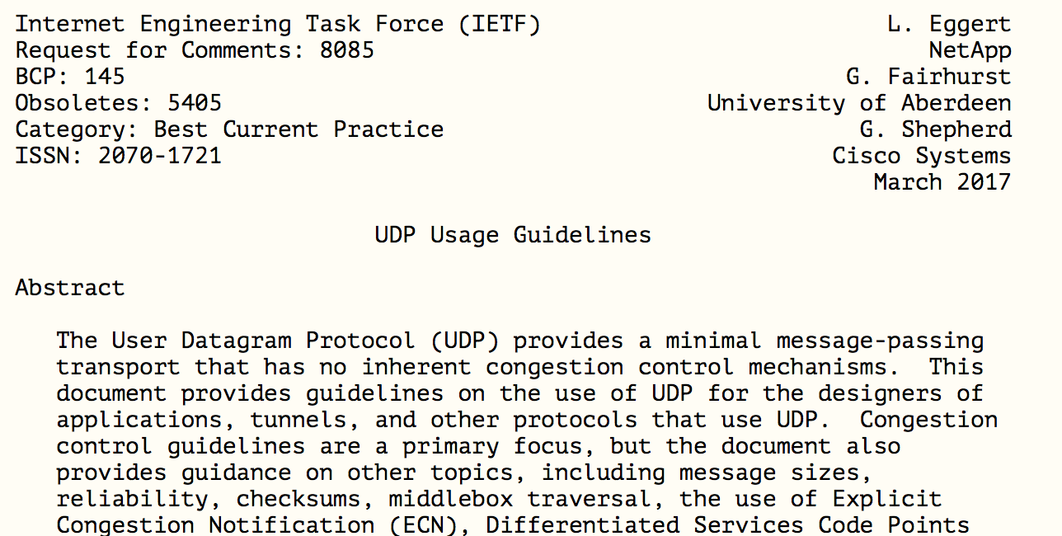
What do the RFC’s say?

Slide 45
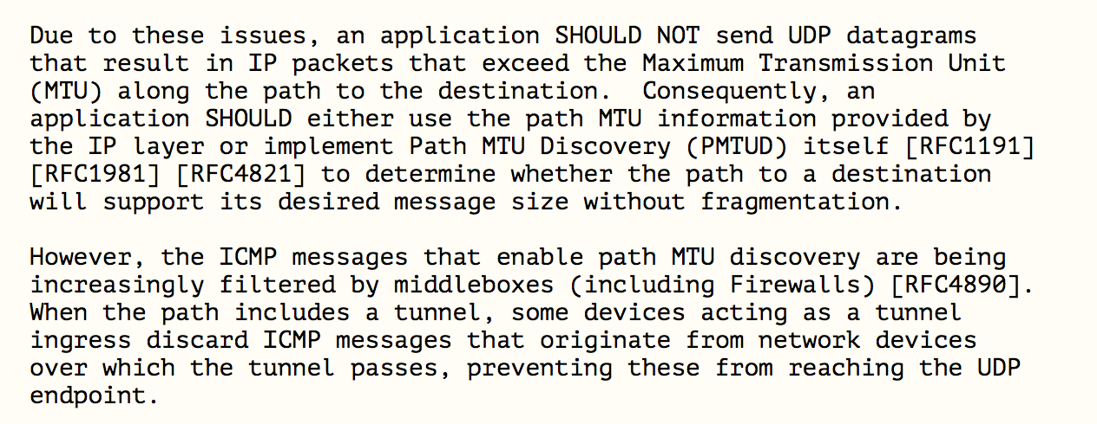
What do the RFC’s say?

Slide 46
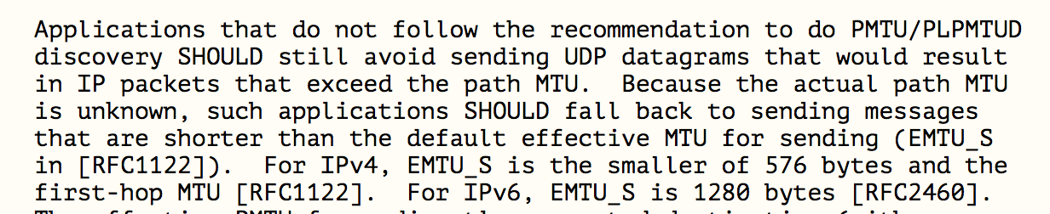
What do the RFC’s say?

Slide 47
What do the RFC’s say?
This BCP is saying that using EDNS(0) in the DNS to signal the capability of accepting large fragmented DNS responses was unwise, and if a host/application does know the path MTU, it should truncate at UDP at 1280 octets (and IPv4 should truncate at 512 octets!)

Slide 48
But would that be enough?
Is the root cause problem with the way our IPv6 networks handle Fragmented IPv6 packets?
Or with the way our IPv6 networks handle IPv6 packets with Extension Headers?
The data presented here suggests that EH drop could be the more significant issue here
Perhaps we might want to think about advice to host stacks and applications to avoid EH altogether!

Slide 49
Thanks!

