Slide 1
The Rise and Rise of Content
Distribution Networks
Geoff Huston
APNIC
WIE December 2017

Slide 2
Our Heritage
The Telephone Network:
  Connected handset to handset
  Intentionally transparent network
  Peer-to-peer service construct
  Network-centric architecture with minimal functionality in the edge devices

Slide 3
Computer Networks
The original concept for computer networks was like the telephone network:
  The network was there to enable connected computers to exchange data
  All connected computers were able to initiate or receive “calls”
  A connected computer could not call ”the network” – the network was an invisible common substrate
  It made no difference if the network had active or passive internal elements

Slide 4
Clients and Servers
The rise of the web-based content publishing model was accompanied by the creation of specialised server computers that published data, and specialised client-side devices who could only retrieve published data
The rise of NATs enforced this role segmentation in the network
  And, coincidentally removed any sense of urgency associated with the transition to IPv6

Slide 5
Content Server
Content Server

Slide 6
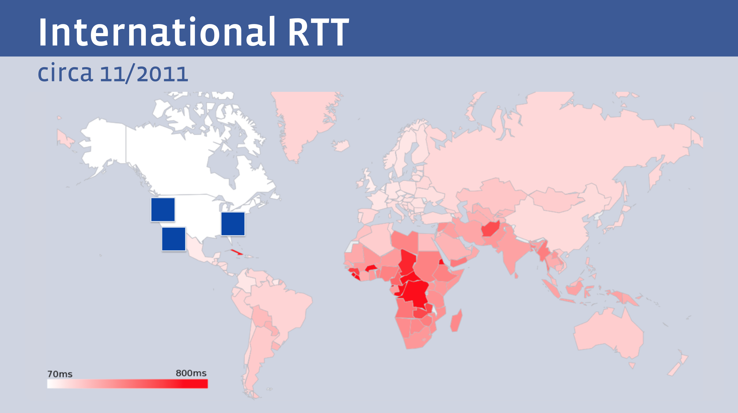
The Tyranny of Distance
  But not all clients enjoy the same experience from a single service portal
Facebook presentation at NANOG 68

Slide 7
Content Distribution
Content Distribution Network

Slide 8
Let them eat data!
The rise of the Content Distribution Network
  Replicate content caches close to large user populations
  The challenge of delivering many replicant service requests over high delay network paths is replaced by the task of updating a set of local caches by the content distribution system and then serving user service requests over the access network
  Reduced service latency, increased service resilience, happy customers!

Slide 9
Who’s building now?
Almost all new submarine international cable projects are heavily underwritten by content providers, not carriers
Large content providers have huge and often unpredictable traffic requirements, especially among their own data centers. Their capacity needs are at such a scale that it makes sense for them, on their biggest routes, to build rather than to buy. Owning subsea fibre pairs also gives them the flexibility to upgrade when they see fit, rather than being beholden to a third-party submarine cable operator.”
Tim Stronge of Telegeography, January 2017

Slide 10
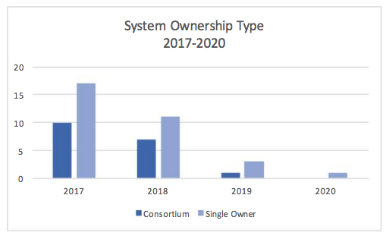
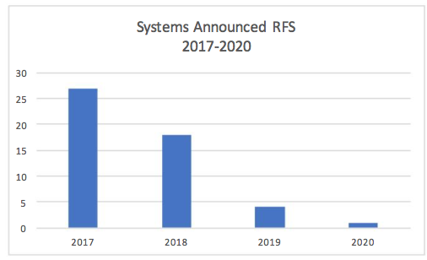
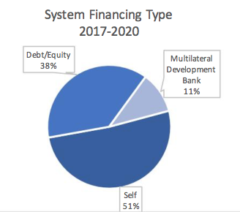
Submarine Cables
And those that are being built are now single owner cables
Fewer cables being built
And the majority are now self-funded
SubTel, Jan 2017

Slide 11
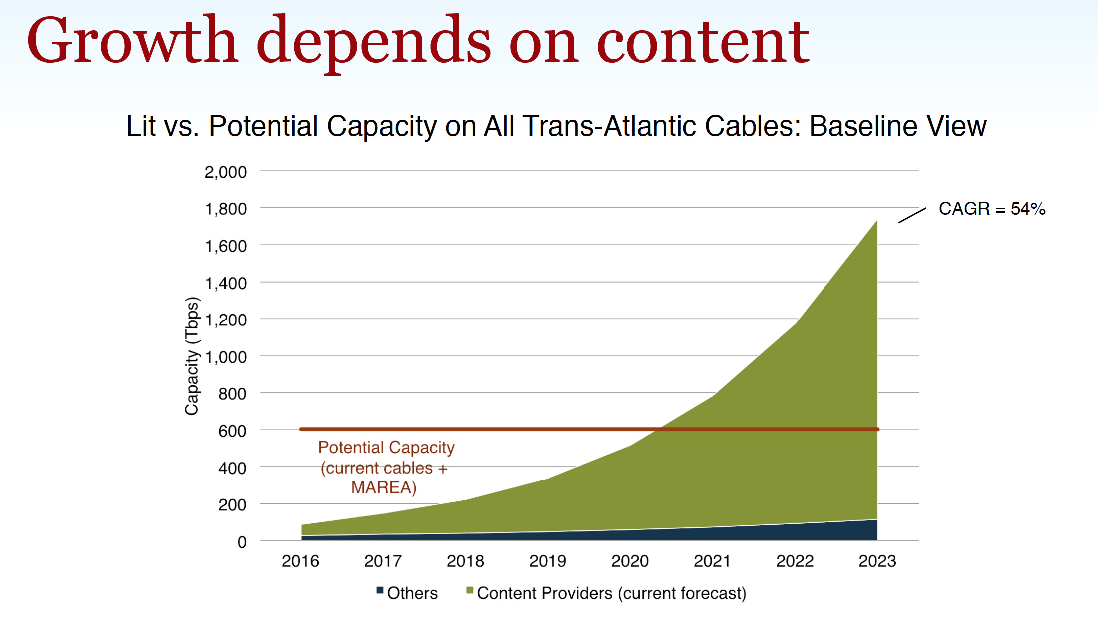
Submarine Cables
And those that are being built are now single owner cables
Fewer cables being built
And the majority are now self-funded
Tim Stronge, Telegeography, Sept 2017

Slide 12
Today’s Internet Architecture
We’ve split the network into clients and servers
  Web servers
  Streaming servers
  Mail servers
  DNS servers
Servers and services now sit in CDN bunkers with global replication and DDOS hardening
Users don’t reach out to content any more - the CDNs bring content to users

Slide 13
Today’s Internet Architecture

Slide 14
Role Reversal
Service portals are increasingly located adjacent to users
And that means changes to the network:
  Public Networks no longer carry users’ traffic to/from service portals via ISP carriage services
  Instead, Private Networks carry content to service portals via CDN services
This shift has some profound implications for the Internet

Slide 15
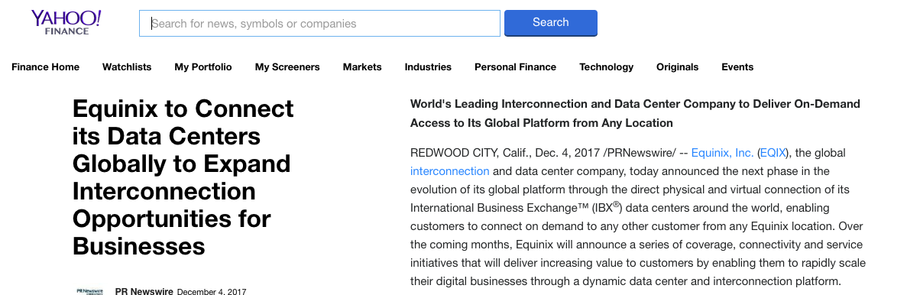
Does Transit have a Future?
We see the CDN systems reserve a carriage resource through dedicated bandwidth / wavelength / cable purchase and effectively bypass the open IP carriage infrastructure

Slide 16
Does Transit have a Future?
If users don’t send packets to users any more…
If content is now delivered via CDNs to users via discrete service cones…
If there is no universal service obligation for content…
If there is no visible definition of the “Internet Route Set” (‘default’) any more…
If there is no economically viable demand for transit any more…
Then why do we still need Transit Service providers?

Slide 17







The Large and the Largest
Company | $B USD
Apple | 791
Alphabet | 664,
Microsoft | 589
Amazon | 459
Berkshire Hathaway | 451
Alibaba Group | 436
Tencent | 405
Facebook | 399
Exxon Mobil | 348
Johnson & Johnson | 347
The world’s 10 largest publicly traded companies, as ranked by their market capitalization, September 2017

Slide 18
Content Really is King
None of these seven technology companies are a telephone company, or even a transit ISP, or even an ISP at all!
All of them have pushed aside carriage networks in order to maintain direct relationships with billions of consumers
These valuable consumer relationships are based on content services, not carriage

Slide 19
Content Consolidation
There are not thousands of content service platforms
  There are just a few left
And the space is dominated by a small number of dominant actors who set the rules of engagement for all others

Slide 20
Content Consolidation
“The size and scale of the attacks that can now easily be launched online make it such that if you don't have a network like Cloudflare in front of your content, and you upset anyone, you will be knocked offline.
…
In a not-so-distant future, if we're not there already, it may be that if you're going to put content on the Internet you'll need to use a company with a giant network like Cloudflare, Google, Microsoft, Facebook, Amazon, or Alibaba.
…
Without a clear framework as a guide for content regulation, a small number of companies will largely determine what can and cannot be online.
Matthew Prince
August 2017
https://blog.cloudflare.com/why-we-terminated-daily-stormer/

Slide 21

We’ve been here before…
High Museum of Art, Atlanta

Slide 22
The Gilded Age
A term applied to America in the 1870 – 1890’s about the building of industrial and commercial corporate giants on platforms that were a mix of industrial innovation and enterprise with elements of greed, corruption and labor exploitation
Andrew Carnegie - US Steel
John Rockfeller - Standard Oil
Theodore Vail - AT&T
George Westinghouse – Rail Brakes
Thomas Edison – General Electric
J P Morgan - Banking

Slide 23
The Gilded Age
During this period in the United States the dominant position within industry and commerce was occupied by a very small number of players who were moving far faster than the regulatory measures of the day.
The resulting monopolies took the US decades to dismember, and even today many of these gilded age companies remain dominant in their field

Slide 24
The Internet’s Gilded Age
At some point in the past decade or so the dominant position across the entire Internet has been occupied by a very small number of players who are moving far faster than the regulatory measures that were intended to curb the worst excesses of market dominance by a small clique of actors.

Slide 25
Who’s Gilding?
Company | $B USD
Apple | 791
Alphabet | 664,
Microsoft | 589
Amazon | 459
Berkshire Hathaway | 451
Alibaba Group | 436
Tencent | 405
Facebook | 399
ExxonMobil | 348
Johnson & Johnson | 347

Slide 26
The Internet’s Gilded Age
These actors have enough market influence to set their own rules of engagement with:
  Users,
  Each other,
  Third party suppliers,
  Regulators and Governments
By taking a leading position with these emergent technologies, these players are able to amass vast fortunes, with little in the way of accountability to a broader common public good

Slide 27

The Internet’s Future
Gittes: How much are you worth?
Cross: I've no idea. How much do you want?
Gittes: I just want to know what you're worth. Over
ten million?
Cross: Oh my, yes!
Gittes: Why are you doing it? How much better can you
eat? What can you buy that you can't already
afford?
Cross: The future, Mr. Gittes - the future!
Chinatown (1974)

Slide 28
Exactly where are we?
We started this journey building a telephone network for computers to communicate between each other
But now one-way content distribution lies at the core of today’s Internet
This content distribution role is an enterprise service framework rather than a public carriage service
The internal parts of the carriage network are now being privatized and removed from public regulatory scrutiny
What’s left is just the last mile

Slide 29
Last Mile Futures
Can independent last mile access networks survive as independent entities in this environment?
  Like the experience with transit markets will they fall victim to the pressure from the cashed up service provider sector and their CDNs?
  If access networks come to rely on imposing tolls on content providers, then at what point will the folk paying the these tolls assert proprietorial control over this last mile asset?
Is this something that markets will resolve, or will we see this as a more insidious form of market failure?

Slide 30
Fin!

