Slide 1
Measuring ATR
Joao Damas, Geoff Huston
@APNIC Labs
March 2018

Slide 2
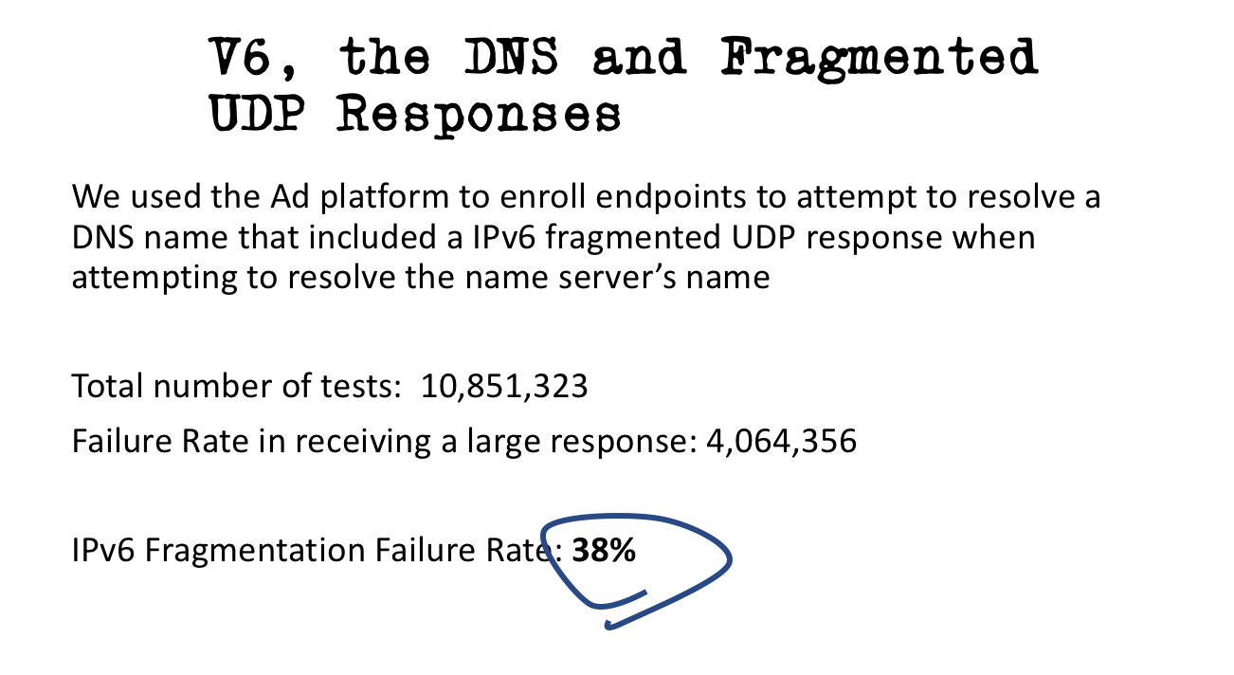
September 2017:

Slide 3
The Internet has a problem …
Instead of evolving to be more flexible and more capable, it appears that the Internet’s transport is becoming more ossified and more inflexible in certain aspects
One of the major issues here is the handling of large IP packets and IP level packet fragmentation
We are seeing a number of end-to-end paths on the network that no longer support the carriage of fragmented IP datagrams
We are concerned that this number might be getting larger, not smaller

Slide 4
The Internet has a problem …
What are we doing about it?
  Fixing this in deployed network infrastructure is extremely hard, so there are efforts underway to modify host and application behaviour to avoid the problem
  One avoidance approach has been to clamp the MSS of sessions to a conservative value that has a very high probability of non-fragmented transmission
    For example, QUIC uses a fixed 1350 octet MTU
    IPv6 sets a minimum unfragmented MTU of 1280 octets within the IPv6 specification
  As long as applications and protocol stacks keep all packets under some conservative MTU setting, then the possibility of encountering IP fragmentation and network/host/firewall/middleware fragmentation packet loss is substantially reduced

Slide 5
The Internet has a problem …
But what about the DNS?
  One application that is making increasing use of large UDP packets is the DNS
  This is generally associated with DNSSEC-signed responses (such as “dig +dnssec DNSKEY org”) but large DNS responses can be generated in other ways as well (such as “dig . ANY”)
  In the DNS we appear to be relying on the successful transmission of fragmented UDP packets, but at the same time we see an increasing problem with the coherence in network and host handling of fragmented IP packets, particularly in IPv6

Slide 6
Changing the DNS
One potential avoidance response is to shift all the DNS to TCP
  But this is a last resort response – TCP has much higher overheads in terms of transaction times and server scaling
  Our current intuition is that the Internet would prefer to continue to operate the DNS to run over UDP as much as possible

Slide 7
Changing the DNS
Or shift just all large DNS transactions to TCP
  This is a reversion to the original DNS specification (pre-EDNS(0) UDP buffer size signalling), where only small (smaller than 512 octets) responses are passed across UDP.
  Larger DNS responses (larger than 512 octets) are truncated and the truncation is intended to trigger the client to re-query using TCP
  Again this seems like a heavy-handed solution that is not always required - IP fragmentation works more often than not

Slide 8
Changing the DNS
Or we could try a hybrid approach of using both fragmented and truncated responses at the same time

Slide 9
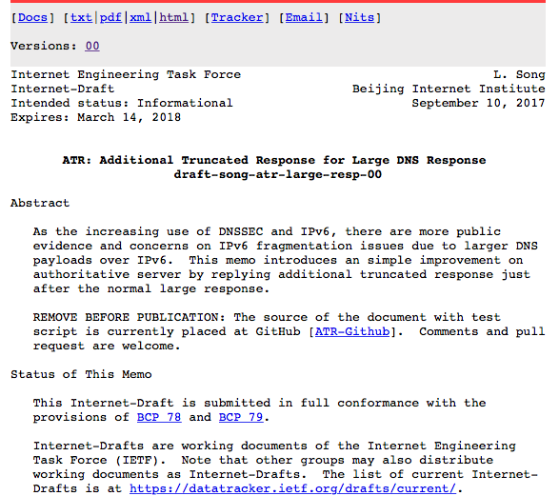
What is “ATR”?
It stands for “Additional Truncated Response”
  Internet draft: draft-song-atr-large-resp-00
    September 2017
    Linjian (Davey) Song, Beijing Internet Institute
It’s a hybrid response to noted problems in IPv4 and IPv6 over handling of large UDP packets and IP fragmentation
ATR adds an additional response packet to ‘trail’ a fragmented UDP response
The additional response is just the original query with the Truncated bit set, and the sender delays this additional response packet by 10ms

Slide 10
ATR Operation
UDP DNS Query
Client
Server

Slide 11
ATR Operation
UDP DNS Query
Client
Server
UDP DNS Response
(Fragmented)

Slide 12
ATR Operation
UDP DNS Query
Client
Server
UDP DNS Response
(Fragmented)
10ms
UDP DNS Response
(Truncated)

Slide 13
ATR Operation
UDP DNS Query
Client
Server
UDP DNS Response
(Fragmented)
10ms
UDP DNS Response
(Truncated)
TCP Query and Response

Slide 14
The Intention of ATR
When a UDP DNS response is fragmented by the server, then the server will also send a delayed truncated UDP DNS response
  The delay is proposed to be 10ms
If the DNS client receives and reassembles the fragmented UDP response the ensuing truncated response will be ignored
If the fragmented response is lost due to fragmentation loss, then the client will receive the short truncated response
The truncation setting is intended to trigger the client to re-query using TCP

Slide 15
The Intention of ATR
Today:
If the client cannot receive large truncated responses then it will need to timeout from the original query,
Then re-query using more resolvers,
Timeout on these queries
Then re-query using a 512 octet EDNS(0) UDP buffersize
Then get a truncated response
Then re-query using TCP

Slide 16
The Intention of ATR
ATR
If the client cannot receive large truncated responses then it will need to timeout from the original query,
Then re-query using more resolvers,
Timeout on these queries
Then requery using a 512 octet EDNS(0) UDP buffersize
Then get a truncated response
Then requery using TCP

Slide 17
What could possibly go wrong?
Network level packet re-ordering may cause the shorter truncated response packet to overtake the fragmented response, causing an inflated TCP load, and the potential for TCP loss to be triggered
Not every client DNS system supports using TCP to emit queries

Slide 18
ATR and Resolver Behaviour
ATR won’t help
ATR will help
ATR won’t be of use, but it
shouldn’t matter
Can’t Receive Fragmented UDP
Can’t Use TCP
How big are each of these pools?
What proportion of users are impacted?

Slide 19
Is ATR worth the effort?
Its unlikely that the resolution delay and resolution failure rate will be any larger using ATR than without it, and more likely that the both average resolution times and the overall DNS resolution failure rate will fall
But will the gains offset the additional costs in generating this additional response?

Slide 20
Experiment Details
Use 6 tests:
  2 tests use ATR responses – one is DNS over IPv4, the other is DNS over IPv6
  2 tests use only truncated responses – IPv4 and IPv6
  2 tests use large fragmented UDP responses - IPv4 and IPv6
Use the fetch of the web object as the measure of DNS resolution success/failure
Experiment counts:
  48M experiments undertook the DNS over IPv4 tests
  23M experiments undertook the DNS over IPv6 tests (47%)

Slide 21
A. Large Fragmented UDP response
DNS over UDP over IPv4 – 21% loss rate
DNS over UDP over IPv6 – 38% loss rate
The IPv4 loss rate is significant at 21% of all samples
  up to 4% could be attributed to experimental uncertainties on linkage of the DNS to web object retrieval
  which leaves 17% as a minimum loss rate in IPv4 for large responses
IPv6 shows a very significant level of loss
  which is comparable to that observed in September 2017
  the minimum loss rate is 34%, accounting for likely web object conversion loss rates

Slide 22
B. Truncated UDP Response and TCP
DNS over IPv4 – 5% TCP loss rate
DNS over IPv6 – 9% loss rate
We are looking here at the proportion of experiments that react to the truncated response with a TCP session. The “loss” referred to here is a loss relating to the lack of a followup TCP session, and does NOT include any web retrieval loss factors
The IPv6 TCP failure rate slightly less than double the IPv4 failure rate

Slide 23
C. ATR
IPv4 DNS:
  72% successfully retrieved the object without using TCP
    38% did not
    This is higher than the large packet drop rate probably due to packet reordering factors)
  16% used TCP
  12% did not use TCP and did not retrieve the web object
IPv6 DNS:
  54% successfully retrieved the object without using TCP
    46% did not
    This is again higher than the large packet drop rate probably due to packet reordering factors)
  28% used TCP
  18% did not use TCP and did not retrieve the web object

Slide 24
Large DNS responses
There is a major issue with large fragmented UDP responses in the DNS, and IPv6 is certainly far more of a problem in this respect than IPv4 - ATR would normally be expected to address this
  The issue would appear to be zealous firewalls in IPv4 and a combination of firewalls and IPv6 extension header packet drop in IPv6
However, there is also a significant TCP drop rate for the DNS
  Here we can probably ascribe this to zealous firewalls, but there may also be UDP-only DNS clients out there as well
Which means that large responses have a drop rate in the DNS, both in UDP and TCP, that cannot be ignored

Slide 25
ATR and Large DNS Responses
IPv4 Failure Rate
WITHOUT ATR: 22%
WITH ATR: 12%
IPv6 Failure Rate
WITHOUT ATR: 38%
WITH ATR: 18%
This is a measurement of the user level impact, not a count of resolvers

Slide 26
ATR Assessment
Is this level of benefit worth the additional server and traffic load when sending large responses?
Is this load smaller than resolver hunting in response to packet drop?
It the faster fallback to TCP for large responses a significant benefit?
Is 10ms ATR delay too short? Would a longer gap reduce response reordering?
Do we have any better ideas about how to cope with large responses in the DNS?

