Slide 1
Who am I talking to?

Slide 2
Who am I talking to?
What’s the Problem?

Slide 3
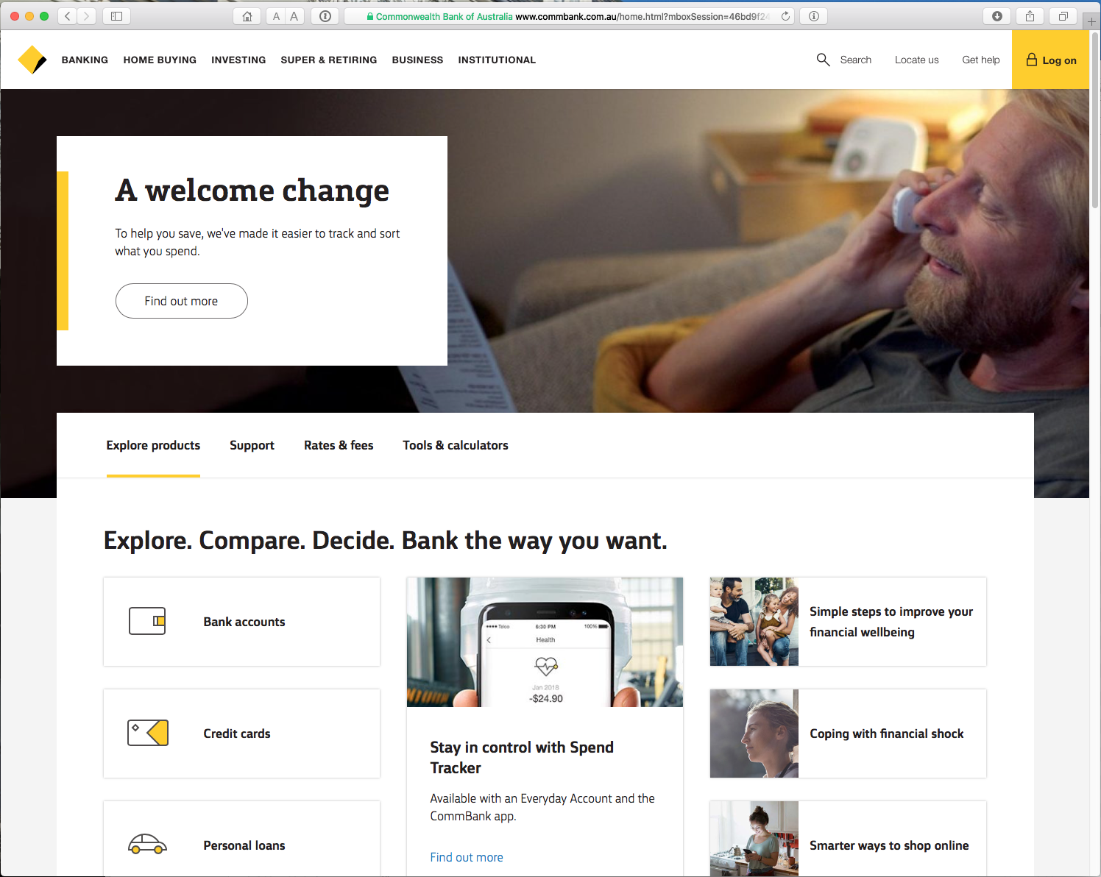
Which Bank? My Bank!
It looks like my bank
But is it my bank?

Slide 4
The Question:
How do you know that you are really going to where you thought you were going to?
It looks like my bank
But is it my bank?

Slide 5

A Clue!

Slide 6
A Clue!
If “green” is all users can rely on, then it’s a pretty unsatisfactory security model!

Slide 7

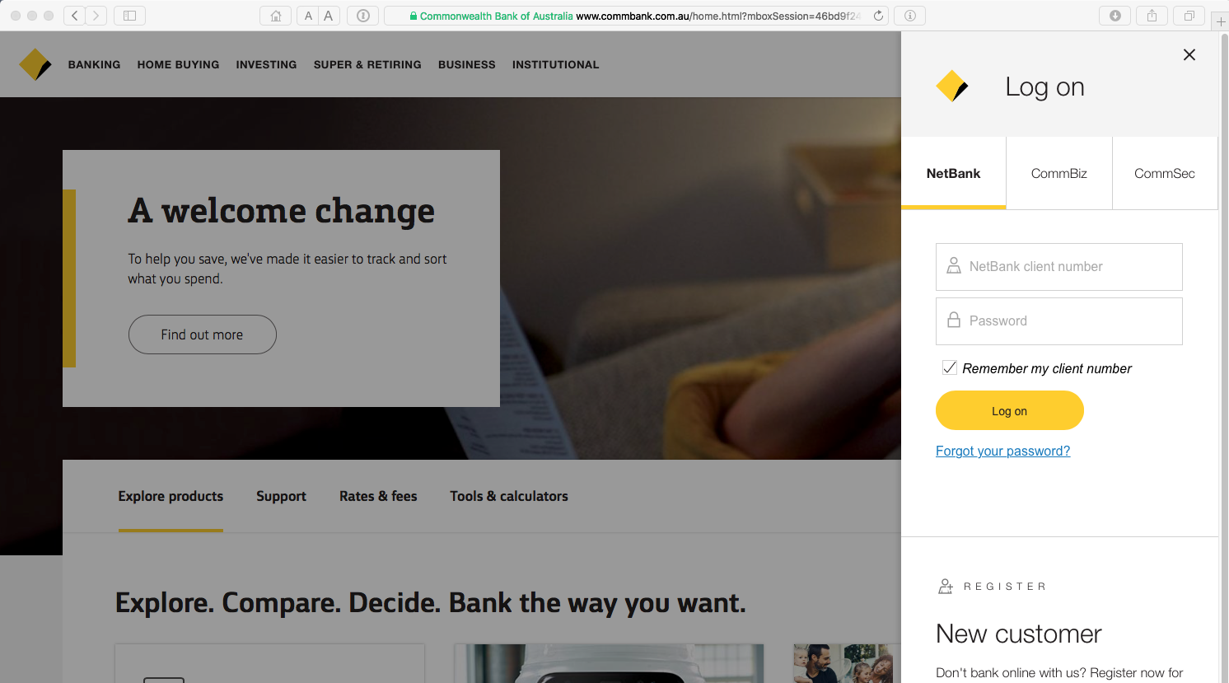
Leakage
Also, how can you keep your session a secret from wire(less) snoopers?

Slide 8
Why is this important?
Because it may not be your bank that you are providing your credentials to
The connection may not be as secure as you might like it to be

Slide 9
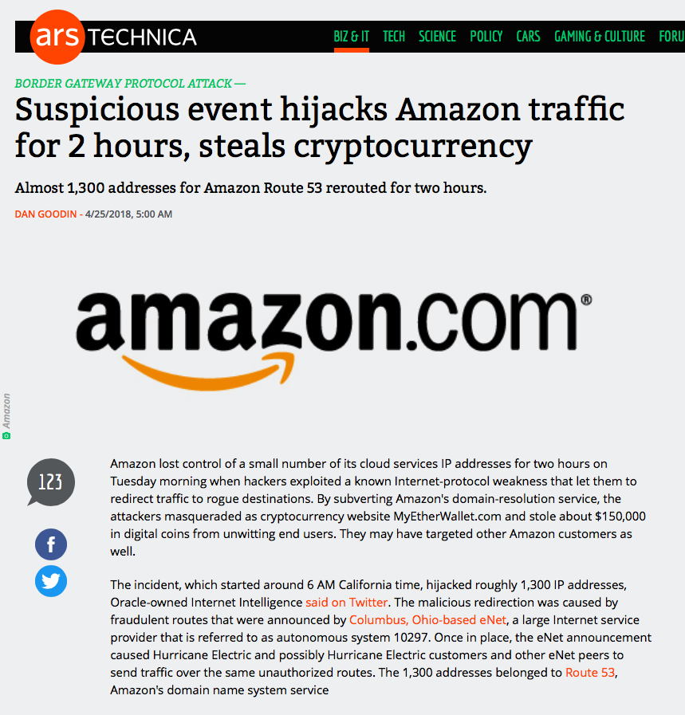
Because sometimes…
Just 2 hours was enough!
And numerous other incidents

Slide 10


Opening the Connection: First Steps
Client:
DNS Query:
www.commbank.com.au?
DNS Response:
23.77.138.30
TCP Session:
TCP Connect 23.77.138.30, port 443
Here’s what happens when I connect to my bank
The first step is a DNS transaction to get an IP address
Then a TCP session is started

Slide 11
Hang on…
$ dig -x 23.77.138.30 +short
a23-77-138-30.deploy.static.akamaitechnologies.com.
That’s not an IP addresses that was allocated to the Commonwealth Bank!
  The Commonwealth Bank of Australia has been assigned the address blocks:
  140.168.0.0 - 140.168.255.255 and
  203.17.185.0 - 203.17.185.255

Slide 12
Hang on…
$ dig -x 23.77.138.30 +short
a23-77-138-30.deploy.static.akamaitechnologies.com.
That’s an Akamai address block
And I am NOT a customer of the Internet Bank of Akamai!
Why should my browser trust that 23.77.138.30 is really the “proper” web site for the Commonwealth Bank of Australia, and not some dastardly evil scam designed to steal my passwords and my money?

Slide 13
A tricker question…
How can my browser tell the difference between an intended truth and a lie?

Slide 14
Secure Connections using TLS 1.2
https://rhsecurity.wordpress.com/tag/tls/

Slide 15
Secure Connections using TLS 1.2
https://rhsecurity.wordpress.com/tag/tls/

Slide 16
Secure Connections using TLS 1.2
How does the browser client
“recognise” this certificate
as the “right” certificate?

Slide 17
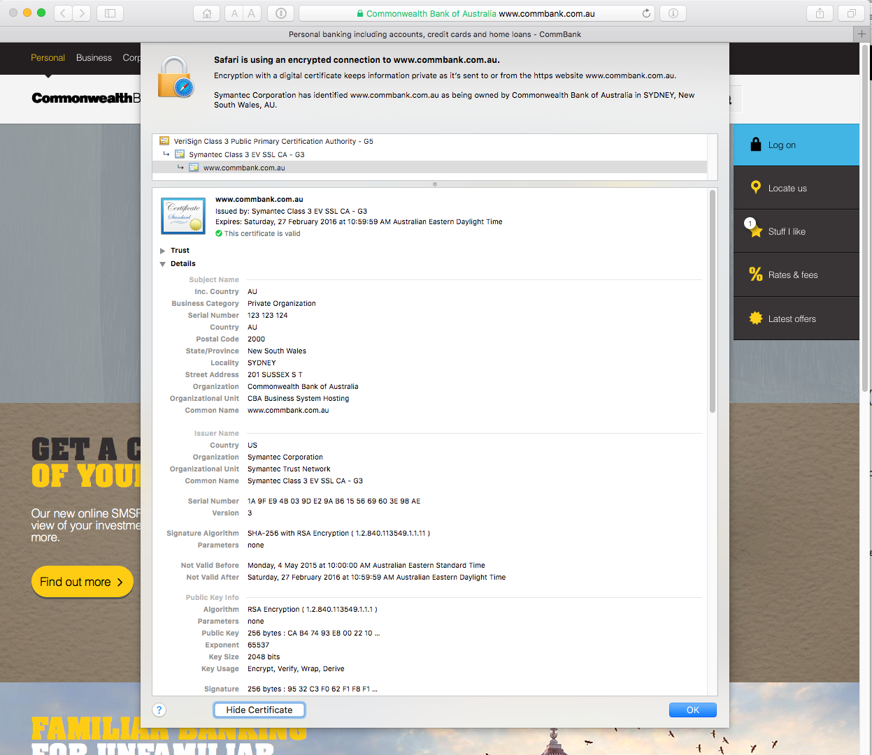

Slide 18
How did my browser know that this is a valid cert?

Slide 19
Domain Name Certification
The Commonwealth Bank of Australia has generated a key pair
And they passed a certificate signing request to a company called “Symantec”
Who was willing to vouch (in a certificate) that the entity who goes by the domain name of www.commbank.com.au also has a certain public key value
So if I can associate this public key with a connection then I have a high degree of confidence that I’ve connected to an entity that is able to demonstrate knowledge of the private key for www.commbank.com.au, as long as I am prepared to trust Symantec and the certificates that they issue
Symantec NEVER lie!

Slide 20
Domain Name Certification
The Commonwealth Bank of Australia has generated a key pair
And they passed a certificate signing request to a company called “Symantec”
Who was willing to vouch (in a certificate) that the entity who goes by the domain name of www.commbank.com.au also has a certain public key value
So if I can associate this public key with a connection then I have a high degree of confidence that I’ve connected to an entity that is able to demonstrate knowledge of the private key for www.commbank.com.au, as long as I am prepared to trust Symantec and the certificates that they issue
Symantec NEVER lie!
Why should I trust them?

Slide 21
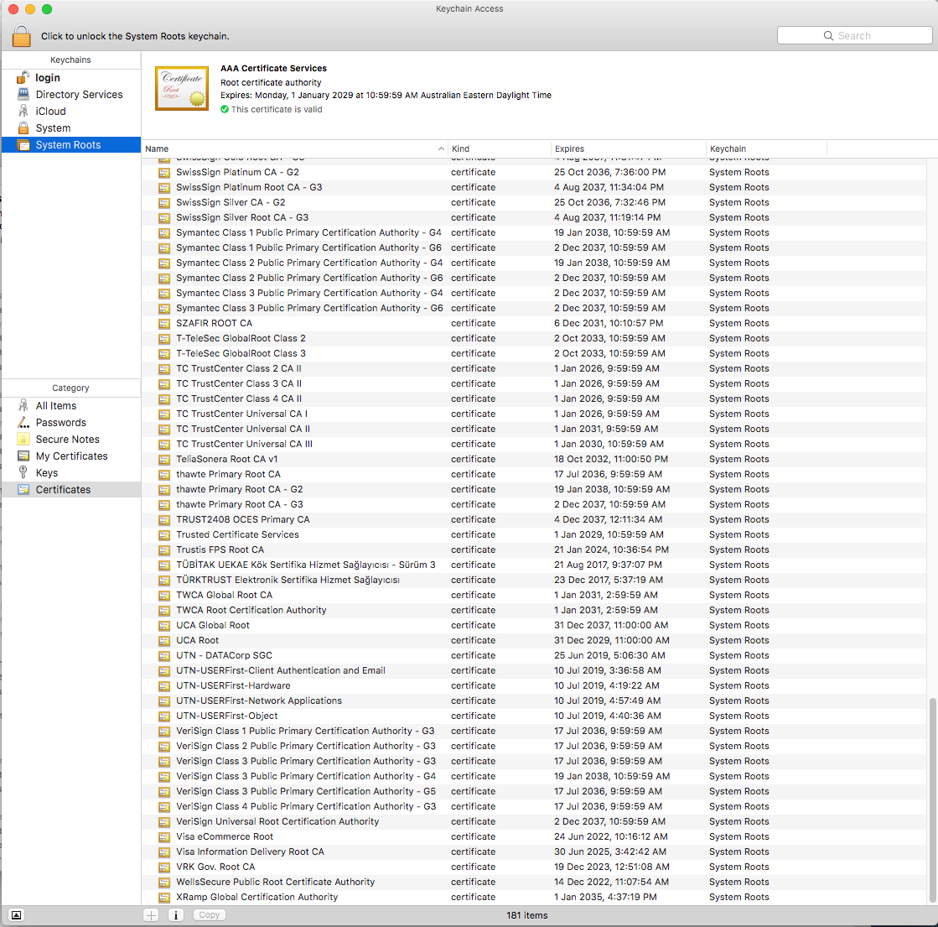
Local Trust
The cert I’m being asked to trust was issued by a certification authority that my browser already trusts – so I trust that cert!

Slide 22
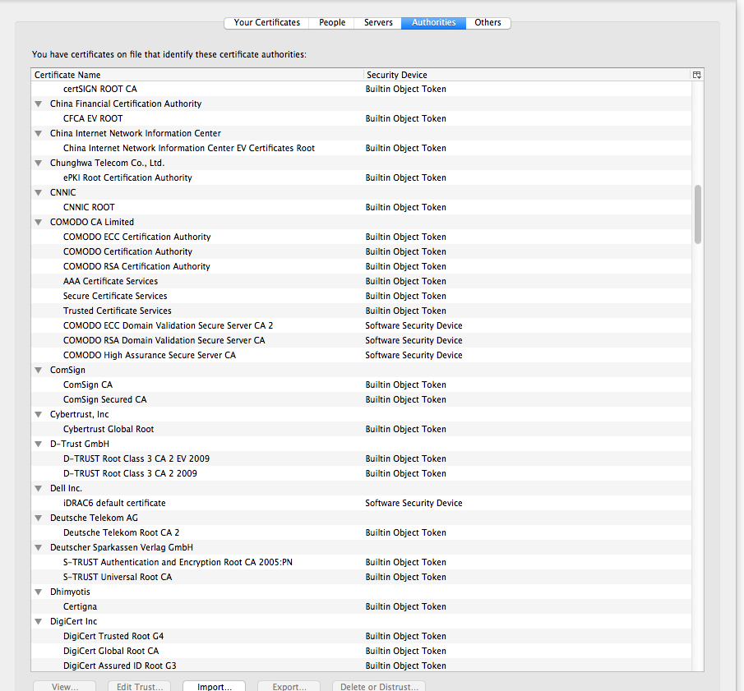
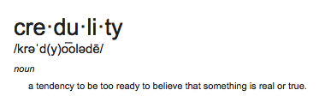
Local Trust or Local Credulity*?
That’s a big list of people to
Trust
Are they all trustable?
*

Slide 23
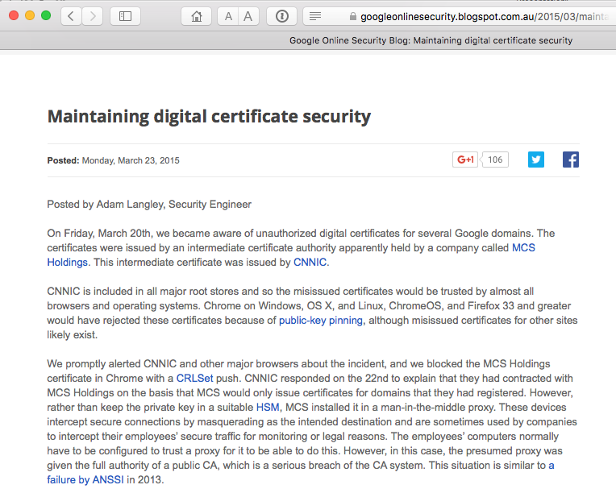
Local Trust or Local Credulity*?
That’s a big list of people to
Trust
Are they all trustable?
Evidently Not!
*

Slide 24
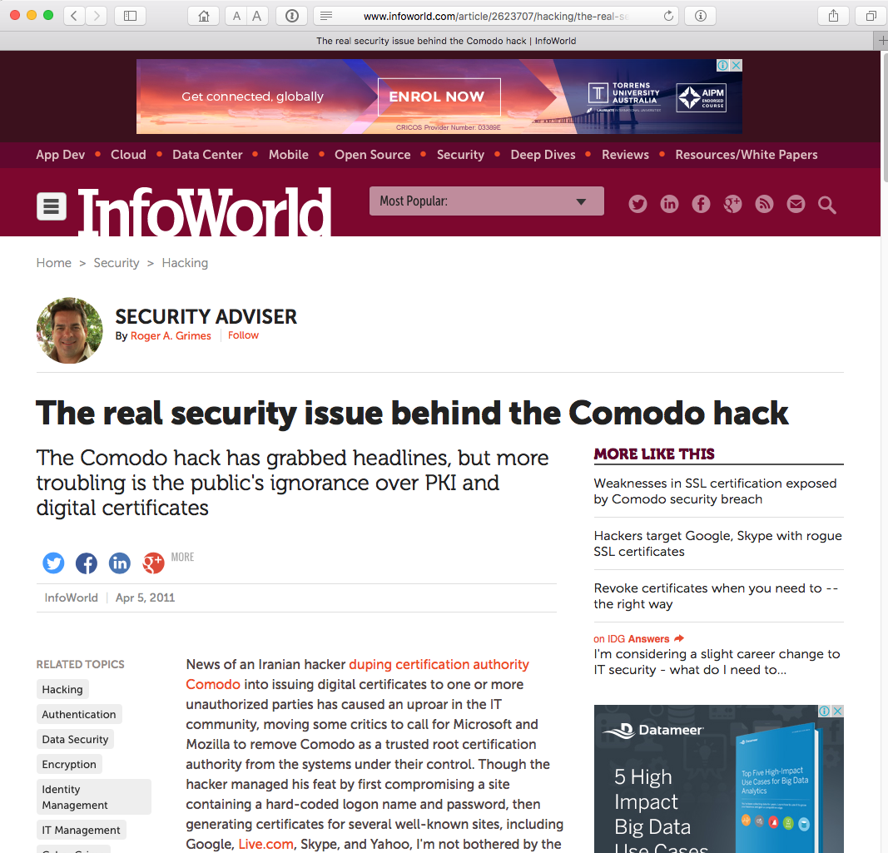
Local Trust or Local Credulity*?
That’s a big list of people to
Trust
Are they all trustable?
Evidently Not!
*

Slide 25
But my bank used Symantec
And Symantec NEVER lies in the certificates they issue

Slide 26
Never?

Slide 27
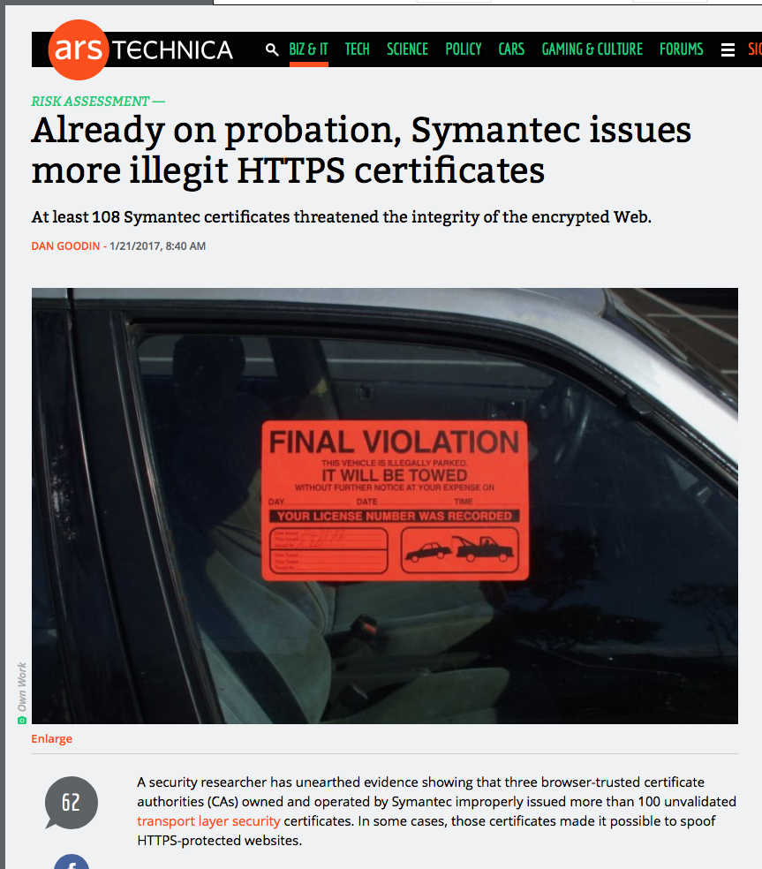
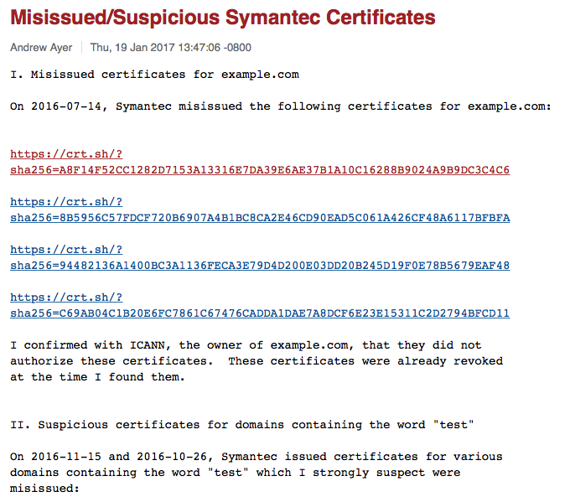
Well, hardly ever
http://arstechnica.com/security/2017/01/already-on-probation-symantec-issues-more-illegit-https-certificates/

Slide 28
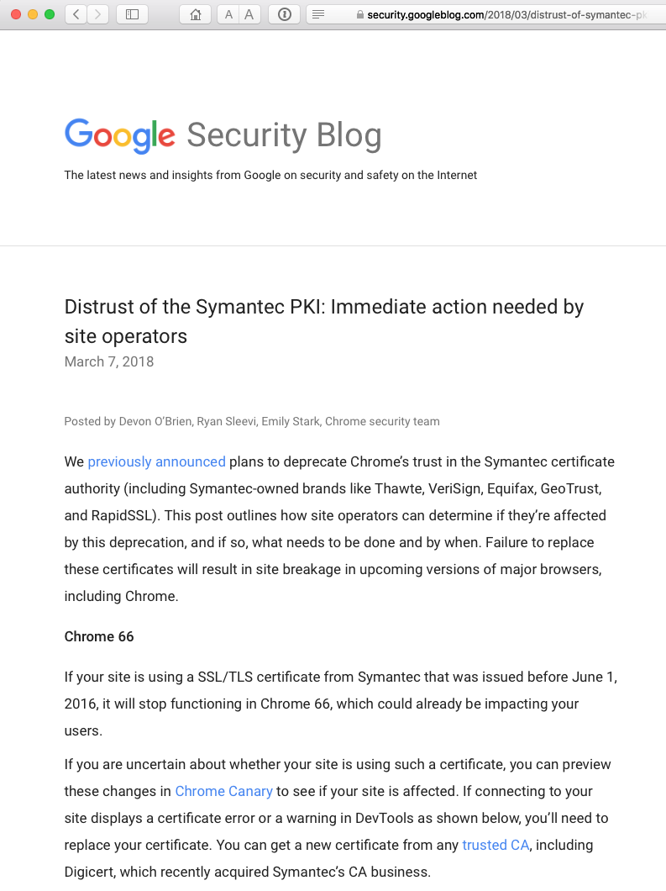
Well, hardly ever
http://arstechnica.com/security/2017/01/already-on-probation-symantec-issues-more-illegit-https-certificates/

Slide 29
What’s going wrong here?
The TLS handshake cannot specify which CA should be used by the client to validate the digital certificate that describes the server’s public key
The result is that your browser will allow any CA to be used to validate a certificate!
Which is an exploited weakness in the CA model

Slide 30
What’s going wrong here?
There is no incentive for quality in the CA marketplace
Why pay more for any certificate when the entire CA structure is only as strong as the weakest CA?
And you browser trusts a LOT of CAs!
  About 60 – 100 CA’s
  About 1,500 Subordinate RA’s
  Operated by 650 different organisations

Slide 31

In a market for security
Where CA’s compete with each other for market share
And quality offers no protection
Than what ‘wins’ in the market?
Sustainable
Cheap!
Resilient
Secure
Privacy
Trusted

Slide 32
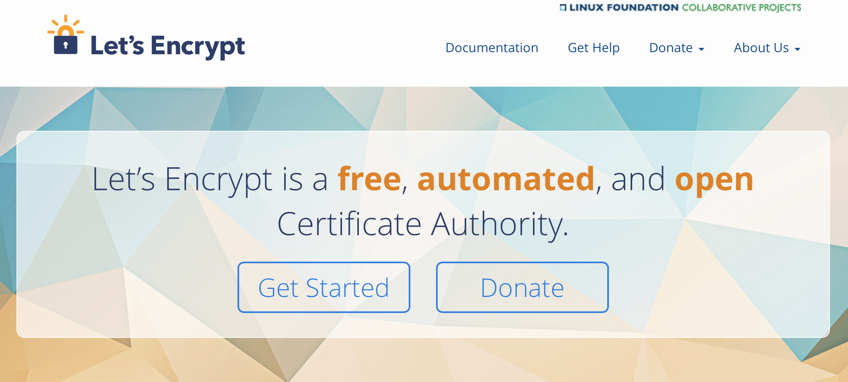
In a market for security
Where CA’s compete with each other for market share
And quality offers no protection
Than what ‘wins’ in the market?
Sustainable
Cheap!
Resilient
Secure
Privacy
Trusted

Slide 33
Who am I talking to?
What can we do about it?

Slide 34
What can we do about it?
The problem with “who am I talking to?” lies in the situation of widely distributed trust in the WebPKI CA environment
How can we improve this situation?

Slide 35
Is this your Certificate?
How can a user be assured that the certificate that they are being presented with, signed and published by a CA that their browser / platform is prepared to trust, is the genuine certificate?

Slide 36
Certificate Transparency
Certificate Transparency is the current response from the CAB Forum
CT is an effort to make the problem everyone’s problem by requiring all trusted CAs to publish immutable logs of all the certificates they issue
  analogous to blockchain for each CA, but with a centralised authority model

Slide 37
Certificate Transparency
Make the problem everyone’s problem by requiring all trusted CAs to publish all the certificates they issue
Leave it to the service publisher to figure out if a fake cert has been issued and logged in the CT logs
  But what then?
  How does the user figure out whether the service point they are accessing has been attacked with a fake cert?

Slide 38
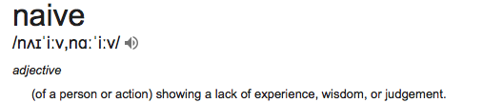
Certificate Transparency is Naïve!
CT attempts to set a universal threshold that all CAs must pass in order to be trusted by a browser
But won’t really protect my browsing
  Inspection of CT logs by third parties is not fast, thorough, timely nor effective
  And revocation of certs requires browsers to perform revocation checks every time (which they don’t)
  Brief (and even long-held) windows of opportunity for exploits still exist

Slide 39
Pinning: Narrowing the Trust Space
CA / Public Key Pinning
  Communicate to the client which CA / which certificate / which public key to trust for a given service name
  Exactly how to undertake this communication in a way that is tamperproof is the challenge

Slide 40
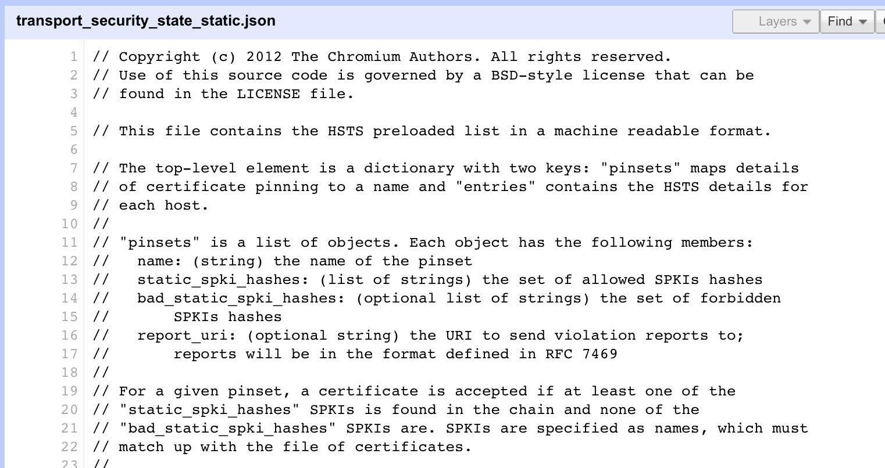
Coded Browser Pinning
https://code.google.com/p/chromium/codesearch#chromium/src/net/http/transport_security_state_static.json

Slide 41
Coded Browser Pinning
https://code.google.com/p/chromium/codesearch#chromium/src/net/http/transport_security_state_static.json

Slide 42
Coded Browser Pinning
https://code.google.com/p/chromium/codesearch#chromium/src/net/http/transport_security_state_static.json
It’s not a totally insane idea -- until you realise that it appears to be completely unscaleable!
It’s just Google protecting itself and no one else

Slide 43
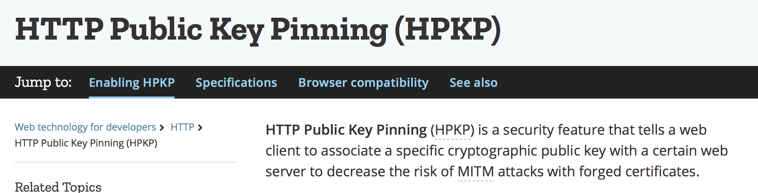
Content Pinning
HPKP

Slide 44
Content Pinning with HPKP
The issues here include
  CA migration can become really convoluted
  There appears to be a Trust on First Use issue
  A MITM attack could withhold the HPKP record, or even substitute its own
Is the effort worth it? Low deployment numbers suggest otherwise!
The Google Chrome team recently deprecated support for HPKP in Chrome because of its perceived complexity and potential side-effects.

Slide 45
DNS Pinning
Where better to find out the public key associated with a DNS-named service than to look it up in the DNS?
If you are prepared to believe the DNS to give you an IP address for the service, then why wouldn’t you also trust the DNS to give you the right pinning record?
(As long as you are using DNSSEC, of course!)

Slide 46
CAA Pinning
Use a DNS record to specify which CA(s) may issue a WebPKI certificate for a domain
Specified in RFC 6844
It’s not clear how CAA protects a user
  If a user can subvert a CA then its likely that they would also be able to subvert the CA’s CAA check
  Unless the user is also prepared to retrieve and check the CAA record then this appears to largely a palliative measure
  But if the user checks the CAA record, then why not just use DANE?

Slide 47
DANE Pinning
Use a DNS server record to:
  specify which CA(s) may issue a WebPKI certificate for connections to a service
or
  specify which EE public key certificate should be presented to the user when connecting to a service
or
  specify which public key will be used when connecting to a service

Slide 48
DANE Pinning
Use a DNS server record to:
  specify which CA(s) may issue a WebPKI certificate for connections to a service
or
  specify which EE public key certificate should be presented to the user when connecting to a service
or
  specify which public key will be used when connecting to a service
Note that CAA is used to pin domains in the DNS while DANE is used to pin service records in the DNS

Slide 49
TLS with DANE
Client receives server cert in Server Hello
  Client lookups the DNS for the TLSA Resource Record of the domain name
  Client validates the presented certificate against the TLSA RR
Client performs Client Key exchange

Slide 50
TLS Connections
DNS
TLSA query
Public Key
Cert

Slide 51
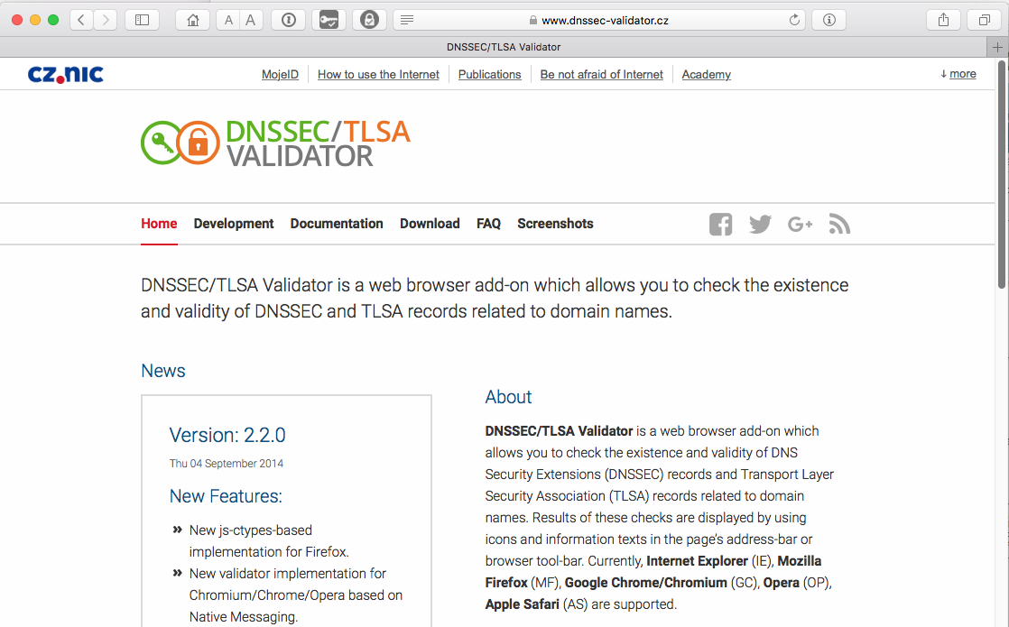
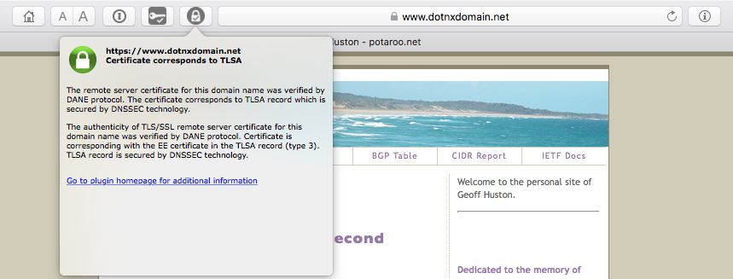
DANE Does DNS via a Browser Extension

Slide 52
But…
DNSSEC as we know it today is just not good enough
DNSSEC validation should not be outsourced to the recursive resolver - setting the AD bit in a DNS response is not good enough
A client needs to directly validate the DNSSEC-signed DANE response
  This requires more DNS queries
  And this takes (too much) time
  And we get pushback from browser vendoras

Slide 53
Faster DNSSEC Validation?
RFC 7901 - CHAIN Query Requests in DNS
  Allows a client to make an “omnibus” DNS query to a recursive resolver to retrieve the set of DNSSEC RRs between the QNAME and a trust point in a single DNS transaction

Slide 54
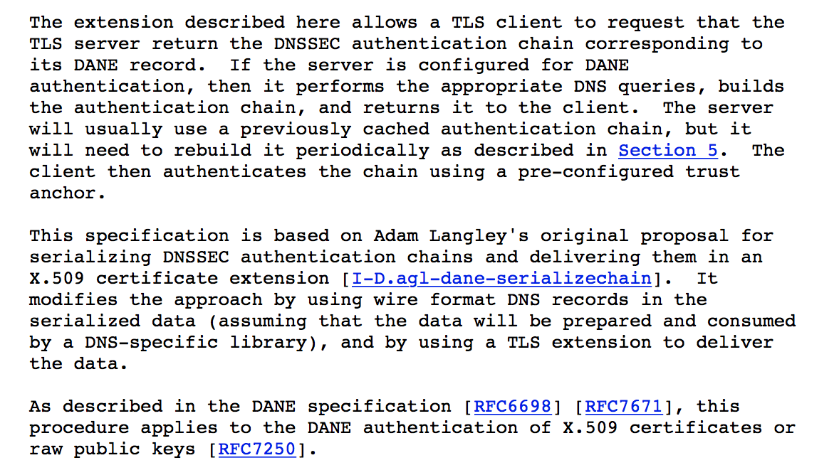
DANE as a TLS Extension?
draft-ietf-tls-dnssec-chain-extension-07

Slide 55
TLS + DANE Chain Connections
Local copy of DNS root zone KSK
Public Key
Cert
DNSSEC validation
+TLSA+DNSSEC Chain
DANE CERT Pinning record

Slide 56
What now?
It appears that we still need WebPKI certs for the moment, but we need to make them more robust in the face of continued attack
DANE+DNSSEC could useful in adding assurance to the WebPKI in a role of WebPKI CA pinning
So far we have not figured out how to reliably catch instances of withholding a DNS TLS extension without paying a DNS query time delay penalty
  Which implies that DANE TLS extension probably represents one more thing to go wrong without a compelling case that can be made about what it actually manages to do to protect the user
  Or we can work out a way to catch withholding efficiently

Slide 57
Conclusions
Corrupting a trusted CA is a nightmare scenario for the WebPKI
DANE appears to offer a natural and compelling alternative to the WebPKI by offering a dynamic system that provides authenticated data to the user that does not rely on expansive trust
But there are some issues that exist in the DNS, DNSSEC and DANE
  Registry practices to ensure that there are very robust defences against domain name hijacking are lacking today and will be lacking tomorrow
  Centralising trust in a single model creates a single point of vulnerability for the entire system
  The KSK model is fragile
  Overloading the DNS with large payloads stresses the UDP-based system beyond their viability, but the case to justify shift to DNS over <X> architectures has a limited value proposition outside of DNSSEC/DANE-based use cases

Slide 58
Thanks

