Slide 1
Why don’t we have a Secure and Trusted Inter-Domain Routing System?
Geoff Huston, APNIC

Slide 2
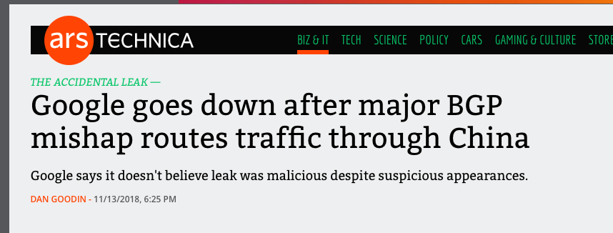
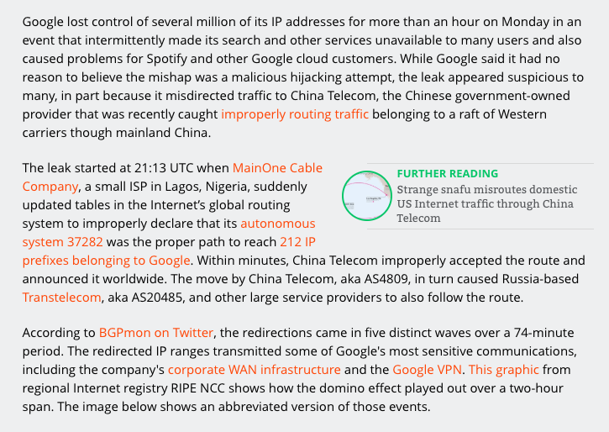
Why do we keep seeing these headlines?

Slide 3
1. The Meta Goal
Can we devise changes to operational practices, or operational tools or routing technologies that manage the inter-domain routing system that could prevent the propagation of false or artificial routing information in the Internet?

Slide 4
This is a Very Challenging Goal
It’s a problem as old as the concept of a distributed inter-domain routing system
Each actor applies local policy constraints on local topology knowledge to guide its local route object propagation decisions
No single actor has sufficient “whole of system” data to determine the difference between what it should’ve learned and what it has learned

Slide 5
The ideal
We want the interdomain routing system to advertise the correct reachability information for “legitimately connected” prefixes at all times
That means that we want to avoid:
  promulgating reachability for bogus address prefixes
  promulgating incorrect paths for reachable prefixes
  blocking paths for legitimately connected prefixes

Slide 6
The problem
While we’d like to think we understand the provenance for each and every IP address, that is not exactly the case
And even if we did, we have no precise knowledge as to which network has the authority to originate a route object for that address
And even then we have no exact knowledge of the inter-domain topology of the network
And even then we have no clear knowledge of the local policy constraints that are applied to the propagation of reachability and topology information

Slide 7
The problem
All of which means that we have no clear model of “truth” to compare to the information flow in the routing system

Slide 8
1. A Weaker Goal
Can we devise changes to operational practices, or operational tools or routing technologies that manage the inter-domain routing system that could resist attempts to inject false or artificial routing information in the Internet?

Slide 9
2. What Data would we like?
An (impossible) ideal data set is the “reference set” that describes a ‘correct’ route object set that should be visible at any vantage point in the network
  And access to a set of credentials that support any such attestation of “correctness”
As a compromise we could settle for a reference set that describes a ‘stable’ route object set that should be visible at any vantage point in the network

Slide 10
What we want and don’t want
BGP anomaly detectors and observatories are all well and good, but they have not proved to be all that useful to the operations community
  They are a bit like smoke alarms – they can’t prevent the root cause, but simply alarm after it happens
What we would like is some form of route acceptance model that can be used as an acceptance filter

Slide 11
Some 10 years ago…
We observed that we needed to improve “truth” in addressing and routing
  We designed a PKI to allow digitally signed attestations about addresses and AS numbers for use in routing
  We published tools to allow network operators to use this PKI
  We supported security extensions to BGP to make use of these signed attestations - BGPSEC

Slide 12
Is BGPSEC the Answer?
Yes and No
  Yes, it can reject anomalous BGP updates upon receipt of the update
  But:
    it relies of the correct operation of the protocol, not the correct implementation of policy
    It is very expensive to run
    It relies on comprehensive adoption, and partial adoption is a worst case scenario for this protocol

Slide 13
What’s going wrong?
BGP hijacking is not perceived as something we should work hard to prevent
  BGP hijacking is not an end in itself, but a part of a larger attack
    E.g. April ‘18 MyEtherWallet raid was an attack involving a domain name registrar, the DNS, a susceptible certificate authority and a BGP route injection to work
The economics of this situation work against it
  Apparently there are inadequate commercial drivers to undertake extensive informed route monitoring that would enable hijack suppression at source
  Probably because integrity of common infrastructure is everyone’s problem which in turn quickly becomes nobody’s problem

Slide 14
How should we look at routing insecurity?
Is this a failure of technology?
  If we had a better routing widget then we would no longer have a problem
Is this an instance of failure in the market?
  Providers see no marginal competitive advantage in deploying these tools
Is this a regulatory failure?
  If we have to turn to some form of imposition on network providers to secure the routing system then how will we do this?
    (The current national and regional regulatory examples in content control and encryption are woeful examples! Why would comparable efforts in routing security fare any better?)

Slide 15
What should we do?
“Let’s do nothing” is an unsatisfactory response
But anything other than “nothing” seems to head towards pointlessly ineffectual!

