Slide 1
IPv6 Performance Measurement
March 2019
Geoff Huston
APNIC

Slide 2
The Measurement
The endpoint retrieves two URLs from the same remote server – one using IPv4 and the other using IPv6
  Unique DNS names and TLS are used to ensure that caching does not play a role in the measurement
We perform full packet capture at the server
Data analysis
  We look at the SYN/ACK exchange at the start of the TLS session
  The time between receipt of the SYN and the subsequent ACK at the server is no less than one RTT between the server and the endpoint (and is a reasonable first order substitute for an RTT)
  A received SYN with no subsequent ACK is interpreted as a failed connection attempt

Slide 3
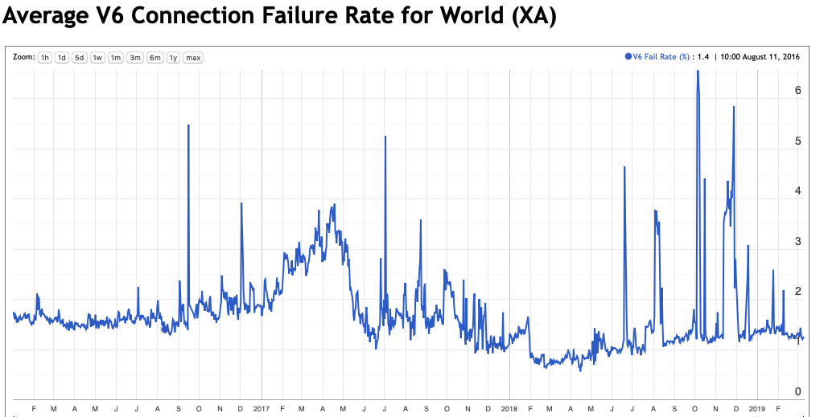
IPv6 TCP Connection Failure

Slide 4
IPv6 TCP Connection Failure
The global failure rate of some 1.2% is better than earlier data (4% failure in early 2017), but its still bad
What we are seeing is most likely a failure to deliver an IPv6 packet from the server to the endpoint
Possible reasons:
  Endpoint using an unreachable IPv6 address
  End site firewalls
  ??

Slide 5
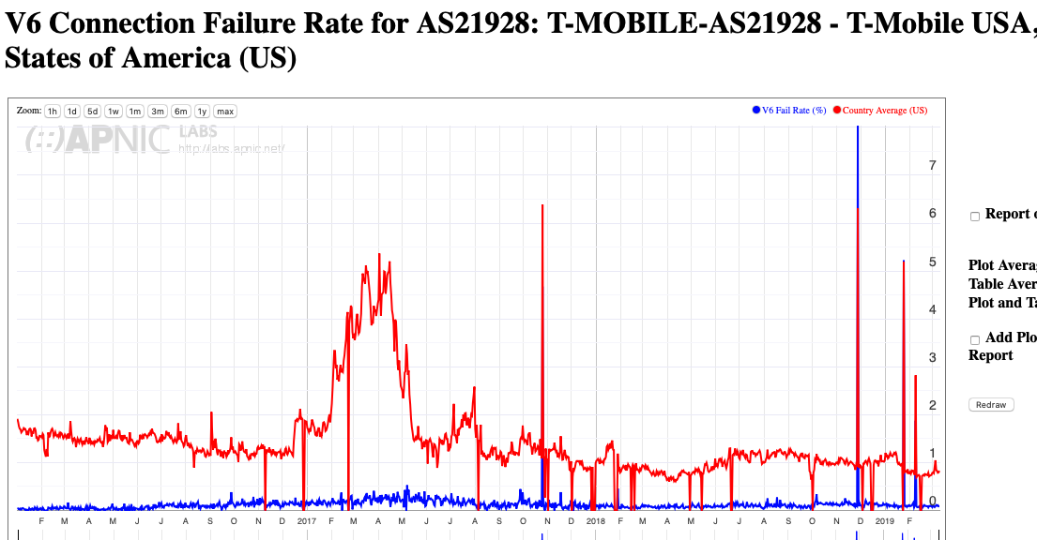
The Good
This 464XLAT mobile network
(T-Mobile) has remarkably small failure rates – the endpoints are connected via native IPv6 and as this is a mobile network there is only a small amount of customer-operated filtering middleware

Slide 6
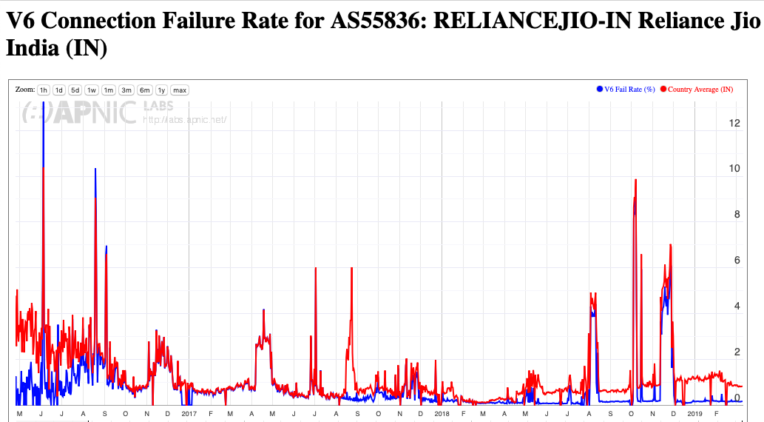
The Good
Similar story in India with Reliance JIO – the endpoints are connected via native IPv6 and as this is a mobile network there is only a small amount of customer-operated filtering middleware

Slide 7
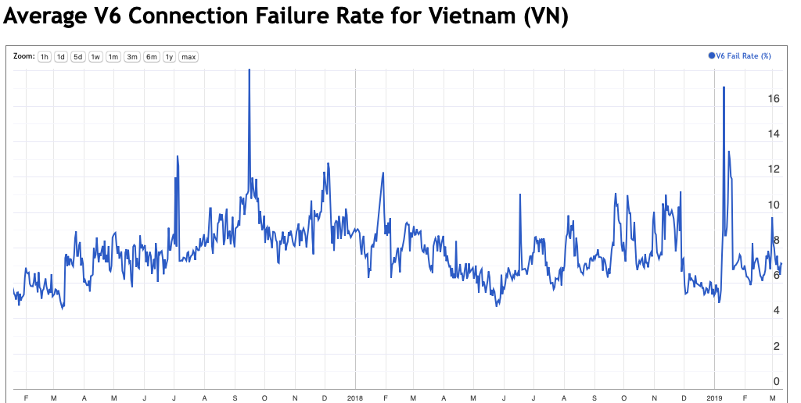
The Bad
Seriously?
A 6%-10% IPv6 connection failure rate is bad enough
A sustained failure rate for over 2 years seems worse!

Slide 8
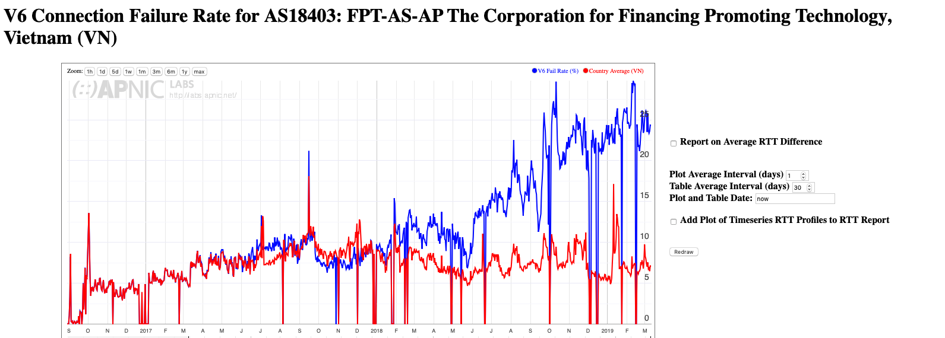
The Appalling!

Slide 9
Comment
For many end users in Vietnam, Panama, Morocco, Turkey, Venezuela, China and Bangladesh their IPv6 service looks pretty broken
  The combination of Dual Stack and Happy Eyeballs masks the problem so that the user does not experience a degraded service
  But this only will work while Dual Stack is around
Other ISPs have managed to do a much better job, such as in the United States, Sweden, Thailand and Korea and the IPv6 connection failure rates are close to experimental noise levels
What’s happening in the second set of countries and ISPs that is NOT happening in the first set?

Slide 10
Possible Issues
IPv6 routing stability
End site IPv6 address assignment
Local Firewalls
Partially broken Hotspots
???

Slide 11
Discussion

