Slide 1
What part of “NO” is so hard for the DNS to understand?
Geoff Huston
Joao Damas
APNIC Labs

Slide 2
We were looking elsewhere…
We were setting up a measurement experiment that was looking at the extent of support for aggressive NSEC caching (RFC8198) in the DNS
The experiment setup involved presenting to the user a DNS name that did not exist from a signed zone, so that we would pass an NSEC record to a DNSSEC-aware resolver
But was was intriguing was that we were seeing many more queries for the non-existent name than we had expected

Slide 3
What we saw:
We used an online ad to get users to query for a unique non-existent DNS name
And then counted the number of queries we saw for these names
That’s an average of 2.37 queries per non-existent name!
Why so many queries?
Queried Names: 60,210,983
DNS Queries: 142,631,272

Slide 4
Expectations
If “NO means NO” then naïvely we would expect to see 1 query per name, not 2.37 queries per name
But maybe that’s just too naïve these days…

Slide 5
Happy Eyeballs and the DNS
A ‘happy eyeballs” dual stack client will launch 2 DNS queries back-to-back (roughly), for A and AAAA records of the name
  23% of clients asked both A and AAAA records
  3% asked only AAAA records (*)
  74% asked only for A records
AAAA?
A?
* If the client asks for a AAAA record and waits for a response before asking for the A record then the NXDOMAIN response will stop the connection process and any subsequent A query will not be performed

Slide 6
Factoring Happy Eyeballs
If we split out the A and AAAA queries the experiment launched 73,537,852 DNS resolution ‘events’
We saw 142,631,272 DNS queries, or an average of 1.93 queries per name
That’s better, but still unexpectedly high

Slide 7
Single vs Multiple Queries
36,059,484 resolution ‘events’ were completed with just 1 query to the authoritative server (49% of all resolution events)
If there were multiple queries for a name (>= 2 queries(, then the average of the multiple queries was 2.84 queries

Slide 8
Distribution of Queries
Is this a generic issue of re-queries across a large set of queries?
Or a small number of queries that are the subject of a frenzy of re-queries?

Slide 9
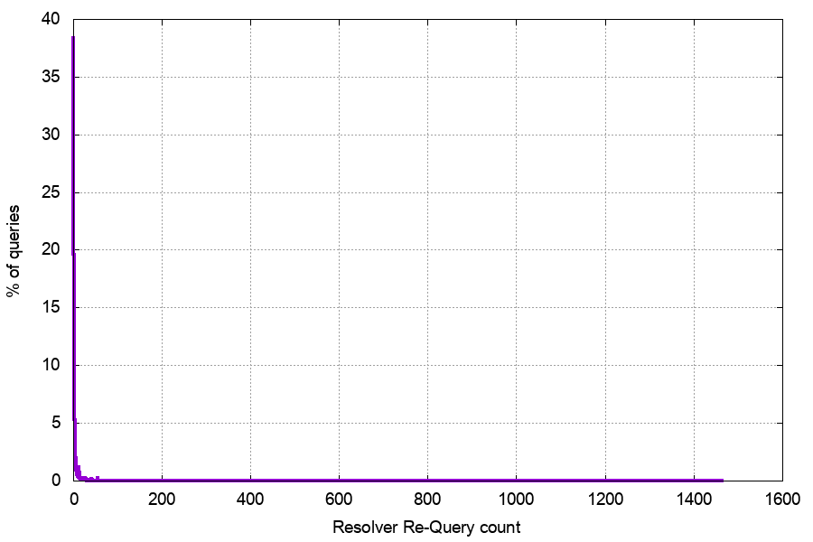
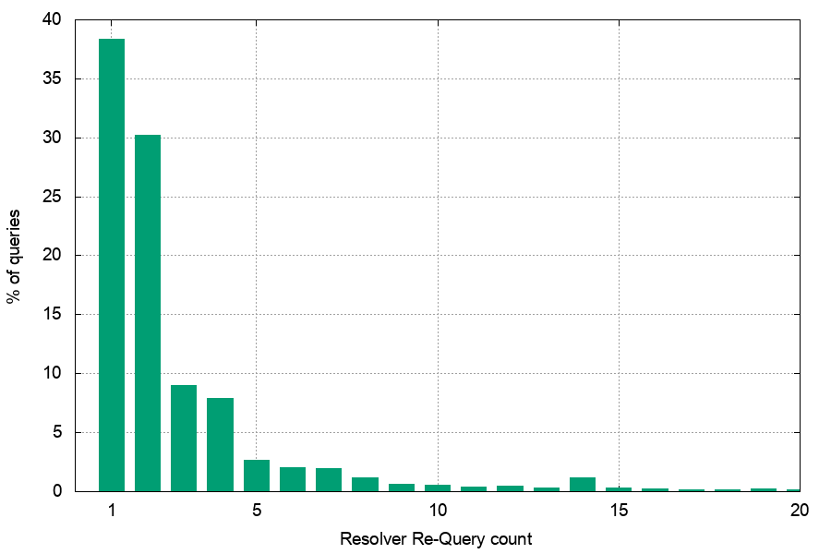
Re-query Distribution
32% of queries were parts of query sequences of 3 or more

Slide 10
Does UDP suck THAT much?
Why is the total re-query rate at 51% of tests?
Surely DNS over UDP is not THAT bad
  The servers are responding to every query
  The signed response is 603 bytes in size
  We are using a distributed setup of servers to localize DNS transactions
  So why are the servers seeing 51% of tests generate 2 or more queries?

Slide 11
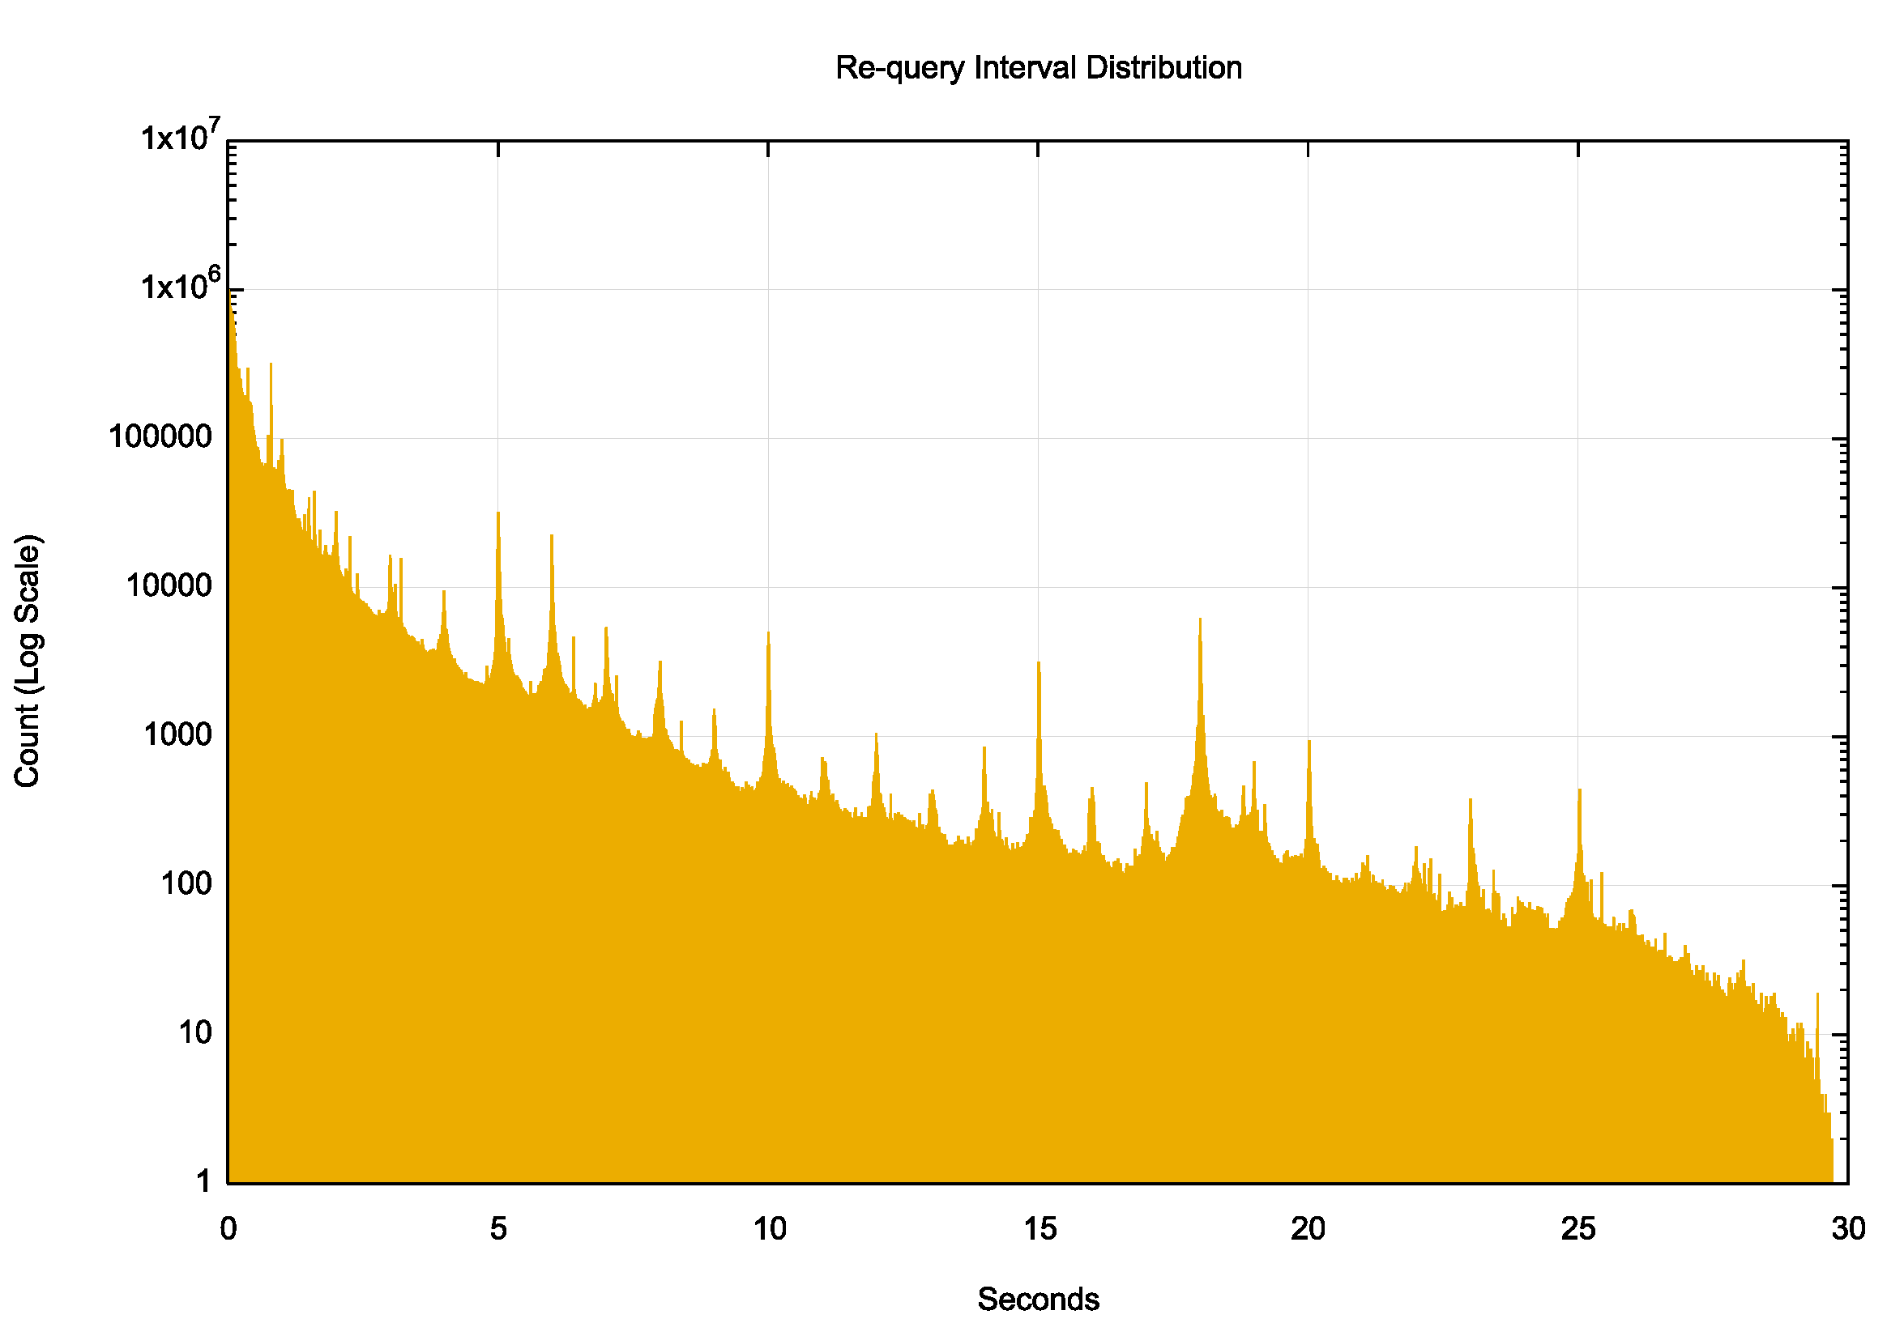
Re-Query Time Intervals
There are strong local peaks at regular 1 second intervals – this would appear to be an end host re-query behaviour

Slide 12
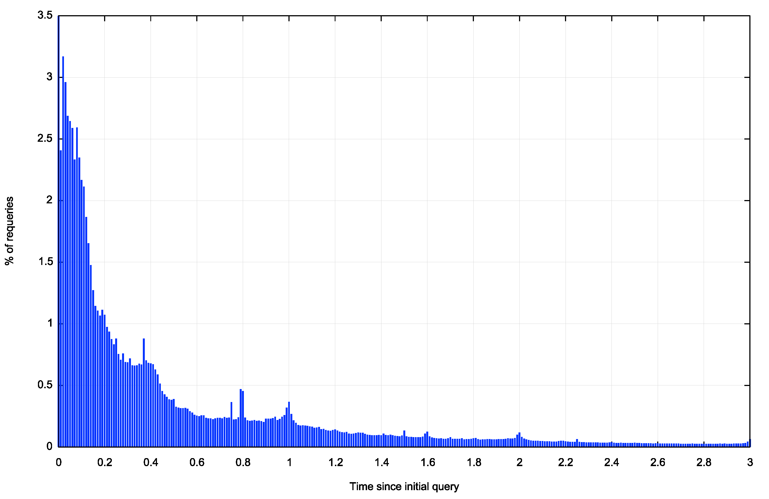
Re-Query Time Intervals
There are local re-query peaks here at 370 ms, 800ms, 1 sec and 1.5sec
It is likely that these time intervals represent recursive resolver re-query timers
370ms
800ms
1s
1.5s

Slide 13
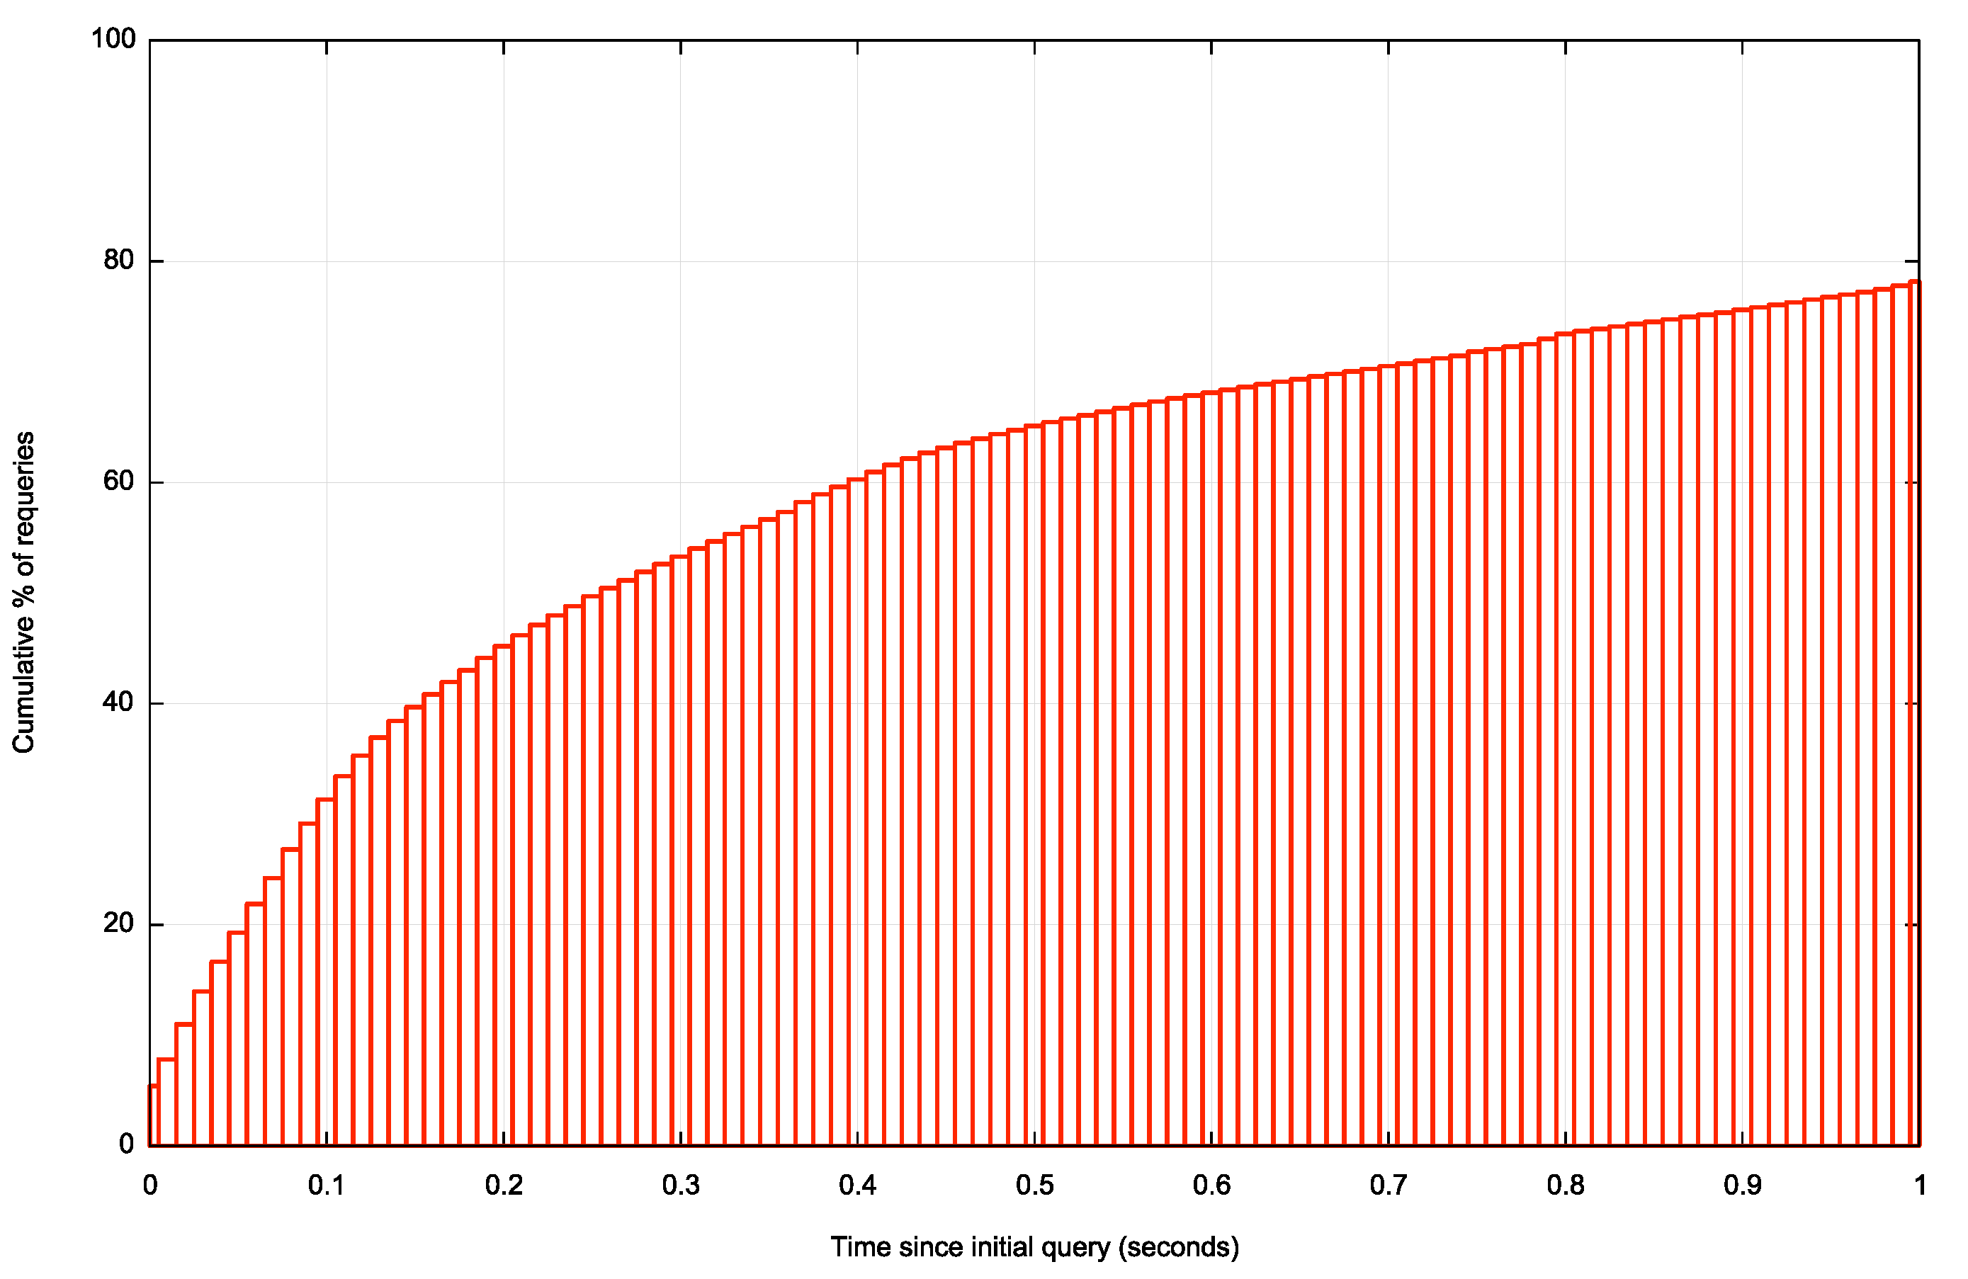
Re-Query Time Intervals
One half of all re-queries occur in the first 250 ms

Slide 14
DNSSEC?
This is a DNSSEC-signed non-existent name.
Is DNSSEC a factor in the excessive re-query volume?
  i.e. is the additional time to validate causing requery timers to trigger?
We added an unsigned non-existent name to the test set

Slide 15
Signed vs Unsigned
Signed Unsigned
Experiments 65,686,452 69,251,349
A/AAAA 81,057,694 84,979,990
Queries 153,697,947 122,665,888
Single Query Exps 47,694,930 60,061,746
Ratio 59% 71%
Multi-Query Exps 33,092,764 24,918,244
Re-Query Rate 3.19 2.51
Split out the ‘happy eyeballs’ factor
DNSSEC validation adds delay, and in around 12% of cases this additional delay causes the resolver system to re-query the name

Slide 16
Signed vs Unsigned
So there are a set of resolvers that are working on the margins of their timers, and in 12% of cases the additional DNSSEC queries to perform validation cause the resolver to time out and re-query.
OK – but the 12% delay factor is still not enough to explain the high query rate for NXDOMAIN responses
What else is going on?

Slide 17
NXDOMAIN re-queries
39% of queries are re-queries when the domain is signed
  And of those, 30% are the same source address and 69% are the same subnet
29% of queries are re-queries when the domain is unsigned
  And of those, 11% are the same source address and 50% are the same subnet
It appears that DNSSEC validation adds a time component that causes resolvers to trigger internal timers and re-query in around 12% of cases

Slide 18
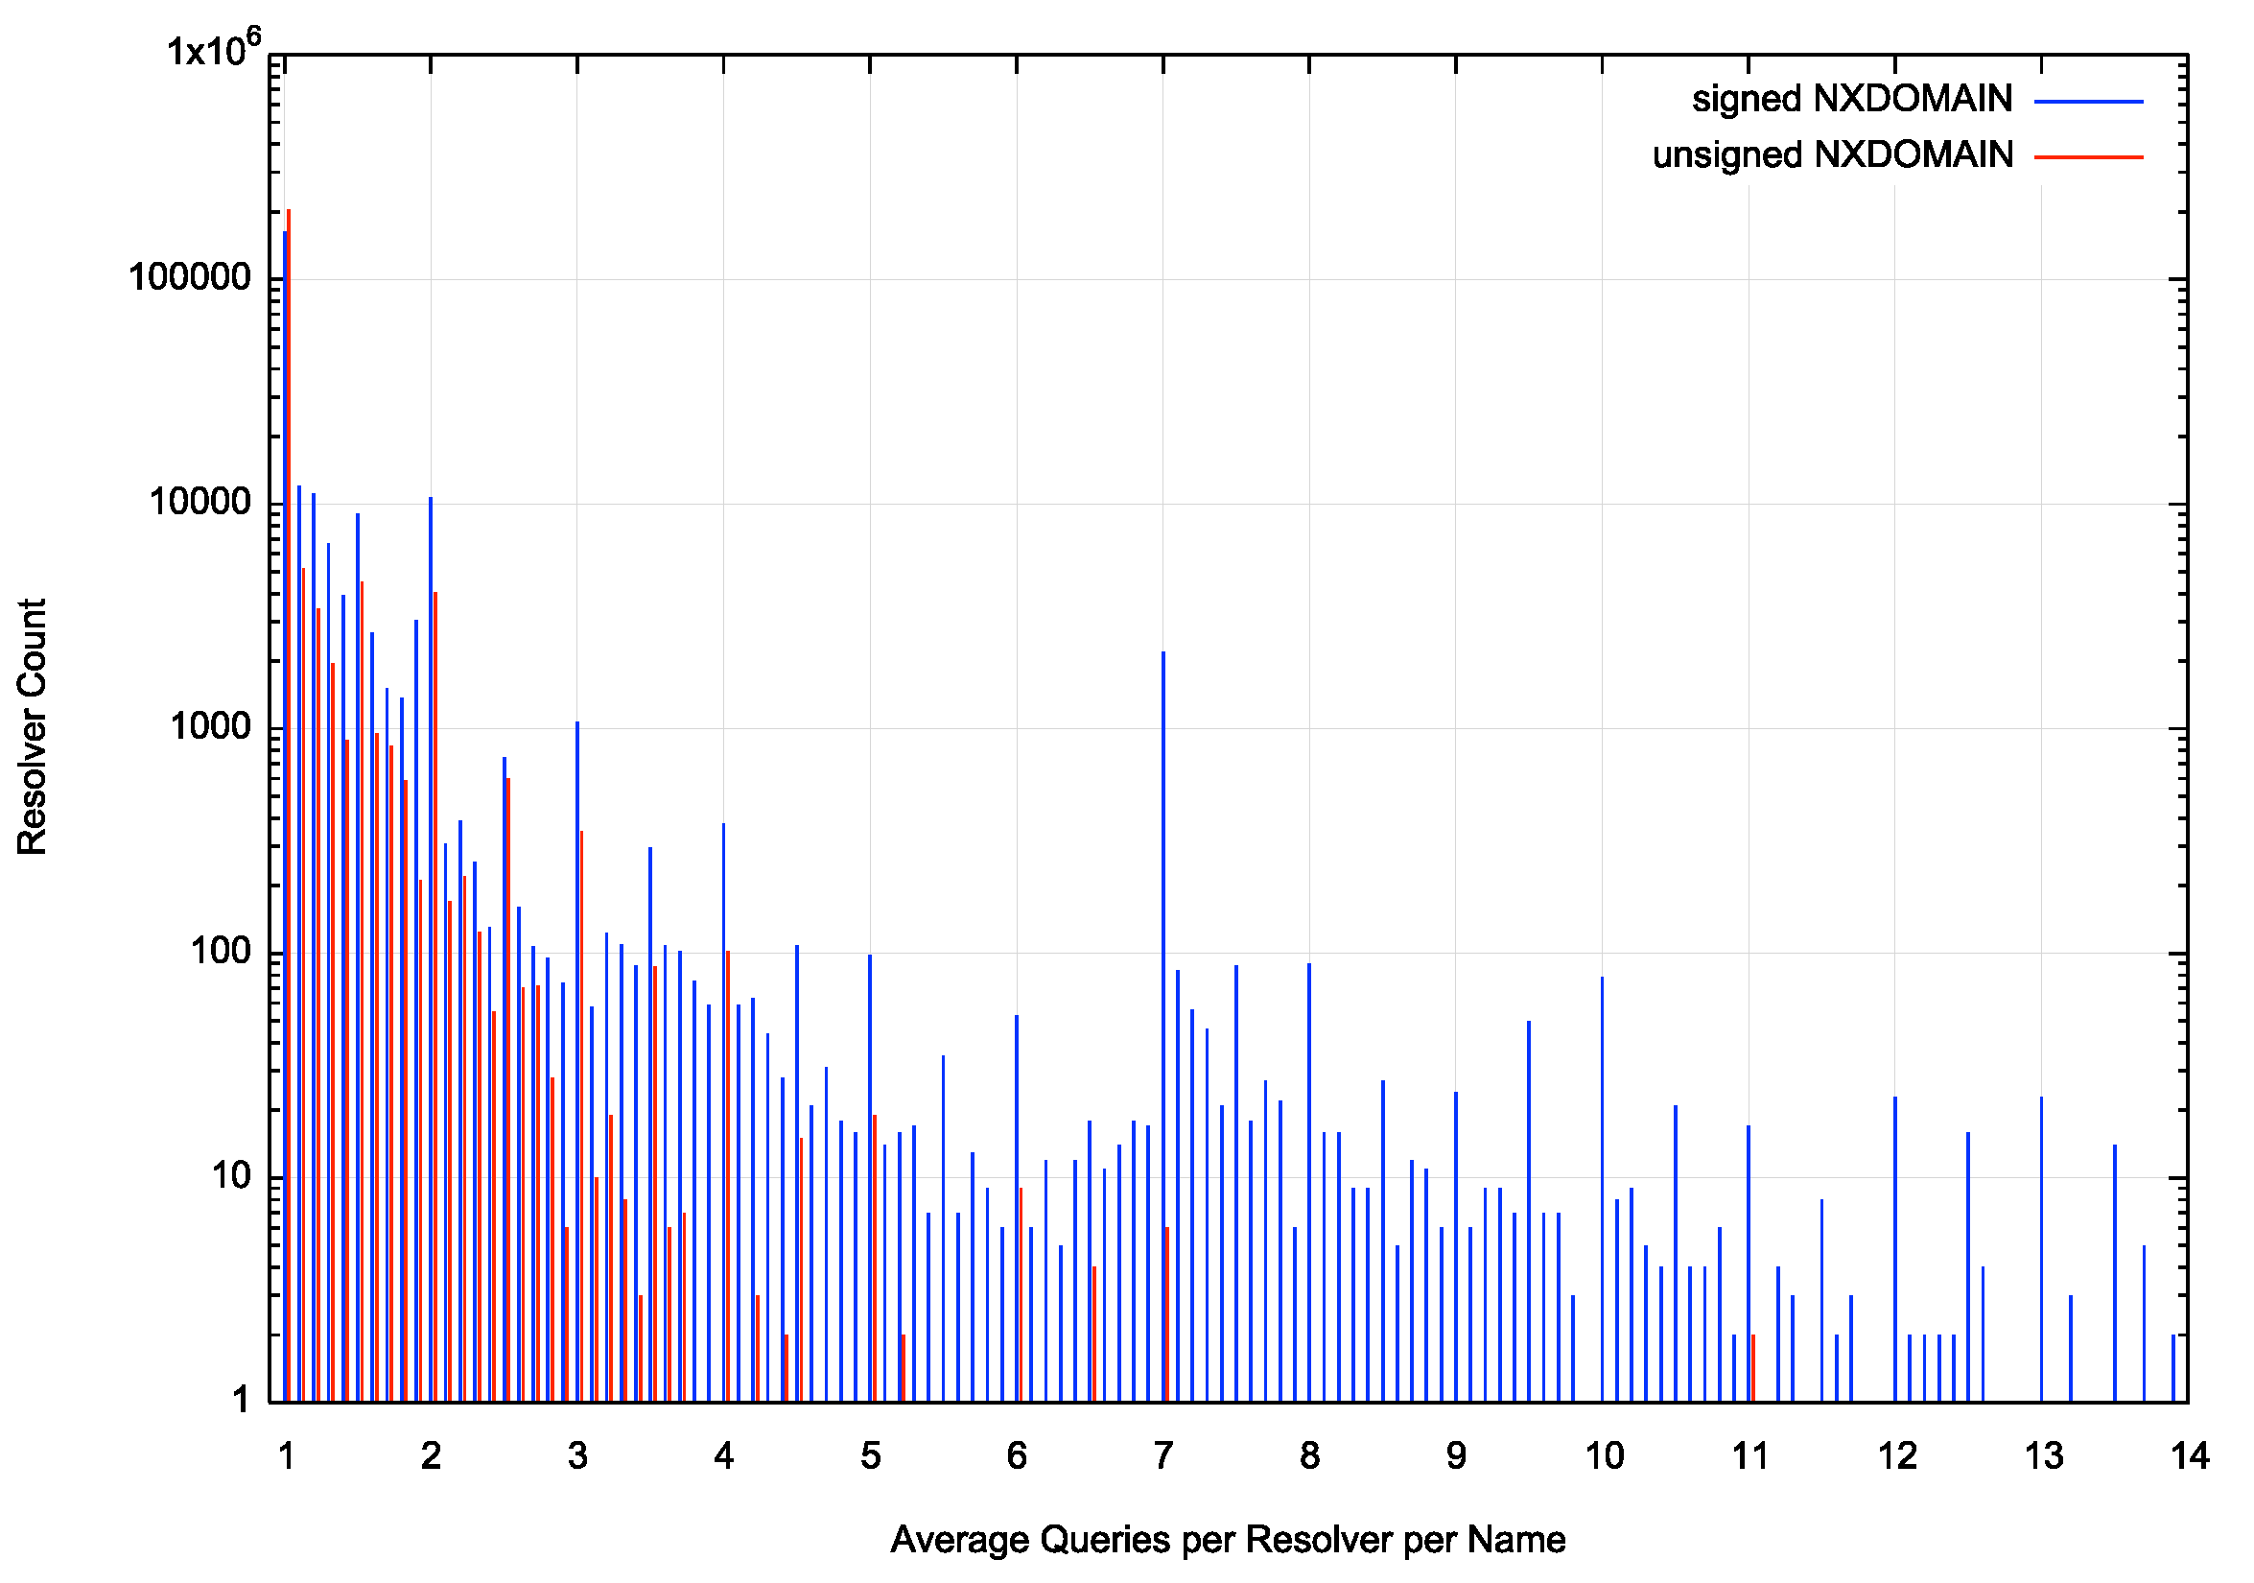
Re-Queries per resolver IP addresss
The log scale exaggerates the effect, but we observe that a DNSSEC-signed NXDOMAIN response generates a higher repeat query profile from the same resolver IP address

Slide 19
Resolver “farms”
We also see query patterns of the form:
Resolver Query Time
7x.xxx.0.178 0.752
6z.zzz.161.146 0.865
7x.xxx.0.230 0.980
6z.zzz.161.220 1.094
7x.xxx.0.188 1.201
6z.zzz.161.182 1.319
7x.xxx.0.180 1.430
6z.zzz.161.144 1.542
7x.xxx.0.226 1.650
7x.xxx.0.138 1.654
6z.zzz.161.134 1.762
6z.zzz.161.222 1.775
It appears that some resolver farms operate by farming
the query across all members of the farm. This pattern seen here shows two such cases where different IP addresses in the same subnet repeat the initial query at approximately 100ms intervals
How common is this form of subnet-based query repetition?

Slide 20
Re-query Profile
Signed Unsigned
Queries 153,697,947 122,665,888
Re-queries 59,782,873 35,297,618
Same IP Address 17,848,729 4,024,583
Same Subnet 41,111,416 17,618,192
Some 70% of the re-queries are from resolvers that share the same subnet prefix when the domain is DNSSEC signed. This drops to 50% with an unsigned domain
This points to some outstanding issues with resolver farm management

Slide 21
It may sound odd but…
Is NXDOMAIN part of the issue here?
Is the re-query rate lower if the name exists in the DNS?
So we also ran the same query count for queries to a dual-stack defined domain name that did exist in the DNS

Slide 22
NXDOMAIN vs A/AAAA re-queries
NXDOMAIN Signed:
41% of experiments generate multiple queries
39% of queries are re-queries (avg of 3.19 queries per experiment)
A/AAAA Signed:
18% of experiments generate multiple queries
13% of queries are re-queries (avg of 5.81 queries per experiment)
NXDOMAIN Unsigned:
39% of experiments generate multiple queries
29% of queries are re-queries (avg of 2.51 queries per experiment)
A/AAAA Unsigned
38% of experiments generate multiple queries
36% of queries are re-queries (avg of 3.03 queries per experiment)

Slide 23
NXDOMAIN vs A/AAAA re-queries
NXDOMAIN Signed:
41% of experiments generate multiple queries
39% of queries are re-queries (avg of 3.19 queries per experiment)
A/AAAA Signed:
18% of experiments generate multiple queries
13% of queries are re-queries (avg of 5.81 queries per experiment)
NXDOMAIN Unsigned:
39% of experiments generate multiple queries
29% of queries are re-queries (avg of 2.51 queries per experiment)
A/AAAA Unsigned
38% of experiments generate multiple queries
36% of queries are re-queries (avg of 3.03 queries per experiment)

Slide 24
How Odd!
The proportion of experiments that are completed in a single query are unchanged with there is an unsigned response
  Where re-query occurs the average number of queries per experiment rises from 2.5 to 3.0
The proportion of experiments that are completed in a single query rise with there is a signed response
  Where re-query occurs the average number of queries per experiment rises from 3.2 to 5.8

Slide 25
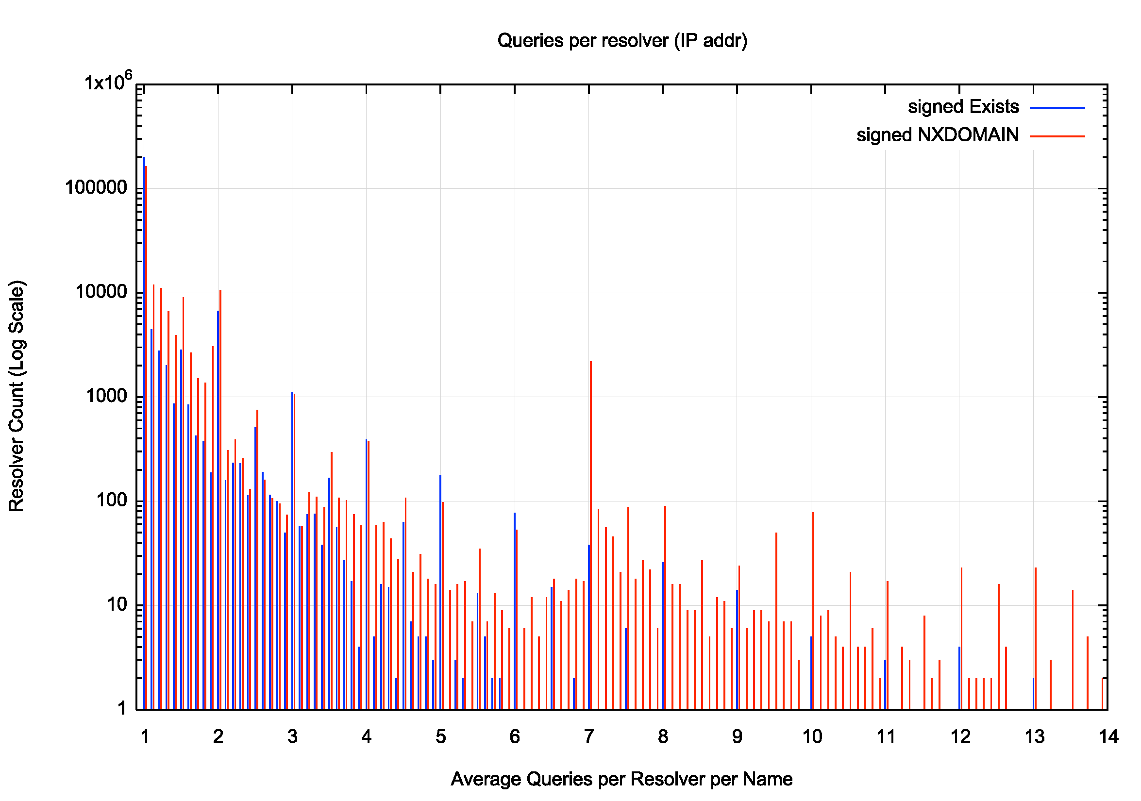
WTF?
A DNSSEC-signed NXDOMAIN response generates more re-queries than a DNSSEC-signed A / AAAA response

Slide 26
Pulling it back together
Why are there so many repeat queries?
  <reasons>
  Resolver Farms
  NXDOMAIN
  DNSSEC Signing
  Happy Eyeballs

Slide 27
Thanks!

