Slide 1
A Review of the KSK Roll
Geoff Huston
APNIC Labs

Slide 2
Why am I presenting this?
I ’m not part of ICANN or the PTI
APNIC is not a root server operator
I’m not a member of the root server cabal
I can’t see root server query data

Slide 3
Why am I presenting this?
But …
  I’m one of almost 4 billion consumers of the DNS, and the stability, integrity and robustness of the DNS root matters for me
  So I’m an interested member of the community of DNS consumers

Slide 4
The Plan
The KSK is “special”
There is no “parent” key for the root
Every DNSSEC-validating resolver needs to load (and trust) the new KSK
The plan is to use “old-signs-new” approach
  The old key signs over the new key for some minimum hold-down period
  DNSSEC-validating resolvers are supposed to add the new key to their local trusted key collection once they have seen a stable sign-over for the hold-down period

Slide 5
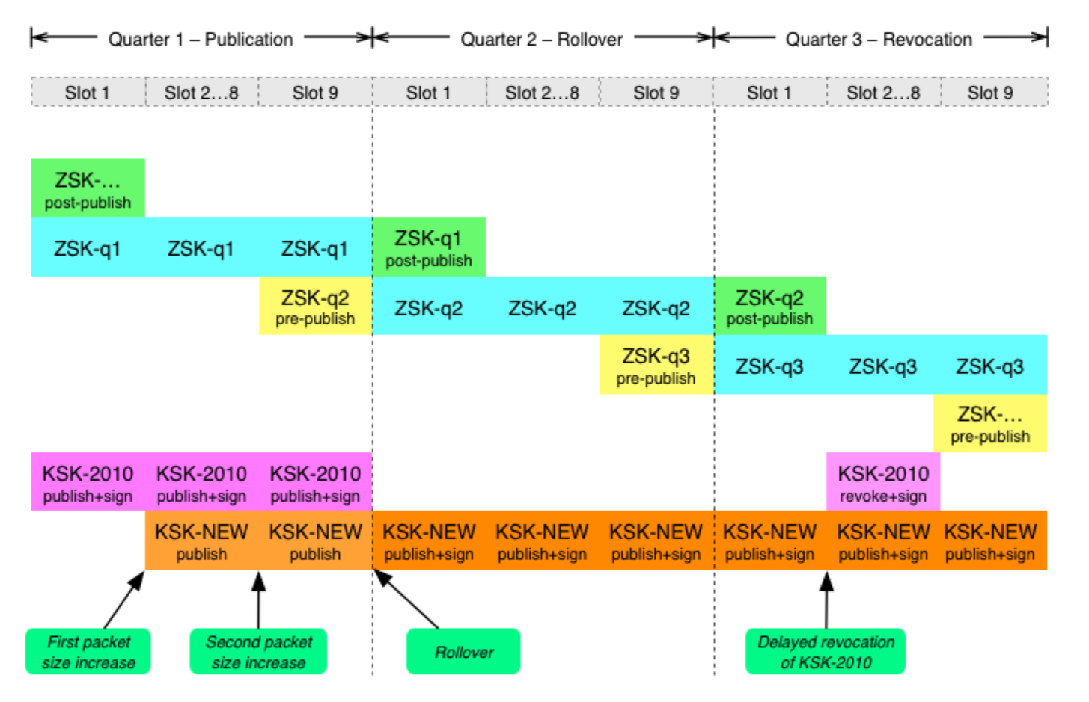
The Plan - V1
11 October 2017

Slide 6
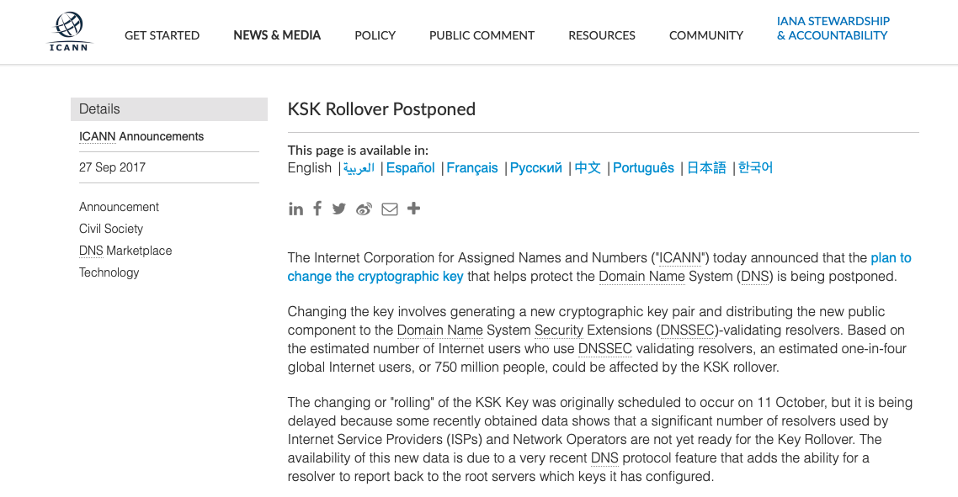
The best laid plans…

Slide 7
The Plan - V2
KSK-2017 is published in the root zone across the pause
27 September 2017
11 October 2018
11 January 2019

Slide 8
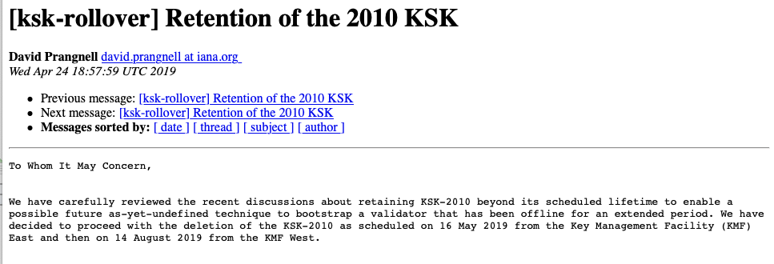
Goodbye KSK-2010

Slide 9
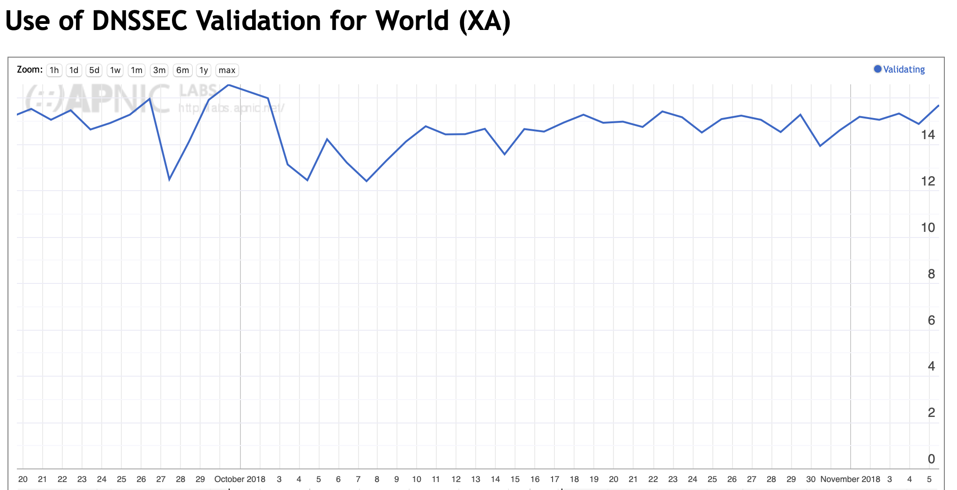
What Worked
The KSK was rolled
Internet-wide DNSSEC validation levels were not significantly impacted

Slide 10
What Did Not
The exercise was not exactly incident free
There were issues with:
  Predicting the impact of the KSK roll
  Measuring the impact of the KSK roll
  Predicting the impact of KSK revocation

Slide 11
KSK Measurement Objective
What number of users are at risk of being impacted by the KSK Roll?

Slide 12
KSK Measurement Objective
What number of users are at risk of being impacted by the KSK Roll?
We can’t do this measurement directly
We can only measure the capabilities of the DNS infrastructure and estimate the impact

Slide 13
Signalling via Queries
Client
DNS Resolver
Server
Queries
DNS Resolver
DNS Resolver
DNS Resolver
DNS Resolver
The query contains added resolver information which passes inward in the DNS towards the authoritative server(s)
DNS Resolver
DNS Resolver
DNS Resolver
DNS Resolver
DNS Resolver
DNS Resolver
DNS Resolver
DNS Resolver

Slide 14
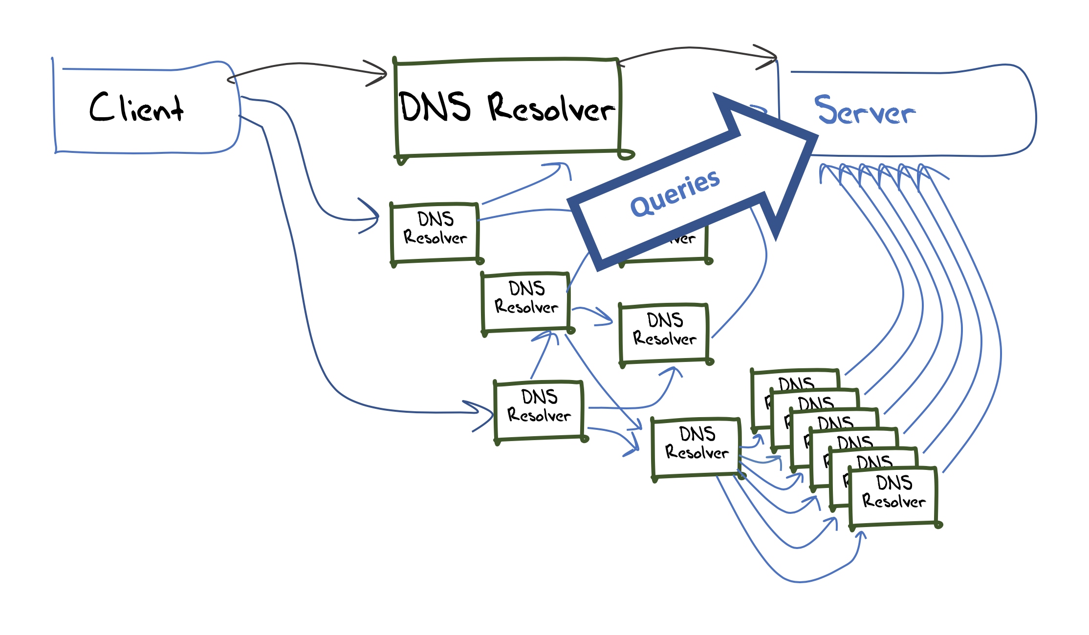
Measuring Resolvers with RFC 8145
Getting resolvers to report on their local trusted key state
  A change to resolver behavior that requires deployment of new resolver code
  Resolvers that support the RFC 8145 signal mechanism periodically include the key tag of their locally trusted keys into a query directed towards the root servers

Slide 15
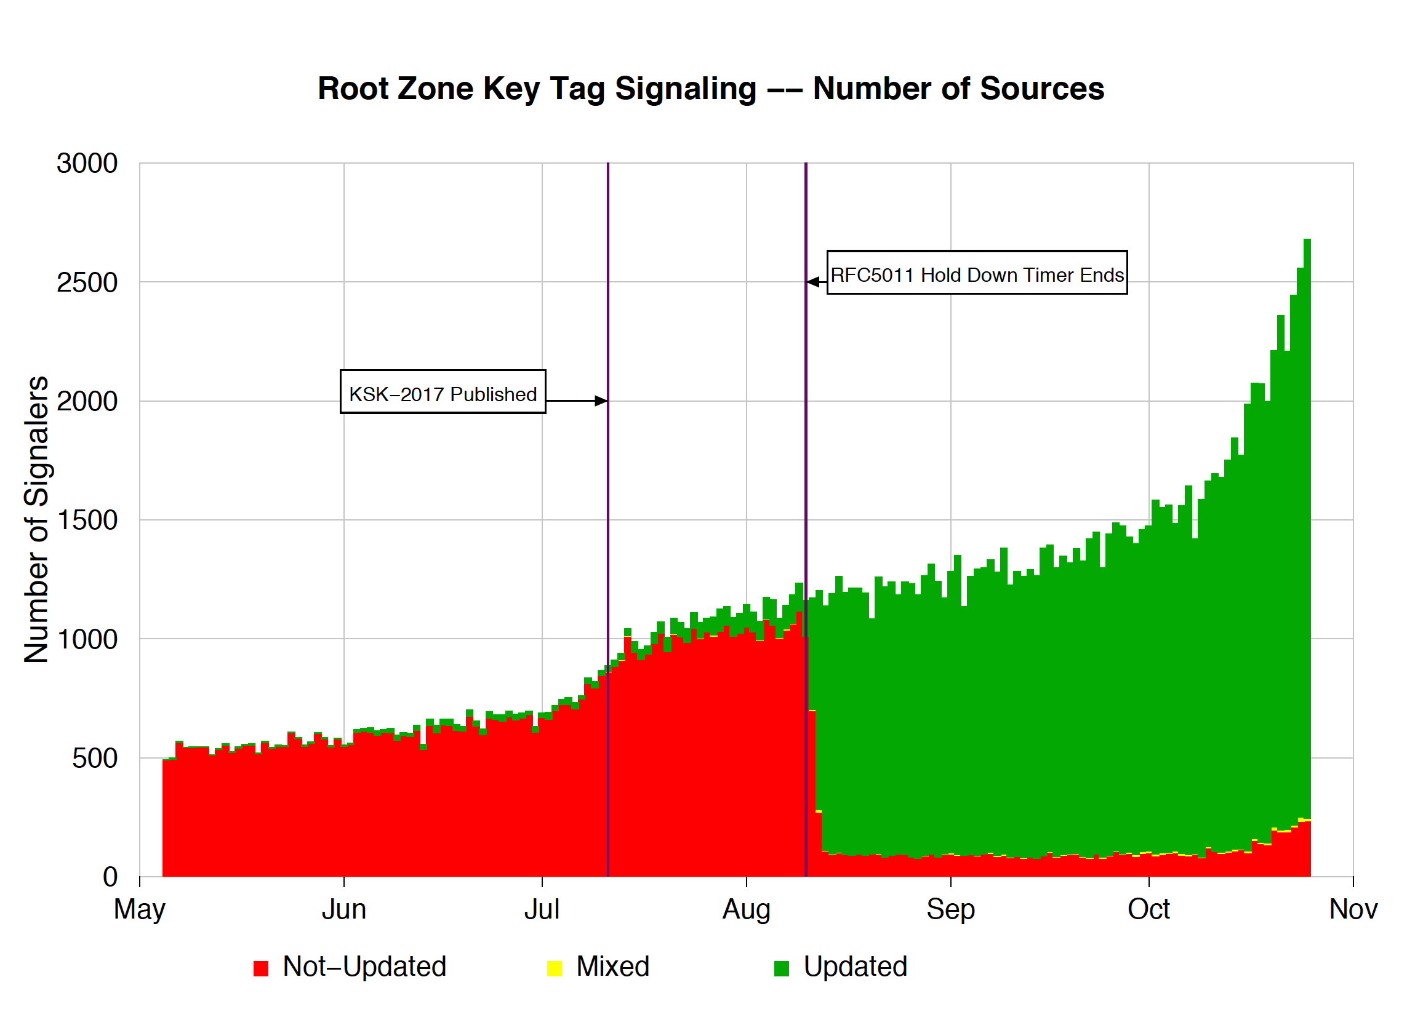
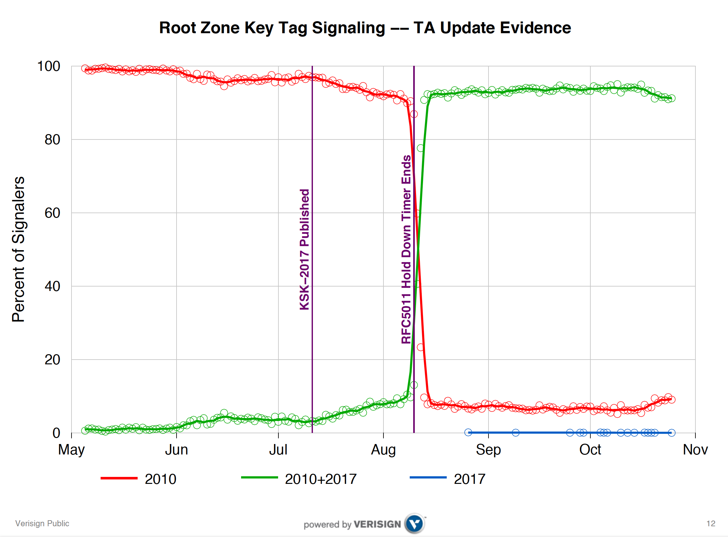
What did we see at the roots?
root service operators
Duane Wessels VeriSign RFC 8145 Signaling Trust Anchor Knowledge In DNS Security Extensions
Presentation to DNSSEC Workshop @ ICANN 60 – 1 Nov 2017
https://schd.ws/hosted_files/icann60abudhabi2017/ea/Duane%20Wessels-VeriSign-RFC%208145-Signaling%20Trust%20Anchor%20Knowledge%20in%20DNS%20Security%20Extensions.pdf

Slide 16
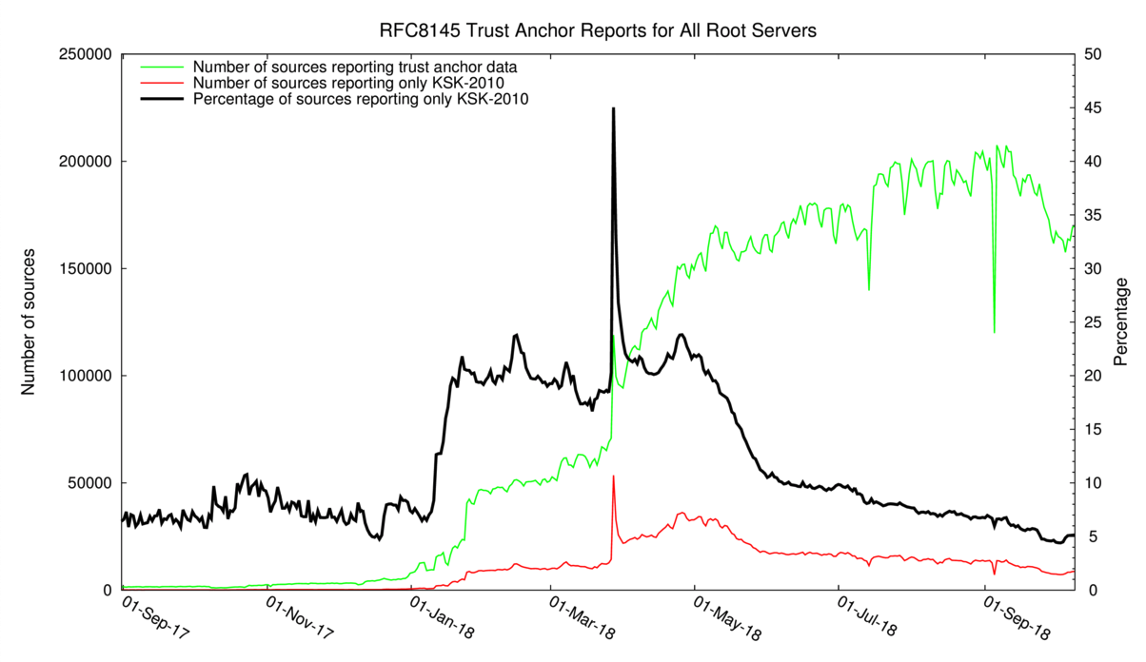
12 months of RFC8145 signalling
Yes, with just a few days to go this mechanism was still reporting 5% ‘breakage’
http://root-trust-anchor-reports.research.icann.org

Slide 17
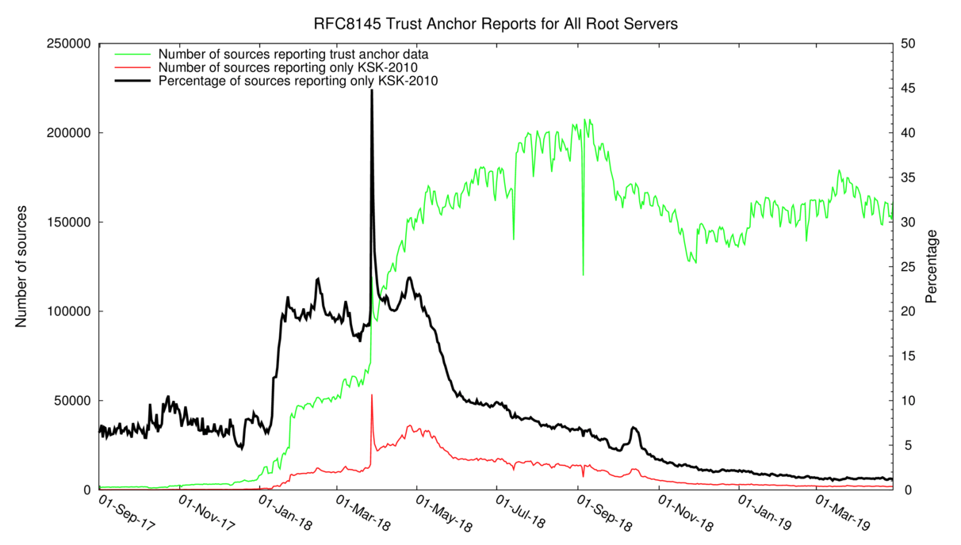
20 months of RFC8145 signalling
This mechanism is still reporting 1% ‘breakage’
http://root-trust-anchor-reports.research.icann.org

Slide 18
What is this saying?
It’s clear that there is some residual set of resolvers that are signalling that they have not yet learned to trust KSK-2017
But its not clear if:
  This is an accurate signal about the state of this resolver
  This is an accurate signal about the identity of this resolver
  Whether the resolver attempts DNSSEC validation
  How many users sit ‘behind’ this resolver
  Whether these uses rely solely on this resolver, or if they also have alternate resolvers that they can use

Slide 19
Why?
Because the DNS does not disclose the antecedents of a query
  If A forwards a query to B, who queries a Root Server then if the query contains an implicit signal (as in this case) then it appears that B is querying, not A
  At no time is the user made visible in the referred query
Because caching
  If A and B both forward their queries via C, then it may be that one or both of these queries may be answered from C’s cache
  In this case the signal is being suppressed
Because its actually measuring a cause, not the outcome
  Its measuring resolvers’ uptake of the new KSK, but is not able to measure the user impact of this

Slide 20
Signalling via Responses
Client
DNS Resolver
Server
Responses
DNS Resolver
DNS Resolver
DNS Resolver
DNS Resolver
The response contains added information or altered behaviours which passes backward in the DNS towards the original querier
DNS Resolver
DNS Resolver
DNS Resolver
DNS Resolver
DNS Resolver
DNS Resolver
DNS Resolver
DNS Resolver

Slide 21
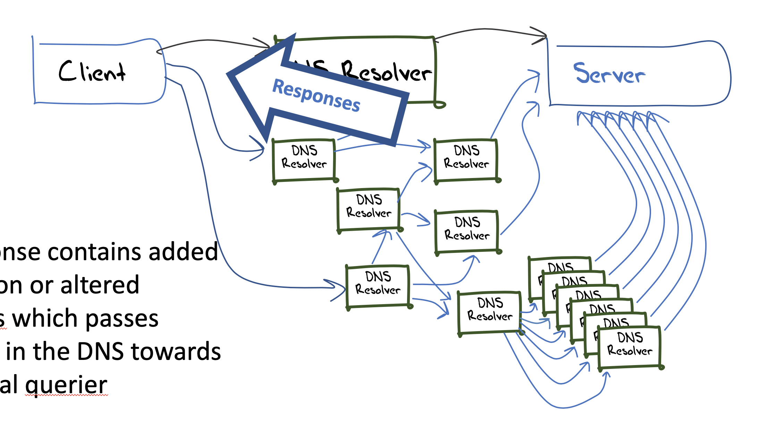
User-Side Measurement
Can we devise a DNS query that could reveal the state of the trusted keys of the resolvers back to the user?
  What about a change to the resolver’s reporting of validation outcome depending on the resolver’s local trusted key state?
    If a query contains the label “root-key-sentinel-is-ta-<key-tag>” then a validating resolver will report validation failure (SERVFAIL) if the key is NOT in the local trusted key store
    If a query contains the label “root-key-sentinel-not-ta-<key-tag>” then a validating resolver will report validation failure (SERVFAIL) if the key IS in the local trusted key store

Slide 22
DNS + Web
How can you tell if a user is able to resolve a DNS name?
  Be the user (get the user to run a script of some sort)
  Look at the DNS server AND the Web server
    The Web object is fetched only when the DNS provides a resolution answer
    But the opposite is not necessarily the case, so there is a noise component in such an approach

Slide 23
Prior to the KSK Roll
16% of users use DNSSEC-validating resolvers
15% of users do not report
their KSK trust-state
0.5% of users report KSK-2017
loaded
0.005% of users report KSK-2017
NOT loaded

Slide 24
Possibly Affected Users
Between 0.1% to 0.2% of users are reporting that their resolvers have not loaded KSK-2017 as a trust anchor
The measurement has many uncertainties and many sources of noise so this is an upper bound of the pool of users who may encounter DNS failure due to to the KSK roll

Slide 25
What happened
SIDN Labs Atlas Measurement

Slide 26
What we saw
% of folk that reported “good”
KSK roll period
% of folk that reported “bad”

Slide 27
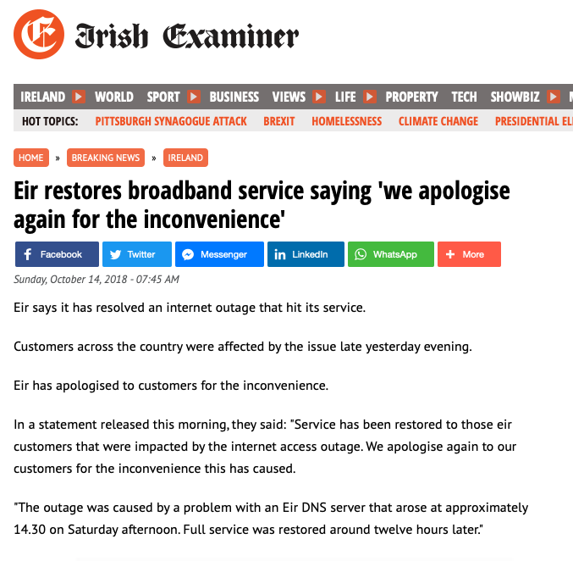

What we heard

Slide 28
What happens when you lose track of the KSK?

Slide 29
Everything goes black

Slide 30
EIR - AS5466 DNSSEC Data
Daily Sample Count
Validating Sample Count
KSK Roll Cache Expiry

Slide 31
Internet DNSSEC Data
Is this part-related to the KSK Roll?

Slide 32
Looking for Affected Networks
Lets use the following filter:
  More than 400 samples / day in the lead up to the KSK roll (using weighted sample count)
  DNSSEC validation level more than 30% prior to the KSK roll
  Drop of more than 33% in DNSSEC validation during the KSK roll

Slide 33
Rank AS CC Seen Validating As Name
Before During After Before During After
1 AS2018 ZA 1,858 1,122 1,473 694 220 288 TENET, South Africa
2 AS10396 PR 1,789 1,673 1,988 1,647 276 33 COQUI-NET - DATACOM CARIBE, Puerto Rico
3 AS45773 PK 1,553 388 1,393 606 178 540 HECPERN-AS-PK PERN, Pakistan
4 AS15169 IN 1,271 438 1,286 1,209 438 1,242 GOOGLE - Google LLC, India
5 AS22616 US 1,264 503 1,526 883 377 1,014 ZSCALER- SJC, US
6 AS53813 IN 1,213 689 1,862 1,063 582 1,419 ZSCALER, India
7 AS1916 BR 1,062 94 991 326 37 277 Rede Nacional de Ensino e Pesquisa, Brazil
8 AS9658 PH 931 281 842 440 136 404 ETPI-IDS-AS-AP Eastern Telecoms, Philippines
9 AS37406 SS 888 486 972 582 365 599 RCS, South Sudan
10 AS263327 BR 882 345 438 776 289 359 ONLINE SERVICOS DE TELECOMUNICACOES, Brazil
11 AS17557 PK 835 430 777 431 277 413 Pakistan Telecommunication, Pakistan
12 AS36914 KE 834 476 937 583 354 670 KENET , Kenya
13 AS327687 UG 802 473 834 390 189 332 RENU, Uganda
14 AS680 DE 773 966 1,332 268 117 289 DFN Verein zur Foerderung, Germany
15 AS201767 UZ 761 538 729 461 200 371 UZMOBILE, Uzbekistan
16 AS37682 NG 695 401 728 593 274 568 TIZETI, Nigeria
17 AS7470 TH 674 214 507 219 94 182 True Internet, Thailand
18 AS51167 DE 670 378 479 214 78 156 CONTABO, Germany
19 AS15525 PT 600 260 593 287 125 284 MEO-EMPRESAS, Portugal
20 AS14061 GB 594 468 672 260 169 313 DigitalOcean, United Kingdom
21 AS37130 ZA 585 5 464 414 0 260 SITA, South Africa
22 AS30998 NG 583 264 484 192 54 143 NAL, Nigeria
23 AS135407 PK 569 227 457 419 207 344 TES-PL-AS-AP Trans World, Pakistan
24 AS16814 AR 565 235 456 258 120 208 NSS, Argentina
25 AS132335 IN 563 17 30 538 17 23 NETWORK-LEAPSWITCH-IN LeapSwitch Networks, India
26 AS5438 TN 559 532 579 526 171 27 ATI,Tunisia
27 AS5466 IE 547 240 401 419 184 329 EIRCOM Internet House, IE Ireland
28 AS18002 IN 538 467 614 277 176 242 WORLDPHONE-IN AS, India
29 AS37209 NG 532 109 438 269 45 194 HYPERIA, Nigeria
30 AS37100 ZA 454 161 401 168 95 131 SEACOM-AS, South Africa
31 AS5588 CZ 453 175 430 186 102 162 GTSCE GTS Central Europe, Czechia
32 AS1103 NL 446 38 363 189 7 132 SURFnet, The Netherlands
33 AS17563 PK 402 117 359 207 64 199 Nexlinx, Pakistan
34 AS327724 UG 401 120 538 208 103 266 NITA, Uganda
35 AS7590 PK 400 122 329 266 84 224 COMSATS, Pakistan

Slide 34
Rank AS CC Seen Validating As Name
Before During After Before During After
1 AS2018 ZA 1,858 1,122 1,473 694 220 288 TENET, South Africa
2 AS10396 PR 1,789 1,673 1,988 1,647 276 33 COQUI-NET - DATACOM CARIBE, Puerto Rico
3 AS45773 PK 1,553 388 1,393 606 178 540 HECPERN-AS-PK PERN, Pakistan
4 AS15169 IN 1,271 438 1,286 1,209 438 1,242 GOOGLE - Google LLC, India
5 AS22616 US 1,264 503 1,526 883 377 1,014 ZSCALER- SJC, US
6 AS53813 IN 1,213 689 1,862 1,063 582 1,419 ZSCALER, India
7 AS1916 BR 1,062 94 991 326 37 277 Rede Nacional de Ensino e Pesquisa, Brazil
8 AS9658 PH 931 281 842 440 136 404 ETPI-IDS-AS-AP Eastern Telecoms, Philippines
9 AS37406 SS 888 486 972 582 365 599 RCS, South Sudan
10 AS263327 BR 882 345 438 776 289 359 ONLINE SERVICOS DE TELECOMUNICACOES, Brazil
11 AS17557 PK 835 430 777 431 277 413 Pakistan Telecommunication, Pakistan
12 AS36914 KE 834 476 937 583 354 670 KENET , Kenya
13 AS327687 UG 802 473 834 390 189 332 RENU, Uganda
14 AS680 DE 773 966 1,332 268 117 289 DFN Verein zur Foerderung, Germany
15 AS201767 UZ 761 538 729 461 200 371 UZMOBILE, Uzbekistan
16 AS37682 NG 695 401 728 593 274 568 TIZETI, Nigeria
17 AS7470 TH 674 214 507 219 94 182 True Internet, Thailand
18 AS51167 DE 670 378 479 214 78 156 CONTABO, Germany
19 AS15525 PT 600 260 593 287 125 284 MEO-EMPRESAS, Portugal
20 AS14061 GB 594 468 672 260 169 313 DigitalOcean, United Kingdom
21 AS37130 ZA 585 5 464 414 0 260 SITA, South Africa
22 AS30998 NG 583 264 484 192 54 143 NAL, Nigeria
23 AS135407 PK 569 227 457 419 207 344 TES-PL-AS-AP Trans World, Pakistan
24 AS16814 AR 565 235 456 258 120 208 NSS, Argentina
25 AS132335 IN 563 17 30 538 17 23 NETWORK-LEAPSWITCH-IN LeapSwitch Networks, India
26 AS5438 TN 559 532 579 526 171 27 ATI,Tunisia
27 AS5466 IE 547 240 401 419 184 329 EIRCOM Internet House, IE Ireland
28 AS18002 IN 538 467 614 277 176 242 WORLDPHONE-IN AS, India
29 AS37209 NG 532 109 438 269 45 194 HYPERIA, Nigeria
30 AS37100 ZA 454 161 401 168 95 131 SEACOM-AS, South Africa
31 AS5588 CZ 453 175 430 186 102 162 GTSCE GTS Central Europe, Czechia
32 AS1103 NL 446 38 363 189 7 132 SURFnet, The Netherlands
33 AS17563 PK 402 117 359 207 64 199 Nexlinx, Pakistan
34 AS327724 UG 401 120 538 208 103 266 NITA, Uganda
35 AS7590 PK 400 122 329 266 84 224 COMSATS, Pakistan
These networks turned DNSSEC validation off!

Slide 35
Impact of the KSK Roll
The immediate impact appears to be some 0.2% - 0.3% of users
In 32 ISP cases service was restored with DNSSEC validation enabled
In 3 ISP cases DNSSEC validation was turned off

Slide 36
But that’s not the end of the story…
The next event was the revocation of KSK-2010 at 1400 UTC, 11 January 2019
  This was meant to be easy
  It required no trust transition on the part of DNSSEC-validating resolvers
  KSK-2010 was published as a signing KEY for DNSSEC with the ”revoke bit” set in the key flags
  While the DNSKEY response was large (1,449 octets) other parts of the DNS generate larger responses for validating resolvers

Slide 37
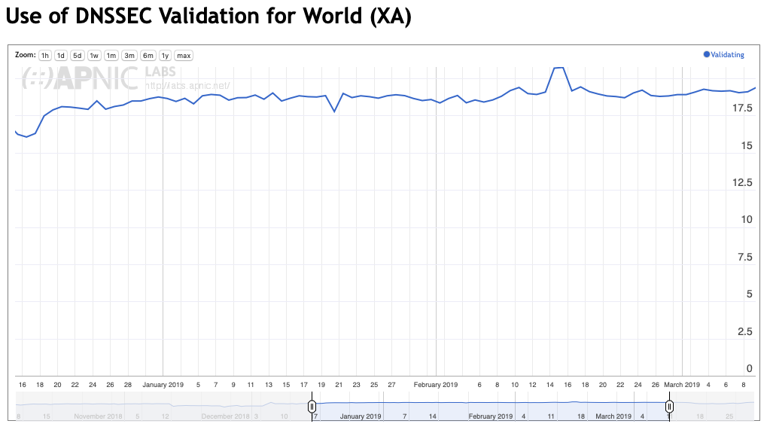
And for clients the revocation was uneventful

Slide 38
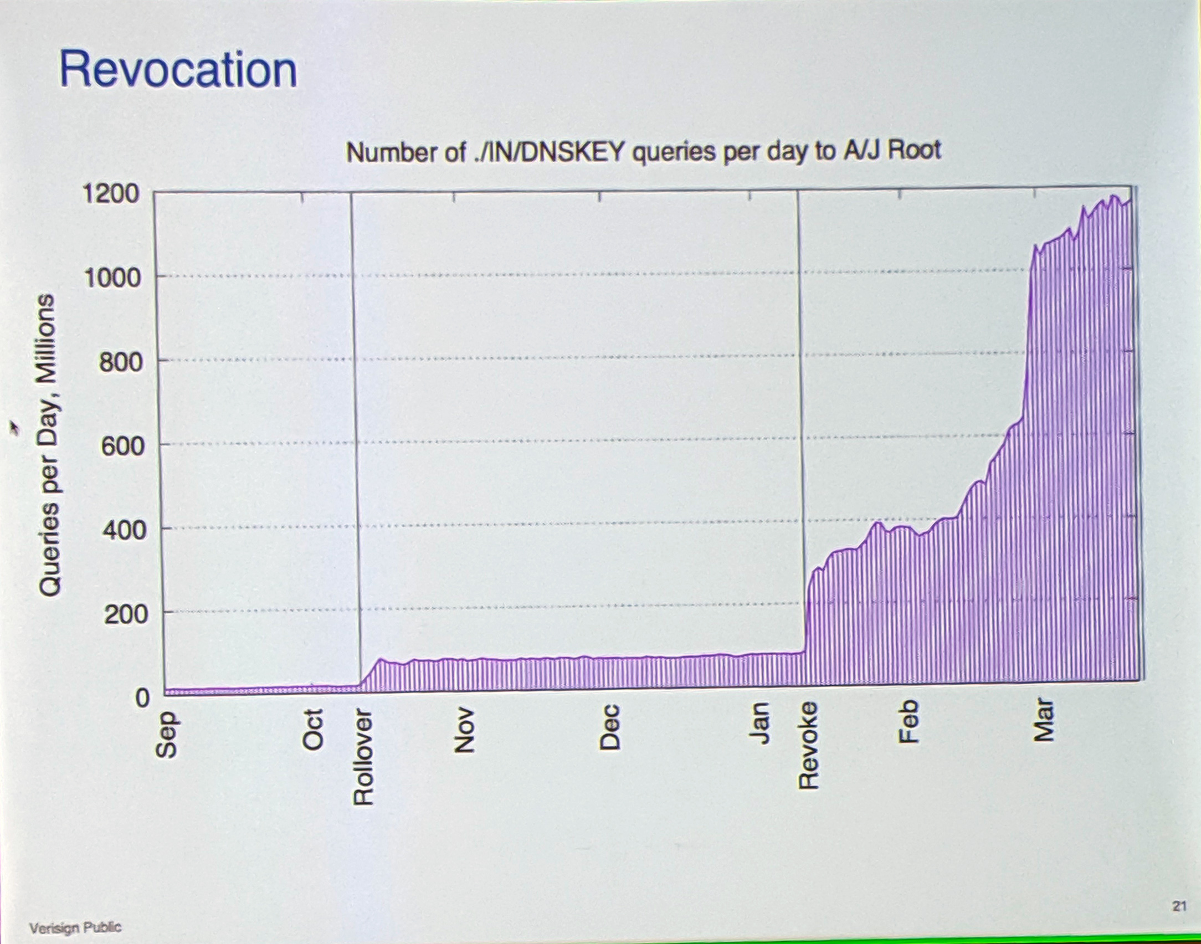
But Root Servers reported a different story
Duane Wessels, KSK Roller Post Analysis, DNS OARC, May 2019

Slide 39
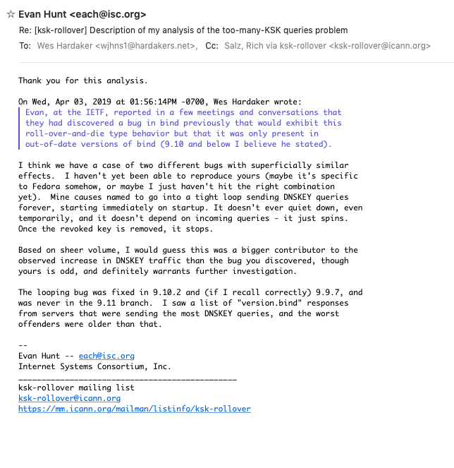
Why?
Query spin in old versions of a popularly deployed resolver

Slide 40
Lessons Learned
Yes, we can roll the KSK!
Yes, the extensive contact campaign helped
BUT
The DNS is VERY opaque!
Instrumentation was extremely challenging

Slide 41
What Next?

Slide 42
Observations
The operation was an experiment
DNS trust state signalling (both forms) seems to add more noise rather than clarity
We could think about making the DNS more transparent
  But there is a clear trade-off between greater transparency and exposing end user behaviours
  So maybe we might not want to go there!

Slide 43
Observations
Is DNSSEC validation most appropriately a resolver function or an edge function?
  Envisaged in DANE Chain Extensions in the TLS - requires edge devices to hold the current KSK value and perform DNSSEC validation
  Is 5011 really the best way for edge devices to maintain their KSK copy?
  Really?
If we want to think about scaling DNSSEC validation to every host device what KSK management practices will scale?

Slide 44
One View
We should perform this operation often
  Maybe we just need to keep rolling every year
  That way we train the manual loaders to keep up!
We should now look at an Elliptical Curve algorithm roll
We should now look at standing a backup KSK provision

Slide 45
Another View
Why are we rolling the KSK?
Actual key compromise might not play out in the same staged manner as a planned key roll
If these planned key rolls are not a rehearsal for some unforeseen potential calamity then why are we deliberately adding instability into DNSSEC?
Is doing this again going to teach us anything new?
Is old-signs-new really the best way to do this?
How should we scale the KSK?

Slide 46
Thanks!

