Slide 1
The Resolvers We Use
Geoff Huston
APNIC

Slide 2
The DoH Debate
DNS over HTTPS (DoH) has excited a lot of reaction:
  Some see this as trying to stop the widespread abuse of users via existing DNS inspection and manipulation practices (the “DNS Privacy” argument)
  Some see this as browsers bypassing a diverse ISP DNS infrastructure and passing DNS traffic to a far smaller set of open resolver operators (the “DNS Centrality” argument)

Slide 3
DNS Centrality
Will DoH make DNS Centrality “worse”?
Hard to say with knowing:
How good/bad is DNS Centrality today?
Hard to answer without data:
Can we measure DNS Centrality?

Slide 4
Measuring the Internet via its Users
At APNIC Labs we’ve been using online ads to measure the user’s view of the Internet for some years
  We ask users to fetch a unique URL
  This involves a DNS resolution and a HTTP GET to our servers
  So we collect sets of DNS queries and user data
We need to match the endpoint against the recursive resolver that performs the DNS query to the auth server

Slide 5
Users and Resolvers
These data sets also allow us to match
  the IP address of the resolver that queries the authoritative name server (the “visible resolver”)
to
  the IP address of the client plztform that retrieves the URL

Slide 6
Top 25 Resolvers – By IP Address
Rank Resolver Use % AS AS Name
1 125.5.210.212 0.57% AS7629 EPLDT, PH
2 196.188.52.8 0.49% AS24757 EthioNet-AS, ET
3 202.56.215.67 0.34% AS24560 Bharti Airtel, IN
4 2401:4900:50:9::5 0.34% AS9498 Bharti Airtel, IN
5 129.205.112.254 0.28% AS37148 Globa Com, NG
6 101.95.144.211 0.27% AS4812 China Telecom, CN
7 2405:200:160c:1957:78::6 0.27% AS55836 Reliance Jio, IN
8 49.45.29.22 0.27% AS55836 Reliance Jio, IN
9 2405:200:160c:1957:78::4 0.27% AS55836 Reliance Jio, IN
10 49.45.29.20 0.27% AS55836 Reliance Jio, IN
49.45.29.21 0.27% AS55836 Reliance Jio, IN
12 2405:200:160c:1957:78::5 0.26% AS55836 Reliance Jio, IN
13 221.228.15.194 0.25% AS4134 Chinanet Backbone, CN
14 101.95.144.210 0.25% AS4812 China Telecom, CN
15 219.128.128.102 0.21% AS58543 China Telecom, CN
16 2405:200:1613:1957:78::4 0.20% AS55836 Reliance Jio, IN
17 49.44.189.220 0.20% AS55836 Reliance Jio, IN
18 2405:200:1613:1957:78::5 0.20% AS55836 Reliance Jio, IN
19 49.44.189.221 0.20% AS55836 Reliance Jio, IN
20 49.44.189.222 0.20% AS55836 Reliance Jio, IN
21 2405:200:1613:1957:78::6 0.20% AS55836 Reliance Jio, IN
22 49.45.28.53 0.19% AS55836 Reliance Jio, IN
23 2405:200:1609:1957:78::5 0.19% AS55836 Reliance Jio, IN
2405:200:1609:1957:78::7 0.19% AS55836 Reliance Jio, IN
49.45.28.55 0.19% AS55836 Reliance Jio, IN
This list looks pretty strange!
A number of these resolvers share the same subnet – are they different resolvers or part of a larger resolver “farm”?

Slide 7
Top Resolvers – by Origin AS
Rank Resolver Use % Open Resolver / AS
1 Google DNS 9.39% GOOGLE, US
2 AS55836 7.89% Reliance Jio, IN
3 AS4134 5.22% ChinaNET Backbone, CN
4 AS4837 2.86% China Unicom, CN
5 AS9498 2.17% Bharti Airtel, IN
6 AS9808 1.66% China Mobile, CN
7 114dns 1.55% ChinaNET Backbone, CN
8 OpenDNS 1.49% OpenDNS, US
9 AS58543 1.47% China Telecom, CN
10 AS24560 1.25% Bharti Airtel, IN
11 dnspai 1.19% China Telecom, CN
12 AS38266 1.10% Vodafone India, IN
13 OneDns 1.01% China Unicom Beijing Province Network, CN
14 AS8151 0.92% Uninet, MX
15 AS45271 0.88% Idea Cellular, IN
16 AS56040 0.83% China Mobile, CN
17 AS7922 0.79% Comcast, US
18 Cloudflare 0.76% Cloudflare, US
19 Level3 0.76% Level 3, US
20 AS23693 0.73% Telekomunikasi Selular, ID
21 AS56046 0.71% China MobilE, CN
22 AS9121 0.66% TTNET, TR
23 AS17974 0.65% Telekomunikasi Indonesia, ID
24 AS7629 0.63% EPLDT, PH
25 AS132199 0.58% Globe Telecom, PH

Slide 8
First Resolver or Full Resolver Set?
End hosts are often configured with 2 or more recursive resolvers
Is there much of a change in the use of recursive resolvers when we look at this full resolver set?
Lets re-run this test with an authoritative name server that always returns the SERVFAIL response code

Slide 9
Top Resolvers – by Origin AS
Rank Resolver Use % Open Resolver / AS
1 googlepdns 22.84% Google, US
2 AS55836 7.92% Reliance Jio Infocomm Limited, IN
3 AS4134 5.59% ChinaNET Backbone, CN
4 AS4837 3.14% China Unicom, CN
5 114dns 3.13% ChinaNET, CN
6 AS9498 2.90% Bharti Airtel IN
7 opendns 2.56% OpenDNS, US
8 AS24560 2.54% Bharti Airtel, IN
9 AS9808 1.87% China Mobile, CN
10 level3 1.54% Level 3, US
11 AS58543 1.53% China Telecom, CN
12 dnspai 1.37% China Telecom, CN
13 cloudflare 1.23% Cloudflare, US
14 onedns 1.20% China Unicom, CN
15 AS38266 1.10% Vodafone India, IN
16 AS56046 1.05 % China Mobile, CN
17 AS8151 1.00% Uninet, MX
18 AS56040 0.96% China Mobile, CN
19 AS45271 0.91% Idea Cellular, N
20 AS7922 0.80% Comcast, US
21 AS23693 0.73% Telekomunikasi Selular, ID
22 AS7629 0.70% EPLDT, PH
23 AS9121 0.68% TTNET, TR
24 AS17974 0.66% Telekomunikasi Indonesia, ID
25 AS132199 0.58% Globe Telecom, PH
Full Resolver Set

Slide 10
Resolver Distribution

Slide 11
Resolver Distribution
90% of users
450 visible resolver sets handle the query load for 90% of all users
Just 3 resolver farms are used by 30% of users!

Slide 12
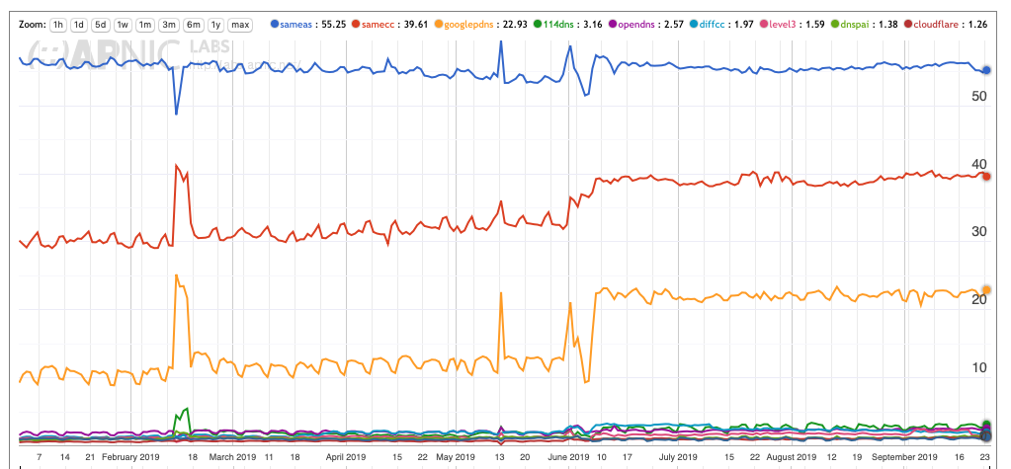
Counting Resolver Use
55% of users use resolvers located in the same network
40% of users use resolvers located in the same country
23% of users use Google’s public DNS service
https://stats.labs.apnic.net/rvrs

Slide 13
Mapping Open Resolvers
For each country can we show the distribution of the resolvers used by users located within that country?

Slide 14
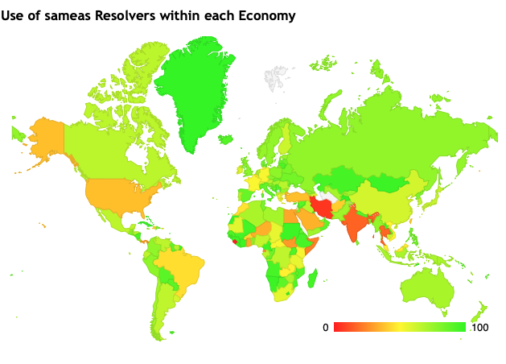
Mapping Open Resolvers
%Clients using ISP resolvers per Economy

Slide 15
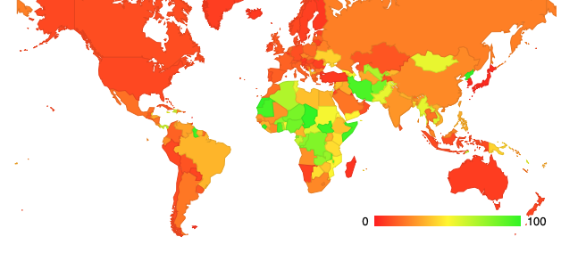
Mapping Open Resolvers
%Clients using Open Resolvers per Economy

Slide 16
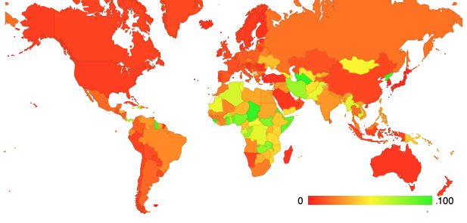
Where is Google’s DNS used?

Slide 17
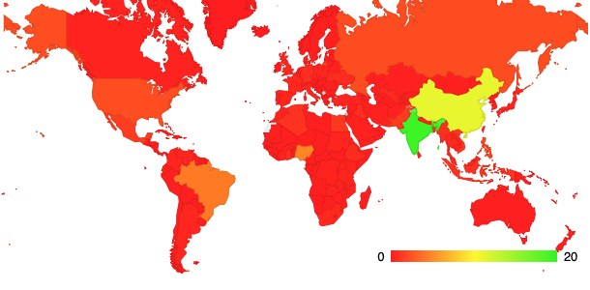
Where are Google’s DNS Users?

Slide 18
Why is this happening?
At lot of this story is Google’s Public DNS, which now has a “market share” of more than 9% of the entire Internet’s user population for first query, and included in 23% of all users’ full resolver sets
  In some cases individual users may want to circumvent content control via national DNS filtering measures
  In other cases ISPs redirecting queries towards Google, as its cheaper than running a local recursive DNS resolver service!
  Most users never twiddle the knobs – so its ISP / application settings rather than user settings that lie behind this resolver distribution

Slide 19
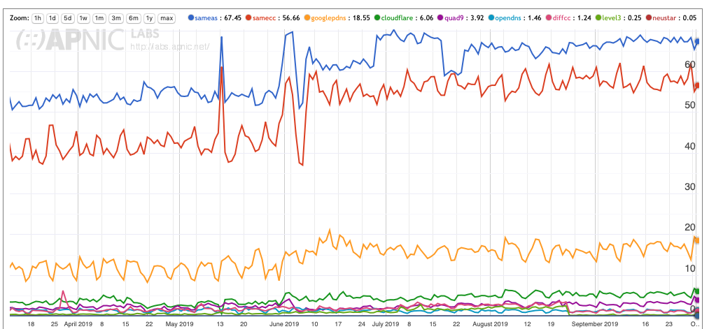
Netherlands
All Resolvers
66% of users use resolvers located in the same network
55% of users use resolvers located in the Netherlands
19% of users use Google

Slide 20
DNS Centrality?
Today: Not really
  Google’s service is used largely because ISPs (and some applications) direct queries to their service
  All other open resolvers have negligible market share from an Internet-wider perspective

Slide 21
Where is the DNS heading?
Is the DNS under pressure to aggregate to ever larger resolvers and server farms?
What is the economic model of name resolution in a highly aggregated environment? Will resolver operators rely on data mining of queries to generate revenue streams?
Is it possible to reduce the information exposure while still using common resolver caches?
What is the nature of the trade-off between resolution performance and information leakage in DNS resolution?
Will application-specific name realms take over this space? Are we seeing the end of the current model of a single infrastructure-level DNS?

Slide 22
Thanks!

