Slide 1
NSEC Caching Revisited
  Geoff Huston, Joao Damas
  APNIC Labs
  October ‘19

Slide 2
What is NSEC Caching?
RFC 8198, July 2017:
If a DNS zone is pre-signed then each zone entry is “connected” to the next with a NSEC (or NSEC3) record
Proof of non-existence of a name is provided by a signed NSEC record that “spans” the query name
If a DNSSEC-validating recursive resolver receives an NSEC record it can cache this record and use it to answer all subsequent queries for names in the NSEC span for the TTL of the record

Slide 3
NSEC Caching Benefits
(according to RFC8198)
Reduced Latency
Decreased Recursive Resolver Load
Decreased Authoritative Server Load
Random name attack mitigation

Slide 4
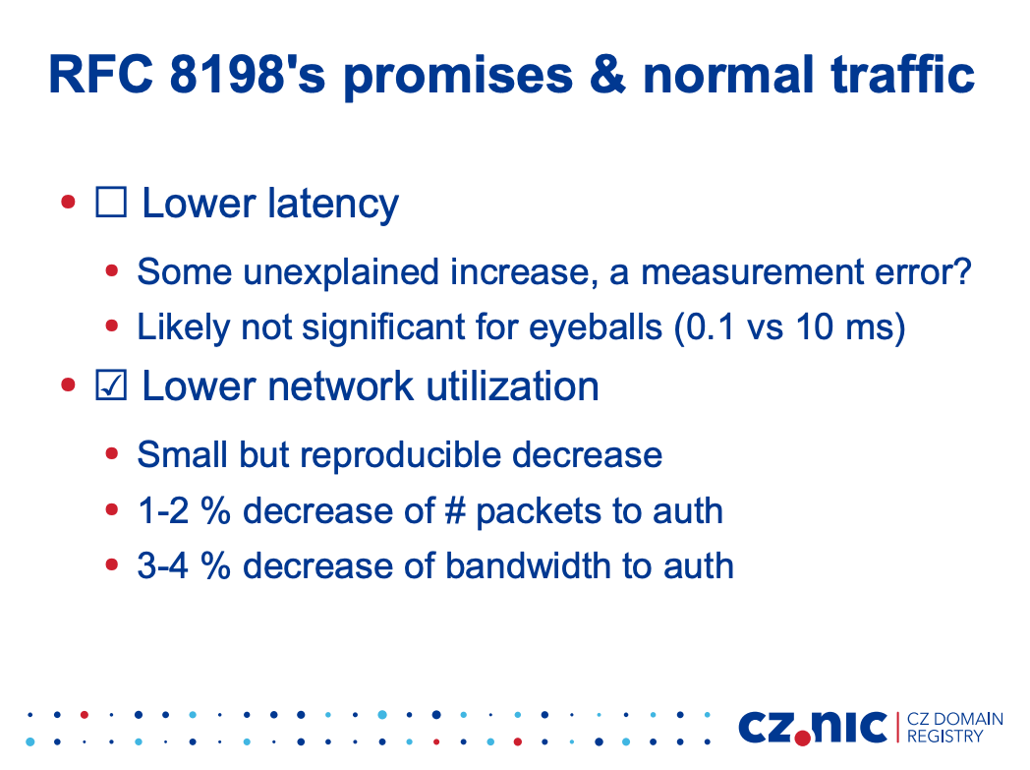
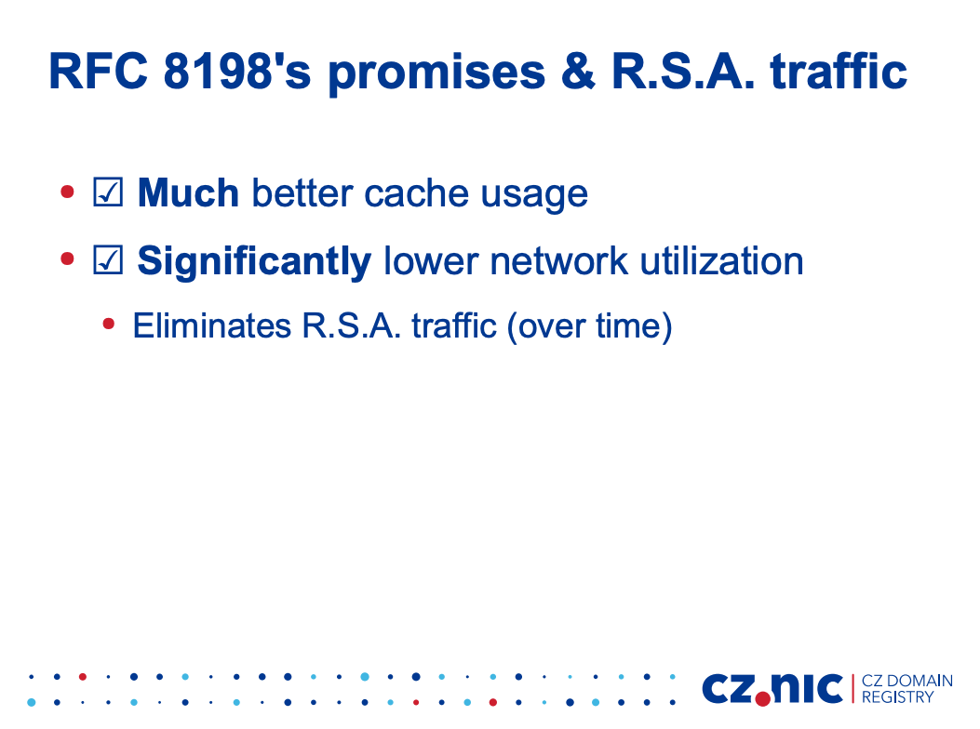
Does it Deliver?
Petr Špaček’s report to DNS OARC 28 (2018)
  https://indico.dns-oarc.net/event/28/contributions/509/attachments/479/786/DNS-OARC-28-presentation-RFC8198.pdf
Random Subdomain Attack Traffic

Slide 5
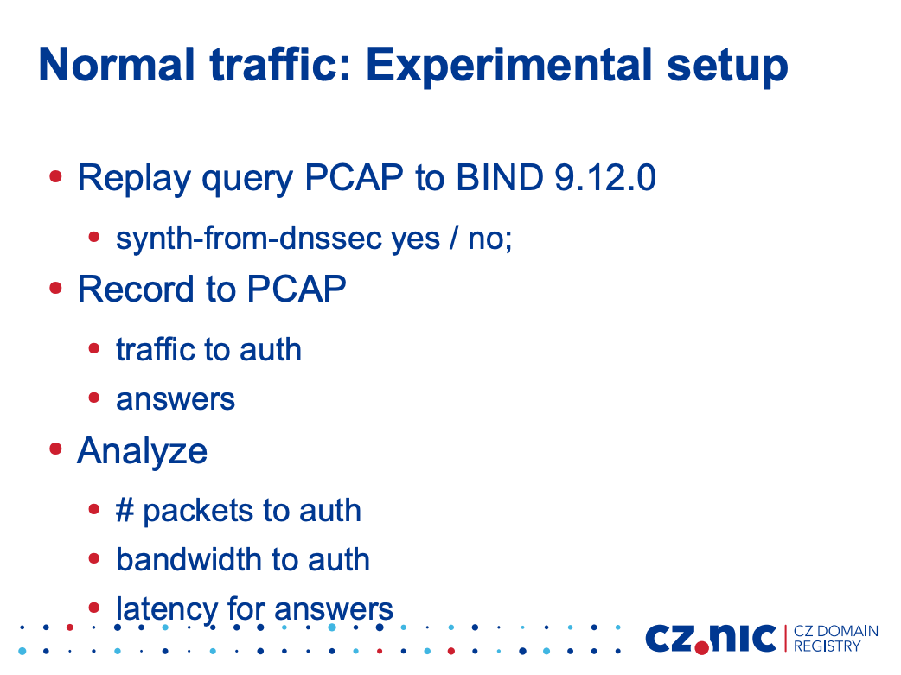
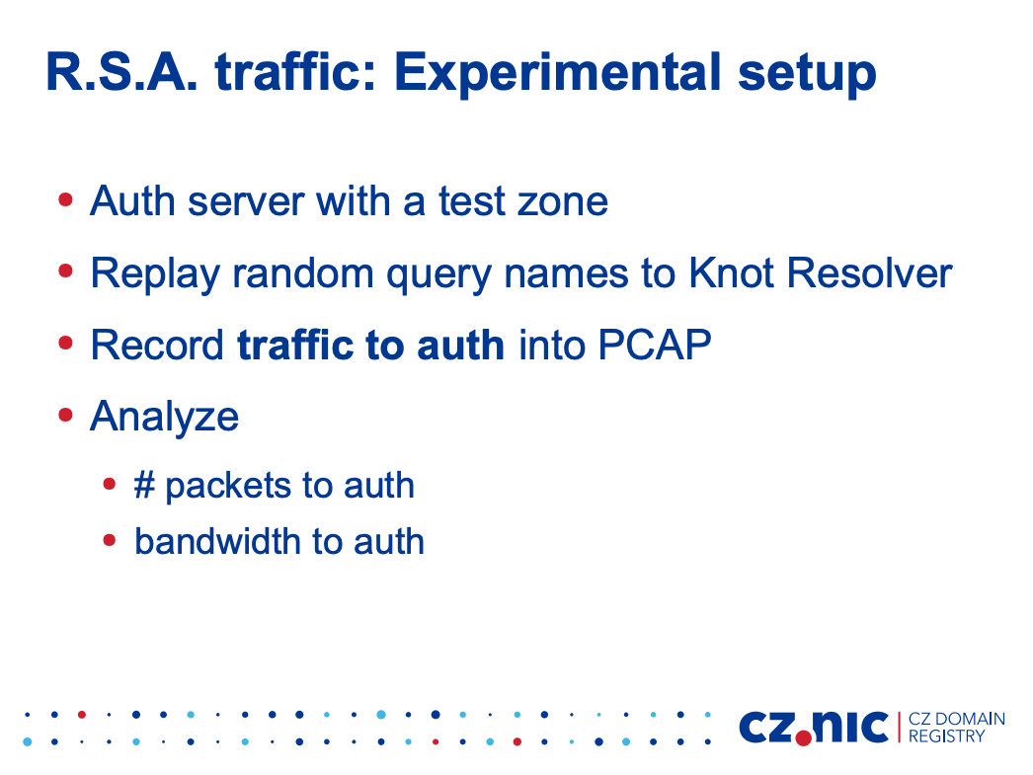
Does it Deliver?
Petr Špaček’s report to DNS OARC 28 (2018)
  https://indico.dns-oarc.net/event/28/contributions/509/attachments/479/786/DNS-OARC-28-presentation-RFC8198.pdf

Slide 6
Benchtop vs Live Measurement
Petr’s results were obtained by feeding a log of query data into a resolver and measuring the query traffic from the resolver to the authoritative server(s)
We thought it would be useful to see if these results are reproducible in the Internet:
To what extent is NSEC caching visible in the DNS today?
How well does NSEC caching work?

Slide 7
Measurement Setup
We use APNIC Lab’s Ad-based measurement platform in conjunction with a set of servers
The Ad campaign delivers some 8M – 12M ads per day to eyeball networks across the entire Internet
Each ad contains an HTML5 script that runs the NSEC experiment:
  Generate unique label name within a DNSSEC-signed domain name and query
  The DNSSEC response is an NXDOMAIN code with an NSEC record that includes a span across the label name space in the domain
  Wait 2 seconds
  Generate a new unique label name sits within the span of the NSEC record

Slide 8
Measurement Setup
Controls:
We use a pair of unique labels that generate a CNAME response to a unique non-existent name
  That way the authoritative server will see the query that generates the CNAME response and depending on whether the recursive resolver is performing NSEC caching the authoritative server may (or may not) see the second CNAME target name query
We use a second pair of labels that are generated within an unsigned zone where the server always returns NXDOMAIN

Slide 9
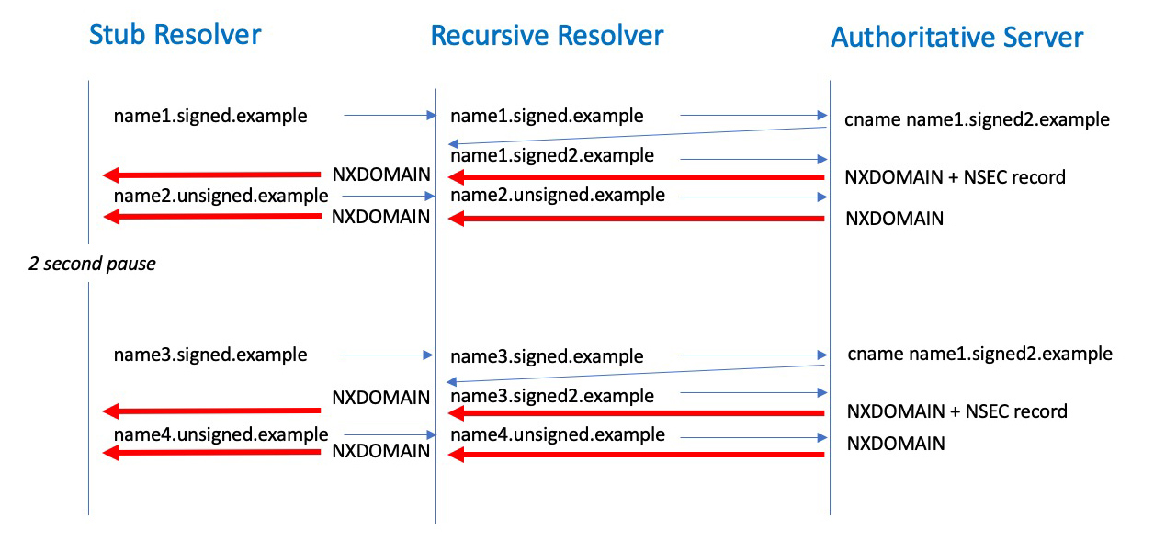
Measurement Details
3

Slide 10
Measurement Details
3
We should not see this query if the recursive resolver is performing NSEC caching

Slide 11
Measurement Details
We might not see this query either if a previous NSEC record has been cached
3
We should not see this query if the recursive resolver is performing NSEC caching

Slide 12
Predictions
How many users sit behind DNSSEC validating resolvers?
In this case the NSEC record is validly signed, so we are interested only in the user’s “first choice” resolver

Slide 13
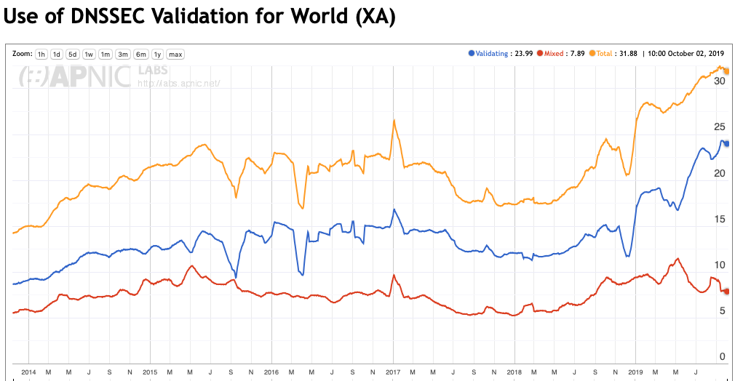
DNSSEC Validation Rates
30% of users send queries to DNS resolvers that perform DNSSEC validation
https://stats.labs.apnic.net/dnssec/XA

Slide 14
Predictions
In up to 30% of these measurements we expect to see a query pattern consistent with DNSSEC validation being performed by the recursive resolver
The maximum NSEC caching rate would therefore be visible for some 30% of users
  While some resolver code has NSEC caching enabled by default other code sets have it as a configurable option
  Somewhere between 0% and 30% of all measurements is the range of possible outcomes from this experiment

Slide 15
Results
7% average outcome
Weekdays tend to be higher
98 days, 266M experiments

Slide 16
This is lower than we had anticipated
And some open resolvers that we had thought were NSEC caching were showing variable behaviour
  Sometimes they queried as if they were NSEC caching and other times not
What’s going on?

Slide 17
DNS Load Balancing
The scenario of a stub resolver sending queries to a single instance of a DNS recursive resolver is being overshadowed by DNS load balancing scenarios
Auth Server
Resolver selection
Stub Resolver
DNS
Load Balancer
Recursive Resolvers

Slide 18
Measuring Load Balancing by IP addresses
Over the 98 day period we observed 559,357 distinct IP addresses that queried the experiment’s authoritative name servers with query names generated by the experiment
If we group these addresses using a /24 (IPv4) and /48 (IPv6) subnet we observed 295,546 distinct subnets
More than one half of the visible recursive resolver set share a common subnet with other recursive resolvers

Slide 19
Query Distribution in Resolver Farms
How do you distribute DNS queries in a resolver farm and maximise cache performance?
  Run some form of cache memory bus across the resolvers to share cached data across all members of the resolver farm
  or
  Hash the query name so that the same resolver handles all queries for a given name

Slide 20
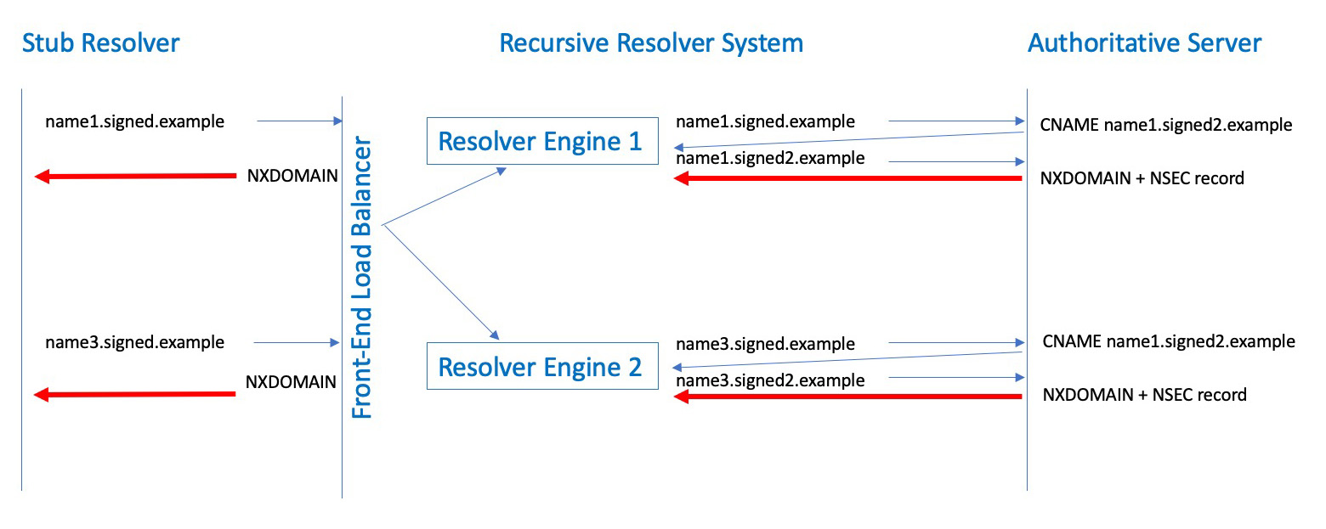
Query Name Hashing and NSEC caching
3

Slide 21
Does NSEC Caching Deliver?
The results are not all that promising for conventional query traffic
Despite a large number of recursive resolvers performing DNSSEC validation (and possibly even performing NSEC caching) the apparent widespread use of qname-hashing DNS load balancers works against NSEC caching

Slide 22
What about NSEC caching as a response to Random Subdomain Attack?
It depends…
If the attack query pattern is widely distributed then each recursive resolver may not experience sufficient query intensity to load all resolver farm members with the cached NSEC records
But
  We didn’t test this scenario using the ad platform using a very high query intensity as we don’t have the capacity in this platform to operate at very high query loads over sustained periods

Slide 23
NSEC Caching?
The recursive resolver needs to perform range checks against its help cache state - this may make lookups into the cache database slightly slower
The cache does not contain individual NXDOMAIN entries for signed zones, so the cache efficiency increases with NSEC caching
Commonly used DNS load balancers appear to spread query names across individual resolver engines and this appears to reduce the effectiveness of NSEC caching for the resolver farm as a whole

Slide 24
NSEC Caching?
Mostly Harmless!
NSEC caching does not appear to be harmful to the DNS
But in today’s resolver environment the interplay between commonly used load balancers and queries for non-existent names tends to negate much of the potential benefit of NSEC caching

Slide 25
One more thing…
The observed model of DNS operational deployment at scale is diverging from the classical stub-resolver-authoritative model that many still use as a reference
Caching has long been a fundamental property of DNS but the current deployment model with extensive use of DNS load balancers alters aggregate cache behaviour
Is it time to consider how DNS load balancers fit within the larger DNS architecture?

Slide 26
Standards?
This is similar to the situation with NATs for many years
The absence of standard specifications that describe how such units should behave mean that individual implementors are able to make their own choices
And this can result in unexpected variance in behaviours for aspects of DNS resolution

Slide 27
Thanks!

