Slide 1
Cause and Effect
Geoff Huston
APNIC Labs
July 2020

Slide 2
Approaches to DNS Measurement...
Gather a set of DNS queries and/ or responses from a recursive resolver or an authoritative server
Sift through the query/response log using some form of selection criteria
Propose a theory of DNS behaviour based on the observed traffic

Slide 3
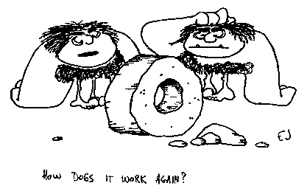
Approaches to DNS Measurement...
The problem with this approach is that there is no clear picture of why the query was made:
It could’ve been a stub resolver query from an application
Or a resolver performing cache refresh
Or a query log analyzer performing query/response validation
Or some form of attack or backscatter from an attack
Or <other>!

Slide 4
Alternatively…
We might understand the effect better if we controlled the cause
  i.e. generate queries in a known context and look at their effect within in the DNS resolution environment

Slide 5

Inside looking Out
Instrument a DNS client
  Use the client to generate various DNS queries
  Measure the absolute outcomes and the variance
This needs the ability to either coopt or manufacture a collection of willing clients

Slide 6
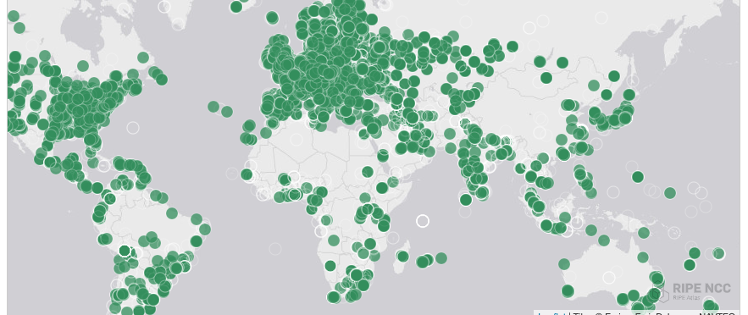
Inside looking Out
  RIPE Atlas
    Many thousands of end points installed in end user networks
    Programmable DNS queries
    Report back

Slide 7

Outside looking In
Set up authoritative server(s)
  Enroll end users to send queries to it
  Measure the outcomes from the perspective of the server, not the end client

Slide 8
How to measure using millions of end devices?
APNIC Lab’s approach
we originally wanted to measure IPv6 deployment as seen by end users
We wanted to say something about ALL users
So we were looking at a way to sample end users in a random but statistically significant fashion across the entire network
We stumbled across the advertising networks...

Slide 9


Slide 10
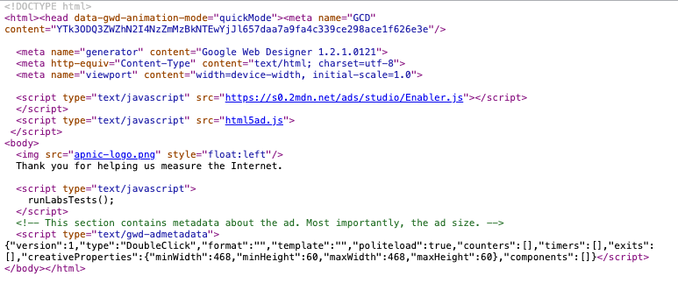

Slide 11
What can be scripted
Not much:
  http.FetchImg()
    i.e. attempt to retrieve a URL
But that’s enough!
  It’s EXACTLY what users do!
  A URL consists of a DNS question and an HTML question
  What if we point both the DNS and the HTML to servers we run?
  As long as each Ad execution uses unique names we can push the user query back to our servers

Slide 12
DNS Label encoding
Think of a DNS name as a microcoded instruction set directed to programmable DNS and HTTP servers …
http://06s-u69c5b052-c13-s1579128735-icb0a3c4c-0.ap.dotnxdomain.net/1x1.png
Coded instructions to the authoritative server to deliver a particular response
Information about the client and when the label was created
Syntactic sugar to keep the advertiser happy!

Slide 13
DNS Label Encoding
Think of a URL name as a microcoded instruction set directed to programmable DNS and HTTP servers …
http://06s-u69c5b052-c13-a4c5-s1579128735-icb0a3c4c-0.ap.dotnxdomain.net/1x1.png
Immediate response
IPv6 access only
Valid DNSSEC signature available
uuid to map multiple queries to a single experiment
User is located in Country 13 (Australia)
User is located in AS1221 (Telstra)
Time is 16 January 2020 9:52am
User’s IPv4 address is 203.10.60.76

Slide 14
Generating a DNS response behaviour
Use the query label to trigger a particular DNS response behaviour, such as:
  Validly DNSSEC-signed or invalidly signed
  Padded (large) response
  Truncated response
  Delayed response
  SERVFAIL response
  NXDOMAIN

Slide 15
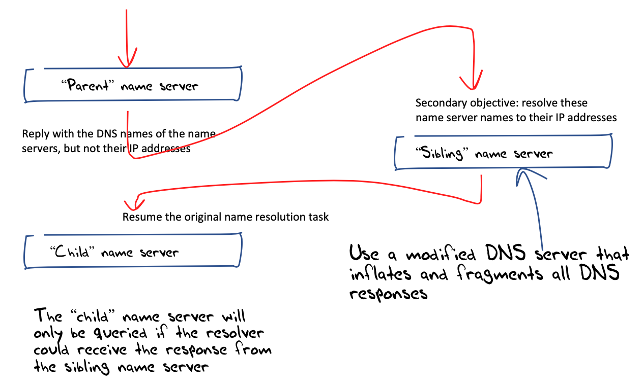
Confirming responses
How can you tell if the client received the DNS response?
  Leverage the DNS discovery process using a technique of “glueless” delegation where the label is at the apex of its own delegated zone
  Inject the DNS behaviour into the name server response
  The final query will only be made if the discovery name server response was received

Slide 16
Example Measurements
DNSSEC validation capability
Distribution of use of open DNS resolvers
DNS happy eyeballs
DNS over IPv6
NSEC caching
Qname minimisation
Zombie query patterns
KSK roll analysis

Slide 17
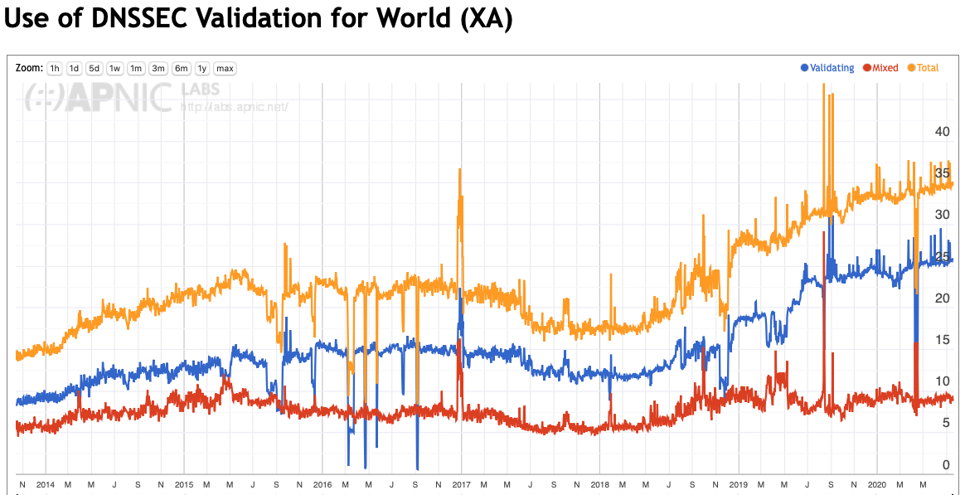
Example: DNSSEC Validation
https://stats.labs.apnic.net/dnssec/XA

Slide 18
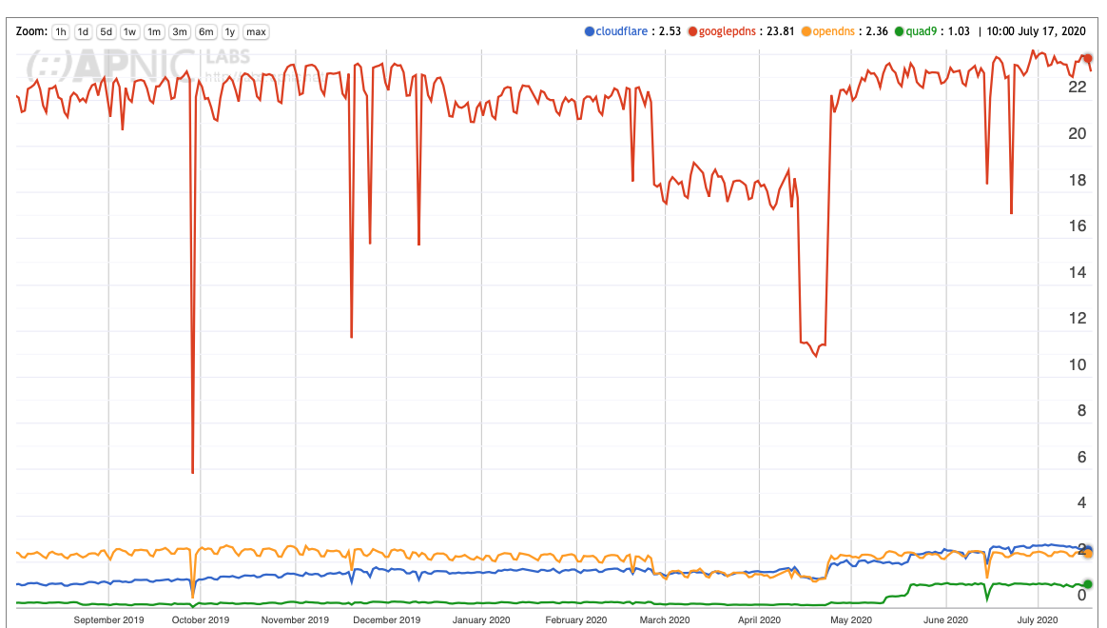
Example: Open DNS Resolver Use
https://stats.labs.apnic.net/rvrs/XA

Slide 19
Thanks!

