Slide 1
Security
Geoff Huston
Chief Scientist, APNIC

Slide 2
Insecurity
Geoff Huston
Chief Scientist, APNIC

Slide 3
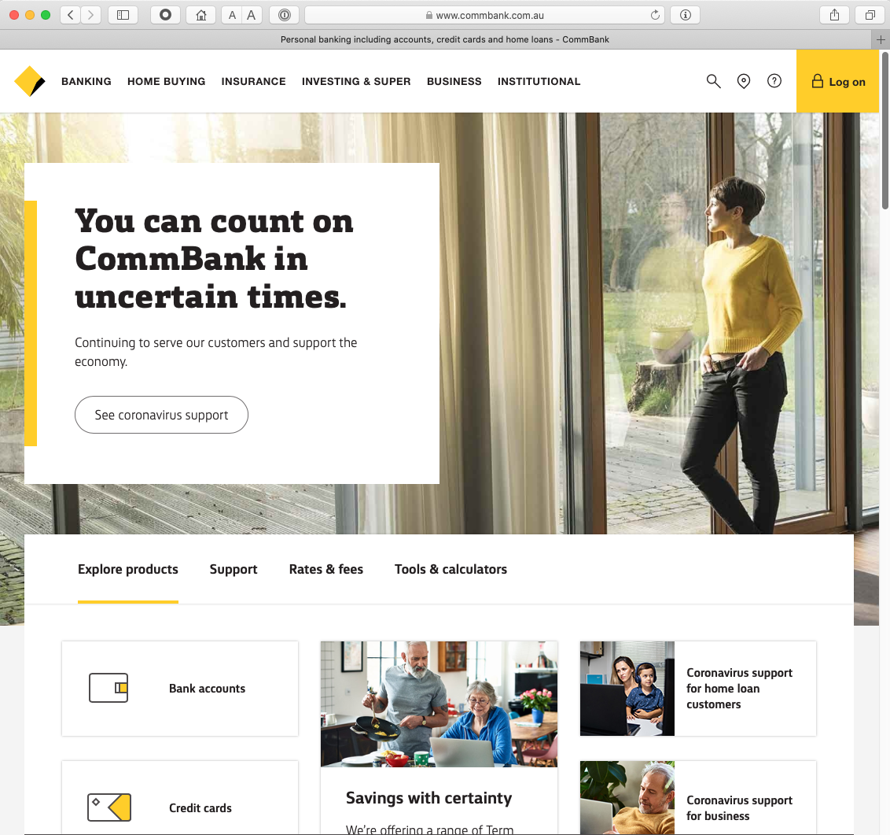
Which Bank?

Slide 4
Which Bank? My Bank!

Slide 5
Which Bank? My Bank!
I hope!

Slide 6
Security on the Internet
How do you know that you are really going to where you thought you were going to?
Its trivial to mock up a web page to look like another

Slide 7
Security on the Internet
How do you know that you are really going to where you thought you were going to?
So why should I enter my username and password into this particular screen?
Its trivial to mock up a web page to look like another

Slide 8


Opening the Connection: First Steps
Client:
DNS Query:
www.commbank.com.au?
DNS Response:
23.214.88.32
TCP Session:
TCP Connect 23.214.88.32, port 443

Slide 9
Hang on…
$ dig -x 23.214.88.32 +short
a23-214-88-32.deploy.static.akamaitechnologies.com.

Slide 10
Hang on…
$ dig -x 23.214.88.32 +short
a23-214-88-32.deploy.static.akamaitechnologies.com.
That’s not an IP addresses that was allocated to the Commonwealth Bank!
  The Commonwealth Bank of Australia has the address blocks
  140.168.0.0 - 140.168.255.255 and
  203.17.185.0 - 203.17.185.255

Slide 11
Hang on…
$ dig -x 23.214.88.32 +short
a23-214-88-32.deploy.static.akamaitechnologies.com.
That’s an Akamai IP address
And I’m NOT a customer of the Internet Bank of Akamai!
Why should my browser trust that 23.214.88.32 is really the authentic web site for the Commonwealth Bank of Australia, and not some dastardly evil scam designed to steal my passwords and my money?
And why should I trust my browser?

Slide 12
The major question…
How does my browser tell the difference between an intended truth and a dastardly lie?

Slide 13

Security on the Internet
Also, how can you keep your session a secret from wire(less) snoopers?

Slide 14
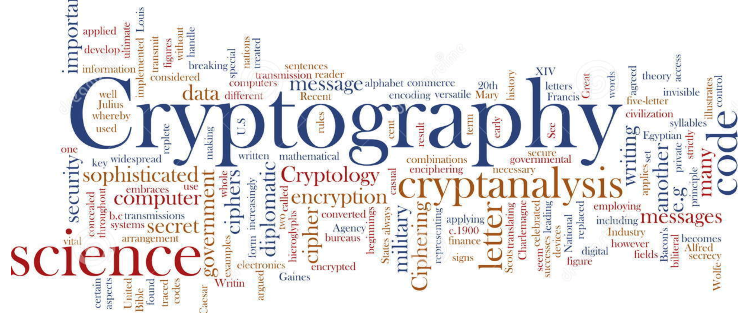
It’s all about cryptography

Slide 15
Public Key Cryptography
Pick a pair of keys such that:
  Messages encoded with one key can only be decoded with the other key
  Knowledge of the value of one key does not infer the value of the other key
  Make one key public, and keep the other a closely guarded private secret

Slide 16
The Power of Primes
(m^{e})^{d} ≡ m (mod n)
As long as d and n are relatively large, and n is the product of two large prime numbers, then finding the value of d when you already know the values of e and n is computationally expensive

Slide 17
Why is this important?
Because much of the foundation of Internet security rests upon this prime number relationship
Because prime number factorization still involves enumeration
And cryptography is still about getting the defender to perform just enough work to make the attacker’s task so much greater that its infeasible

Slide 18
Back to Public/Private Key Pairs
If I have a copy of your PUBLIC key,
And you encrypt a message with your PRIVATE key,
Then I can decrypt the message.
And I know it was you that sent it.
And you can’t deny it.

Slide 19
Public Key Certificates
But how do I know this is YOUR public key?
  And not the public key of some dastardly evil agent pretending to be you?
I don’t know you
I’ve never met you
So I have absolutely no clue if this public key value is yours or not!

Slide 20
Public Key Certificates
What if I ‘trust’ an intermediary?
  Who has contacted you and validated your identity and conducted a ‘proof of possession’ test that you have control of a private key that matches your public key
Then if the intermediary signs an attestation that this is your public key (with their private key) then I would be able to trust this public key
This ‘attestation’ takes the form of a “public key certificate”

Slide 21
Public Key Certificates
If the intermediary signs an attestation that this is a public key (with their private key) then
  I trust this intermediary
  And this intermediary has said that this is your public key
  Then I can trust that this is your public key
This ‘attestation’ takes the form of a “public key certificate”

Slide 22
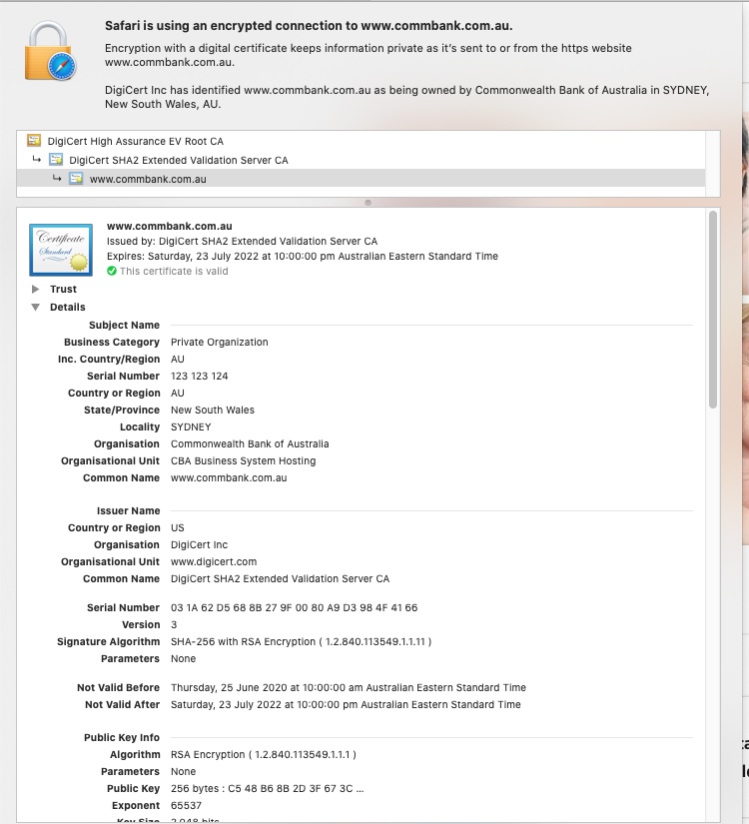

Slide 23
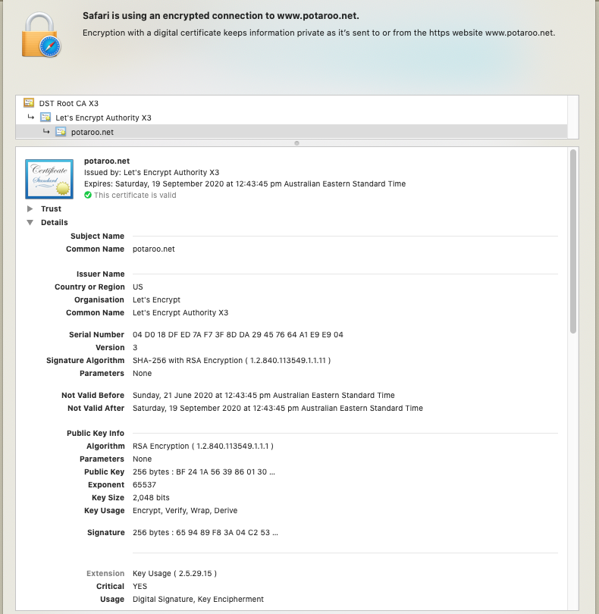
No all certificates are the same - This certificate binds a public key to a set of names without any attestation to the identity of the name “holder”

Slide 24
Spot the Difference
Safari
Chrome

Slide 25
Spot the Difference
Safari
Chrome
This web site’s certificate was issued to an organisation called the “Commonwealth Bank of Australia” located in Sydney, Australia
This web site’s certificate was issued to “Cloudflare Inc” located in San Francisco, USA!!
This web site’s certificate says nothing about the entity that holds the public key associated with this domain

Slide 26
Moving on…
Ok, so the certificate system is a total mess, but TLS still works, right?

Slide 27
Secure Connections using TLS
https://rhsecurity.wordpress.com/tag/tls/

Slide 28
Secure Connections using TLS
https://rhsecurity.wordpress.com/tag/tls/

Slide 29
Secure Connections using TLS
https://rhsecurity.wordpress.com/tag/tls/

Slide 30
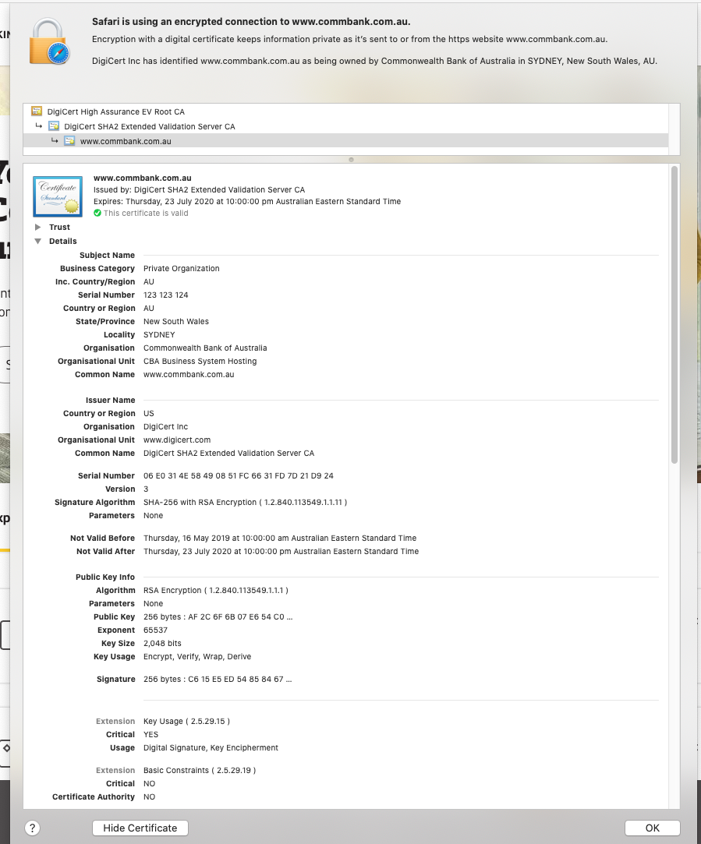

Slide 31
Secure Connections using TLS
How does the client
recognise this certificate
as the “right” certificate?
https://rhsecurity.wordpress.com/tag/tls/

Slide 32
How did my browser know that this is a “valid” cert?

Slide 33
Domain Name Certification
The Commonwealth Bank of Australia has generated a key pair
And they passed a certificate signing request to a company called “DigiCert Inc” in the US
Who was willing to vouch (in a certificate) that the entity is called the Commonwealth Bank of Australia and they have control of the the domain name www.commbank.com.au and they have a certain public key
So if I can associate this public key with a connection then I have a high degree of confidence that I’ve connected to an entity that is able to demonstrate knowledge of the private key for www.commbank.com.au, as long as I am prepared to trust DigiCert and the certificates that they issue
And I am prepared to trust them because DigiCert NEVER lie!

Slide 34
Domain Name Certification
The Commonwealth Bank of Australia has generated a key pair
And they passed a certificate signing request to a company called “DigiCert Inc” in the US
Who was willing to vouch (in a certificate) that the entity is called the Commonwealth Bank of Australia and they have control of the the domain name www.commbank.com.au and they have a certain public key
So if I can associate this public key with a connection then I have a high degree of confidence that I’ve connected to an entity that is able to demonstrate knowledge of the private key for www.commbank.com.au, as long as I am prepared to trust DigiCert and the certificates that they issue
And I am prepared to trust them because DigiCert NEVER lie!
How do I know that? Why should I trust them?

Slide 35
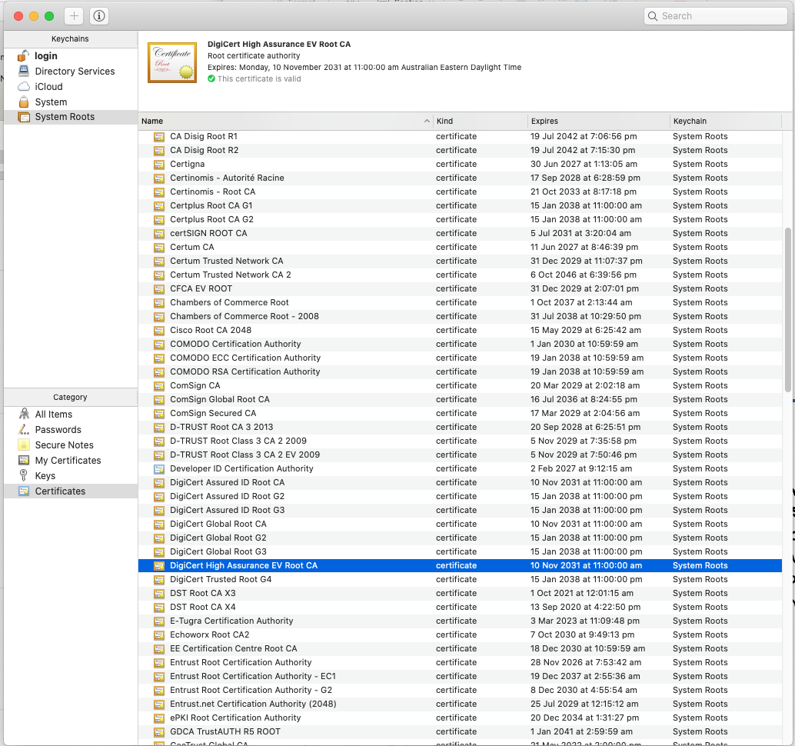
Local Trust
The cert I’m being asked to trust was issued by a certification authority that my browser already trusts – so I trust that cert!

Slide 36
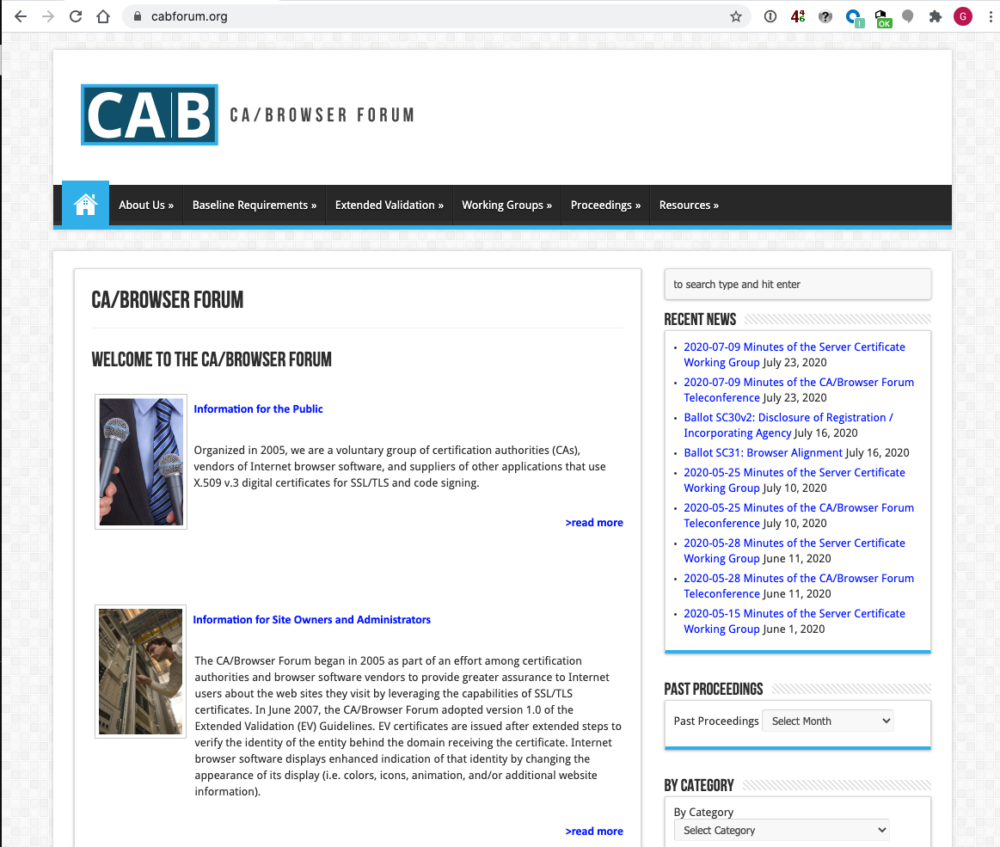
Local Trust
These Certificate Authorities are listed in my computer’s trust set because they claim to operate according to the practices defined by the CAB industry forum (of which they are a member) and they never lie!

Slide 37
Local Trust
These Certificate Authorities are listed in my computer’s trust set because they claim to operate according to the practices defined by the CAB industry forum (of which they are a member) and they never lie!
So somebody (I have never met) paid someone else (whom I have also never met) some money and then my browser trusts everything they have ever done and everything they will ever do in the future – ok?

Slide 38
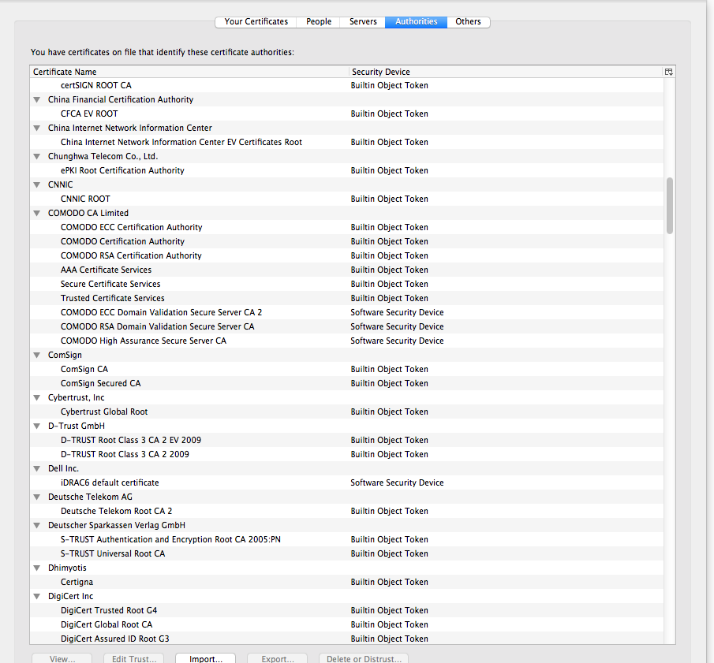
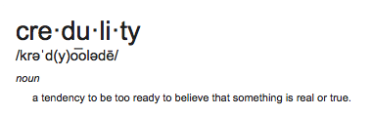
Local Trust or Local Credulity*?
Wow!
Are they all trustable?
*

Slide 39
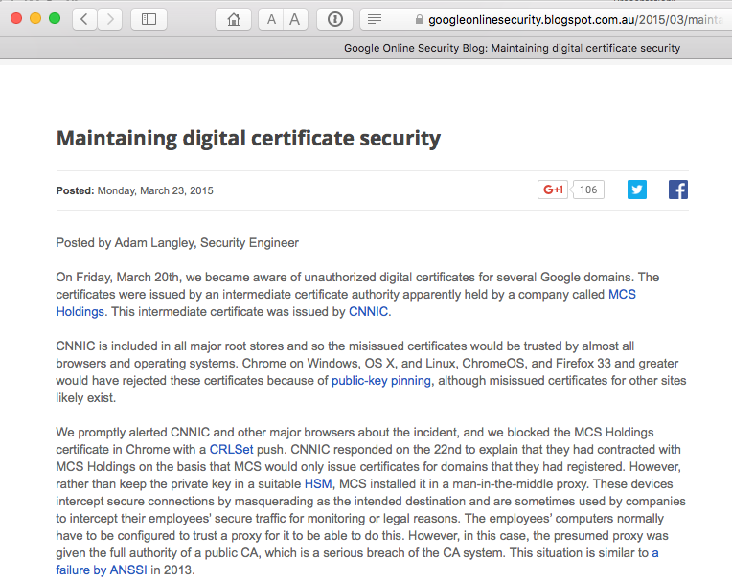
Local Credulity
Wow!
Are they all trustable?
Evidently Not!

Slide 40
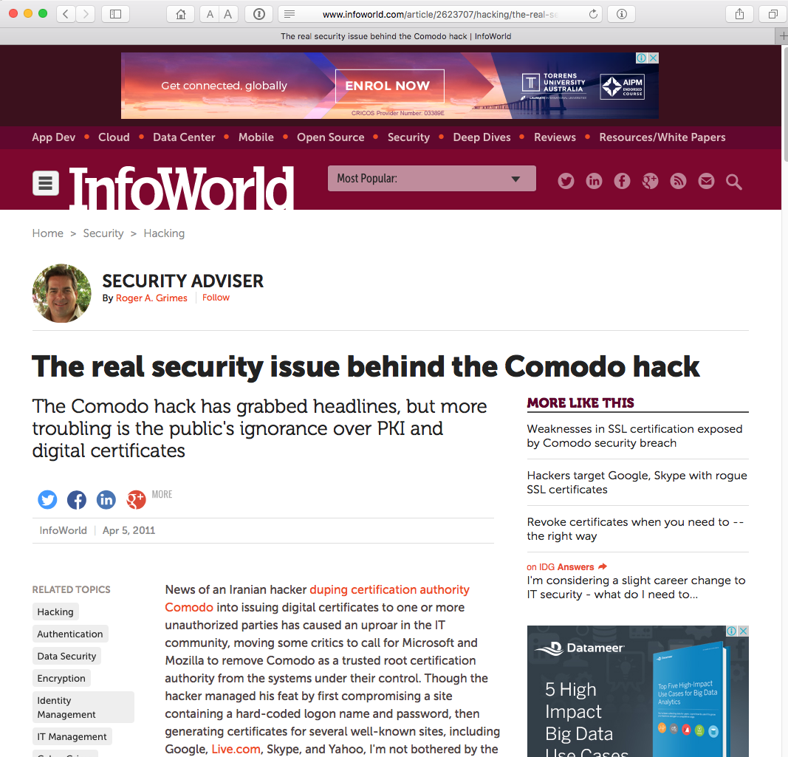
Local Credulity
Wow!
Are they all trustable?
Evidently Not!

Slide 41
Never?

Slide 42
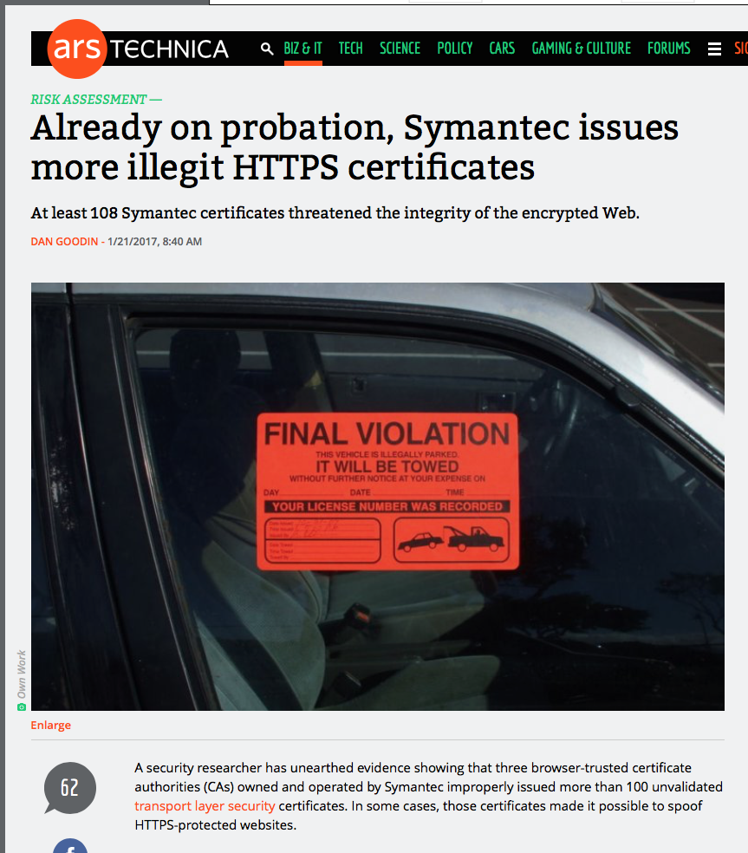
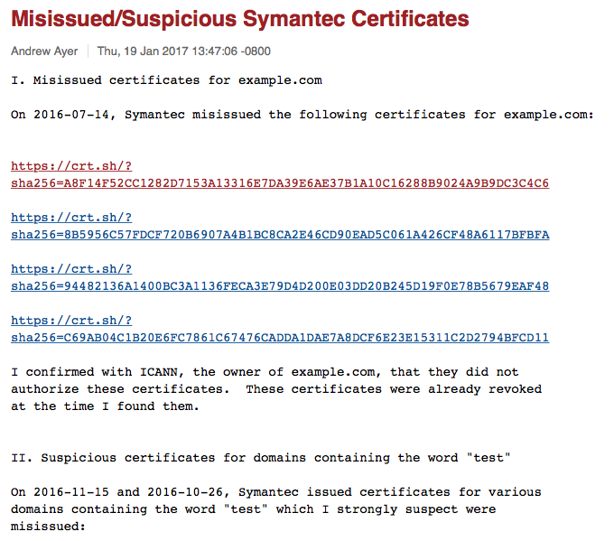
Well, hardly ever
http://arstechnica.com/security/2017/01/already-on-probation-symantec-issues-more-illegit-https-certificates/

Slide 43
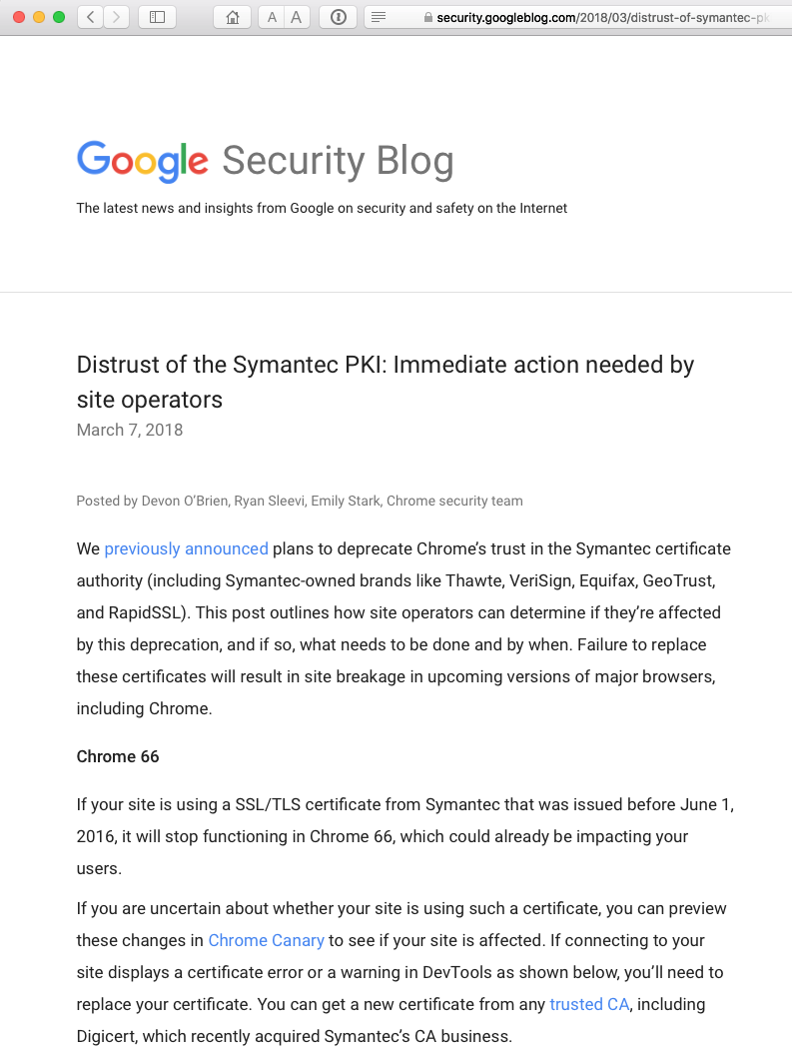
Well, hardly ever

Slide 44
With unpleasant consequences when it all goes wrong

Slide 45
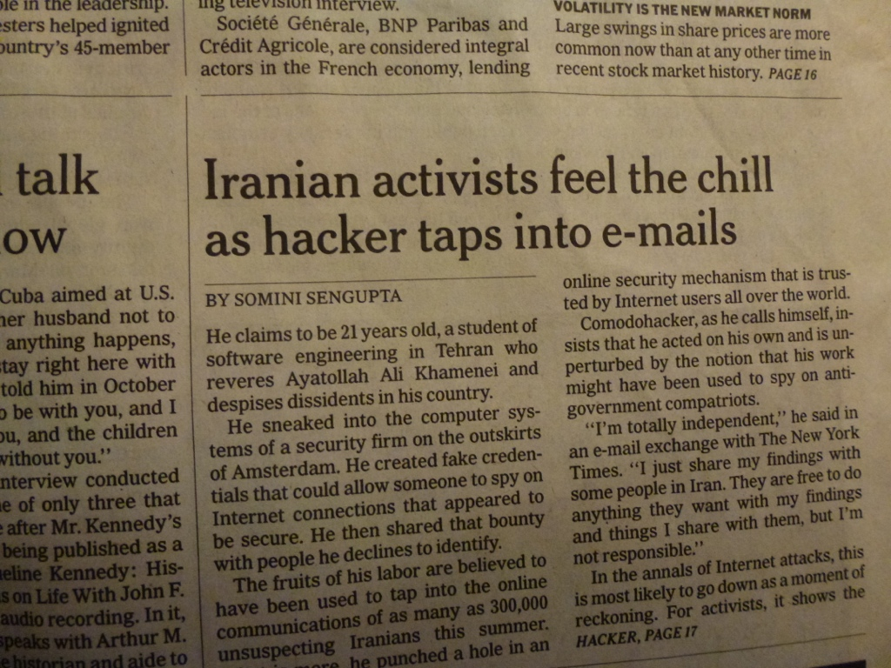
With unpleasant consequences when it all goes wrong
International Herald Tribune
Sep 13, 2011 Front Page

Slide 46
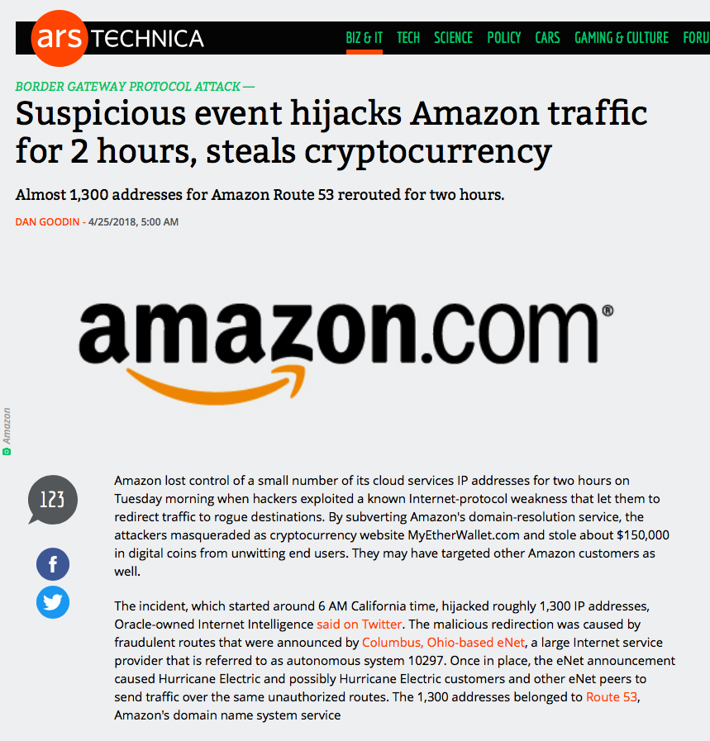

Slide 47
What’s going wrong here?

Slide 48
What’s going wrong here?
The TLS handshake cannot specify WHICH CA should be used by the client to validate the digital certificate that describes the server’s public key
The result is that your browser will allow ANY CA to be used to validate a certificate!

Slide 49
What’s going wrong here?
The TLS handshake cannot specify WHICH CA should be used by the client to validate the digital certificate that describes the server’s public key
The result is that your browser will allow ANY CA to be used to validate a certificate!
WOW! That’s awesomely bad!

Slide 50
What’s going wrong here?
The TLS handshake cannot specify WHICH CA should be used by the client to validate the digital certificate that describes the server’s public key
The result is that your browser will allow ANY CA to be used to validate a certificate!
Here’s a lock – it might be the lock on your front door for all I know.
The lock might LOOK secure, but don’t worry – literally ANY key can open it!
WOW! That’s awesomely bad!

Slide 51
What’s going wrong here?
There is no incentive for quality in the CA marketplace
Why pay more for any certificate when the entire CA structure is only as strong as the weakest CA
And your browser trusts a LOT of CAs!
  About 60 – 100 CA’s
  About 1,500 Subordinate RA’s
  Operated by 650 different organisations
See the EFF SSL observatory
http://www.eff.org/files/DefconSSLiverse.pdf

Slide 52
In a commercial environment
Where CA’s compete with each other for market share
And quality offers no protection
Then what ‘wins’ in the market?
Sustainable
?
Resilient
Secure
Privacy
Trusted

Slide 53
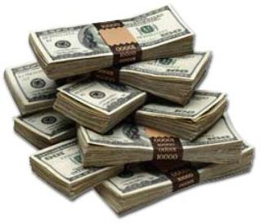
In a commercial environment
Where CA’s compete with each other for market share
And quality offers no protection
Then what ‘wins’ in the market?
Sustainable
Cheap!
Resilient
Secure
Privacy
Trusted

Slide 54
But its all OK
Really.
Because ‘bad’ certificates can be revoked
And browsers always check revocation status of certificates

Slide 55
Always?

Slide 56
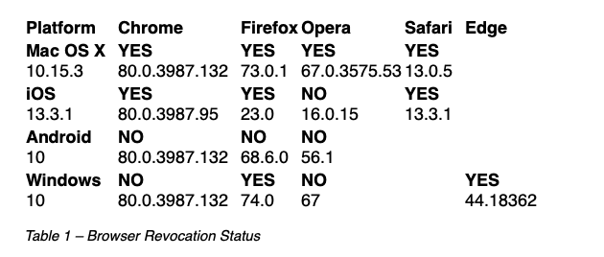
Ok – Not Always.
Some do.
Sometimes.
https://www.potaroo.net/ispcol/2020-03/revocation.html

Slide 57
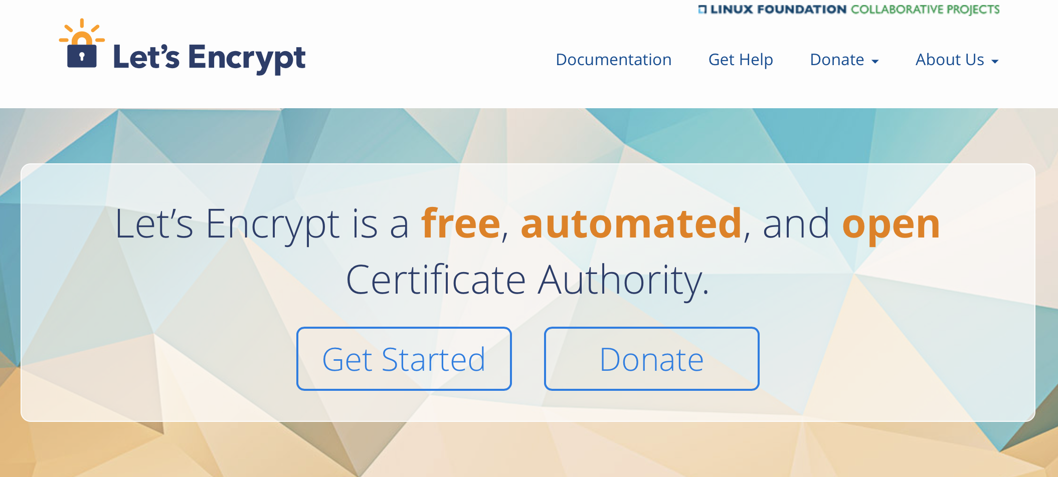
How can we fix this?
Option A: Take all the money out of the system!

Slide 58
How can we fix this?
Option A: Take all the money out of the system!
Will the automation of the Cert Issuance coupled with a totally free service make the overall environment more or less secure?
I think we already know the answer!

Slide 59
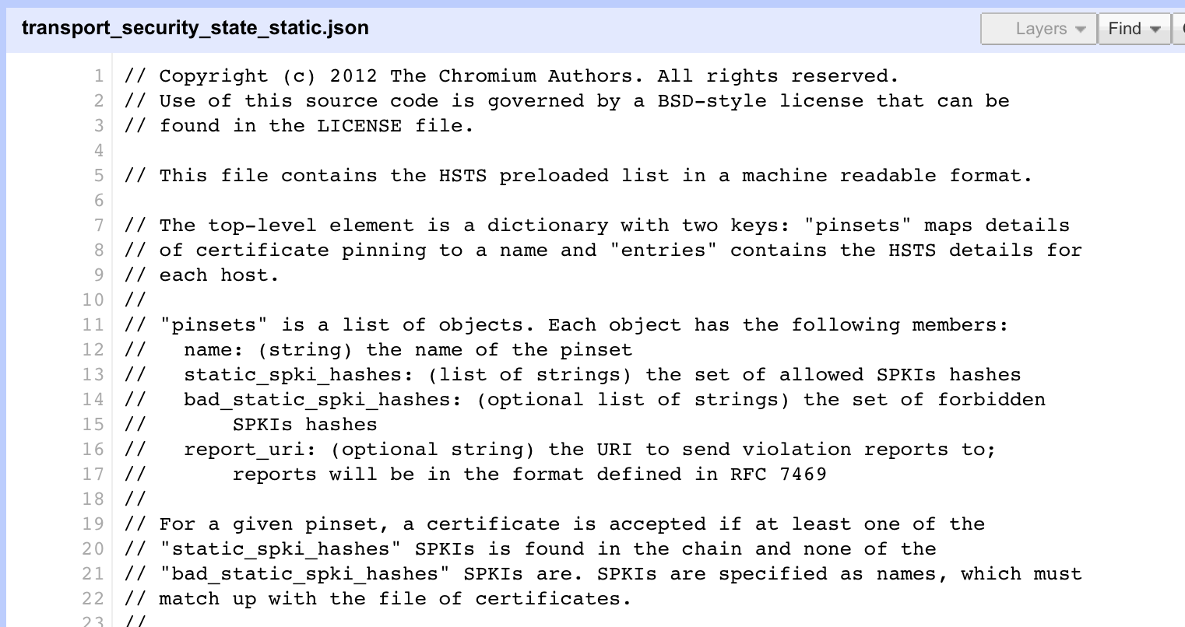
How can we fix this?
Option B: White Listing and Pinning with HSTS
https://code.google.com/p/chromium/codesearch#chromium/src/net/http/transport_security_state_static.json

Slide 60
How can we fix this?
Option B: White Listing and Pinning with HSTS
https://code.google.com/p/chromium/codesearch#chromium/src/net/http/transport_security_state_static.json
Its not a totally insane idea -- until you realise that it appears to be completely unscaleable!
Its just Google protecting itself and no one else

Slide 61
How can we fix this?
Its not a totally insane idea -- until you realise that it appears to be completely unscaleable!
Its just Google protecting itself and no one else
Option B: White Listing and Pinning with HSTS
https://code.google.com/p/chromium/codesearch#chromium/src/net/http/transport_security_state_static.json

Slide 62
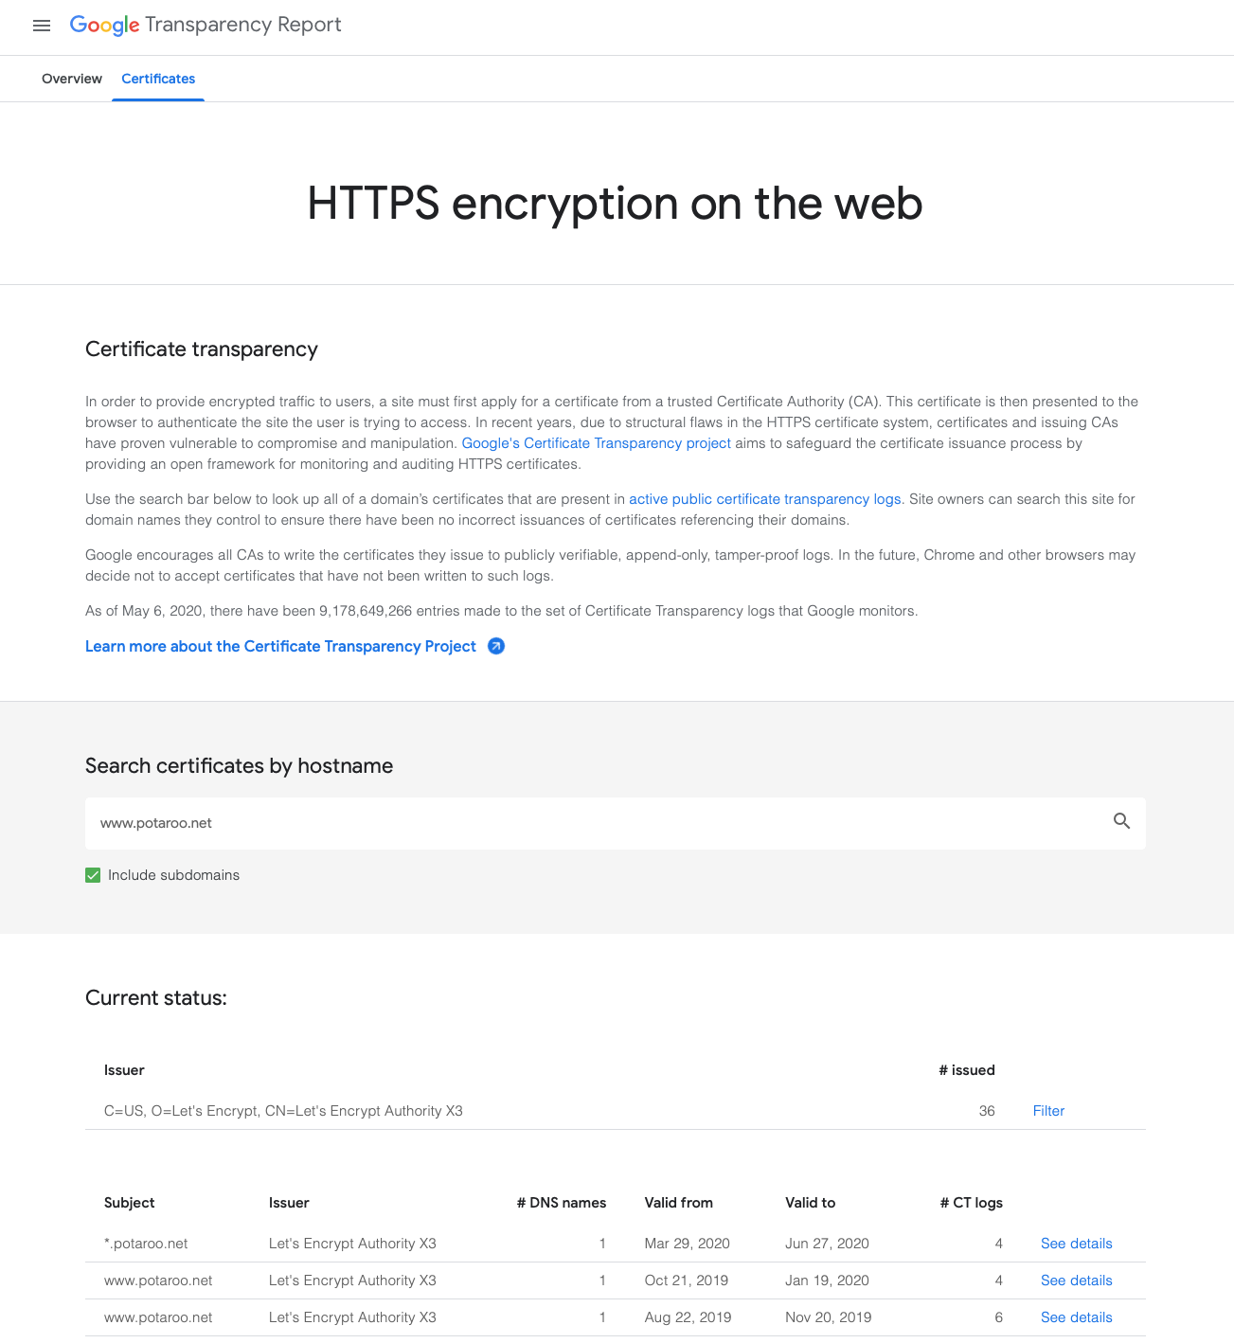
How can we fix this?
Option C: Certificate Transparency

Slide 63
How can we fix this?
Option C: Certificate Transparency
This is true
This is a fail

Slide 64
How can we fix this?
Option C: Certificate Transparency
Its just so broken
These transparency logs are a case of same week service in a millisecond world -- Assuming anyone looks in the first place!
Cert Transparency is probably worse than a placebo!

Slide 65
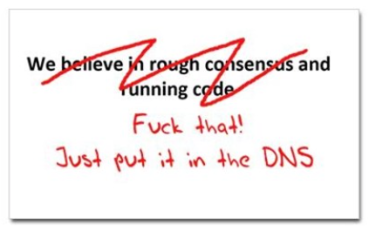
How can we fix this?
Option D: Use the DNS!
www.cafepress.com/nxdomain

Slide 66
Seriously? The DNS?
Where better to find out the public key associated with a DNS-named service than to look it up in the DNS?
  Why not query the DNS for the HSTS record?
  Why not query the DNS for the issuer CA?
  Why not query the DNS for the hash of the domain name cert?
  Why not query the DNS for the hash of the domain name public key?

Slide 67
Seriously? The DNS?
Where better to find out the public key associated with a DNS-named service than to look it up in the DNS?
  Why not query the DNS for the HSTS record?
  Why not query the DNS for the issuer CA?
  Why not query the DNS for the hash of the domain name cert?
  Why not query the DNS for the hash of the domain name public key?
Who needs CA’s anyway?

Slide 68
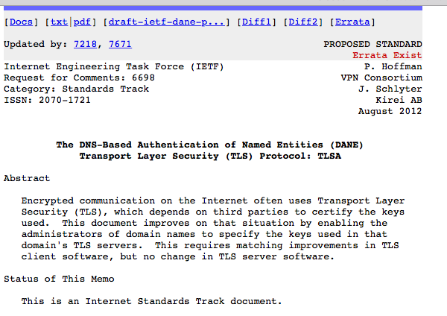
DANE
Using the DNS to associated domain name public key certificates with domain name
RFC6698 -- You should read this!

Slide 69
TLS with DANE
Client receives server cert in Server Hello
  Client lookups the DNS for the TLSA Resource Record of the domain name
  Client validates the presented certificate against the TLSA RR
Client performs Client Key exchange

Slide 70
TLS Connections
DNS Name
TLSA query
Public Key
Cert
https://rhsecurity.wordpress.com/tag/tls/

Slide 71
Just one problem…
The DNS is full of liars and lies!
And this can compromise the integrity of public key information embedded in the DNS
Unless we fix the DNS we are no better off than before with these TLSA records!

Slide 72
Just one response…
We need to allow users to validate DNS responses for themselves
And for this we need a Secure DNS framework
Which we have – and it’s called DNSSEC!

Slide 73
DANE + DNSSEC
Query the DNS for the TLSA record of the domain name and ask for the DNSSEC signature to be included in the response
Validate the signature to ensure that you have an unbroken signature chain to the root trust point
At this point you can accept the TLSA record as the authentic record, and set up a TLS session based on this data

Slide 74
DANE + DNSSEC
Query the DNS for the TLSA record of the domain name and ask for the DNSSEC signature to be included in the response
Validate the signature to ensure that you have an unbroken signature chain to the root trust point
At this point you can accept the TLSA record as the authentic record, and set up a TLS session based on this data
Yes, but No!

Slide 75
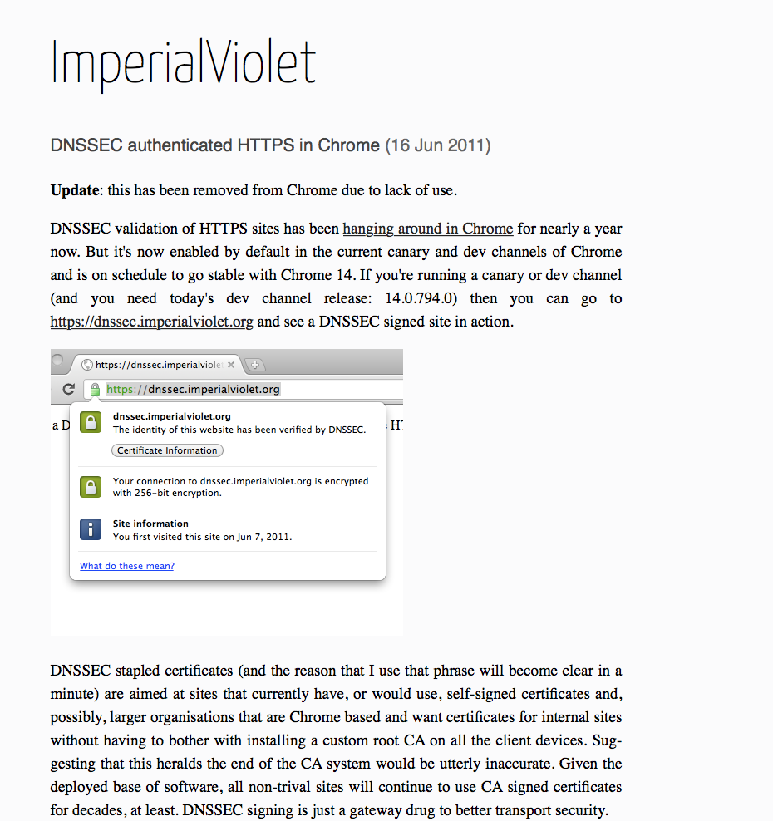
DANE + DNSSEC
DANE validation can be SO SLOW!

Slide 76
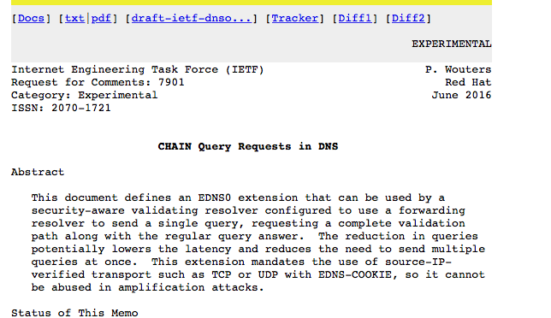
Or…
Faster validation?

Slide 77
Or … Look! No DNS!
Server packages server cert, TLSA record and the DNSSEC credential chain in a single bundle
Client receives bundle in Server Hello
  Client performs validation of TLSA Resource Record using the supplied DNSEC signatures plus the local DNS Root Trust Anchor without performing any DNS queries
  Client validates the presented certificate against the TLSA RR
Client performs Client Key exchange

Slide 78
Doing a better job
We could do a far better job at Internet Security:
Publishing DNSSEC-signed zones
Publishing DANE TLSA records
Using DNSSEC-validating resolution
Using TLSA records to guide TLS Key Exchange
Stapling the TLSA + sig bundle into TLS

Slide 79
Doing a better job
We could do a far better job at Internet Security:
Publishing DNSSEC-signed zones
Publishing DANE TLSA records
Using DNSSEC-validating resolution
Using TLSA records to guide TLS Key Exchange
Stapling the TLSA + sig bundle into TLS
But nothing has happened for more than a decade!
Why not?

Slide 80
Why is change so hard?
We have different goals
  Some people want to provide strong hierarchical controls on the certificates and keys because it entrenches their role in providing services
  Some want to do it because it gives them a point of control to intrude into the conversation
  Others want to exploit weaknesses in the system to leverage a competitive advantage
  Some people think users prefer faster applications even if they have weaknesses
  Others think users are willing to pay a time penalty for better authentication controls

Slide 81
Users and Trust
Users just want to be able to trust that the websites and services that they connect to and share their credentials, passwords and content with are truly the ones they expected to be using without first studying for a PhD in Network Operational Security
Somehow we are missing that simple objective and have interposed complexity and adornment that have taken on a life of their own and are in fact eroding trust
And that’s bad
If we can’t trust our communications infrastructure, then we don’t have a useful communications infrastructure.

Slide 82
What a dysfunctional mess we’ve created!

Slide 83
That’s it!
Questions?

