Slide 1

BGP in 2020
Geoff Huston
APNIC Labs

Slide 2
The Highlights
IPv4 FIB Summary
IPv6 FIB Summary
FIB Projections
Churn
Conclusions

Slide 3
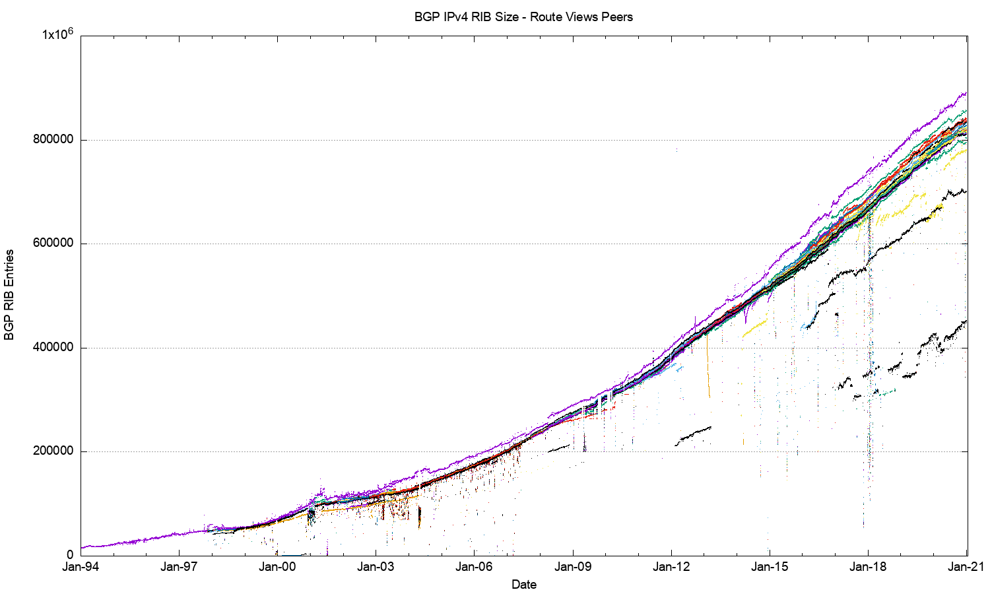
27 Years of Routing the Internet
This is a view pulled together from each of the routing peers of Route-Views
2011: Address Exhaustion
2005: Consumer Market
2001: The Great Internet
Boom and Bust
1994: Introduction of CIDR

Slide 4
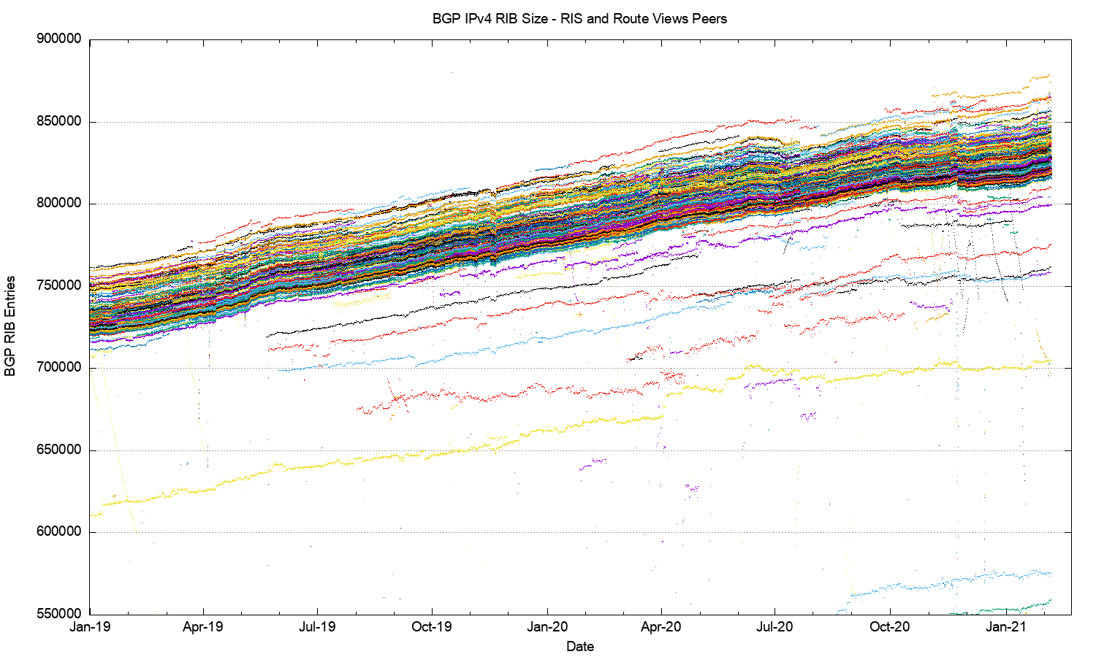
2019-2020 in detail
average growth trend

Slide 5
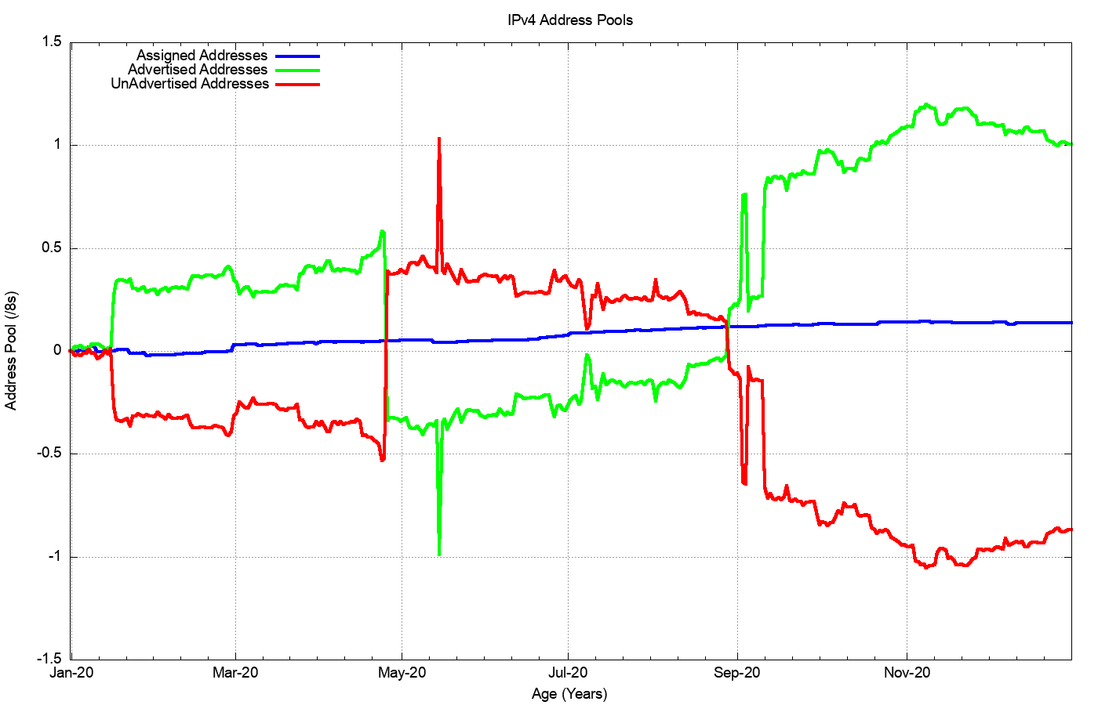
2019: Assigned vs Recovered
Change in the Unadvertised Address Pool
16.5M advertised
RIR Allocations
2.3M allocated
14.5M recovered
Change in Advertised Addresses

Slide 6
What happened in 2020 in V4?
Routing Business as usual – despite IPv4 address exhaustion!
  From the look of the growth plots, its business as usual, despite the increasing pressures on IPv4 address availability
  The number of entries in the IPv4 default-free zone reached 860,000 by the end of 2020
  The pace of growth of the routing table was slightly lower than the rolling 5-year average, with 52,000 new entries in 2020
  The AS position was steady with 3,400 new AS’s per year
  Transit relationships have not changed materially over 2020 for most networks
  IPv4 address exhaustion is not changing this picture as yet
  Instead, we appear to be advertising shorter prefixes into the routing system

Slide 7
The Highlights
IPv4 FIB Summary
IPv6 FIB Summary
FIB Projections
Churn
Conclusions

Slide 8
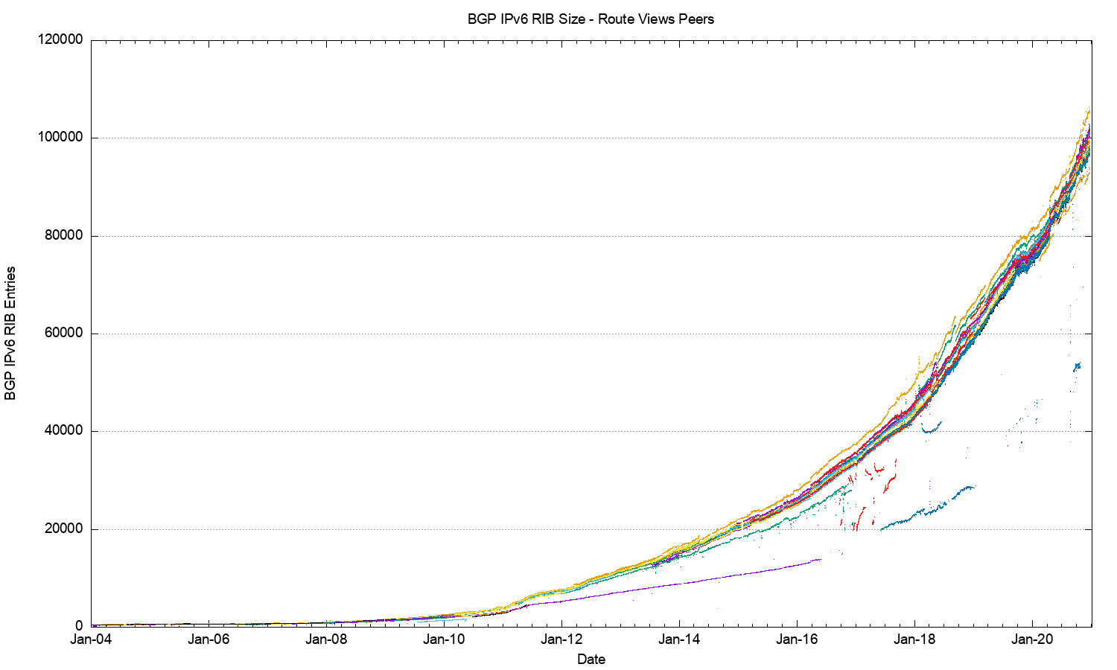
The Route-Views View of IPv6
IANA IPv4 Exhaustion

Slide 9
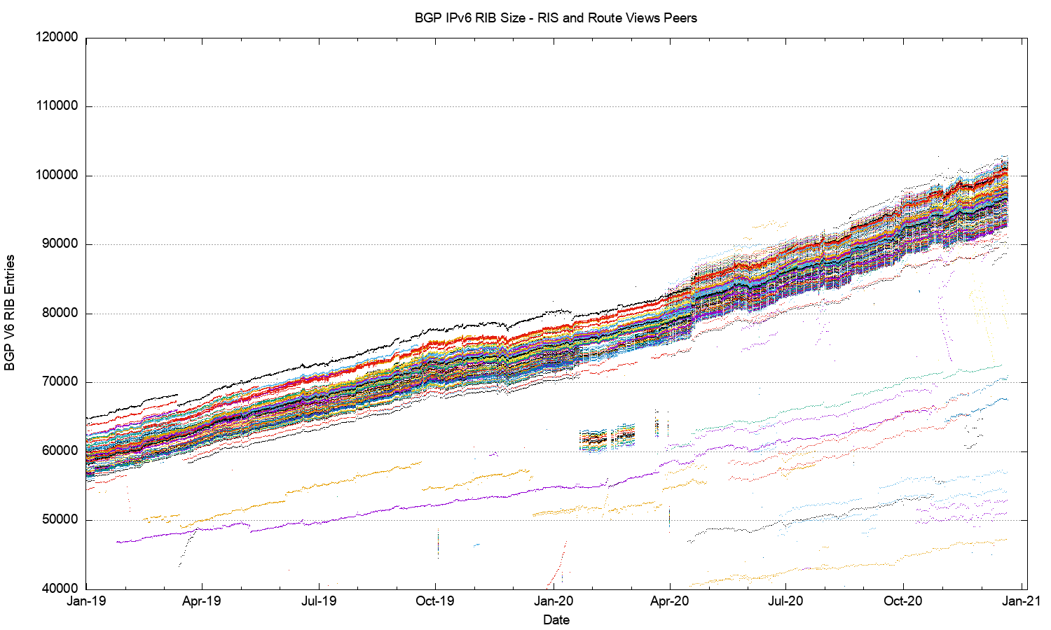
2019-2020 in Detail

Slide 10
V6 in 2020
Overall IPv6 Internet growth in terms of BGP is still increasing, and is currently at some 25,000 route entries p.a.
It’s a case of increasing growth, not just constant growth
  More use of /48 more specifics
  More networks advertising IPv6 prefixes

Slide 11
The Highlights
IPv4 FIB Summary
IPv6 FIB Summary
FIB Projections
Churn
Conclusions

Slide 12
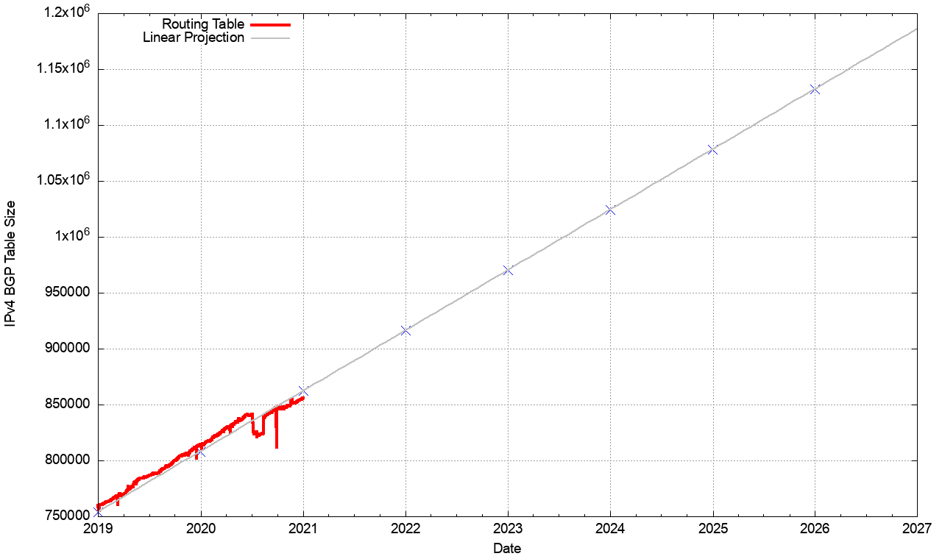
V4 BGP Table Size Predictions
Date RIB Size Prediction
Jan 2017 646,000
2018 699,000
2019 760,000
2020 814,000
2021 866,000
2022 916,000
2023 970,000
2024 1,024,000
2025 1,078,000
2026 1,132,000

Slide 13
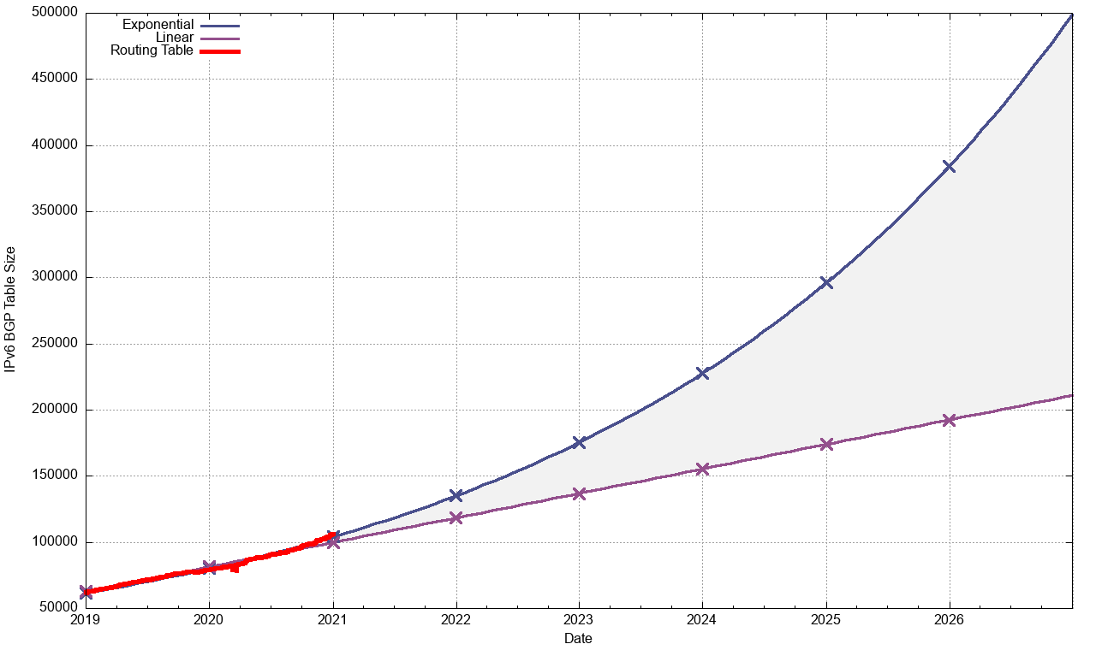
V6 BGP Table Size Predictions
Linear Exponential
Jan 2017 35,000
2018 45,000
2019 62,000
2020 79,000
2021 104,000
2022 118,000 135,000
2023 136,000 175,000
2024 155,000 228,000
2025 174,000 296,000
2026 192,000 384,000
Note that the IPv6 tables are 128bits wide – i.e. 4x the size of the IPv4 tables!

Slide 14
BGP Table Growth
The absolute size of the IPv6 routing table is growing much faster than the IPv4 table
They will require the same memory size in around 4 years time, given that each IPv6 entry is 4 times the memory size of an IPv4 entry
As long as we are prepared to live within the technical constraints of the current routing paradigm, the Internet’s use of BGP will continue to be viable for some time yet

Slide 15
The Highlights
IPv4 FIB Summary
IPv6 FIB Summary
FIB Projections
Churn
Conclusions

Slide 16
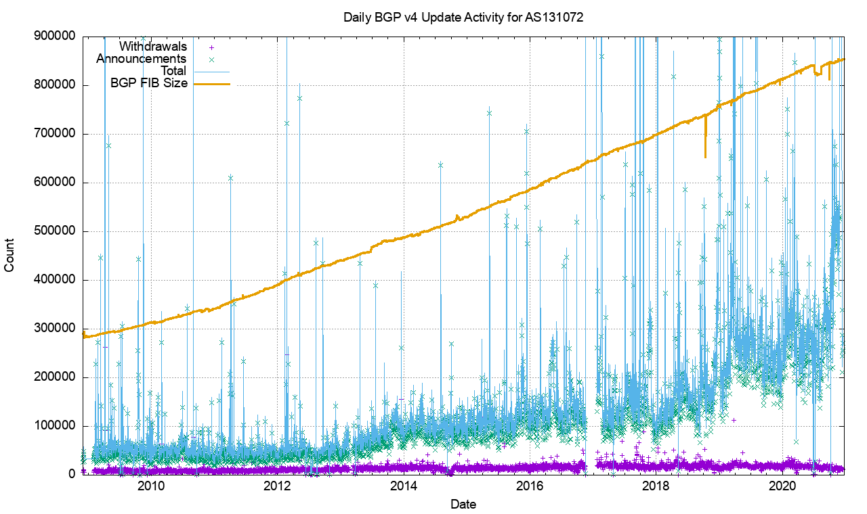
IPv4 BGP Updates

Slide 17
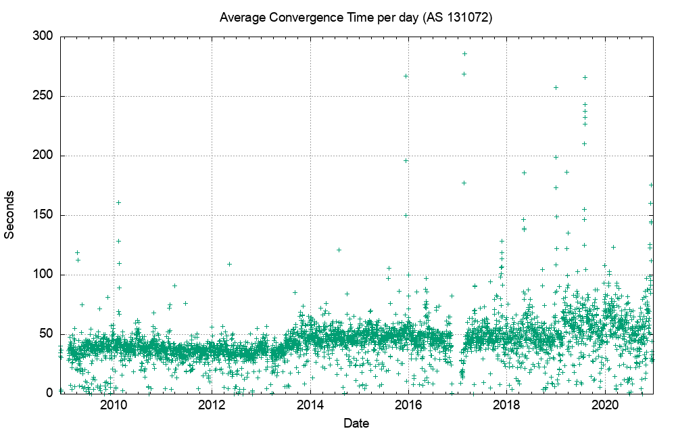
IPv4 BGP Convergence Performance

Slide 18
Updates in IPv4 BGP
The beginnings of concern …
The number of updates per instability event and the time to converge has been relatively constant for many years – its now starting to rise, both in the number of unstable prefixes and the time to converge
20% of prefixes generate 80% of all updates. Less than 5% of all origin networks are linked to 80% of all updates. Instability is still concentrated in a small number of pathological cases. Its just that the instability itself from these sources is getting worse.

Slide 19
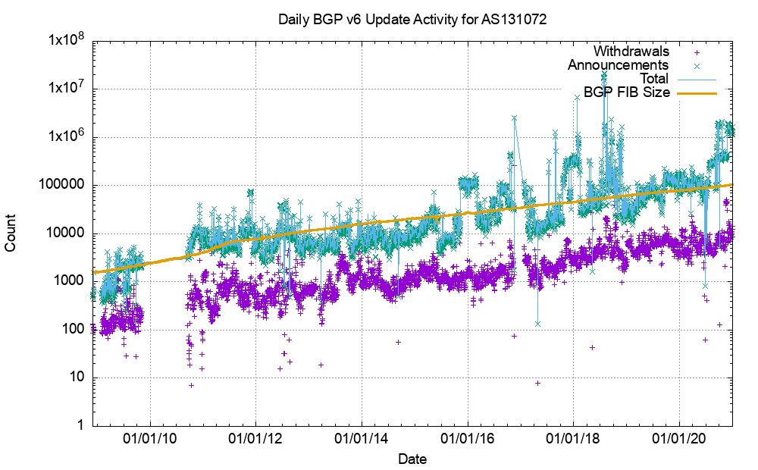
V6 BGP Updates

Slide 20
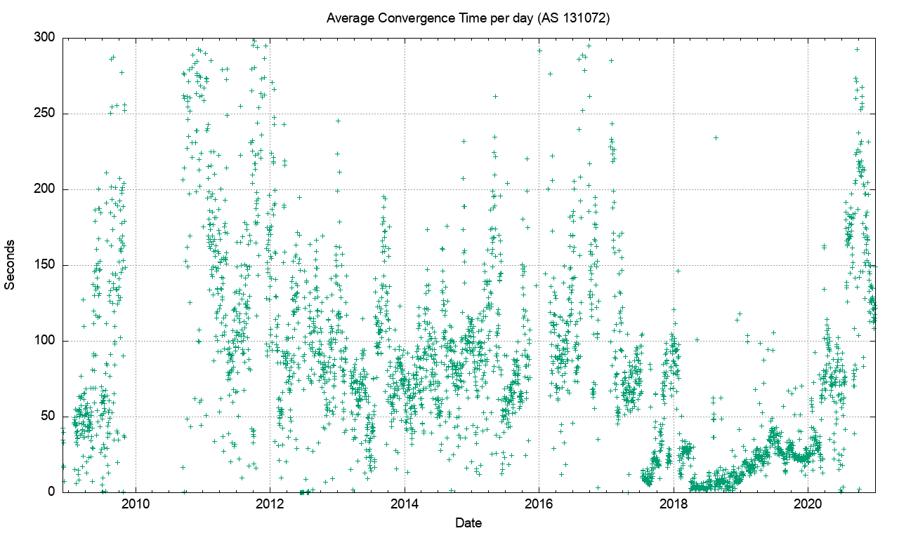
V6 Convergence Performance

Slide 21
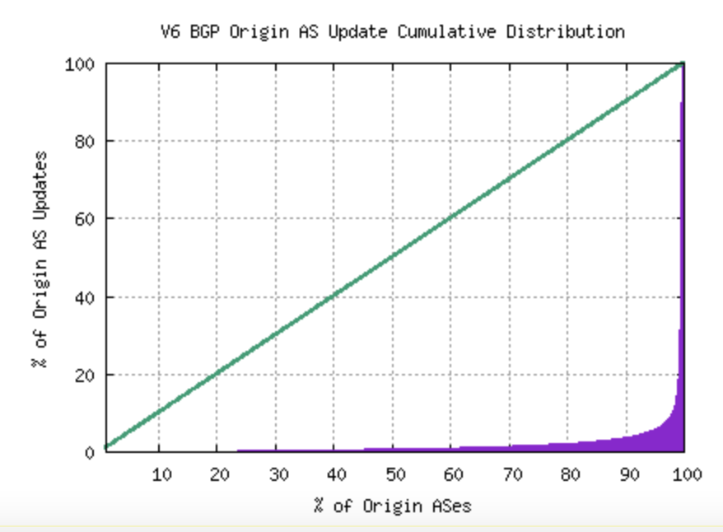
Updates in IPv6 BGP
Nobody is looking…
Compared to IPv4, the IPv6 network exhibits a high level of routing instability, which is unexpected as the old overlay approaches are disappearing and the topology of IPv6 is now converging to the same topology as IPv4
Just 5 AS’s generate 30% of the BGP update load in the past 2 weeks. Instability is still concentrated in a small number of pathological cases. The instability itself from these sources is getting worse.

Slide 22
The Highlights
IPv4 FIB Summary
IPv6 FIB Summary
FIB Projections
Churn
Conclusions

Slide 23
Routing Futures
There is still little in the way of scaling pressure from BGP as a routing protocol – the relatively compressed topology and stability of the infrastructure links tend to ensure that BGP remains effective in routing the internet. Instability levels are rising, generally driven by a small set of highly unstable “super generators”
The issues of FIB size, line speeds and equipment cost of line cards represent a more significant issue for hardware suppliers – we can expect cheaper line cards to to use far smaller LRU cache local FIBs in the high-speed switches and push less-used routes to a slower / cheaper lookup path. This approach may also become common in very high-capacity line cards

Slide 24
Some Practical Suggestions
Understand your hardware’s high speed FIB capacity in the default-free parts of your network
Review your IPv4 / IPv6 portioning - a dual-stack eBGP router will need 970,000 32-bit IPv4 slots and 175,000 128-bit IPv6 slots for a full eBGP routing table in line cards over the coming 24 months if they are using a full eBGP FIB load (plus internal routes of course)
Judicious use of default routes in your internal network may allow you drop this requirement significantly
Using a hot cache for line card FIB cache would reduce the memory requirement significantly without visible performance cost

Slide 25
That’s it!
Questions?

Slide 26
The Complete Pack

Slide 27
27 Years of Routing the Internet
This is a view pulled together from each of the routing peers of Route-Views
2011: Address Exhaustion
2005: Consumer Market
2001: The Great Internet
Boom and Bust
1994: Introduction of CIDR

Slide 28
2017-2020 in detail
average growth trend

Slide 29
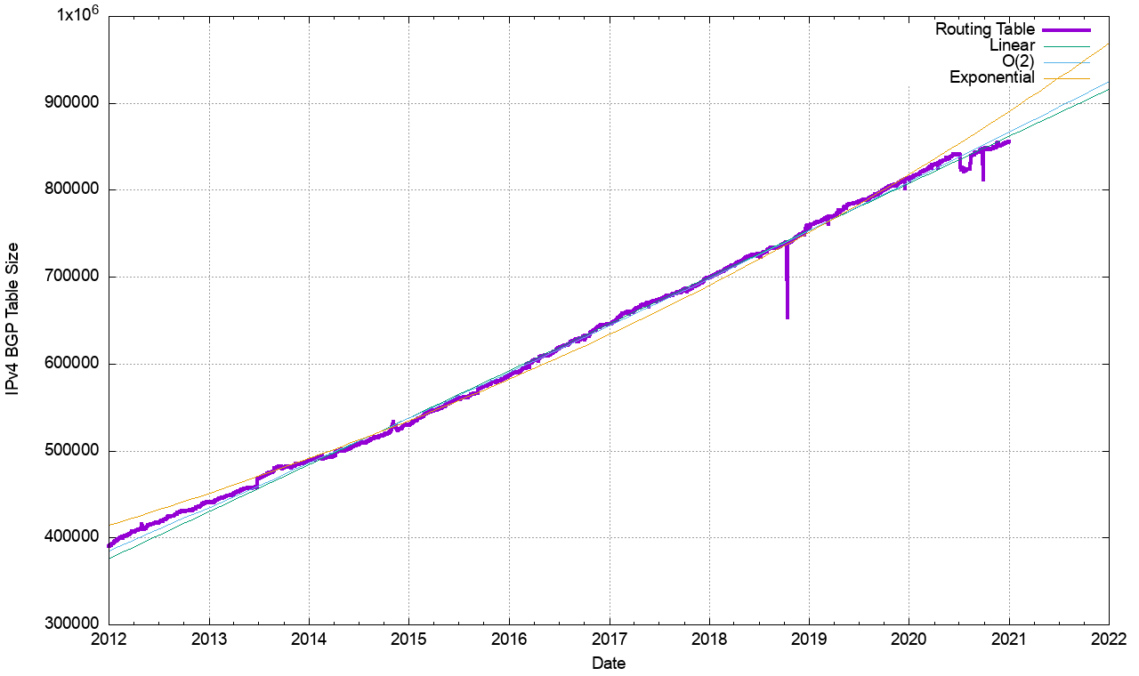
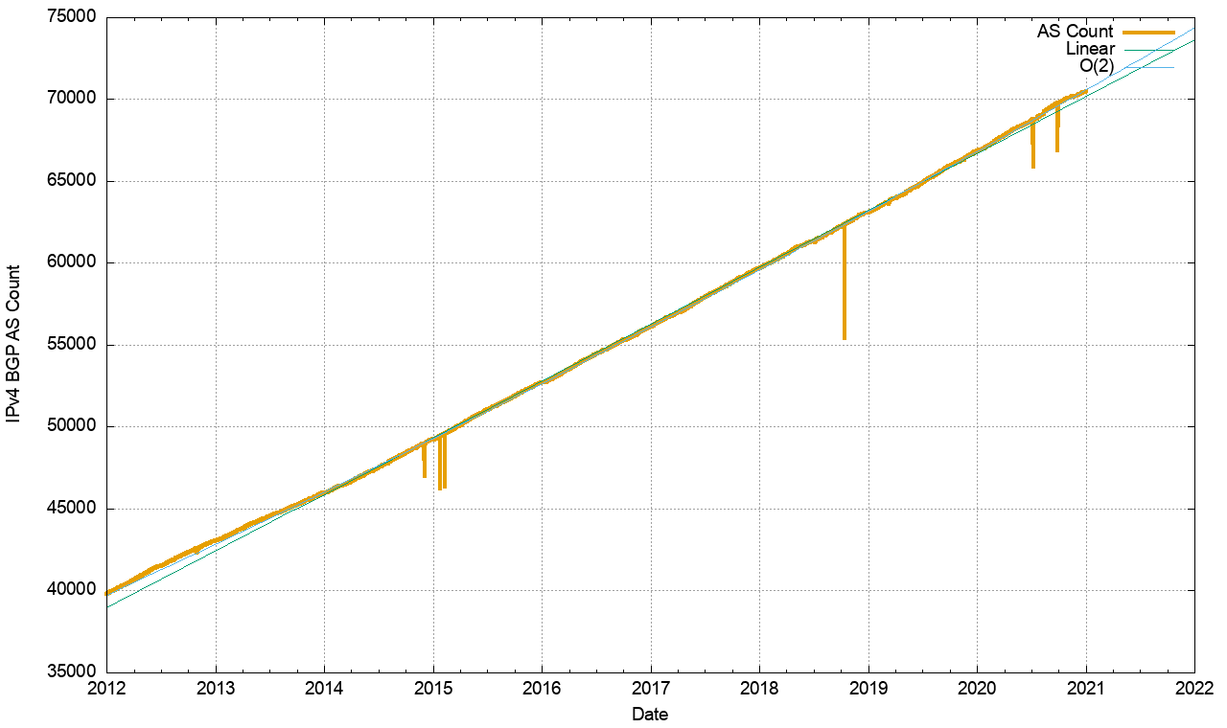
Routing Indicators for IPv4
Routing prefixes – growing by some 51,000 prefixes per year
AS Numbers– growing by some 3,400 prefixes per year

Slide 30
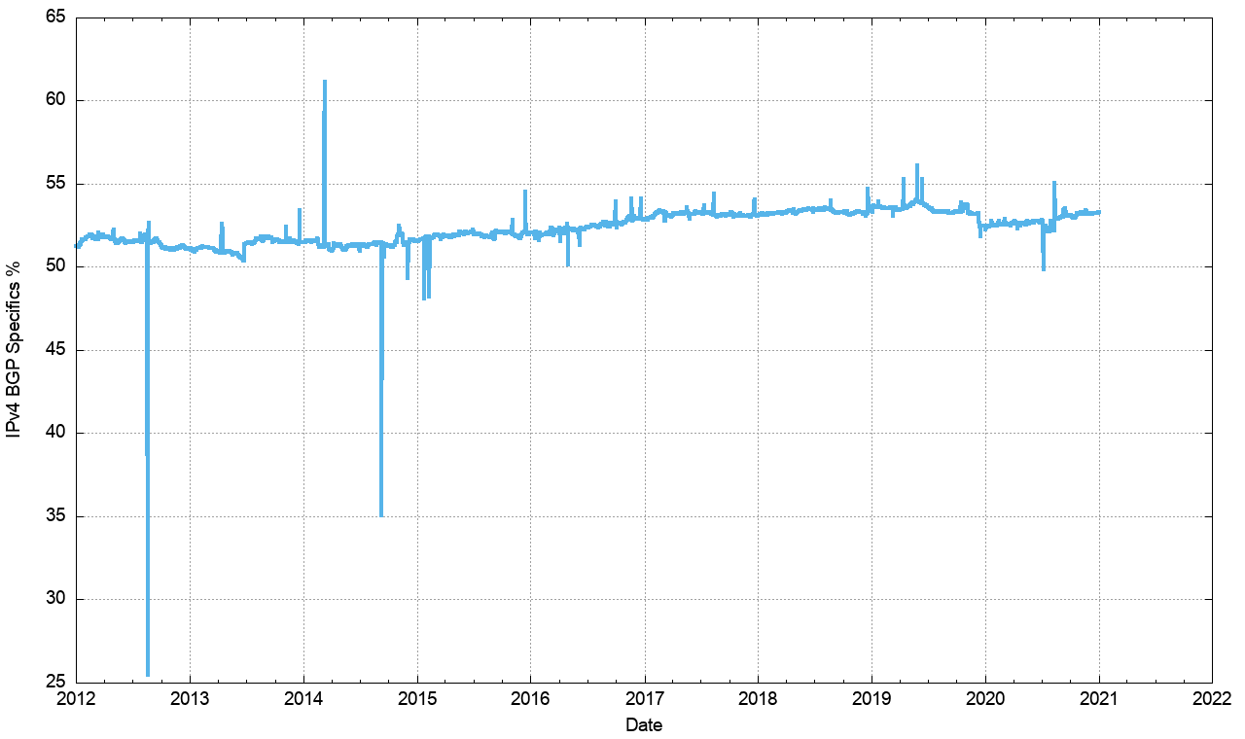
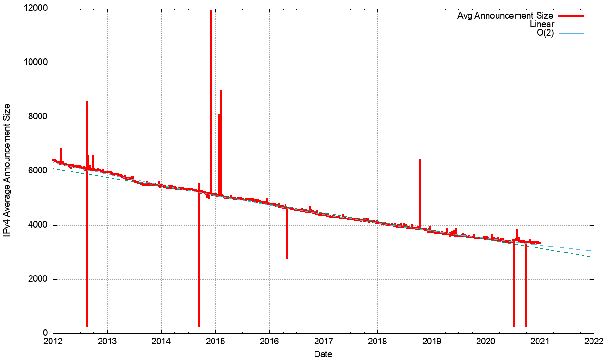
Routing Indicators for IPv4
More Specifics are still taking up slightly more than one half of the routing table
But the average size of a routing advertisement continues to shrink

Slide 31
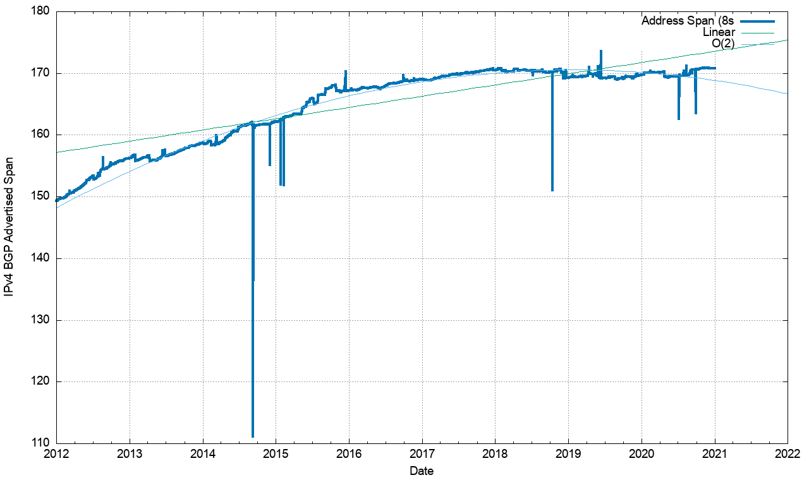
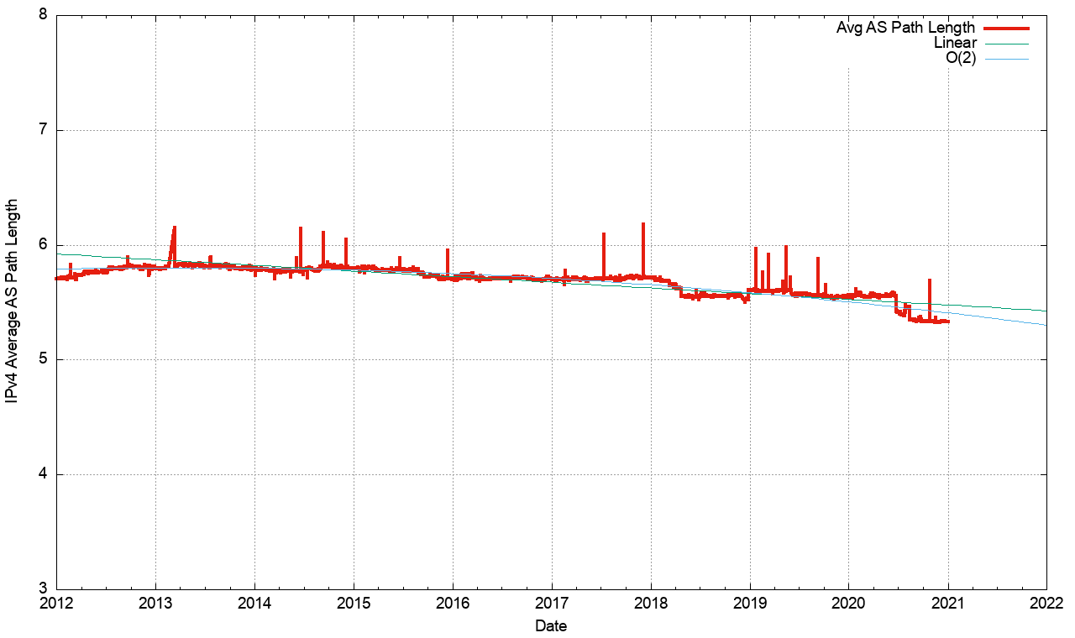
Routing Indicators for IPv4
Address Exhaustion is now visible in the extent of advertised address space
The “shape” of inter-AS interconnection appears to be relatively steady

Slide 32
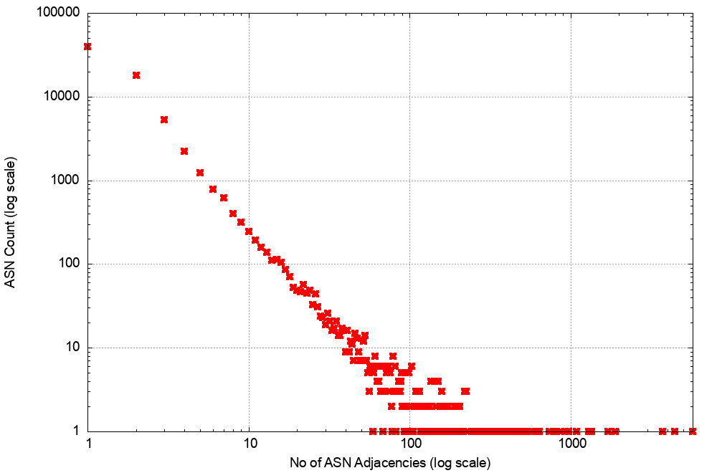
AS Adjacencies (AS131072)
57,343 out of 70,532 ASNs have 1 or 2 AS Adjacencies (82%)
2,342 ASNs have 10 or more adjacencies
9 ASNs have >1,000 adjacencies
5,727 AS6939 HURRICANE - Hurricane Electric, Inc., US
4,433 AS3356 LEVEL3 - Level 3 Communications, Inc., US
3,707 AS174 COGENT-174 - Cogent Communications, US
1,896 AS6461 ZAYO Bandwidth, US
1,711 AS7018 ATT-INTERNET4 - AT&T Services, Inc., US
1,701 AS3257 GTT-Backbone, DE
1,349 AS2914 NTT America, US
1293 AS1299 TELIANET Telia Carrier, SE
1,148 AS3549 LVLT-3549, US
Most networks are stub AS’s
A small number of major connectors

Slide 33
What happened in 2020 in V4?
Routing Business as usual – despite IPv4 address exhaustion!
  From the look of the growth plots, its business as usual, despite the increasing pressures on IPv4 address availability
  The number of entries in the IPv4 default-free zone reached 860,000 by the end of 2020
  The pace of growth of the routing table was slightly lower than the rolling 5-year average, with 52,000 new entries in 2020
  The AS position was steady with 3,400 new AS’s per year
  Transit relationships have not changed materially over 2020 for most networks
  IPv4 address exhaustion is not changing this picture as yet
  Instead, we appear to be advertising shorter prefixes into the routing system

Slide 34
Post-Exhaustion Routing Growth
What’s driving this post-exhaustion growth?
  Transfers?
  Last /8 policies in RIPE and APNIC?
  Leasing and address recovery?

Slide 35
Advertised Address “Age”
2010
2% of all new addresses announced in 2010 were >= 20 years ‘old’ (legacy)
80% of all new addresses announced in 2010 were allocated or assigned within the past 12 months

Slide 36
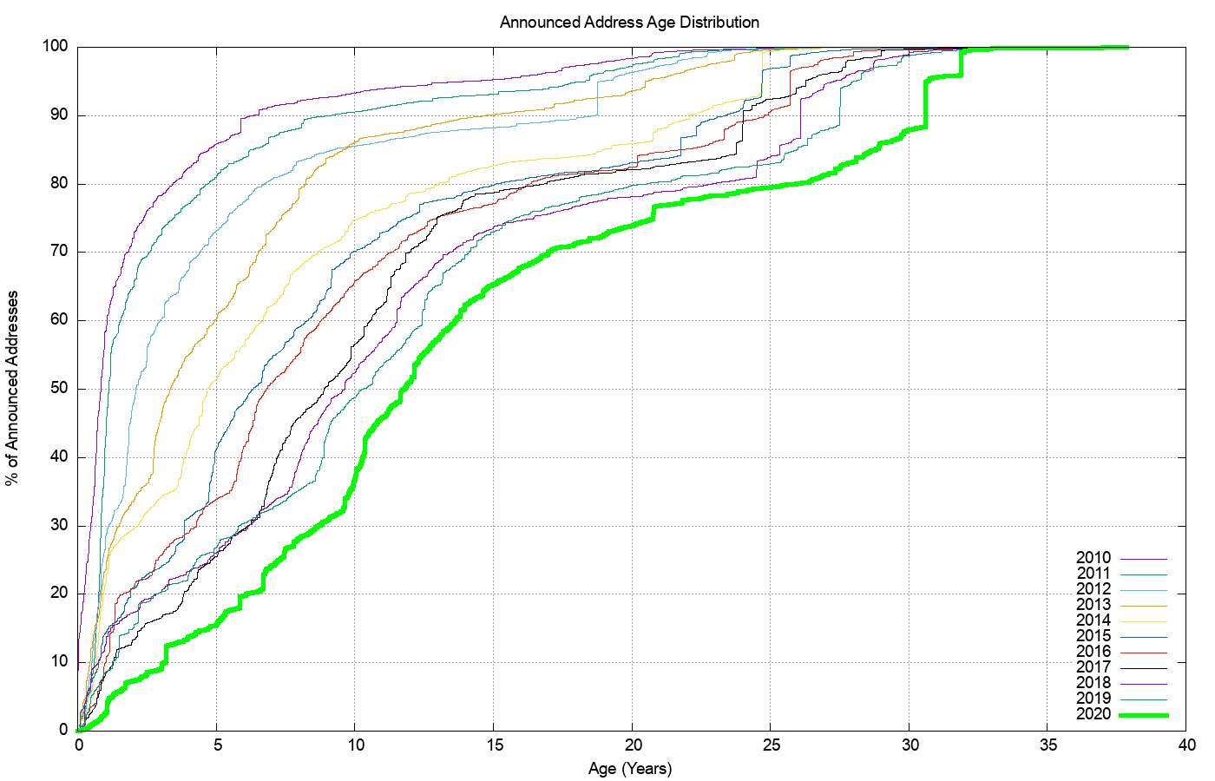
Advertised Address “Age”
Re-use of legacy addresses
last /8 allocations and transfers

Slide 37
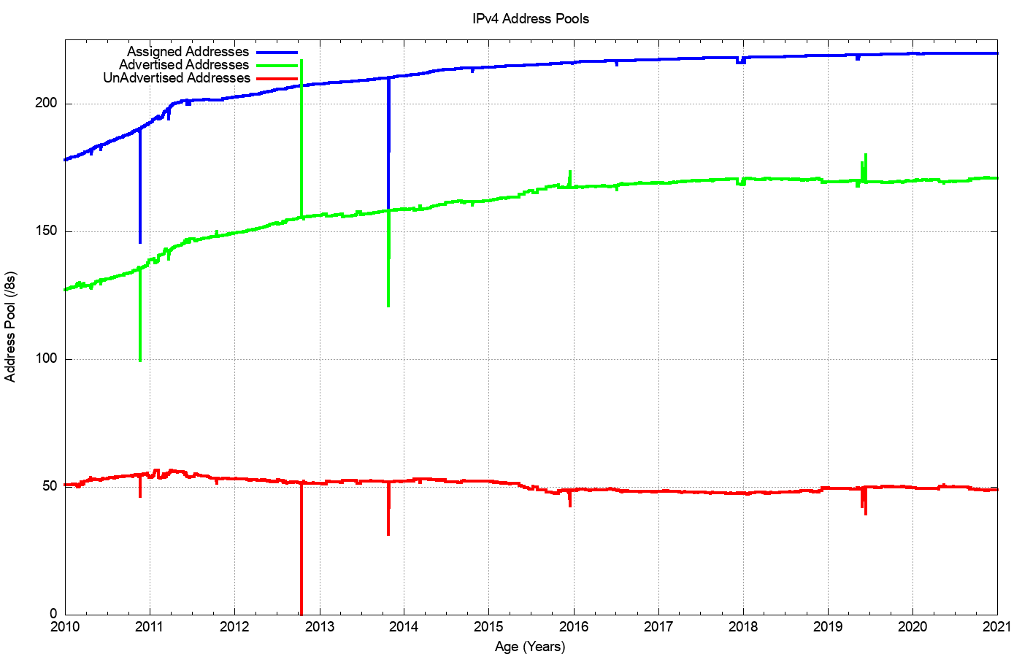
IPv4 Advertised vs Unadvertised

Slide 38
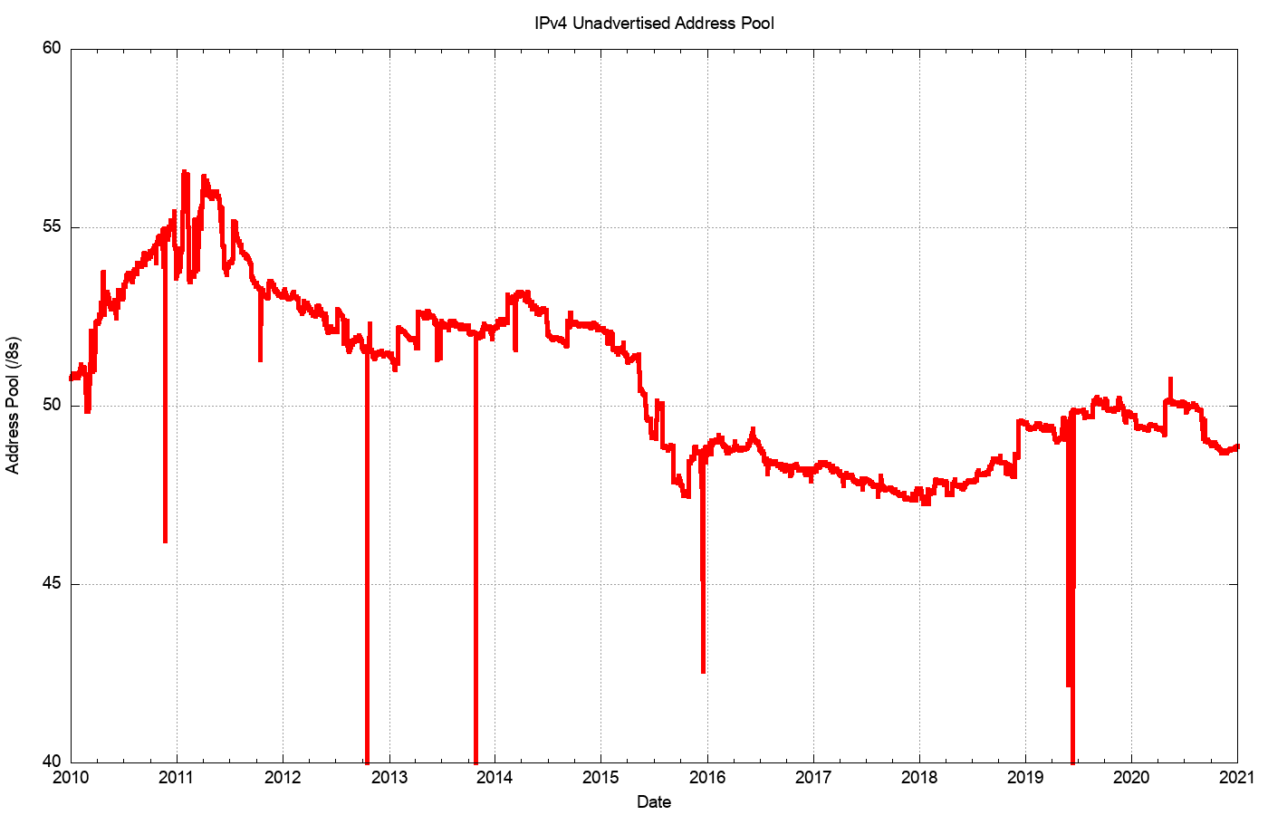
2005 – 2020: Unadvertised Addresses

Slide 39
2019: Assigned vs Recovered
Change in the Unadvertised Address Pool
RIR Allocations
Change in Advertised Addresses

Slide 40
V4 in 2020
16,855,124 addresses were added to the routing table across 2020
2,306,432 addresses were assigned by RIRs in 2019
And a net of 14,548,692 addresses were drawn from the pool of unadvertised addresses
In 2020 we saw legacy blocks transferring away from ISPs / end user sites and heading towards cloud SPs.

Slide 41
The Route-Views View of IPv6
IANA IPv4 Exhaustion

Slide 42
2018-2019 in Detail

Slide 43
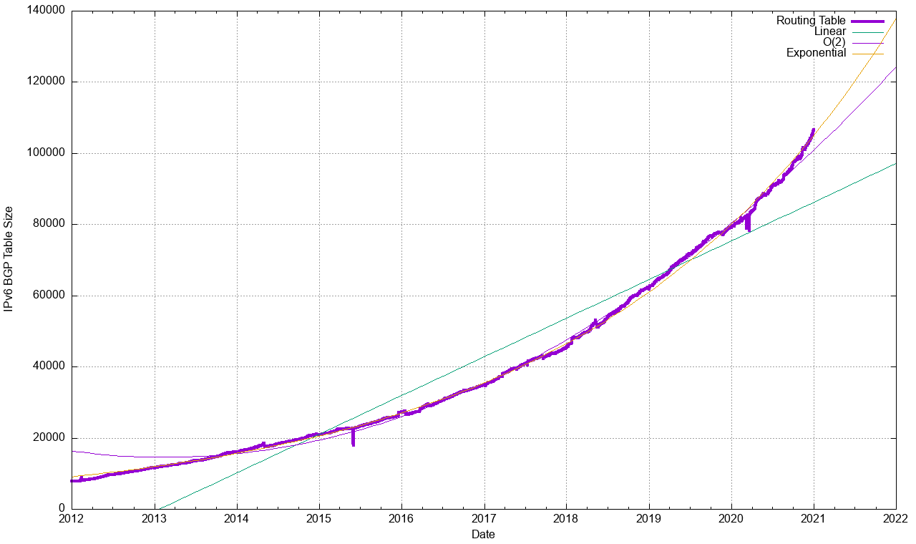
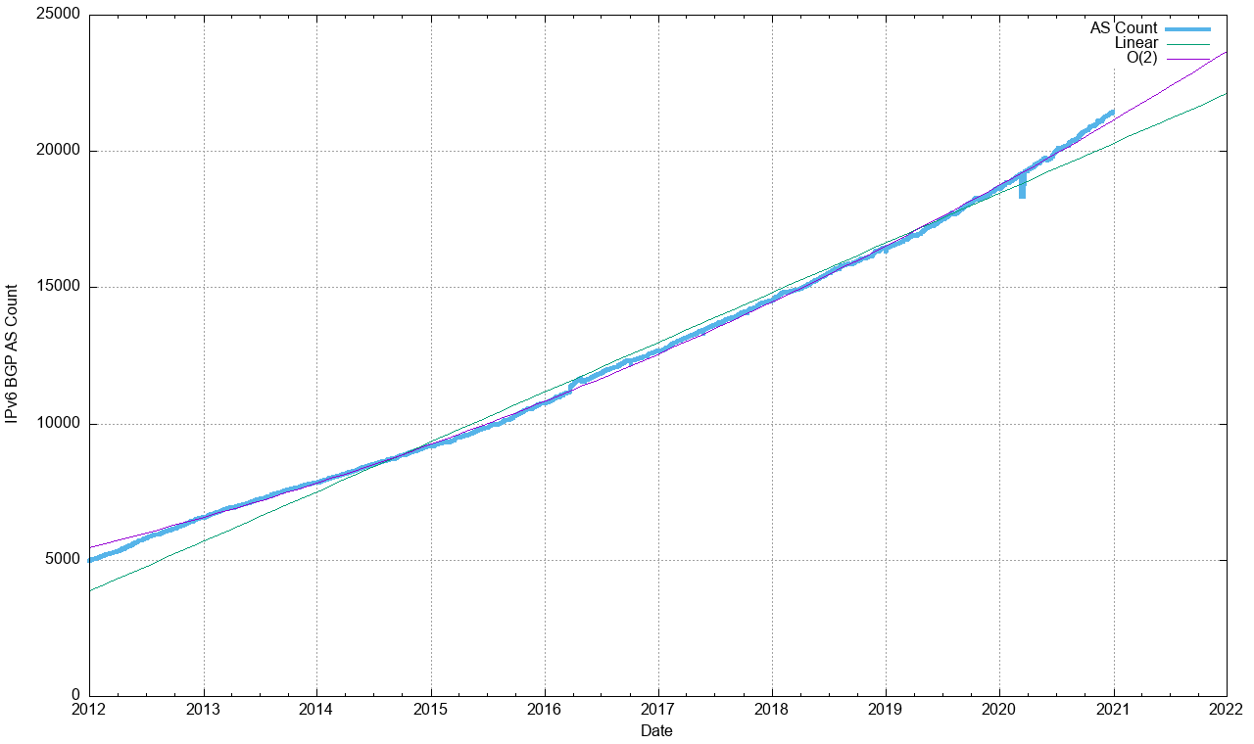
Routing Indicators for IPv6
Routing prefixes – growing by some 25,000 prefixes per year
AS Numbers– growing by some 2,200 ASNs per year (which is 60% the V4 growth)

Slide 44
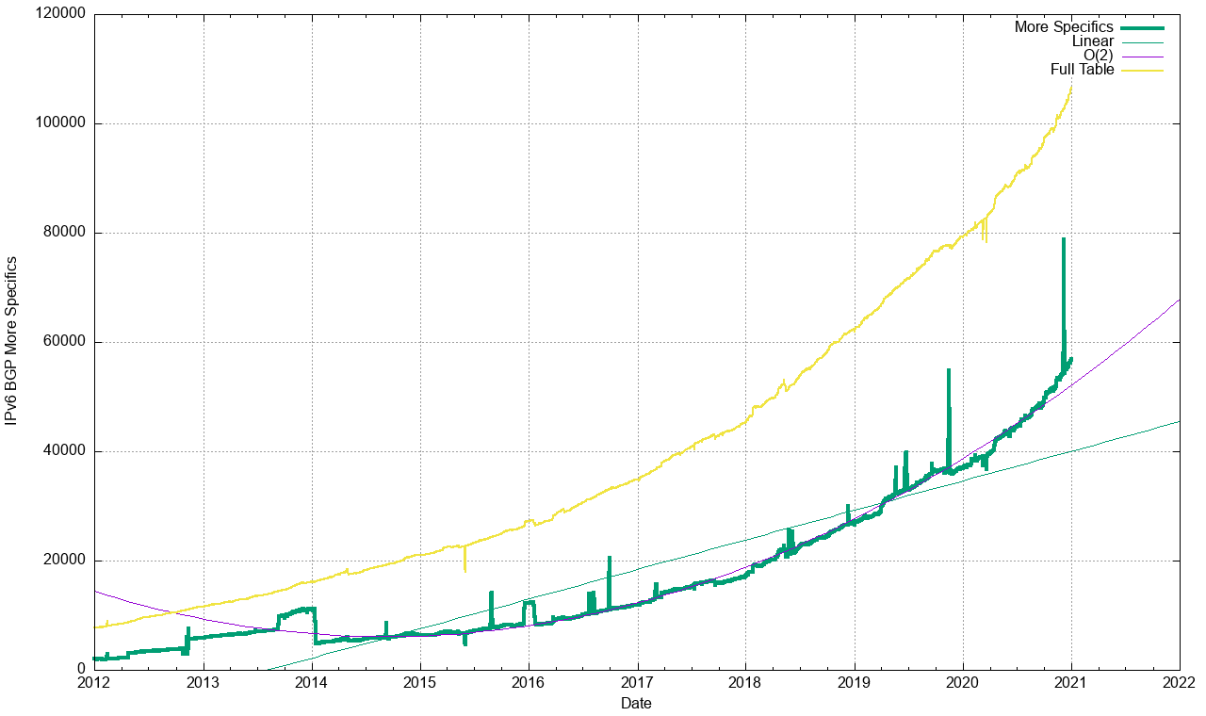
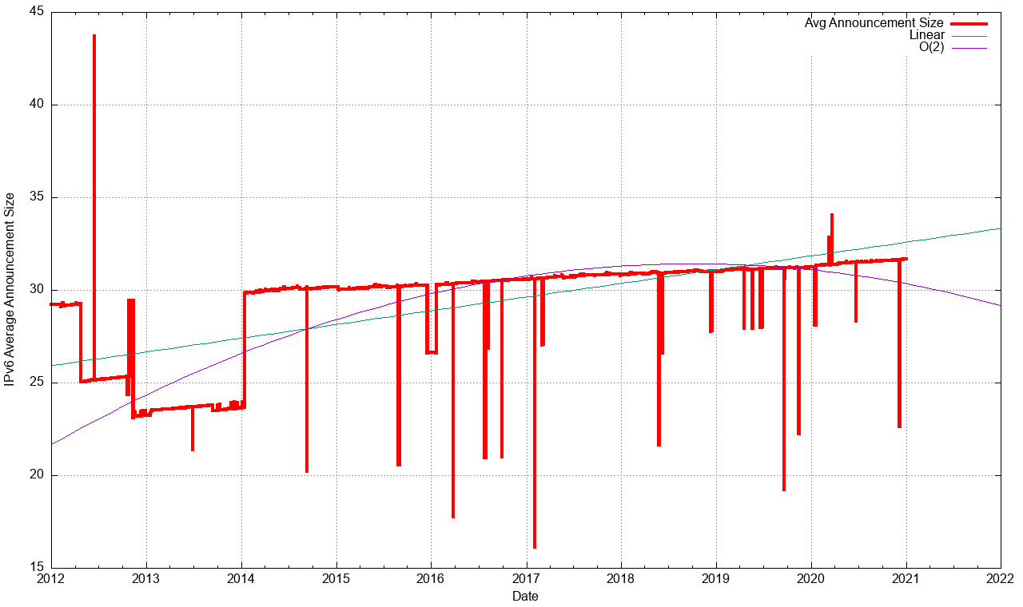
Routing Indicators for IPv6
More Specifics now take up one half of the routing table
The average size of a routing advertisement is getting smaller

Slide 45
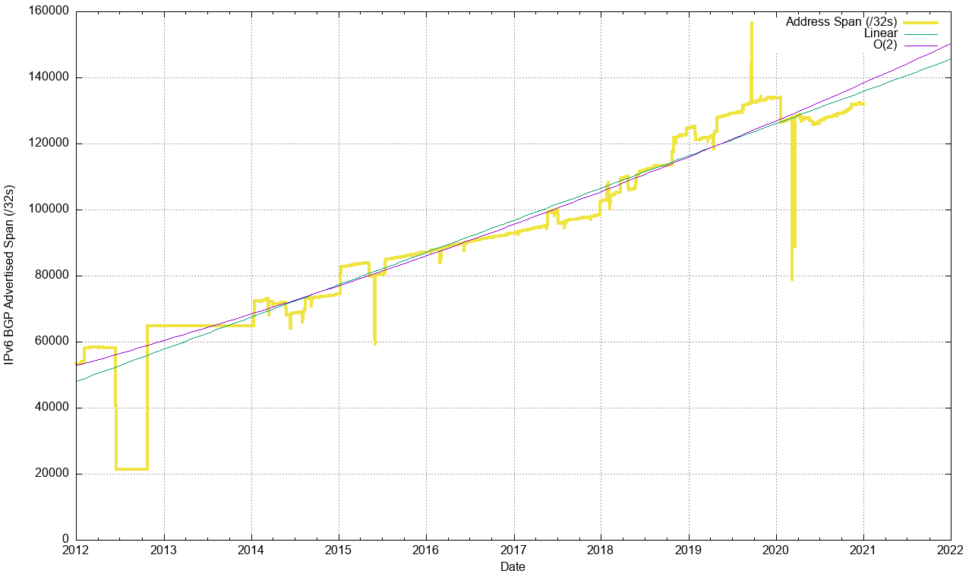
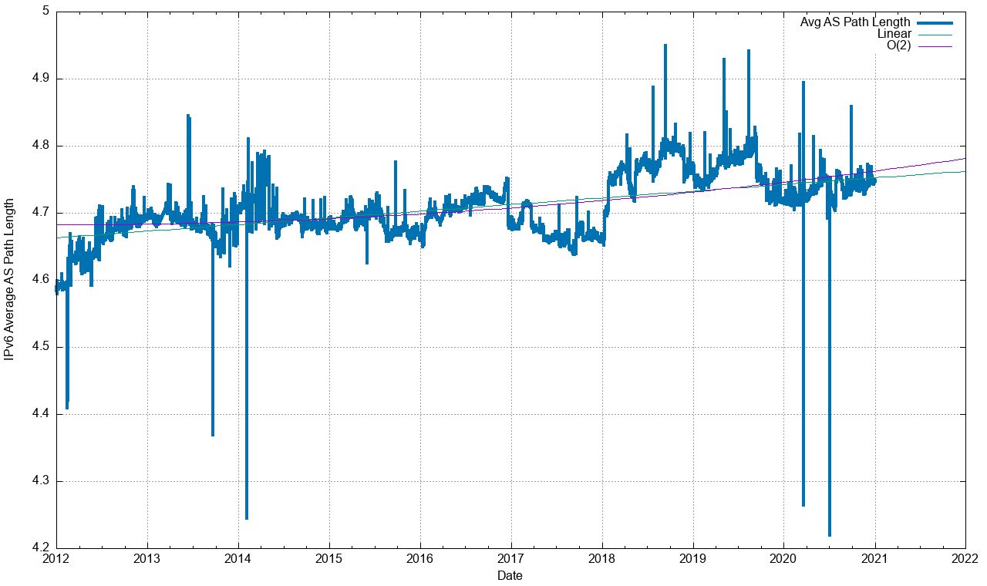
Routing Indicators for IPv6
Advertised Address span is growing at an exponential rate
The “shape” of inter-AS interconnection in IPv6 is rising slightly. Local connections appear to be replacing overlay trunk transits

Slide 46
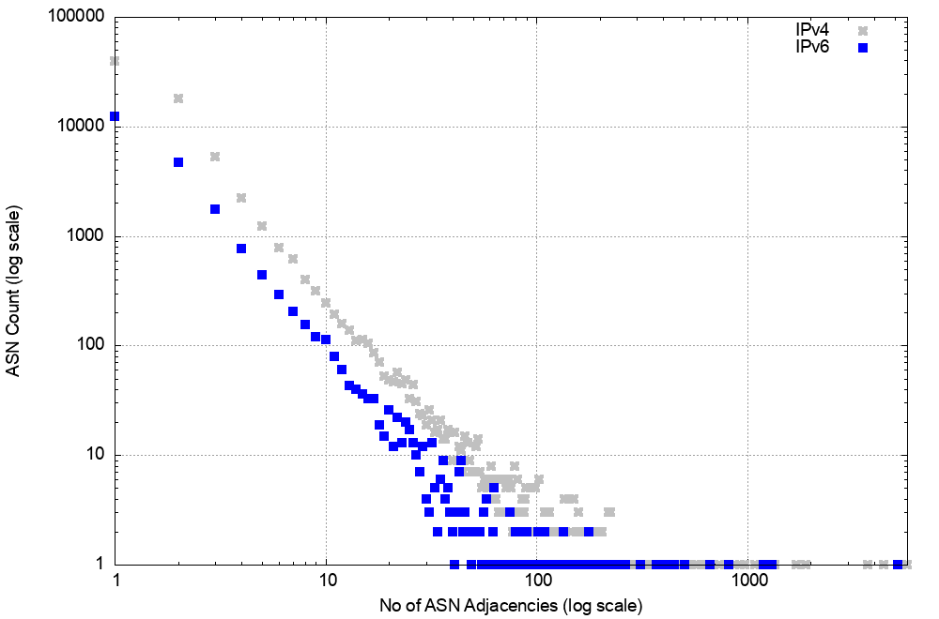
AS Adjacencies (AS131072)
16,961 out of 21,489 ASNs have 1 or 2 AS Adjacencies (80%)
798 ASNs have 10 or more adjacencies
4 ASNs have >1,000 adjacencies
5,177 AS6939 HURRICANE - Hurricane Electric, Inc., US
1,315 AS3356 LEVEL3 - Level 3 Communications, Inc., US
1,196 AS174 COGENT-174 - Cogent Communications, US
1,191 AS1299 Telia Carrier, SE

Slide 47
V6 in 2020
Overall IPv6 Internet growth in terms of BGP is still increasing, and is currently at some 25,000 route entries p.a.
It’s a case of increasing growth, not just constant growth
  More use of /48 more specifics
  More networks advertising IPv6 prefixes

Slide 48
What to expect

Slide 49
BGP Size Projections
How quickly is the routing space growing?
What are the projections of future BGP FIB size?

Slide 50
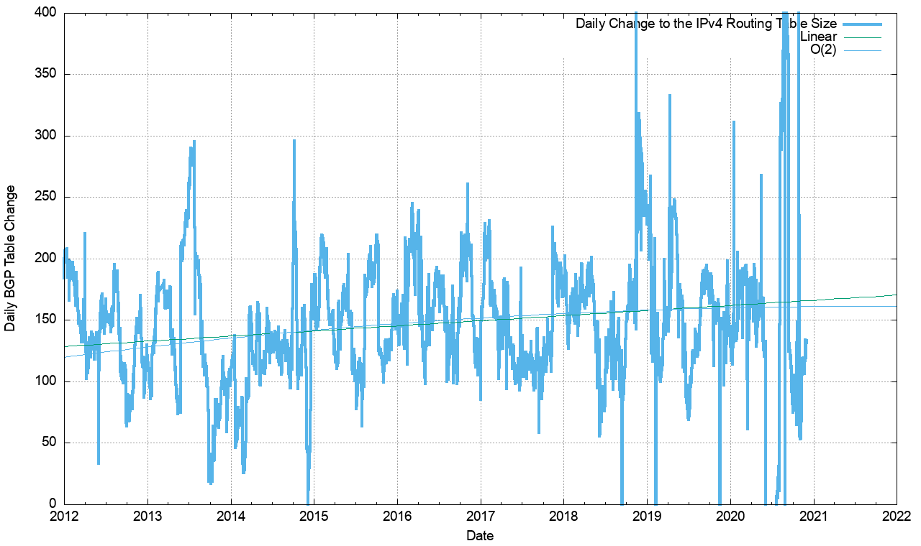
V4 - Daily Growth Rates
Growth in the V4 network appears to be constant at a long-term average of 150 additional routes per day, or some 54,000 additional routes per year

Slide 51
V4 BGP Table Size Predictions
Date RIB Size Prediction
Jan 2017 646,000
2018 699,000
2019 760,000
2020 814,000
2021 866,000
2022 916,000
2023 970,000
2024 1,024,000
2025 1,078,000
2026 1,132,000

Slide 52
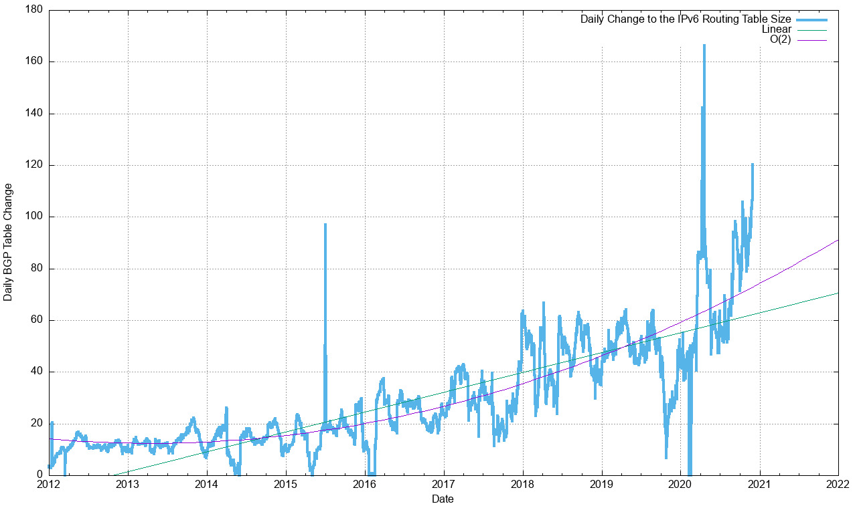
V6 - Daily Growth Rates

Slide 53
V6 BGP Table Size Predictions
Linear Exponential
Jan 2017 35,000
2018 45,000
2019 62,000
2020 79,000
2021 104,000
2022 118,000 135,000
2023 136,000 175,000
2024 155,000 228,000
2025 174,000 296,000
2026 192,000 384,000

Slide 54
BGP Table Growth
The absolute size of the IPv6 routing table is growing much faster than the IPv4 table
They will require the same memory size in around 4 years time, given that each IPv6 entry is 4 times the memory size of an IPv4 entry
As long as we are prepared to live within the technical constraints of the current routing paradigm, the Internet’s use of BGP will continue to be viable for some time yet

Slide 55
BGP Updates
What about the level of updates in BGP?

Slide 56
IPv4 BGP Updates

Slide 57
IPv4 BGP Convergence Performance

Slide 58
Updates in IPv4 BGP
The beginnings of concern …
The number of updates per instability event and the time to converge has been relatively constant for many years – its now starting to rise, both in the number of unstable prefixes and the time to converge
20% of prefixes generate 80% of all updates. Less than 5% of all origin networks are linked to 80% of all updates. Instability is still concentrated in a small number of pathological cases. Its just that the instability itself from these sources is getting worse.

Slide 59
V6 BGP Updates

Slide 60
V6 Convergence Performance

Slide 61
Updates in IPv6 BGP
Nobody is looking…
Compared to IPv4, the IPv6 network exhibits a high level of routing instability, which is unexpected as the old overlay approaches are disappearing and the topology of IPv6 is now converging to the same topology as IPv4
Just 5 AS’s generate 30% of the BGP update load in the past 2 weeks. Instability is still concentrated in a small number of pathological cases. The instability itself from these sources is getting worse.

Slide 62
Routing Futures
There is still little in the way of scaling pressure from BGP as a routing protocol – the relatively compressed topology and stability of the infrastructure links tend to ensure that BGP remains effective in routing the internet. Instability leves are rising, generally driven by a small seet of highly unstable “super generators”
The issues of FIB size, line speeds and equipment cost of line cards represent a more significant issue for hardware suppliers – we can expect cheaper line cards to to use far smaller LRU cache local FIBs in the high-speed switches and push less-used routes to a slower / cheaper lookup path. This approach may also become common in very high-capacity line cards

Slide 63
Some Practical Suggestions
Understand your hardware’s high speed FIB capacity in the default-free parts of your network
Review your IPv4 / IPv6 portioning - a dual-stack eBGP router will need 970,000 32-bit IPv4 slots and 175,000 128-bit IPv6 slots for a full eBGP routing table in line cards over the coming 24 months if they are using a full eBGP FIB load (plus internal routes of course)
Judicious use of default routes in your internal network may allow you drop this requirement significantly
Using a hot cache for line card FIB cache would reduce the memory requirement significantly without visible performance cost

Slide 64
That’s it!
Questions?

