Slide 1
An Update on IPv6 Fragmentation
Geoff Huston
Chief Scientist, APNIC

Slide 2
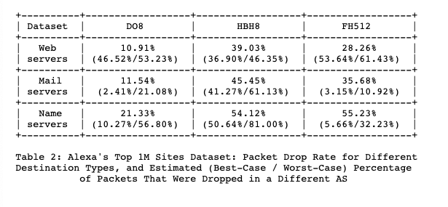
Initial Tests: 2014 (RFC 7872)
August 2014 and June 2015
Sent fragmented IPv6 packets towards “well known” IPv6 servers (Alexa 1M and World IPv6 Launch
Drop Rate:

Slide 3
APNIC Test – August 2017
Use APNIC IPv6 measurement platform to test the drop rate of IPv6 packets flowing in the opposite direction (server to client)
This is an improvement over
the RFC7872 measurement

Slide 4
APNIC Test - 2021
Re-work of the 2017 measurement experiment
  Same server-to-client TCP session fragmentation mechanism
  Uses a middlebox to fragment outgoing packets - drop is detected by a hung TCP session that fails to ACK the sequence number in the fragmented packet
  This time we randomly vary the initial fragmented packet size between 1,200 and 1,416 bytes
  Performed as an ongoing measurement

Slide 5
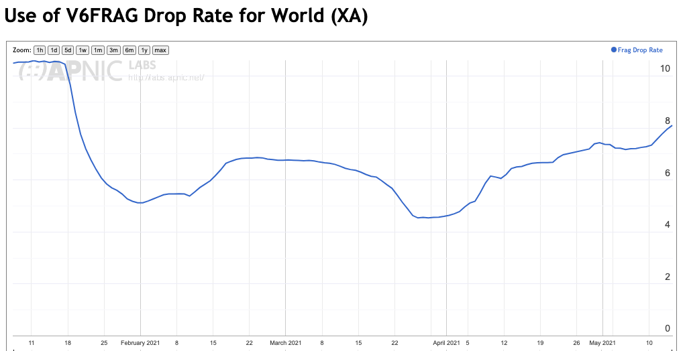
2021 Fragmentation Drop Rate
This is a significant improvement over 2017 data
Since 2017 there are 10x the number of IPv6 users and the fragmentation drop rate has come down by 2/3 – we appear to be getting better at handling IPv6 fragments!

Slide 6
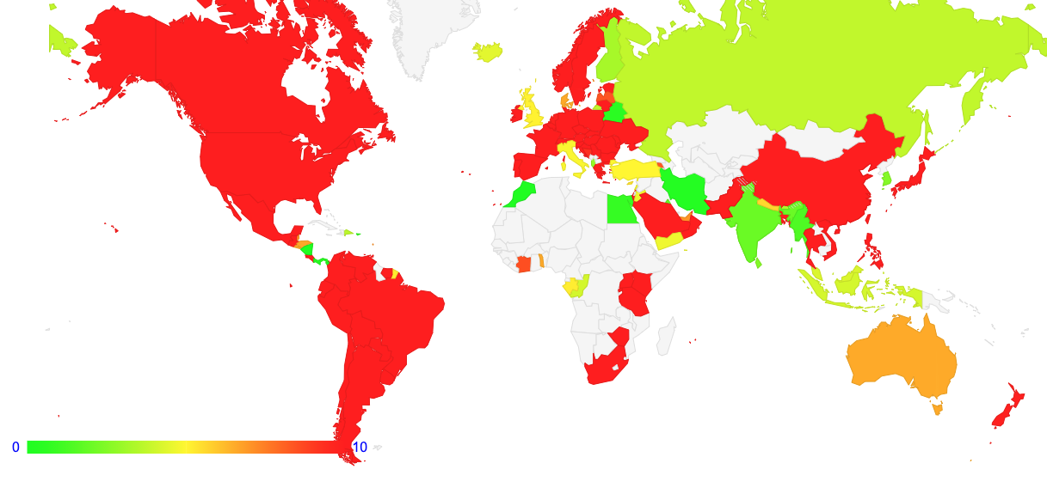
2021 Fragmentation Drop Rate
More recent IPv6 deployments appear to be a lot better than more mature ones

Slide 7
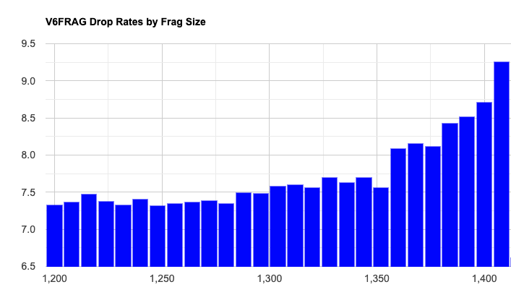
Drop Rate by Size
This is unexpected. At a total IPv6 packet size of 1408 bytes we did not expect to see higher packet drop rates for this packet size, as there is still an IP encapsulation budget of 92 bytes

Slide 8
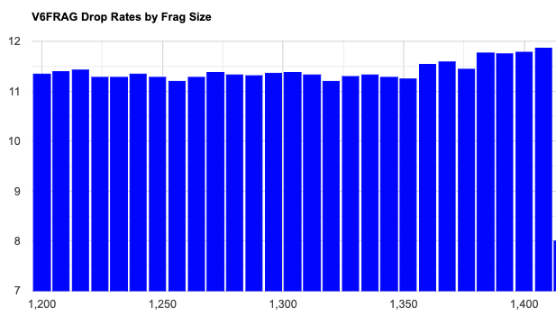
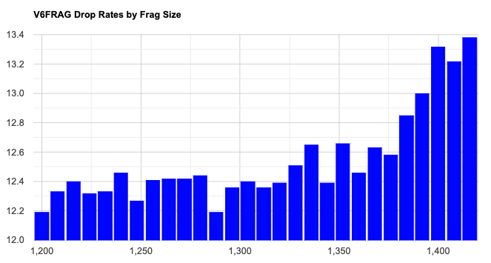
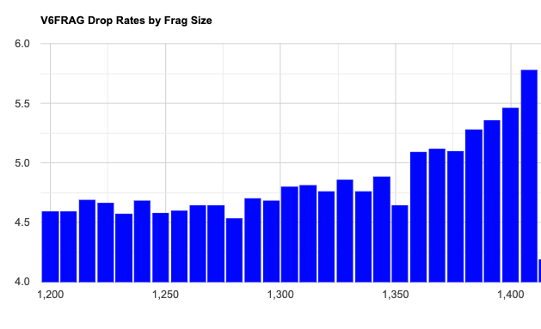
Drop Size Profile by Region
North America
Europe
Asia

Slide 9
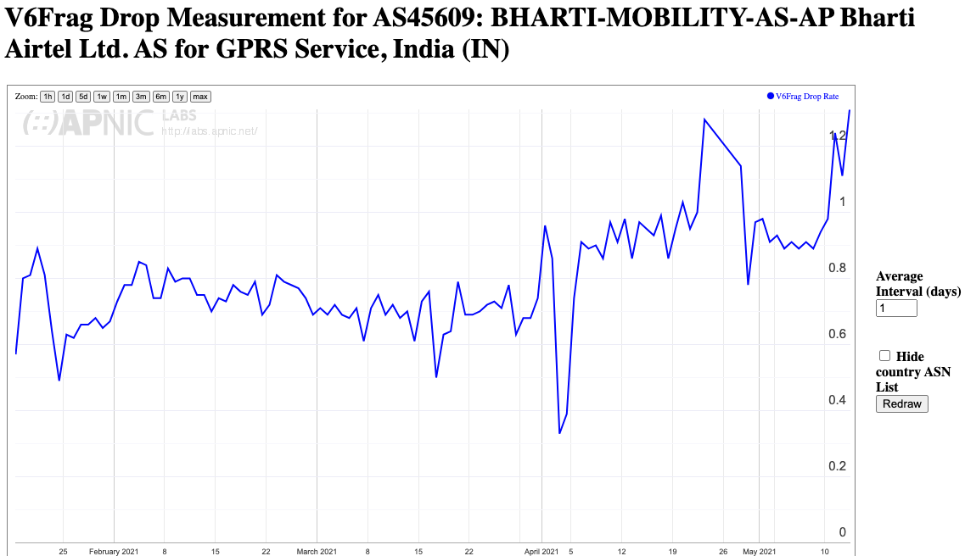
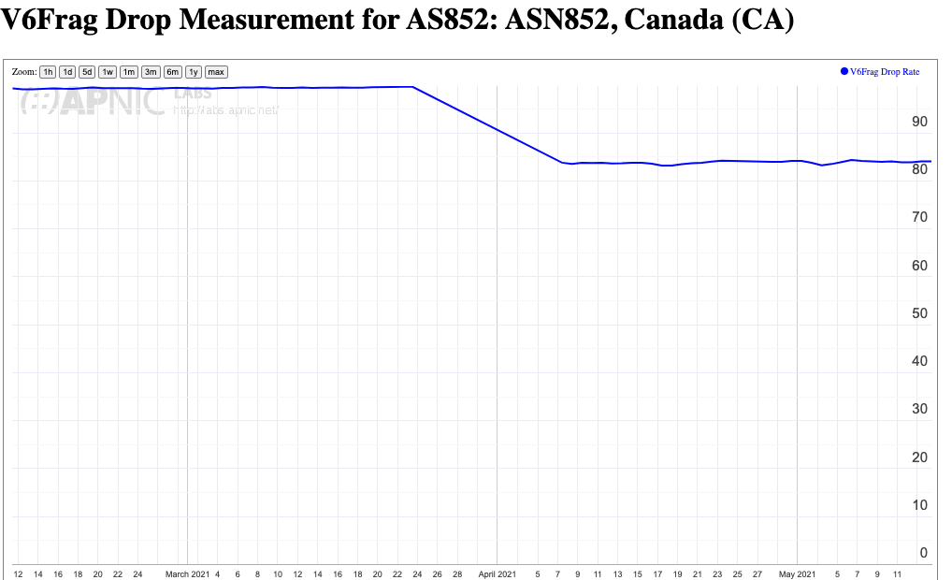
Why?
Drop patterns vary across service providers, so there are probably contributary factors from network equipment and configurations
80% Drop
1% Drop

Slide 10
Why?
Other potential factors that could contribute:
Local security policies
IPv6 EH may trigger “slow path” processing in network equipment that could lead to higher drop rates
IPv6 Path MTU woes!

Slide 11
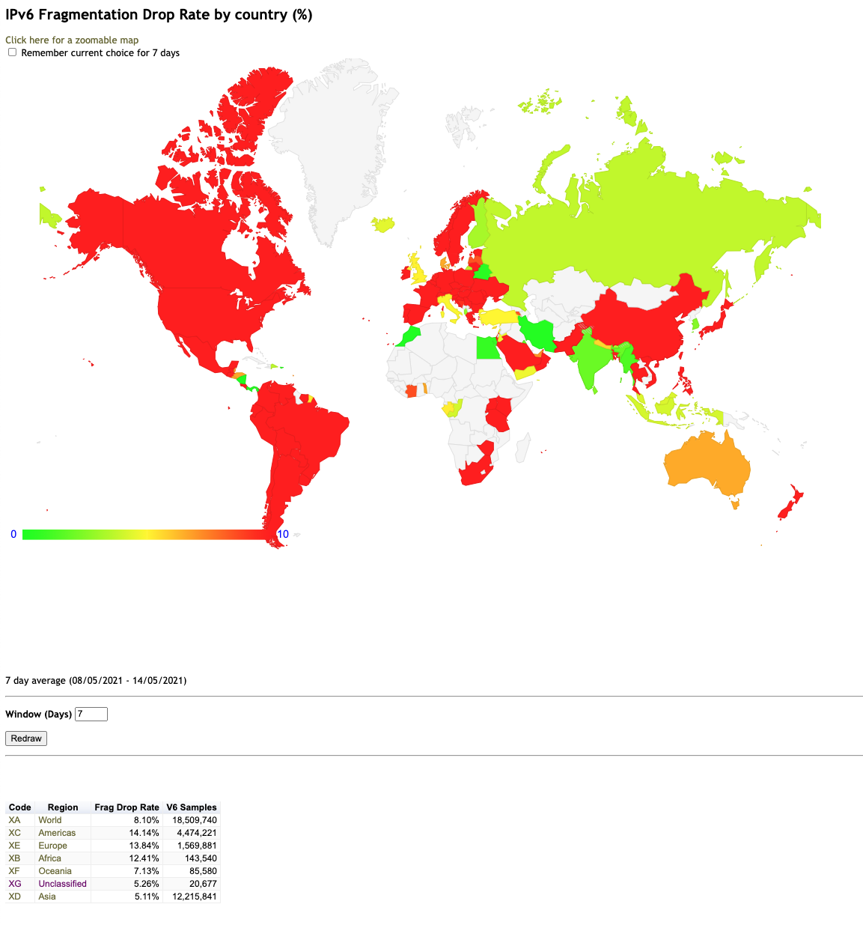

Daily Report
https://stats.labs.apnic.net/v6frag

Slide 12
Summary
The network is improving it’s handling of fragmented packets
In 5 years its gone from unusably bad to tolerably poor
Recent IPv6 deployments appear to show more robust handling of IPv6 packets
Smaller frags appear to be more robust than larger ones (if you are going to fragment a packet, prefer smaller fragment sizes)

Slide 13
That’s it!

