Slide 1
Measurement of DNSSEC Validation with Edwards Curve Cryptography
Geoff Huston, Joao Damas
APNIC Labs
September 2020

Slide 2
Edwards Curve Cryptography
Relatively recent crypto offering, first published in 2011
One of the Elliptic-Curve family of algorithms, using a “twisted Edwards Curve”
Intended to distinguish itself from other crypto algorithms by being:
  Faster
  Unencumbered by lingering IPR disputes
  High crypto “density”
  Public domain source code

Slide 3
I’m really not a crypto geek
So I’ll do a REALLY BRIEF summary of Edwards Curves
The normal form of elliptic curves that Harold Edwards studied in 2007 was:
x² + y² = c² + c²x²y²
The twisted transform of such curves results from the relationship
ax² + y² = 1 + dx²y²
These curves can be used to derive a digital signature algorithm for use in public key cryptography, described in RFC 8032.

Slide 4
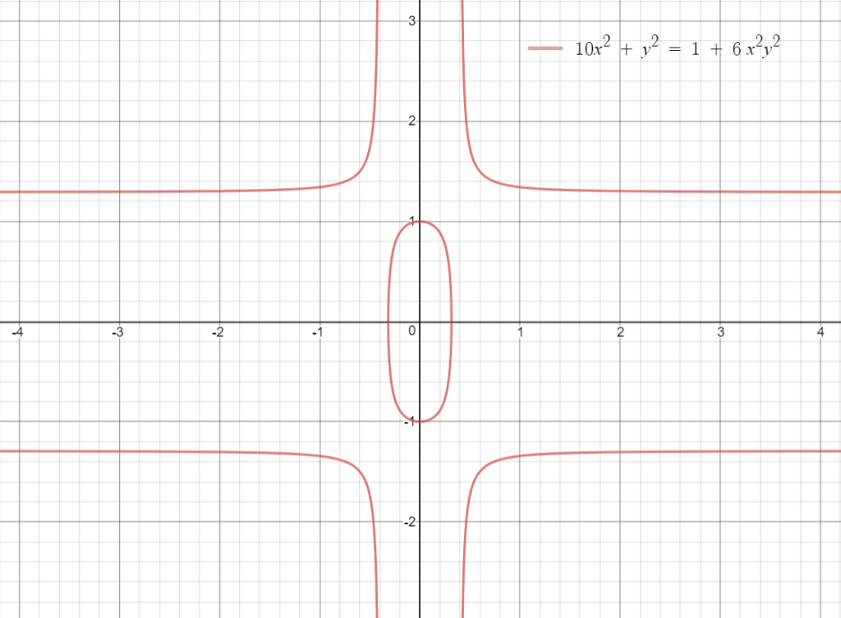
I’m still not a crypto geek
Ed25519 uses an instance of this Edwards Curve curve where:
  a = -1 and d = -121665/121666
and is mapped into a prime field p where
  p = 2²⁵⁵ – 19.
This produces the relationship:
  -x² + y² = 1 – (121665/121666) x²y² (mod 2²⁵⁵ – 19)

Slide 5
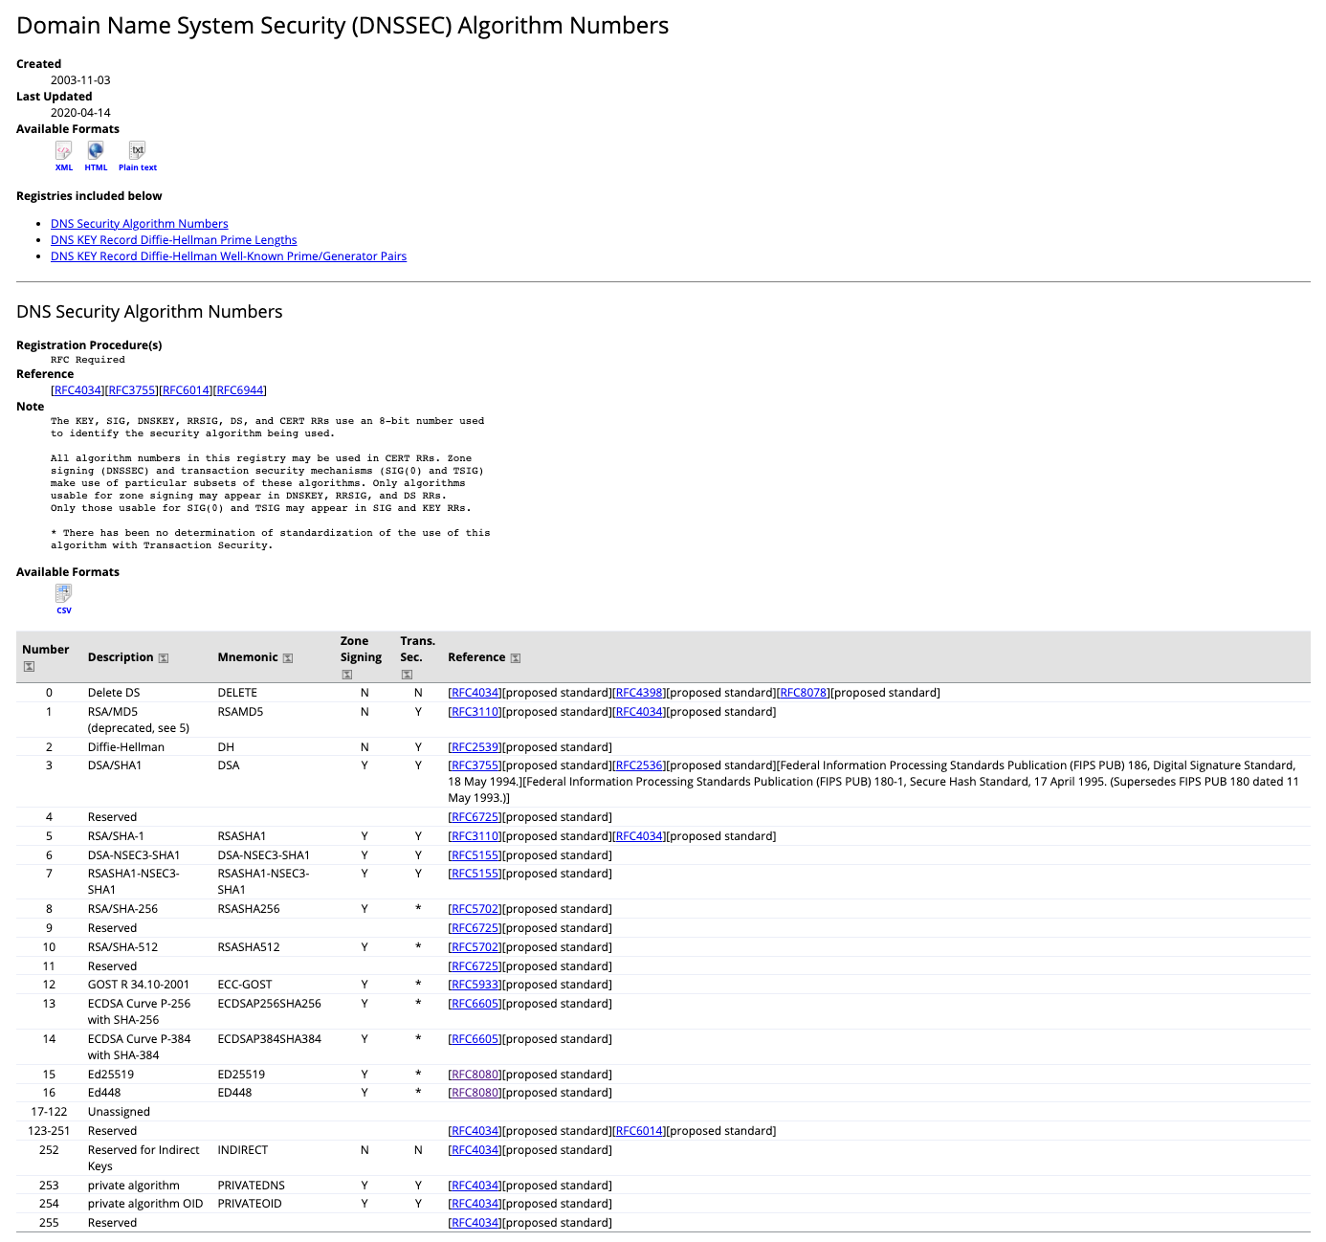
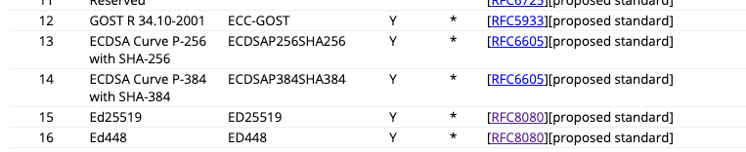
Ed25519 crypto protocol
https://www.iana.org/assignments/dns-sec-alg-numbers/dns-sec-alg-numbers.xhtml

Slide 6
Ed25519 Evaluation
1. Key Size
Algorithm | Private Key | Public Key | Signature Record
Ed25519 | 179 bytes | 300 bytes | 146 bytes
ECDSA P-256 | 187 bytes | 353 bytes | 146 bytes
RSA-2048 | 1,776 bytes | 620 bytes | 403 bytes
RSA-4096 | 3,312 bytes | 967 bytes | 744 bytes

Slide 7
Ed25519 Evaluation
2. Key Processing Time
zone with 500K entries, OpenSSL 1.1.1k libraries on a FreeBSD 12.2 host with the DNSSEC toolset supplied with Bind 9.16.16. Validation time is elapsed time for 50K queries with DNSSEC validation
Algorithm | Signing Time | Relative | Validation Time
Unsigned |  |  | 905 secs
Ed25519 | 800 secs | 1 | 1,008 secs
ECDSA P-256 | 450 secs | 0.56 | 1,036 secs
RSA-2048 | 3,000 secs | 3.75 | 1,173 secs
RSA-4096 | 3,312 secs | 4.14 | 1,176 secs

Slide 8
Validation Support for Ed25519
We used an ad-based measurement to measure the support for Ed25519
  Control URL – unsigned DNS name
  Positive URL – signed with Ed25519
  Negative URL – bad Ed25519 RRSIG record
What happens when a resolver does not support a signing protocol?
  It treats the name as unsigned (RFC 4035)

Slide 9
A user is recorded as supporting Ed25519
We observe A/AAAA queries for both DNS names
We observe DNSKEY and DS queries for both DNS names
We observe a web fetch for the valid URI and no web fetch for the invalid URI
The inference of the invalid condition is that all the recursive resolvers need to support ED25519 for the test to record a positive result

Slide 10
A user is recorded as NOT supporting Ed25519
We observe A/AAAA queries for both DNS names
If we observe DNSKEY and DS queries for both DNS names then we call this “mixed” support
We observe a web fetch for the valid URI and a web fetch for the invalid URI

Slide 11
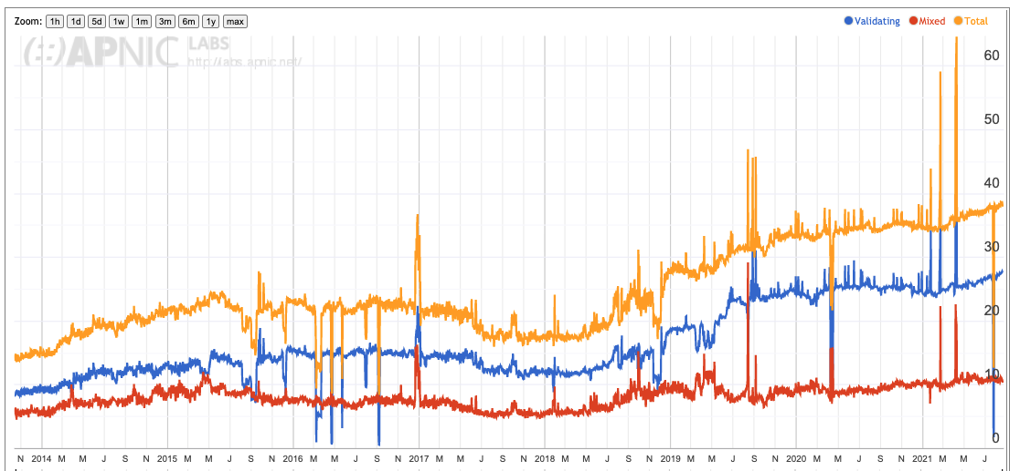
What is a DNSSEC validation “baseline”?
All user’s resolvers perform DNSSEC validation
% of Users
Only some user’s resolvers perform DNSSEC validation
Test case uses RSA signatures
Test case uses ECDSA-P256 signatures

Slide 12
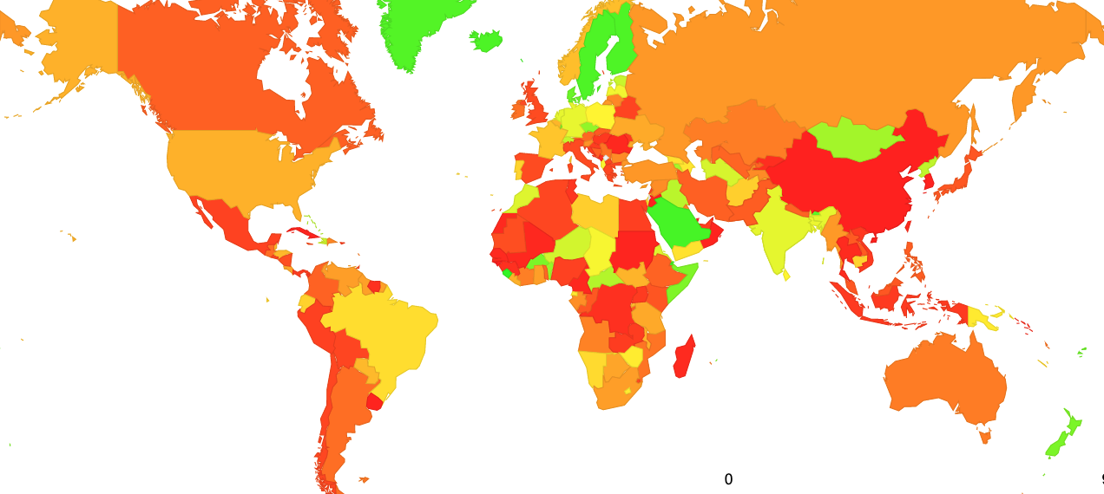
What is a DNSSEC validation “baseline”?
Distribution of DNSSEC Validation
per Economy – August 2021

Slide 13
ECDSA P-256 vs Ed25519
Measurement conducted in May 2021
% users who use ECDSA P-256-aware validating resolvers
% users who use Ed25519-aware validating resolvers

Slide 14
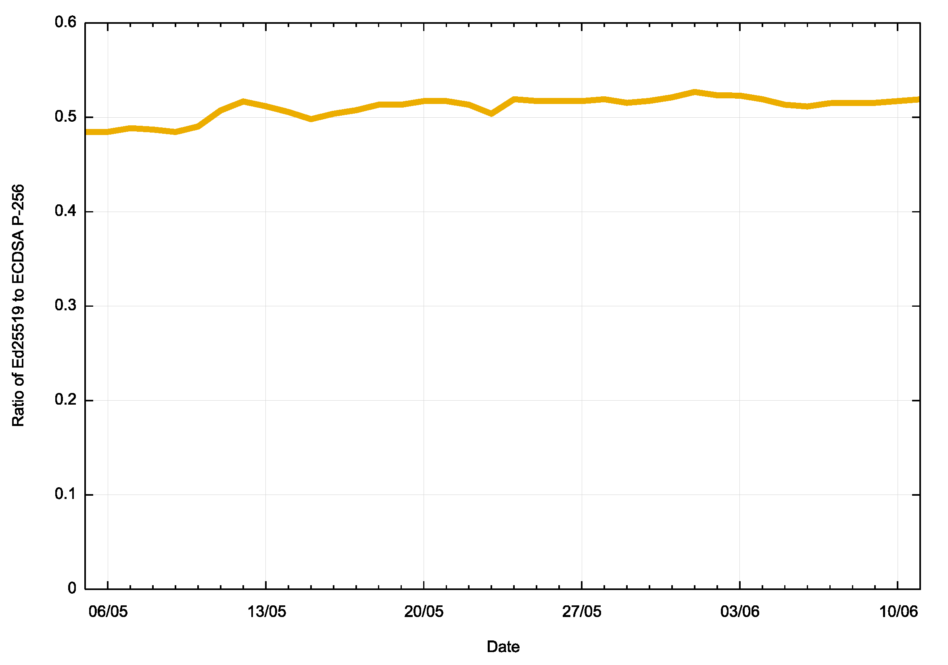
ECDSA P-256 vs Ed25519
Measurement conducted in May 2021
Ratio of Ed25519 : ECDSA
Only 50% of users who use ECDSA-aware validating resolvers are also capable of validating Ed25519 sigs

Slide 15
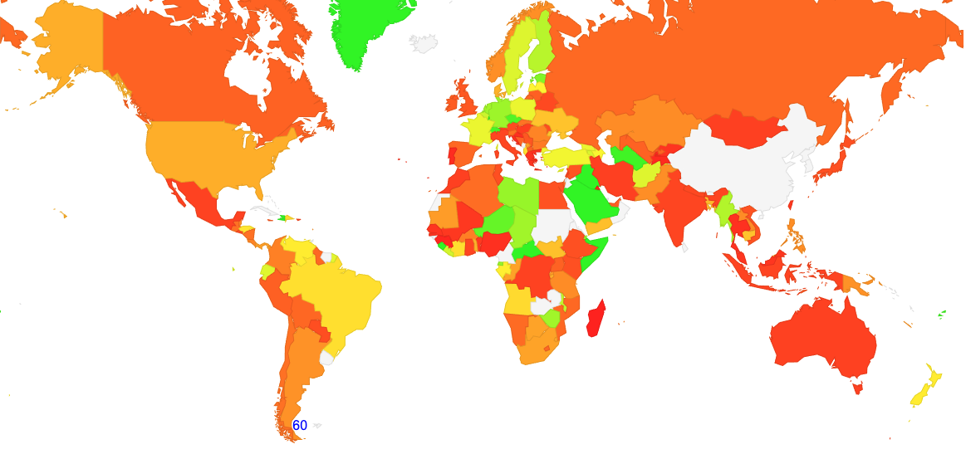
Where?

Slide 16
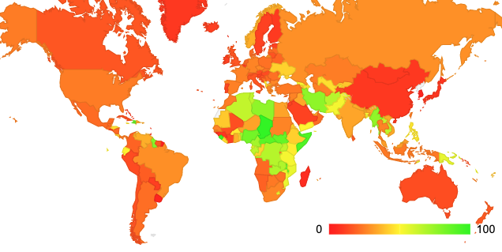
Is this due to Google’s 8.8.8.8 Service?
Uses 8.8.8.8
Support for Ed25519
There is a reasonable correlation in Africa, but less so elsewhere

Slide 17
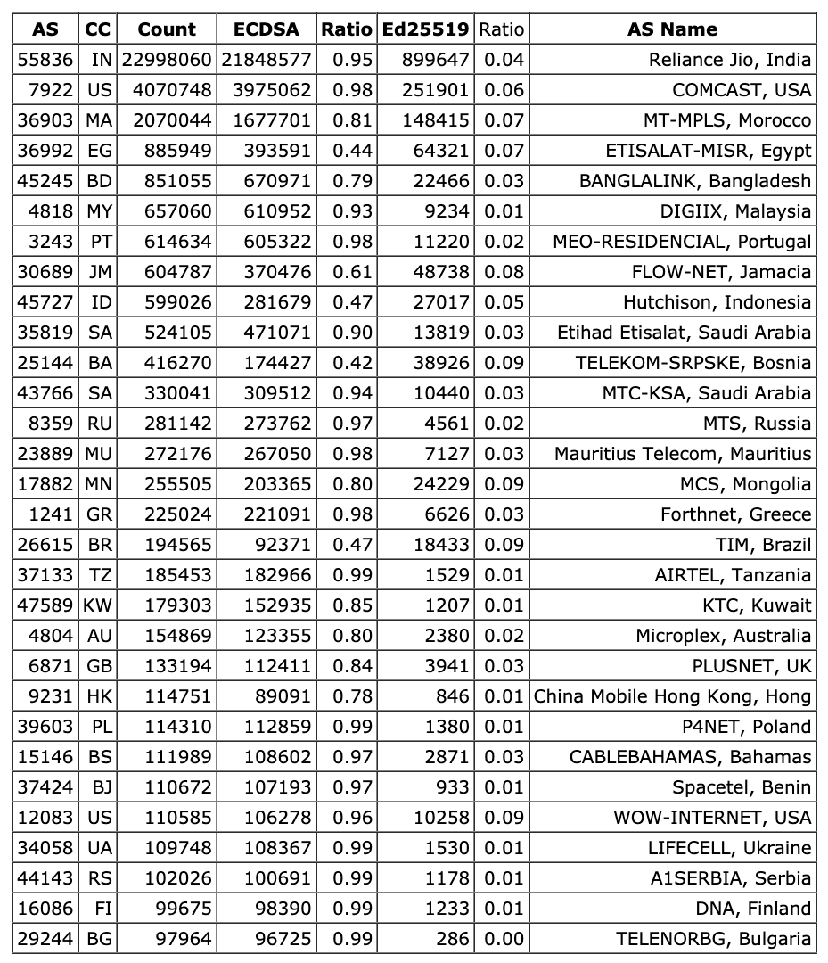
ISP View
List of the “largest” ISPs whose resolvers support ECDSA, but do not support Ed25519 for DNSSEC validation

Slide 18
Is Ed25519 viable for DNSSEC?
No, not today
  It has smaller keys and signatures than RSA-2048
  It is the same size as ECDSA
  It is a lot faster to sign a zone than RSA-2048 but a lot slower than ECDSA (2x)
  It is (a little) faster to validate than ECDSA and RSA
  But…
  It is really not adequately supported by DNSSEC-validating resolvers deployed today

Slide 19
Questions?

