Slide 1
Today’s Internet Question:
Is “Big” Necessarily “Bad”?
Geoff Huston
APNIC
September 2021

Slide 2
Today: Critical Vulnerabilities
Outages by Fastly and Akamai have global impact, affecting all kinds of enterprises
A DDOS attack on DYN managed to cause a meltdown of the Internet for the entire eastern seaboard of the US
Google has such a massively dominant position across technology that everyone else is left trying to just fill in the gaps – HTTP/3, QUIC, TLS, BBR, to name just a few
Mobile devices are either made by Apple or run Android
Chrome completely dominates browser space
The entire world now finds itself relying on just one chip manufacturer!

Slide 3
Wasn’t the Internet going to solve this?
Weren’t we building a a platform that avoided all such forms of centralised orchestration?
What technical choices have we made with the evolution of the Internet that has created critical points of vulnerability?
Or is the current reliance on a small set of providers for all of our common tech needs an unavoidable outcome of a market-based approach to service provision?
But perhaps there is a bigger question:…

Slide 4
How can we fix this?
Such a level of global dependence of a small set of enterprises that completely dominate their market sector is never a comfortable place to be
Monopolies always end up price gouging and entrenching their incumbency by supressing further innovation
Just how bad is it today?
Is it too late to try and fix it?

Slide 5

This is not a new question…
High Museum of Art, Atlanta

Slide 6
Foundations: the US in the 1870’s
The dislocation of a previously agrarian workforce by the civil war created the opportunity for expansion of the industrial workforce through urbanisation and immigration
Liberalised capital markets with offshore investment encouraged entrepreneurial ventures
The telegraph (and subsequently the telephone) network allowed the projection of power and influence, allowing corporate entities to expand their effective scope beyond a single locale
The massive expansion of the national railway system allowed efficient distribution of goods throughout the year
  Raw materials could be shipped to factories, factory products could be shipped to markets
Industrialisation transformed a myriad of small scale local cottage industries into large scale industrial production undertaken by just a few

Slide 7
The Gilded Age
A term applied to America in the 1870 – 1890’s about the building of new industrial and commercial corporate giants on platforms that were a mix of industrial innovation and enterprise with elements of greed, corruption and labor exploitation
Andrew Carnegie - US Steel
John D. Rockefeller - Standard Oil
Theodore Vail - AT&T
George Westinghouse – Rail Brakes
Thomas Edison – General Electric
J P Morgan - Banking

Slide 8
The Gilded Age
During this period in the United States the dominant positions within industry and commerce were occupied by a very small number of players who were moving far faster than the regulatory measures of the day.
The resulting monopolies took the US decades to dismember, and even today many of these gilded age companies remain dominant in their field

Slide 9
The Sherman Anti-Trust Act
An attempt to curtail the excessive aggregation of power that interferes with trade and competition
The act was intended to protect the public from the perils of failure of a market to sustain competition within the market
It prohibits anti-competitive arrangements and conduct that creates market monopolisation that results in the restraint of trade and competition within a market
Applied in 1911 to Standard Oil, American Tobacco and General Electric
Applied in 1982 to AT&T

Slide 10
What happened between 1911 and 1982?
What happened after 1982?
Why wasn’t the Sherman Act bought to bear on other industrial enterprises through most of the 20th century?
  Unintended side-effects of application the Sherman Act may be a factor - the break up of Standard Oil and American Tobacco caused the economic panic of 1910-1911
  Dominant enterprises turned to political lobbying to forestall political action in the form of anti-trust actions
  The US assumed a dominant position in international markets
    In 1913 the US auto industry was already manufacturing 485,000 units out of a world total of 606,000, and by 1929 Ford, GM and Chrysler had 80% of global market share
  The US domestic economy was a major beneficiary of large scale US enterprises dominating the global market, making them politically untouchable in the domestic marketplace

Slide 11
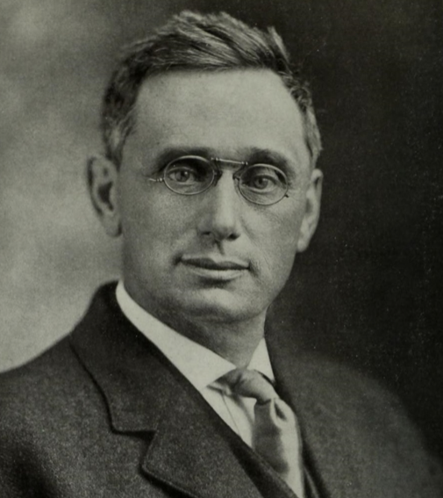
Louis Brandeis
“Big is Bad” by definition
US Supreme Court – 1916 – 1939
He argued that big business was too big to be managed effectively in all cases.
The growth of these very large enterprises that were at the extreme end of the excesses of monopolies, and their behaviours harmed competition, harmed customers and harmed further innovation
The quality of their products tended to decline, and the prices of their products tended to rise once they had achieved market dominance
When large companies can shape their regulatory environment, take advantage of lax regulatory oversight to take on more risk than they can manage, and transfer downside losses onto the taxpayer, then we should be very concerned
  We cannot regulate our way out of this situation, so the power of the large enterprise becomes entrenched and assumes disproportionate importance in the domestic economy
  ”Too Big to Fail” was a term coined in the financial crises of 2008, but it has precedents dating back to the late 19th century

Slide 12
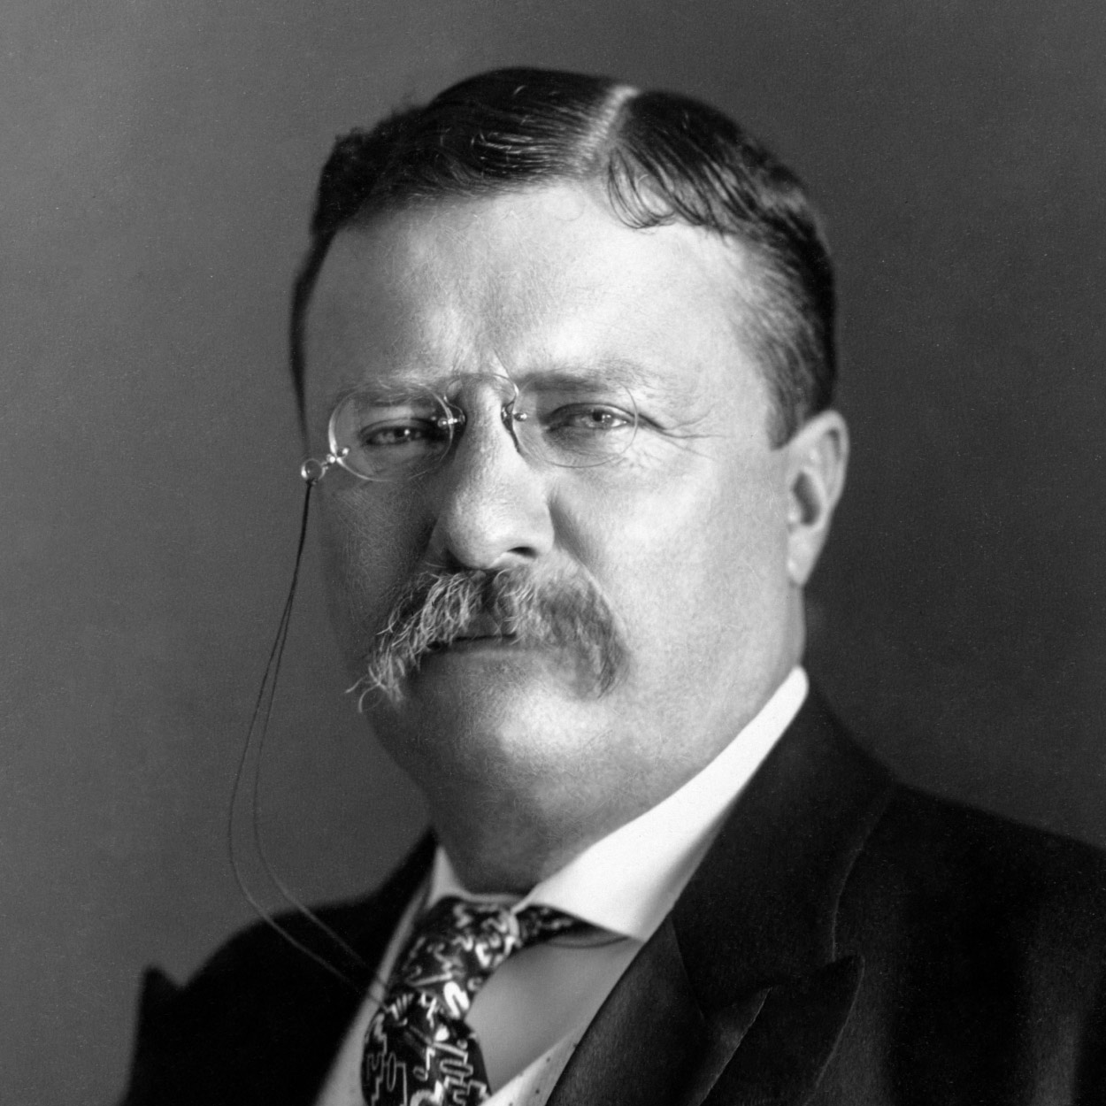
Theodore Roosevelt
… and carry a big stick!
US President 1901 – 1909
There are legitimate economies of scale where large enterprises could achieve higher efficiencies and lower prices to consumers in the production of goods and services by virtue of the volume of production
Large enterprises gain access to volumes of capital and resources that are otherwise inaccessible
The auto industry and the electricity industry are examples of a prohibitively expensive luxury good that turned into a generally accessible product through the application of massive scale in production of the good
An effective and strong regulatory framework can ensure adequate consumer safeguards

Slide 13
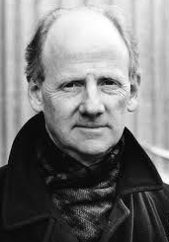
Salvation through Regulation? No way!
John Ralston Saul
Author of Voltaire’s Bastards
Brandeis: no methods of regulation ever have been or can be devised to remove the menace inherent in private monopoly and overwhelming commercial power
John Ralston Saul: you should never expect the private sector to safeguard the public interest
If we regulate, then are we attempting to forestall the condition, or applying regulatory sanctions on the consequent behaviour?
What happens during periods of rapid change in the enterprise landscape? How does regulation remain relevant? How can we prevent regulation from embedding enterprises in the past?

Slide 14
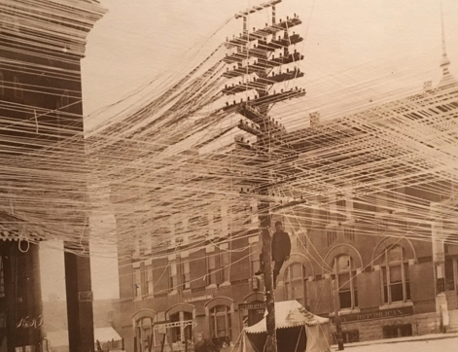
The Rise of Telephony
First introduced at the World Expo in 1876 the telephone became the subject of a massive boom

Slide 15
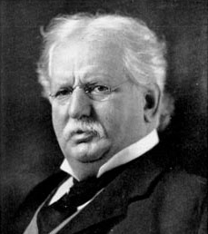
Public vs Private
The transformation of the telephone from a luxury good to a public utility required large scale capital resources beyond the reach of most private enterprises
In most countries the role was assumed by the Postal service as a public service
In the US Theodore Vail made a deal with the US Congress for AT&T to become a state-sanctioned monopoly that would operate in the public interest
  It took less than 6 years for AT&T to shake off these commitments and become a more traditional monopoly acting purely in self interest
  And it took the US a further 6 decades years to dismantle AT&T’s monopoly!
  AT&T became so powerful that US foreign policy in telecommunications was simply a restatement of AT&T’s commercial interests!

Slide 16

Telephony Deregulation
Starting in the 1980’s there was strong pressure from the US to open up the telco sector to competition
This pressure spread worldwide through the IMF and the World Bank as US interests saw opportunities in disrupting cosy national monopolies
However it played out in a different way, as the real deregulation was in the data market and the rise of the Internet

Slide 17
The Rise of the Internet
Initially, the Internet was seen as a poster child for the transformative power of deregulation and private sector investment
The telco sector was too large to rapidly deploy resources to meet escalating demand, so entrepreneurs moved in with venture capital backing
When the Internet began to consolidate, volume economics came into play – larger actors were able to offer services at a lower price point, which increased their market share, which added to their volume, which…

Slide 18
The Rise and Rise of the Internet
There were few natural barriers to growth
  No labour force limitations
  No geographic limitations
  No regulatory inhibitors
  No coherent business models to follow, so investors became irrationally optimistic over future growth potential
Digital business models quickly became global in scope
  Uber, WeWork, Cisco, Microsoft, Amazon, Apple, etc
This “winner take all” environment created an environment that is dominated by a small number of giant enterprises that operate at a global scale

Slide 19
The Internet’s Gilded Age
At some point in the past decade or so the dominant position across the entire Internet has been occupied by a very small number of players who are moving far faster than the regulatory measures that were intended to curb the worst excesses of market dominance by a small clique of actors.

Slide 20
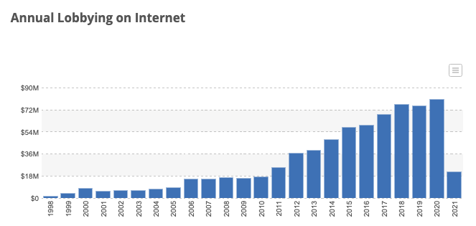
The Internet’s Gilded Age
At some point in the past decade or so the dominant position across the entire Internet has been occupied by a very small number of players who are moving far faster than the regulatory measures that were intended to curb the worst excesses of market dominance by a small clique of actors.
Source: Open Secrets

Slide 21
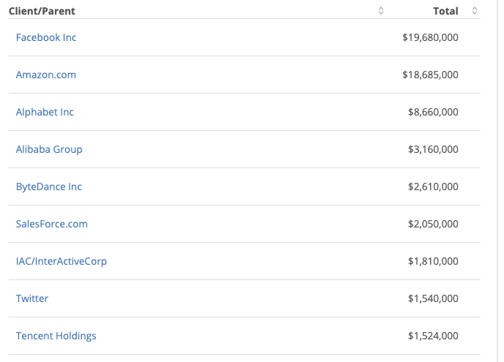
The Internet’s Gilded Age
2020 Lobbying Sources - US
At some point in the past decade or so the dominant position across the entire Internet has been occupied by a very small number of players who are moving far faster than the regulatory measures that were intended to curb the worst excesses of market dominance by a small clique of actors.
Source: Open Secrets

Slide 22
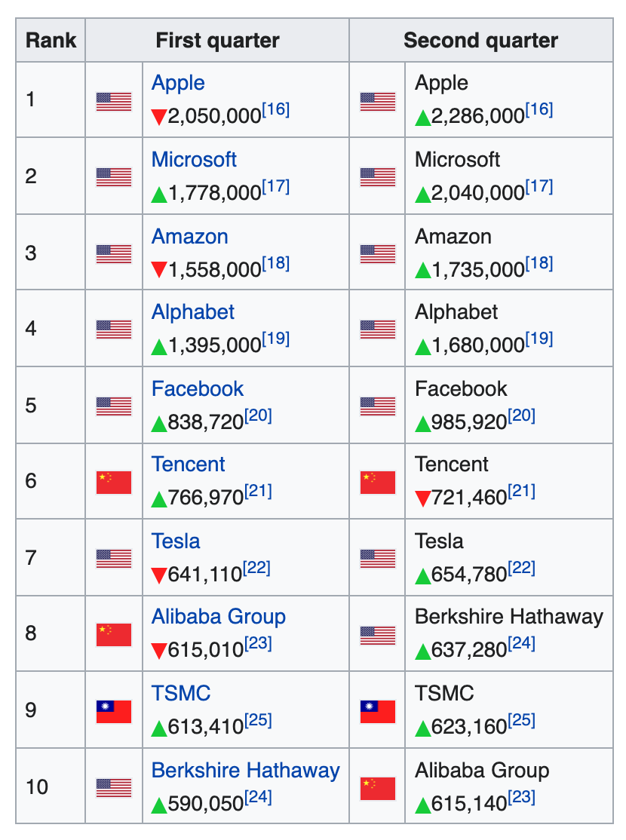
Market Sentiment
8 of the 10 largest publicly traded companies are now technology companies
In this top 10 list there are no
- financial services
- chemicals
- industrials
- retails
Based on national GDP Apple’s market cap is now more valuable than all but 8 of the world’s economies!
https://en.wikipedia.org/wiki/List_of_public_corporations_by_market_capitalization

Slide 23
The Internet’s Gilded Age
These actors have enough market influence to set their own rules of engagement with:
  Users,
  Each other,
  Third party suppliers,
  Regulators and Governments
By taking a leading position with these emergent technologies, these players can amass vast fortunes, with little in the way of accountability to a broader common public good

Slide 24
What’s the problem?
Is it that these enterprises are:
  so big?
  exploitative of their workers?
  distorting markets?
  extracting monopoly rentals from consumers?
  not providing consumers what they want?
It’s hard to sustain a case for any of these criticisms against these digital giants

Slide 25
It’s what we want
It seems that these enterprises have focussed very sharply on giving users precisely what they want
The ability to customise a solution to a market of 1 and still bring economies of scale to that market underlies their success
Their ability lies in achieving a critical mass in size that allows them sufficient bulk to capitalise an asset that individually is worthless
So we all use these services – because they are obtained through the capitalisation of something that individually we are incapable of capitalising

Slide 26
There are side-effects
In order to understand what each consumer wants, the service provider needs to understand the consumer
Which brings us to…

Slide 27

Surveillance Capitalism
Much of the wealth and impact of these activities is built upon a foundation of aggregation of individual user behaviour and construction of personal profiles
It also has benefitted from a cavalier attitude towards data security and privacy concerns and the absence of regulatory imposts that attempt to safeguard some basic common aspects of personal privacy

Slide 28
Change and Monopolies
We are now communicating with a computer-mediated environment rather than with each other
The network itself is largely incidental to this evolving story, and this is not really about the Internet any more
It’s about a set of revolutionary social changes on a par with the industrial revolution that have been triggered by abundant computing, storage and comms
And it’s dominated by a very small cartel of monopolists

Slide 29
Change and Monopolies
We are now communicating with a computer-mediated environment rather than with each other
The network itself is largely incidental to this evolving story, and this is not really about the Internet any more
It’s about a set of revolutionary social changes on a par with the industrial revolution that have been triggered by abundant computing, storage and comms
And it’s dominated by a very small cartel of monopolists
“Every monopoly and all exclusive privileges are granted only at the expense of the public interest”
Andrew Jackson, 1830

Slide 30

Incumbency Rewards
Gittes: How much are you worth?
Cross: I've no idea. How much do you want?
Gittes: I just want to know what you're worth. Over ten million?
Cross: Oh my, yes!
Gittes: Why are you doing it? How much better can
you eat? What can you buy that you
can't already afford?
Cross: The future, Mr. Gittes - the future!
Chinatown (1974)

Slide 31
More Regulation? This time, for sure!
Anti-Big Tech Bills in 2021 in the US Congress:
  US Ending Platform Monopolies Act
  America Choice and innovation Online Act
  Merger filing Fee Modernisation Act
  Platform Competition and Opportunity Act
  Augmenting Compatibility and Competition by Enabling Service Switching (ACCESS) Act
EU draft bills:
  Digital Services Act (Content Moderation)
  Digital Markets Act (pre-emptive act against monopoly dominance)
China:
  Direct action against Alibaba and the Ant Group
  Direct actions against DiDi
  Stop foreign floats of Chinese enterprises

Slide 32
What we might want
If this situation calls for some public sector response then perhaps the thrust of any such response should focus on the user rather than the dynamics of the market
But the public sector efforts to do so remain largely ineffectual despite the magnitude of the public concern over private sector seizure of the space of public discourse

Slide 33
Where are we?
We are now communicating with a computer-mediated environment rather than with each other
The network itself is largely incidental to this evolving story, and this is not really about the Internet any more
It’s about a set of revolutionary social changes on a par with the industrial revolution that have been triggered by abundant computing, storage and communications

Slide 34
Maybe its more than this
In a world of abundant content what do we choose to view?
What do we choose to believe?
Search becomes the arbiter of content selection and assumes a level of ultimate importance in this world
What’s the outcome of search being dominated by a single entity?

Slide 35
Is it about what we buy or is this more about what we think?
Bing – 5%
Google – 89%
Share of search in US market - 2021
https://gs.statcounter.com/search-engine-market-share/all/united-states-of-america

Slide 36
Where does all this head?
For our society this market-driven digitisation of our world has the potential to be incredibly empowering or incredibly threatening
Or both at the same time!

Slide 37
Wherever we’re heading…
It’s not the Internet any more
That has already died and gone to silicon heaven!

Slide 38

Sic transit gloria mundi
In 1776 English historian Edward Gibbon published a mighty 6 volume work tracing the Roman Empire (and Western Civilisation) from the height of Empire to the fall of Byzantium
The seeds of of the empire’s eventual decline and fall were sown early in its rise

Slide 39
Thanks!

