Slide 1
IP Technology Adoption in Bhutan
Geoff Huston
APNIC Labs

Slide 2
Why?
Bhutan has a really high rate of adoption of DNSSEC in their recursive resolvers
And a decent rate of RoV ROA filtering for BGP
And a close to perfect rate of signed ROAs in their address infrastructure
Yet …
Not much IPv6!

Slide 3
Bhutan is not that unusual
Many national environments have a unique technology adoption profile across these 4 technologies:
DNSSEC IPv6 ROA Signing RoV Filtering
Bhutan high not much perfect decent
Sweden high not much not really good
Brazil high decent nope none
Spain low not much decent none
India high huge decent not much
US so-so good decent so-so
Mongolia high nope perfect! good

Slide 4
Sameness and Differences
All these markets have a similar technology base for consumers
And they all use equipment drawn from a similar pool of vendors
And the supply costs are largely the same across the entire network
Yet…
They have different consumer “wealth” indicators
There are different technology deployment models in each national market
Though relative wealth and technology choices do not correlate well!

Slide 5
Lets look at each technology in a little more detail

Slide 6
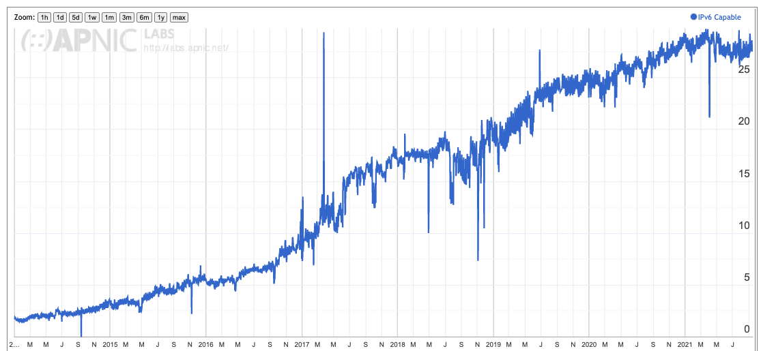
IPv6 Adoption - 2014 to Today
28% of the Internet’s user base have IPv6 today

Slide 7
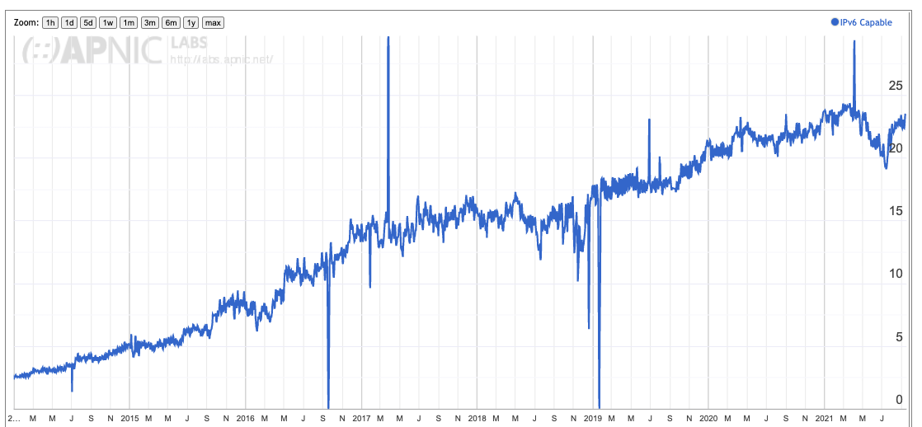
Europe is (slightly) lagging…
23% of the Europe’s user base have IPv6 today

Slide 8
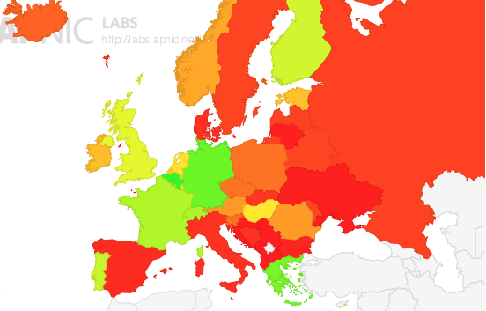
And is very diverse
IPv6 is deployed in Central
Europe and Greece, but not in
the North, South or East

Slide 9
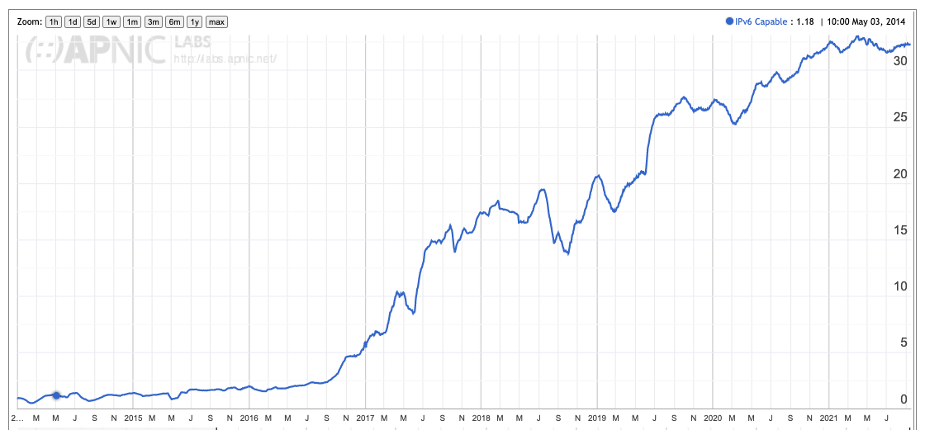
Asia has better numbers

Slide 10
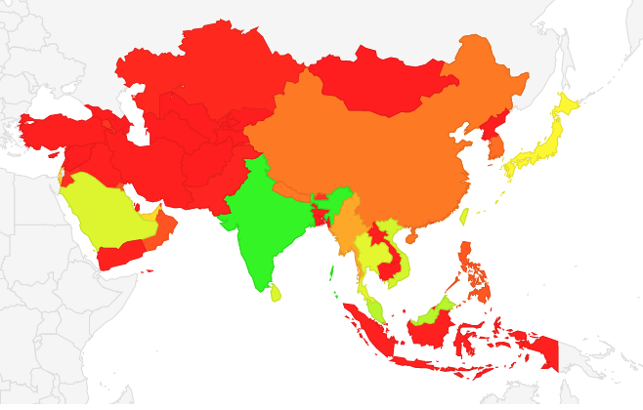
And similar diversity

Slide 11
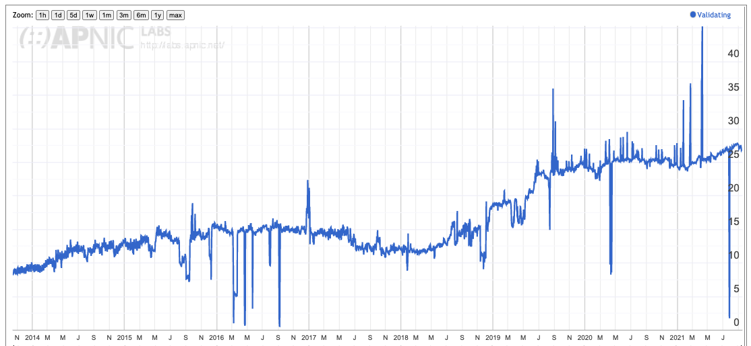
DNSSEC adoption

Slide 12
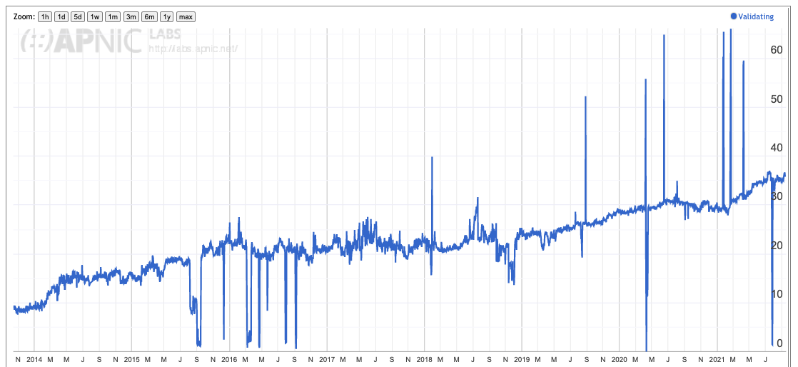
Europe is (slightly) ahead

Slide 13
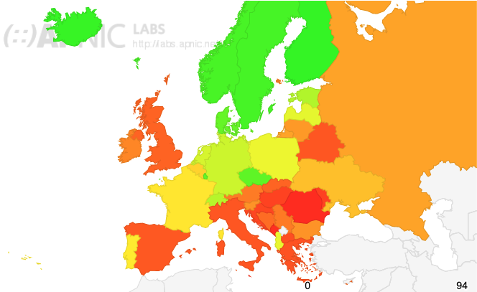
Same (but different) diversity
DNSSEC is deployed in Northern Europe,
but not as much in Central, Southern or
Eastern Europe

Slide 14
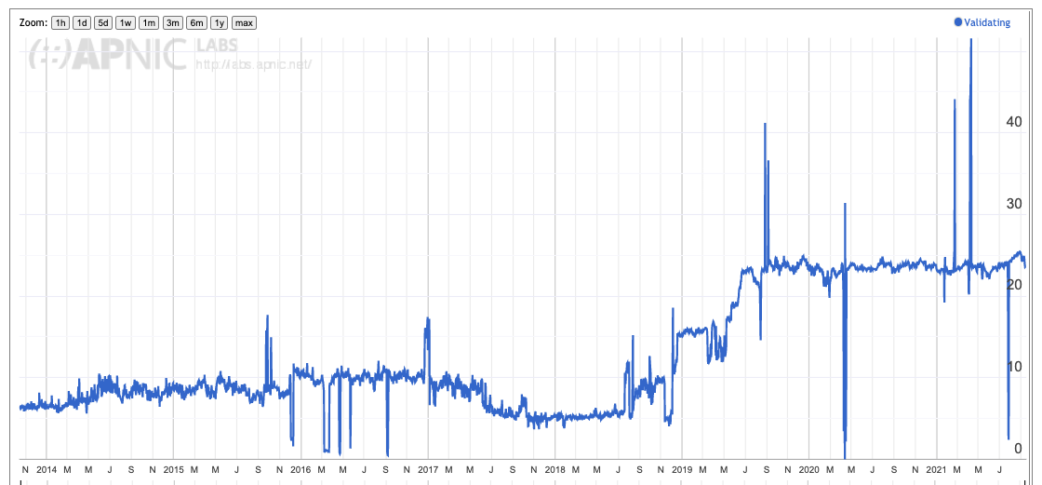
Asia has been steady for 24 months

Slide 15
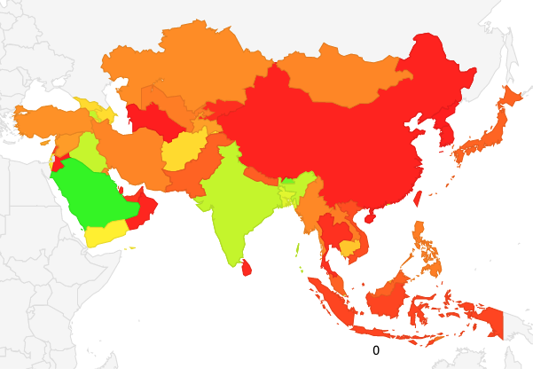
And again a diverse spread

Slide 16
RPKI ROV Adoption
All End Users behind ROV-aware filters: 14%
European users: 10%
Asian users: 10%

Slide 17
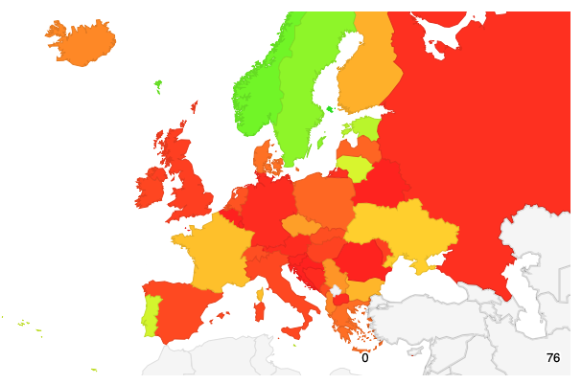
RPKI ROV Adoption in Europe
Rate of RoV Filtering

Slide 18
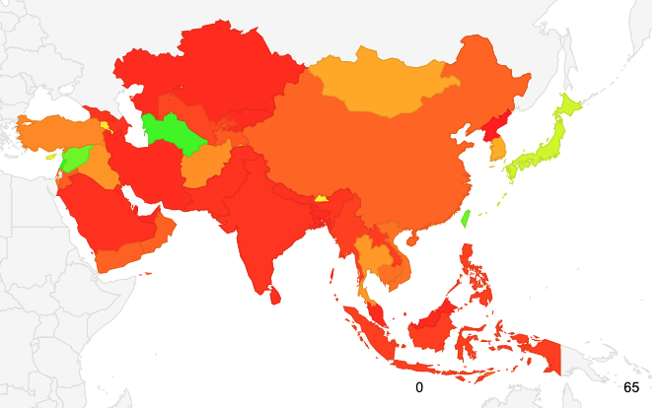
RPKI ROV Adoption in Asia
Rate of RoV Filtering

Slide 19
Why is there such diversity in deployment?

Slide 20



Challenges for adoption:
This is a deregulated and
competitive environment
There are many different players
Each with their own perspective
?
And all potential approaches will be explored!

Slide 21
Challenges for adoption:
2. The myth of long-term planning
?
“IPv6 Transition will take many years...
5 years, maybe 10 years, maybe longer”
Are we still firmly committed to the plans we had 5 years ago? How about our 10-year-old plans?
The longer the period of transition, the higher the risk of completely losing the plot and heading into other directions!

Slide 22
Today’s Internet Architecture
Challenges:
The Internet keeps changing

Slide 23
Some providers see advantage in adoption
Competitive positioning in a diverse market
Early adoption of future mainstream technologies (first user advantage)
Perception of enhanced utility, security and safety in these more recent technologies

Slide 24
Others see reasons to wait …
IPv6 is a 1990’s technology solution to a 1980’s networking architectural challenge – CDN feeder networks do not need globally unique address plans across every device all of the time
DNSSEC is only partially-implemented. If we pushed DNSSEC validation to the edges of the network we’re scared that the DNS will slow down to unacceptable levels.
RPKI Route Origin Validation makes DNS route hijacking only slightly harder. More moving parts can introduce fragility, and not necessarily enhance operating stability

Slide 25
Lets return to Bhutan
And see which service providers have adopted each of these technologies

Slide 26
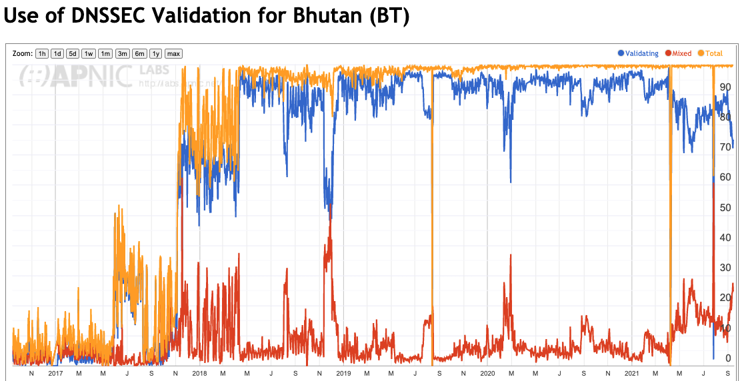
Bhutan and DNSSEC

Slide 27
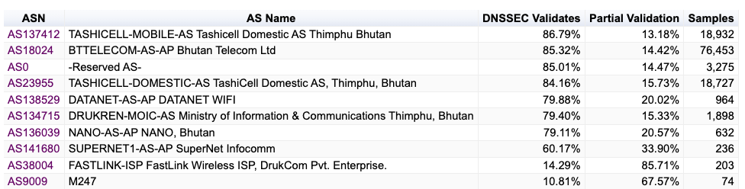
Bhutan ISPs and DNSSEC

Slide 28
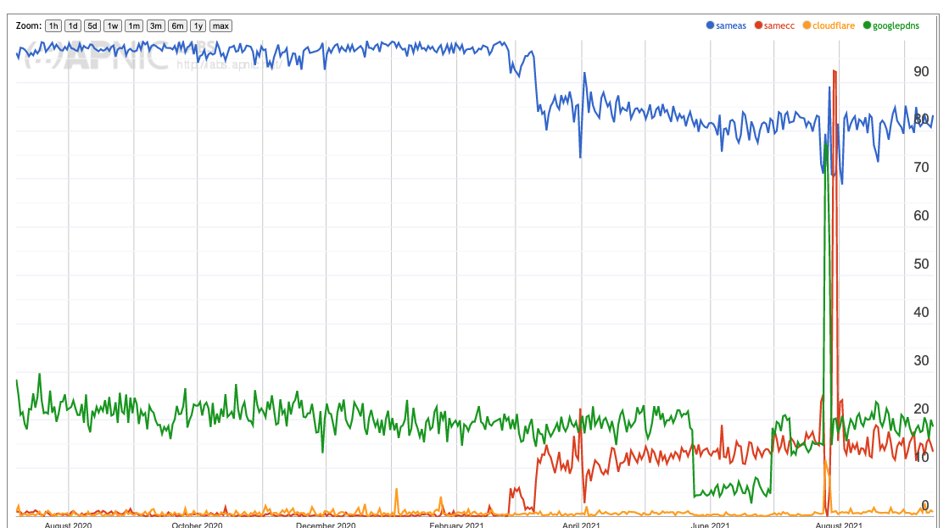
Bhutan and DNS Resolver Use
ISP Resolver
Google
Different AS, still in Bhutan
Cloudflare

Slide 29
Bhutan and DNS Resolver Use
ISP Resolver
This is TashiCell Mobile (AS134417) using DNS resolvers in Tashicell Domestic AS 23955)
Google
Different AS, still in Bhutan
Cloudflare

Slide 30
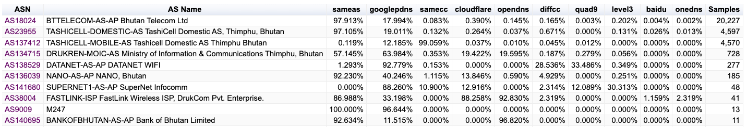
Bhutan and DNS Resolvers
ISP Resolver
Other resolvers not in Bhutan
Chinese open resolvers
Other resolvers in Bhutan

Slide 31
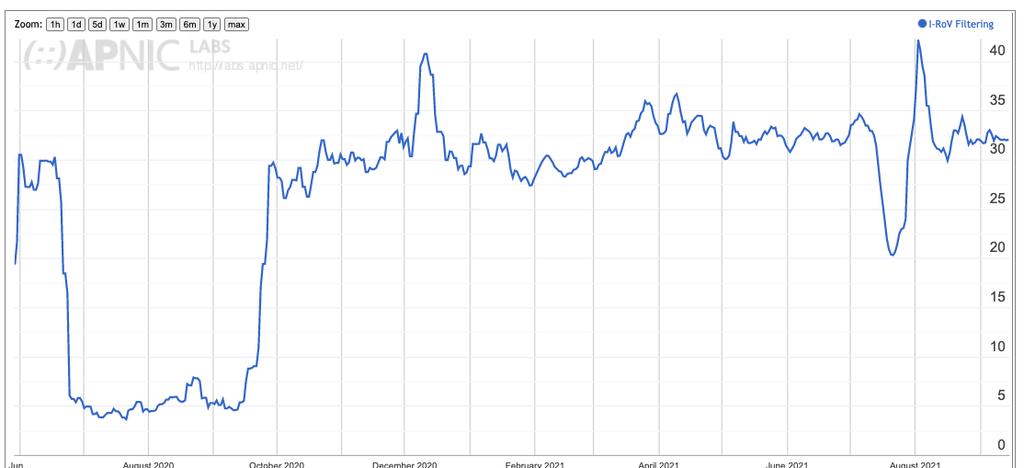
Bhutan and ROV Filtering

Slide 32
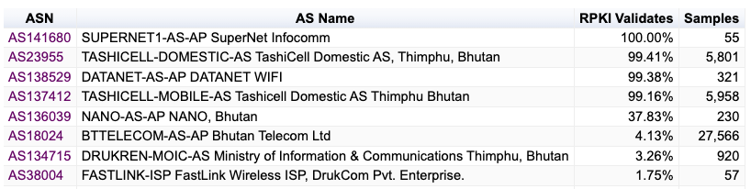
Bhutan and ROV Filtering
This is impressive!
Obviously AS18024 (Bhutan Telecom) is not ROV filtering yet

Slide 33
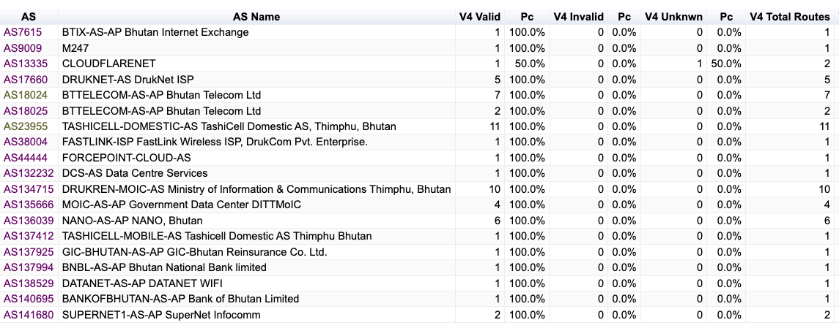
Bhutan and ROA Production IPv4

Slide 34
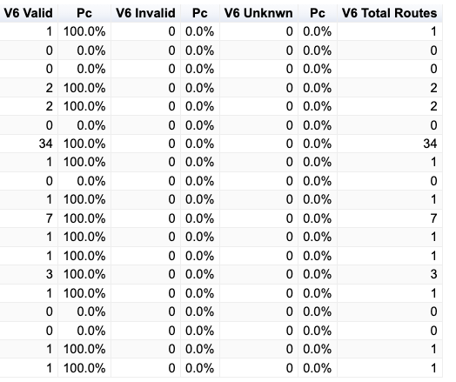
Bhutan and ROA Production IPv6

Slide 35
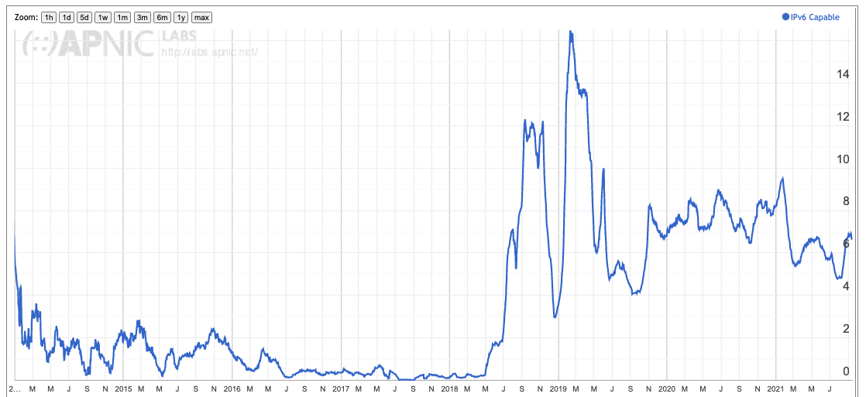
And then there’s IPv6

Slide 36
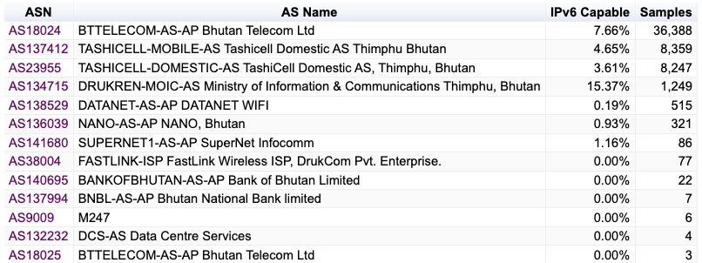
And then there’s IPv6

Slide 37
And then there’s IPv6
WHY so low?

Slide 38
Thanks!

