Slide 1
Content vs Carriage
Geoff Huston
Chief Scientist, APNIC

Slide 2
The best arguments in this industry…
Are the old arguments
Because we can rehearse our positions time and time again!
Let’s spin the time wheel back to 2005…

Slide 3
Net Neutrality
Interview with SBC CEO Edward Whitacre, Business Week Online, 7 November 2005
How concerned are you about Internet upstarts like Google, MSN, Vonage, and others?
How do you think they're going to get to customers? Through a broadband pipe. Cable companies have them. We have them. Now what they would like to do is use my pipes free, but I ain't going to let them do that because we have spent this capital and we have to have a return on it. So there's going to have to be some mechanism for these people who use these pipes to pay for the portion they're using. Why should they be allowed to use my pipes?
The Internet can't be free in that sense, because we and the cable companies have made an investment and for a Google or Yahoo! or Vonage or anybody to expect to use these pipes [for] free is nuts! "

Slide 4
Net Neutrality
Scott Kriens, chairman and chief executive of California-based Juniper Networks, says it is inevitable that the internet will split into different data streams, and those who can afford a better quality of service will be able to buy it.
Argument is raging over this issue in the US, where the Congress and Senate are debating bills that would either allow or prevent such a change.
Opponents claim that privileging some applications over others - for instance video over the web - could hamper innovation. Also it could fragment the internet so that it was no longer available to everyone in its entirety, but only to those who could pay for the full service.
But Mr Kriens says the internet has to be overhauled, to develop the full potential of technology such as streaming video and voice-over-IP telephony. "It has to change," he says.
Sydney Morning Herald, 21 November 2006

Slide 5
The Roles
The Cast of Players:
  Access, Carriage, Services, Content, Customers
The Critical Question:
  Who owes who?
  And how much?

Slide 6

Inter-Provider Settlements
A user buys a postage stamp from the local post office
A user writes a letter
A user affixes a stamp to the letter in order to prepay for the entire delivery process
The local post operator passes the letter to the destination post operator
The local post operator pays the destination post operator a termination delivery fee as an inter-provider settlement
The letter is delivered at no cost to the receiver

Slide 7

Inter-Provider Settlements
A user dials a phone number using a local telephone company
The local phone company creates a connection to the destination phone company
The destination phone company completes the call request
The call is answered at no cost to the receiver
The call is metered by the local phone company and the caller is charged for the entire cost of the call
The call is metered by the terminating phone company and a termination settlement fee is charged to the local phone company as an inter-provider settlement

Slide 8
Inter-Provider Settlements
A user takes out a broadband subscription from a local ISP
A user takes out a streaming video subscription from a video streamer
A user streams a video
Option 1 – Settlement Free
The ISP and the streamer are both being funded by the user – there is no settlement to be paid
Option 2 – Content pays for Carriage
The streamer also pays for carriage across the ISP network
Option 3 – Carriage pays for Content
The ISP pays the streamer on behalf of its users and bundles the streaming service into its retail service

Slide 9
The Tradition
Network Neutrality and Common Carrier Roles:
  The Carrier’s network is strictly neutral with respect to carried content
  The network does not prevent the carriage of data and services
  The network does not bias its response or tariffs in favour of certain services and service providers
  The network is strictly neutral with respect to competing service providers
  Everybody pays to use the carriage network

Slide 10
Content vs Access
Round 1: ~1995
  Content pays Access
  The network provided the connection between customers and service providers
  Customers paid the network service provider to access the services
  Service providers paid the network service provider to access the customers
  MSN, numerous Portal Services

Slide 11
Content vs Access
Round 1: ~1995
  Content pays Access
  The network provided the connection between customers and service providers
  Customers paid the network service provider to access the services
  Service providers paid the network service provider to access the customers
  MSN, numerous Portal Services
Failure!

Slide 12
Content vs Access
Round 2: ~2000
  Access pays Content
  Content providers were failing in the initial rounds of pay-per-view models of content distribution
  Content providers mounted the case that the only reason why customers paid access providers for Internet access was their uniquely compelling content, generated at great expense
  Ergo: Access providers owed content providers a share of the access fees if they wanted to continue to have access to their content

Slide 13
Content vs Access
Round 2: ~2000
  Access owes Content
  Content providers were failing in the initial rounds of pay-per-view models of content distribution
  Content providers mounted the case that the only reason why customers paid access providers for Internet access was their uniquely compelling content, generated at great expense
  Ergo: Access providers owed content providers a share of the access fees if they wanted to continue to have access to their content
Failure!

Slide 14
Content vs Access
Round 3: ~2003
  Access owns Content
  Network Access Providers attempted to generate their own proprietary content
  Content was only accessible within their access domain
  Network enterprises purchased content generators
  Remember Telstra’s tilt at Fairfax? Yahoo’s proprietary content?

Slide 15
Content vs Access
Round 3: ~2003
  Access owns Content
  Network Access Providers attempted to generate their own proprietary content
  Content was only accessible within their access domain
  Network enterprises purchased content generators
  Remember Telstra’s tilt at Fairfax? Yahoo’s proprietary content?
Failure!

Slide 16
Content vs Access
Round 4: ~2006
  Content owes Access
  Penetration of high speed broadband and a new round of software platforms enables a new generation of content providers
  Google looks at traditional media enterprises and takes on the advertising industry with an entirely novel model of advertiser-funded content and services
  The network service provider gets squeezed out of the content model completely and is relegated to dumb pipe provider
  The network provider heads off to the regulator to seek relief from the onerous common carrier provisions in order to leverage a position against content providers

Slide 17
Content vs Access
Round 4: ~2006
  Content owes Access
  Penetration of high speed broadband and a new round of software platforms enables a new generation of content providers
  Google looks at traditional media enterprises and takes on the advertising industry with an entirely novel model of advertiser-funded content and services
  The network service provider gets squeezed out of the content model completely and is relegated to dumb pipe provider
  The network provider heads off to the regulator to seek relief from the onerous common carrier provisions in order to leverage a position against content providers
Failure!

Slide 18
Content vs Access
Round 5: ~2010
  The Rise of the CDN and the Death of Transit

Slide 19
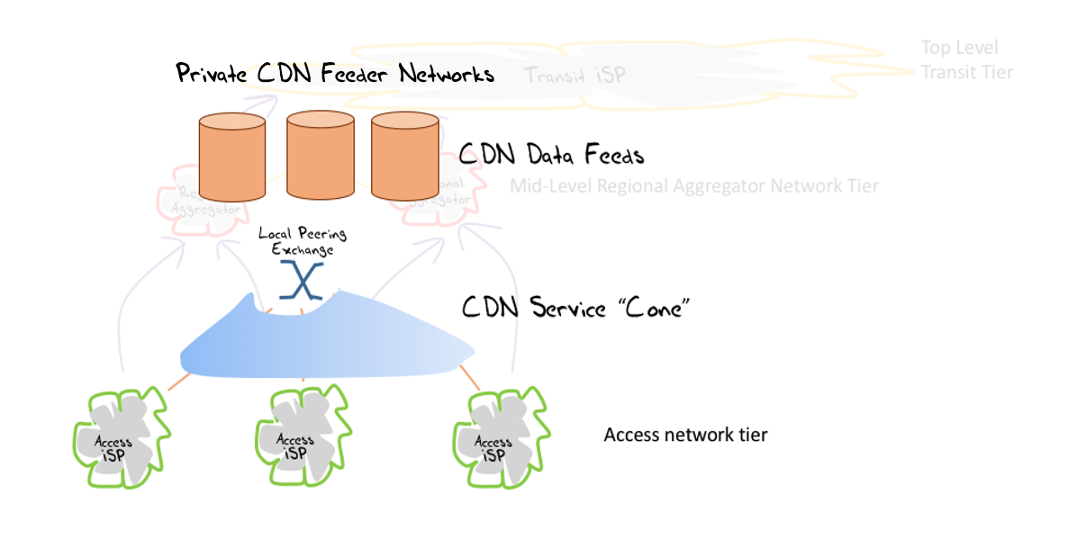
Content vs Access
Round 5: ~2010
  The Rise of the CDN and the Death of Transit

Slide 20
Content vs Access
Round 5: ~2010
  The Rise of the CDN and the Death of Common Carriage
  The content service industry has aggregated to the extent that they can operate their own carriage services at lower cost and greater efficiency through content distribution networks
  All that’s left to the old carriage industry are a collection of last mile access networks

Slide 21
Why is this an issue at all?
There are many commodity utility enterprises in today’s world
  water, electricity, transportation,…
Why is network infrastructure provision any different?

Slide 22
Why is this an issue at all?
Because its easier to blame <Google | Netflix |*> for the weaknesses in a poor <network design | business model | retail offering | *> than actually fixing it!
Which leads to the obvious question:
  Why install a high speed broadband access infrastructure at all if it was never capable of being used to its full extent?

Slide 23

Because …
It wasn’t always this way for the telco business model
  Complete control of the network
  Complete control of the service
  Complete control of the customer

Slide 24
What does the telco want to be?
This sector has no desire to become a commodity utility provider
  It has the wrong skills, wrong assets, wrong technology, wrong shareholders, wrong management, and the wrong outlook to survive in a harsh commodity utility world
It still needs its past all over again…

Slide 25
The Converged Telco Utopia
A small number of vertically integrated “full” service providers leveraging their underlying infrastructure investment into a high yield, high margin service delivery retail system using a single network platform for comprehensive service delivery
Low cost, high value, strong service control, fantastic margins!

Slide 26
Wouldn’t it be wonderful…
If you could account for, and bill, the end user for the value of delivered services rather than just the packets
Customers paid you for value-added service solutions, rather than the marginal cost of packet delivery
Service Providers paid you for access to your customers

Slide 27
Or is this Hopelessly Unrealistic?
Each new generation of carriage technology is heralded as the harbinger of a wonderous new converged era of communications service provision and a new era of control over service delivery
But – it never works that way!

Slide 28
Carriage Reality
Deregulation, intense competition, branching role specialization at every level
Resulting in
  many parallel service delivery networks, many network operators,
  industry-wide duplication of activities,
  continual exposure to inefficient resource use,
  extensive regulatory provisions,
  exposure of niche markets,
  limited planning capability,
  high investment risks,
  high costs,
  low operating margins,
  continual restatement of investor expectations,
  negative returns on equity investments,
  continual recycling of management and staff

Slide 29
Content Reality
Scale

Slide 30
So, what’s the real problem?

Slide 31
So, what’s the real problem?
Money!

Slide 32

Reality
Carriage operators are losing control of pricing, services, technology, content and customers
  CDNs and Over-The-Top services using IP end-to-end impact every aspect of the telco business model
  Almost the only residual asset left for the traditional carriage provider is the local access loop
    And that’s the subject of intense pressure

Slide 33
The Reality
The digital economy we have today is largely based on surveillance capitalism and advertising
  Service providers sell the user to advertisers
  Users either don’t pay for the service or pay a highly subsidised price
But carriage providers are generally prevented from entering this market
  But it didn’t stop them from trying

Slide 34
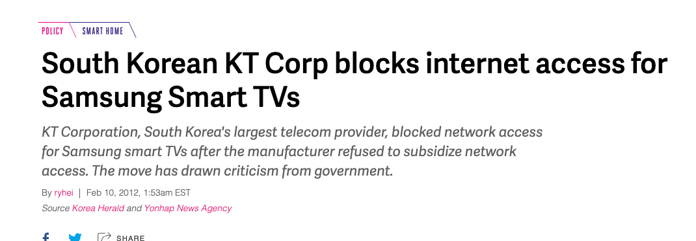
The Revenge of Carriage
Content blocking and selective damage

Slide 35
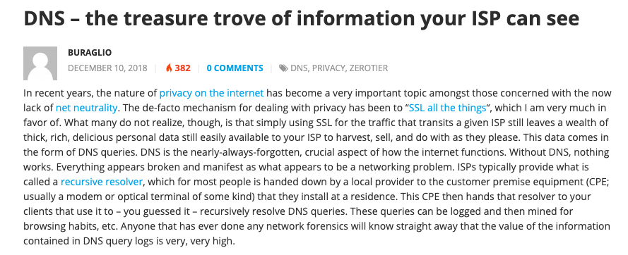
The Revenge of Carriage
Content blocking and selective damage
Active user tracking

Slide 36

The Counter Move
Content is exploiting end-to-end encryption to hide everything
  Encrypt the content (TLS)
  Encrypt the meta-data of the content (ECH)
  Encrypt the DNS (DoT, DoQ, DoH)
  Encrypt the transport protocol (QUIC)
  Encrypt the end points from each other (Oblivious services)
This pushes the carriage provider into a commodity role, dealing in undistinguished opaque traffic

Slide 37
What are we learning?
This tension between carriage and content is not going away any time soon!
Vertically integrated service providers are fading away into history - the deregulated competitive service industry continues to specialize rather than generalize at every level
Carriage is no longer an inescapable monopoly - massively replicated content can be used as a substitute for many carriage service elements
Structural cross-subsidies weaken the longer-term incentives for efficient infrastructure investment

Slide 38
Thanks!

