Slide 1
Some Thoughts on the Nature of the Internet
Geoff Huston
APNIC
May 2022

Slide 2
A couple of tricky questions:
What is the nature of the Internet?
How can the Internet follow a global public interest agenda?

Slide 3
A couple of tricky questions:
What is the nature of the Internet?
How can the Internet follow a global public interest agenda?

Slide 4
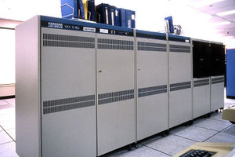
It used to be so simple…
1980’s:
The network was the transmission fabric for computers
It was just a packet transmission facility
Every other function was performed by attached mainframe computers

Slide 5
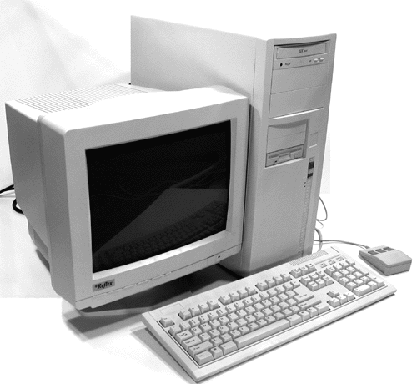
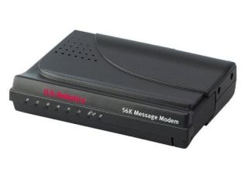
Then we went client/server
1990’s:
The rise of the Personal Computer as the “customer’s computer”
We started to make a distinction between “customers” and “network”
  The naming system was pulled into the network
  The routing system was pulled into the network
  Messaging, content and services were pulled into the network
We created the asymmetric client/server network architecture for the Internet

Slide 6
Internet Infrastructure of 2000
Rapid expansion of infrastructure in many directions:
Exchanges, Peering Points and Gateways
Tier 1 ISPs
Transit and Traffic Engineering
Data Centres and Service “Farms”
Quality of Service Engineering
MPLS, VPNs and related network segmentation approaches
Customer Access Networks
Content Distribution Networks

Slide 7
What is the nature of the Internet?
The problem with this question is that the Internet keeps on changing!
So maybe to answer this we need to look at the forces of change…

Slide 8
What’s driving change today?
Users want:
Bigger
Faster
Better
Cheaper

Slide 9

Bigger
Increasing transmission capacity by using photonic amplifiers and wavelength multiplexing for fibre cables
Adding link aggregation capability
Serving content and service transactions by distributing the load across many individual platforms through server and content aggregation
The rise of high capacity mobile edge networks and mobile platforms add massive volumes to content delivery
To manage this load we’ve stopped pushing content and transactions across the network and instead we serve from the edge

Slide 10
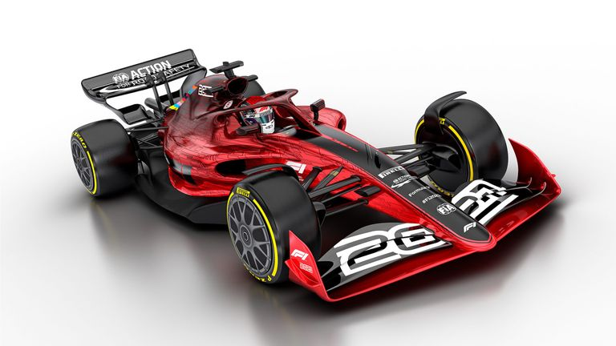
Faster
Reduce latency - stop pushing content and transactions across the network and instead serve from the edge
The rise of CDNs serve (almost) all Internet content and services from massively scaled distributed delivery systems.
“Packet Miles” to deliver content to users has shrunk - that’s faster!
The development of high frequency cellular data systems (4G/5G) has resulted in a highly capable last mile access network with Gigabit capacity
Applications are being re-engineered to meet faster response criteria
Compressed interactions across shorter distances using higher capacity circuitry result in a faster Internet

Slide 11
Better
If “better” means “more trustworthy” and “more privacy” then we are making progress at last!
  Encryption is close to ubiquitous in the world of web services
  TLS 1.3 is moving to seal up the last open TLS porthole, the SNI field
  Oblivious DNS and Oblivious HTTP is moving to isolate knowledge of the querier from the name being queried
  The content, application, and platform sectors have all taken the privacy agenda up with enthusiasm, to the extent that whether networks are trustable or not doesn’t matter any more – all network infrastructure is uniformly treated as untrustable!

Slide 12

Cheaper
We are living in a world of abundant comms and computing capacity – its cheaper and faster to replicate content and services
And we are working in an industry when there are significant economies of scale – so we centralise functions to fewer and fewer actors
And all this is largely funded by capitalising a collective asset that is infeasible to capitalise individually – your profile
The result is that a former luxury service accessible to just a few has been transformed into an affordable mass-market commodity service available to all

Slide 13
So it’s all good!
Right?

Slide 14
A couple of questions to think about
In a world of private CDN networks does Transit matter any more?
  Or Peering? Or Exchanges? Or Gateways?
  Or are all these network infrastructure elements heading inexorably to valueless irrelevance?

Slide 15
A couple of questions to think about
In a world of private CDN networks does Transit matter any more?
  Or Peering? Or Exchanges? Or Gateways?
  Or are all these infrastructure elements heading inexorably to valueless irrelevance?
In a world of NATs, CDNs and Cloud services what is the role of globally unique IP addresses?
  Or have we transferred all the function of the network into the domain name environment?
  Is “the Internet” now uniquely defined by the use of a common name space?

Slide 16
What is the Internet today?
A common name space used for content and service delivery
And not much else

Slide 17
A couple of tricky questions:
What is the nature of the Internet?
How can the Internet follow a global public interest agenda?

Slide 18
What is the “public interest” here?
What is left of our former public communications infrastructure?
  It seems that the public shared network is collapsing into a collection of private content distribution systems that are neither open nor shared
  Google, Amazon, Meta and Microsoft are almost the only entities building more high capacity undersea trunk infrastructure
  And Starlink and Amazon are looking set to capture the LEO space of satellite comms
But does anyone care any more?
The Internet is already fast, cheap, and ubiquitous
  What’s the public interest problem here?

Slide 19
The nature of Private Enterprise
Private enterprises are not there to uphold a public interest
  That’s the role of governments
So when an industry is deregulated, as happened in telecommunications, you need to be pretty confident that the motives of the private sector investors and some form of common public interest coincide
  Because this is a really difficult place to reverse out from if they don’t!

Slide 20
How do you negotiate with a 900lb gorilla?
You don’t!
Once you pass the entire global communications endeavour to a market-based private sector regime, then it takes on a momentum of its own that places it entirely outside of historic forms of national regulation and control
And that’s what we need to come to terms with today!

Slide 21
Thanks!

