Slide 1
The DNS Resolver Landscape
Geoff Huston AM
Chief Scientist, APNIC

Slide 2
DNS System Architecture
Authoritative Servers
Cache
Recursive Resolver
Stub Resolver
Application

Slide 3
DNS System Architecture
Authoritative Servers
ISP
Recursive Resolver
ISP Resolver
Cache
Stub Resolver
Application

Slide 4
DNS System Architecture
Authoritative Servers
Recursive Resolver
“Open” Resolver
Cache
ISP
Stub Resolver
Application

Slide 5
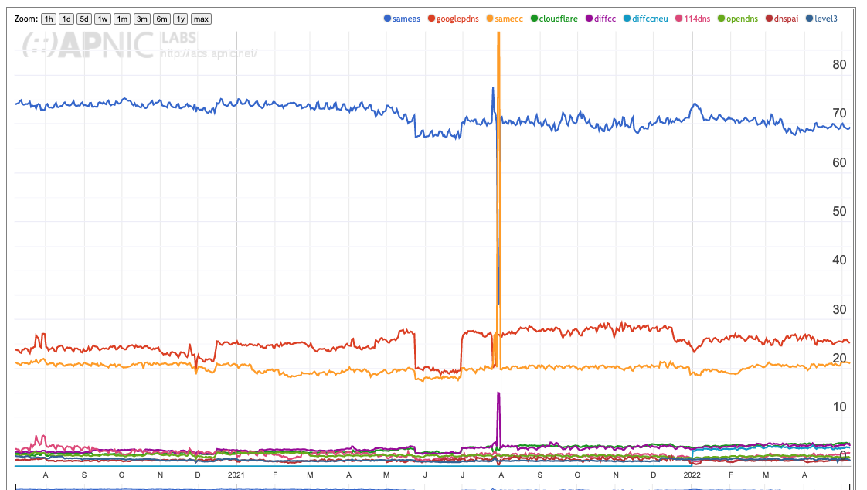
Use of Resolvers
68% of users direct their DNS queries to the ISP-operated recursive resolvers
25% of users direct their DNS queries to Google’s open resolver service
20% of users direct their DNS queries in in-country DNS

Slide 6
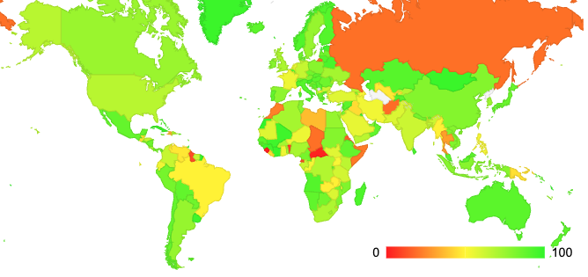
Use of ISP Resolver
We have no current data for Russia
https://stats.labs.apnic.net/rvrs

Slide 7
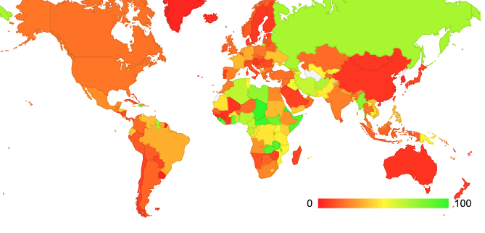
Use of Google’s DNS Service
We have no current data for Russia
https://stats.labs.apnic.net/rvrs

Slide 8
Why use an Open DNS Resolver?
It’s often faster (a busier cache is a better cache!)
It’s often more reliable
It supports DNS over TLS and DNS over HTTPS
It performs DNSSEC validation
It does not filter DNS responses in any way
But
It requires a customisation of the device / local network
Unless you use TLS there are many more opportunities for eavesdropping and manipulation

Slide 9
Why use an Open DNS Resolver?
It’s often faster (a busier cache is a better cache!)
It’s often more reliable
It supports DNS over TLS and DNS over HTTPS
It performs DNSSEC validation
It does not filter DNS responses in any way
But
It requires a customisation of the device / local network
Unless you use TLS there are many more opportunities for eavesdropping and manipulation
Many enterprise networks use open DNS resolvers

Slide 10
Why use the ISP resolver?
It can provide better content steerage – leading to faster content
It requires no customisation of the device / local network
But
It may perform local DNS filtering
It may be used for in-country meta-data collection
Less opportunity for third party eavesdropping and manipulation

Slide 11
Why use the ISP resolver?
It can provide better content steerage – leading to faster content
It requires no customisation of the device / local network
But
It may perform local DNS filtering
It may be used for in-country meta-data collection
Less opportunity for third party eavesdropping and manipulation
Most retail customers use ISP resolvers

Slide 12
DNS Forwarders
Sometimes its not so straightforward as one or the other
ISPs sometimes forward all their queries to one or more open DNS resolvers and don’t operate their own DNS resolution service
  To the customer it looks like the ISP’s service
  But the ISP can pouh the cost of operating this service on to the Open Resolver service

