Slide 1
Revocation
Geoff Huston, Joao Damas
APNIC Labs

Slide 2
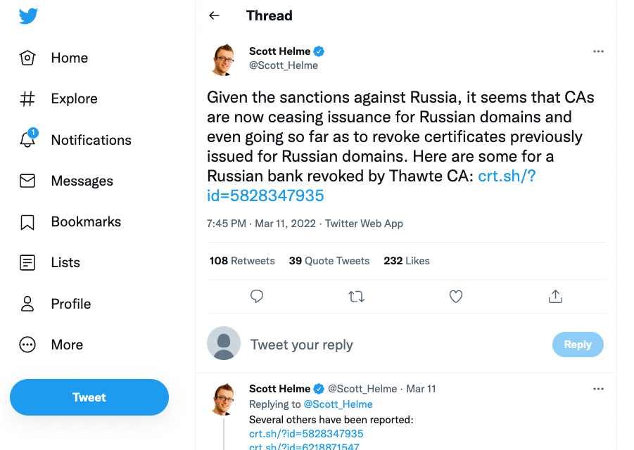
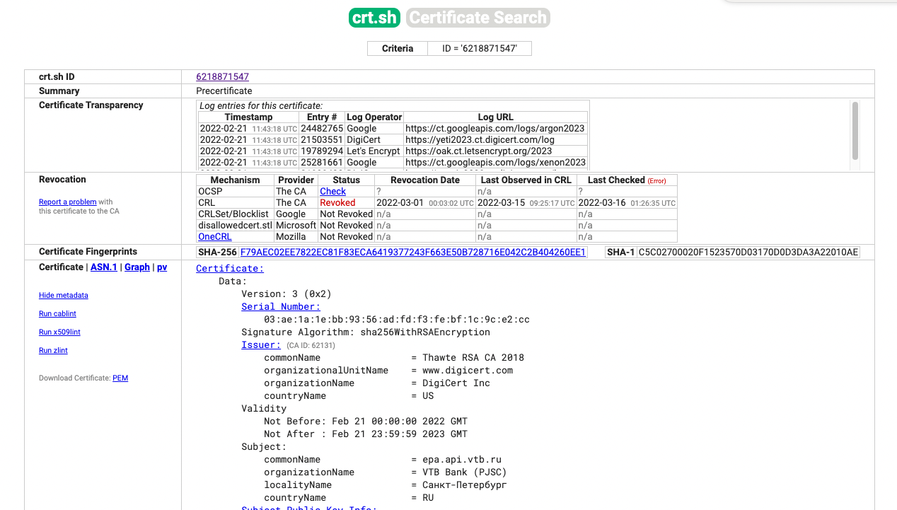
Certificate Revocation as a “sanction”

Slide 3
Certificate Revocation as a “sanction”
Does Certification Revocation even “work”?
Will clients still be able to connect to your ‘secured’ content or service even when the certificate has been revoked?

Slide 4
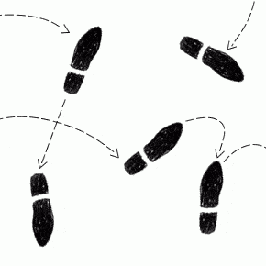
Let’s take a step back…

Slide 5
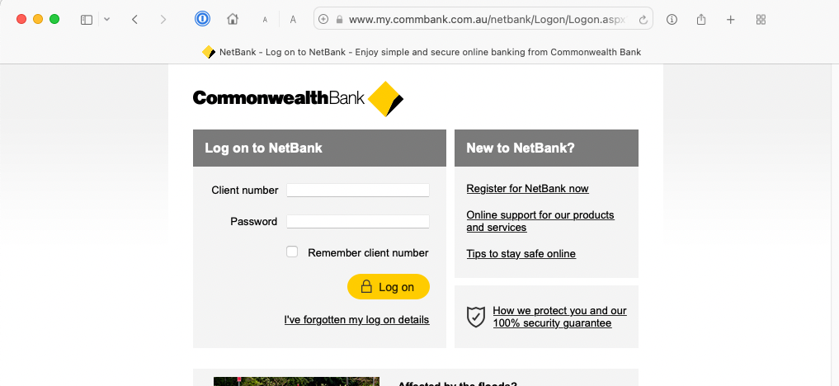
Why should I trust this?
How can I be assured that this is my bank and not a clever scam?

Slide 6
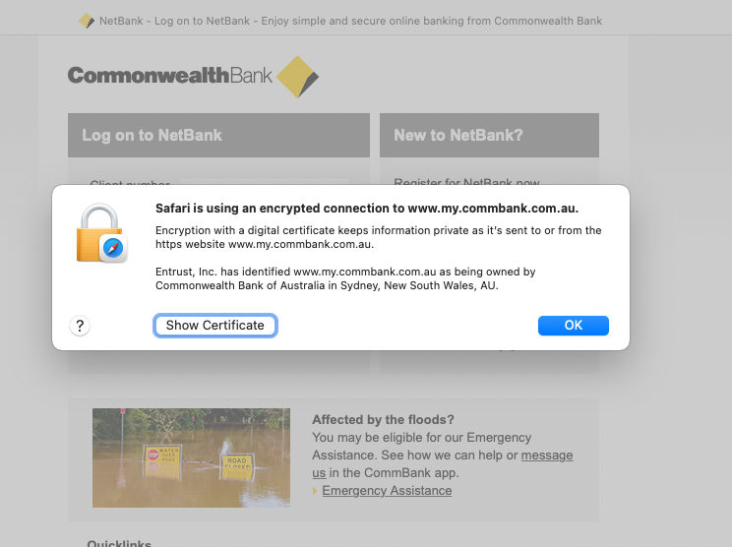
This sounds reassuring, but why the hell should I trust “Entrust Inc”?
With a name like that they sound pretty dodgy! I have never met these folk and I have no idea what this means.
OK - what does this certificate say?

Slide 7
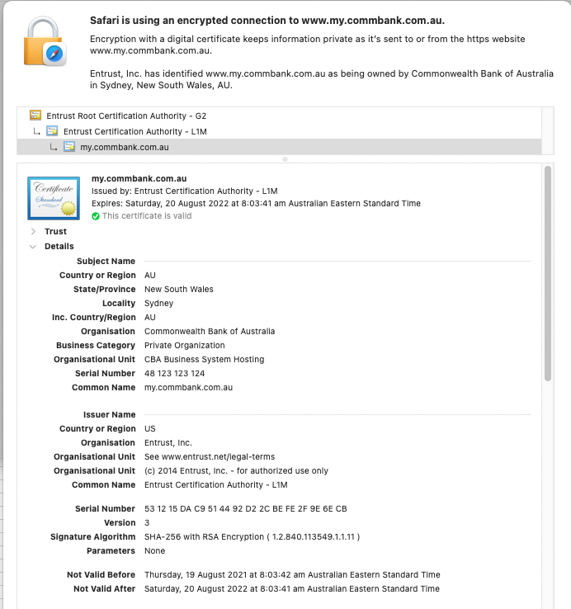
“This certificate is “valid”
Fair enough, but why should I trust it?

Slide 8
“This certificate is “valid”
Fair enough, but why should I trust it?
This certificate is 7 months old, and I am being asked to trust it for the next 5 months!
What if the private key is leaked in the next 5 months? What if the CA is breached? What if …
What if something happens in the next 5 months that says that I really should not trust this certificate any more?

Slide 9
The Answer is Revocation!
Each CA maintains a “Certificate Revocation List”
This is a list of the serial numbers of all current certificates issued by this CA that should no longer be trusted
If a Bad Thing happens, or for any other reason, and the CA believes that the certificate cannot be trusted, then the certificate’s serial number is added to this CA’s Certificate Revocation List
Anyone who is worried about the “currency” of a certificate should check to see if its serial number is listed in the CA’s current CRL

Slide 10
The Answer is Revocation!
Each CA maintains a “Certificate Revocation List”
This is a list of the serial numbers of all current certificates issued by this CA that should no longer be trusted
If a Bad Thing happens, or for any other reason, and the CA believes that the certificate cannot be trusted, then the certificate’s serial number is added to this CA’s Certificate Revocation List
Anyone who is worried about the “currency” of a certificate should check to see if its serial number is listed in the CA’s current CRL
But how can a client perform this check?

Slide 11
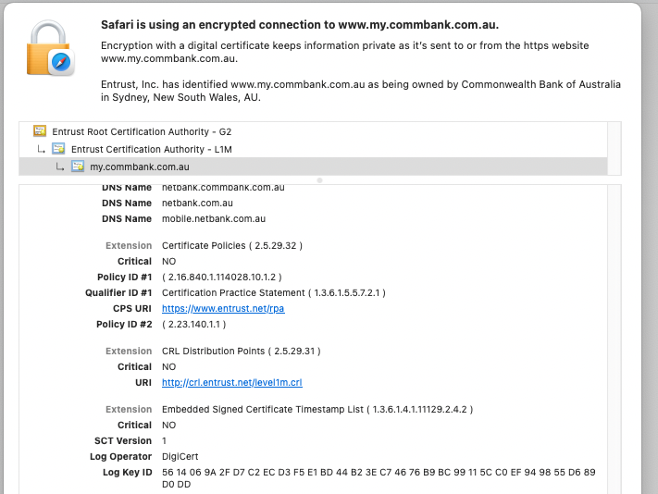
The URL for the CA’s CRL is listed in the certificate, if the CA publishes a CRL
Here’s the one for Entrust Inc…

Slide 12
The URL for the CA’s CRL is listed in the certificate, if the CA publishes a CRL
Here’s the one for Entrust Inc…
Its not an HTTPS URL, but it’s a signed object requiring authentication, so tampering is challenging whether or not the retrieval transport is authenticated and encrypted

Slide 13
What’s in that CRL?
$ wget http://crl.entrust.net/level1m.crl
$ openssl crl -inform DER -text -noout -in level1m.crl
Certificate Revocation List (CRL):
Version 2 (0x1)
Signature Algorithm: sha256WithRSAEncryption
Issuer: /C=US/O=Entrust, Inc./OU=See www.entrust.net/legal-terms/OU=(c) 2014 Entrust, Inc. - for authorized use only/CN=Entrust Certification Authority - L1M
Last Update: Mar 14 05:00:49 2022 GMT
Next Update: Mar 21 05:00:49 2022 GMT
CRL extensions:
X509v3 Authority Key Identifier:
keyid:C3:F7:D0:B5:2A:30:AD:AF:0D:91:21:70:39:54:DD:BC:89:70:C7:3A
X509v3 CRL Number:
5765
2.5.29.60:
..20220312050049Z
Revoked Certificates:
Serial Number: 4D2931EF3C9592A49F43E286B4CEADE7
Revocation Date: Feb 11 12:22:55 2022 GMT
CRL entry extensions:
X509v3 CRL Reason Code:
Superseded
Serial Number: 6CD01168AC0B47C1C8B643393883DADD
Revocation Date: Dec 26 01:02:59 2021 GMT
CRL entry extensions:
X509v3 CRL Reason Code:
Key Compromise
[repeated 5,070 times]
Out of 5,072 certificates in Entrust’s CRL
3,236 are “Superseded”
387 are “Compromised”

Slide 14
How do you check a certificate using a CRL?
Retrieve the CRL
Validate the digital signature of the CRL against the CRL contents
Validate that the digital signature was generated by the CA’s private key, and create a validation chain to a Trust Anchor
Validate the currency of the CRL with Update Date of the CRL
Look for the Certificate’s Serial Number in the CRL
If you find it listed in the CRL then the certificate is a dud!

Slide 15
Does anyone actually do this?

Slide 16
Does anyone actually do this?
No!

Slide 17
Does anyone actually do this?
No!
Its takes too long to perform the CRL checking actions and nobody is willing to pay this time penalty
Its also a totally inefficient design – why retrieve the entire CRL when all you want to know is the status of a single certificate?
This may have worked for circulating printed lists of revoked credit card numbers in a bygone age, but its completely useless today (though even then nobody checked!)

Slide 18
Plan B - OCSP
Online Certificate Status Protocol
Allows a client to query the CA to query the revocation status of an individual certificate
The retrieval, validation and lookup function associated with CRLs is pushed back to the CA, and the client now only needs to validate the OCSP response
Sounds interesting

Slide 19
OCSP
CA OCSP Server
2.
OCSP Query/Response
TLS Server
1.
Client
TLS Handshake
Domain Name
Certificate

Slide 20
Does it work? Is OCSP being used?
How many users would still visit a website (using HTTPS of course) if the site certificate was revoked and the CA does not publish a CRL?
Let’s try and answer this question

Slide 21
Measurement Process
Use a scripted Ad with a URL
DNS name component is unique (removing caching considerations)
Generate a Let’s Encrypt wildcard certificate – and then immediately revoke it!

Slide 22
$ openssl ocsp -issuer lets-encrypt-r3-cross-signed.pem.txt -serial 0x04F6351FB48399440794386973D8BD9C4095
-url http://r3.o.lencr.org -text
OCSP Request Data:
Version: 1 (0x0)
Requestor List:
Certificate ID:
Hash Algorithm: sha1
Issuer Name Hash: 48DAC9A0FB2BD32D4FF0DE68D2F567B735F9B3C4
Issuer Key Hash: 142EB317B75856CBAE500940E61FAF9D8B14C2C6
Serial Number: 04F6351FB48399440794386973D8BD9C4095
Request Extensions:
OCSP Nonce:
0410E32D127F0CAE78737814324013BF904C
OCSP Response Data:
OCSP Response Status: successful (0x0)
Response Type: Basic OCSP Response
Version: 1 (0x0)
Responder Id: C = US, O = Let's Encrypt, CN = R3
Produced At: Mar 13 16:22:00 2022 GMT
Responses:
Certificate ID:
Hash Algorithm: sha1
Issuer Name Hash: 48DAC9A0FB2BD32D4FF0DE68D2F567B735F9B3C4
Issuer Key Hash: 142EB317B75856CBAE500940E61FAF9D8B14C2C6
Serial Number: 04F6351FB48399440794386973D8BD9C4095
Cert Status: revoked
Revocation Time: Mar 8 16:22:24 2022 GMT
This Update: Mar 13 16:00:00 2022 GMT
Next Update: Mar 20 15:59:58 2022 GMT
Next Update: Mar 20 15:59:58 2022 GMT
Revocation Time: Mar 8 16:22:24 2022 GMT
A manual OCSP check shows that the certificate has been revoked

Slide 23
Measurement Process
Use a scripted ad with a URL
DNS name component is unique (removing caching considerations)
Generate a Let’s Encrypt wildcard certificate – and then immediately revoke it!
Capture TCP packets at the server(s)
  SNI field shows the client commencing the TLS initial exchange
Capture the web logs
  Log entry is written on server’s object delivery if the TLS session completes successfully (which probably should not happen when the certificate is revoked)

Slide 24
Measurement Expectations
Let’s Encrypt does not publish its CRL in its issued certificates – so this is an OCSP check
If every client application performed an OSCP revocation check then we’d see no web fetches at all!
And if nobody supports OCSP then we’d see a high correlation between the SNI capture and the web logs
What do we expect to see?

Slide 25
What do applications do today?
Let’s bench test a few common platforms and browsers
Apple platforms and Firefox generally perform an OSCP check, and other’s don’t.

Slide 26
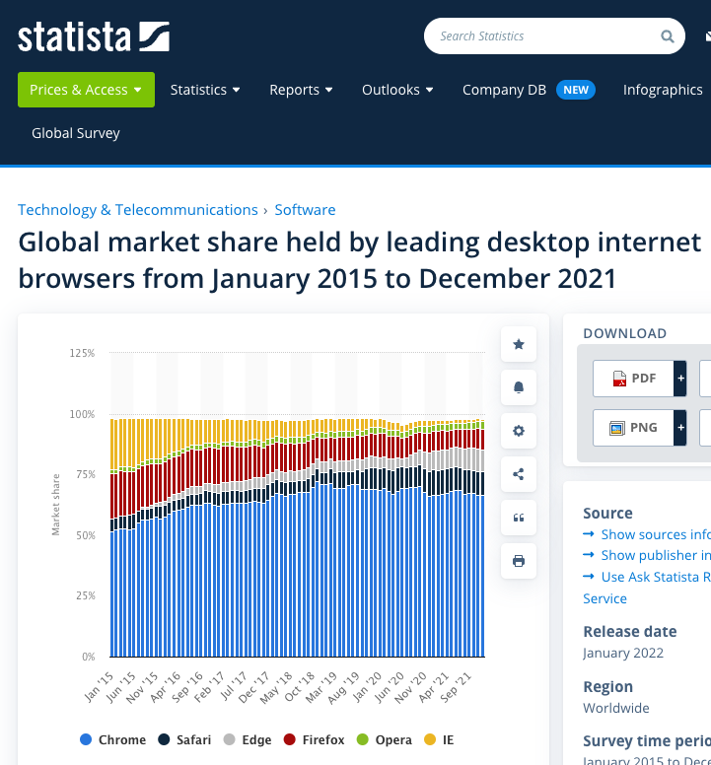
What do applications do today?
Let’s bench test a few common platforms and browsers
Apple Platforms plus Firefox appear to have approx. 20% market share
So we would expect a 20% OCSP check rate in a measurement

Slide 27
Measurements
Global Outcomes – 5 days in March 2022
Total Count: 16,480,316
OCSP Checking Enabled: 3,512,478 (21%)
No OCSP Check: 12,967,835 (79%)
Seems that theory and practice correlate tolerably well

Slide 28
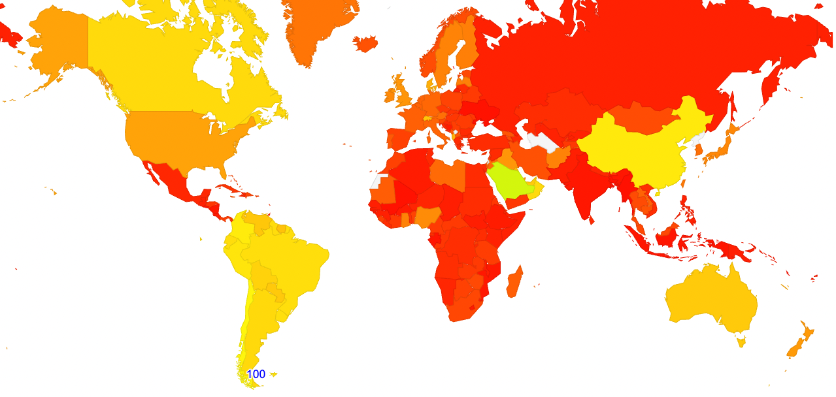
World Map of OCSP Checking
This is really a map of Apple platform market share by CC

Slide 29
OCSP Scorecard
It’s still a round time time penalty of additional delay
It tells the CA what each client is doing = a significant privacy leak
It imposes critical load on the CA’s OCSP servers
What should the client do if the OCSP server is uncontactable?
  Fail? – DDOS vector
  Allow? – Vulnerability vector
Some platforms and browsers support OCSP checking
Some don’t
This seems like a stupidly inconsistent and haphazard basis for the web’s only security framework!

Slide 30
OCSP = Fail?
“That's why I claim that online revocation checking is useless - because it doesn't stop attacks. Turning it on does nothing but slow things down. You can tell when something is security theater because you need some absurdly specific situation in order for it to be useful.”
Adam Langley,
https://www.imperialviolet.org/2014/04/19/revchecking.html

Slide 31
Plan C – OCSP Stapling?
“If we want a scalable solution to the revocation problem then it's probably going to come in the form of short-lived certificates or something like OCSP Must Staple. Recall that the original problem stems from the fact that certificates are valid for years. If they were only valid for days then revocation would take care of itself. ”
Adam Langley,
https://www.imperialviolet.org/2014/04/19/revchecking.html

Slide 32
What about OCSP Stapling?
Rather than pushing the responsibility for revocation checking entirely onto the client with CRLs, or turning it into a query/response interrogation of the CA’s server with OCSP, can the content server furnish the ‘current’ OCSP response as a stapled attribute of the TLS credentials?

Slide 33
Stapled OCSP
CA OCSP Server
2.
OCSP Query/Response
TLS Server
1.
Client
TLS Handshake
Domain Name
Certificate
OCSP
Response

Slide 34
What about OCSP Stapling?
Rather than pushing the responsibility for revocation checking entirely onto the client with CRLs, or turning it into a query/response interrogation of the CA’s server with OCSP, can the content server furnish the ‘current’ OCSP response as a stapled attribute of the TLS credentials?
Yes – OCSP Stapling (RFC6066) and TLS Must Staple (RFC7633)
There is no additional network latency in TLS start as the OCSP data is in-band
The CA does not attain knowledge of client-initiated sessions
The CA does not have to operate a high capacity server infrastructure to respond to client OCSP queries
The client can fail ‘hard’ on missing or unvalidatable OCSP data

Slide 35
What do applications do today?
Let’s bench test a few common platforms and browsers
Why is Chrome not checking OCSP Stapling?

Slide 36
We need to talk about Chrome
Chrome does not perform OCSP checks – it uses “CRLsets”
  (https://www.imperialviolet.org/2012/02/05/crlsets.html)
Chrome crawls across participating CAs, trims the CRLs to strip out “unimportant” revocations and sends this to the chrome browser
What happens if:
  your CA is not part of Chrome’s CRLset?
  Your certificate revocation is not “sufficiently important”?
then you lose! Chrome will happily set up the TLS session anyway.

Slide 37
We need to talk about Chrome
Chrome does not perform OCSP checks – it uses “CRLsets”
  (https://www.imperialviolet.org/2012/02/05/crlsets.html)
Chrome crawls across participating CAs, trims the CRLs to strip out “unimportant” revocations and sends this to the chrome browser
What happens if:
  your CA is not part of Chrome’s CRLset?
  Your certificate revocation is not “sufficiently important”?
then you lose! Chrome will happily set up the TLS session anyway.
I thought the entire approach over the last few years with free certificates and browsers forcing everything to use HTTPS was to shift object security from being a luxury good to a universal commodity.
Yet Chrome is saying that revocation is not universally accessible. Its more like an exclusive luxury good once more!
Why has Chrome done this?

Slide 38
Who’s Serving Stapled OCSP content?
Cloudflare – yes (https://blog.cloudflare.com/ocsp-stapling-how-cloudflare-just-made-ssl-30/)
Akamai – yes (https://community.akamai.com/customers/s/question/0D50f00005RtplACAR/how-to-enable-ocsp-stapling?language=en_US)
Azure – under construction?
Fastly – yes: (https://support.fastly.com/hc/en-us/community/posts/360040448792-Support-for-OCSP-stapling-)
<insert CDN here>

Slide 39
What’s the point of OCSP Stapling?
The default outcome of a evaluation of a current certificate is to accept it, as long as the client can construct a validation chain to a local trust anchor
CRLs and OCSP is meant to alert you to a changed circumstance that indicates that the certificate should not be trusted
So the only OCSP item that is useful is one that indicates that the certificate has been revoked
But why should a server send me the certificate and a stapled OCSP response if the signed OCSP response says that the certificate has been revoked?
  Shouldn’t the server use this OCSP information itself and fail the TLS handshake if the certificate that it was going to proffer is revoked?

Slide 40
Revocation is a Failure!
If the point of this entire certificate architecture is to inform the user that the location that they have reached is or is not the location that they intended to reach, then why is it useful at all if it can’t inform the user that the certificate that is being used is not to be trusted NOW
If the best that CRLs, OCSP, Stapled OCSP and CRLsets can inform you is the trust status of a certificate at some time in the past then why is this information any different from the certificate itself?
If the entire purpose of these revocation mechanisms is only to reduce the “trust window” of a certificate, then why not just use certificates with a more constrained trust window (of a few hours or so)?

Slide 41
Certificates are a Failure?
The problem with certificates that provide a trust window of a few hours, is that the existing CA infrastructure and the use models of locally stashed certificates just can’t cope with such an increased intensity of certificate re-issuance
So we just persist with long-lived certificates and non-functional revocation mechanisms, because it’s the path of least resistance
If certificates are incapable of informing a client that they are about to be drawn into misplaced trust then what exactly are they good for anyway?
The entire objective here was to answer the simple question: “Is the service that I am about to connect to the service that I intended to connect to?” And the problem is that this entire certificate structure can only answer a question that relates to the past, not the present!

Slide 42
Certificates are a Failure?
The problem with certificates that provide a trust window of a few hours, is that the existing CA infrastructure and the use modelsof locally stashed certificates just can’t cope with such an increased intensity of certificate re-issuance
So we just persist with long-lived certificates and non-functional revocation mechanisms
If certificates are incapable of informing a client that they are about to be drawn into misplaced trust then what exactly are they good for anyway?
The entire objective here was to answer the simple question: “Is the service that I am about to connect to the service that I intended to connect to?” And the problem is that this entire certificate structure can only answer a question that relates to the past, not the present!
If we can’t fix these issues with X.509 certificates then why do we bother using X.509 certificates at all?

Slide 43
And then there’s the DNS…
The problem here is not TLS, and not the use of digital signatures to assure the veracity of information, but the properties of the certificate infrastructure to allow this veracity to be established as a current piece of information
The DNS has a similar issue of accuracy and timeliness
  It manages to contain this time lag though the use of Cache Timers (TTLs), managed by zone admins, to set a maximal time between referral back to the authoritative information sources
  There is a constant refresh of DNS information passed to the client from the authoritative servers

Slide 44
And then there’s Stapled DANE …
If the entire purpose of this security measure is to associate a key pair with an intended service name then why not Just Use the DNS?
  Place the public key of a service into the DNS alongside its other attributes
  Use conventional TTL mechanisms to control the maximal caching lag of this information
  Sign these records with DNSSEC
  And staple the DNSSEC validation chain of the public key record into the TLS handshake as a stapled chained response as an alternative to using X.509 certificates
  i.e. use DANE, Chained Responses and TLS Stapling

Slide 45
Where have we got to?
X.509 certificate revocation is broken and we can’t fix it
About the only fix is to pull certificate lifetimes down to a small number of hours – i.e. limit the scope of potential damage of a compromised certificate
  But the certificate system as we know it won’t scale with such massively shortened certificate lifetimes
Yet in the DNS, the common TTL is measured in hours
So why don’t we just ditch all this X.509 brokenness and just turn all of this over to DANE and the DNS?

Slide 46
Questions?

