Slide 1
The Path to Resolverless DNS
Geoff Huston AM
Chief Scientist, APNIC

Slide 2
DNS System Architecture
Authoritative Servers
Cache
Recursive Resolver
Stub Resolver
Application

Slide 3
DNS System Architecture
Authoritative Servers
Internet
ISP
Cache
Recursive Resolver
Client
Stub Resolver
Application

Slide 4
Issues
Speed – the DNS can be exceptionally slow, and the interaction with resolver caches makes resolution unpredictable
Filtering – the DNS is a convenient control point for content management
MetaData collection – the DNS is a real time window on user behaviour
  This can be performed at the recursive resolver, or by a third party on the path between the stub resolver and the recursive resolver
Search – NXDOMAIN rewriting into active search

Slide 5
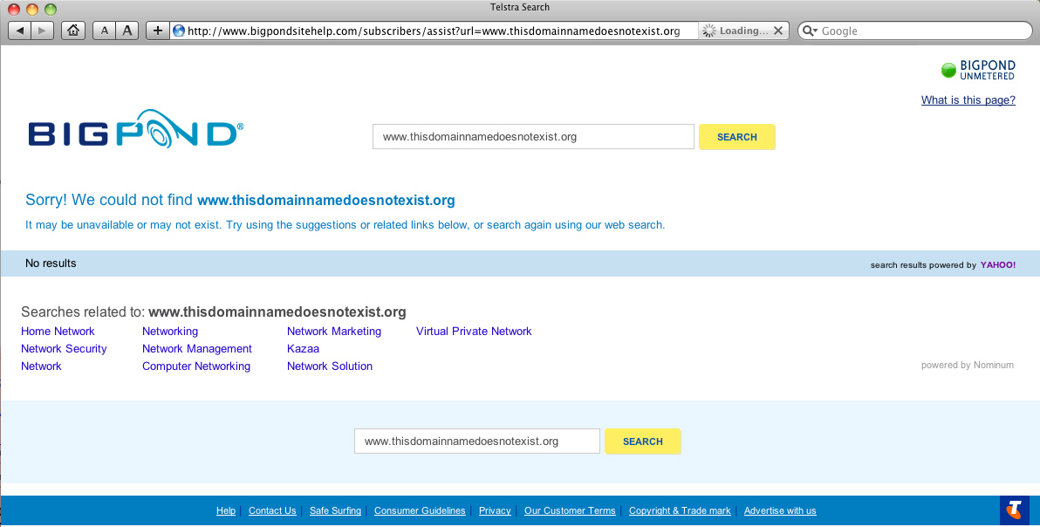

Slide 6
Background
Browser vendors were simplifying the UI and combined the navigation and search input boxes to a single window
This resulted in a significant level of cross leakage between DNS and Search
Some DNS resolver operators saw an opportunity to gather revenue by re-directing NXDOMAIN to search
Google responded quickly with a large scale open DNS service that provided absolute integrity of responses, and supported DNSSEC validation to back this up
Google’s DNS service rapidly gathered momentum, particularly in the enterprise sector

Slide 7
DNS System Architecture
Authoritative Servers
Internet
Cache
Open Recursive Resolver
Internet
!!
ISP
Client
Stub Resolver
Application

Slide 8
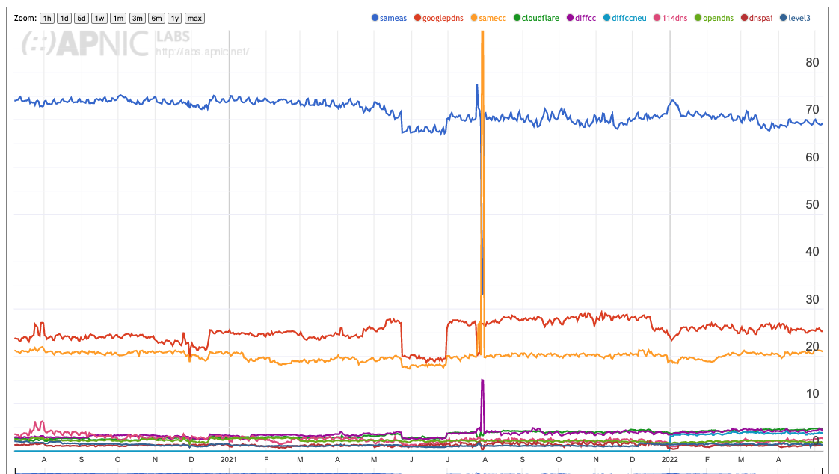
Use of Resolvers in the Internet
68% of users direct their DNS queries to the ISP-operated recursive resolvers
25% of users direct their DNS queries to Google’s public DNS service
20% of users direct their DNS queries in in-country DNS
https://stats.labs.apnic.net/rvrs

Slide 9
But…
DNS queries use unencrypted UDP by default
  Which itself is a huge DOS issue
Combining this with a transit across the public Internet between the stub and open recursive resolver exposes further issues:
  The potential for third party monitoring, interception and substitution
  Loss of locational accuracy if the DNS is used to perform content steering for CDNs

Slide 10
DNS Privacy
The response to the issues of DNS over UDP has been the development of DNS stub-to-recursive connections over encrypted transport sessions
  DNS over TLS (DoT) uses DNS over TCP over a persistent TLS session
  DNS over QUIC (DoQ) uses DNS over an encrypted QUIC transport session over UDP
  DNS over HTTPS (DoH) uses DNS over HTTP/3 (over QUIC) where supported, and DNS over HTTP/2 (over TLS) otherwise

Slide 11
DoT/DoQ/DoH properties
The stub resolver can authenticate the recursive resolver server identity
  Which mitigates various forms of session interception
Session encryption
  Which mitigates various forms of payload tampering
No Head of Line Blocking (in DNS over HTTPS/3, and DoQ)
No UDP fragmentation and TCP failover issues
Long-held stub/recursive sessions and TCPFO can amortise the encryption and session overheads over many queries
  Which means it’s not much different to UDP in terms of per query overheads

Slide 12
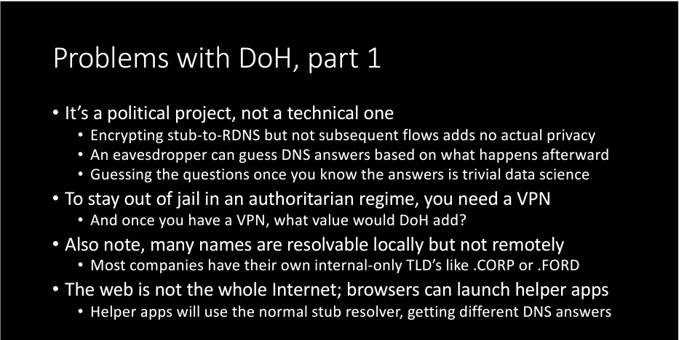
Why DoH in particular?
DoH is simply DNS queries and responses packaged with an HTTP header, so why bother? Why not just use DoT or DoQ?
  One view:
Paul Vixie, DNS Wars: Episode IV, NANOG 85, 2019

Slide 13
Why DoH?
DoH is simply DNS queries and responses packaged with an HTTP header, so why bother? Why not just use DoT or DoQ?
But maybe its more than a political project:
  Because it sits alongside all other HTTPS traffic on TCP port 443 (HTTP/2) and UDP port 443 (HTTP/3) and is harder for network level isolation of DNS traffic
  Because generic HTTP caching controls can be used to enable or disable the use of HTTP caching
  Because HTTP/2 and HTTP/3 includes support for reordering, parallelism, priority and header compression
  Because applications need not use the local stub DNS resolver and can direct DoH queries to a recursive resolver of its own choice
  Because HTTP/2 and HTTP/3 includes “Server Push”

Slide 14
“Server Push”?
RFC 7540: Hypertext Transfer Protocol Version 2 (HTTP/2)
8.2. Server Push
HTTP/2 allows a server to pre-emptively send (or "push") responses
(along with corresponding "promised" requests) to a client in
association with a previous client-initiated request. This can be
useful when the server knows the client will need to have those
responses available in order to fully process the response to the
original request.

Slide 15
But in DoH this means…
8.2. Server Push
HTTP/2 allows a server to pre-emptively send (or "push") responses
(along with corresponding "promised" requests) to a client in
association with a previous client-initiated request. This can be
useful when the server knows the client will need to have those
responses available in order to fully process the response to the
original request.
DNS
DNS
DNS

Slide 16
What about HTTP/3?
Yes – draft-ietf-quic-http
4.4. Server Push
Server push is an interaction mode that permits a server to push a
request-response exchange to a client in anticipation of the client
making the indicated request. This trades off network usage against
a potential latency gain. HTTP/3 server push is similar to what is
described in Section 8.2 of [HTTP2], but uses different mechanisms.
Each server push is assigned a unique Push ID by the server. The
Push ID is used to refer to the push in various contexts throughout
the lifetime of the HTTP/3 connection.

Slide 17
Which means…
When a server sends a response to an HTTP request it can also push unrequested DNS responses
This allows the user application to use these DNS resolution outcomes immediately and bypass DNS resolution delays
  It’s faster
The user is not making these resolution queries, and is not generating meta data within the DNS
  It has some privacy benefits

Slide 18
But …
How do you know that the server is pushing the “truth” when it provides these DNS answers?
The secure transport means that tampering is challenging, but the user should still validate these responses (assuming that they are DNSSEC-signed in the DNS)
Which would mean that the user still has to chase down the DNSSEC validation chain, and most of the the original speedup advantages are lost
Or maybe not…
  The server could also push the collection of DNSSEC validation responses to the client
  The server could also repackage these responses into a RFC7901 EDNS0 Chain Response, attached to the original response

Slide 19
DNSSEC-Validated DNS data
DNSSEC validation provides the user with assurance that the data is:
  Authentic
  Current
  Complete (for each RRType)
If that’s the case then why does it matter how the stub learned the data?
  It could be a DNS query / response transaction
  It could be via a server push over DoH
DNSSEC validation is providing the assurance that the data is usable

Slide 20
What if the pushed DNS response is unsigned?
Er, um, er…
It’s probably best to discard it!
  You have no idea how the server obtained the DNS data in the first place
  You don’t know how current the data is
  You really don’t know if the server is trying to deceive you
  And you have no idea who you are implicitly trusting if you use the data

Slide 21
What can we say about Resolverless DNS?
It gives HTTP-based applications and services far more control over the quality of the user experience
  It allows the server to pre-provision the client with DNS data that is likely to be useful in the context of the application
  It allows the client side application to perform rapid DNSSEC validation without relying on stub resolver capabilities and settings
  It can replace UDP-based timers, query retries, fragmentation and TCP switching with server-to-client provision
  It operates over a secured connection with an authenticated server
  It does not leak metadata through DNS query streams
As long as the DNS data is DNSSEC-signed

Slide 22
What about unsigned DNS data?
Forget it!
Resolverless DNS responses of unsigned DNS data just opens up more potential vulnerabilities with little in the way of reasonable mitigation

Slide 23
Where is this leading?
The changing economics of the Internet
  The shift to advertiser-funded content and service has sucked the revenue base from access and common infrastructure
  Internet infrastructure is a commodity-based activity which resists innovation
  The incentives to innovate lie in the application and service layers
  Infrastructure is under continued pressure to achieve further efficiencies and there is a consequent pressure to scale up and centralise
The DNS is caught up in this, and innovation in the DNS is extremely challenging to get adoption these days
Does Resolverless DNS have a chance?

Slide 24
Is there a role for Resolverless DNS?
Perhaps
But I would suggest it necessarily assumes DNSSEC
Which, at present, is a tough assumption
  Because few zones are signed
    Because DNSSEC signatures tend to create larger responses, which is a problem in UDP DNS
    Because advanced zone signing a zone is infeasible for very large zones
    And signing on the fly can be fragile
    In summary, few zones are DNSSEC are signed is because its unreliable and expensive and the benefits do not seem to offset against the additional risks
  And few resolvers validate
    Because it takes time
    And stresses out UDP DNS

Slide 25
What about RFC 7901?
What is a pushed DNS response was framed as if the client had set the EDNS0 CHAIN option with the root zone as the closest trust point?
That way the client is provided with the DNS response and the chain of signatures that permit the client to perform local validation of the response in a single pushed DNS object
And if the zone is unsigned - then no DNS response is pushed

Slide 26
Why is this interesting?
The DNS is:
  A massive time penalty
  A significant privacy leak
  A consistent source of failure
Resolverless DNS won’t fix all the DNS all at once
  But it can hand a significant amount of control over application and service quality back to these HTTPS-based applications and services
  And it’s a whole lot faster!
  And is hides the client from the DNS resolution infrastructure
And for those reasons it’s a very interesting step in the possible evolution of the DNS

Slide 27
Why is this interesting?
We have spent a huge amount of effort over the last decade trying to make the Internet faster:
  We’ve been deploying CDNs to replicate content and services and bring them closer to users
  We’ve been deploying non-blocking transport protocols (such as QUIC) to exploit parallelism
  We’ve been tuning TCP and network behaviour to create more efficient and faster network transactions
  We’ve been packing more information in the DNS to make service startup faster (SVC and HTTPS records)
And much of this innovation is happening at the application levels of the protocol stack where there is ample money and an impatient agenda, avoiding incurring any further dependencies on the lower layers of common infrastructure where there is neither money nor impatience!

Slide 28
DIscuss!

