Slide 1
A Quick look at QUIC
Geoff Huston, Joao Damas,
APNIC Labs

Slide 2
QUIC is…
HTTP/2
HTTP/3
HTTP
Multistream
HTTP
TLS
Session Encryption
QUIC
Multistream
Encryption
Data stream integrity
Congestion Control
TCP
Data stream integrity
Congestion Control
UDP
IP

Slide 3
QUIC is…
A transport level framing protocol that offers applications access to the basic IP datagram services offered by IP through the use of UDP
  All other transport services (data integrity, session control, congestion control) are shifted to the application
QUIC also places the transport control fields inside the encryption envelope, so QUIC has minimal exposure to the network

Slide 4
Looking for QUIC
At APNIC we use Ads to perform large scale measurements of network service capabilities as seen by users
  IPv6 deployment
  DNSSEC validation
  Fragmentation
Can we use this measurement platform to see the level of use of QUIC in today’s network?

Slide 5
Setting up QUIC
Server:
  nginx v1.21.7 with QUIC functions included
DNS:
  Set up an HTTPS record for each URL with value: alpn=“h3”
Content:
  Alt-Svc: h3=“:443”
  (This second method requires a subsequent query to allow the client to use the Alt-Svc capability. We perform a 2-second delayed second query for this URL in the measurement experiment approximately one fifth of the time. We keep the domain name constant and vary the URL args to detect the second fetch.)

Slide 6
Setting up QUIC
Server:
  nginx v1.21.7 with QUIC functions included
DNS:
  Set up an HTTPS record for each URL with value: alpn=“h3”
Content:
  Alt-Svc: h3=“:443”
First Fetch
Second Fetch

Slide 7
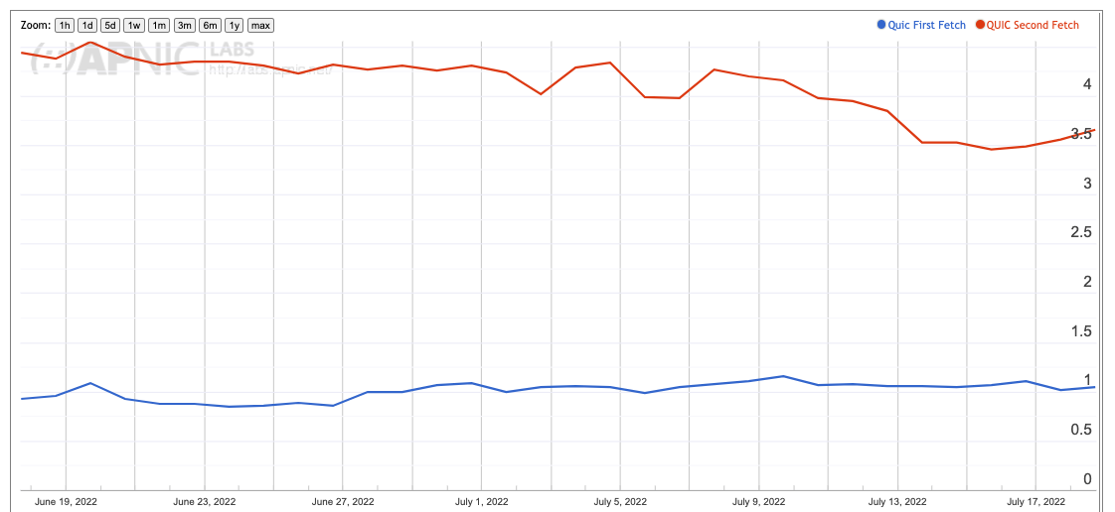
QUIC Use – June/July 2022
About 3.5% of users use HTTP/3 for the second fetch
About 1% of users are seen to use HTTP/3 on first fetch

Slide 8
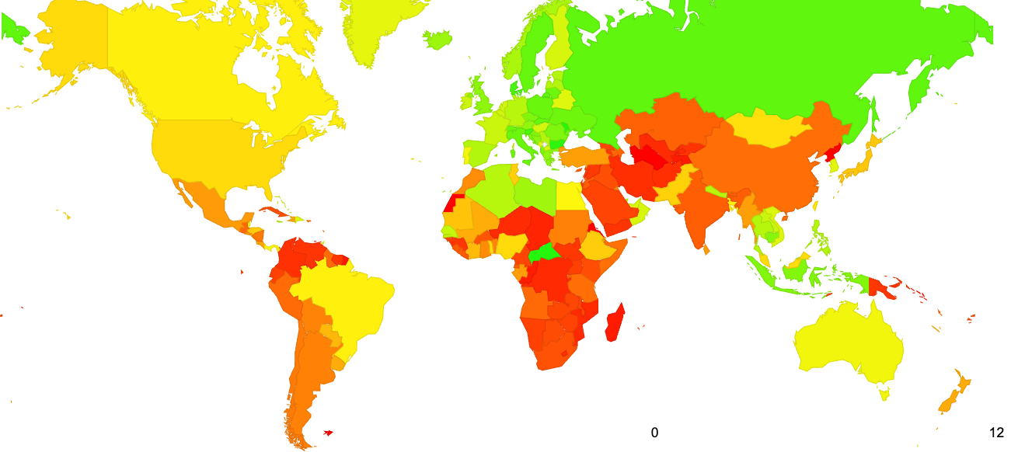
QUIC Use – June/July 2022

Slide 9
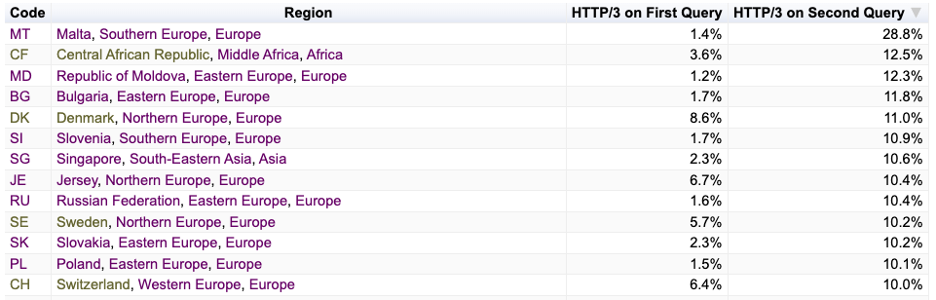
QUIC Use – June/July 2022

Slide 10
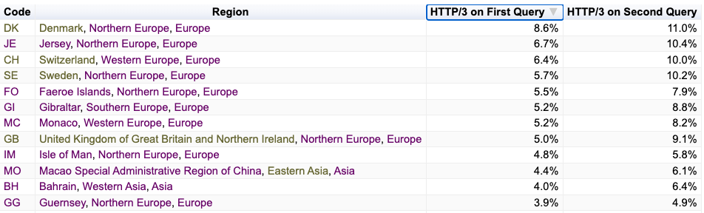
QUIC Use – June/July 2022

Slide 11
Some Questions:
Which clients are performing QUIC and why?
What are the QUIC MSS values?
What is the QUIC connection failure rate?
Is QUIC faster than HTTP/2 + TLS?

Slide 12
1. OS Clients* performing QUIC
TCP/TLS QUIC on First Fetch QUIC on Second Fetch
iOS 5.5% 93.3% 16.1%
Mac OS 1.0% 2.8% 0.6%
Android 84.5% 1.7% 77.9%
Win 5.5% 1.4% 4.3%
Linux 0.4% 0.2% 0.2%
Others 3.1% 0.6% 0.9%
100.0% 100.0% 100.0%
* Based on reported browser string

Slide 13
1. Browser Clients* performing QUIC
TCP/TLS QUIC on First Fetch QUIC on Second Fetch
Chrome 91.8% 4.1% 81.7%
Safari 4.3% 93.3% 16.1%
Firefox 0.8% 2.4% 1.0%
Edge 0.7% 0.0% 0.5%
Opera 0.2% 0.1% 0.6%
Others 2.2% 0.1% 0.1%
100.0% 100.0% 100.0%
* Based on reported browser string

Slide 14
1. Who does QUIC and why?
Apple Safari clients use a DNS HTTPS query and some of these clients then follow up with a fetch over QUIC. The observed DNS HTTPS query to QUIC fetch conversion rate was relatively small.
Chrome clients use the Alt-Svc field as a QUIC trigger for some clients. Again, the observed QUIC conversion rate was observed to be relatively small
* Based on reported browser string

Slide 15
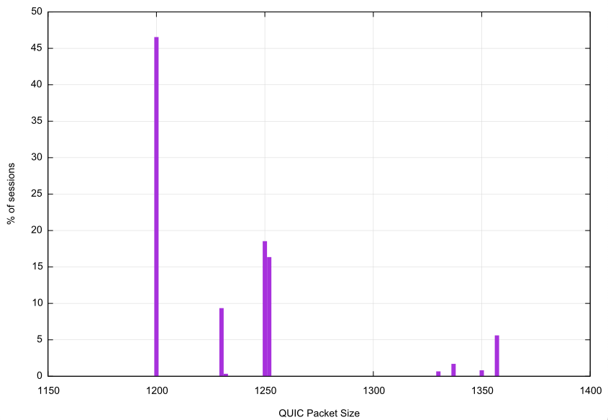
2. QUIC Packet Size distribution
QUIC clients take a very conservative approach to maximum packet sizes to avoid packet fragmentation complications
Maximum Packet Sizes used in QUIC sessions:
1,200 octets – 46.6%
1,250 octets – 18.5%
1,252 octets – 16.4%

Slide 16
3. QUIC Connection Loss
In this measurement framework we cannot measure client -> server loss, but we can measure server-> client loss by looking for incomplete QUIC initial connections that do not complete
  (this form of connection loss could be due to the client filtering incoming UDP port 443 packets)
Initial QUIC Connections: 19,211,357
Failed Connections: 46,645
Failure Rate: 0.24%

Slide 17
4. Is QUIC Faster?
Let’s compare the user-measured time to load an object using HTTP/2 and the same user’s measured time to load the same object using HTTP/3
  There are a number of variables in the user time measurement, including varying time penalties relating to the internal task scheduling within the browser, but these individual factors should be cancelled out over a large enough sample set

Slide 18
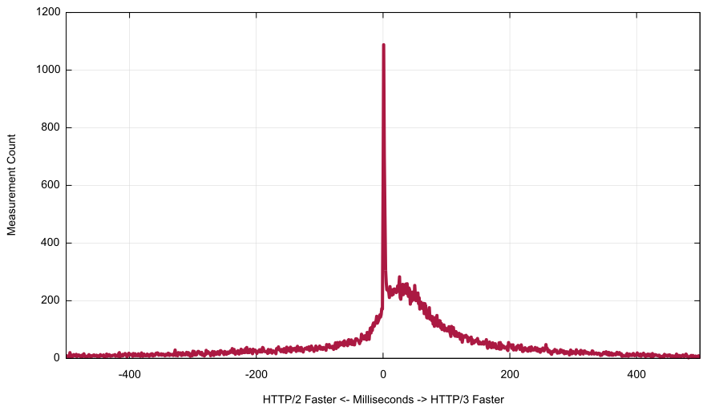
4. TCP/TLS vs QUIC speed difference
Area where QUIC is faster
Non-QUIC Faster
ms
QUIC Faster

Slide 19
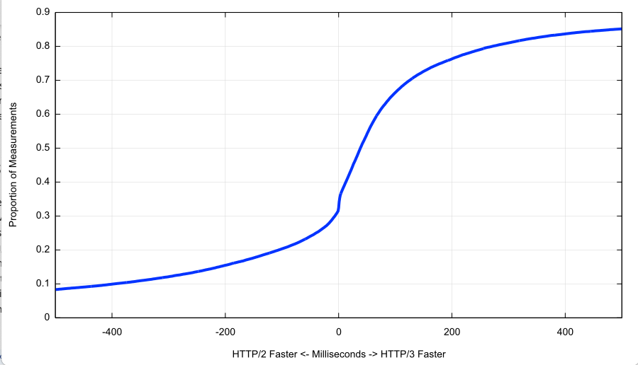
4. Cumulative Distribution
HTTP/3 is faster to perform object retrieval in 2/3 of the observed cases
Non-QUIC Faster
ms
QUIC Faster

Slide 20
Some Answers:
Which clients are performing QUIC?
  The recent change appears to relate predominately to iOS 15.x clients (iPhones and iPads) using HTTPS queries and selectively performing an object retrieval over HTTP/3 at a rate of approximately 1 in 5
What are the QUIC MSS values?
  Most QUIC clients limit their total IP packet size to a max of either 1,250 or 1,252 octets. Largest observed packet was 1,357 octets
What is the QUIC connection failure rate?
  Extremely small at 0.24%. This falls within the bounds of experimental error in this experiment’s framework.
Is QUIC faster than HTTP/2 + TLS?
  Yes, more than 2/3 of the time QUIC will complete in less elapsed time than the equivalent HTTP/2 retrieval

Slide 21

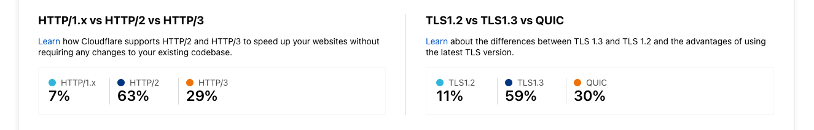
Observations
These QUIC use numbers are far lower than other published measures

Slide 22
Why so low?
QUIC is enabled by default in Chrome, so we might expect to see 90% of all connections using QUIC on the second and subsequent fetches.
Cloudflare’s numbers are based on fetches from their stores, and its unclear which are “first” fetches and which are “repeat” fetches from their summary data.
The APNIC numbers are based on scripted behaviours of individual clients enrolled via online ads, and the Chrome behaviour is triggered by a scripted repeat fetch following a 2 second timer.

Slide 23
More Questions
Why is the HTTPS DNS query rate 3x to 4x higher than the Safari QUIC fetch rate?
  Surely a HTTP/3 aware browser would try using QUIC if the DNS response indicated that the service was HTTP/3 capable
Is a 2 second scripted wait for Chrome too fast in practice?
  How long does it take for content directives to be stashed in the browser to direct future actions?
Does Chrome have the same defaults everywhere? Or are there localized settings in India and China (for example) that disable QUIC by default?
Does Safari have the same defaults everywhere?

Slide 24
Thanks!
Ongoing HTTP/3 Measurement Report at APNIC Labs:
https://stats.labs.apnic.net/QUIC

