Slide 1
Building the Internet’s Largest Measurement System
Geoff Huston
APNIC Labs

Slide 2
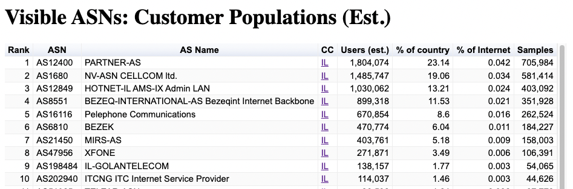
Israeli ISPs

Slide 3
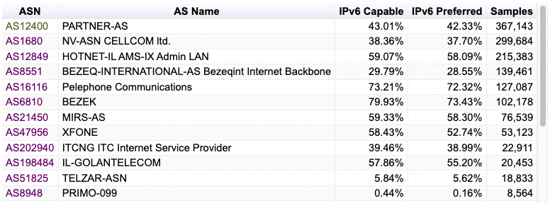
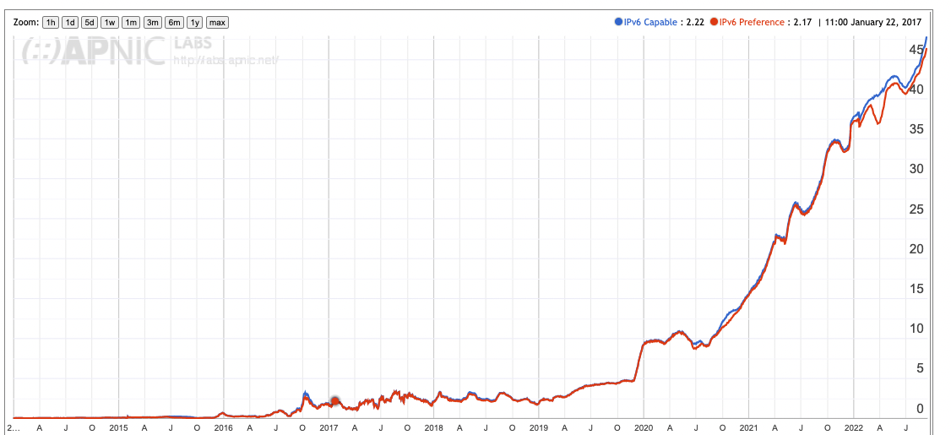
Use of IPv6 in Israel

Slide 4
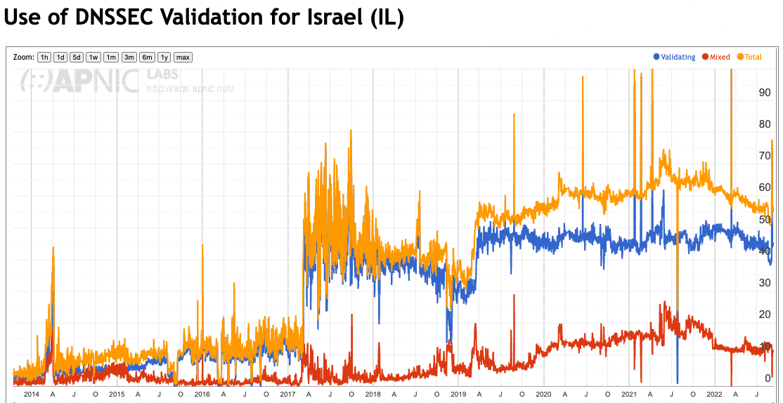
Use of DNSSEC in Israel

Slide 5
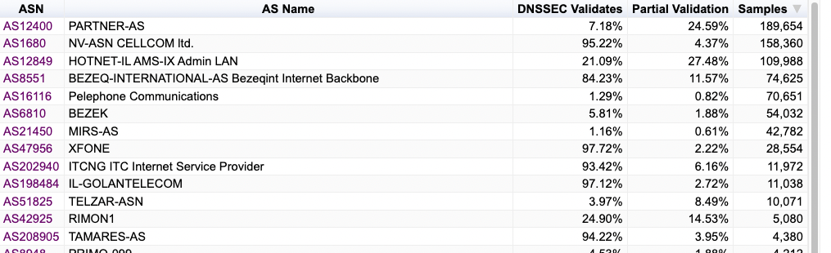
Use of DNSSEC in Israel

Slide 6
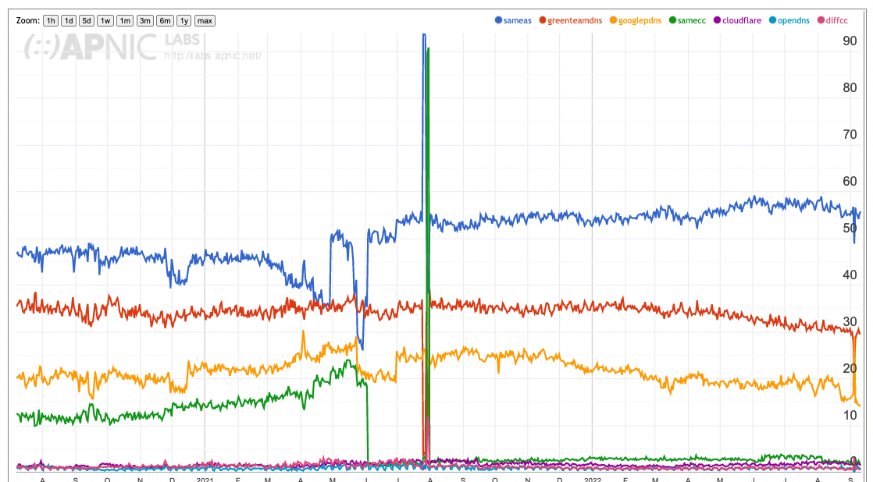
DNS Resolver use in Israel

Slide 7
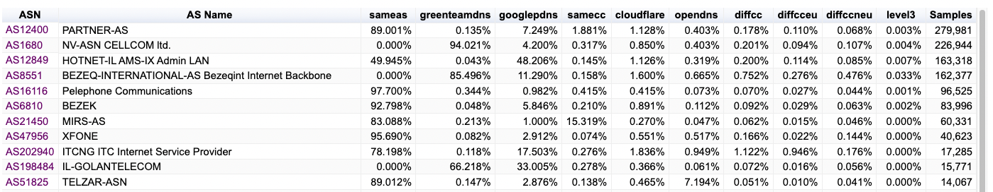
DNS Resolver use in Israel

Slide 8
So much to measure…
so little time!

Slide 9
How and what
The basic questions are to figure out what measurement approach to use:
  whole of network metrics vs sample measurements
  system behviour metrics vs user experience metrics vs component metrics
  snapshot metrics vs time series measurements
And then figure out how to perform the measurement:
  Passive vs active
  Dedicated probes vs enrolment
  Deliberate and Intentional vs Opportunistic

Slide 10
APNIC’s path into measurement
2010:
  IPv4 exhaustion is just around the corner - so how “ready” are we to operate an IPv6 Internet?

Slide 11
“Measurable” IPv6 Questions
How much traffic uses IPv6?
How many connections use IPv6?
How many routes are IPv6 routes?
How many service providers offer IPv6?
How many domain names have AAAA RRs?
How many domain NS’s use AAAA’s?
How many DNS queries are for AAAA RRs?
How many DNS queries are made over IPv6?
How many end devices have IPv6?
How many end devices use IPv6?
…

Slide 12
Close, but
None of these specific measurement questions really embrace the larger question of IPv6 “readiness” for the Internet as a whole
  They are all aimed at measuring IPv6 within particular facets of the network infrastructure, but they don’t encompass all of the infrastructure of the network at once

Slide 13
What’s the question?
To make an IPv6 connection everything else (routing, forwarding, DNS, transport) has to work with IPv6
So can we measure:
  How many connected devices on today’s Internet are capable of making IPv6 connections?
What if we use scripting on a web server to text the capabilities of clients via a scripted set of related web object fetches

Slide 14
Scale of Measurement
We really need to use a massively popular web service to conduct this experiment
  But “massively popular web services” worry constantly about service resiliency and privacy of their data regarding users
  They tend to be extremely suspicious of adding script elements to their service that performs third party dual stack tests with their clients (and I can’t blame them!)
So, we need to rethink this approach…

Slide 15

How to conduct measurements at scale
Be Google

Slide 16
How to conduct measurements at scale
Or get Google to place your measurement code on millions of end user’s systems, all of the time

Slide 17
How to conduct measurements at scale
How?

Slide 18

Online Ads

Slide 19
Ads use scripts
Each time an ad is loaded the ad server loads creative content and scripts on to the client’s browser
The script can include action items to fetch ‘network assets’
  Typically used to load alternate images, sequences
  Its not a generalized network stack, subject to constraints such as limited to certain object loads, reduced run-time library
There are on-Load, on-Hover and on-Click actions
We want to minimise interactions so we use on-Load scripting

Slide 20
This can work
We can instrument the target host via an ad script
  we can constrain the ad script to talk to our server(s)
  And if we instrument the servers we can infer the target host properties
Ads try to deliver to new users all of the time
  We want to measure new sample points all of the time to avoid implicit repeat bias in the measurement set
Ads are biased towards ‘clicks’
  We are not interested in clicks
  We just want impressions
  Impressions are far cheaper than clicks!

Slide 21
Advertising placement logic
Fresh Eyeballs == Unique endpoints
  We have good evidence the advertising channel is able to sustain a constant supply of unique endpoints
Pay by click, or pay by impression
  If you select a preference for impressions, then the channel tries hard to present your ad to as many unique endpoints as possible
Time/Location/Context tuned
  Can select for time of day, physical location or keyword contexts (for search-related ads)
  But if you don’t select, then placement is generalized
Aim to fill budget
  If you request $100 of ad placements per day, then inside 24h the algorithm tries hard to even placement but in the end the ad placement algorithm will ramp up your ad to achieve enough views, to bill you $100

Slide 22
Advertising placement logic
Set a ‘CPM’ bid in the ad
  Clicks Per Millepressions: bid rate to pay per thousand impressions
Uneven distribution of ads throughout the day
  But we can compensate for this by running 24 x 1-hour campaigns per day
Use multiple campaigns each with a constrained locale
  That way we can ‘encourage’ the ad system to give the ad a broad placement
Outcome: 25M placements per day, on a mostly even placement model with end of day ‘soak’ to achieve budget goal

Slide 23
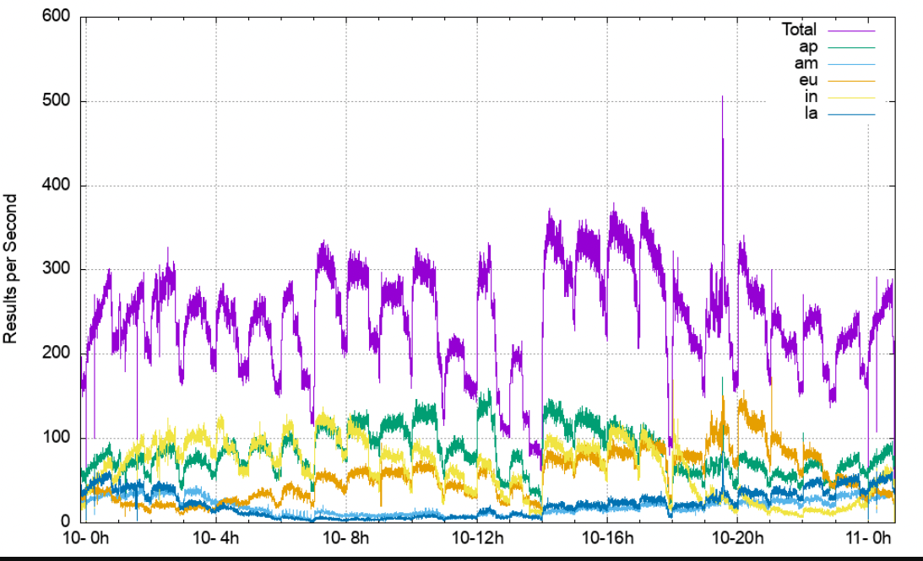
Advertising placement logic
Asia (Singapore)
America (Dallas)
Europe (Frankfurt)
Asia (Mumbai)
S America (Sao Paulo)
Set a ‘CPM’ bid in the ad
  Clicks Per Millepressions: bid rate to pay per thousand impressions
Uneven distribution of ads throughout the day
  But we can compensate for this by running 24 x 1-hour campaigns per day
Use multiple campaigns each with a constrained locale
  That way we can ‘encourage’ the ad system to give the ad a broad placement
Outcome: 25M placements per day, on a mostly even placement model with end of day ‘soak’ to achieve budget goal
Completed Measurement per second
26 hours

Slide 24
What can be scripted in an Ad
Not much:
  http.FetchImg()
    i.e. attempt to retrieve a URL
But that’s enough!
  It’s EXACTLY what users do!
  A URL consists of a DNS question and an HTML question
  What if we point both the DNS and the HTML to servers we run?
  As long as each Ad execution uses unique DNS names we can push the user query back to our servers and avoid the use of caching

Slide 25
Measuring IPv6 via Ads
Use HTML5 code that is executed on ad impression
  Client retrieves set of “tests” from an ad-controller
  Client is given 10 URLs to load, including:
    Dual Stack object
    V4-only object
    V6-only object
    Result reporting URL (10 second timer)
    All DNS is dual stack
    All URLs use a unique DNS label

Slide 26
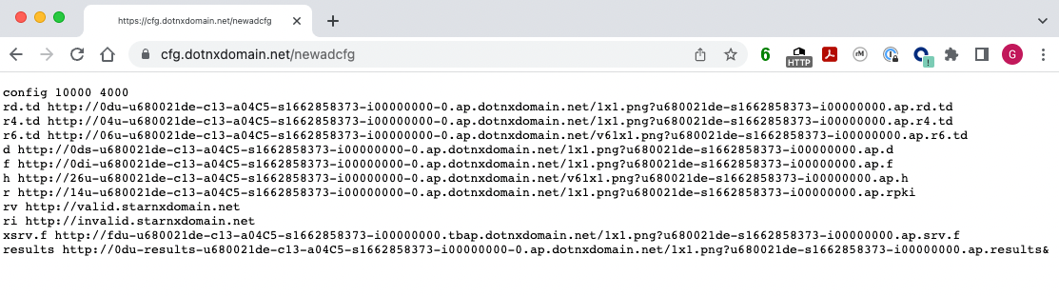
For Example

Slide 27
DNS Label Encoding
Think of a URL name as a micro-coded instruction set directed to programmable DNS and HTTP servers …
http://06s-u69c5b052-c13-a4c5-s1579128735-icb0a3c4c-0.ap.dotnxdomain.net/1x1.png
Immediate response
IPv6 access only
Valid DNSSEC signature available
uuid to map multiple queries to a single experiment
User is located in Country 13 (Australia)
User is located in AS1221 (Telstra)
Label Creation Time is 16 January 2020 9:52am
User’s IPv4 address is 203.10.60.76

Slide 28
Experiment Server config
There are five server sets, identically configured in VMs in DCs (Frankfurt, Singapore, Dallas, Sao Paulo, Mumbai)
The experiment script directs the client to the “closest” server set (based on geolocation of the client IP address)
Server set has dedicated DNS and web content server VMs

Slide 29
Collected Data
Per Server, Per Day:
  HTTP access log
    (successfully completed fetches)
  DNS query log
    (incoming DNS queries)
  Packet capture
    All packets!

Slide 30
Data Analysis
For example – IPv6 measurement
  IPv6 “capable” means that the client successfully fetched the URL target that is only accessible using IPv6
  IPv6 “preferred” means that the client used IPv6 to fetch the dual stack URL target
  Aggregate data by origin AS and by geolocation CC
  “Normalise” the country data against estimates of national user populations (to compensate for aD placement bias at a national level)
  Generate IPv6 daily report and data to data set

Slide 31
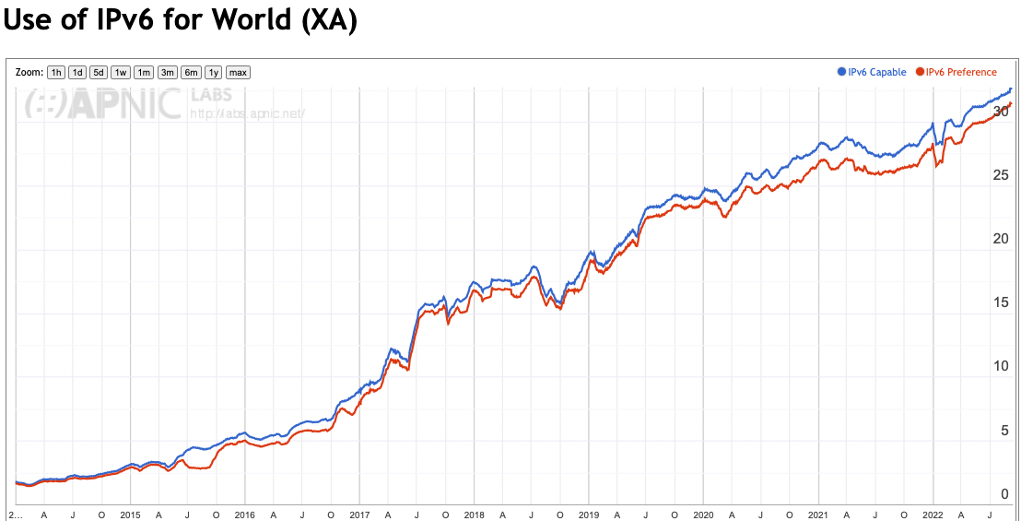
V6 Time Series

Slide 32
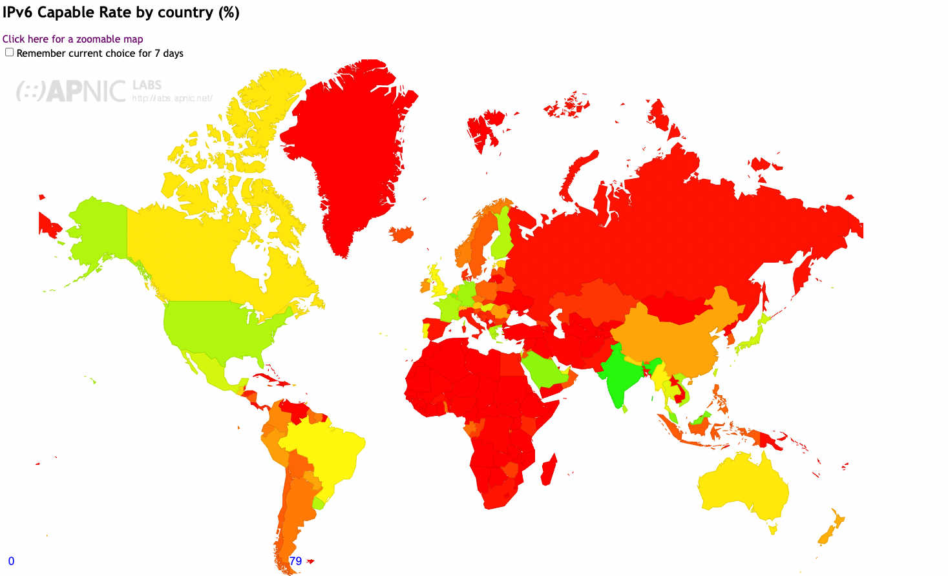
IPv6 Report
https://stats.labs.apnic.net/ipv6

Slide 33
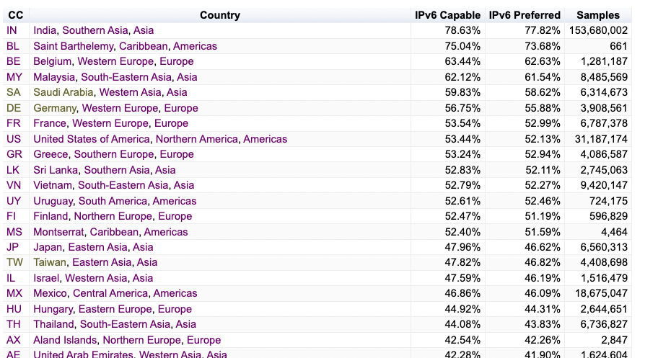
IPv6 Report
https://stats.labs.apnic.net/ipv6

Slide 34
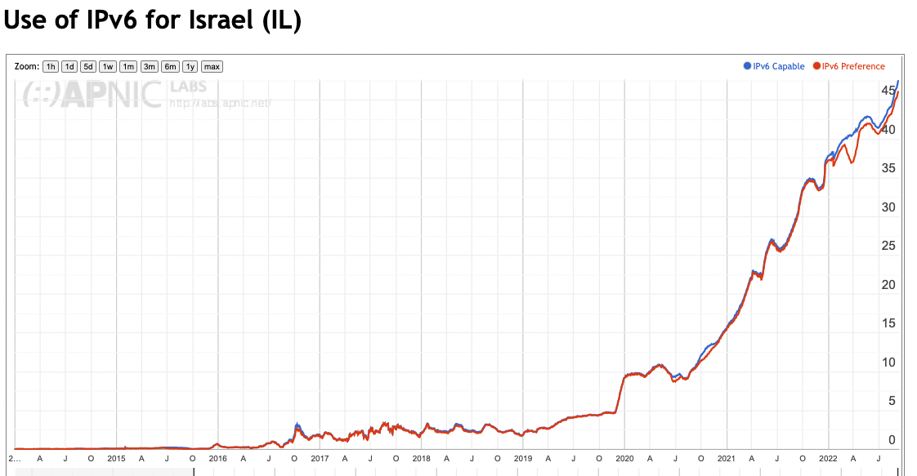
Per-Country Time Series - Israel
https://stats.labs.apnic.net/ipv6/IL

Slide 35
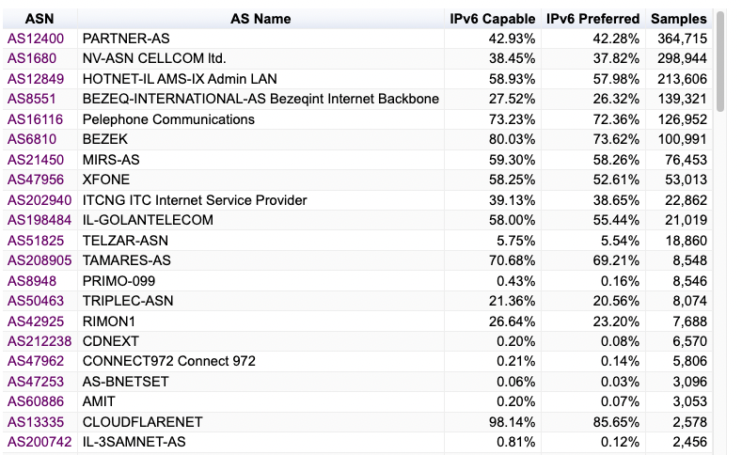
Per-Country Time Series - Israel
https://stats.labs.apnic.net/ipv6/IL

Slide 36
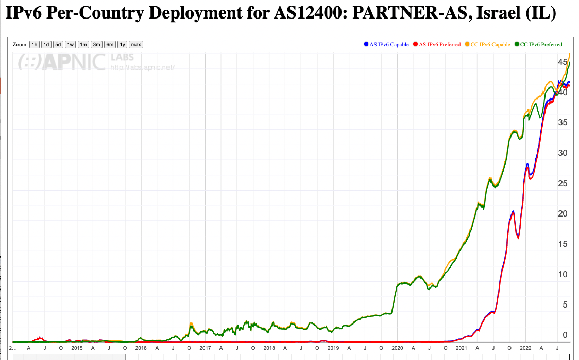
Per-Network Time Series
https://stats.labs.apnic.net/ipv6/AS12400

Slide 37
What about DNSSEC Use?
Can we use the same platform to measure the proportion of users who sit behind DNS resolvers that perform DNSSEC validation?

Slide 38
What about DNSSEC Use?
Can we use the same platform to measure the proportion of users who sit behind DNS resolvers that perform DNSSEC validation?
DNSSEC-signed DNS name
Invalidly-signed DNSSEC-signed DNS name

Slide 39
DNSSEC Test
A client is sitting behind DNSSEC validating resolvers if:
  It fetches the validly-signed DNS URL
  It does not fetch the invalidly-signed DNS URL
  It queries for the address using EDNS0 DNSSEC OK field
  It queries for the zone DNSKEY record for both DNS names *
A client “partially” validates if the validation failure causes the client to use an alternative non-validating resolver and resolve the name
* This last one is a bit of a challenge as we want to see these queries at the authoritative server and not have them masked by caching – so we use a LDNS-based auth server to create a dynamic DNS server that constructs a DNSSEC signed delegated zone on the fly

Slide 40
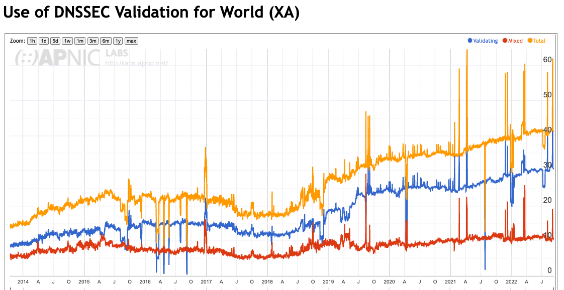
DNSSEC Results
https://stats.labs.apnic.net/dnssec/XA

Slide 41
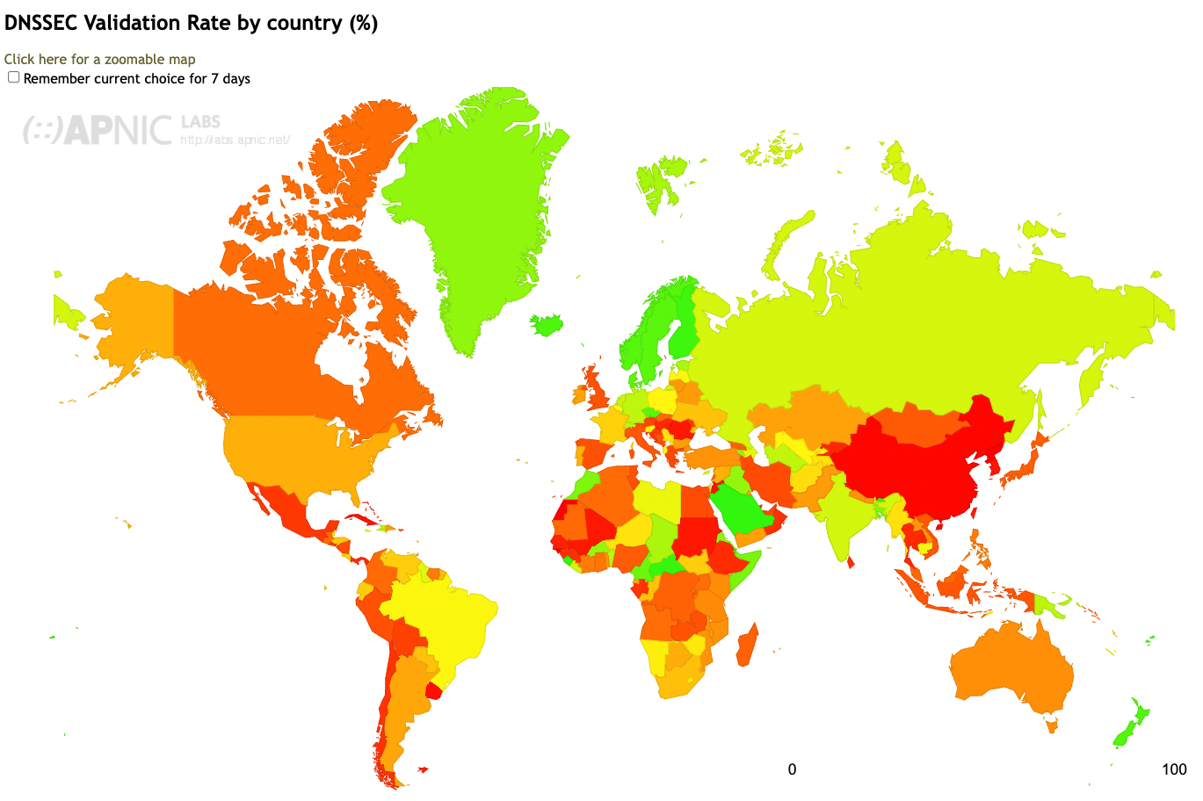
DNSSEC Results
https://stats.labs.apnic.net/dnssec

Slide 42
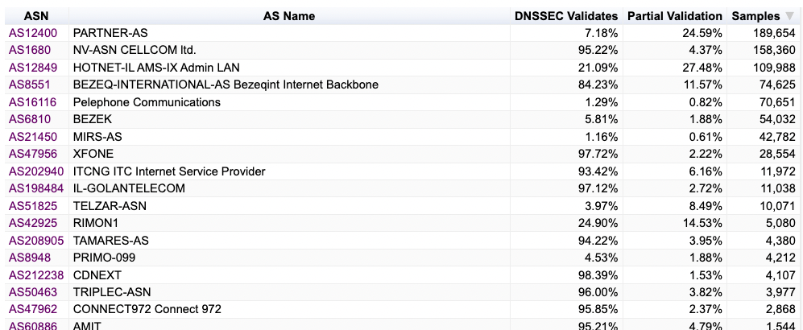
DNSSEC Validation in Israel
https://stats.labs.apnic.net/dnssec/IL

Slide 43
Other server side measurement techniques
We treat the DNS name (and the full URL) as a set of server instructions and use a combination of dynamic DNS, NGINX modules and 2-step packet processing to generate specific server-side behaviours that we want to measure

Slide 44
Other server side measurement techniques – Glueless DNS
“Glueless” DNS delegation to provide explicit confirmation that a resolver has received a response
  The client is forced to resolve the name of the zone name servers before proceeding with the original resolution task
  If the name of the name servers is dynamically generated and unique then DNS caching won’t help
  We’ve used this technique to measure:
    IDN support
    qname minimisation
    DNS fragmentation management
    DNS dual stack behaviour

Slide 45
Other server side measurement techniques - Repeats
Explicitly directed repeat fetches to trigger content directives for HTTP/3
  Chrome relies on receiving an Alt-Svc: content directive before it will switch over to use HTTP for fetches from this server
  Which means it will only use HTTP/3 on the second (or subsequent) fetch
  To create this behaviour we have to allow the measurement script to schedule this fetch multiple times, with a small idle interval between fetches

Slide 46
Other server side measurement techniques – SERVFAIL DNS
SERVFAIL responses to force the client resolver to cycle through all configured recursive resolvers
  This technique uses a LDNS path that responds with a SERVFAIL response for all DNS queries for this name set
  This is intended to cause the local resolver to cycle through all locally configured recursive resolvers to find a resolver that will respond to the query
  We used this is exposing the set of resolvers that a user may use to resolve a name

Slide 47
Other server side measurement techniques – IPv6 Packet Mangling
IPv6 packet manipulation to insert crafted IPv6 packets into an established TCP stream
  To manipulate an IPv6 packet to manually control fragmentation and other forms of Extension Headers we use a “front end” unit to pick up incoming packets and pass them to a conventional back end server
  The return packet is modified to add the appropriate Extension Header and/or Fragment before passing back to the end client

Slide 48
Measurement Projects
IPv6 Performance (connection reliability and relative speed)
IPv6 Fragmentation
IPv6 Extension Header loss Rates (HBH and DST)
DNS: Use of ECDSA and EDDI DNSSEC signing algorithms
DNS: Fragmentation Drop (and TCP support)
DNS resolver use profile (use of open DNS resolvers)
DNS KSK roll probes (RFC8509)
Support for QUIC use (HTTP/3)
Support for Route Origination Validation
Zombies and tracking
https://stats.labs.apnic.net

Slide 49
Server Side Measurement
This approach complements client side measurements (CAIDA’s ARK, RIPE NCC’s Atlas) and network-level internal measurements by using a large scale server side measurement platform
In this form of server-side measurement the client does what clients always do - fetch URLs
We can test particular client behaviours and network behaviours by deliberately altering the server-side behaviour and triggering the behaviour in a measured behaviour
The benefit of this approach is that rather than measuring the effect and inferring the cause, in this approach we trigger a cause and then correlate the observed outcomes against the known cause.

Slide 50
Thanks!
Measurement Reports at APNIC Labs:
https://stats.labs.apnic.net

