Slide 1
DoH vs DoT
Geoff Huston, Joao Damas
APNIC Labs

Slide 2
What’s the question again?
We’ve seen two efforts to add session encryption in the stub-to-recursive resolution path
  Use DNS over TLS over TCP
  Use DNS over HTTPS (collectively that’s HTTPS/2 and HTTPS/3)
Some Android platforms have the ability to configure a “Secure DNS” resolver that then uses DOT to query the recursive resolver
In some areas Firefox has adopted a “Trusted Recursive Resolver” program that uses DoH

Slide 3
But…
Only nerds twiddle with the knobs
So uptake is likely to be small
Unless it is part of some automated framework where the user is not directly consulted

Slide 4
Can we measure DoT and DoH uptake?
Authoritative Servers can’t help
Stub resolver data can’t really help (limited view)
And recursive data is generally locked away
  And quite properly so!

Slide 5
Recursive Resolver Data
At APNIC we have limited access to the data relating to the use of the 1.1.1.1 recursive resolver
  We don’t know who is querying, but we do see the query protocol
  The market share of Cloudflare’s open resolver service is around 4% of users which is a non-trivial resolver in the open resolver set (ranked #2 in terms of market share)

Slide 6
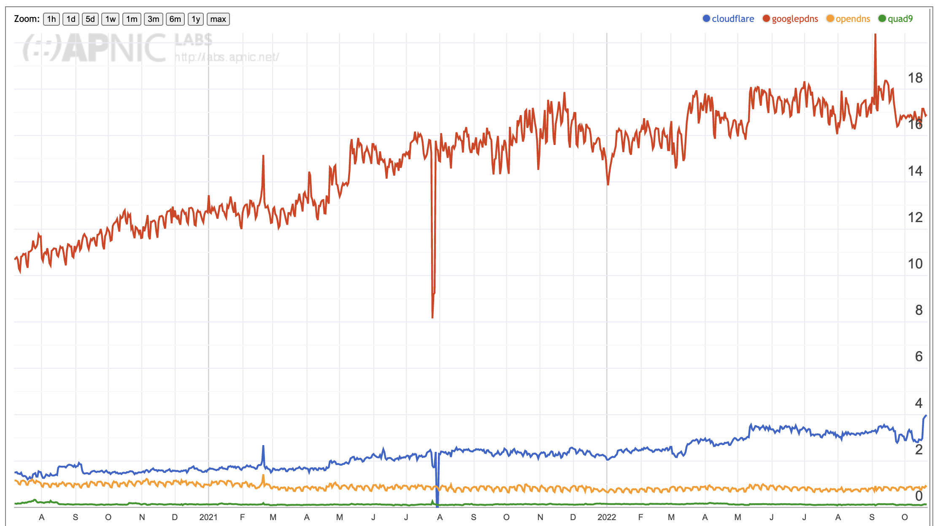
Cloudflare’s ”market share” of Open DNS resolvers
Google
Cloudflare’s 1.1.1.1 is used by
some 4% of eyeball users
Open DNS (Umbrella)
Quad 9
https://stats.labs.apnic.net/rvrs

Slide 7
Recursive Resolver Data
At APNIC we have limited access to the data relating to the use of the 1.1.1.1 recursive resolver
  We don’t know who is querying, but we do see the query protocol
  The market share of Cloudflare’s open resolver service is around 4% of users which is a non-trivial resolver in the open resolver set (ranked #2 in terms of market share)
  It’s a skewed view because it’s a TRR with Firefox

Slide 8
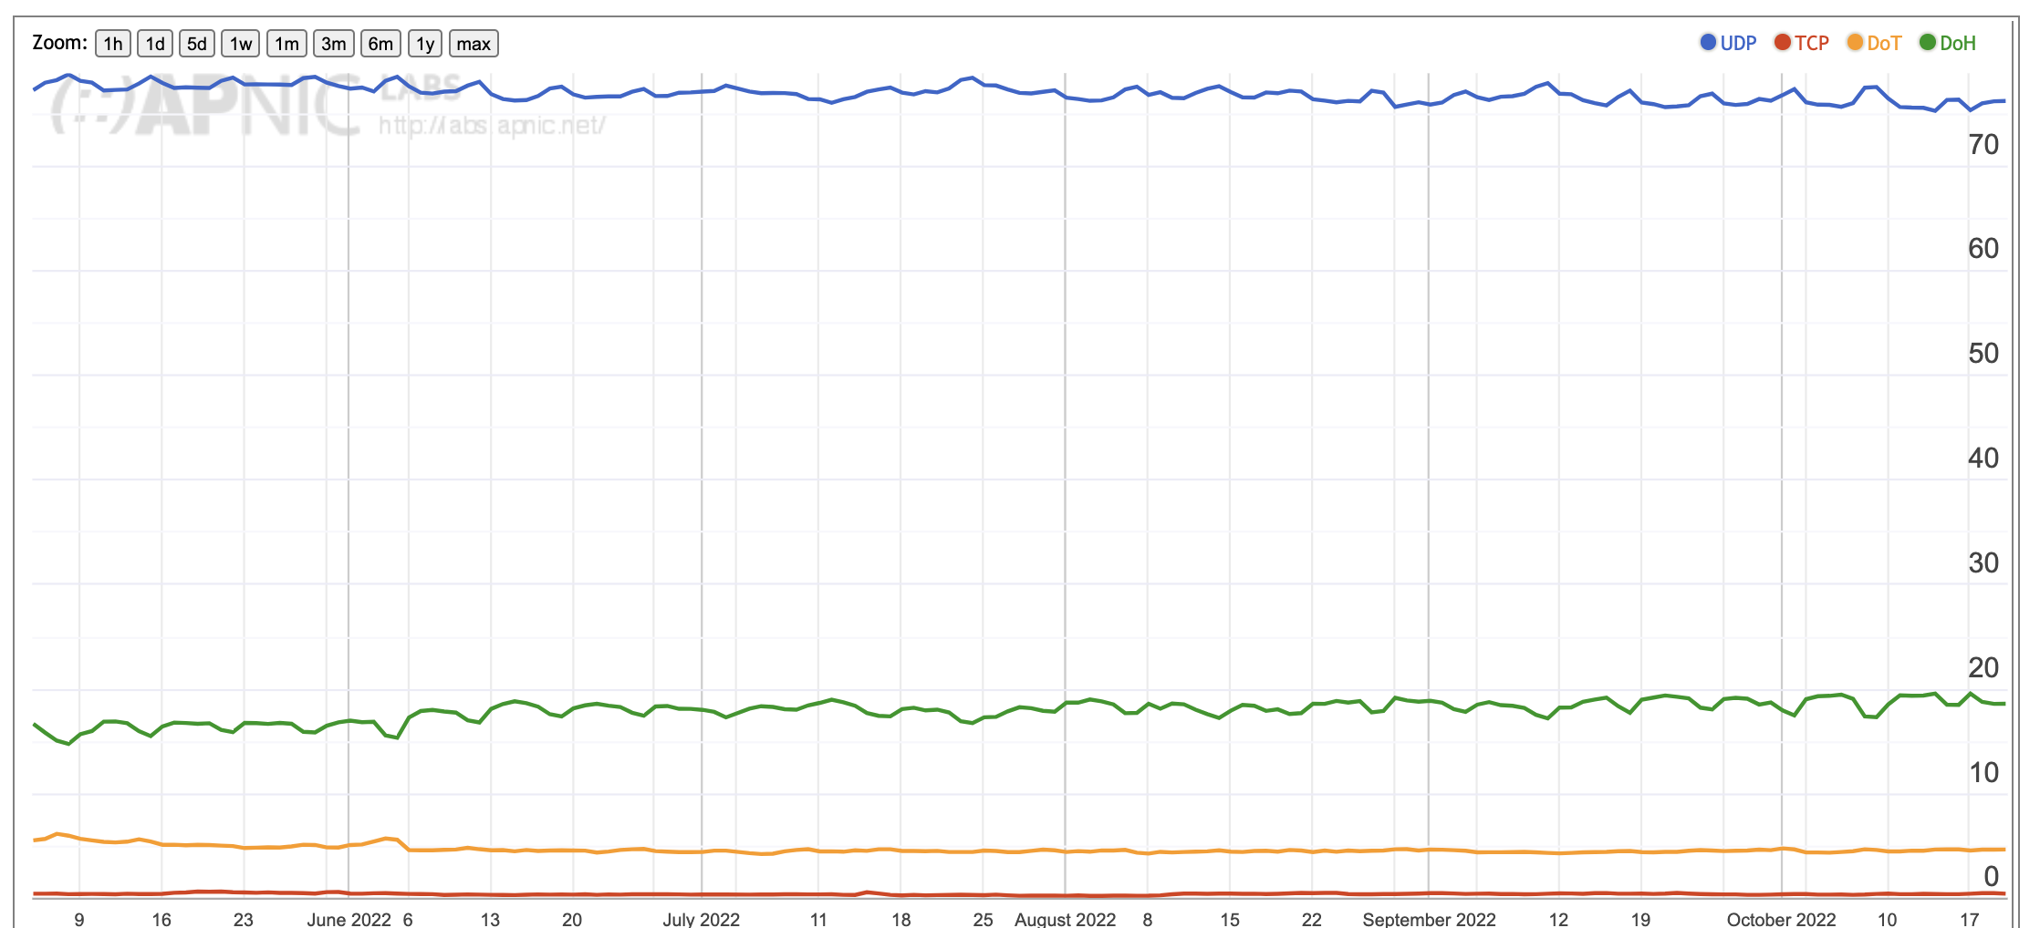
DoH vs DoT vs Do53

Slide 9
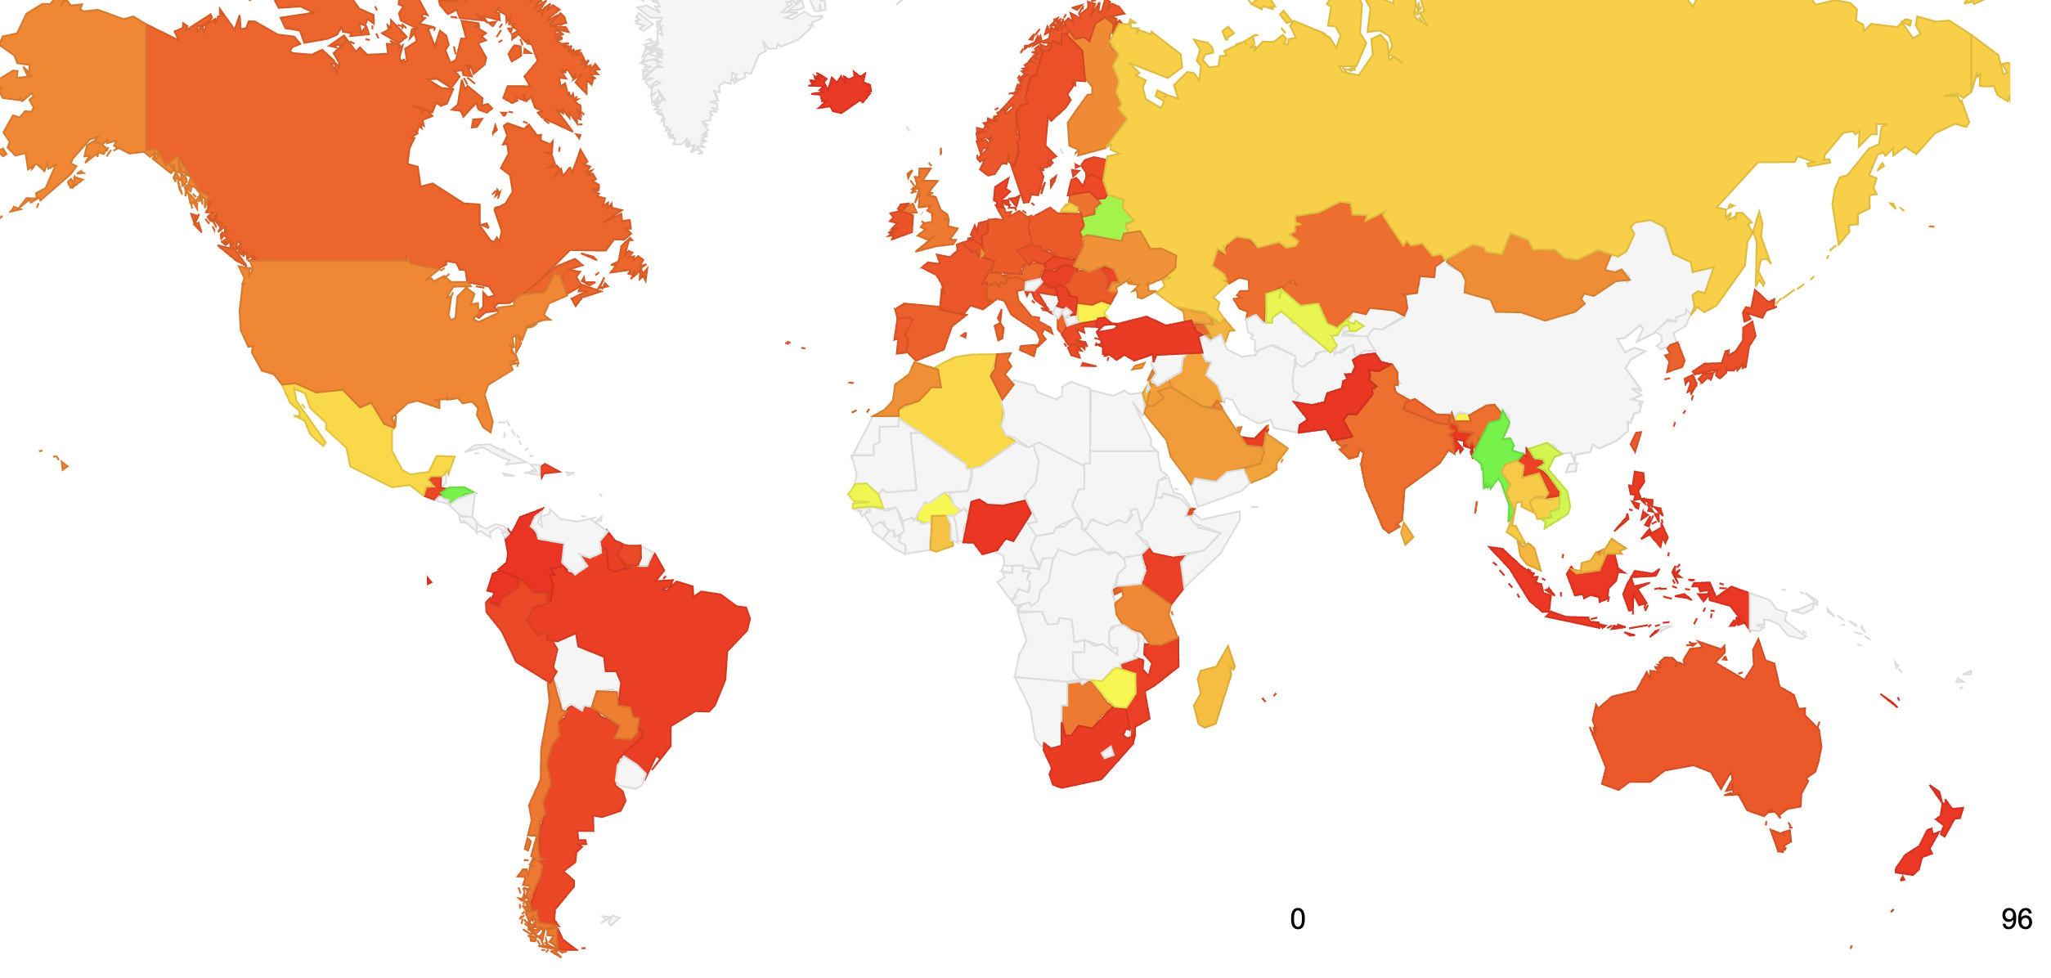
Where is DoH used?

Slide 10
DoH Use
Appears to be correlated to the Firefox Trusted Recursive Resolver use

Slide 11
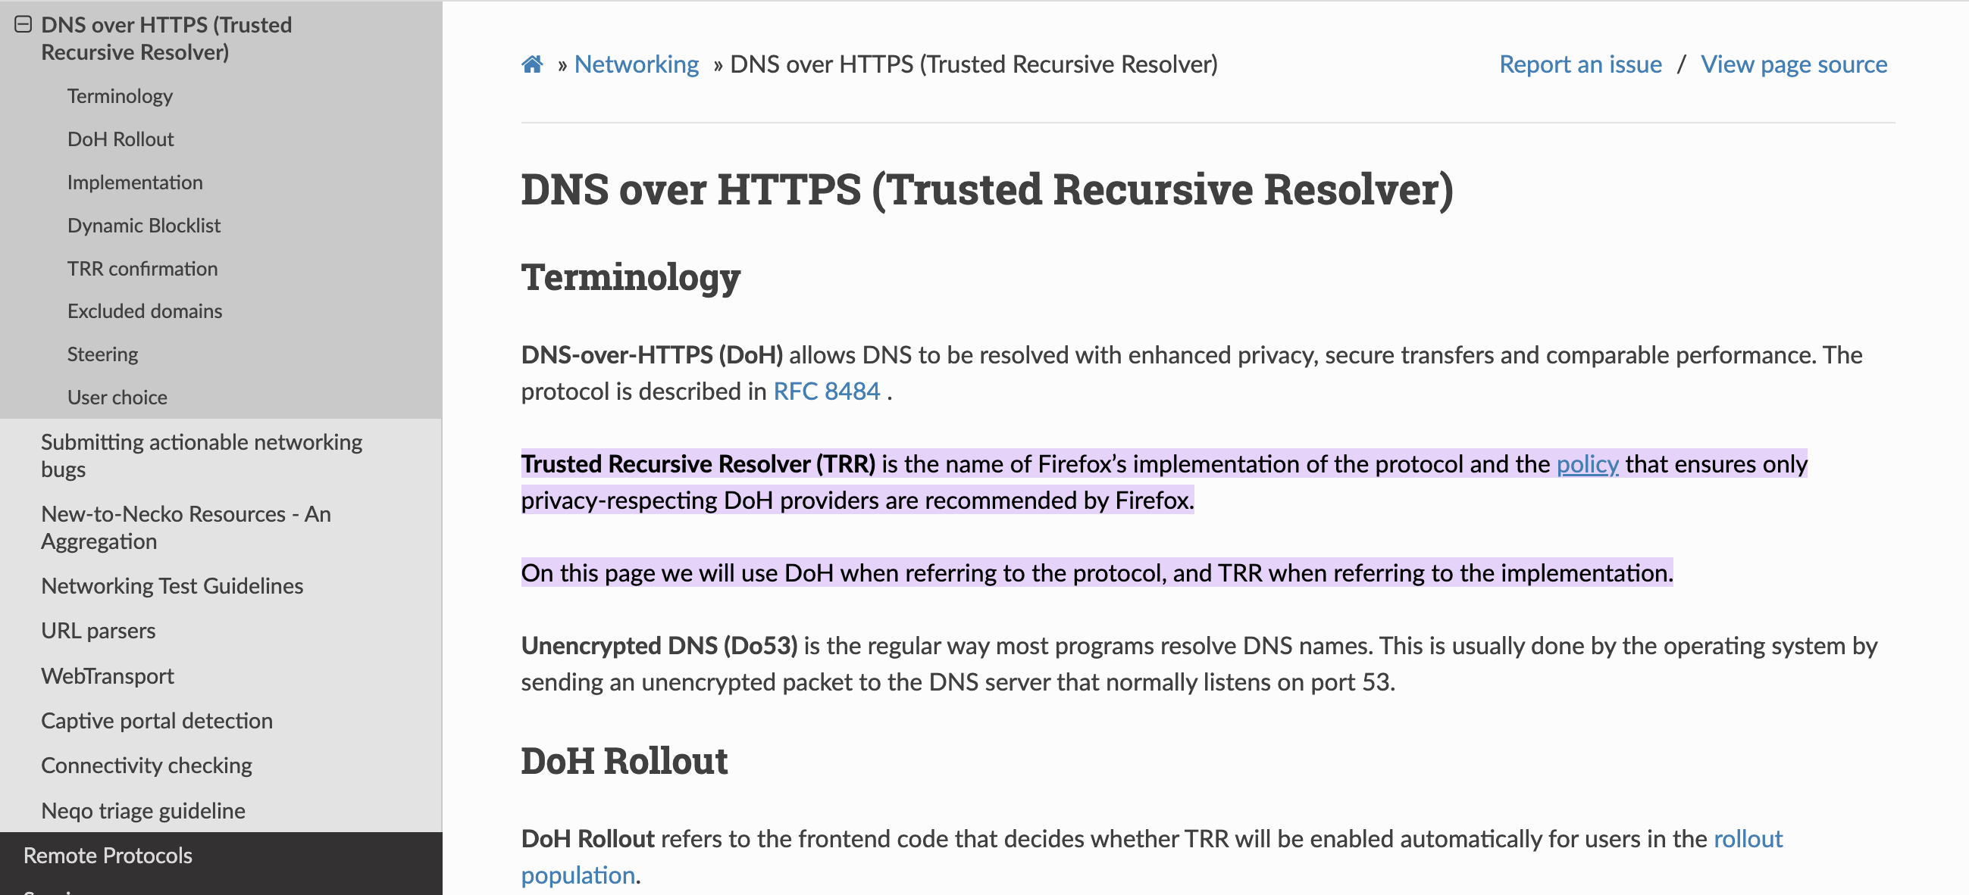
What’s the question again?

Slide 12
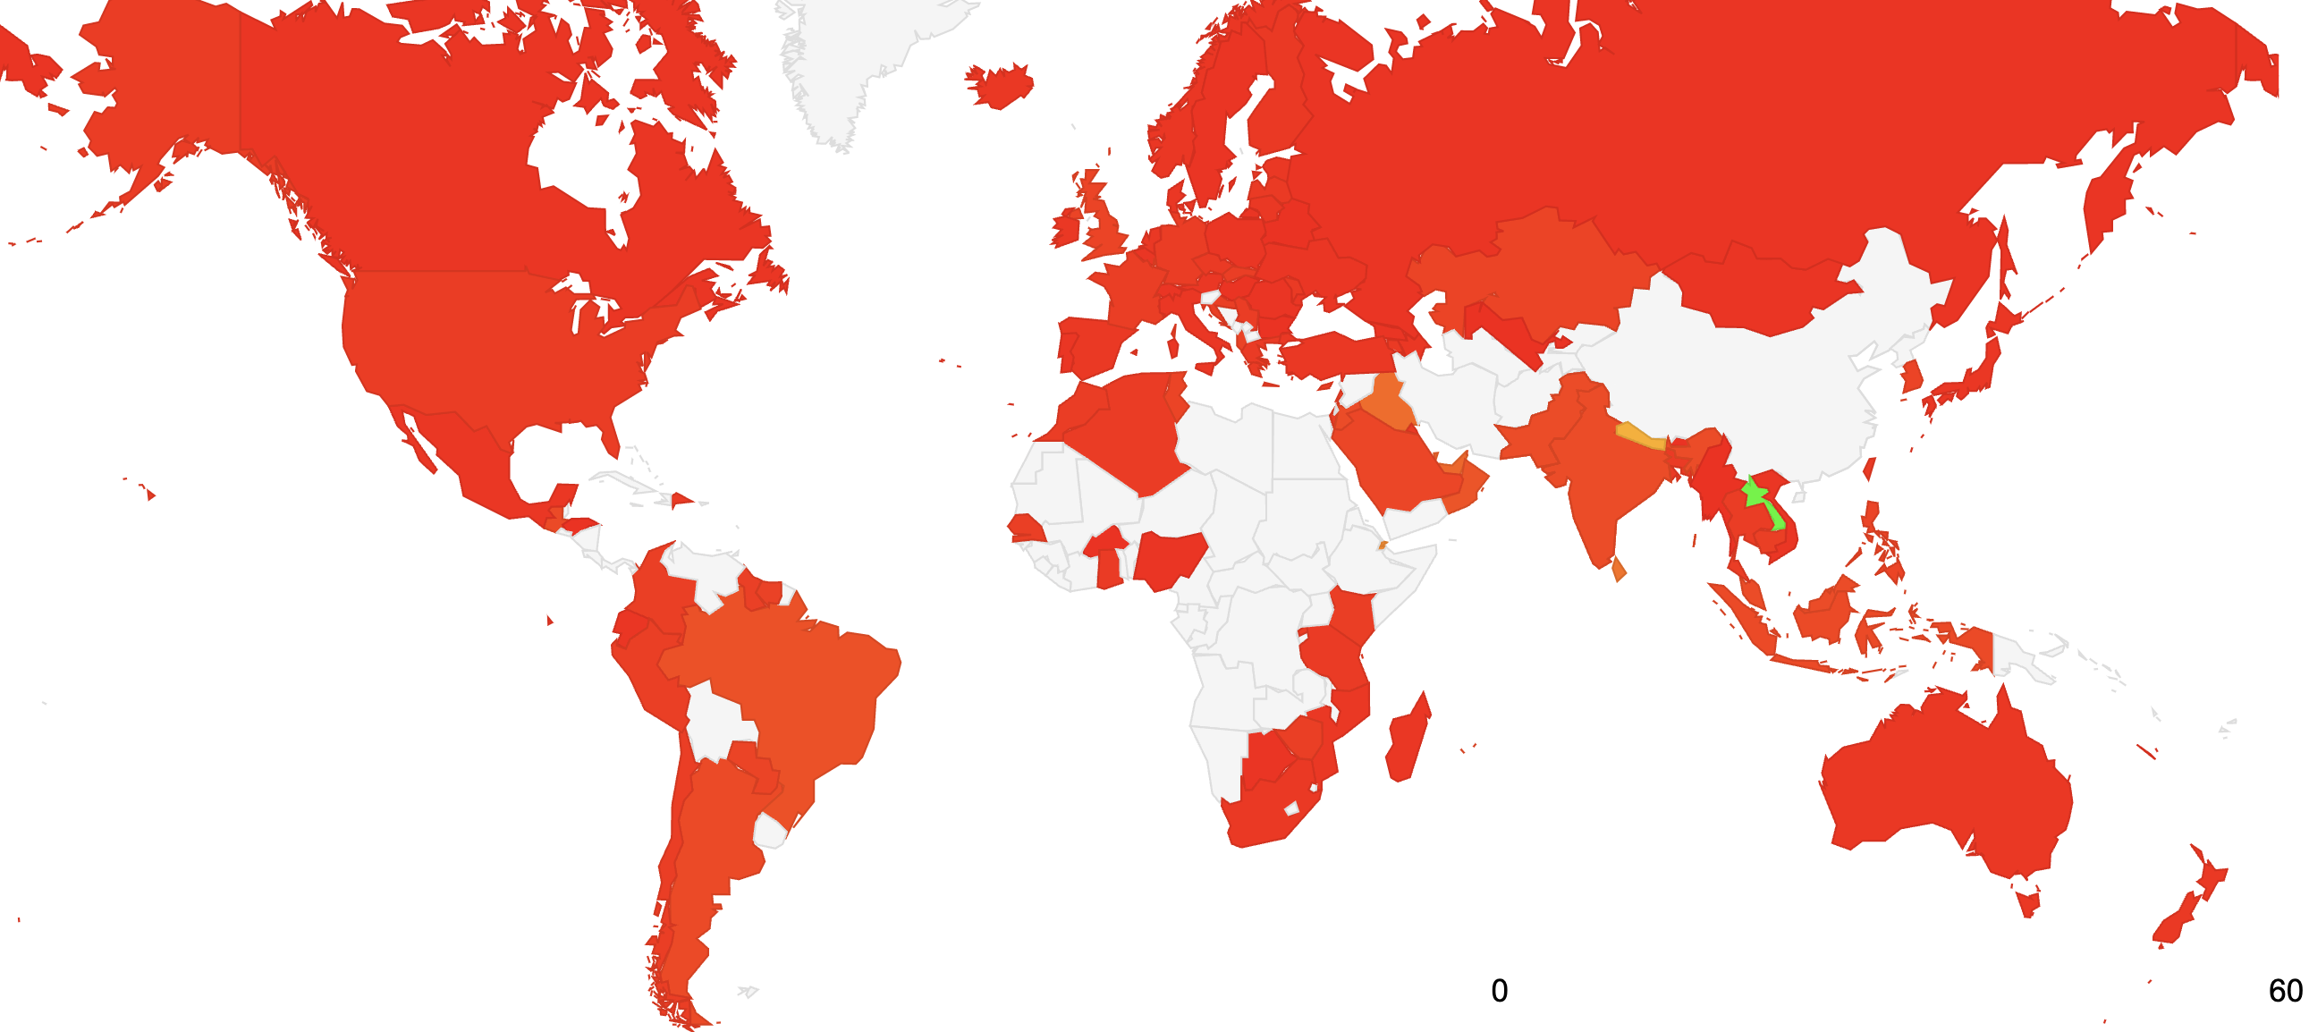
Where is DoT used?

Slide 13
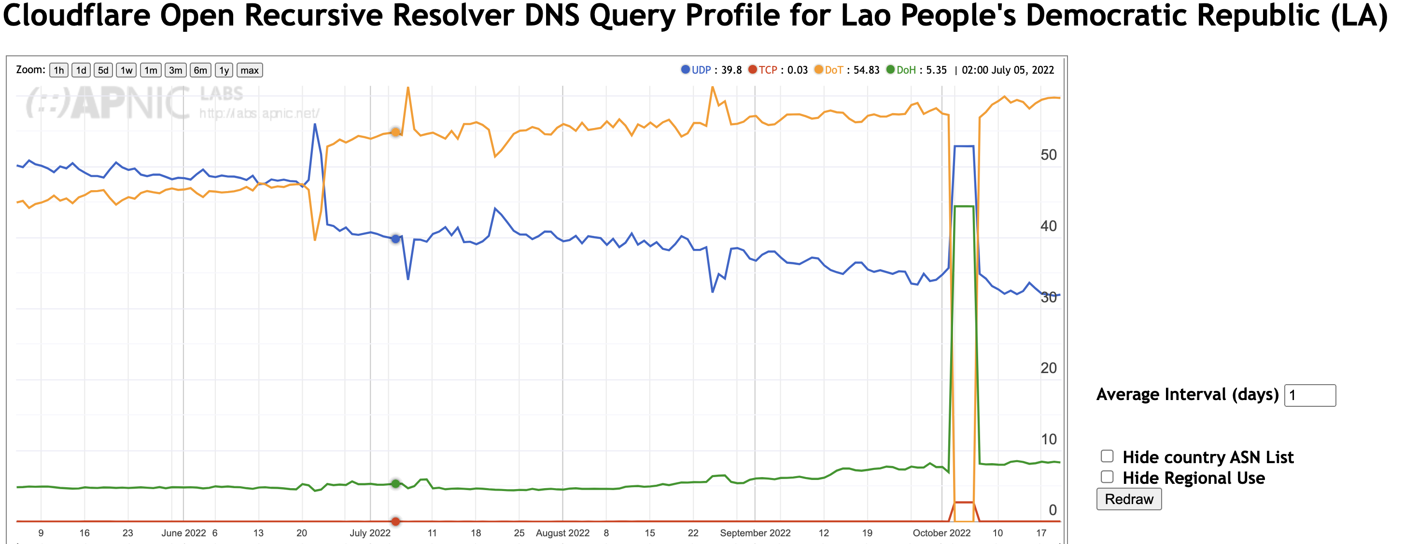
Laos!

Slide 14
Observations
DoH use appears to be related to browser behaviour (Firefox)
  Use levels are growing over the past 6 months
  But its not clear whether this is Firefox-related, or other apps experimenting with DoH or <…>
DoT use is relatively small with some singular exceptions (Laos)
  Relative use levels are declining

Slide 15
Thanks!

