Slide 1
IPv6 Extension Headers
Again!
Geoff Huston, Joao Damas
APNIC Labs

Slide 2
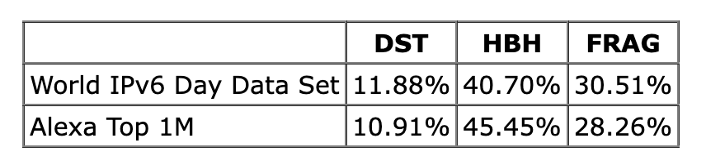
RFC 7872 - 2016
Sending crafted IPv6 packets within a TCP session to web servers and measuring the success rate through receiving a TCP ACK from the server2
Observed Drop Rate
PadN to 8 bytes
2 x 512 byte frags

Slide 3
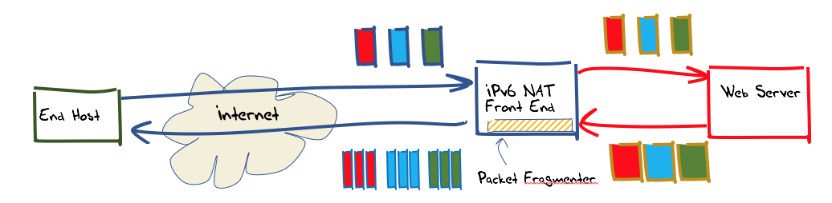
APNIC’s Test Rig
We use an ad campaign to direct browsers to retrieve a URL from our server
The server sits behind a front end that performs packet mangling (and TCP MSS wrangling)
The particulat packet transform is selected at random for each TCP session
AD:
Get <URL>

Slide 4
Tests
Random selection of:
Fragmentation
  Vary the size of the initial fragment: 1200, 1208, 1216, … 1416 octets
DST Header
  Use 0x1E type code, filled with 0’s
  Size 8, 16, 32, 64, 128 octets
HBH header
  Use 0x1E type code, filled with 0’s
  Size 8, 16, 32, 64, 128 octets

Slide 5
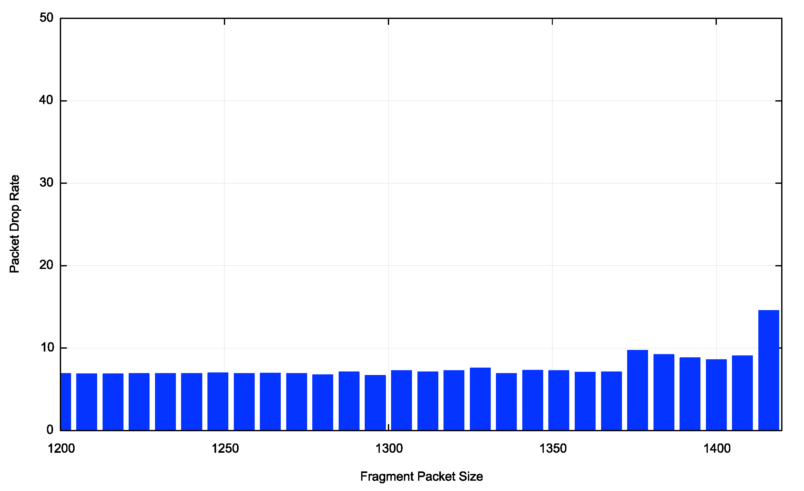
Fragmentation Drop Rate
Huh?

Slide 6
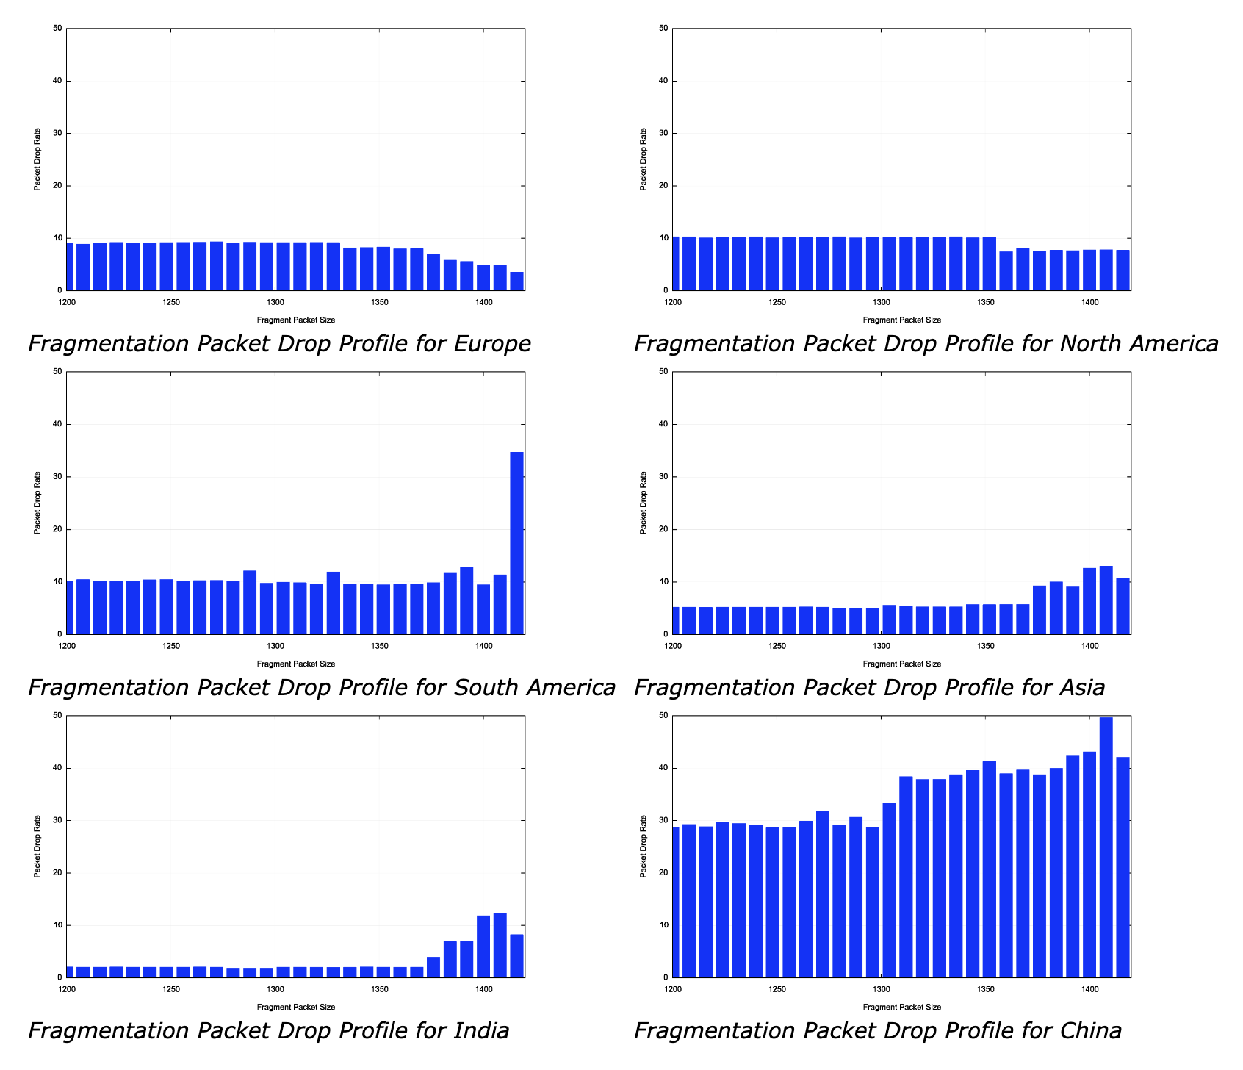
Fragmentation around the world
In Europe and North America the drop rate DECREASES for large sized initial frag packets
In South America there is a large drop signal at 1416 bytes
In Asia the drop rate INCREASES at 1380 bytes
India has a small drop rate up to 1380 bytes
China has a large drop rate for all sizes, but it shifts up at 1316 bytes

Slide 7
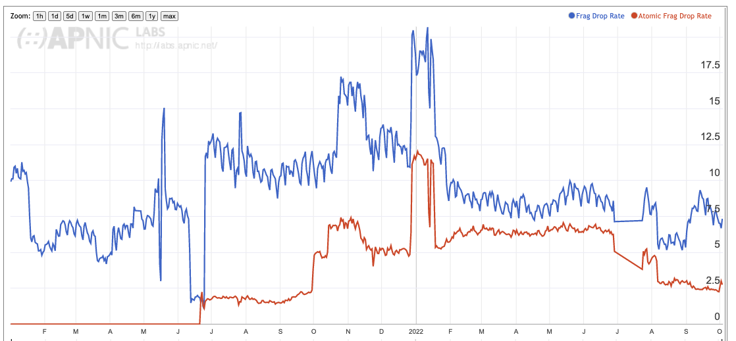
Fragmentation or EH
Let’s also include an “Atomic Fragment”
Overall Frag Drop rate
Atomic Frag Drop rate

Slide 8
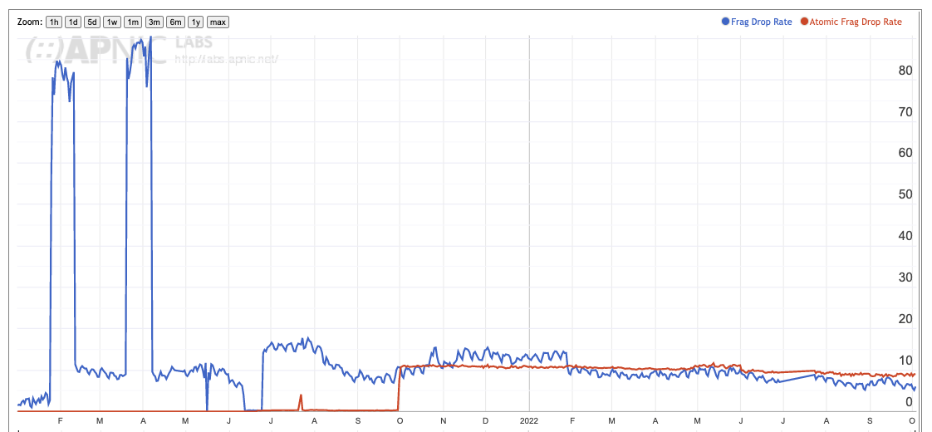
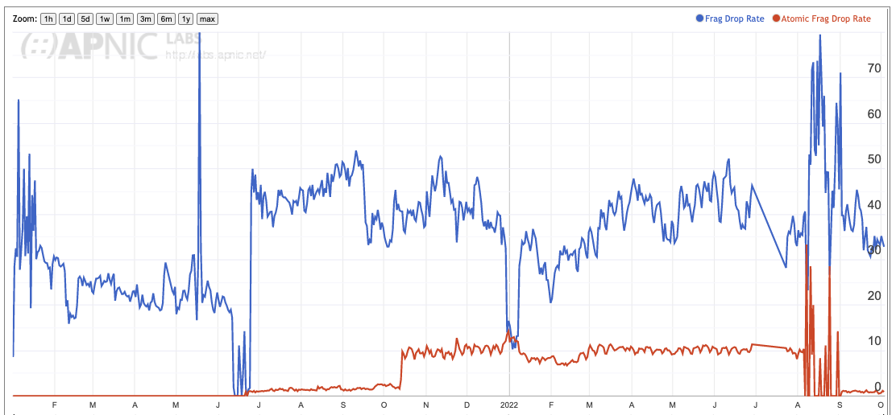
Country variations
China
United States

Slide 9
Why?
<insert favourite theory here>

Slide 10
DST EH Drop Rate

Slide 11
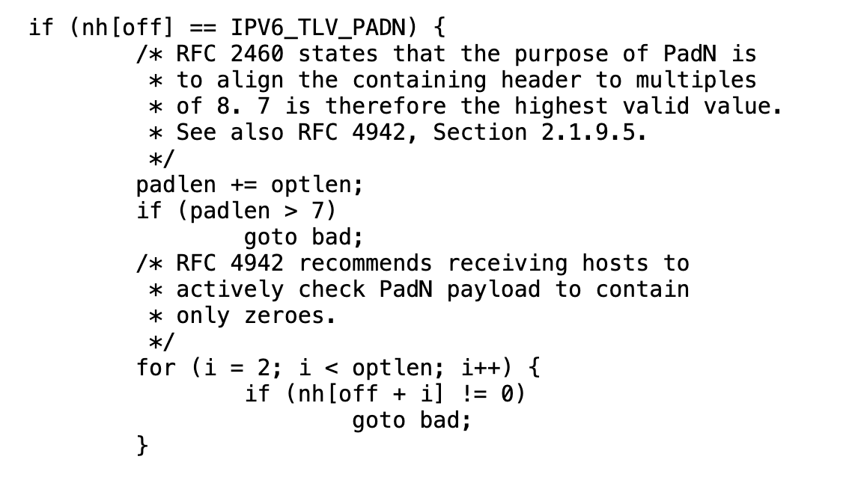
DST EH Drop Rate
Linux Filter

Slide 12
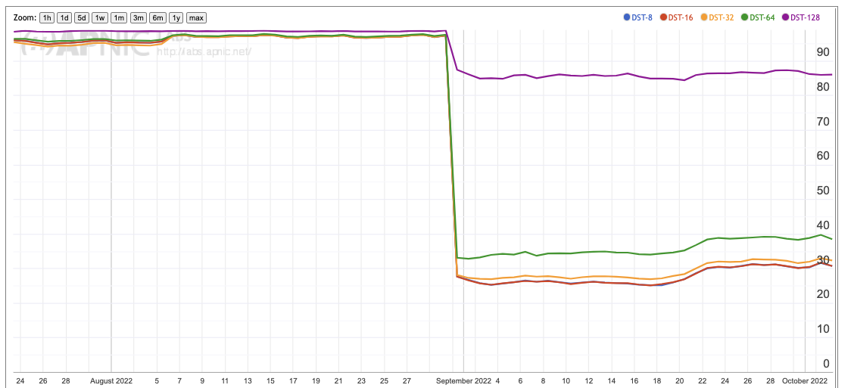
DST EH drop rate
128 byte
64 byte
padN – all 1’s
0x1E – all 0’s

Slide 13
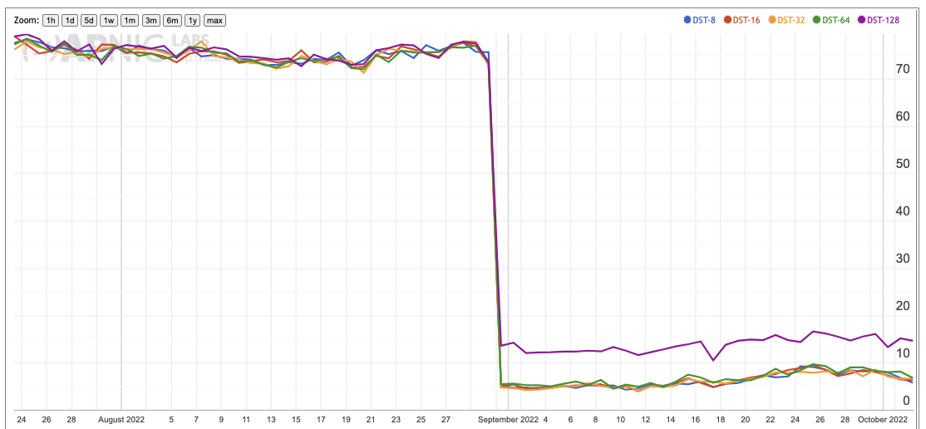
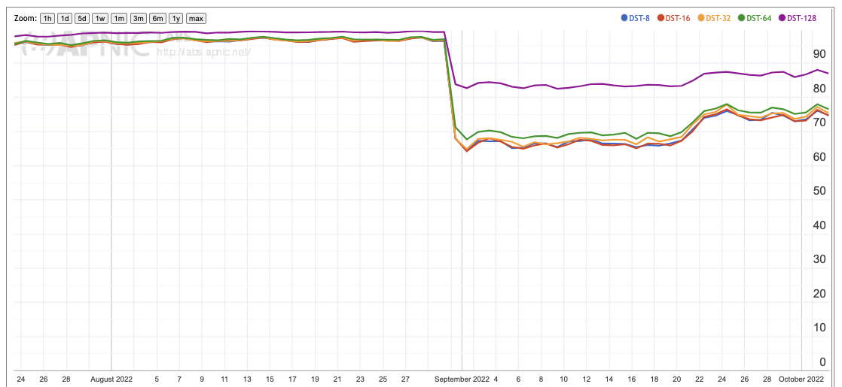
Country Variations
United States
Greece

Slide 14
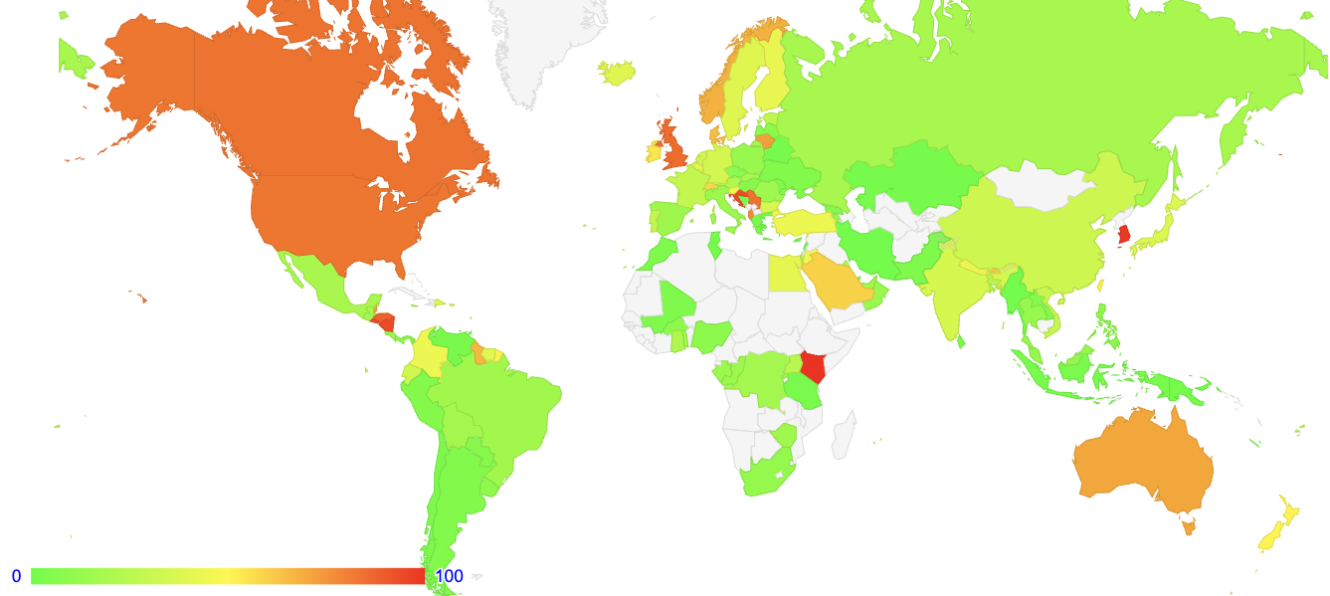
Variations in DST drop rate

Slide 15
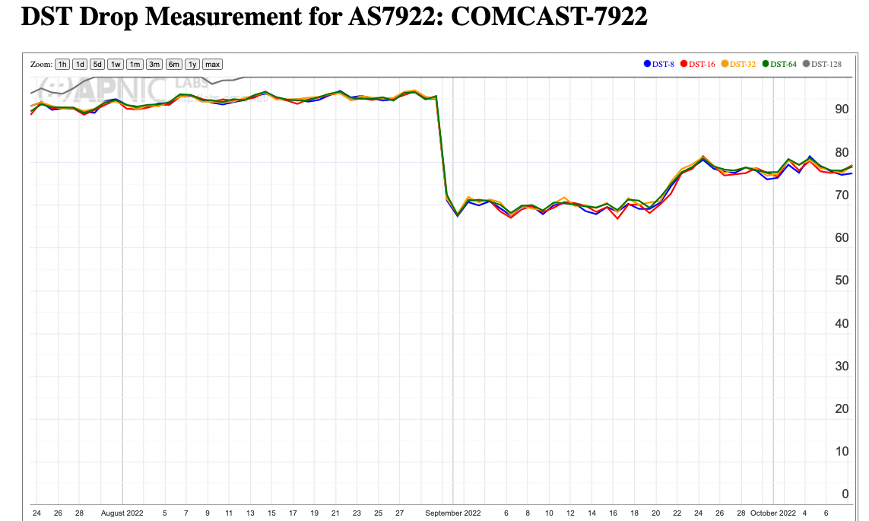
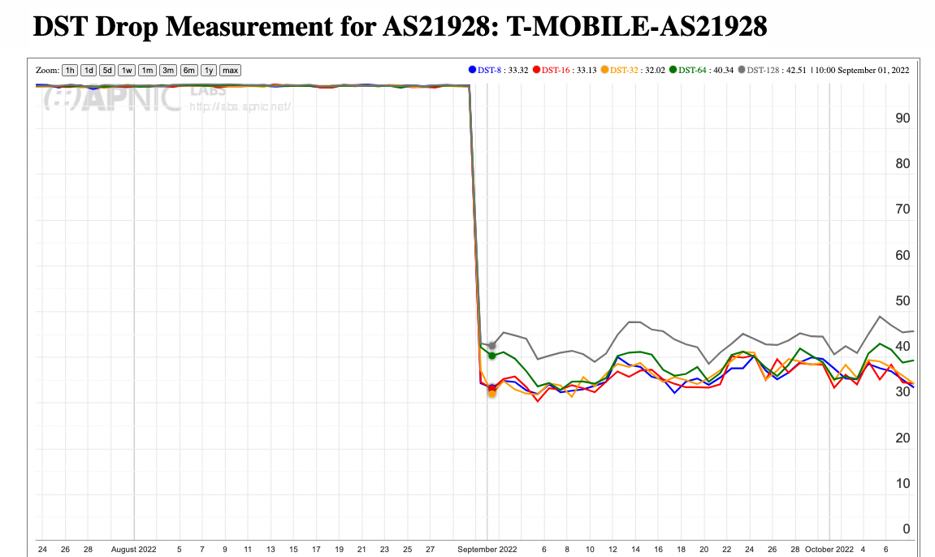
Network Type?
Fixed Line Provider
Mobile Provider

Slide 16
HBH EH drop rate

Slide 17
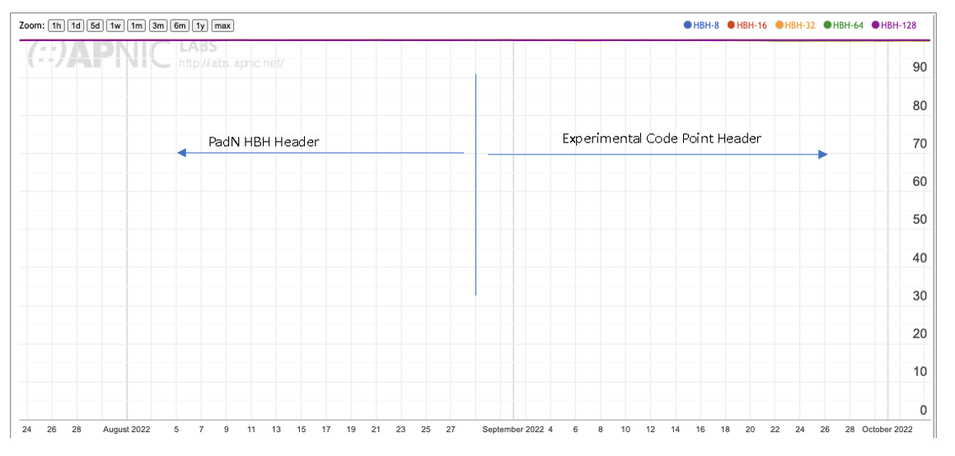
HBH EH drop rate

Slide 18
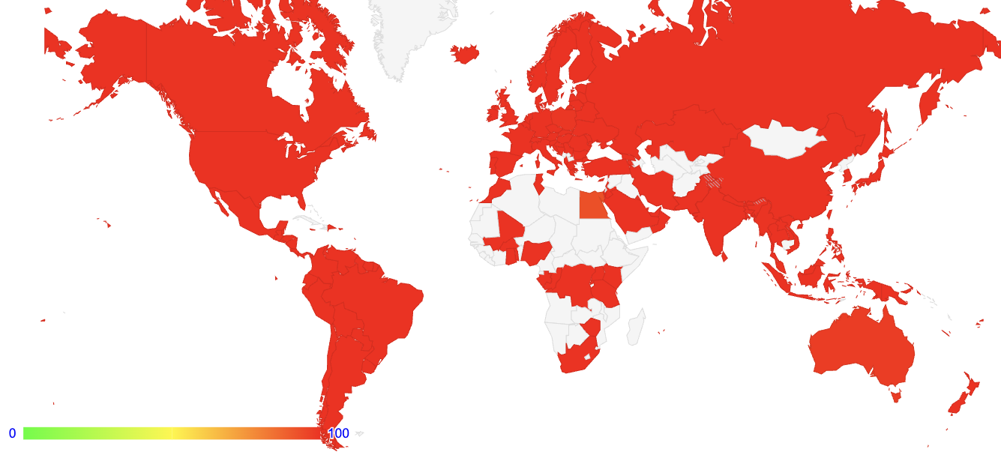
Everybody Everywhere

Slide 19
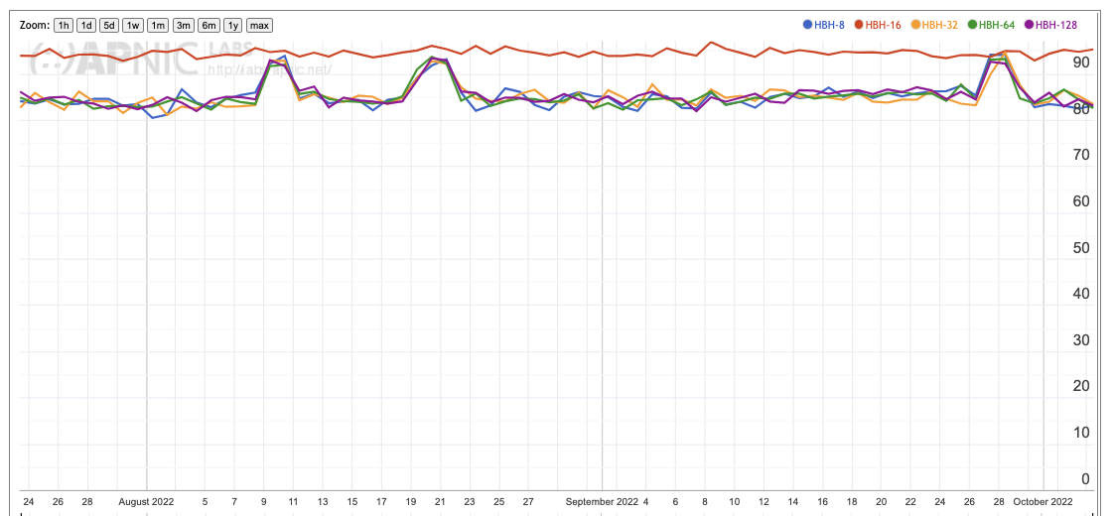
With one exception
HBH Option Drop Rate for ETISALAT-MIR (AS36992), Egypt

Slide 20
What can we say here?
“It depends”
  The IPv6 transition strategy
  The ISP equipment and config
  The CPE being used
  The mobile platform(s) being used
  End devices being used
  Private Relays / Proxies
  <insert reason>

Slide 21
What can we say?
There are issues with networks, hosts, CPE, and the IPv6 selected transition technology
Depending on where you test, and what you test (end-to-end, end-to-infrastructure, infrastructure-to-end, mobile ends, fixed line ends) its likely that you are going to see differing results for fragmentation and DST EHs
We can’t see any HBH of any size with one exception (and the single exception tends to suggest that the packets are able to leave the source network we are using and enter the transit networks)

Slide 22
Thanks!

