Slide 1
A Quick look at QUIC
Geoff Huston

Slide 2
QUIC is…
QUIC
HTTP/3
HTTP/2
HTTP
Multi-stream
HTTP
TLS
Session Encryption
QUIC
Multi-stream
Encryption
Data stream integrity
Congestion Control
e2e encrypted
TCP
Data stream integrity
Congestion Control
e2e encrypted
UDP
IP

Slide 3
TCP is..
A transport protocol that constructs a reliable full duplex adaptive streaming service constructed on top of an unreliable IP datagram service
  Uses a coordinated state between the two end systems without any network intervention or mediation
  Uses a sliding window to allow lost data to be resent
  Uses ACK-clocking to regulate the sending behaviour to match network path capacity estimate
  Has been tweaked to support (*to some degree) multi-stream and RPC transport models

Slide 4
TCP isn’t…
Fully independent of the underlying platform’s transport services
Fully multi-stream (it has head of line blocking)
Free from on-the-wire network intervention (TCP control parameters are sent in the clear)
Has e2e encryption as a second step / afterthought
Everything for everyone – it relies on the application to perform data framing and in-band control

Slide 5
QUIC is…
Constructed upon a transport level framing protocol that offers applications access to the basic IP datagram services offered by IP through the use of UDP
  All other transport services (data integrity, session control, congestion control, encryption) are shifted towards the application. A platform may provide a QUIC API, but the application can also provide its own service
So much more than “encrypted TCP over UDP”:
  Support for multi-stream multiplexing that avoids head-of-line blocking and exploits a shared congestion and encryption state
  Faster - Combines transport and encryption setup exchange in a single 3-way exchange
  Customisable - QUIC implementations can use individual flow controllers per flow
  QUIC places it’s transport control fields inside the encryption envelope, so QUIC has minimal exposure to the network
  Supports record and RPC service models as well as streaming and datagram

Slide 6
QUIC is address agile
NATs are hostile to QUIC because of the outer UDP wrapper
A NAT may rebind (shift the externally visible address/port of a host during a session), as NATs are not generally aware of UDP streaming states
QUIC uses a persistent “connection ID”
  If a host receives a QUIC frame with the same connection ID and a new IP address / port it will send a challenge by way of a random value that should be echoed back. This is all performed within the e2e encryption envelope. That way QUIC can map into new address/port associations on the fly

Slide 7
QUIC also…
Is IP fragmentation intolerant – QUIC uses PMTUD, or defaults to 1,200 octet UDP payloads
Never retransmits a QUIC packet – retransmitted data is sent in the next QUIC packet number – this avoids ambiguity about packet retransmission
Extends TCP SACK to 256 packet number ranges (up from 3)
Separately encrypts each QUIC packet
May load multiple QUIC packets in a single UDP frame

Slide 8
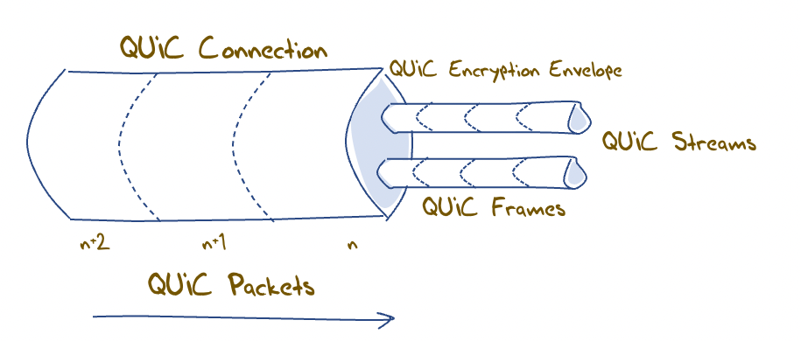
QUIC flow structuring
A QUIC connection is broken into “streams” which are reliable data flows – each stream performs stream-based loss recovery, congestion control, and relative stream scheduling for bandwidth allocation
QUIC also supports unreliable encrypted datagram delivery

Slide 9
QUIC and RPC
By associating each RPC request/reply with a new stream QUIC can support asynchronous RPC transactions using reliable messaging
  This can handle lost, mis-ordered and duplicated RPC messages without common blocking or throttling

Slide 10
QUIC and Load Balancing
This assumes that a front-end load balancer is capable of performing load balancing on UDP flows using the UDP connection 5-tuple
If the remote end performs NAT rebinding the load balancer will be thrown by this shift, and it has no direct visibility into the e2e session to uncover the connection ID
Using UDP to carry sustained high-volume streams may not match the internal optimisations used in server content delivery networks
If we really want large scale QUIC with front end load balancing and we still need to tolerate NATs then we will need to think about how the end point can share the connection ID state with its front end load balancer, or terminate the QUIC session in the front end and use a second session to the selected server

Slide 11
QUIC and DOS
Very little lies outside the encryption envelope in QUIC
Which means all incoming packets addressed to the QUIC port need to be decrypted
But the session uses symmetric crypto so the packet decode overhead is far smaller than the asymmetric load
Its not the best answer, but its not disastrous either!

Slide 12
Looking for QUIC
At APNIC we use Ads to perform large scale measurements of network service capabilities as seen by users
  IPv6 deployment
  DNSSEC validation
  Fragmentation
Can we use this measurement platform to see the level of use of QUIC in today’s network?

Slide 13
Setting up QUIC
Server:
  nginx v1.21.7 with QUIC functions included
DNS:
  Set up an HTTPS record for each URL with value: alpn=“h3”
Content:
  Alt-Svc: h3=“:443”
  (This second method requires a subsequent query to allow the client to use the Alt-Svc capability. We perform a delayed second query for this URL in the measurement experiment)

Slide 14
Two QUIC triggers, two behaviours
The Safari browser (V16) is triggered by the presence of the DNS HTTPS record with an “alpn” value of “h3”
  Once established, the browser client expects the server to keep the QUIC session open. If the session is closed “prematurely” Safari will drop back to HTTP/2 over TCP/TLS
  What’s “premature” in seconds?
    I dunno!
    More than 1 second. Less than 65 seconds.
    We use a server session keepalive interval of 20 seconds and that seems to work

Slide 15
Two QUIC triggers, two behaviours
The Chrome browser is triggered by the content directive within the delivered page
  But this creates an issue with HTTP/2 and persistent connection support
  When the browser performs the followup fetch after the initial fetch, the connection is likely still open. The browser will prefer to use the open connection rather then opening up a new QUIC connection, despite the inclusion of a content directive. So this in-content signalling is not all that effective as a QUIC trigger.
  How long should we wait before performing the second query? Or how long should we set the server’s keepalive persistence timer?
    I dunno!
    More than 1 second. Less than 65 seconds.
    We use a keepalive interval of 20 seconds and that seems to work

Slide 16
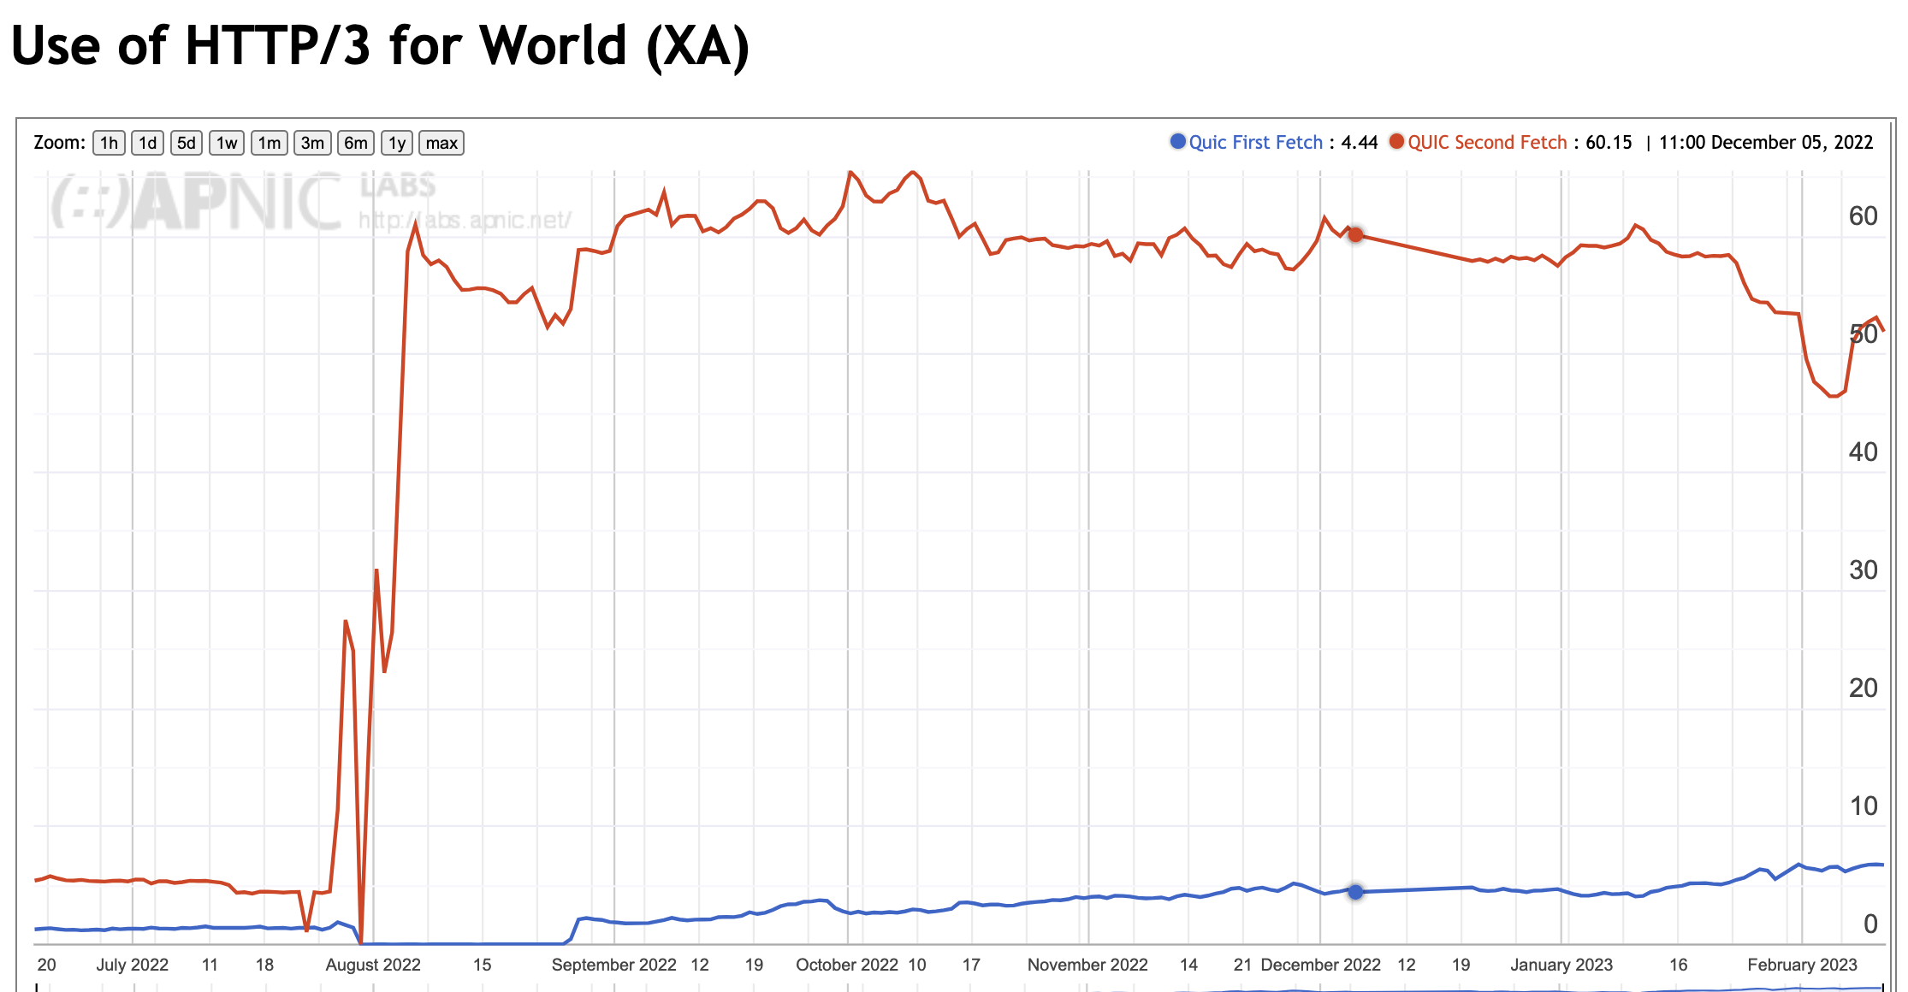
Measuring QUIC use
2nd and subsequent fetches
First fetch

Slide 17
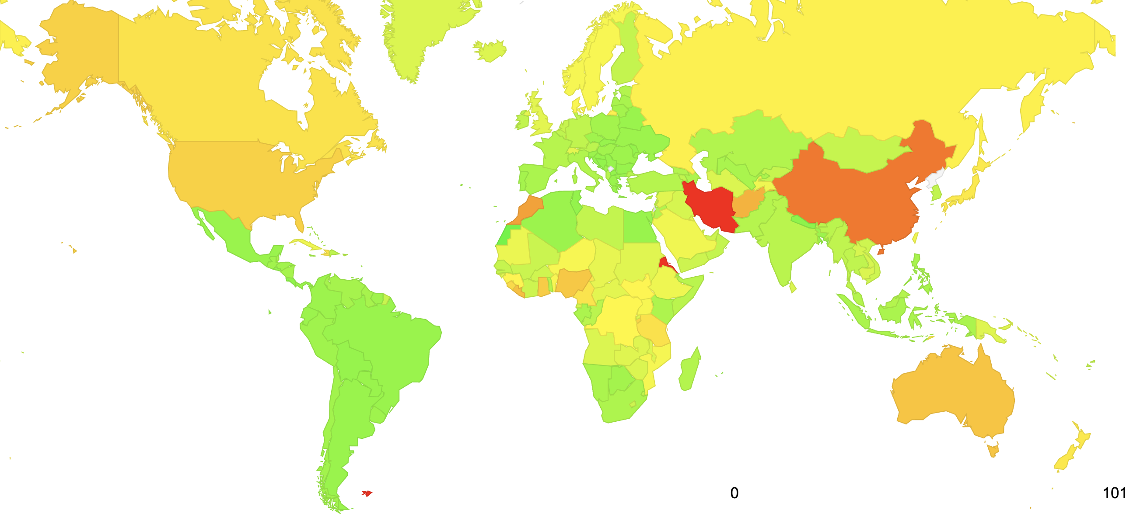
Measuring QUIC Use

Slide 18
Why?
If both Safari and Chrome support QUIC these days then why is the measurement number not closing in on 100%?
  I suspect its about many enterprise environments blocking UDP port 443
  And some ISPs
  And of course the Great Firewall of China

Slide 19
Is QUIC Faster?
Let’s compare the user-measured time to load an object using HTTP/2 and the same user’s measured time to load the same object using HTTP/3
  There are a number of variables in the user time measurement, including varying time penalties relating to the internal task scheduling within the browser, but these individual factors should be cancelled out over a large enough sample set

Slide 20
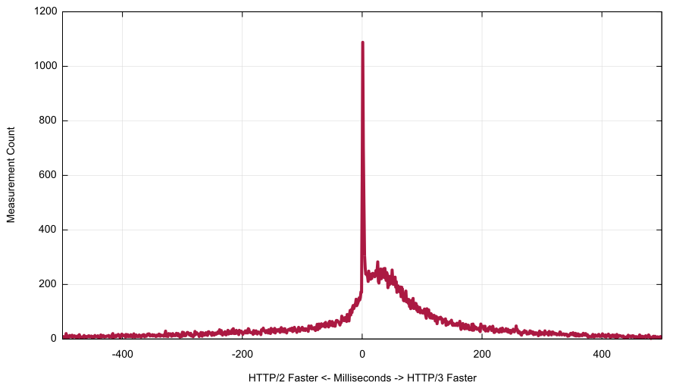
Is QUIC faster?
Area where QUIC is faster
Non-QUIC Faster
ms
QUIC Faster

Slide 21
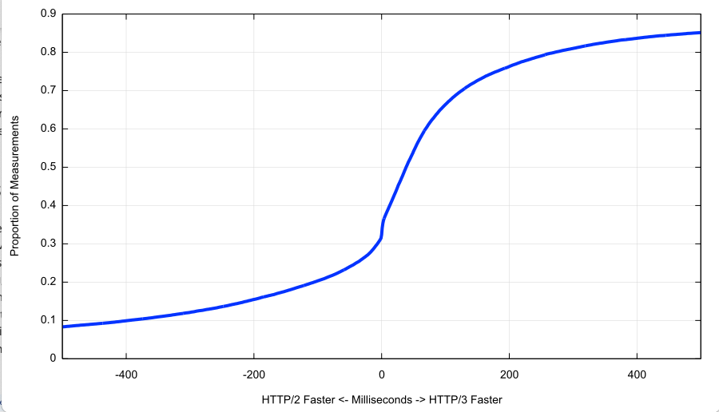
Is QUIC faster?
HTTP/3 is faster to perform object retrieval in 2/3 of the observed cases
Non-QUIC Faster
ms
QUIC Faster

Slide 22
Thanks!
Ongoing HTTP/3 Measurement Report at APNIC Labs:
https://stats.labs.apnic.net/quic

