Slide 1
DNS in EU before dns4EU
  Geoff Huston, APNIC

Slide 2
A Measurement Opportunity
Sometimes there are ideal windows for “before and after” measurements
  in attempting to measure the effectiveness of changes to the DNS resolution environment
In this case it’s the DNS4EU initiative

Slide 3
Measurement Questions
What does the DNS resolution landscape look like before the introduction of DNS4EU?
How would we like to measure the impact of DNS4EU on EU users?
What deployment choices for DNS EU would make measurement easier? (or more challenging!)

Slide 4
DNS Resolution in EU
APNIC’s Measurement methodology:
  Use an ad campaign to generate URLs with unique DNS labels
  Match the queries seen at our authoritative DNS server to the query names generated when the ad was impressed to the user’s browser
  Compare the IP address of the resolver who presents the query to the auth DNS server to the IP address of the user
Ad system
Measurement server
Auth DNS server
html5 measurement script
DNS resolution
environment
End user

Slide 5
Type of Resolver
Resolver classes
  “known” open DNS resolver
  ISP resolver (same origin AS as user)
  Same country as user (domestic)
  Different country to user (foreign)
Ad system
Measurement server
Auth DNS server
html5 measurement script
DNS resolver
DNS resolution
environment
End user

Slide 6
Query Behaviour
First query (who will the user believe)
Single query (who gets to see the user’s query)
Multiple queries (who MAY get to see the user’s query)
Ad system
Measurement server
Auth DNS server
html5 measurement script
DNS resolver
DNS resolution
environment
End user

Slide 7
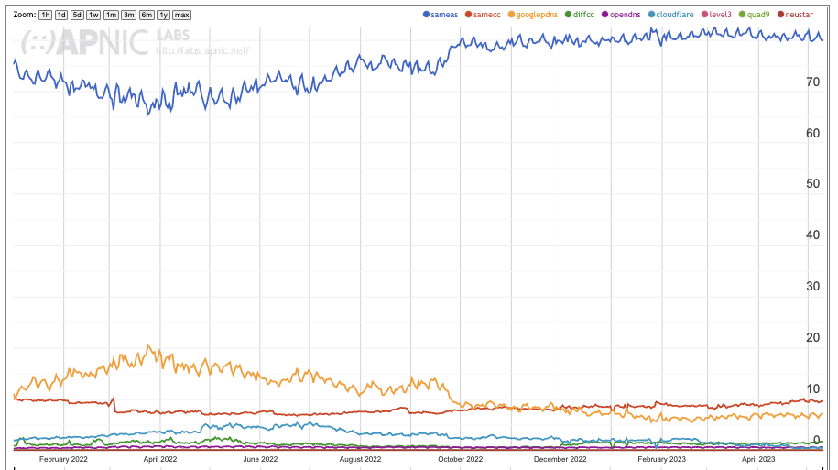
EU Profile – First Query
Same AS
Same CC
Google PDNS

Slide 8
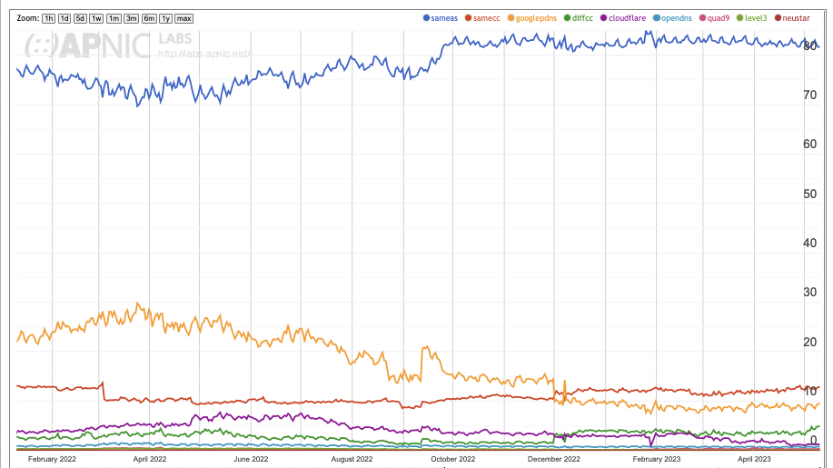
EU Profile – All Queries
Same AS
Same CC
Google PDNS
Diff CC

Slide 9
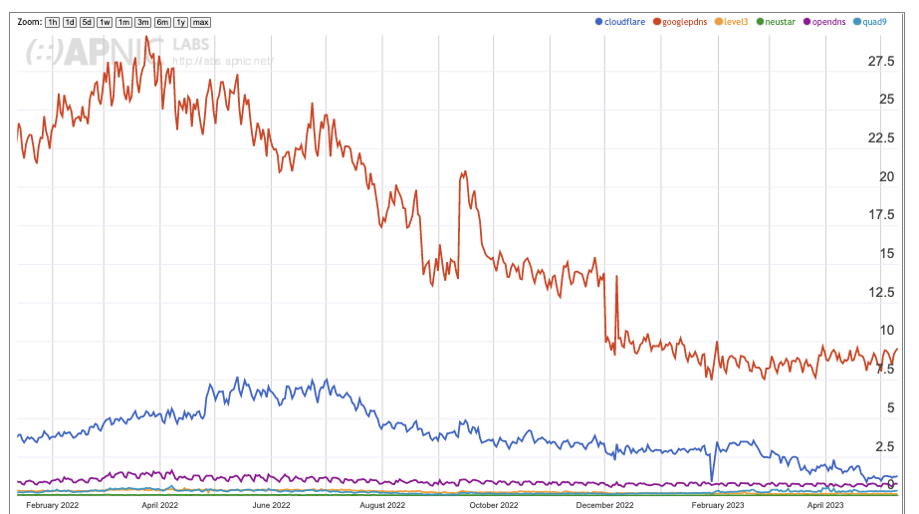
EU Profile – Open DNS resolvers
Google PDNS
Cloudflare
OpenDNS

Slide 10
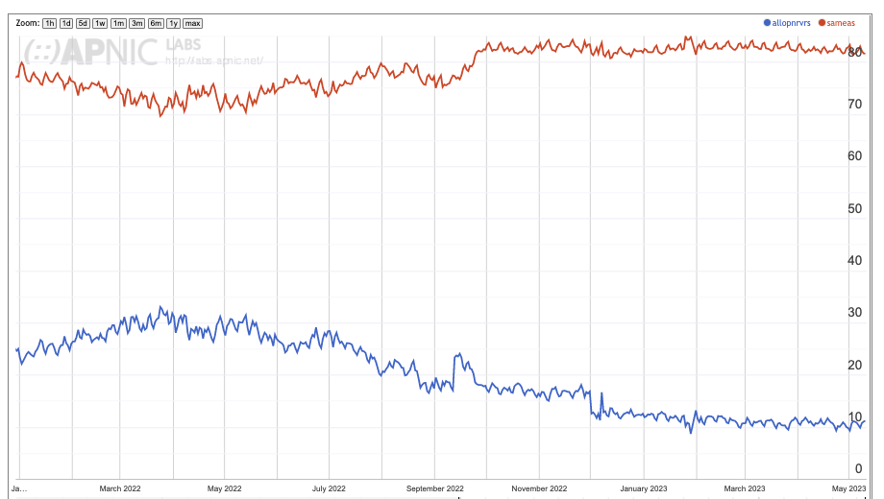
Use of Open Resolvers in EU
Declined sharply from a peak of 30% of users in early 2022 to 10% of users today
Google’s Public DNS service has 80% of market share of the open resolver “market”
Open resolver use has a strong weekday preference – which indicates a strong adoption preference in enterprise networks, but far smaller levels of individual user uptake
  Users generally don’t stray away from the default settings
ISP Resolver
Open Resolvers

Slide 11
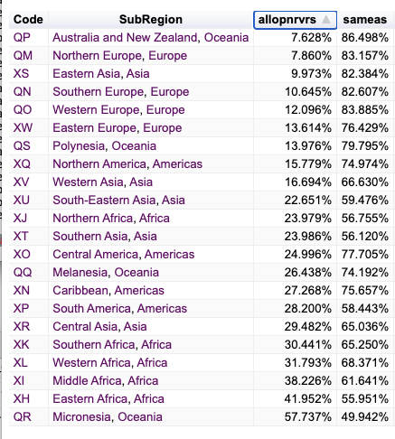
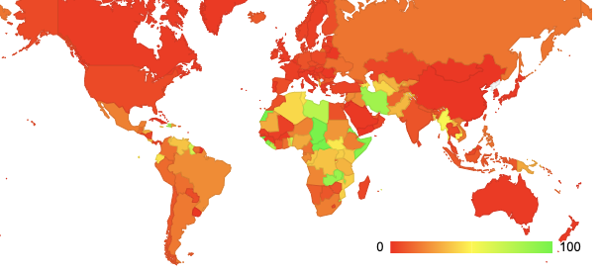
Is EU “different”?
A much larger level of use of open DNS resolvers is seen in Africa, South and Central Americas and Asia
As in EU, the majority of this user of open resolvers is due to the use of Google’s service

Slide 12
The potential impact of DNS4EU
With less than 10% of users directing queries away from the local ISP resolver towards an open DNS resolver it would seem that the potential for change in the EU DNS environment is not all that great

Slide 13
DNS4EU Deployment Options
Same as existing open DNS resolver services:
  Anycast service address
  Multiple service sites
  Each service site may use a front end load balancer and a collection of backend resolver engines
  Deployed at IX points(?)
As a replacement for the ISP’s existing recursive resolver service
  Deeply embedded in ISP infrastructure

Slide 14
Measuring the impact of DNS4EU
If this service will use some form of constant service address and an anycast configuration
  Then measurement of the uptake of this service can be undertaken in the same way that the use of other open DNS resolvers is measured
If the service is embedded in ISP infrastructure then the measurement of this service will be far more challenging to undertake externally

Slide 15
Comments and Questions?

