Slide 1
The Evolution of Carriage, Content and Interconnection
Geoff Huston AM
Chief Scientist, APNIC

Slide 2
Conversations change
We used to talk about “Tier 1” transit providers, peering, paid peering, and customers
Then we talked about Exchange Points, Data Centres and peering
Now we are talking about autonomous content distribution networks and embedding content in access networks
Why is this such a rapidly changing environment?

Slide 3
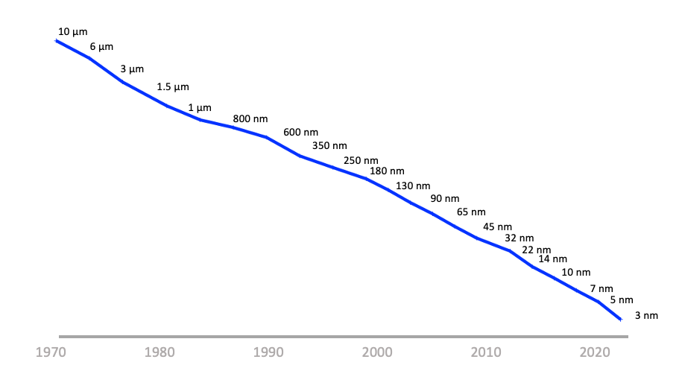
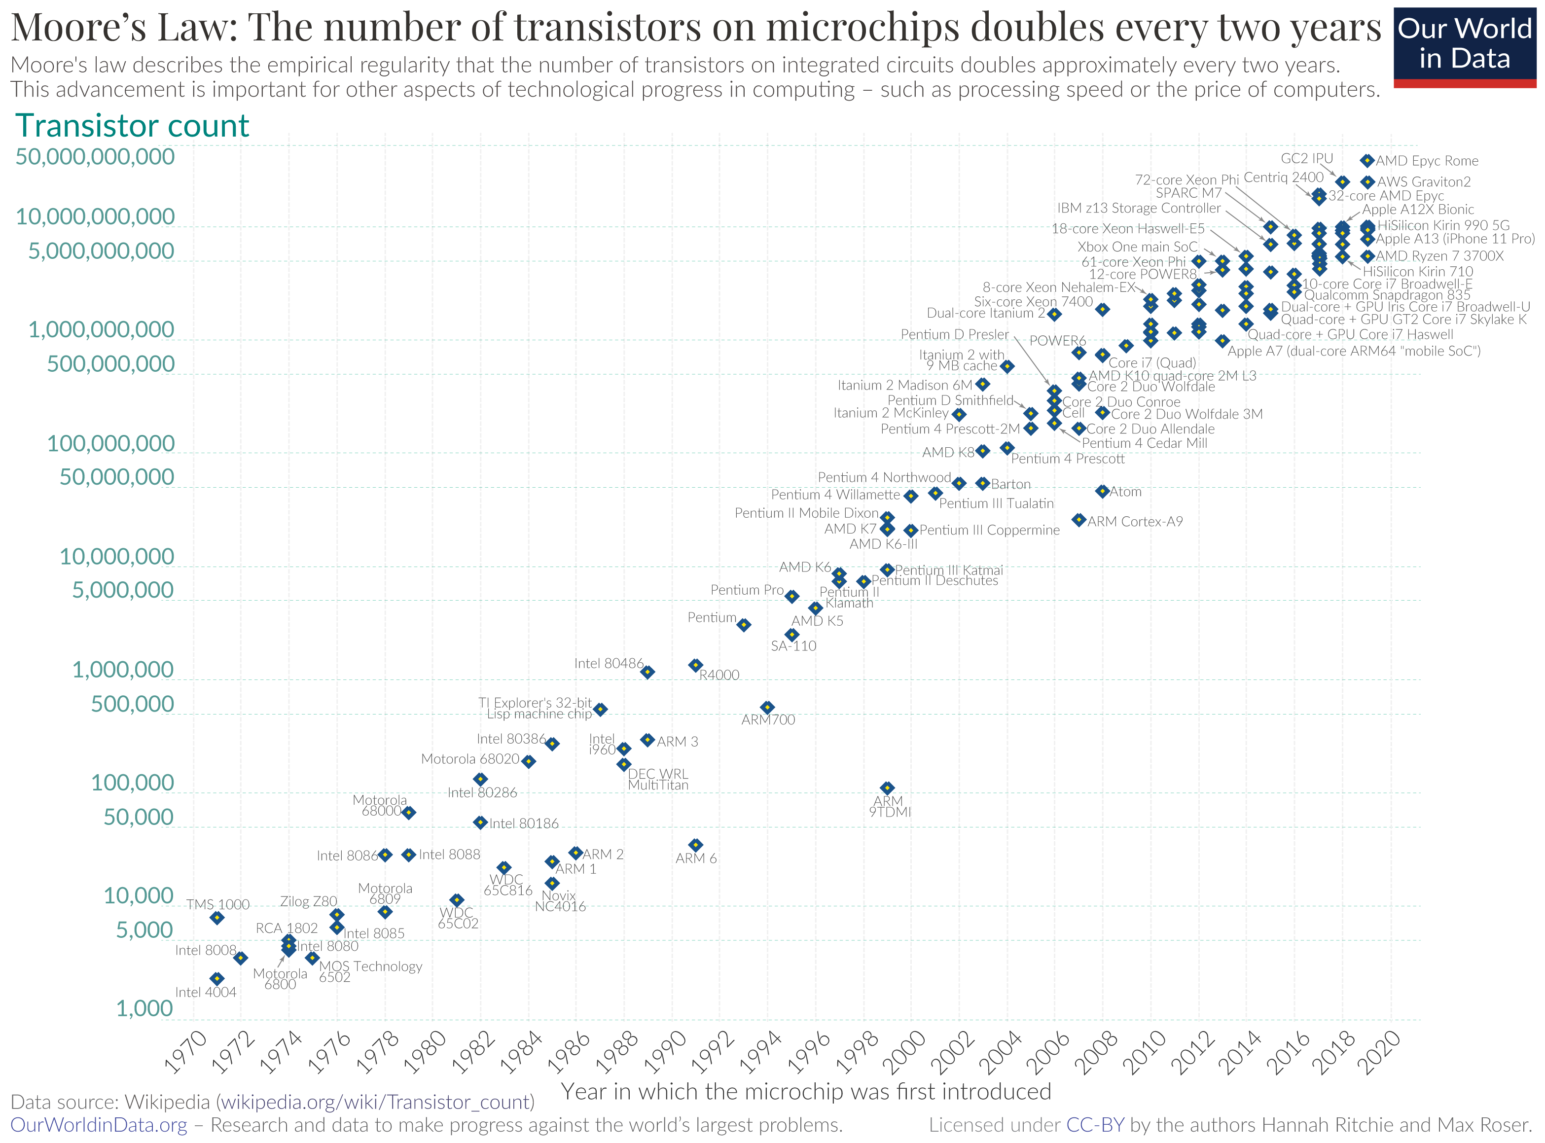
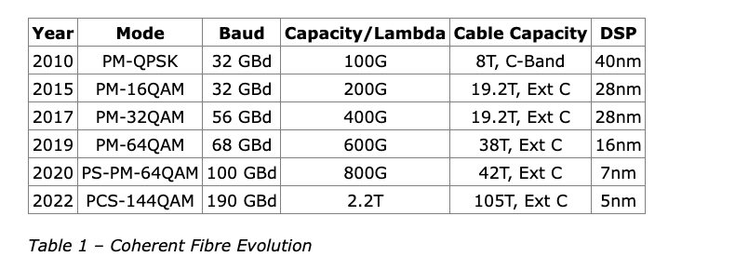
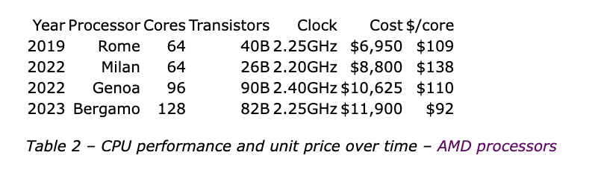
The Driver of Change: Moore’s Law
Silicon Chip Track Width
Silicon Chip Track Width over time
Silicon Chip transistor counts

Slide 4
What does this mean?
The economics of silicon chip evolution have a profound impact on the computing space - no technology can survive more than 5 years in the computing sector!
No business plan can survive more than 5 years in the computing area!
And given that the carriage sector is now a digital carriage platform, the carriage sector is no exception here

Slide 5
The 1990’s Internet
Interconnection Friction

Slide 6
Change
Networks are no longer transit services that connect users to services
Content distributors are using abundance of computing, storage and capacity to bring content to users

Slide 7
Today’s Internet Architecture

Slide 8
Change
Greater capacity in edge networks has enabled
Greater use of high-volume streaming content
Leading to adoption of higher capacity technologies in edge network
Which also enables reductions in the unit cost of carriage in edge networks

Slide 9
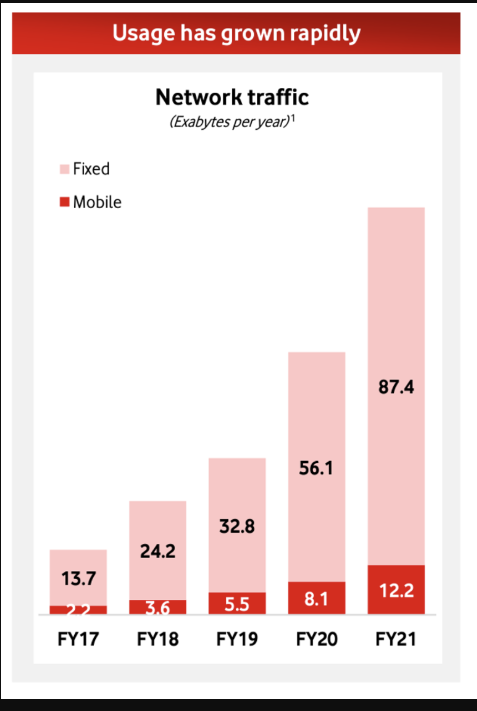
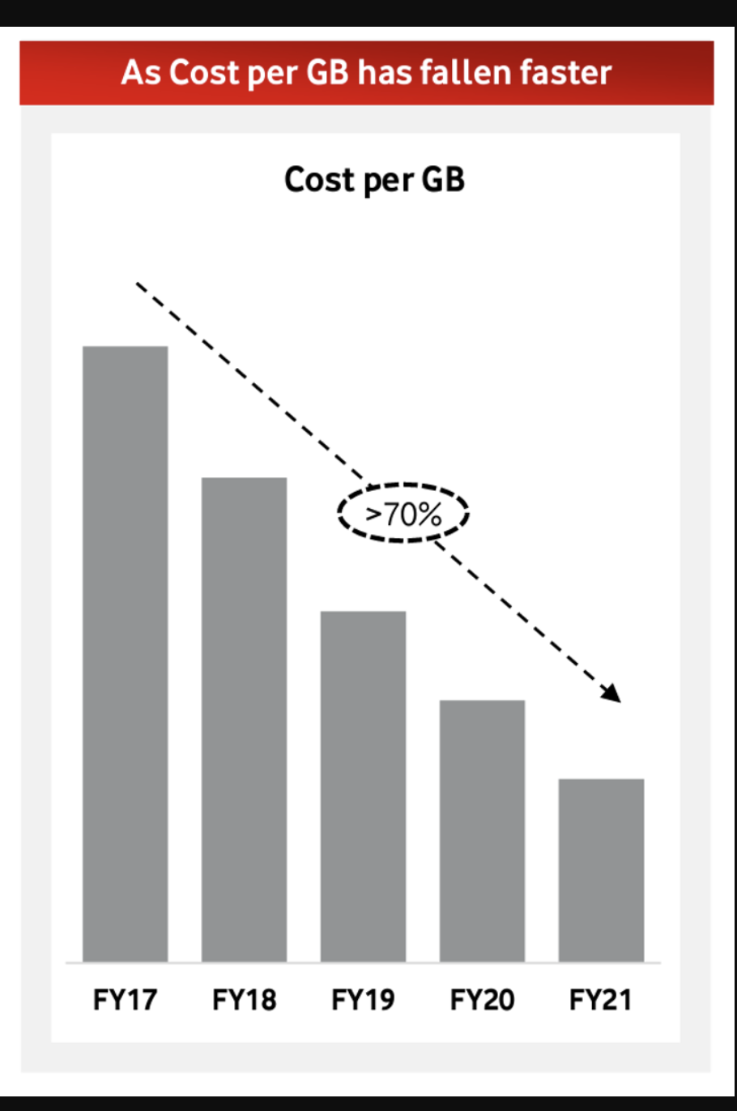
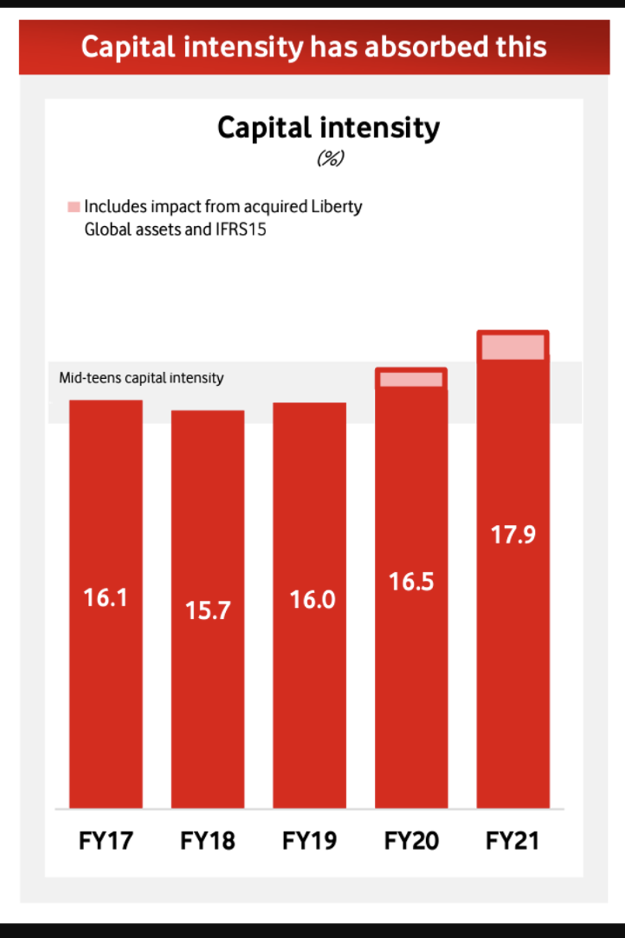
Change
Source: Vodaphone 2021 Investor Briefing

Slide 10
Change
Refreshing edge network technologies allows for significant capacity increases
  3G -> 4G -> 5G mobile access
  DSL -> VDSL -> Fibre in wired access
Failure to reinvest in edge access places the operator in a disadvantaged competitive position

Slide 11
Conclusion
The carriers’ case that increases in carried traffic volumes should be funded by content streamers is based on a desire by the carriage sector to cling to outdated technology and financial models for carriage that are well and truly over their Use By dates!

Slide 12
Regulatory Responses?
Regulate the interconnection regime?
  Poor outcomes that distort the interconnection market whern regulators have attempted this
Regulate inter-provider pricing?
  Allows the less efficient operators to be cross-subsidised by more efficient operators
  Inhibits technology refresh in carriage networks

Slide 13
How to deal with termination monopolies?
Neutralise the capital investment infrastructure as a competitive level and facilitate competition at the retail level
  Australian NBN-style of common access network, or New Zealand’s Crown Infrastructure Partners program
  Allow seamless consumer switching between retail providers
  Encourage MVNO operators in the mobile space

Slide 14
What are we learning?
“Sender Pays” in Internet access networks does not improve the efficiency of the carriage infrastructure, nor does it benefit consumers
Carriage is no longer an inescapable monopoly - massively replicated content can be used as a substitute for many public carriage service elements
Structural cross-subsidies and poor regulatory responses weaken the longer-term incentives for efficient infrastructure investment

Slide 15
Thanks!

