Slide 1
The Evolution of Carriage and Content
Geoff Huston AM
Chief Scientist, APNIC

Slide 2
Conversations change
When we talked about the Internet:
We used to talk about Tier 1 transit providers, peering, settlements, and customer cones
Then we talked about Exchange Points, Data Centres and content peering
Now we are talking about autonomous content distribution networks and embedding content in access networks
Why is this such a rapidly changing environment?

Slide 3
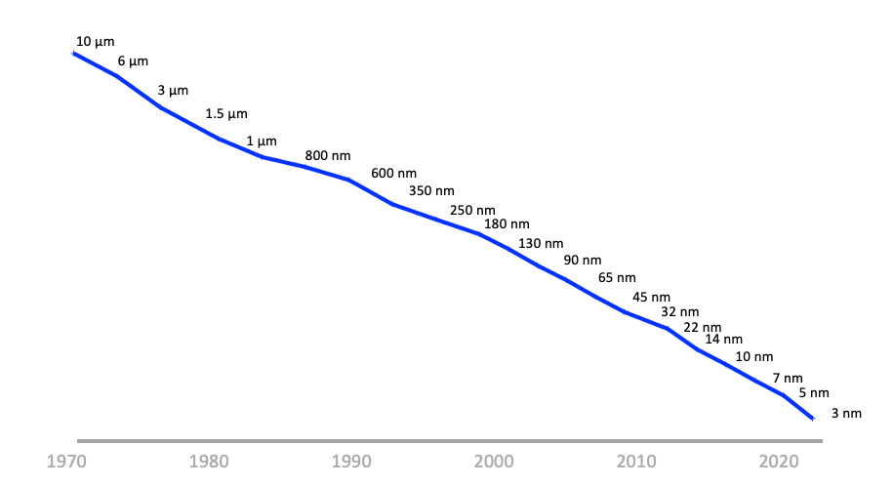
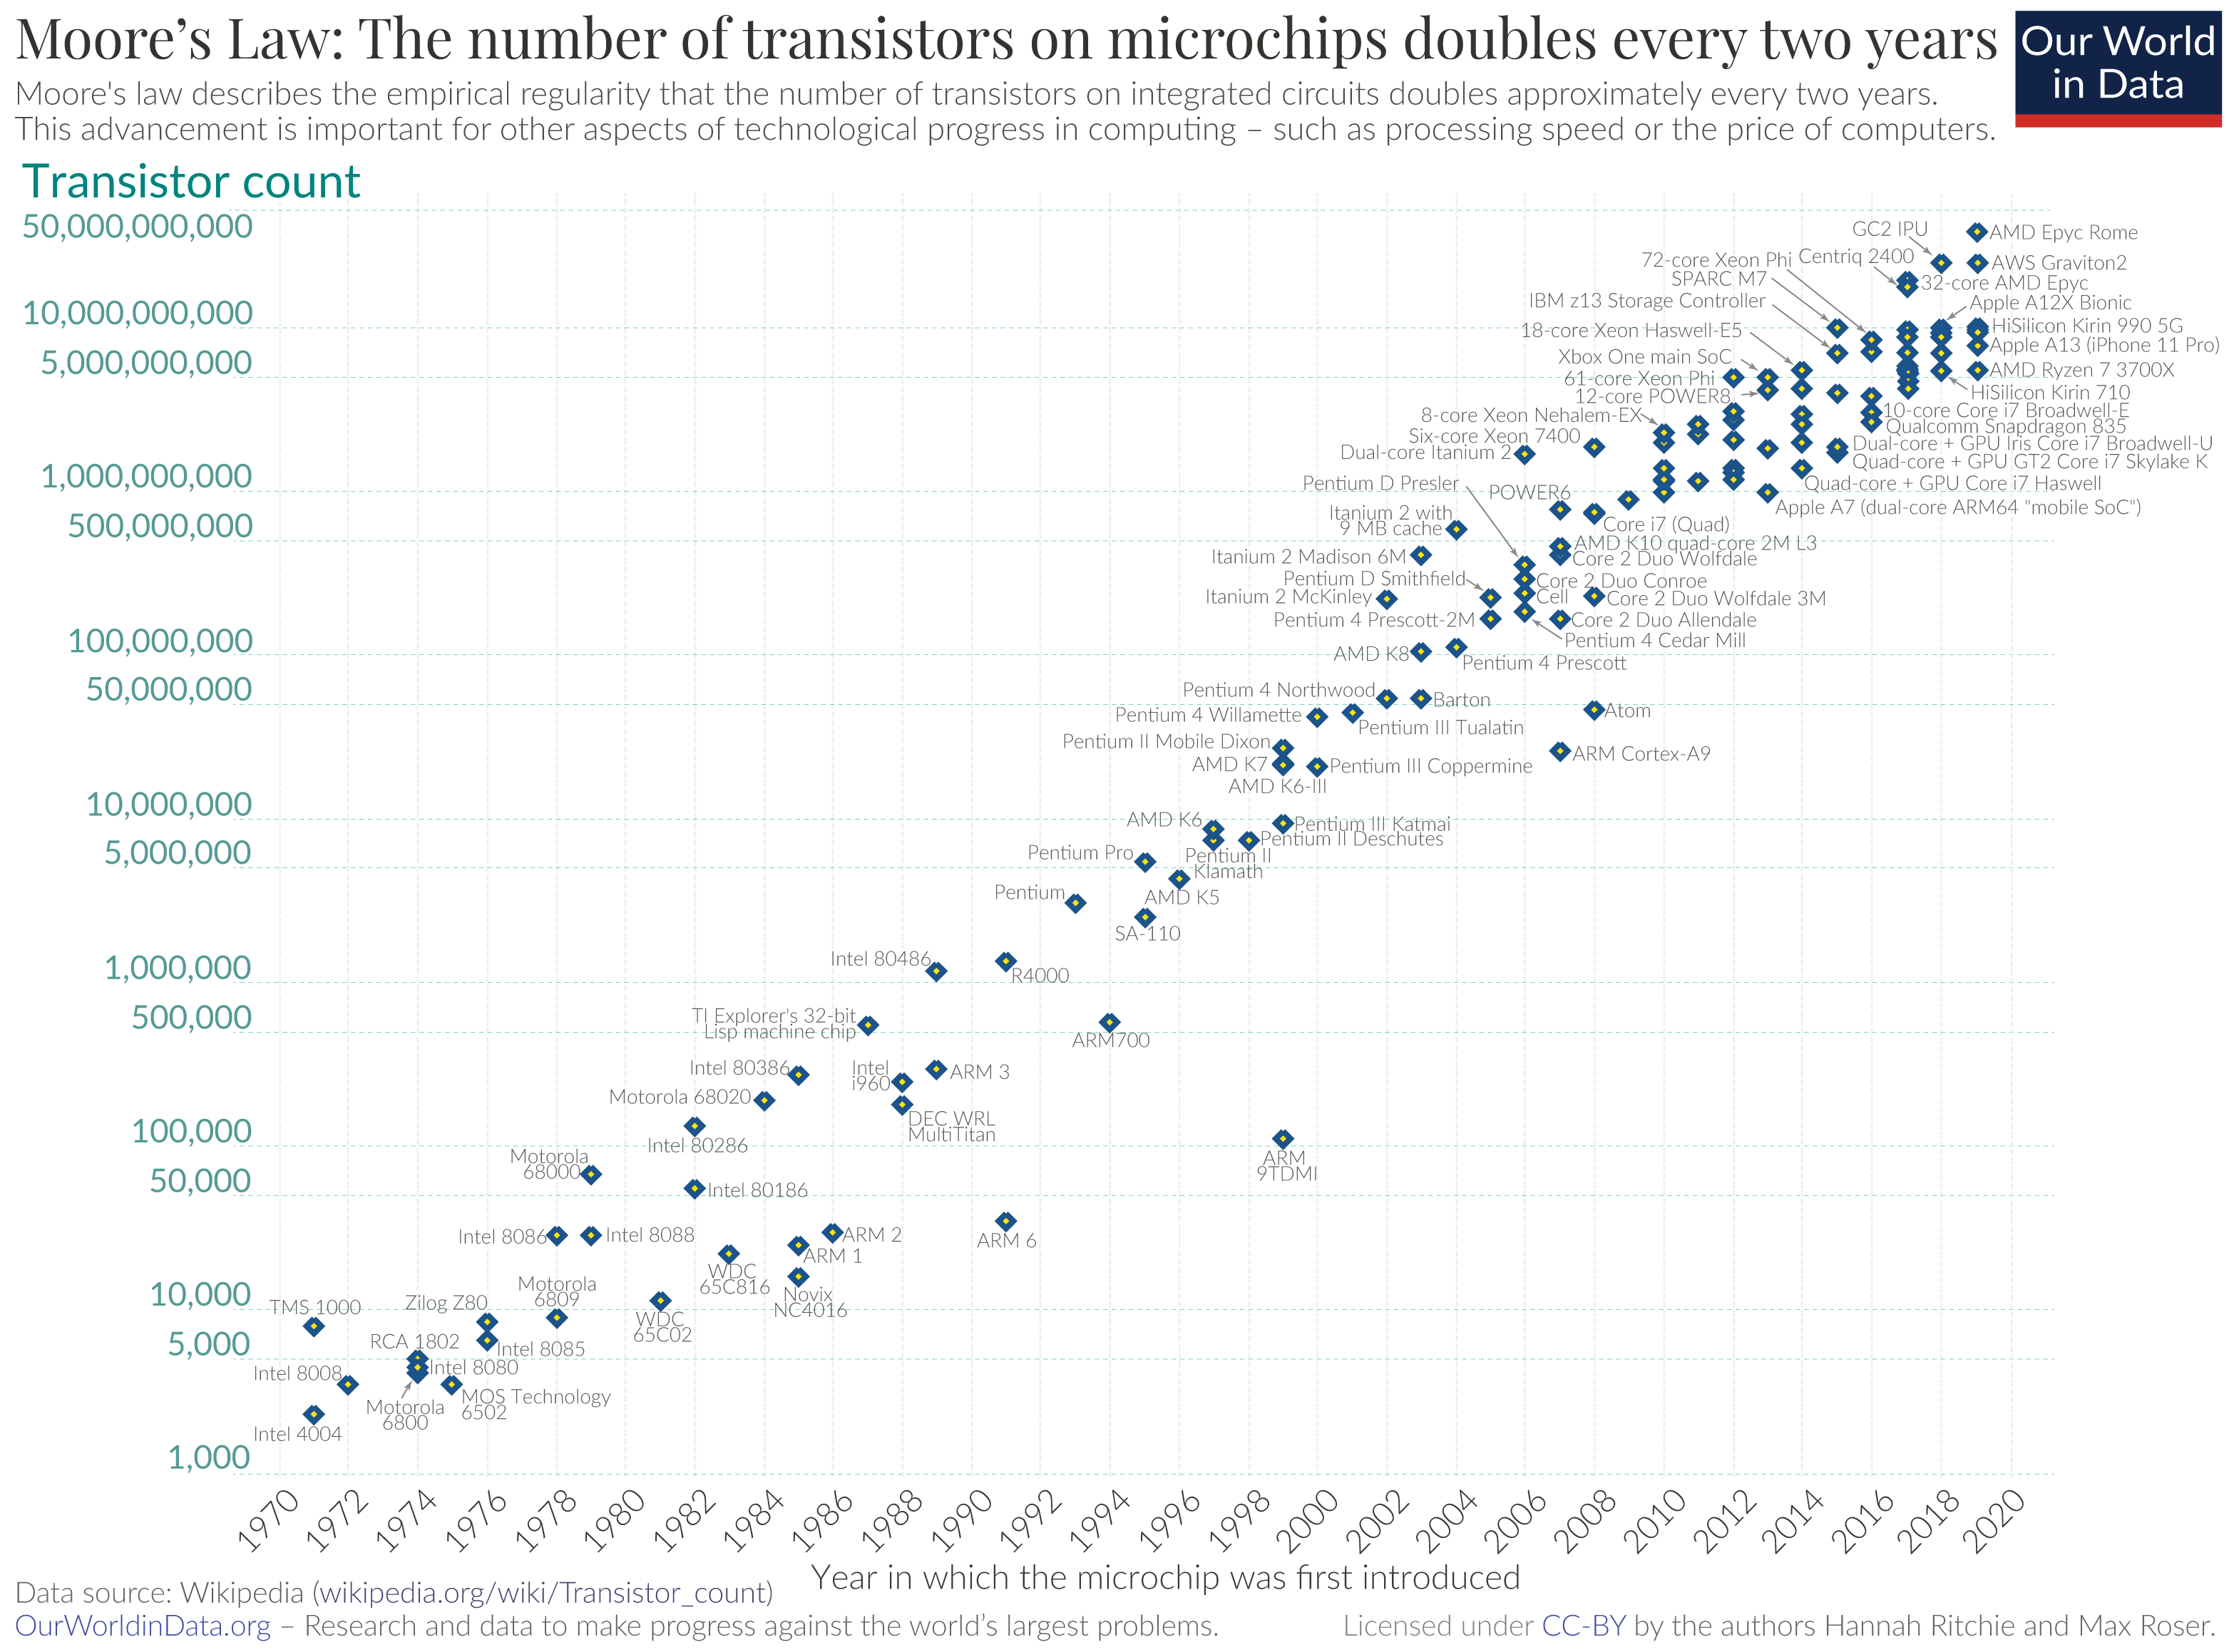
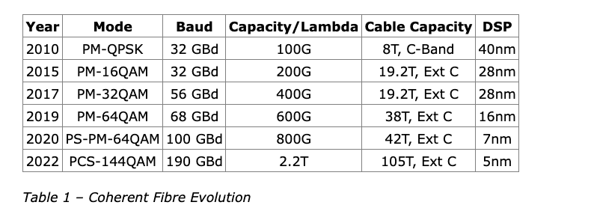
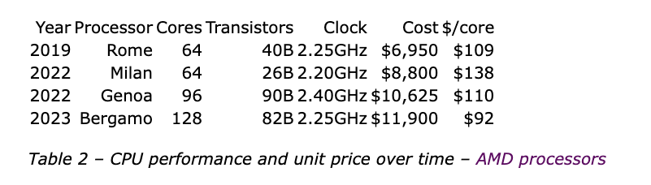
The Driver of Change: Moore’s Law
Silicon Chip Track Width
Silicon Chip Track Width over time
Silicon Chip transistor counts

Slide 4
What does this mean?
The economics of silicon chip evolution have a profound impact on the computing and communications space - no technology can survive more than 5 years in this sector!
No business plan can survive more than 5 years!
And given that the carriage sector is now a digital carriage platform, the carriage sector is no exception here

Slide 5
Change
Networks are no longer transit services that connect users to services
Content distributors are using abundance of computing, storage and capacity to bring content to users
We pre-provision content and service at the edge of access networks and no longer rely on networks to carry user’s traffic to remote service points.

Slide 6
Today’s Internet Architecture

Slide 7
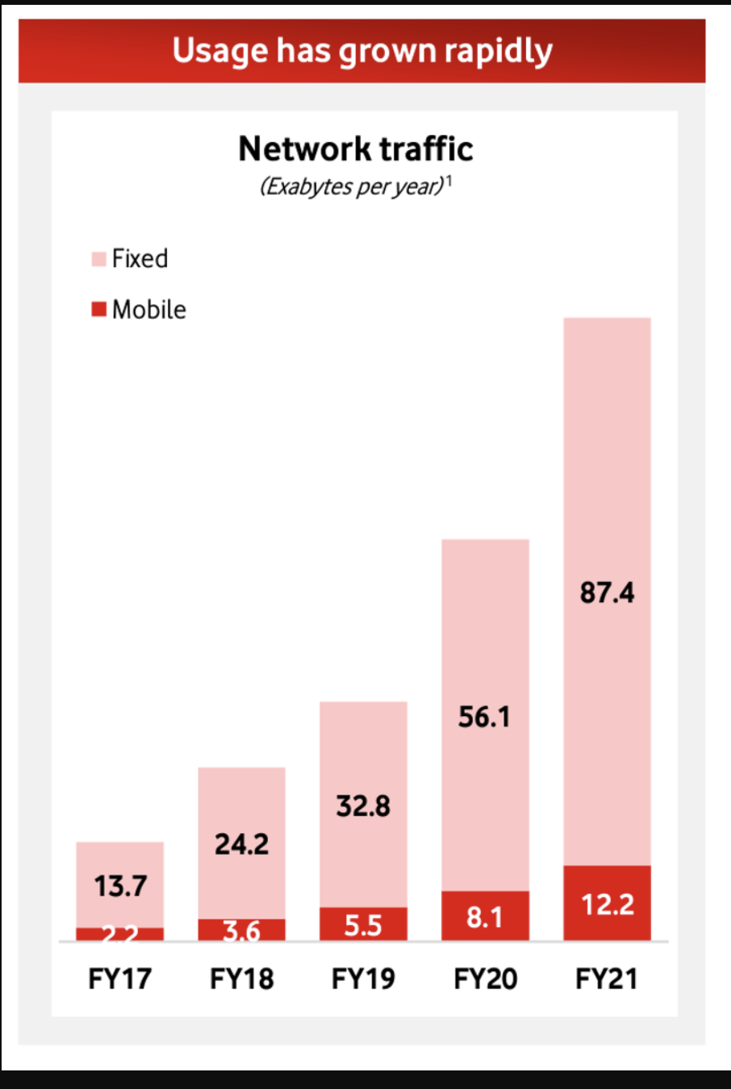
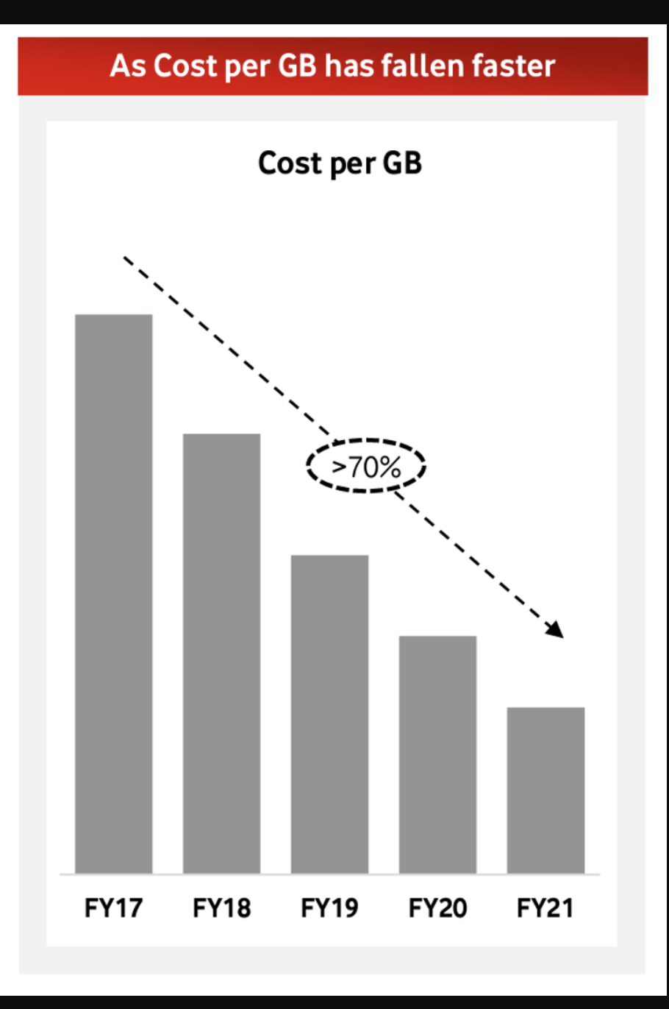
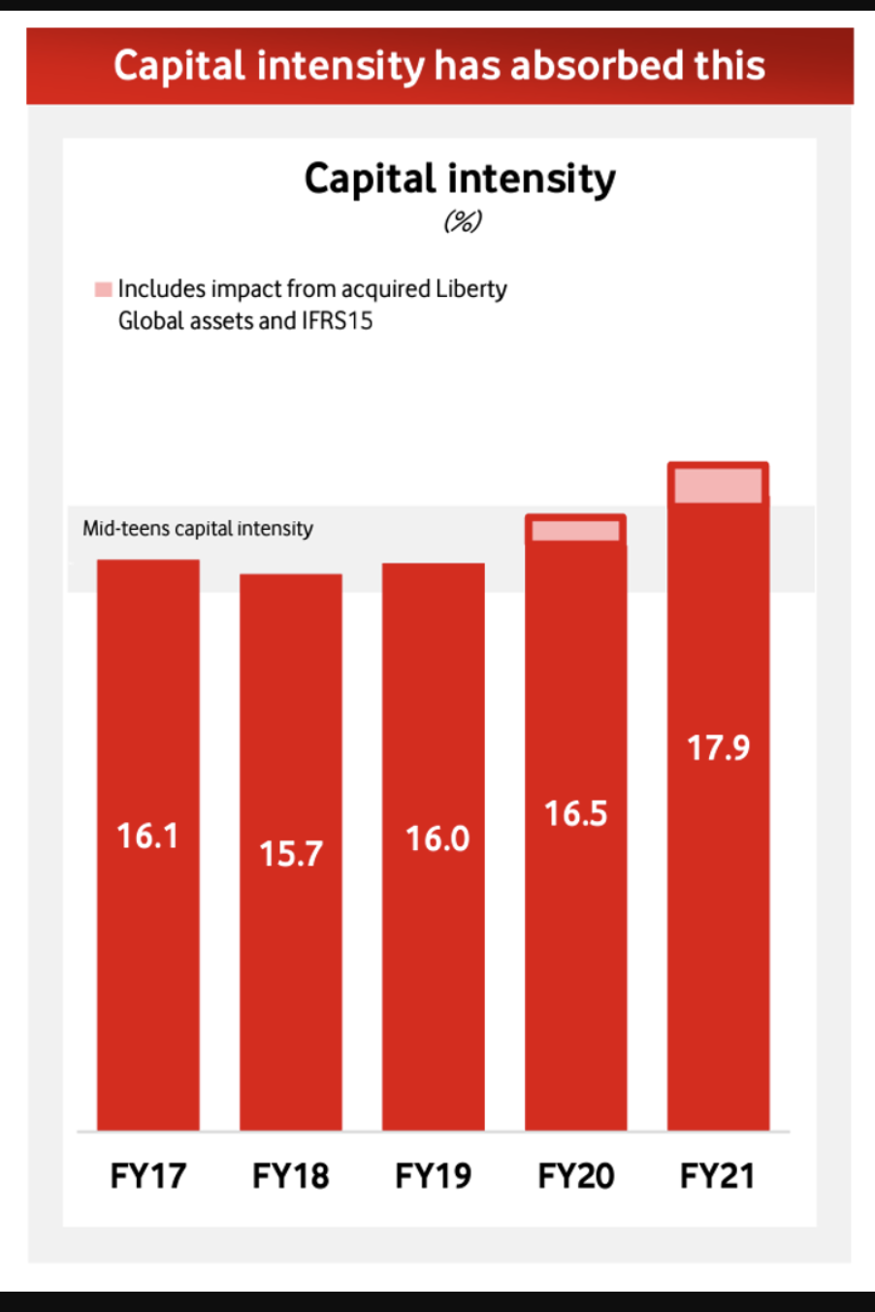
Change
Source: Vodaphone 2021 Investor Briefing

Slide 8
Transit?
Once the CDN caches sit “inside” the Edge NAT of the Access ISP then the entire wide area network becomes a marginal activity compared to the value of the content feeds!
There is no public transit any more
  Its just a collection of private distribution systems

Slide 9
Internet Names and Addresses?
If the Internet is just a collection of discrete CDN service ‘cones’ then why should we expect end users to pay for the maintenance of:
  A global address plan?
  A global name system?
  A single global network?

Slide 10
It’s not just the Death of Transit
It’s the re-purposing of the entire network
  Service provisioning sits within cloud providers and distributed data centres
  Edge computers are now acting as televisions into the clouded world of data
  The distinction between personal and public data realms is disappearing into the realm of corporately owned private data empires

Slide 11
Exactly where are we?
We started this journey in the 1970’s wanting to build a telephone network for computers to communicate with each other
We ended up building the digital counterpart to television networks
One-way content distribution lies at the core of today’s Internet volume and value
This content distribution role is an enterprise service framework rather than a public carriage service
The internal parts of the carriage network are now being privatized and removed from public regulatory scrutiny

Slide 12
Policy?
If CDN feeder networks are private networks, and there is little residual public carriage other than last mile access networks, then what do we really mean by “public communications policy”?
In the regulatory world ‘content’ is commerce, not carriage!

Slide 13
Policy?
In today’s Internet what do we mean in a policy sense by concepts such as:
“universal service obligation”
“network neutrality”
“rights of access” or even
“market dominance”
when we are talking about diverse CDNs as the dominant actors in the Internet?

Slide 14
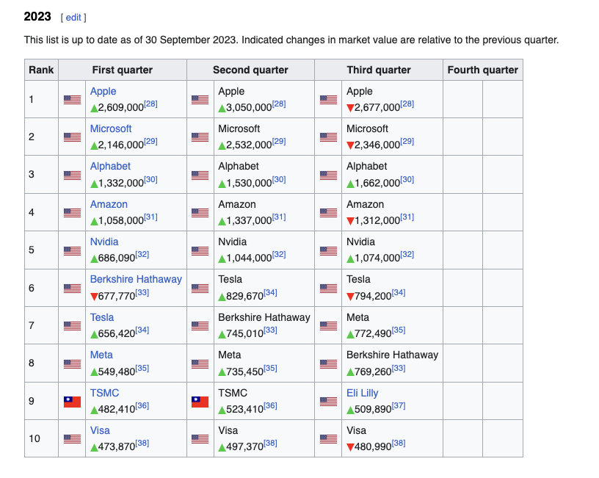
The Large and the Largest
https://en.wikipedia.org/wiki/List_of_public_corporations_by_market_capitalization

Slide 15
Content Really is King
None of these companies are a telephone company, or even a transit ISP, or even an ISP at all!
Eight of them have pushed aside intermediary distribution networks in order to maintain direct relationships with billions of consumers
These valuable consumer relationships are based on content services, not carriage

Slide 16
Content Consolidation
There are not thousands of content service platforms
  There are just a few left
And the space is dominated by a small number of dominant actors who set the rules of engagement for all others

Slide 17
Content Consolidation
“The size and scale of the attacks that can now easily be launched online make it such that if you don't have a network like Cloudflare in front of your content, and you upset anyone, you will be knocked offline.
…
In a not-so-distant future, if we're not there already, it may be that if you're going to put content on the Internet you'll need to use a company with a giant network like Cloudflare, Google, Microsoft, Facebook, Amazon, or Alibaba.
…
Without a clear framework as a guide for content regulation, a small number of companies will largely determine what can and cannot be online.
https://blog.cloudflare.com/why-we-terminated-daily-stormer/
August 2017

Slide 18
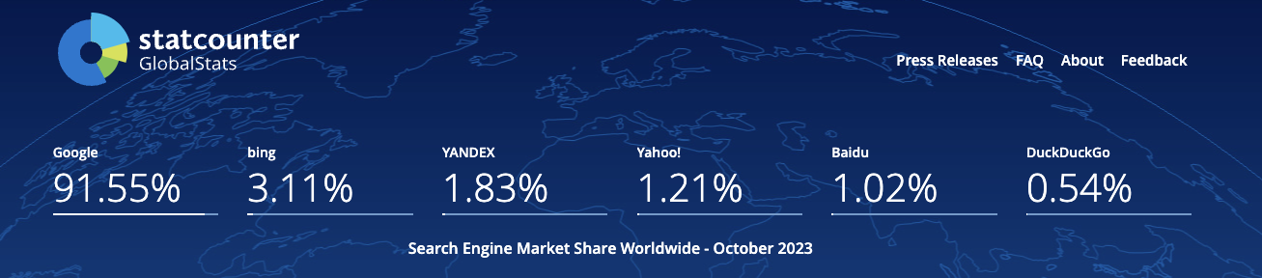
What is truth anyway?
When everyone uses just one search engine then that engine defines a de facto “truth” and all others have to match its results

Slide 19
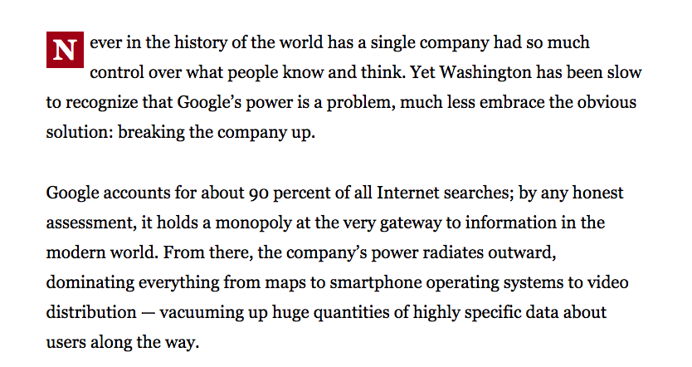
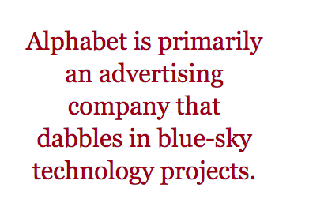
Consolidation?
Boston Globe , June 14 2018

Slide 20
Competition or Cartel?
With a small number of truly massive enterprises at the heart of the area of digital content and service is this still a space that is shaped by competitive pressures?
Or do these dominant incumbents get to set their own terms of engagement with each other, with users, and even with the public sector?

Slide 21
Competition or Cartel?
With a small number of truly massive enterprises at the heart of the area of digital content and service is this still a space that is shaped by competitive pressures?
Or do these dominant incumbents get to set their own terms of engagement with each other, with users, and even with the public sector?
As concerning as this might sound, it’s not a novel situation!

Slide 22
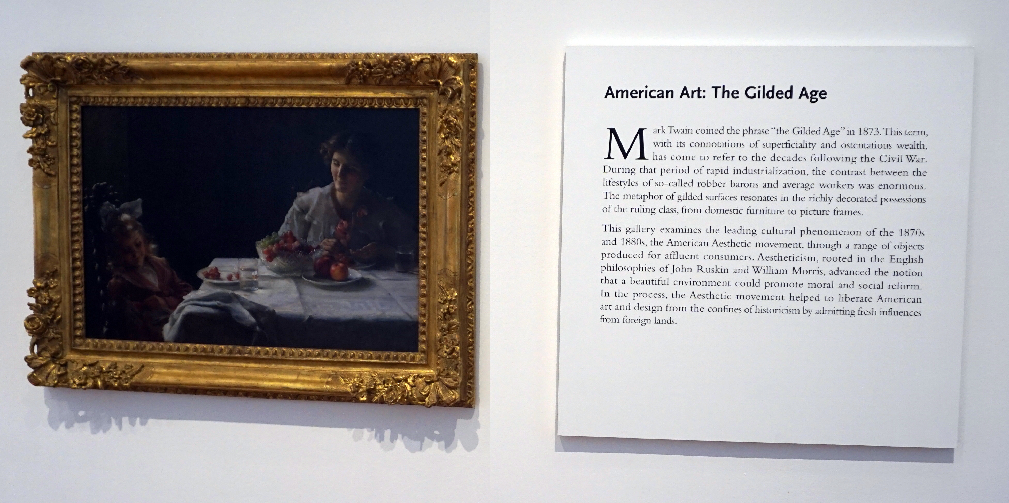
We’ve been here before…
High Museum of Art, Atlanta

Slide 23
The Gilded Age
A term applied to America in the 1870 – 1890’s about the building of industrial and commercial corporate giants on platforms that were a mix of industrial innovation and enterprise with elements of greed, corruption and labor exploitation
Andrew Carnegie - US Steel
John Rockfeller - Standard Oil
Theodore Vail - AT&T
George Westinghouse – Rail Brakes
Thomas Edison – General Electric
J P Morgan - Banking

Slide 24
The Gilded Age
During this period in the United States the dominant position within industry and commerce was occupied by a very small number of players who were moving far faster than the regulatory measures of the day.
The resulting monopolies took the US decades to dismember, and even today many of these gilded age companies remain dominant in their field

Slide 25
The Internet’s Gilded Age
At some point in the past decade or so the dominant position across the entire Internet has been occupied by a very small number of players who are moving far faster than the regulatory measures that were intended to curb the worst excesses of market dominance by a small clique of actors.

Slide 26
The Internet’s Gilded Age
These actors have enough market influence to set their own rules of engagement with:
  Users,
  Each other,
  Third party suppliers,
  Regulators and Governments
By taking a leading position with these emergent technologies, these players are able to amass vast fortunes, with little in the way of accountability to a broader common public good

Slide 27
The Internet’s Gilded Age
These actors have enough market influence to set their own rules of engagement with:
  Users,
  Each other,
  Third party suppliers,
  Regulators and Governments
By taking a leading position with these emergent technologies, these players are able to amass vast fortunes, with little in the way of accountability to a broader common public good
Is this the Internet we were dreaming of?

Slide 28

The Internet’s Future
Gittes: How much are you worth?
Cross: I've no idea. How much do you want?
Gittes: I just want to know what you're worth. Over
ten million?
Cross: Oh my, yes!
Gittes: Why are you doing it? How much better can
you eat? What can you buy that you can’t
already afford?
Cross: The future, Mr. Gittes - the future!
Chinatown (1974)

Slide 29
What is this all about?
This is no longer just a conversation about incremental changes in carriage and communications within the Internet.
For me, the essential topic of this conversation is how we can strike a sustainable balance between an energetic cartel that has rapidly amassed overarching control of the digital service and content space, and the needs of the larger society in which we all would like some equity of opportunity to thrive and benefit from the outcomes of this new digital age.

Slide 31
Thanks!

