Slide 1
BGP in 2023
Geoff Huston

Slide 2
A super-brief summary of BGP!
BGP is the distributed routing protocol that manages the reachability of address prefixes across the Internet
  Its objective is to distribute to all BGP speakers a current list of reachable address prefixes and the local next-hop interface to use to forward packets to each address prefix
This is an instance of a Bellman-Ford Distance Vector routing protocol
  BGP uses a “Path Vector” to prevent loop formation and aid in the comparison of routes

Slide 3
For example:…
bgpd# show ip bgp
BGP table version is 0, local router ID is 203.133.248.2
Status codes: s suppressed, d damped, h history, * valid, > best, = multipath,
i internal, r RIB-failure, S Stale, R Removed
Origin codes: i - IGP, e - EGP, ? - incomplete
Network Next Hop Metric LocPrf Weight Path
* 1.0.0.0/24 202.12.28.1 0 4777 13335 i
* 203.119.104.2 0 4608 13335 i
*> 203.119.104.1 0 4608 13335 i
* 1.0.4.0/22 202.12.28.1 0 4777 2500 7660 4635 7545 2764 38803 i
* 203.119.104.2 0 4608 1221 2764 38803 i
*> 203.119.104.1 0 4608 1221 2764 38803 i
* 1.0.5.0/24 202.12.28.1 0 4777 2500 7660 4635 7545 2764 38803 i
*> 203.119.104.2 0 4608 1221 2764 38803 i
* 203.119.104.1 0 4608 1221 2764 38803 i
* 1.0.16.0/24 202.12.28.1 0 4777 2516 3356 2519 i
* 203.119.104.2 0 4608 1221 3356 2519 i
*> 203.119.104.1 0 4608 1221 3356 2519 i

Slide 4
Why look at BGP Tables?
BGP is one of the few tools that lets us see all of the Internet at once.
The functional objective of BGP is to flood reachability information for all reachable address prefixes to all BGP speakers
Which means that looking at BGP tables can be related to looking at the entire Internet!

Slide 5
The Highlights
IPv4 Summary
IPv6 Summary
FIB Projections
Churn
Directions

Slide 6
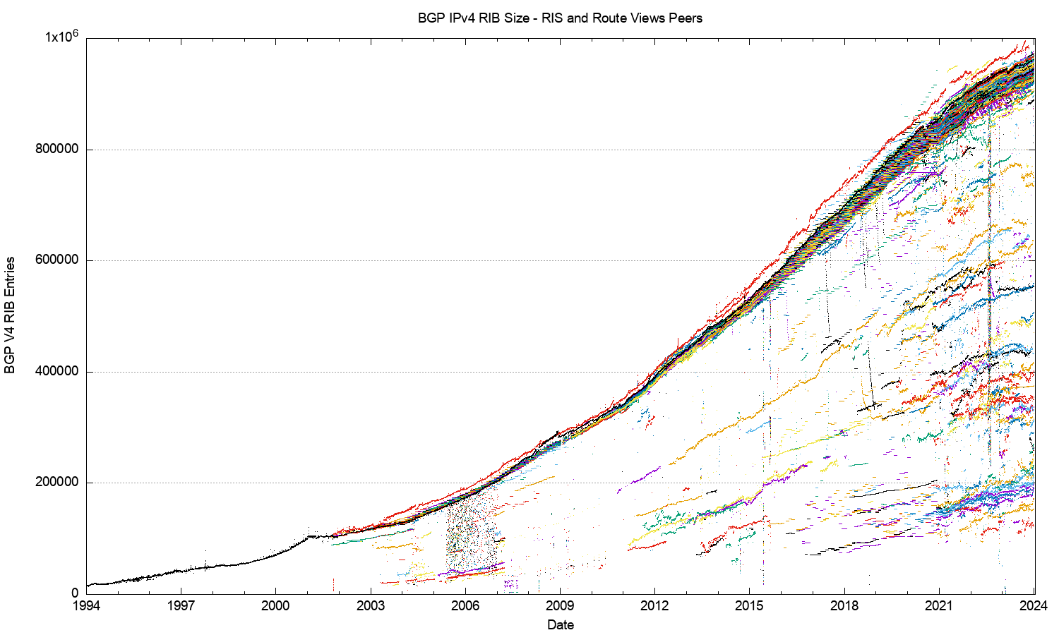
30 Years of Routing the IPv4 Internet
This is a view pulled together from each of the routing peers of Route-Views and RIPE RIS
2011: Onset of Address Exhaustion
2005: Consumer Market
2001: The Great Internet
Boom and Bust
1994: Introduction of CIDR

Slide 7
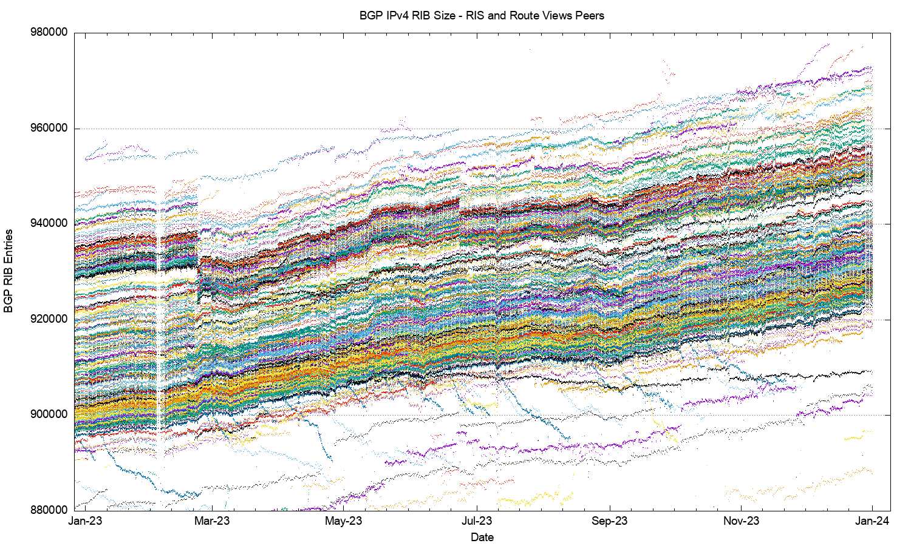
IPv4 in 2023

Slide 8
IPv4 in 2023
Large Withdrawal
60K entry variation
22 Feb
TTNET – Turkey
AS9121 -5,279 prefixes
AS47331 -2,427 prefixes

Slide 9
Aside: What happened to TTNET?
These are all withdrawals of more specific prefixes

Slide 10
AS Prefix Count over 2023
Dropped Prefixes
Added Prefixes

Slide 11
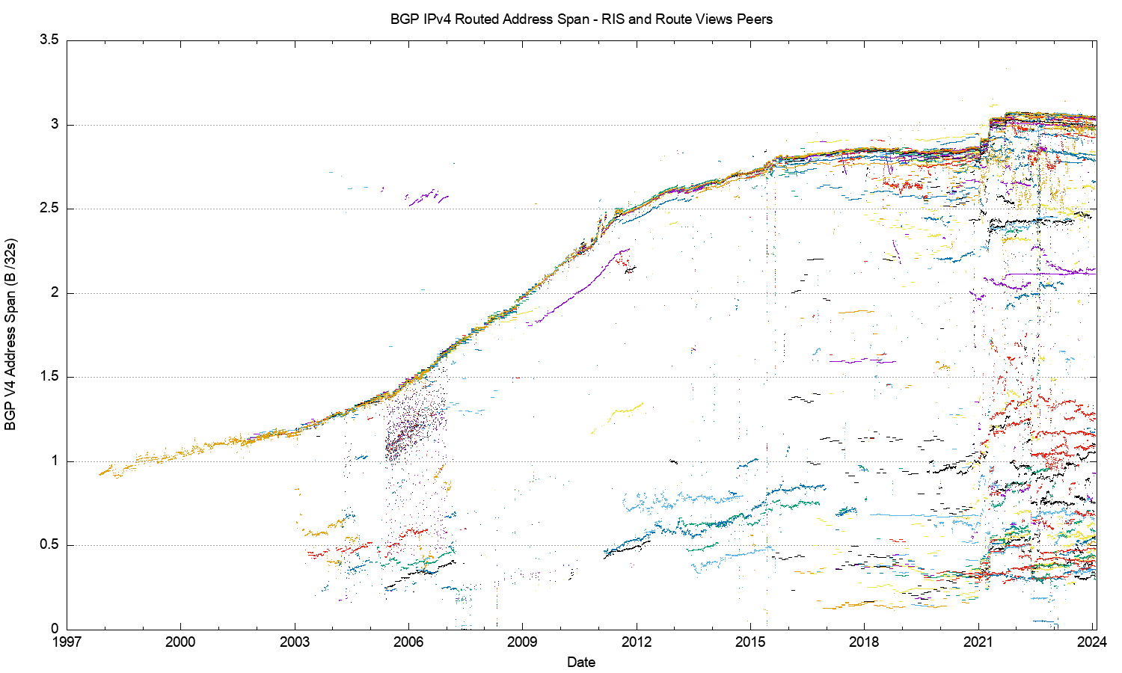
30 Years of IPv4 Advertised Address Span
2021: Advertised DoD blocks
This is a view pulled together from each of the routing peers of Route-Views and RIPE RIS
2011: Onset of Address Exhaustion
2005: Consumer Market
2001: The Great Internet
Boom and Bust

Slide 12
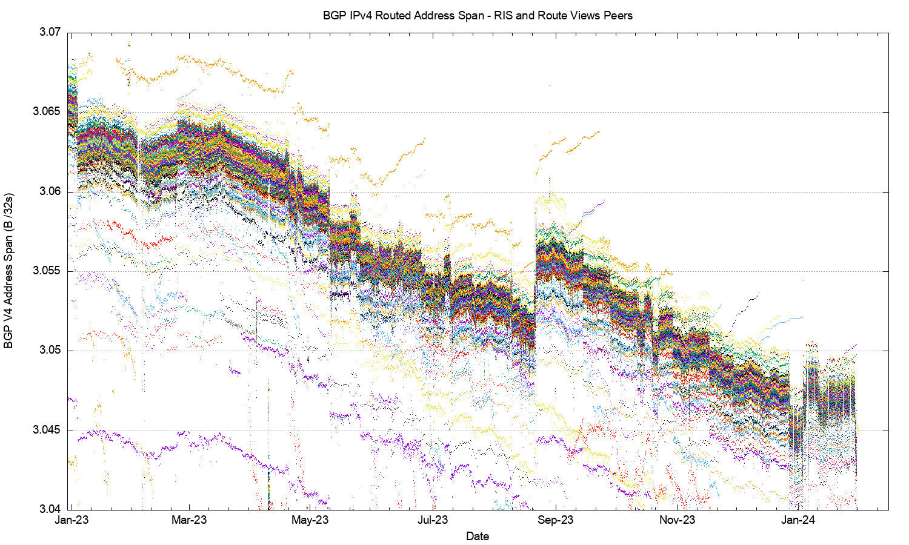
2023 in Detail
Amazon O2 – 22 Aug

Slide 13
2023: Assigned vs Recovered Addresses
Change in UnAdvertised Addresses
640M unadvertised
+18M delta
RIR Allocations
3.6B allocated
-0.02M delta
Change in the Advertised Address Pool
3.0B advertised
-18M delta

Slide 14
2023: Assigned vs Recovered Addresses
Change in UnAdvertised Addresses
No net “address recovery” occurred across 2023 in IPv4
A total of 18M addresses were withdrawn from the advertised network, and shifted to the unadvertised pool
The net change in the unadvertised pool was an increase of 18M addresses
640M unadvertised
+18M delta
RIR Allocations
3.7B allocated
+0,5M delta
Change in the Advertised Address Pool
3.0 advertised
-18M delta

Slide 15
2018-2023: 6 Year Assigned vs Recovered Addresses
DoD block Advertisments
Advertised IPv4 span
starts to decline
Residual RIR Address pools are exhausted

Slide 16
Advertised Span per Origin AS over 2023
Reduced Advertised Address Span
Increased Advertised Address Span

Slide 17
What happened in 2023 in V4?
  From the look of the routing growth plots, the growth of the size of the IPv4 network is slowing down
  The number of entries in the IPv4 default-free zone reached 920K – 960K by the end of 2023
  The pace of growth of the routing table was slightly lower than the rolling 5-year average, with 20,000 new entries in 2023 (was 36,000 in 2022)
  The AS position was slightly lower with 1,100 new AS’s advertised in 2023 (was 1,400 in 2021)
  Transit relationships have not changed materially over 2022 for most networks
  The address range spanned by the advertised route set declined in 2023 by the equivalent of 1 /8
  The overall IPv4 routing growth trends slowed down or even reversed through 2023

Slide 18
What happened in 2023 in V4?
  From the look of the routing growth plots, the growth of the size of the IPv4 network is slowing down
  The number of entries in the IPv4 default-free zone reached 920K – 960K by the end of 2023
  The pace of growth of the routing table was slightly lower than the rolling 5-year average, with 20,000 new entries in 2023 (was 36,000 in 2021)
  The AS position was slightly lower with 1,100 new AS’s advertised in 2023 (was 1,400 in 2021)
  Transit relationships have not changed materially over 2022 for most networks
  The address range spanned by the advertised route set declined in 2023 by the equivalent of 1 /8
  The overall IPv4 routing growth trends slowed down or even reversed through 2023
Have we reached Peak IPv4?

Slide 19
The Highlights
IPv4 Summary
IPv6 Summary
FIB Projections
Churn
Directions

Slide 20
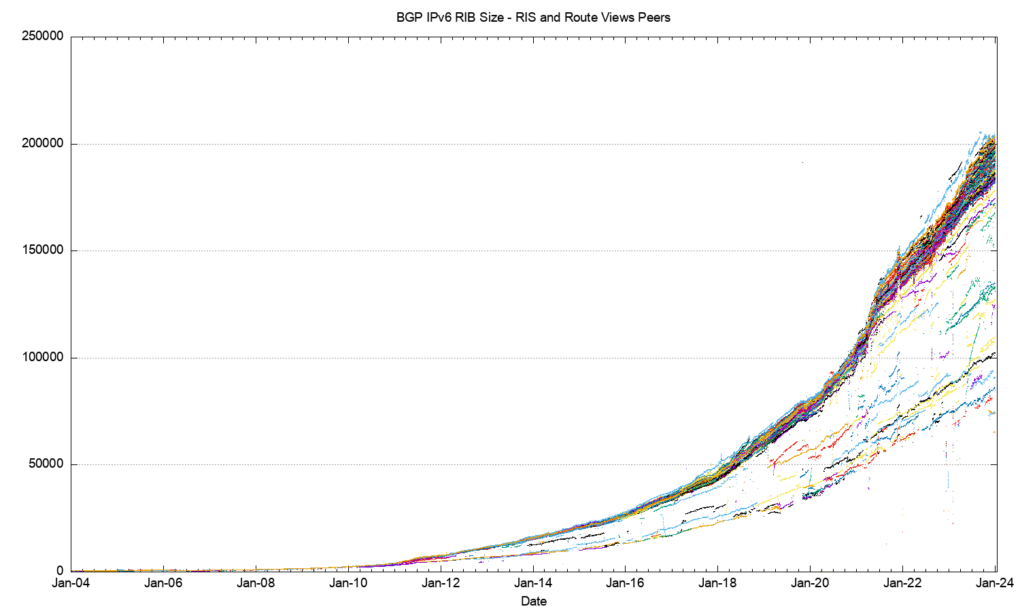
The 20-Year View of IPv6
IANA IPv4 Exhaustion

Slide 21
2023 IPv6 FIB in Detail

Slide 22
2023 IPv6 FIB in Detail
AS60539 + 2,049 prefixes – HUICAST_TELECOM, HK
AS18403 + 3,292 prefixes – FPT, VN

Slide 23
More Specifics in IPv6
IPv6
IPv4
45% of all IPv6 prefixes are /48’s

Slide 24
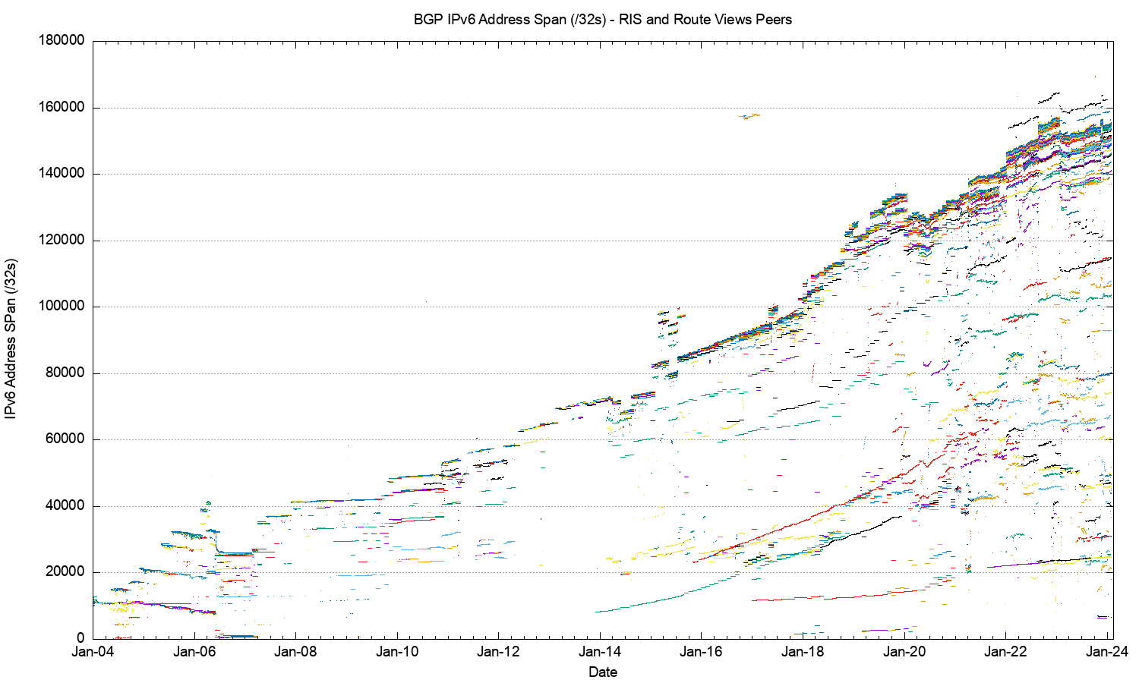
20-Year IPv6 Advertised Address Span

Slide 25
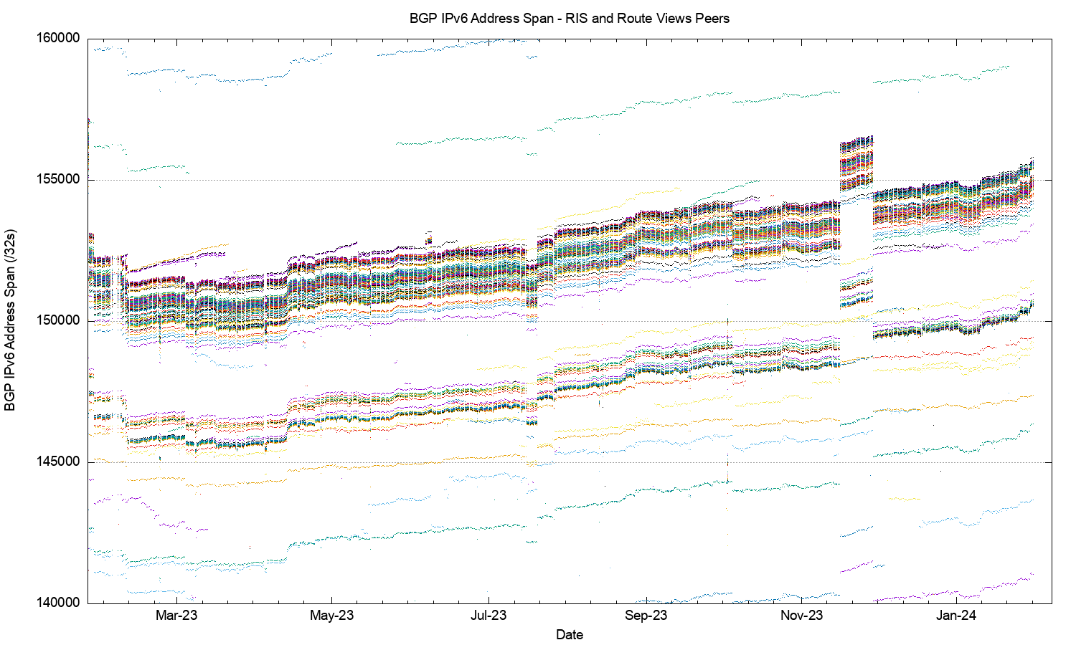
IPv6 Advertised Address Span in 2023

Slide 26
V6 in 2023
Overall IPv6 Internet growth in terms of BGP is still increasing, and is currently at some 30,000 route entries p.a. (17%)
  Predominate use of /48 more specifics
  2,000 more AS’s advertising IPv6 prefixes
  Growth of 2,500 /32 equivalents in the advertised address span ( 1.6%)
  Growth rates across 2023 are lower than 2018 – 2020 annual rates

Slide 27
The Highlights
IPv4 Summary
IPv6 Summary
FIB Projections
Churn
Directions

Slide 28
V4 BGP Table Size Predictions
Date RIB Size Prediction
Jan 2019 760,000
2020 814,000
2021 856,000
2022 906,000
2023 942,000
2024 944,0000 949,000
2025 958,000
2026 958,000
2027 947,000
2028 928,000
2029 898,000

Slide 29
V4 BGP Table Size Predictions
Date RIB Size Prediction
Jan 2019 760,000
2020 814,000
2021 856,000
2022 906,000
2023 942,000
2024 944,0000 949,000
2025 958,000
2026 958,000
2027 947,000
2028 928,000
2029 898,000
The best fit projection model to the past 4 years of FIB data is a polynomial function that peaks in 2024 at just under 1M entries

Slide 30
V6 BGP Table Size Predictions
Linear Exponential
Jan 2019 62,000
2020 79,000
2021 106,000
2022 147,000
2023 172,000
2024 201,000 198,000 227,000
2025 226,000 293,000
2026 254,000 380,000
2027 282,000 491,000
2028 310,000 635,000
2029 337,000 822,000
Note that the IPv6 tables are 128bits wide – i.e. 4x the size of the IPv4 tables!

Slide 31
V6 BGP Table Size Predictions
Linear Exponential
Jan 2019 62,000
2020 79,000
2021 106,000
2022 147,000
2023 172,000
2024 201,000 198,000 227,000
2025 226,000 293,000
2026 254,000 380,000
2027 282,000 491,000
2028 310,000 635,000
2029 337,000 822,000
The growth model for IPv6 is highly uncertain today – It looks like a linear growth model matches the most recent 24 months of data
The underlying network growth is lower, and over half of the growth in this model is due to the continued intensive use of /48 more specifics
Note that the IPv6 tables are 128bits wide – i.e. 4x the size of the IPv4 tables!

Slide 32
BGP Table Growth
The absolute size of the IPv6 routing table is growing much faster than the IPv4 table
  These two tables will require the same storage/lookup size in around 1 year from now, given that each IPv6 entry is 4 times the bit size of an IPv4 entry
The good news …
  As long as we are prepared to live within the technical constraints of the current routing paradigm, the Internet’s use of BGP will continue to be viable for some time yet

Slide 33
The Highlights
IPv4 FIB Summary
IPv6 FIB Summary
FIB Projections
Churn
Directrions

Slide 34
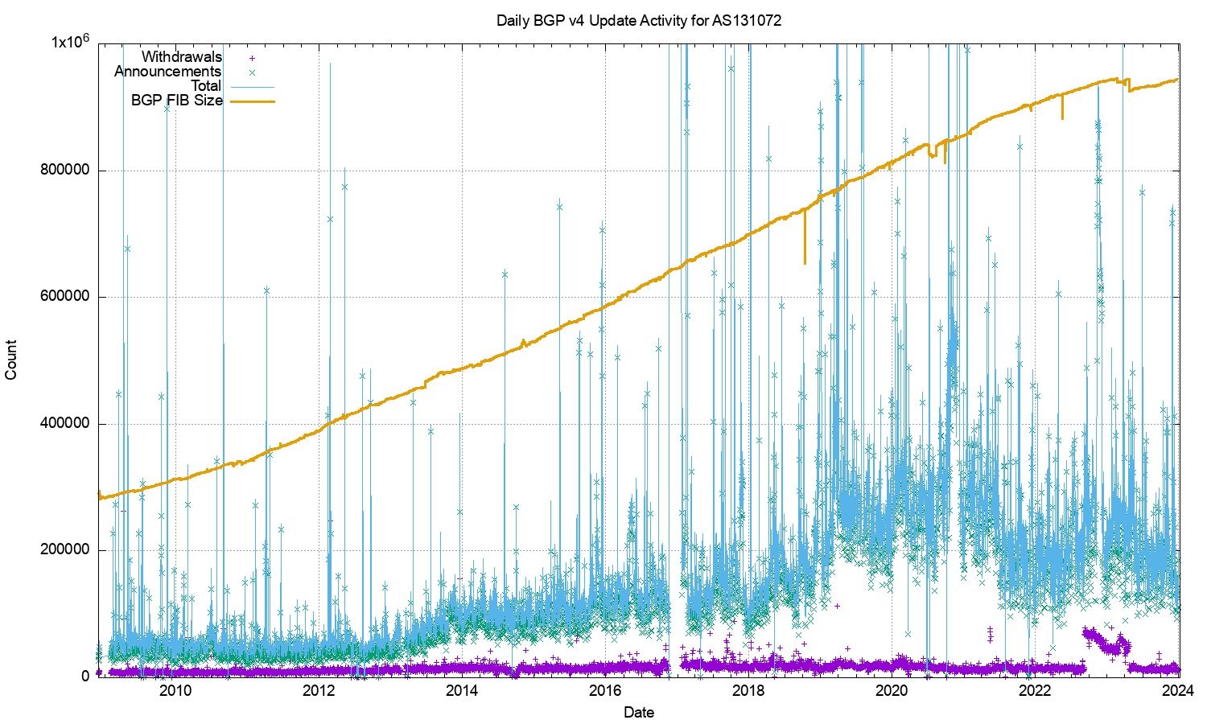
IPv4 BGP Updates – Daily Updates

Slide 35
IPv4 BGP Updates – Daily Updates
The IPv4 network is surprisingly stable
The number of withdrawals per day has been relatively steady for some 15 years (aside from some increases in 2022/3)
The number of updates per day has been declining through 2023

Slide 36
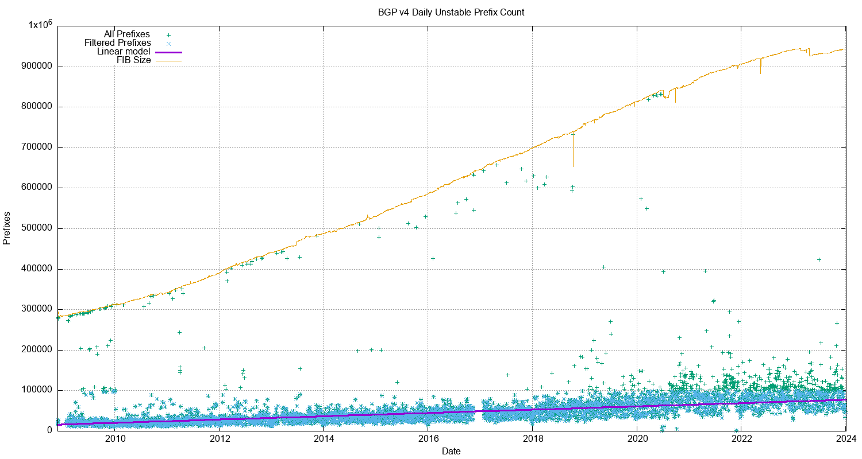
IPv4 Unstable Prefixes per Day

Slide 37
IPv4 Unstable Prefixes per Day
The number of prefixes that are the subject of updates has been slowly increasing over this 15-year period
The rate of increase of unstable prefixes is far lower than the number of advertised prefixes

Slide 38
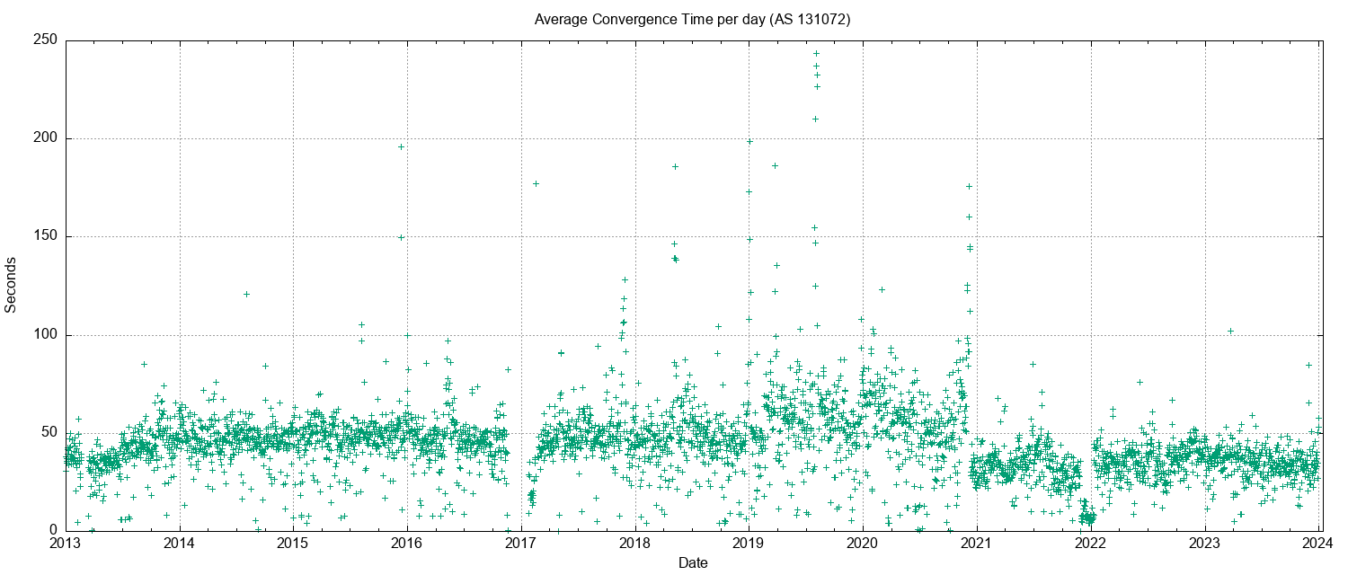
IPv4 BGP Convergence Performance

Slide 39
IPv4 BGP Convergence Performance
Convergence performance has been steady for 15 years, despite the massive growth in the network
The network topology continues to increase in density, keeping critical AS Paths short as the network itself increases in size

Slide 40
Updates in IPv4 BGP
The IPv4 inter-domain routing system is still highly stable
The number of updates per instability event and the time to converge to a stable forwarding state has been relatively constant for many years - it rose in 2019 - 2020 and has declined again in 2021, and stabilized in 2022
20% of prefixes generate 80% of all updates. Less than 5% of all origin networks are linked to 80% of all updates. Routing instability is concentrated in a small number of highly unstable cases.

Slide 41
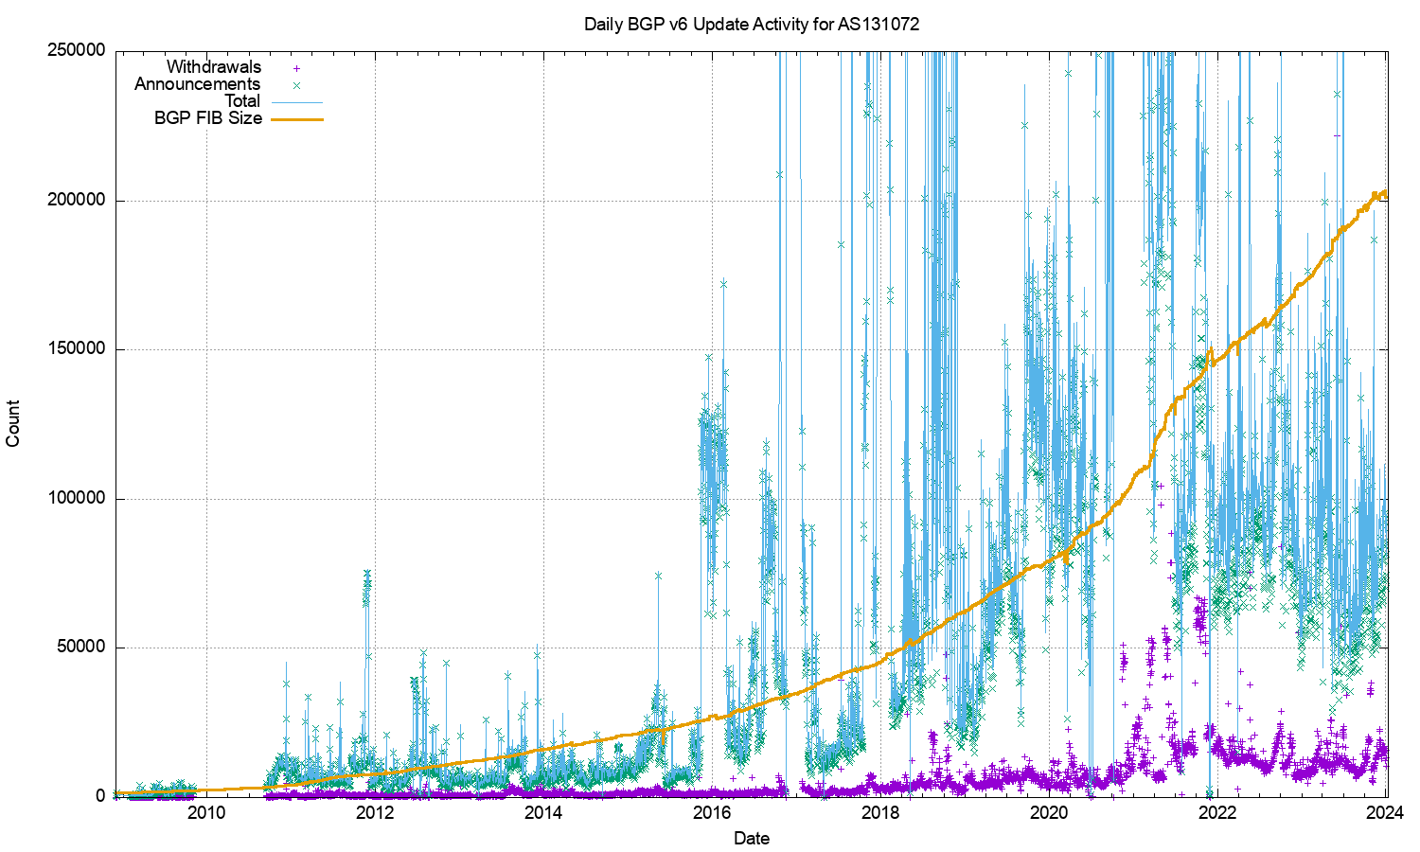
V6 BGP Updates

Slide 42
V6 BGP Updates
The growth trajectory of IPv6 has slackened off, and the daily total of updates and withdrawals has been steady across 2023

Slide 43
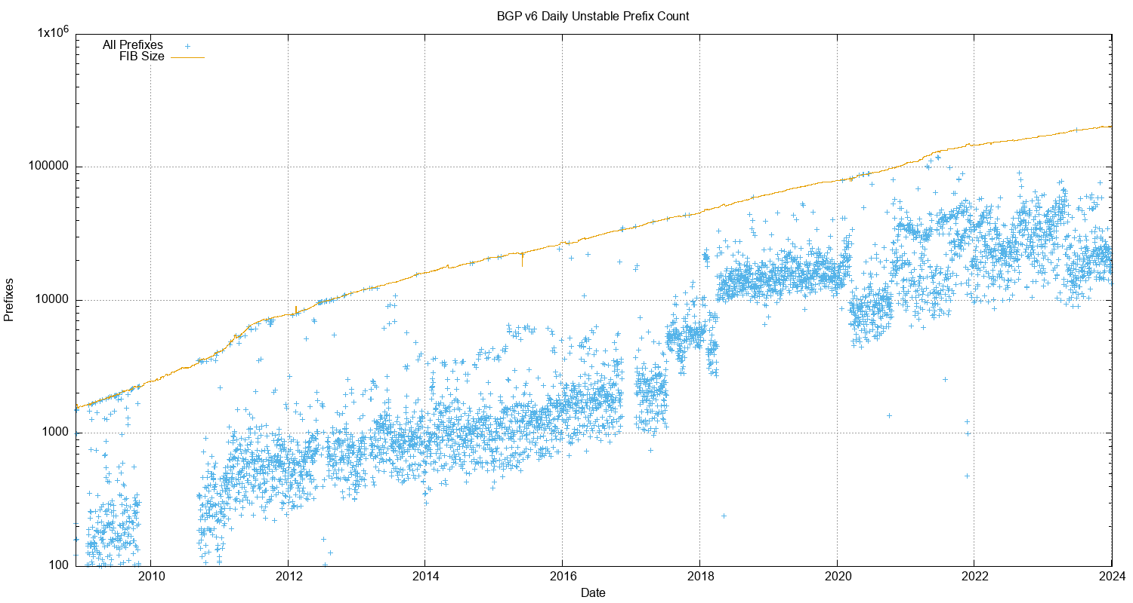
V6 Unstable Prefixes
LOG Scale!

Slide 44
V6 Unstable Prefixes
The number of unstable address prefixes stabilised across 2023
Proportionally, IPv6 prefixes are ~2x more likely to be updated as compared to the IPv4 BGP network
LOG Scale!

Slide 45
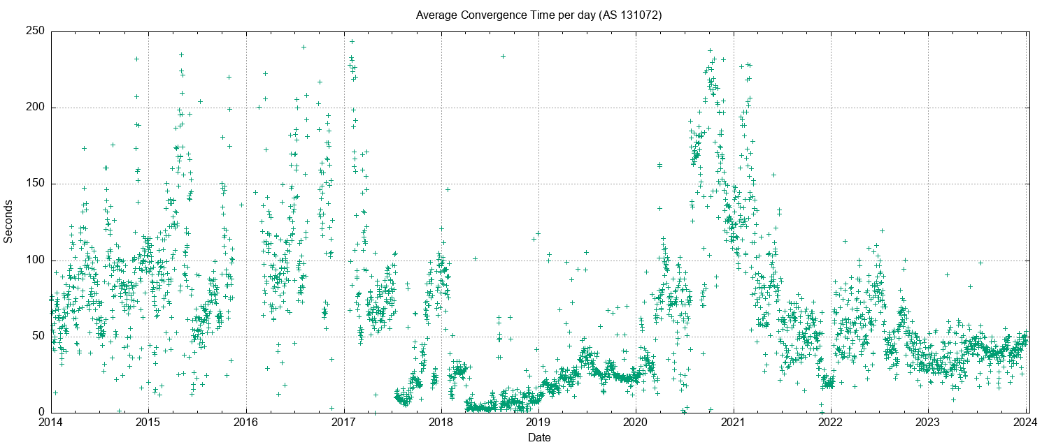
V6 Convergence Performance

Slide 46
V6 Convergence Performance
Time to converge has been very unstable for years in IPv6
This is now stabilising to a level that is on a par with the IPv4 network

Slide 47
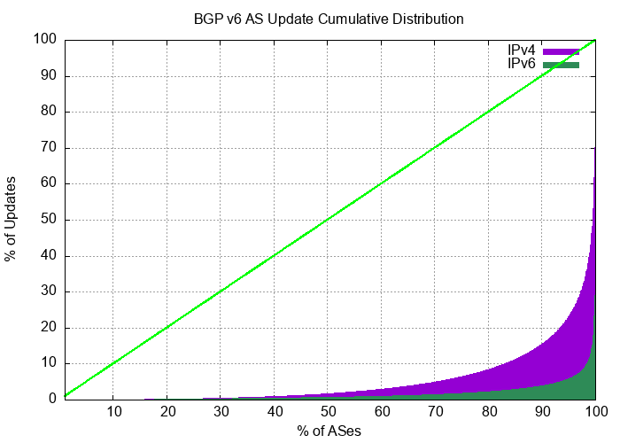
Updates in IPv6 BGP
It’s improving …
Compared to IPv4, the IPv6 network has exhibited a high level of skew of routing instability, where a small number of networks contribute disproportionately to the overall level of BGP updates in IPv6.
Just 2 AS’s generated 50% of the BGP IPv6 update load in the last 2 weeks of 2023. IPv6 routing instability is still concentrated in a small number of pathologically unstable cases.

Slide 48
The Highlights
IPv4 FIB Summary
IPv6 FIB Summary
FIB Projections
Churn
Directions

Slide 49
Directions: Securing Routing
The plan of study in securing the routing system is to:
  Characterize the current behaviour of the Internet’s inter-domain routing system
  Understand the bounds of “normal” behavior
  Characterize the ways in which routing information can be manipulated
  Ways to identify anomalous routing information
  Augment the routing environment with means to perform this detection

Slide 50
Some Open Questions
Should a useful secured routing system be reactive or preventative?
In a market-drive economy who pays for security?
Is the most effective response technical or regulatory?
Where / how should we respond?
  Is this a network issue with a network solution?
  Or should applications protect themselves?
What is the nature of “trust” in a networked environment?
How can crypto help?

Slide 51
That’s it!
Questions?

