Slide 1
Triggering QUIC
Geoff Huston AM
APNIC
July 2025

Slide 2
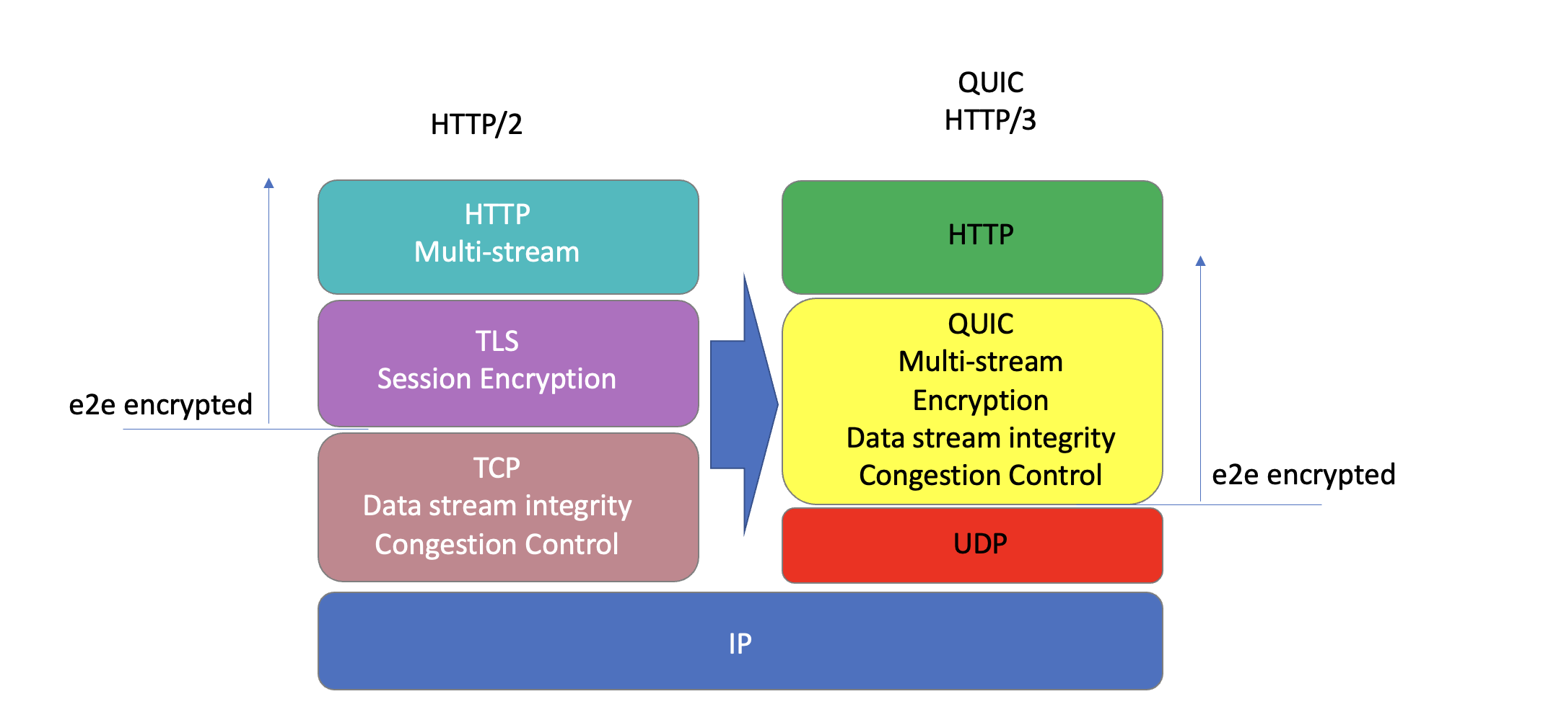
What’s QUIC?
An end-to-end encrypted transport protocol, providing more flexibility, faster connection setup, and a larger set of transport services than TCP
Operates over UDP port 443

Slide 3
Triggering QUIC in HTTP
Method 1 - Use content-level Alt-Svc controls to trigger the client to use the QUIC transport protocol (if it can):
  Add Alt-Svc: h3=“:443” to the HTML headers

Slide 4
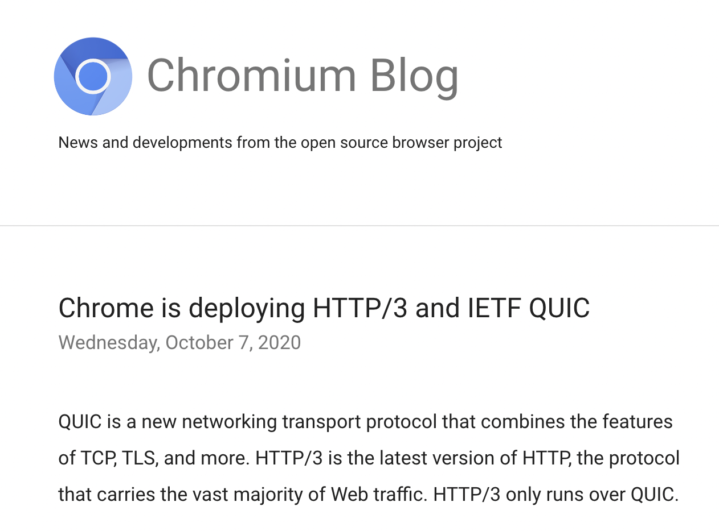
Setting Expectations
Chrome has a dominant share of browser instances - roughly, some 65%*
Chrome has been supporting a switch to QUIC via the Alt-Svc directive since 2020
* Oberlo.com

Slide 5
Setting Expectations
Chrome has a dominant share of browser instances - roughly, some 65%*
Chrome has been supporting a switch to QUIC via the Alt-Svc directive since 2020
So, we should expect up to 65% of clients will try to connect using QUIC if the server signals it supports QUIC – right?
* Oberlo.com

Slide 6
The Alt-Svc Trigger
This trigger is only effective when the client contacts this server for the second time
  But HTTP/1.1 and HTTP/2.0 use session persistence to keep the original TCP/TLS session open, so the condition where a client needs to open a new connection is less likely to occur
  The per-server Alt-Svc information is cached by the user for only 24 hours by default

Slide 7
The Alt-Svc Trigger
This trigger is only effective when the client contacts this server for the second time
  But HTTP/1.1 and HTTP/2.0 use session persistence to keep the original TCP/TLS session open, so the condition where a client needs to open a new connection is less likely to occur
  The ser server Alt-Svc information is cached by the user for only 24 hours by default
So, QUIC use will only be visible when a server is visited by a client for a second time AFTER the keep-alive expires.

Slide 8
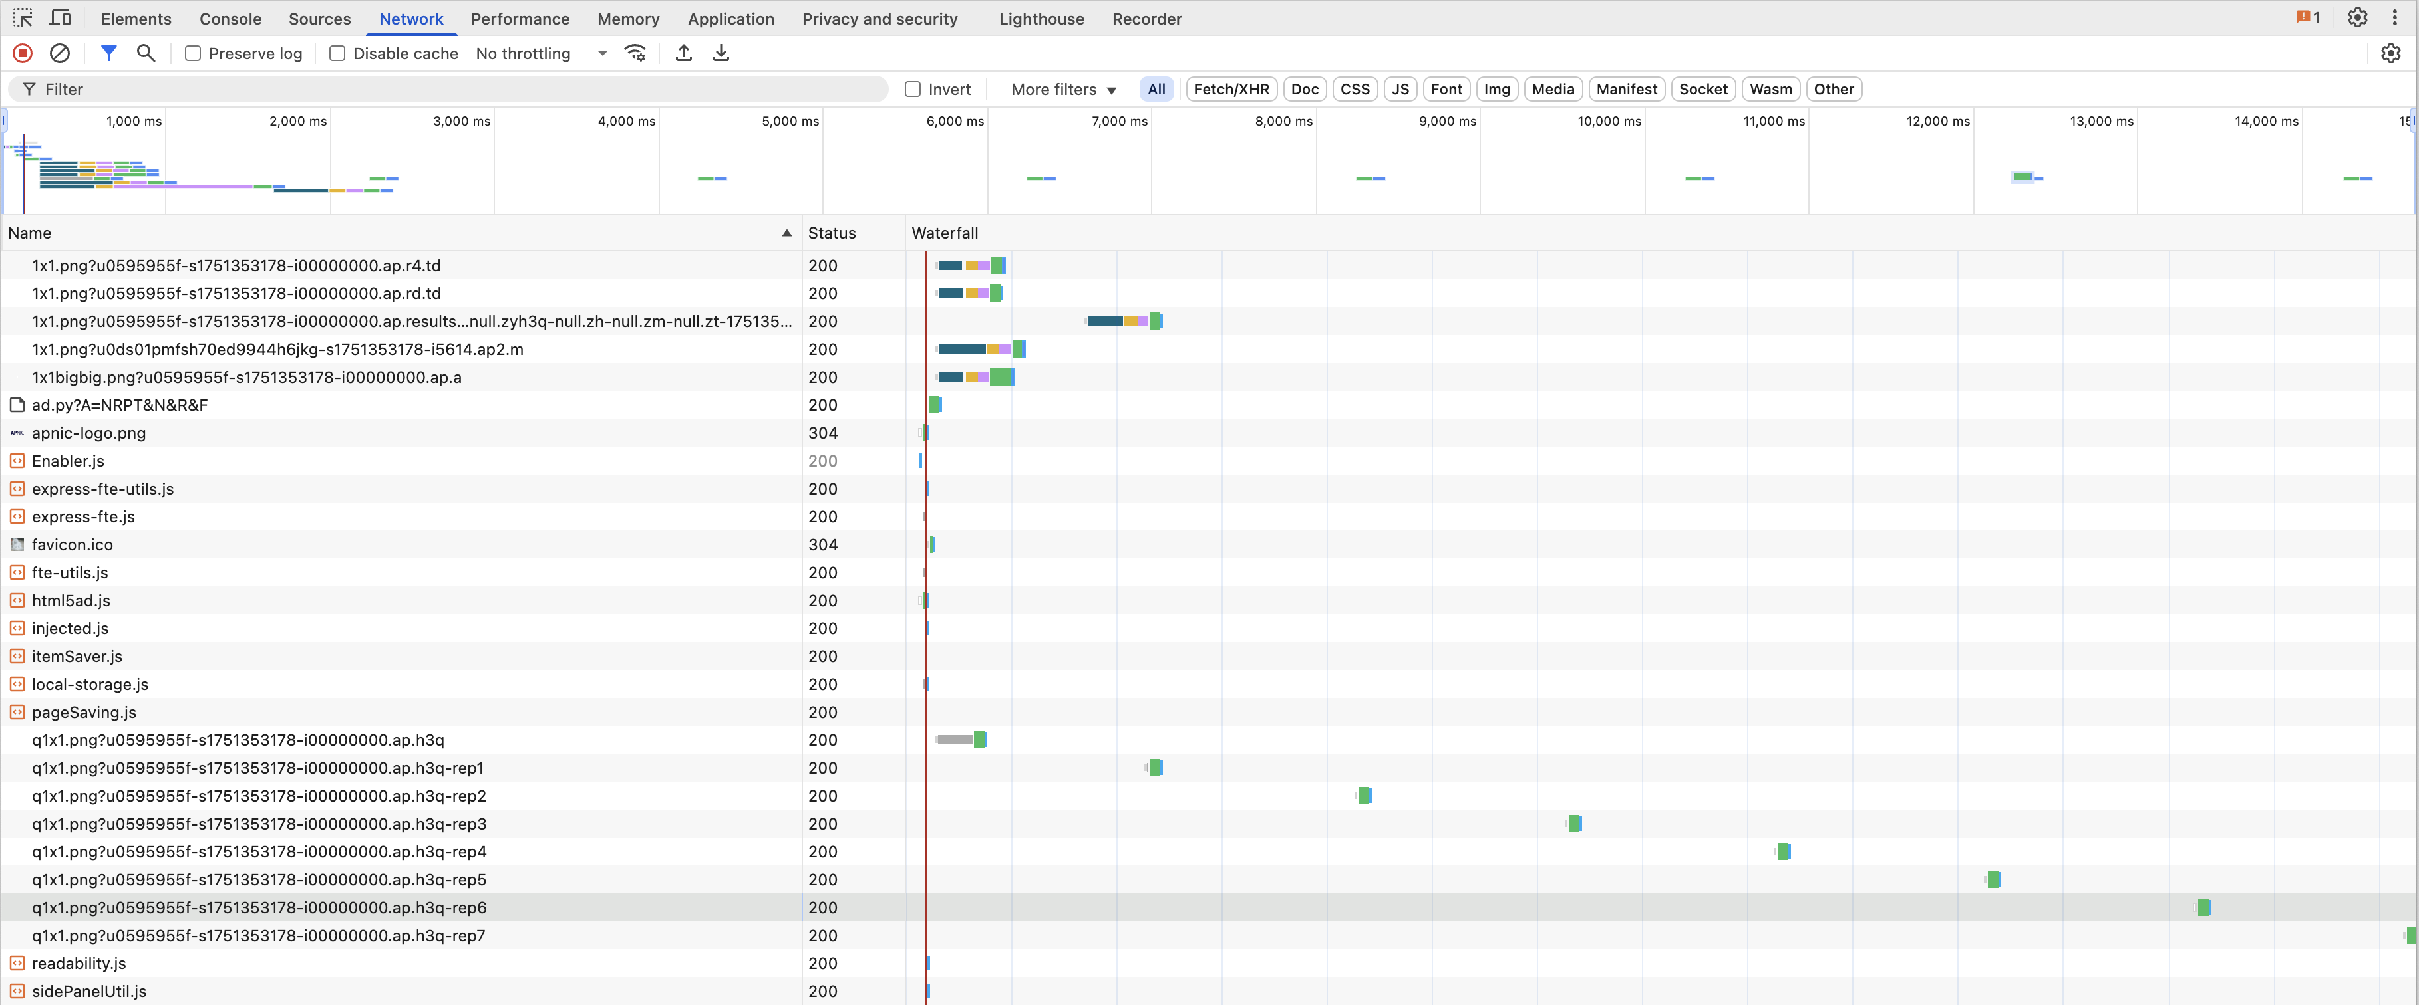
APNIC’s measurement
We need to trigger the conditions of a second fetch in the measurement:
Set the server keepalive time to 1 second
Request the same web object a total of 8 times using 2 second intervals between requests

Slide 9
Triggering QUIC in HTTP
Method 2 - Use the DNS to trigger QUIC:
  Set up an HTTPS record for the service name, with value: alpn=“h3”
  This allows Safari to use QUIC from the first access

Slide 10
Safari supports QUIC
(using Method 2)
Apple’s Safari is now supporting QUIC, using an HTTPS query/response in the DNS, where the apln directive can specify the use of the HTTP/3 protocol to access this service
QUIC can be triggered immediately (no wait for the second visit), so presumably, if the client performs a DNS HTTPS query, and the response indicates that the server supports QUIC, then the client should use QUIC for the connection

Slide 11
Setting Expectations
Chrome has a dominant share of browser instances - roughly, some 65%*
Apple Safari is now supporting QUIC, using the DNS HTTPS trigger
So, a QUIC-aware server platform should be seeing up to 85% of its sessions using QUIC
  This figure is probably not achievable as the content level control requires some precise conditions for the “second” visit:
    long enough between visits for the session keepalive timer to expire
    Short enough such that the local cache of server capabilities has not expired
* https://gs.statcounter.com/browser-market-share

Slide 12

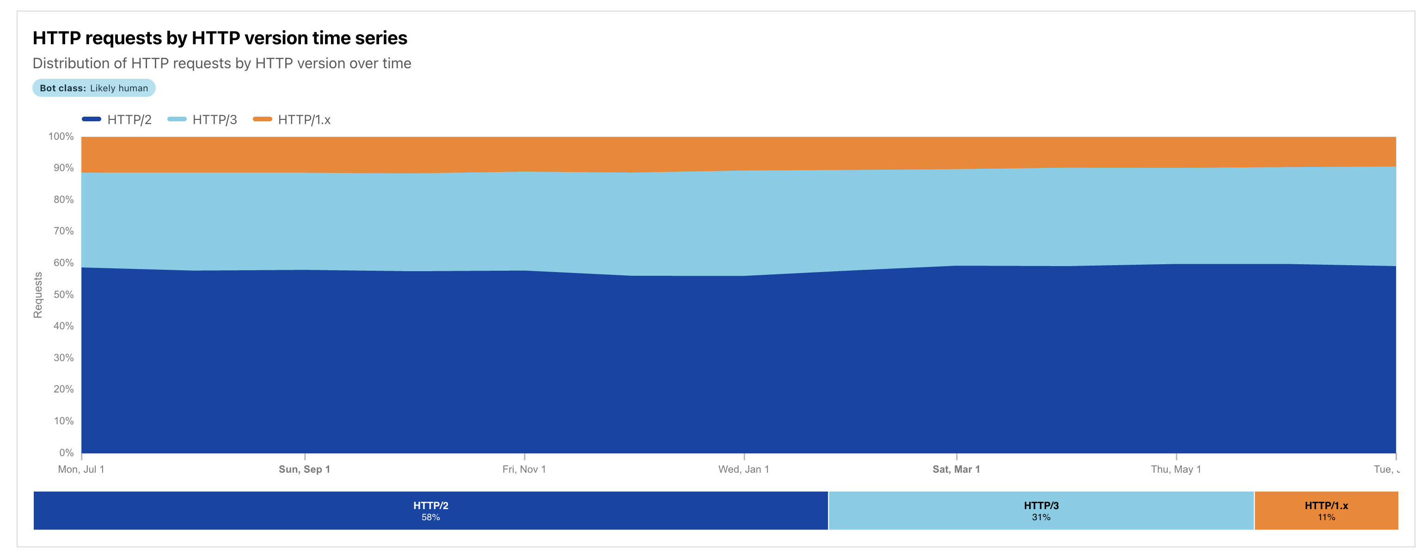
Cloudflare’s Numbers – 31%
12 Month Time Series
QUIC

Slide 13
Cloudflare’s Numbers – 31%
12 Month Time Series
That result is less than half of the maximum possible result if this is just alt-svc directive being used to trigger QUIC
QUIC

Slide 14
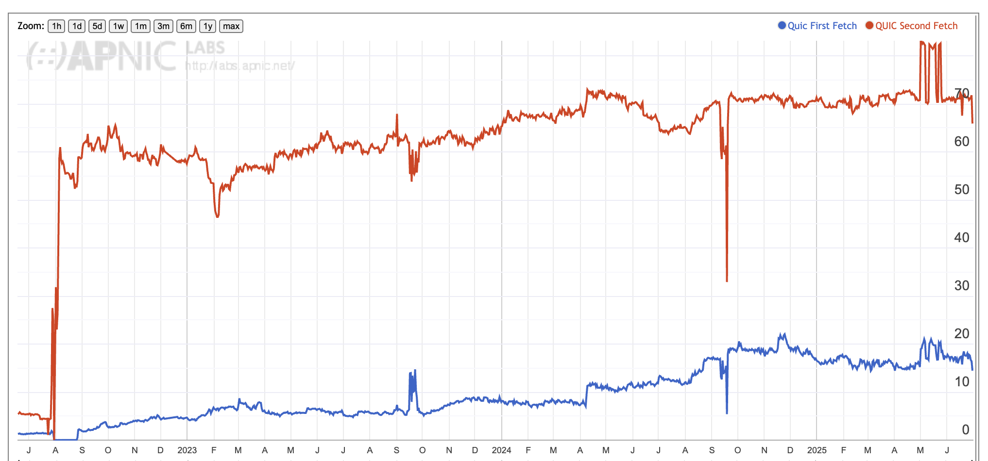
APNIC’s Numbers – 70%
Second and Subsequent Fetches – mainly Chrome clients are added here
First Fetch – mainly Safari clients
Playing with keepalive parameters!

Slide 15
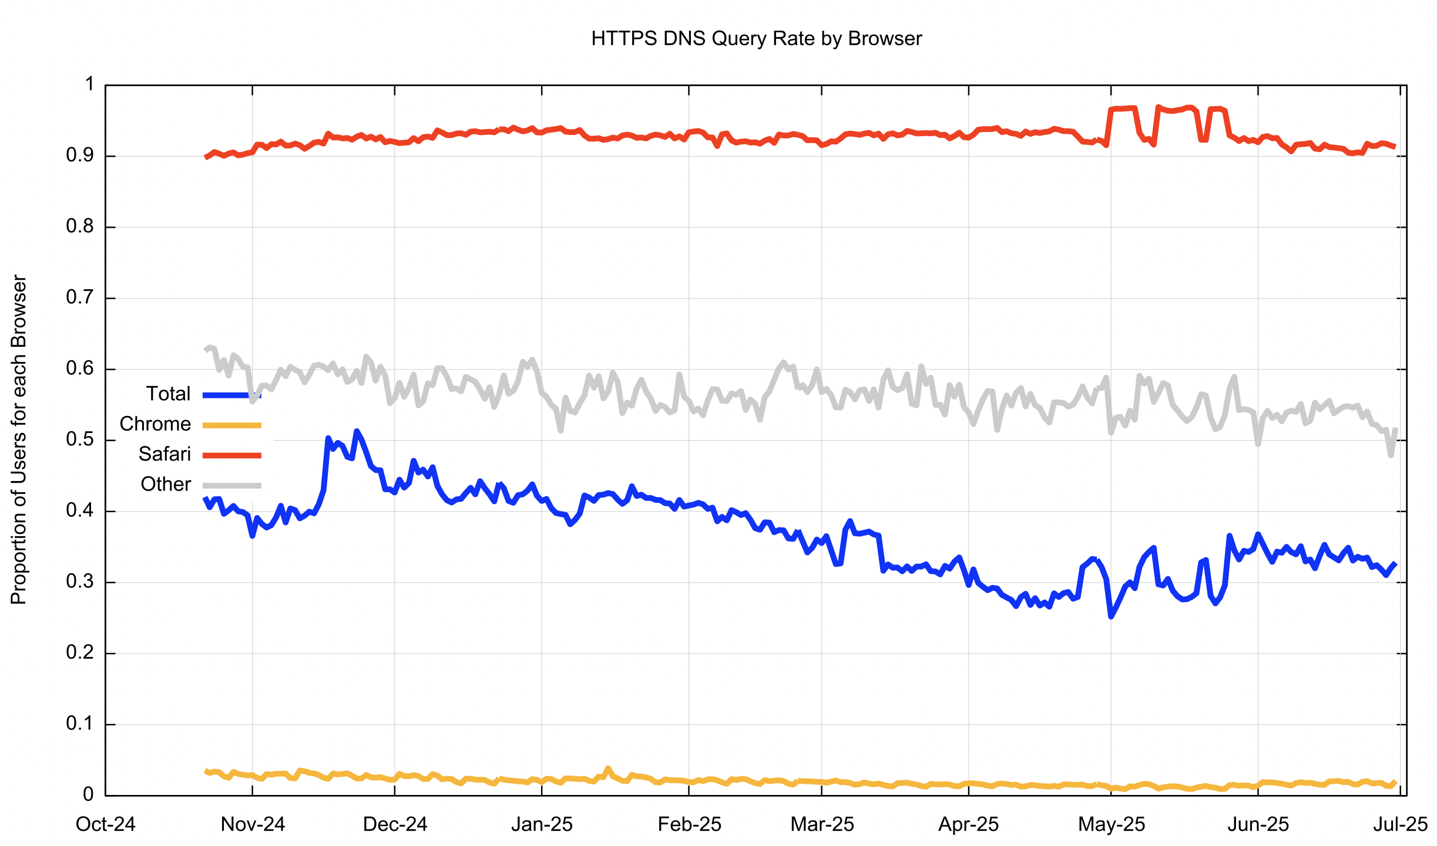
Method 2 - DNS HTTPS Query Rate
How many users are generating DNS HTTPS Queries?
Most Safari browsers consistently query for a
DNS HTTPS record
Safari
Others
Total
Chrome
Around 3% of Chrome browsers query for the HTTPS record

Slide 16
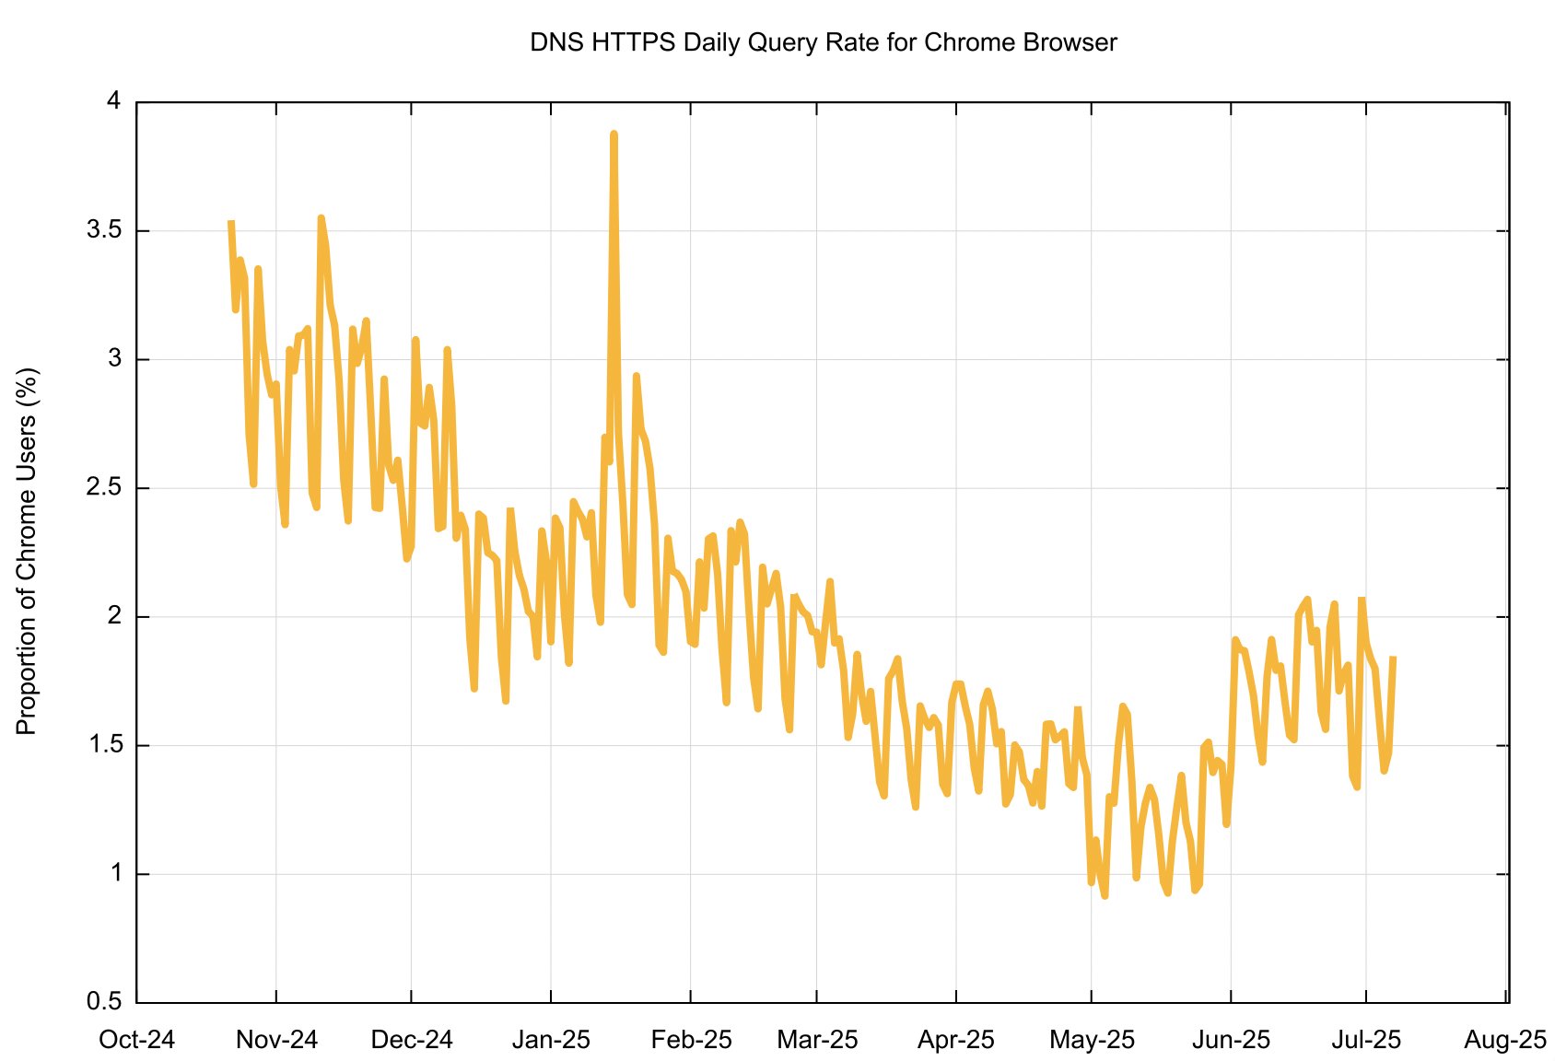
Chrome Browser HTTPS Query Rate
There is a strong weekly pattern in this data where weekend query rates are lower than weekday query rates
Query rates halved between October 2024 and May 2025, then rose across June 2025

Slide 17
Chrome Browser HTTPS Query Rate
There is a strong weekly pattern in this data where weekend query rates are lower than weekday query rates
Query rates halved between October 2024 and May 2025, then rose across June 2025
Why is Chrome’s use of the DNS HTTPS query so low?
Is this Chrome, or the user’s local network environment?

Slide 18
QUIC Use
If QUIC access is supported by the current releases by both the major browsers, then we should see a high QUIC use rate when the ability to use QUIC is signaled by both methods (alt-svc and DNS HTTPS)
What do we see?

Slide 19
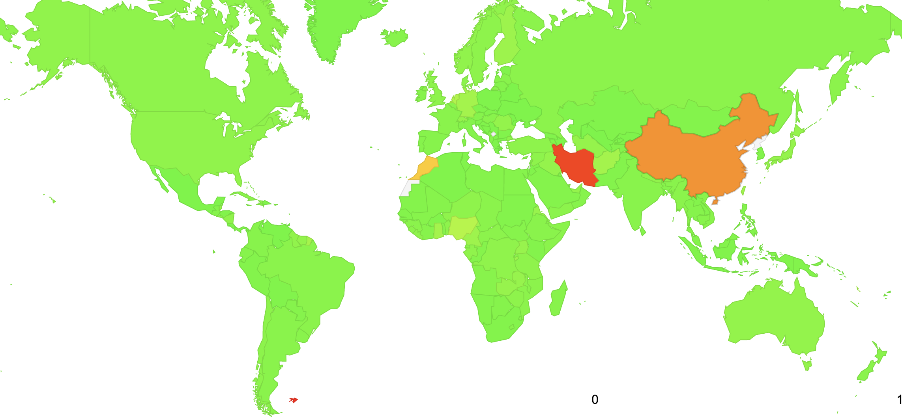
Global QUIC Use
0%
100%

Slide 20
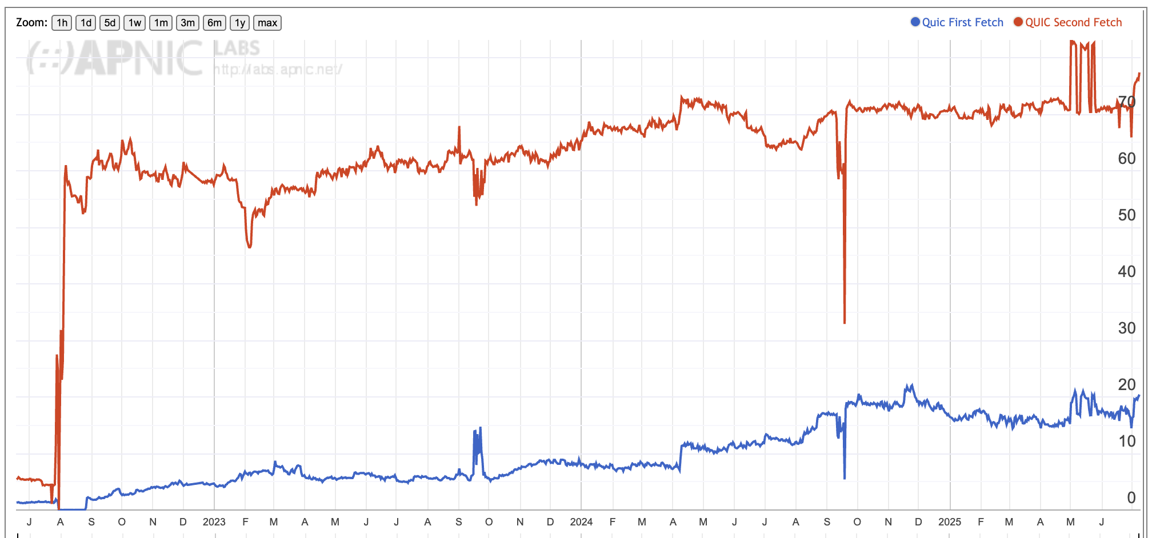
Global QUIC Use
Second and Subsequent Fetches – mainly Chrome clients are added here
First Fetch – mainly Safari clients

Slide 21
Global QUIC Use
It’s likely that there is some form of national-level block on UDP port 443 traffic in China and Iran

Slide 22
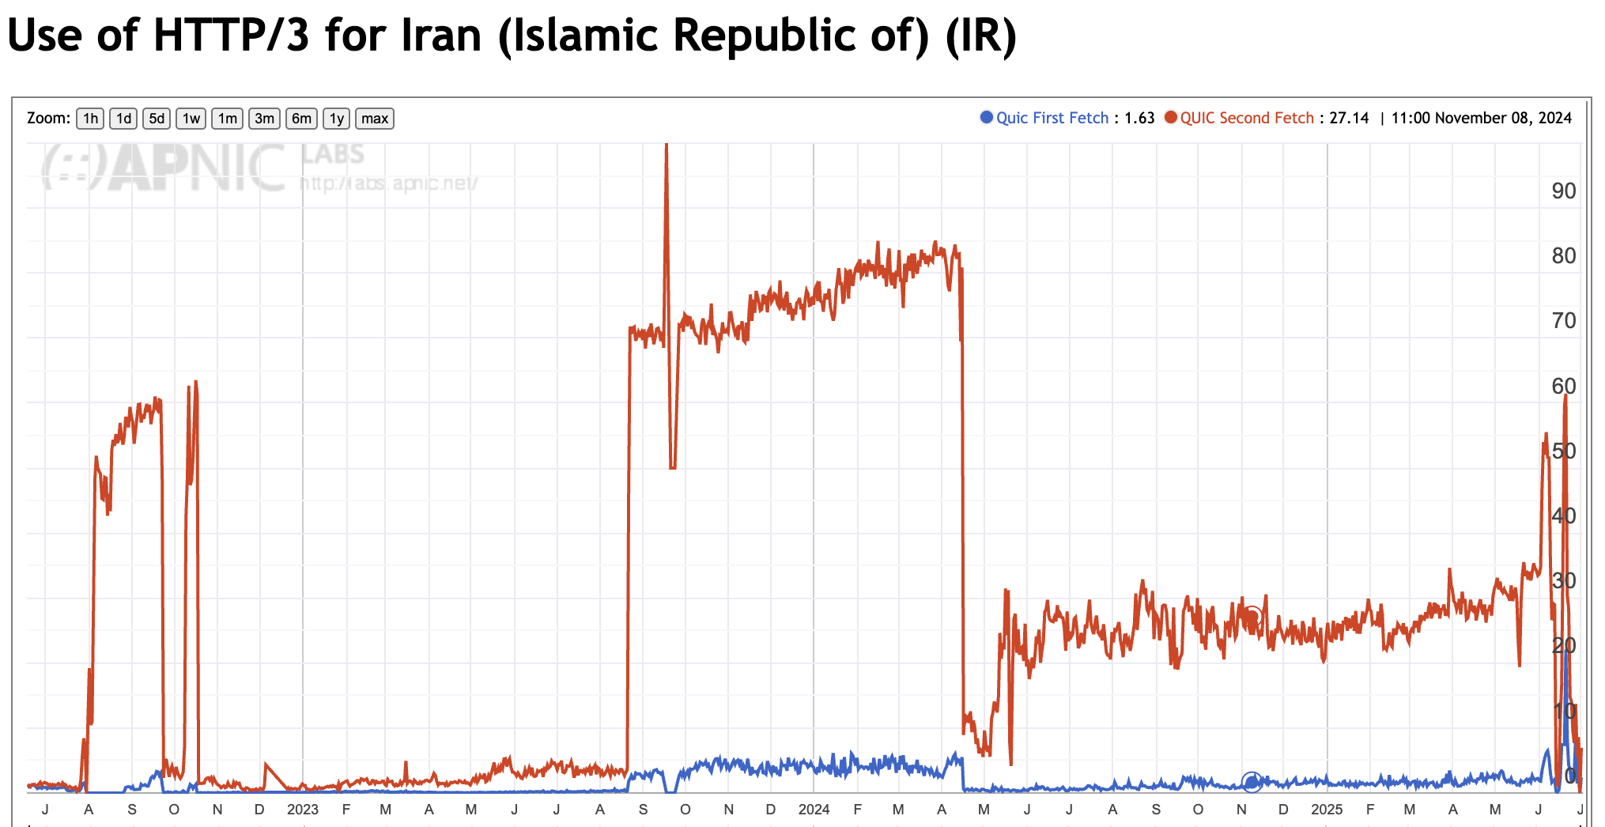
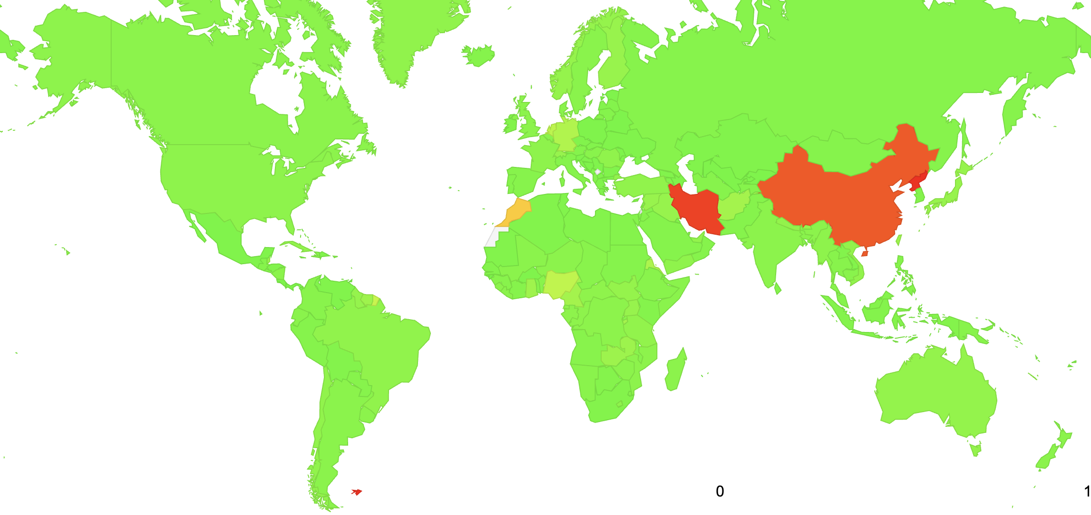
Global QUIC Use
It looks like this network-level block has been variously turned on and off over the past few years in Iran

Slide 23
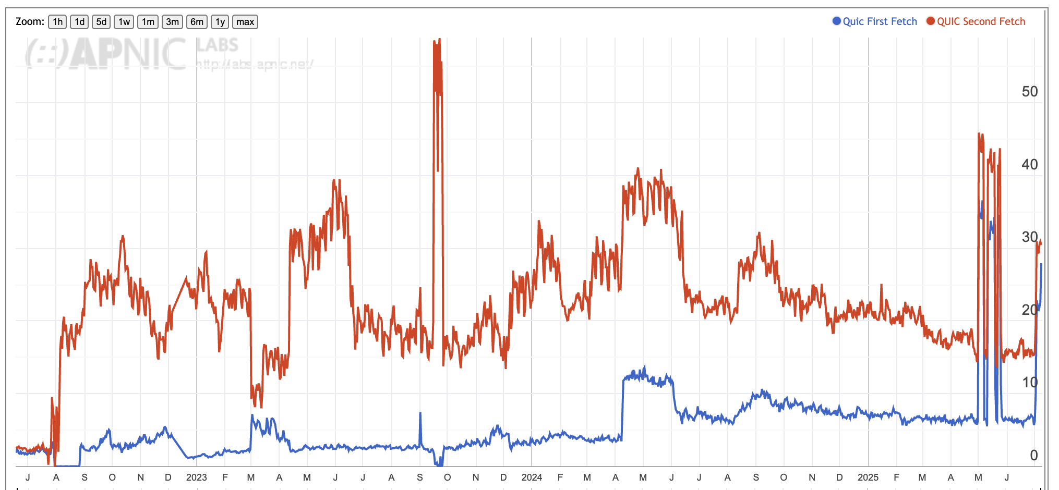
Global QUIC Use
It looks like there is some form of network-level block operating in China, but its effects are not uniform across all China’s networks

Slide 24
QUIC Use
If QUIC access is supported by the current releases by both the major browsers then we should see a high QUIC use rate when the ability to use QUIC is signaled by both methods (alt-svc and DNS HTTPS)
What do we see?
In most locales the alt-svc method of triggering QUIC is supported by browsers and network infrastructure
What about the DNS HTTPS method of triggering QUIC?
  Who uses a DNS HTTPS query?
  Are HTTPS responses being filtered by DNS infrastructure in some cases?

Slide 25
The DNS HTTPS record
The HTTPS record can also contain ipv4hint and ipv6hint attributes
Any A and AAAA records for a name will be used by a client in preference to these hint attributes
But if there is no A and no AAAA record in the zone, then a HTTPS-aware client will be forced to use these address hint attributes
Let’s try that, and allow the client to use either HTTP/2 OR HTTP/3:
test_name IN HTTPS 1 . alpn="h2,h3" ipv4hint=192.0.2.1 ipv6hint=2001:db8::1

Slide 26
DNS HTTPS Use Rate
How many users can use DNS HTTPS responses?
Data collected over a 24-hour period (7/7/2025)
Few Chrome users (1.7%) perform an HTTPS query, and even fewer (0.1%) followup with a fetch of the web object.
Most Safari users (97.3%) perform an HTTPS query, and most (96.3%) followup with a fetch of the web object. Fewer users (75%) prefer to use QUIC to perform web object retrieval when given the choice.

Slide 27
DNS HTTPS Use Rate
How many users can use DNS HTTPS responses?
Data collected over a 24-hour period (7/7/2025)
Why is Safari not using QUIC in 25% of cases?
Few Chrome users (1.7%) perform an HTTPS query, and even fewer (0.1%) followup with a fetch of the web object.
Most Safari users (97.3%) perform an HTTPS query, and most (96.3%) followup with a fetch of the web object. Fewer users (75%) prefer to use QUIC to perform web object retrieval when given the choice.

Slide 28
DNS HTTPS Use Rate
How many users can use DNS HTTPS responses?
Data collected over a 24-hour period (7/7/2025)
Chrome uses alt-svc and not DNS HTTPS
Safari uses DNS HTTPS
Few Chrome users (1.7%) perform an HTTPS query, and even fewer (0.1%) followup with a fetch of the web object.
Most Safari users (97.3%) perform an HTTPS query, and most (96.3%) followup with a fetch of the web object. Fewer users (75%) prefer to use QUIC to perform web object retrieval when given the choice.

Slide 29
Does Safari also use alt-svc?
How many users can use QUIC when there is only an alt-svc directive and no DNS HTTP record?
Data collected over a 24-hour period (10/7/2025)
Most Chrome users (91.6%) perform a QUIC retrieval on the subsequent fetch.
Few Safari users (2.9%) perform a QUIC retrieval in the subsequent fetch, indicating that the browsers are NOT following the alt-svc directive

Slide 30
Does Safari also use alt-svc?
How many users can use QUIC when there is only an alt-svc directive and no DNS HTTP record?
Data collected over a 24-hour period (10/7/2025)
No, Safari does not appear to use the alt-svc directive
Most Chrome users (91.6%) perform a QUIC retrieval on the subsequent fetch.
Few Safari users (2.9%) perform a QUIC retrieval in the subsequent fetch, indicating that the browsers are NOT following the alt-svc directive

Slide 31
Conclusions/Questions
If you want to serve content over QUIC you have to support BOTH QUIC trigger methods of a DNS HTTP record AND an alt-svc directive to signal QUIC capability to Chrome and Safari clients.
Why doesn’t Chrome also use the HTTPS query?
  Are they concerned about the greater DNS query load that would result from such a change?
Why doesn’t Safari also use the alt-svc directive?
Why do 24% of Safari users NOT perform a QUIC fetch despite a HTTPS record being queried?
Why do 2% of Safari users perform an initial QUIC fetch when there is no DNS HTTPS trigger?

Slide 32
Thanks!

