Slide 1
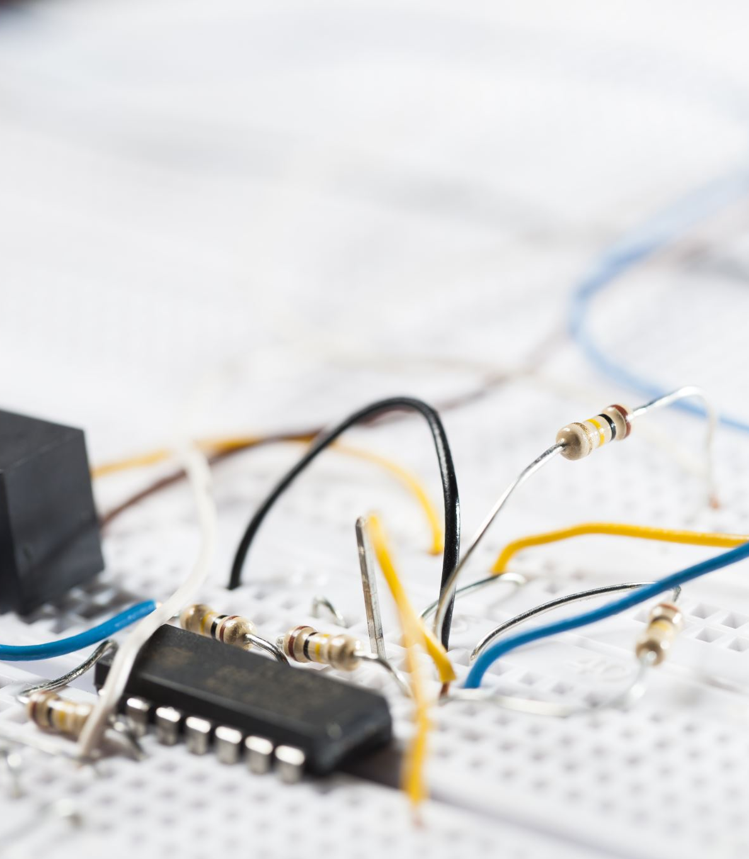
An IETF Tutorial -
All you wanted to know about the IETF
Geoff Huston AM
October 2025

Slide 2
ALL you wanted to know?
Well, maybe not everything, but I’ll try to share my own experience as a long standing IETF participant in this presentation

Slide 3

My IETF History
1st IETF Meeting – IETF 15 November 1989 Honolulu

Slide 4






My IETF History
1st IETF Meeting – IETF 15 November 1989 Honolulu
I’ve attended at least 100 IETF meetings since then (I’ve lost count!)
Member of the Internet Architecture Board: 1999 – 2005
Chaired the TACIT, SHIM6, GROW, and SIDR Working Groups
(Currently) Co-Chair of the the DNS Directorate

Slide 5
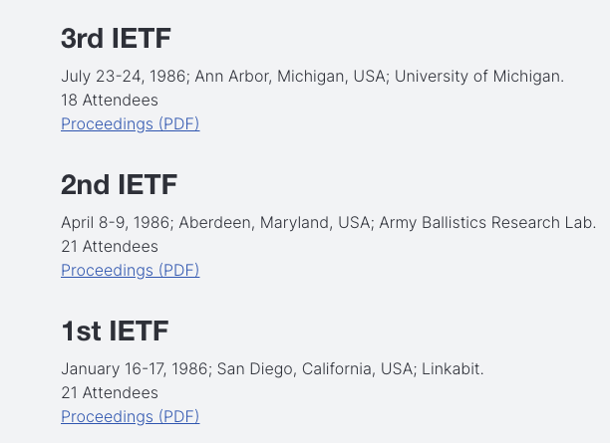
IETF Meetings
Outgrowth of the ARPA network with the advent of the NSF Internet project that expanded the network to a set of US universities. Strong researcher participation, scant vendor interest!

Slide 6
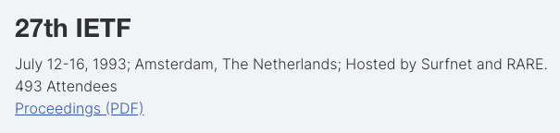
IETF History
First IETF hosted outside the US

Slide 7
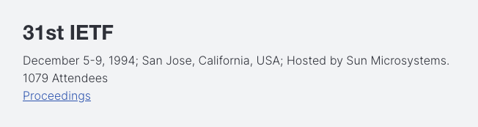
IETF History
First IETF with more than 1,000 attendees

Slide 8
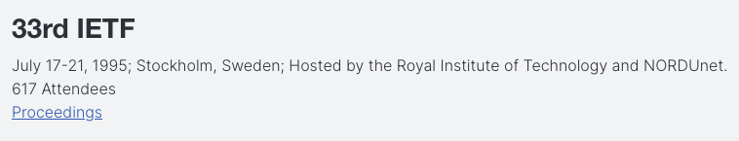
IETF History
The formation of a “standalone” IETF

Slide 9
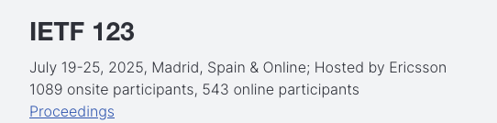
IETF History
Latest IETF Meeting

Slide 10
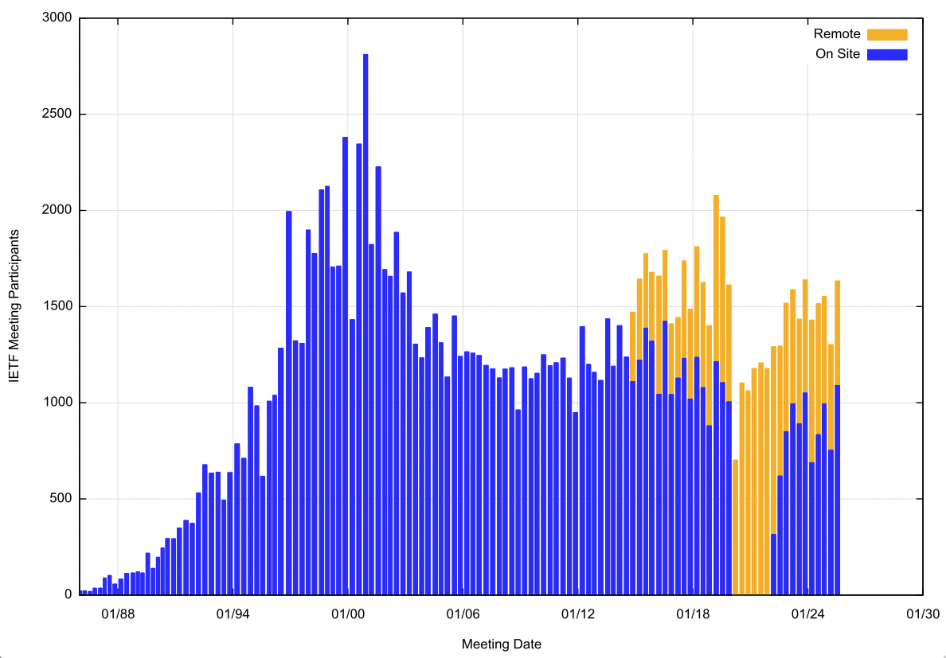
IETF Meeting Attendance

Slide 11
IETF Meetings
IETF meetings are a 7-day event that includes:
  Working Group Sessions
  Birds of a Feather Sessions
  Area-wide Sessions
  IRTF Research Group sessions
  Plenary sessions
  Tutorials
  Social Events
  Hackathon and Code Sprints
  And a whole raft of various side-meetings and business meetings

Slide 12
IETF Meetings
As well as:
  Hallway conversations
  Editing sessions
  Informal brainstorming
  Many fine lunches and dinners!

Slide 13
IETF Meeting Locations
Originally the IETF met in US locations, with a couple of excursions to Canada
The IETF first ventured off to Europe in 1993, to Amsterdam, and finally met in the Asia /Pacific region in 2000, in Adelaide
These days the IETF rotates between Asia/Pacific, US/Canada, and Europe for its meetings each year

Slide 14
Asia/Pacific Meetings
March 2025 – Bangkok
March 2024 – Brisbane
March 2023 – Yokohama
November 2019 – Singapore
November 2018 – Bangkok
November 2017 – Singapore
November 2017 – Seoul
November 2015 – Yokohama
November 2014 – Honolulu
November 2011 – Taipei
November 2010 – Beijing
November 2009 – Hiroshima
March 2004 – Seoul
July 2002 – Yokohama
March 2000 - Adelaide

Slide 15
The IETF is a Standards Body
The IETF’s purpose is to generate Standard Specifications of technologies that can be used by product manufacturers and product buyers to specify product conformance to a set of behaviours, interoperability and performance
The primary output of the IETF is the RFC document series (“Request for Comment”)

Slide 16
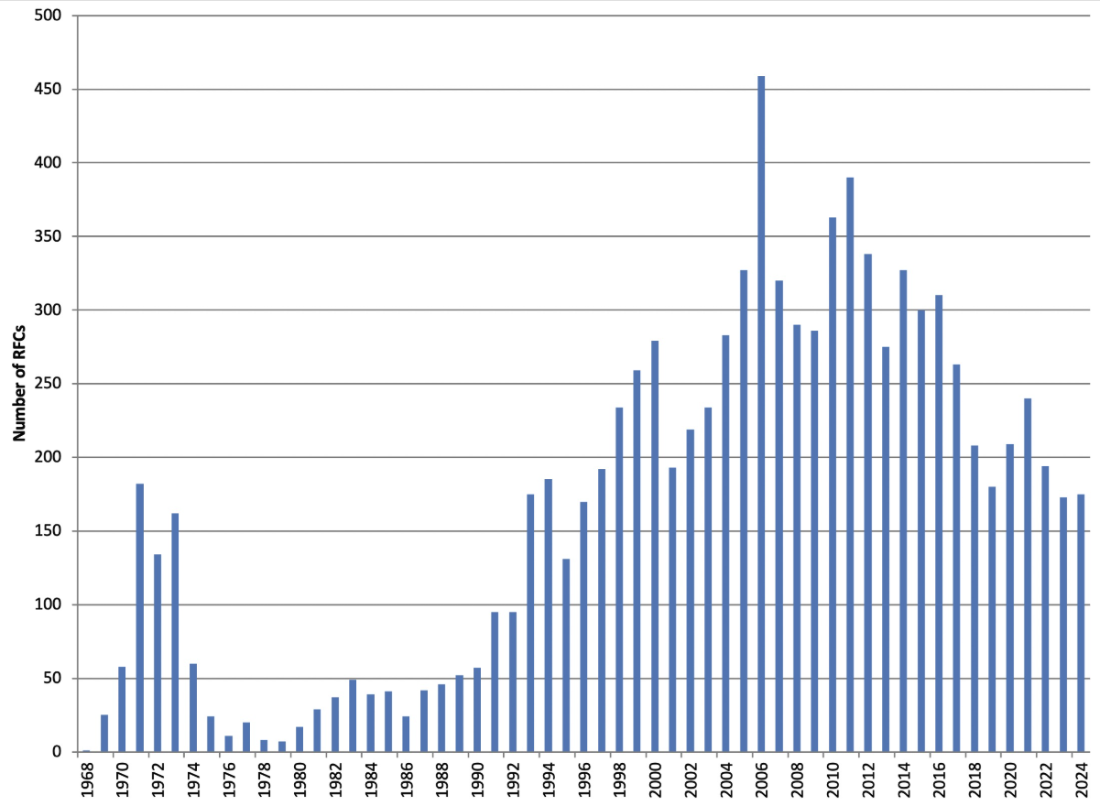
IETF RFC Publication
The RFC document series originated in 1969 to hold the working notes for the ARPAnet research program
The RFC collection now has some 9,879 documents, organized into Standard Track, Experiments, Best Current Practice, Informational, Updated and Historic
Landmark RFCs:
RFC 791, Internet Protocol, Sep 1981
RFC 793, TCP, Sep 1981
RFC 1883, IPv6, Dec 1985
RFC 1034, Domain Names, Nov 1987
RFC 1771, BGP-4, Mar 1995
https://www.rfc-editor.org/rfcs-per-year/

Slide 17
Overview
Peak IETF meeting attendance occurred back in 2000
In-person attendance has been slowly declining since then, although the rise in online attendance has offset that decline to some extent
Peak RFC publication occurred in 2011 (400 RFCs p.a.)
The current RFC publication rate is now below 200 RFCs p.a.

Slide 18
The Culture of the IETF
It’s not “conventional” international technology standards body:
  It is not a meeting of government representatives nor a peak body of a set of national standards bodies (as compared to the ISO or the IEC)
  Its not based in an international treaty (as compared to the ITU)
  It has no formal membership structure – There are no qualifications of preconditions to participating in IETF activities
  It does not adopt standards by voting, or ballots or any other formal means of counting expressions of support or opposition
  It’s process is fixed, but flexible at the same time!
  It’s outcomes (RFCs) are openly available without charge or constraint – RFCs are copyrighted by the IETF, but are made freely available
  RFCs are not mandatory to adopt

Slide 19
The Culture of the IETF
The IETF is perhaps best described as a fluid collection of interested subject matter experts
  There IETF has no concept of a “standing” membership
  Individual experts contribute to the work of a working party on the basis of their interest and expertise in the subject matter
  These contributions are open, not qualified by any forms of non-disclosure provisions, and permit the IETF process to develop these contributions during the standards process

Slide 20
The Culture of the IETF
From time to time the IETF has achieved consensus on positions of opinion:
  RFC 7258 ”Pervasive Monitoring is an Attack” which states the position that “Pervasive monitoring is a technical attack that should be mitigated in the design of IETF protocols, where possible.”
  RFC 2804 “IETF Policy in Wiretapping” which states that “the IETF has decided not to consider requirements for wiretapping as part of the process for creating and maintaining IETF standards.”
but these actions are uncommon, as the IETF strives not to be an active participant in any national or international political space

Slide 21
The Culture of the IETF
It’s informal and techno-nerd aligned
  No dress code, no visible hierarchy
  These are smart and often (highly) opinionated individuals, who do not necessarily have a high level of people skills
  What other might see as “rude” even “arrogant” is seen as simply being blunt and direct – if a suggested approach make no sense, then that’s the exact feedback you will likely see at the IETF!

Slide 22
The measurement of “success”
Is not the number of meetings or meeting attendees
Is not the number of RFCs
Success is based on market adoption of standardized technologies

Slide 23
The Purpose of the IETF
To develop and maintain standards for technologies used to provide Internet service and services over the Internet
    There is NO clear delineation of what is “in scope” for the IETF and what is not. In general, the IETF is not used to standardize media (local area networks, radio, optical, etc). The IETF is also very selective at the application layer as to what applications sit within the IETF’s scope, but there is no consistency in this selectivity. IP is within the IETF’s scope, as is end-to-end transport. The ways to secure these functions is in the IETF’S scope, but the cryptographic algorithms used as the foundation of such security is not.
  In general, the IETF will work on an issue if there is interest to do from IETF participants, and the work is not already being undertaken any other standards body

Slide 24
The Purpose of the IETF
To develop and maintain standards for technologies used to provide Internet service and services over the Internet
Ensure that the technology itself is secure and can be operated securely
  That’s perhaps an overly ambitious objective. “think about security” is a better objective, as necessarily there are complex trade-offs between usability and technology paranoia and the IETF tends towards the pragmatic compromise over the rigid forms of absolutism

Slide 25
The Purpose of the IETF
To develop and maintain standards for technologies used to provide Internet service and services over the Internet
Ensure that the technology itself is secure and can be operated securely
Ensure that the technology can support scale of deployment and use
  If there is one common theme of the internet so far, its unrelenting growth. This means that the technologies standardised by the IETF need to be capable of sustaining large scale growth

Slide 26
The Purpose of the IETF
To develop and maintain standards for technologies used to provide Internet service and services over the Internet
Ensure that the technology itself is secure and can be operated securely
Ensure that the technology can support scale of deployment and use
Open and fiercely independent
  And opinionated!
  Capture of the IETF is simply not an option !

Slide 27
IETF Mantras
“We reject kings, presidents, and voting. We believe in rough consensus and running code”
  The IETF does not impose authority in a hierarchical manner. No individual or office is in control of the activities undertaken in the IETF context
  There is no use of voting in the IETF to determine an outcome. There is not even a concept of “membership” of the IETF that would assist in defining who has the ability to exercise a vote in any case
  The IETF seeks to establish a common consensus across individuals who have familiarity with the topic. That’s not unanimity, nor complete inclusion. It’s an expression of the core of common agreement among individuals
  The specifications should be sufficient to allow for the independent development of code that conforms to the specification where the code performs the functions described in the specification. The specification should be such that the implementations interoperate with each other

Slide 28
IETF Mantras
We are all here as individuals, not as corporate or government representatives
  The IETF processes place no additional weight to a contribution if it is made by a government or by an industry entity
  All RFCs credit individual authors - there are no anonymous work party authors. RFC may also acknowledge the contributions of other individuals.
  By convention, updated RFCs still credit the individual authors of the original documents
  Which is a fine thing to say, but the reality is that corporates and at times government bodies fund individual to attend IETF meetings and participate in IETF activities

Slide 29
IETF Mantras
Come Prepared!
  IETF Working Group sessions and the associated mailing list activity is not there to educate folk about the technology being studied
  Working Group sessions assume that participants have read the drafts and are ready to contribute to the discussion

Slide 30
The IETF Document Management Process
It all starts with an Internet Draft
  Internet drafts are individual contributions
  They are held in the drafts repository for a period of 6 months, then deleted!
  Thay are intended to be work-in-progress notes, and should not be cited
  They are used as the working space for RFCs, where drafts get progressively refined
Working Group Adoption
  The next step is “adoption” of a draft by a Working Group
  Adoption is a call to the Working Group to see if there is interest in developing the draft

Slide 31
The IETF Document Management Process
Working Group Documents
  The drafts’ authors assume an editor role and respond to items raised in Working Group sessions and on the mailing list
  An area directorate may be asked to also review the draft
  It’s up to the Working Group Chair to make the call to the working gropup to see if the document is ready for the next step – this is the Working Group Last Call (WGLC)
IESG Review
  The document is passed to the Area Director who submits it to the IESG for an IESG ballot
    (yes, I know I said “no votes”, but the ballot is a consensus gathering process among IESG members to see if there is general agreement that the document is ready)
  It’s possible that the document is passed back to the Working Group, but normally it would head to the RFC Editor Queue

Slide 32
The IETF Document Management Process
RFC Editor
  The document is processed by the RFC Editor for a final pass, consistency of style and references
  The authors are given a last call to approve and then…
RFC
  The document is assigned an RFC Number and published as an RFC

Slide 33
Intellectual Property Rights
In general, the IETF Working Groups prefer to standardize technologies with no known IPR claims. There are always exceptions to this, and royalty-free licensing is preferred over other forms of IPR, all other things being equal
When contributions are made to the IETF the contributor grants to the IETF the right to copy, publish, display and distribute the work, and to modify or prepare derivative works
  You can’t ask the IETF to adopt your favourite technology and prevent the IETF from making changes!

Slide 34
The Organisation of the IETF
The work of the IETF is roughly divided into:
  The engineering of the Internet and IP technologies (the “Internet Engineering Task Force”, or IETF)
  Facilitating researchers to delve into related topics that do not have an immediate impact on engineering and operations (the “Internet Research Task Force”, or IRTF)
  A secretariat to perform organizational functions and support the work of the other IETF entities

Slide 35
IETF Organisation
Internet Engineering Steering Group
General
15 WGs
Applications/Real Time
29 WGs
Operations &
Management
26 WGs
Security
33 WGs
Web/Internet Transport
20 WGs
Internet
17 WGs
Routing
24 WGs

Slide 36
IRTF Organisation
IRTF Chair
CFRG
Crypto Forum
DINRG
Decentralisation of the Internet
GAIA
Global Access to the Internet for all
HRPC
Human Rights Protocol Considerations
ICCRG
Internet Congestion Control
ICNRG
Information-Centric Networking
MAPRG
Measurement and Analysis for Protocols
NMRG
Network Management
PANRG
Path Aware Networking
PEARG
Privacy Enhancements and Assessments
QIRG
Quantum Internet
RASPRG
Research and Analysis of Standards Processes
SPACERG
Systems and Protocols for Space Networking
SUSTAIN
Sustainability and the Internet
T2TRG
Thing-to-Thing
UFMRG
Usable Formal Methods

Slide 37
Internet Architecture Board
Architectural Commentary
Standards Process Appeals and Oversight
External Liaisons
Oversight of IETF Protocol and Parameter Registries function - IANA

Slide 38
Others
IETF Trust
RFC Editor
Independent Submissions Editor
Nominating Committee

Slide 39
Funding
2025 Budget:
The IETF has expenses of some $12M per year
Revenue from 3 x IETF meetings per year raise $4.5M
The Internet Society contributes $8M
The IETF Endowment contributes $300K
  The current objective is to build the Endowment Fund to $US50M, and as a longer-term objective to lift this to $150M

Slide 40
Does the IETF develop technologies any more?
In the early days the IETF was the place where technologies were developed and debugger, and where deployment was coordinated
At that time IETF attracted researchers and academics, developers, network operators and vendors
The IETF does not do much in the way of development any more
  “design by committee” is excruciatingly painful and often fails!
  IPv6 is a good example of the flaws in this process
These days the IETF tends to take in contributions by others and passes the technology through a working group review for sanity and consistency
These days the IETF attracts researchers, vendor developers, and social scientists!

Slide 41
Working Code?
These days many vendors are not interested in implementing every internet draft that it on its way to become an RFC
  Its just too expensive to constantly tweak a deployed product to implement every idea that is under discussion in an IETF Working Group
These days many vendors wait for a Proposed Standard RFC to be published before considering whether to implement it (or not)
  Which implies that the characterization of ”running code” is more aspirational than real!

Slide 42
Futures
The IETF relies on continued participation to keep going
As long as there are interested folk to attend meetings, contribute to Working Groups, write Internet drafts and volunteer for leadership roles, there is likely to be an IETF!
But without that level of support, it will be unable to continue!
So, the IETF’s future is largely up to you!

Slide 43
Thanks!

