Slide 1
LocalRoot++
Making Localroot the default in the DNS
Geoff Huston

Slide 2
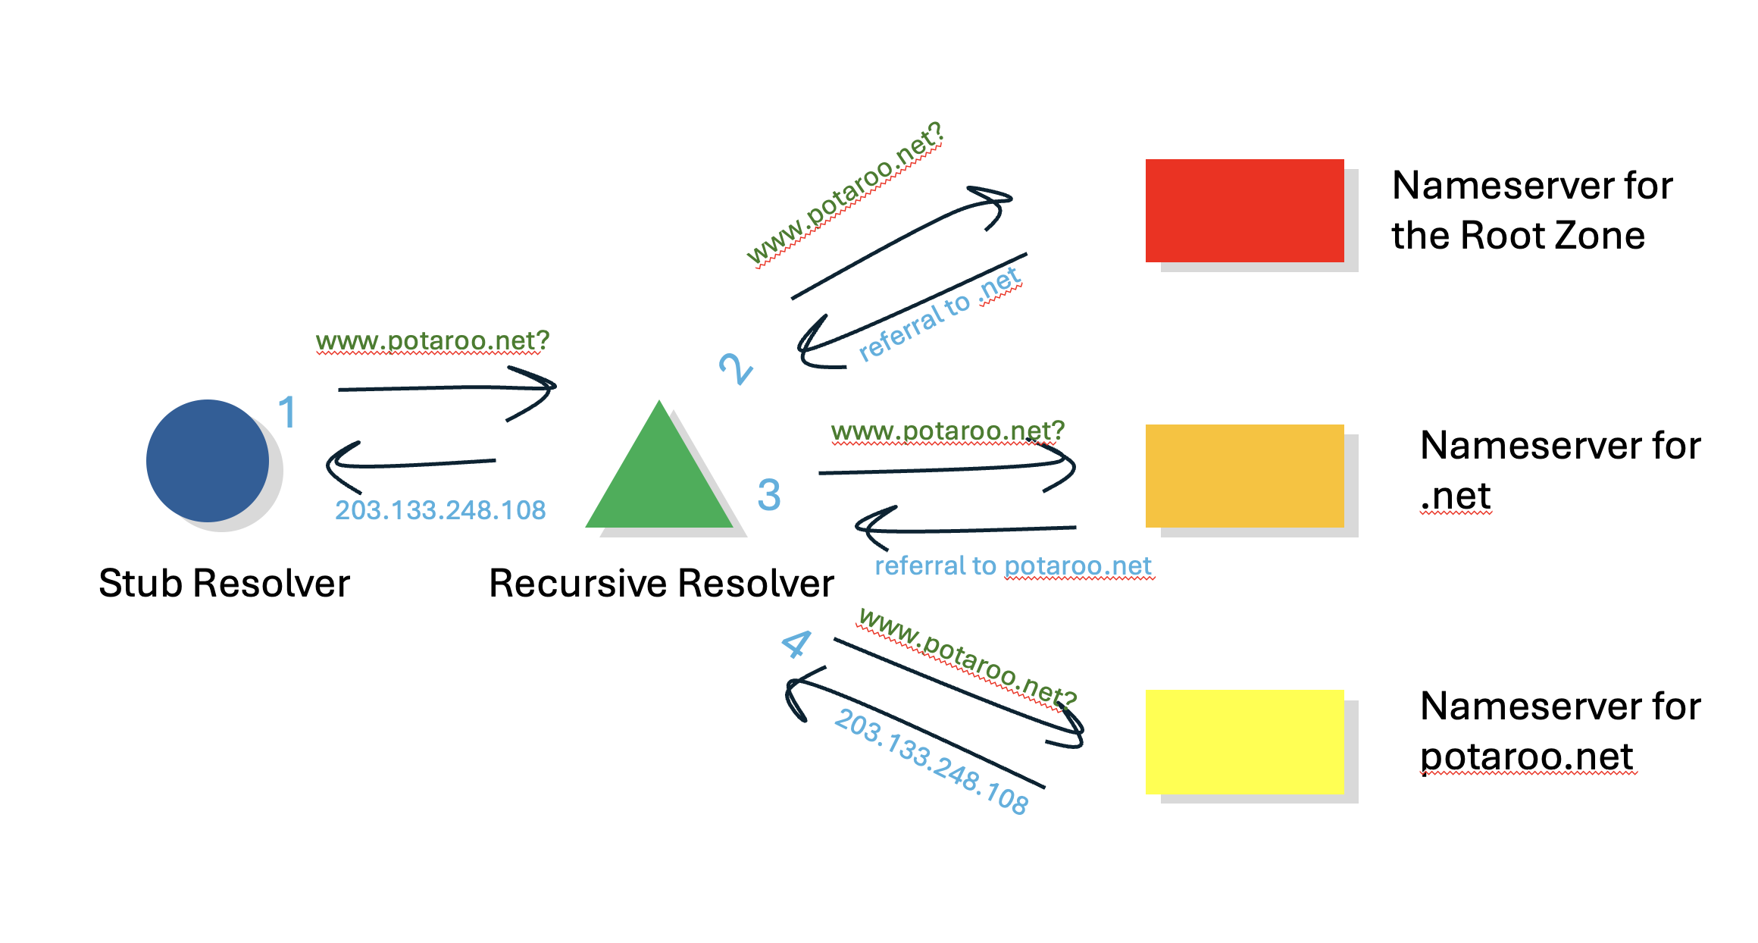
The Role of the Root in the DNS
Every DNS resolution starts with root data
But you knew all this!

Slide 3
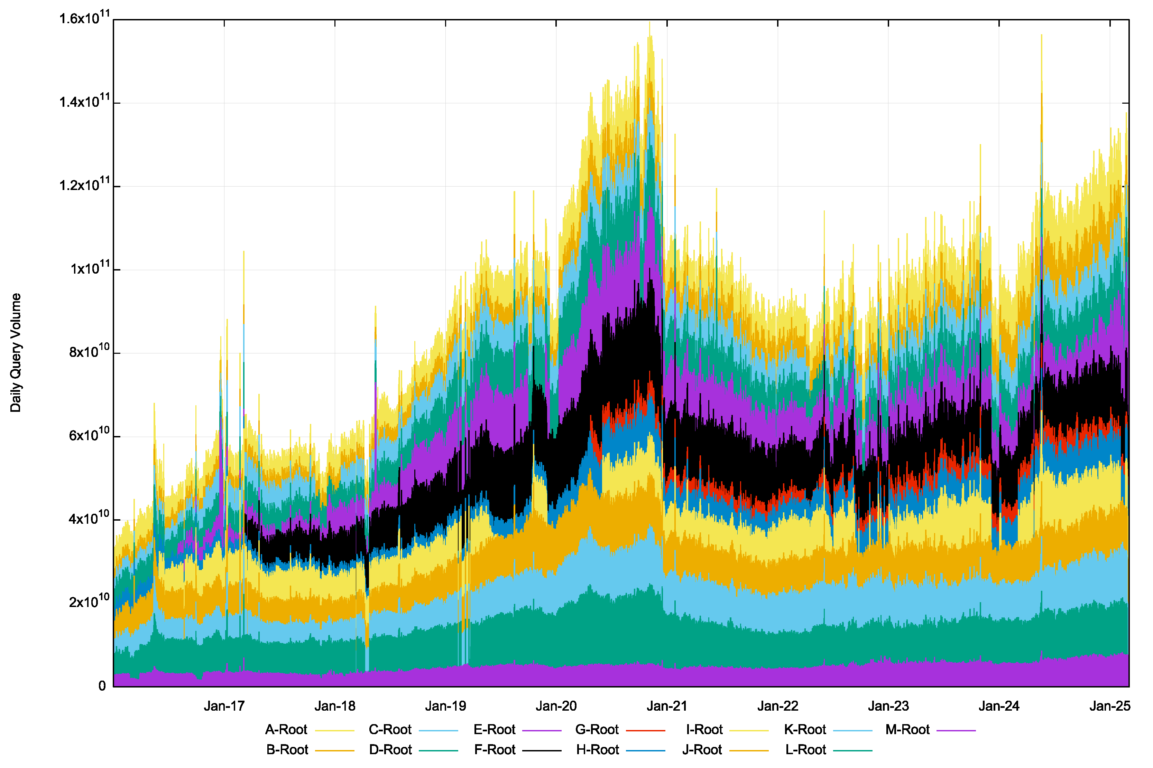
Root Query Load over time
2017
2021
2025
From https://github.com/rssac-caucus/RSSAC002-data

Slide 4
Root Query Load over time
Chrome stopped their use of Chromeiods
2017
2021
2025
From https://github.com/rssac-caucus/RSSAC002-data

Slide 5
Root Query Load over time
130B Queries per day
Jan 25
90B Queries per day
Jan 23
2017
2021
2025
From https://github.com/rssac-caucus/RSSAC002-data

Slide 6
Root Growth
That’s a 40% growth over two years!
  No other aspect of the Internet’s common infrastructure service portfolio has grown by the same relative volume over this period
  Indeed, many of the Internet’s metrics are showing signs of market saturation
I thought that queries to the root servers were only used to prime recursive resolvers on startup, and refresh expired cached entries
  Which makes this growth profile challenging to explain!

Slide 7
Aside: The Economics of the DNS
Conventionally, when a good is consumed the consumer pays the producer a fee to compensate for the cost of production
  Increasing consumption generates additional fees which can fund higher production volumes
BUT DNS queries are essentially unfunded
  ISPs bundle the cost of operation of their in-house recursive resolver into their access fee
  No recursive resolver pays authoritative servers to answer queries about the domains that they serve
  If there is a revenue stream, it comes from the DNS zone administrators who are paying for these nameservers to serve their zone.
  Except for the root zone
    Which no one pays for!

Slide 8
The Inherent Contradiction
How are we ensuring that the root zone service can continue to grow in capacity in response to this resumption in the growth of query rates?
Somehow, we need to factor in the apparent need to escalate the investment of resources that are in effect donated into the DNS to operate this service by this small collection of root service operators.

Slide 9
How can we further scale the root service?

Slide 10
More Named Root Servers
Why not just expand the number of named root services from 13 to some a larger number?
  13 was based on a non-fragmented priming response in an IPv4 only environment
  When we moved to dual stack operation it was no longer possible to keep the response with 512 octets
    A priming response is 811 bytes these days
Adding more named servers to the root does not necessarily add useful resilience nor does it add useful capacity

Slide 11
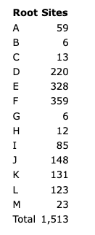
More Root Service Platforms
Another option is to use the inherent parallelism that’s obtained through anycast, and this has been enthusiastically embraced by the root name service operators. Anycast increases overall system capacity and improves service resilience
Anycast doesn’t necessarily result in even load balancing across servers
Anycast Site Counts for Root Servers, March 2025 (https://root-servers.org/)

Slide 12
More Root Service Platforms
Even this anycast form of expanding the distributed root service may not be enough in the longer term.
If we are facing a 25% compound annual query growth rate, then in four years from now we may need double the root service capacity from the current levels, and in a further four years we’ll need to double it again. Exponential growth is a very harsh master.
Can this anycast model of anycast replicated root servers expand indefinitely?
Or should we look elsewhere for scaling solutions?

Slide 13
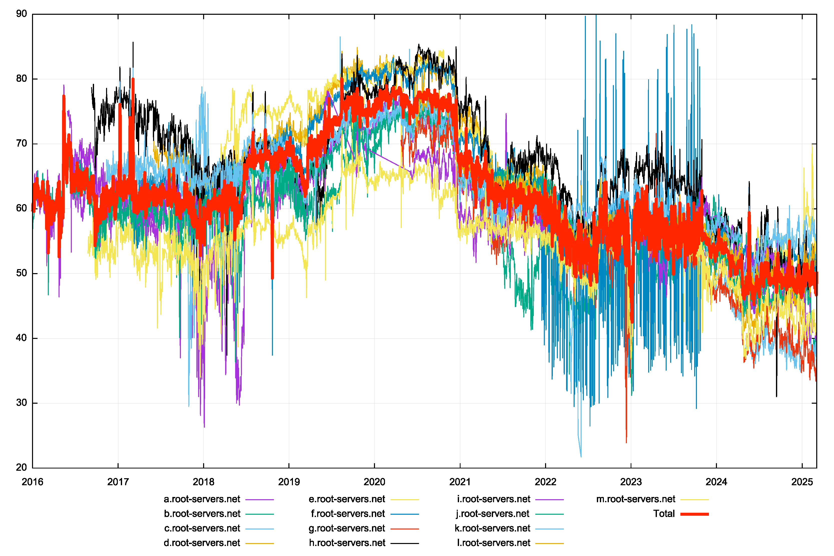
Caching for Negative Responses
One half of all queries to the Root Servers are answered with NXDOMAIN
RFC8198 describes a way to cache the negative space in the root zone by leveraging the NSEC records
% of responses that are NXDOMAIN - RSSAC002 data

Slide 14
Caching for Negative Responses
One half of all queries to the Root Servers are answered with NXDOMAIN
RFC8198 describes a way to cache the negative space in the root zone by leveraging the NSEC records
% of responses that are NXDOMAIN - RSSAC002 data

Slide 15
Aren’t we negative caching already?
Bind supports this function as of release 9.12.
Unbound supports this as of release 1.7.0.
Knot resolver supports this as of version 2.0.0.
But the queries at the root zone keep growing despite the declining proportion of queries resulting in an NXDOMAIN response!
How can we increase the effectiveness of local caching and reduce the query dependence on the root zone servers?

Slide 16
Cache the ENTIRE Root Zone?
Rather than caching individual entries from the root zone why not configure recursive resolvers to cache the ENTIRE root zone
Its tiny - 2.2Mbytes!
It’s signed with a ZONEMD record, so the resolver can validate the authenticity and currency of the root zone
It’s private – queries to the root zone don’t leak beyond the recursive resolver
This approach is documented as RFC 8806 (using AXFR - zone transfer over TCP)

Slide 17
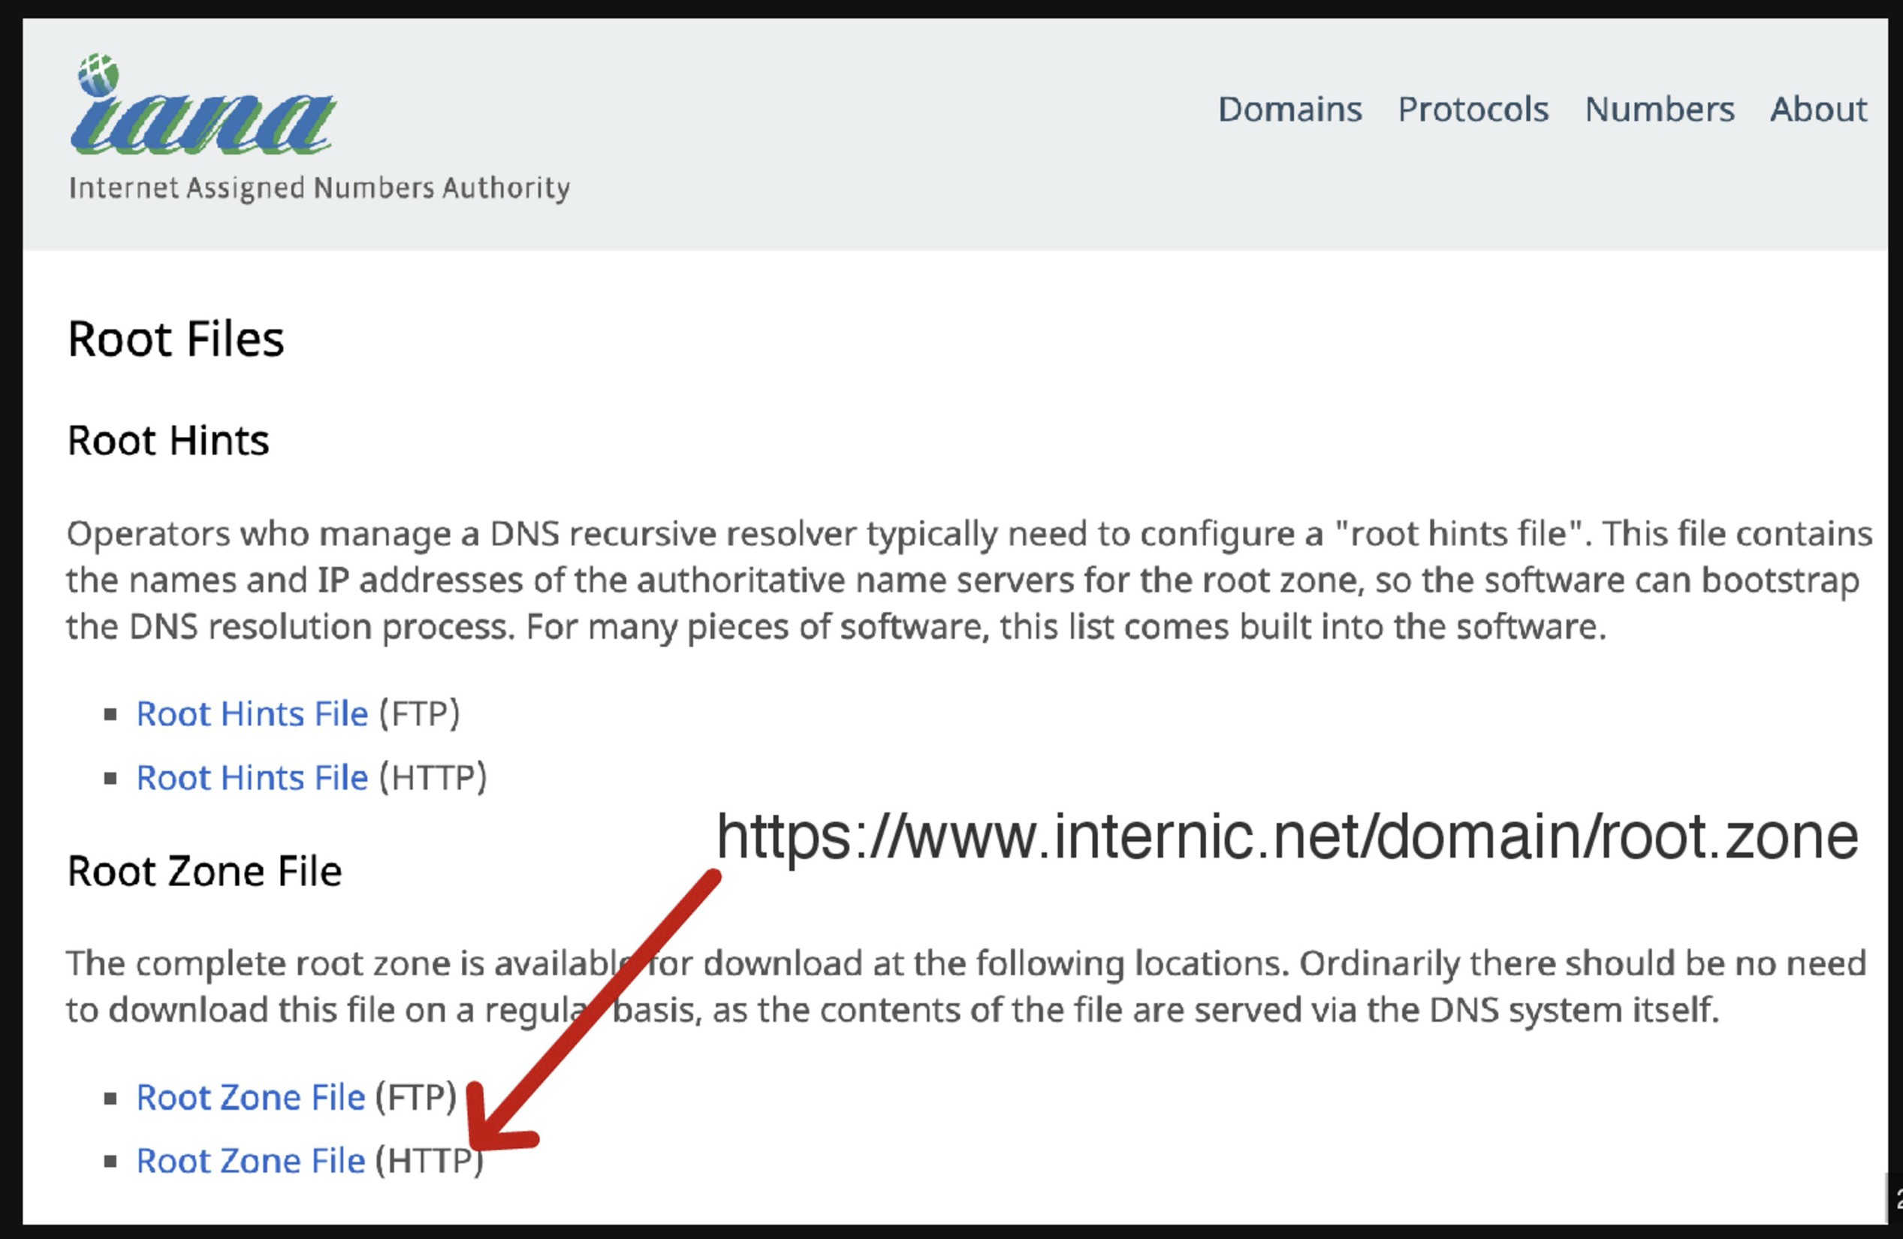
Cache the ENTIRE Root Zone

Slide 18
Cache the ENTIRE Root Zone
How?
  Bind config:
    // prime the server with knowledge of the root servers
    zone "." { type mirror; };
  Knot config:
    modules.load(‘prefil’)
    Prefill.config({ [‘.’] = { url=‘https://www.internic.net/domain/root.zone’, interval=86400 })
  Unbound config:
    auth-zone:
    name: "."
    url: "https://www.internic.net/domain/root.zone"
    fallback-enabled: yes
    for-downstream: no
    for-upstream: yes
    zonefile: "root.zone"
    prefetch: yes

Slide 19
Why?
Increased resolution speed
  It’s a local lookup every time
Improved privacy
  No root queries leak!
Decreased root zone attack surface
  Non-existent root label queries are answered directly by the resolver and not passed into the DNS
Reduced external service dependence in the DNS

Slide 20
Why don’t we...
Make a prefetch of the root zone the default action for recursive resolvers?
And fall back to incremental queries only when/if the prefetch fails
draft-wkumari-dns-localroot-bcp to be discussed at IETF124 proposes using a BCP to change the default behaviour of DNS resolvers to make localroot the default action

Slide 21
Thanks!

