Slide 1
I. Why is Securing the Internet’s Routing System so hard?
Geoff Huston, APNIC

Slide 2
Usual BGP Disaster-Porn Clips…

Slide 3
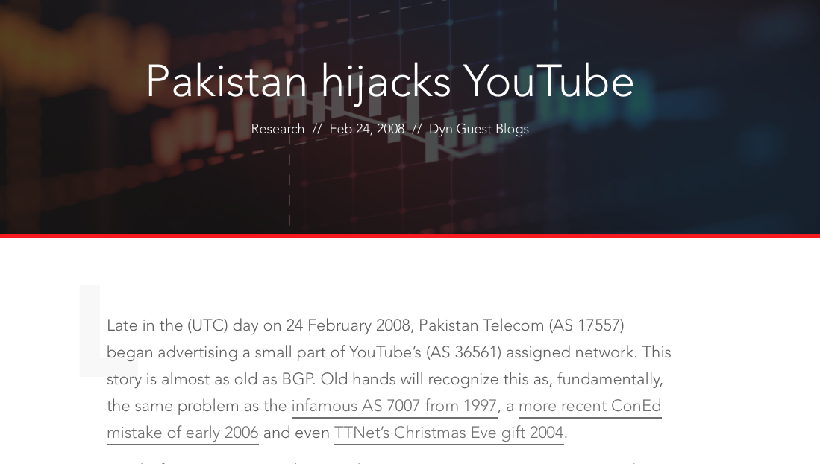

Slide 4
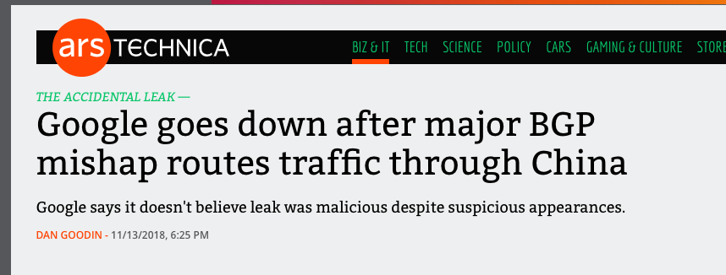
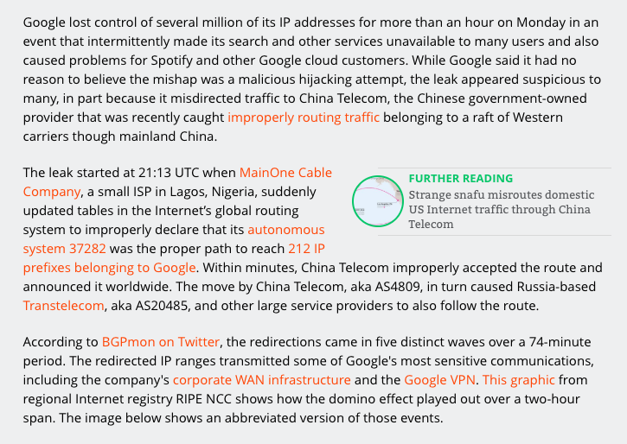

Slide 5
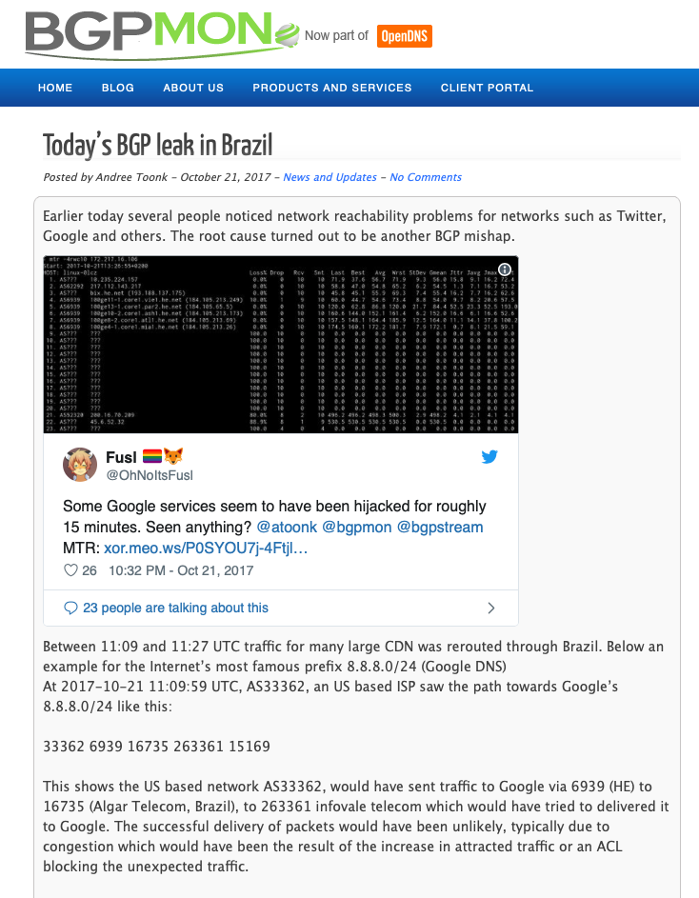

Slide 6
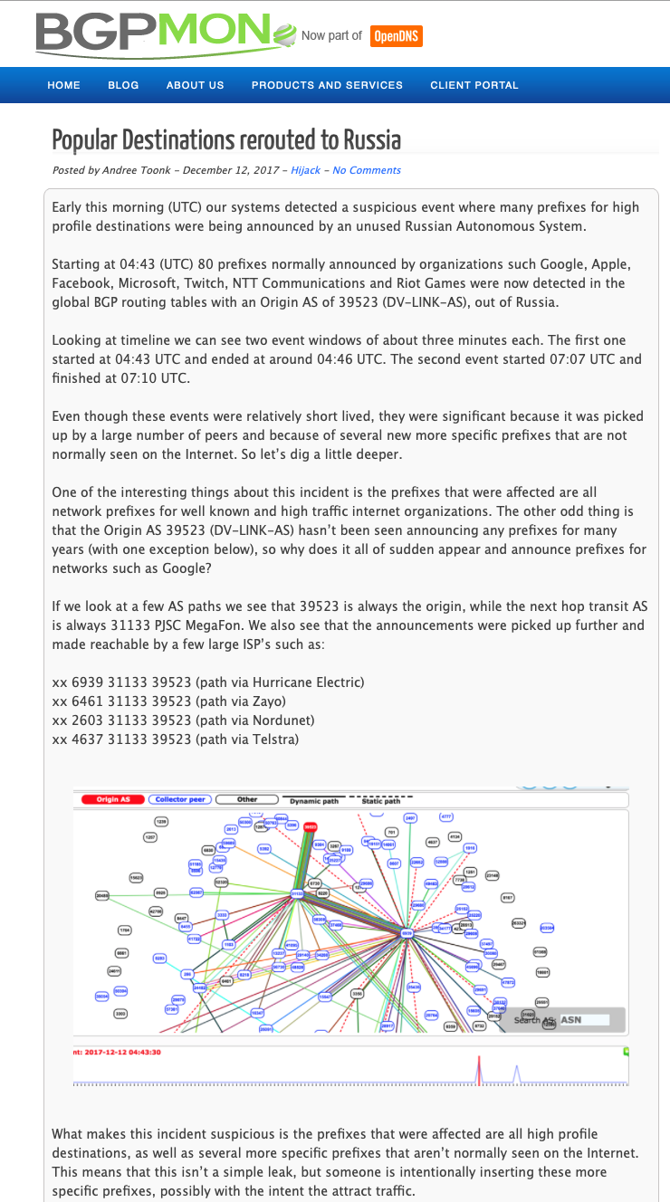

Slide 7
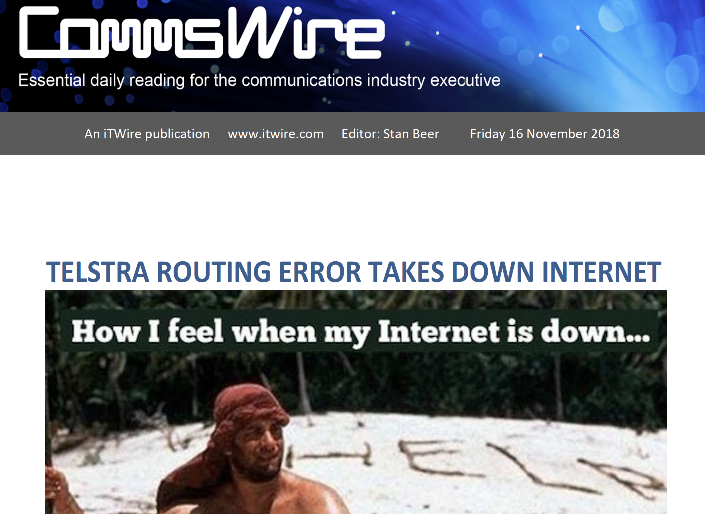

Slide 8
Degrees of Difficulty…
Why are some issues so challenging to solve, while others seem to be effortless?
For example: Why was the IPv4 Internet an unintended runaway success in the 90’s, yet IPv6 has been a decades-long protracted exercise in industry-wide prevarication?

Slide 9
Routing Accidents Abound
The majority of routing incidents are generally understood to be accidental in nature (rather than malicious)
Because if this, we generally don't react as aggressively when there is a routing incident, and so there aren't nearly as many reputational consequences for networks which originate such routing anomalies.
As an example, if the news had been ”<isp> maliciously steals traffic destined for X" instead of the meme of "Meh, routing is hard!" there may be more in terms of real world implications for <isp>…
  On the other hand, there is increasing interest by governments, particularly in the area of network support of vital services, and when these fail, even through operational mishap, there can be very real consequences, both in fatalities and to the company
    See “Optus and the 000 failure in September 2025”

Slide 10
Internet “Successes”
IPv4 (and datagram packet switching)
Network Address Translators (perversely!)
TCP evolution and adaptation
DNS
Content Distribution Systems
Streaming

Slide 11
Success Factors
Piecemeal deployment without the requirement for central orchestration
Tangible advantages to early adopters
Economies of scale as adoption numbers increase
Alignment of common benefit with individual benefit

Slide 12
Internet Non-Successes
Failures!
SPAM
DDOS defence
BCP 38 deployment
Secure end systems
Secure networks
Secure Routing

Slide 13
Failure Factors
Need for orchestrated actions (flag days)
Technologies that require universal or near universal adoption
Where there are common benefits but not necessarily individual benefits
No clear early adopter advantage

Slide 14
What makes a problem “hard?”
It might be technically challenging: While we understand what we might want that does not mean we know how to construct a solution
It might be economically mis-aligned: The costs of a solution are not directly borne by the potential beneficiaries of deploying the solution
It might be motivated by risk mitigation: We are notorious for undervaluing future risk!

Slide 15
Why is securing the Inter-domain Routing System so hard?
No single entity is in charge
We can’t “audit” a BGP speaker and its route set for “compliance”, as we have no standard reference route set to compare it with
We can’t arbitrate between conflicting BGP information (because there is no standard reference point)
There are no credentials that allow a BGP object to be compared against the original route injection (because BGP is a hop-by-hop protocol)
Because BGP route propagation is based on sequences of opaque local decisions

Slide 16
Why should we worry?

Slide 17

Because its too easy to be “bad” in routing

Slide 18
What’s the Risk?
User traffic gets diverted enabling a Man-in-the-Middle attack on a service
Re-directed network path
False route to server address
Service Point
User
“normal” network path

Slide 19
What’s the Risk?
Mount a Denial Attack:
  Divert the traffic to a sinkhole, thereby denying access to the service
    Crude, but effective!
>/dev/null !
Insert null route to server address
Service Point
User
“normal” network path

Slide 20
What’s the Risk?
DNS Attacks via Routing
Divert DNS traffic to fake DNS servers and provide fake answers
  Very few domains are DNSSEC-signed and nowhere near enough resolvers perform DNSSEC validation
  The faked answer can pass unchallenged

Slide 21
What’s the Risk?
Server Attacks Attacks via Routing
Divert TCP traffic to fake servers and provide fake answers
  The attacker can collect user credentials while shadowing the actual site
Re-directed network path
“shadow” path
route to faked server
Service Point
User
“normal” network path
21

Slide 22
An attack vector on HTTPS…
Let’s say you can find an online trusted CA
  that uses the DNS as proof-of-possession of a DNS name in order to mint a domain name certificate
  And the DNS name is not DNSSEC protected
You can mint a fake domain name certificate by:
  Mount a routing attack on the DNS infrastructure with a fake DNS responder
  Answer everything correctly except for *.victim ACME DNS challenge from the CA
  And for the *.victim challenge queries respond with your own answer
  Which means you can answer the CA’s DNS challenge
Now you have a trusted fake domain name certificate
You are now able to pull off a MITM attack on a TLS ‘protected’ service
A similar attack can be mounted in a web challenge environment by hijacking the IP address of the web service

Slide 23
“I want a Pony” Routing Security wish list
Identify whether an address is “bogus” or not
Assure that the address holder has given their permission for an address to be announced into the routing system
Identify which AS(s) have been given this permission
Identify if the AS Path is consistent with the ‘correct’ operation of BGP
Identify if the AS Path is consistent with the routing policies of the each of the Ases
Identify when routing information is being ‘incorrectly’ withheld

Slide 24
II. Background – How we got to here

Slide 25
Route Registeries
First used in the early 1990’s as the Route Arbiter Database (RADB) as part of the NSFNET program
Describes route origination and inter-AS routing policies
An explicit declaration of intent in routing
Route Registries can be used by others to filter BGP announcements, filtering out route advertisements that are not described in the route registry
  Primary value in preventing neighbor route leaks
  Can be used to prevent hijacks

Slide 26
RPSL and IRR Tools
Route Policy Specification Language
  A formal language to allow network operators to describer routing policies and a set of tools to help operators generate routing filters
Tools
  IRRToolSet, RtConfig, rpsltool
  Gather routing policy data from route registries and transform the data into a route filter set
  The route filter set is intended to filter route objects that do not match the declared route policy

Slide 27
Route Registry Issues
Poor Authority Model (or the complete lack of one in many cases!)
  How can a user know that a RR entry is genuine and current?
  How can a user know that a RR entry is maintained by an entity who is the authoritative “owner” of an IP address or ASN?
  How can a user tell the difference between a current RR entry and a lapsed historical RR entry?
Too many Route Registries
  If two different RRs contain conflicting information, what are users meant to do?
Incomplete Data
  If a route is not described in a Route Registry is it just the registry that is missing data or is the route itself invalid?
Scaling issues
  No realistic way to apply IRR filters to upstreams
RPSL got too geeky!
  The Route Policy Language used by Route Registries got overly expressive and complex to use

Slide 28
What’s missing in that picture?
If we want to improve the usefulness of route registries, we probably need a robust authority model
How about Digital Signatures?
The signatures can provide currency and authenticity
The authority model can allow RR entries to be seen as explicit authorities or permissions from address holders to network operators and from network operators to other networks

Slide 29
From trying to Secure Routing to trying to Secure the Routing Protocol - sBGP
sBGP – an effort to secure the “correct” operation of the BGP protocol
  Secure UPDATE messages to protect them from inflight tampering, assure the receiver of the authenticity of the sender, assure the receiver that the UPDATE was correctly addressed, and the sender was authorized to send the UPDATE
  Requires X.509 certificates and a PKI for address and ASN ownership
  Route origination required a signed authority by the address owner to permit the AS operator to originate the prefix
  Route propagation required the route advertiser to sign over the route, it’s AS Path and the AS of the peer that is receiving the route update
  Cannot validate route withdrawals
  Does not incorporate routing policy constraints

Slide 30
And an Alternative - soBGP
sBGP required intensive processing capability on routers, as route propagation requires a new signature for every propagation step for every prefix
soBGP used a “lighter” approach that combined route origination attestations with AS Adjacency (topology) attestations
  sBGP is able to verify the AS Path of an update, while soBGP can conclude that the AS Path represents a plausible path through the inter-AS topology
Neither can validate route withdrawals
Neither incorporates routing policy constraints

Slide 31
Deciding is hard
sBGP and soBGP represented different trade-offs between processing load and levels of assurance
A new Working Group (RPSEC) was formed to list the set of functional requirements that a secure routing framework should address
  The working group reached agreement on the require to add signed credentials to validate the function of route origination
  It stalled on the topic of path validation, with no consensus between path validation and path plausibility
  The group did not get around to considering adherence to policy constraints

Slide 32
Authority Injection
Both sBGP and soBGP had the issue of how to create a testable association of an address and AS number resource with the holder/operator of the resource
An effort was constructed on the foundation of RFC3779, with the active engagement of the Regional Internet Registries as Certification Authorities to build and maintain a PKI for IP number resources

Slide 33
RFC3779: X.509 Public Key Certificates for IP addresses and AS Numbers
An X.509 Public key certificate that includes a set of IP addresses and AS numbers
If a certificate can be validated against a trust anchor, then it indicates that:
  The IP addresses and/or AS numbers have been validly allocated
  The holder of the subject key pair is the current holder of the IP addresses and/or AS numbers
  Attestations validly signed using the private key can be considered as genuine authorities that cannot be repudiated

Slide 34
Route Origination Authority
An address holder can convey a ‘permission’ for an AS to originate a BGP route for the address by signing a permission authority (ROA) using a signing key associated with a valid public key address certificate
This authority:
  can be validated by any interested party
  is dated, so currency is known
  cannot be repudiated

Slide 35
If we all used ROAs then:
Identify whether an address is “bogus” or not
Assure that the address holder has given their permission for an address to be announced into the routing system
Identify which AS(s) have been given this permission
Identify if the AS Path is consistent with the ‘correct’ operation of BGP
Identify if the AS Path is consistent with the routing policies of the each of the Ases
Identify when routing information is being ‘incorrectly’ withheld

Slide 36
Is 3 out of 6 good enough to get a pony?
NO!
  The hijack can reproduce the origin and if the ROA is sloppy then it can use a more specific
  Even if the ROA is tight the conflicting routes can still support a desired attack profile

Slide 37
From ROAs to a fully secure BGP - BGPSEC
ROAs are good, but probably not enough to stop a determined routing attacker
  The attacker simply needs to replicate the BGP origination in the AS path to be accepted as “good”
So we really need to secure the BGP AS Path as well
We can do this with RPKI certs!
  Every eBGP speaker has a key that is certified by the AS
  When an update is passed to a neighbor AS, the router signs across the existing AS Path signature and the neighbor AS
  A BGPSEC speaker validates a received update by checking that
    there is a current ROA to describe the address and origin AS
    The received AS Path can be validated as a sequence of sign-over-sign operations by the AS keys
AS 1
AS 3
AS1 -> AS2
Signed AS1
AS1 -> AS2
Signed AS1
AS 2
AS2 -> AS3
Signed AS2
AS1 -> AS2
Signed AS1
AS 4
AS2 -> AS4
Signed AS2

Slide 38
But this form of ASPath protection is hard…
This is a replay of sBGP: BGPSEC cannot cope with partial adoption
  It cannot jump across non-participating networks
It has a high crypto overhead for session restarts
It does not define how to promulgate the collection of certificates required to validate the digital signatures
It does not necessarily identify and prevent route leaks
Which means that BGPSEC is not looking like its going to be deployed everywhere
  Which means that there is little value in deploying it anywhere

Slide 39
Reviving Path Plausibility
We were pretty convinced about the value of RPKI certificates and digital signatures
  Because we really have nothing better to offer in their place
But the AS Path protection elements of BGPSEC are a critical problem!
We revived a variant of soBGP’s AS connection certificate: ASPAs
  Combines part of inter-AS topology and path inter-AS routing policy
  An AS lists all of its “upstream” providers in a signed object
This can provide a form of path plausibility together with a set of policy filters

Slide 42
Additional Material
Some measurement snapshots
What can you do today
soBGP redux
Some General Comments

Slide 43
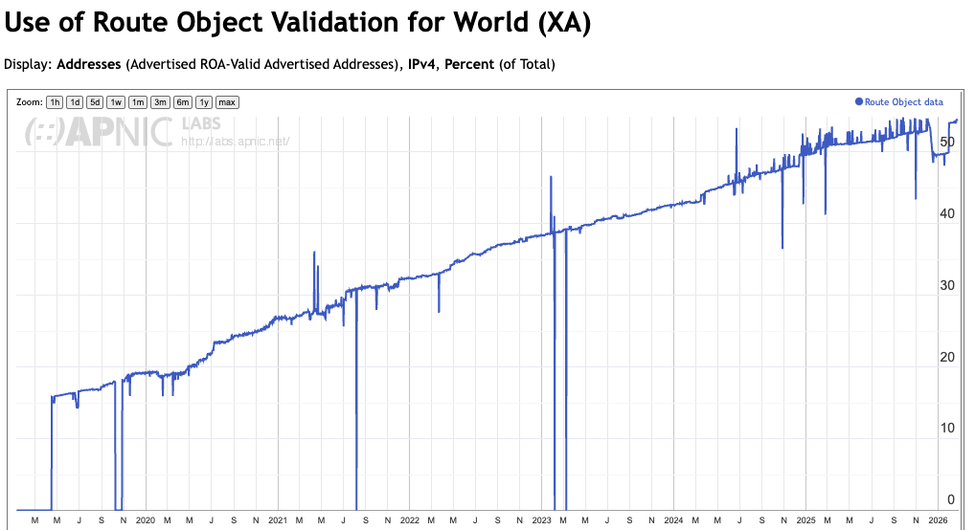
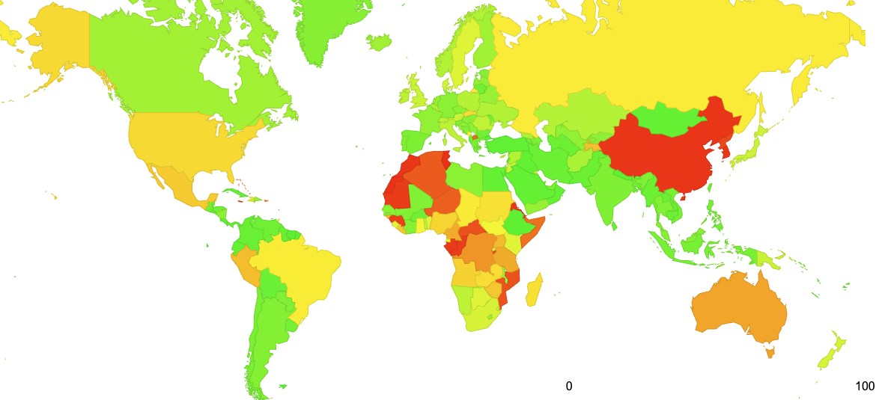
1 – Measurement Snapshots
ROA creation is VERY widespread
https://stats.labs.apnic.net/roas

Slide 44
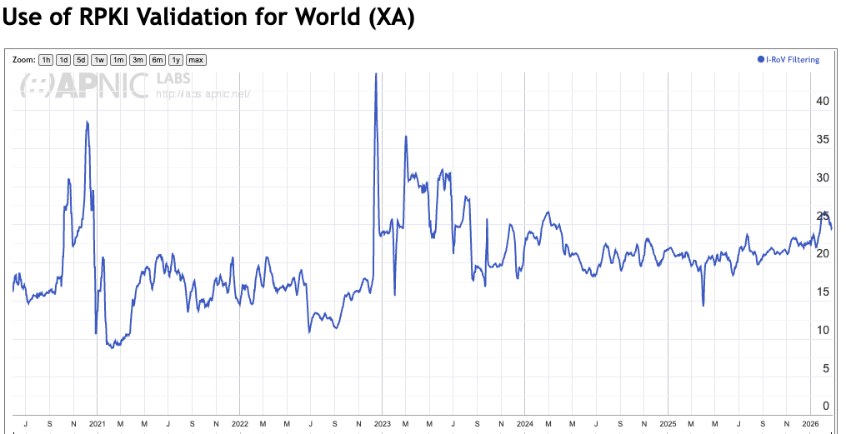
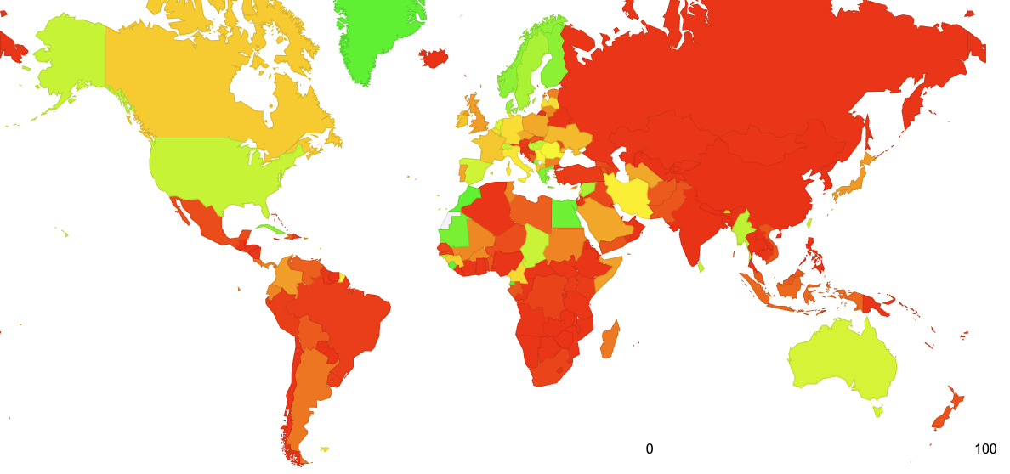
Measurement Snapshots
But applying ROAs to routing updates across all Ases has never really been adopted!
https://stats.labs.apnic.net/rpki

Slide 45
2. What can you do today?
“Don’t let the perfect be the enemy of the good!”
  You could just wait for a complete routing security framework to be invented
  Or you could do something practical right now that might be helpful

Slide 46
What can you do today?
You might want to take some steps to make routing attacks easier to detect and easier to deflect
  BCP38 filters can help
      UDP DOS attacks are very common
  Generating ROAs can help
      Maybe they won’t help a lot today, but as more networks filter on ROAs then they will be more effective to protect against simple address hijacking
  Route Registry objects can help
      www.irr.net
      Again this is not a complete answer, but its better than nothing
  You should really should filter your customers
    Filter customer routing updates according to BCP38, ROAs and IRR profiles
  Consider signing up to MANRS
    https://www.manrs.org/ (Even spending a few minutes thinking about routing security is better than not thinking about it at all)
  DNSSEC-sign your domain name
  Validate DNS responses

Slide 47
3. soBGP: an alternative to BGPSEC
Instead of the high overhead of AS Path validation we can look at secure origin BGP (soBGP) from 2003
soBGP looked at the AS Path as a topology vector composed of a number of paired AS adjacencies
  An AS publishes a signed adjacency attestation for all of its neighbors
  If a signing AS appeared in an AS Path then its neighbors in the AS Path must also by described in the adjacency attestion

Slide 48
soBGP and AS Adjacencies
AS 1
AS 3
AS3 -> AS2
Signed AS3
AS1 -> AS2
Signed AS1
AS 2
AS2 -> AS3
Signed AS2
AS Path Processing using AS Adjacency ‘hints’
AS1 -> AS2 -> AS3 plausible
AS1-> AS3 -> AS2 implausible
AS1-> AS2 -> AS3 -> AS4 implausible
AS2 -> AS1
Signed AS2
AS2 -> AS4
Signed AS2
AS 4
AS4 -> AS2
Signed AS4

Slide 49
soBGP compared to BGPSEC
Lower crypto overhead
Can be used in scenarios of partial adoption
Does not prevent a network from learning false information, but prevents a network being used in a falsified AS path
  Unless you also include the AS’s peers
  And so on
  Incremental deployment generates incremental benefit
Can include directionality in the AS adjacency attestation
  As a simple “policy” filter

Slide 50
soBGP compared to ASPAs
ASPAs add the aspect of a policy assertion into a eBGP peering session – namely that one network is an “upstream” provider to the other
  Routes learned from one provider cannot be propagated to another provider
Can ASPAs provide robust assurances in scenarios of partial deployment?
Is a unilateral assertion of BGP adjacency an adequate protection against rogue AS’s generating bogus assertions?

Slide 51
4. Generic Concerns over PKIs
Is a trust hierarchy the best approach to use?
  The concern here is concentration of vulnerability
    If validation of routing information is dependent on the availability and validity of a single root trust anchor then what happens when this single digital artifact is attacked?
  But is there a viable alternative approach?
    Can you successfully incorporate robust diversity of authentication of security credentials into a supposedly highly resilient secure trust framework?
This is a very challenging question about the nature of trust in a diverse networked environment!
Web trust – 1,500 CAs vs DNSSEC trust – 1 key
Which is ‘better’?

Slide 52
Generic Concerns over universality
A major issue here is that of partial use and deployment
  This security mechanism has to cope with partial deployment in the routing system
    The basic conventional approach of “what is not certified and proved as good must be bad” will not work in a partial deployment scenario
  In BGP we need to think about both origination and the AS Path of a route object in a partial deployed environment
    AS path validation is challenging indeed in an environment of piecemeal use of secure credentials, as the mechanism cannot tunnel from one BGPsec “island” to the next “island”
  A partially secured environment may incur a combination of high incremental cost with only marginal net benefit to those deploying BGPsec

Slide 53
Generic Concerns: Prevention vs Detection
Is certification the only way to achieve useful outcomes in securing routing?
  Is this form of augmentation to BGP to enforce “protocol payload correctness” over-engineered, and does it rely on impractical models of universal adoption?
  Can various forms of routing anomaly detectors adequately detect the most prevalent forms of typos and deliberate lies in routing with a far lower overhead, and allow for unilateral detection of routing anomalies?
  Or are such anomaly detectors yet another instance of “cheap security pantomime” that offer a thinly veiled placebo of apparent security that is easily circumvented or fooled by determined malicious attack?

