Slide 1
IPv6
Geoff Huston AM

Slide 2
Why?

Slide 3
Because we ran out of IP addresses

Slide 4
Again.

Slide 5
We’ve been here before ...
The original ARPAnet design from 1969 used the NCP protocol, which used 8 bit addresses in the NCP packet header
  Maximum network span of 256 nodes
  Enough?
  Well yes, because at the time computers were the size of entire rooms, cost many millions of dollars and there were only a few thousand in the entire world.
  At the time, the entire concept of shrinking the computer to something you could hold in one hand and trying to connect billions of them together was just too far into the future to worry about

Slide 6
Transition V1.0
Turns out that 8 bits of addresses was not enough for the next generation of mini-computers
ARPAnet undertook a transition from NCP to a new protocol: TCP/IP:
  Expansion from 8-bit to 32-bit addresses
  Flag Day: 1 January 1983
  Shutdown and reboot every node into the new protocol!

Slide 7
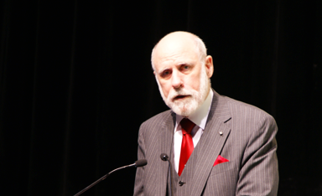
“This time, for sure!” *
* Actually Vint Cerf didn’t say this!

Slide 8
IP Version 4
32-bit address field
  That’s 4,294,967,296 addresses!
In 1983 that looked like enough for a HUGE number of computers

Slide 9
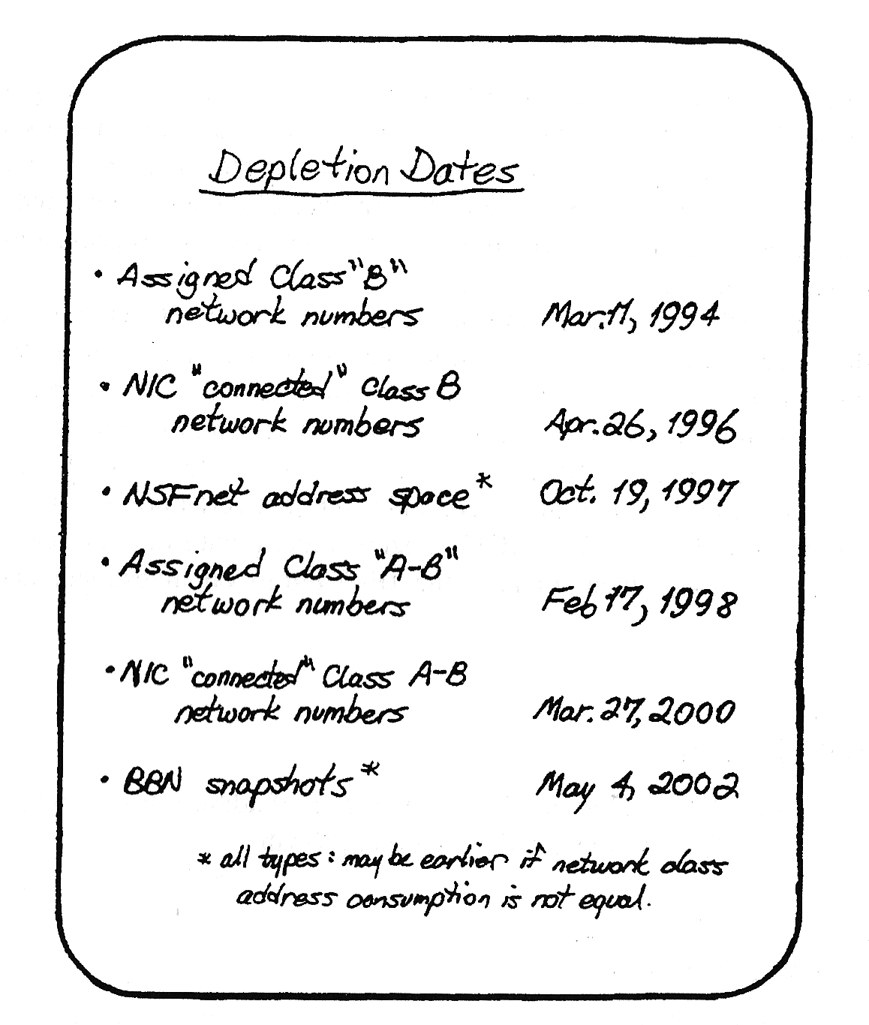
Digital Pressures
Through the 1980’s computers changed from large expensive pieces of ironware to desktop consumer products
  The size of the computer market changed from thousands to tens of millions
And the prospect was even smaller, cheaper and more
  By 1990 that 4 billion address space was looking pretty small
  And it was not going to last much longer!
Frank Solensky – IETF 1990
Presentation on IPv4 Address Depletion Predictions

Slide 10
What did we do? We paniced!
This was a brutal wakeup call
  We had hardly started with the Internet and its demise was just 4 years away!
  We rapidly worked on short term responses to push this exhaustion date out
  To give us more time to work on the longer term solutions
So:
  We dropped the classful address plan
  We introduced NATs to allow address sharing
  We worked on a new protocol

Slide 11
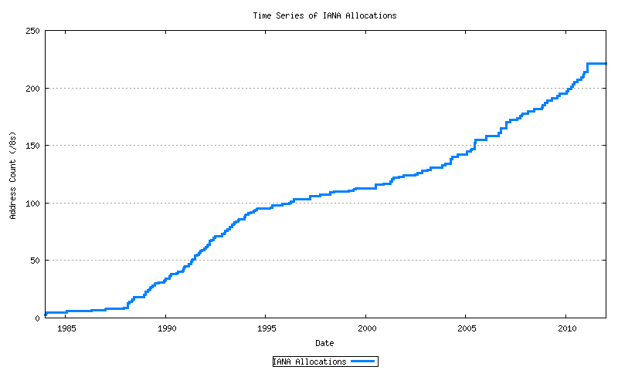
The short-term band aid worked!
14 years of extra time
Exhaustion!
Mobiles
GFC
Broadband
Boom & Bust
CIDR
A&R networks
The short term response to imminent depletion
NSFNET

Slide 12
That longer term plan
Was to develop a new IP protocol
And then transition the Internet over to use this new protocol

Slide 13
What is this new protocol?

Slide 14
IPv6!

Slide 15
IPv6 is…
IPv4 with larger address fields
Not much else changed
  It’s still an address-based stateless datagram forwarding protocol
  It still has decoupled forwarding, routing, naming, transport
  The interfaces to the underlying media protocols are largely unchanged
  The APIs to interface to the upper layers are largely unchanged
The transition to IPv6 should be easy!

Slide 16
Aside: “Not much else changed”

Slide 17
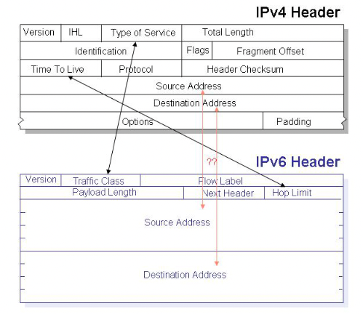
Aside: “Not much else changed”
What actually changed with IPv6:
6 fields were preserved
7 fields were removed

Slide 18
Aside: “Not much else changed”
What changed with IPv6:
  128 bit address fields
  Semi-Fixed host/network boundary
  Replace Broadcast and ARP with Multicast and SLAAC
  Removed on-the-fly fragmentation with source fragmentation
  Make Fragmentation Controls an optional Extension Header
  No NATS!
  Flow Label
  Change “Options” to “Extension Headers”
  Multi-Addressing
  Scoped Addresses

Slide 19
128 bit addresses
Network ID
Interface ID
64 bits
64 bits
We experimented with a constant interface ID for a while, and realised that this was an unacceptable privacy leak if the value was held constant
So clients use a temporary random interface identifier for the low order 64 bits
Which means that the constant length of an IPv6 address is back to 64 bits

Slide 20
The Flow ID
Huh?
It probably sounded like a reasonable thing at the time
But no one remembers what its good for!
So that’s 20 waste bits in the header!

Slide 21
Extension Headers
Don’t work on today’s silicon!
High speed switching gear that wants to preserve TCP and UDP packet flows need to see the TCP and UDP headers at a fixed offset in the packet header
Extension headers are a chained header structure where each header points to the next header, with the transport header at the end of the chain
Unravelling that chain in very high speed silicon is a challenging task
Easier to drop all IPv6 packets with extension headers!

Slide 22
Fragmentation Control
Packet Fragmentation was a big feature of the IPv4 design
  It allowed new media types to the integrated into the Internet environment seamlessly
  But it had a performance cost
The IPv6 design disallowed fragmentation on the fly
  If a packet is too big for the next hop you need to send a signal to the source and discard the too-big packets
  This is slow and unreliable
  The signalling is also uinreliable
  So the best response is to avoid packet fragmentation completely
  Which means that packets in IPv6 tend be 1,280 octets
  Which has a performance cost

Slide 23
No NATs!
Really?
We’ve grown addicted to NATs and IPv6 NATs are already a common feature of IPv6

Slide 24
Aside: “Not much else changed”
What’s giving us grief with IPv6:
  128 bit address fields
  Semi-Fixed host/network boundary
  Replace Broadcast and ARP with Multicast and SLAAC
  Removed on-the-fly fragmentation with source fragmentation
  Make Fragmentation Controls an optional Extension Header
  No NATS!
  Flow Label
  Change “Options” to “Extension Headers”
  Multi-Addressing
  Scoped Addresses

Slide 25
Transition should be easy?
Right?

Slide 26
Transition should be easy?
Well, no, not really!

Slide 27
Why is this taking so long?
IPv6 was a minimal change to IPv4
  So early adopters found little in the way of an early adoption benefit
IPv6 was not backward compatible with IPv4
  This is a key “feature” of protocols that use fixed length addresses in their packet headers – you can’t jam all 128 bits into a 32 bit field.
  This meant that IPv6 hosts could not directly communicate with IPv4 hosts
  IPv6 adopters still had to support IPv4
  This meant that EVERYONE has to transition to dual stack BEFORE we can drop IPv4

Slide 28
Transition, the second time around
That last point is important – let me repeat it for you:
This meant that EVERYONE has to transition to dual stack BEFORE we can drop IPv4
  A “Flag Day” switchover is impossible
  Piecemeal replacement won’t work either, as IPv6 is not backward compatible with IPv4
  So, we need to run both protocols in tandem “for a while”
  But bear in mind that one protocol has already run out of addresses
  And network growth continues at record levels

Slide 29
What we thought was the IPv6 Transition Plan
Size of the Internet
IPv6 Deployment
IPv6 Transition – Dual Stack
IPv4 Pool Size
Time

Slide 30
The Plan
We would build in a piecemeal fashion “islands” of dual stack networks while we still had adequate amounts of IPv4
The IPv6 islands were meant to grow faster than the Internet itself
Over time the dual stack “islands” would link up
Once the entire Internet was dual stack we could drop IPv4

Slide 31
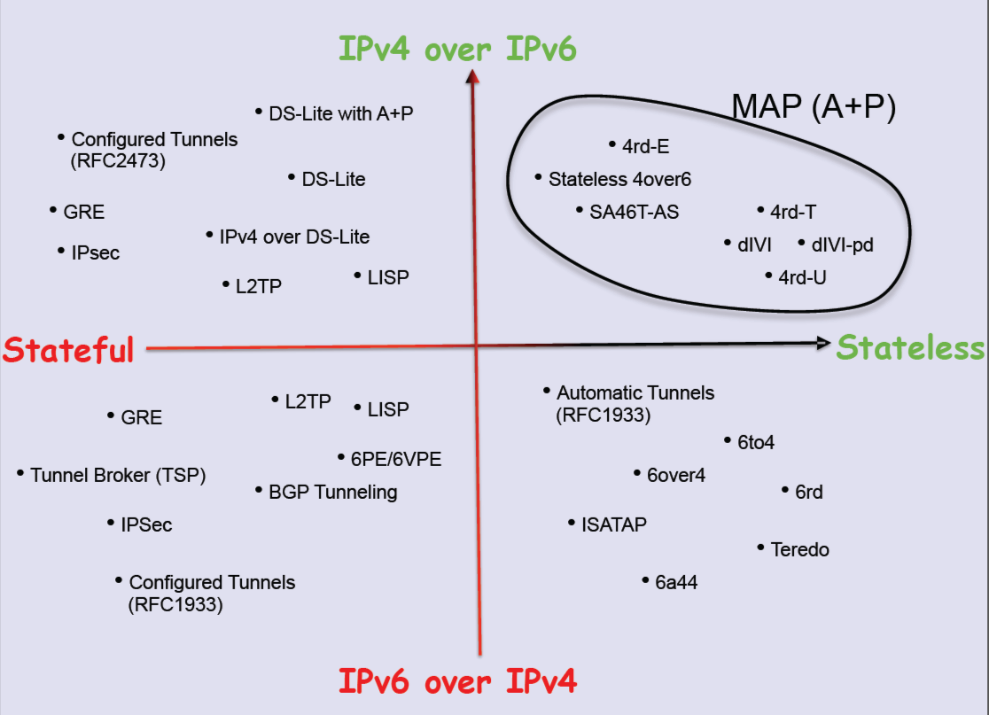
But Dual Stack is hard
Our only tools were tunnelling and/or translation

Slide 32
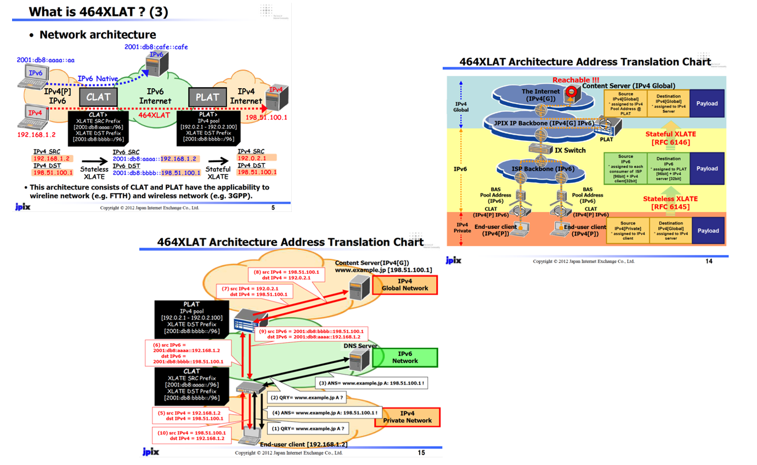
Complexity layered on complexity

Slide 33
The IPv6 Transition Plan as it happened!
IPv4 Pool Size
Size of the Internet
IPv6 Deployment
IPv6 Transition – Dual Stack
Time

Slide 34
Why did we stuff up this transition?

Slide 35
“The Internet” does not exist
Noone is in control
  The Internet is not a singly managed entity
  Noone is there to tell anyone else what they can (or cannot) do
  The Internet is a collection of markets (Goods and services, Transmission and switching, Technologies, …)
  We find it impossible to orchestrate collective synchronised actions across all these distinct activities
  So the status quo accumulates a huge amount of inertial momentum
  Which makes it terribly hard to change direction in an orderly manner!

Slide 36
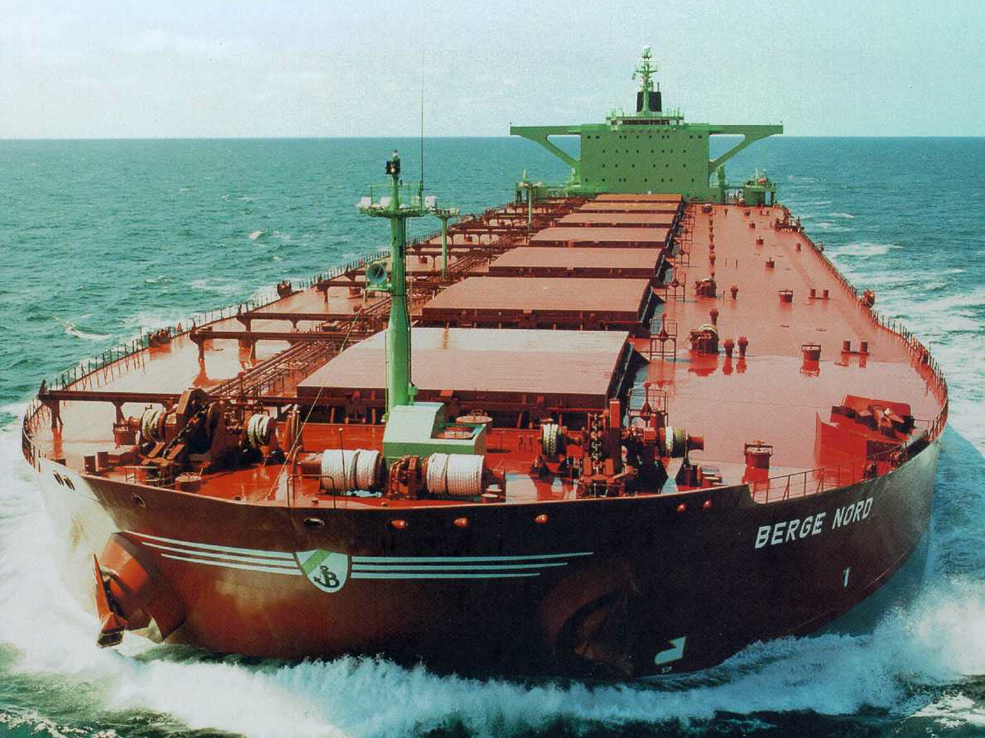
The transition is more like this!

Slide 37
It’s now 2026 and we are still in this transition
We underestimated the awesome ability of NATs to squeeze out address efficiencies – the past decade of massive growth on the Internet has been largely based on various forms of NAT usage
NATs expanded the usable IPv4 address capacity by a further ~20 bits
  Each bit of increased address size doubles the total capacity of the space
  It’s taken us much longer than we thought to fill up these additional address bits
  There is no common sense of urgency here

Slide 38
So how is this transition going?
Slowly!

Slide 39
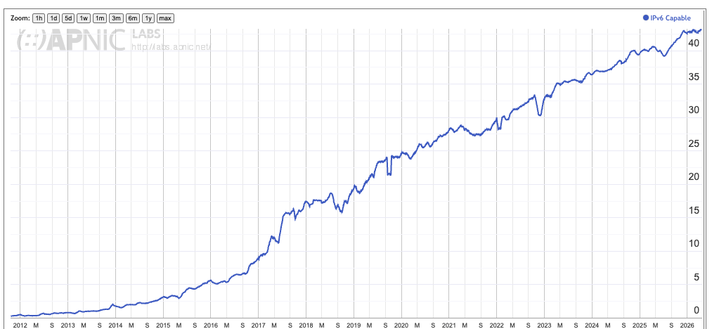
Let’s look at progress so far
% of Internet Users
Date

Slide 40
Why is this taking so long?
NATs are just too good!
  NATs drive every part of today’s internet, and we’ve adapted the entire IP infrastructure and application space to work in a NAT environment
  And we changed the architecture of the Internet into a client/server model
    Where clients don’t need permanently assigned public addresses
  NATs have allowed us to build a network with some 40 billion connected devices – and we are confident that we can grow further

Slide 41
Why is this taking so long
The transition timetable is not being set by the early adopters
  There is not enough competitive advantage for early adopters to drive the transition
The transition timetable is not being set by the late adopters
  At some point the last to adopt cannot impose a hold over everyone else
Transition is a form of “majority” decision making
  It’s a case of “critical mass” that will determine at what point dual stack service providers will contemplate dropping IPv4 and completing their part of the transition

Slide 42
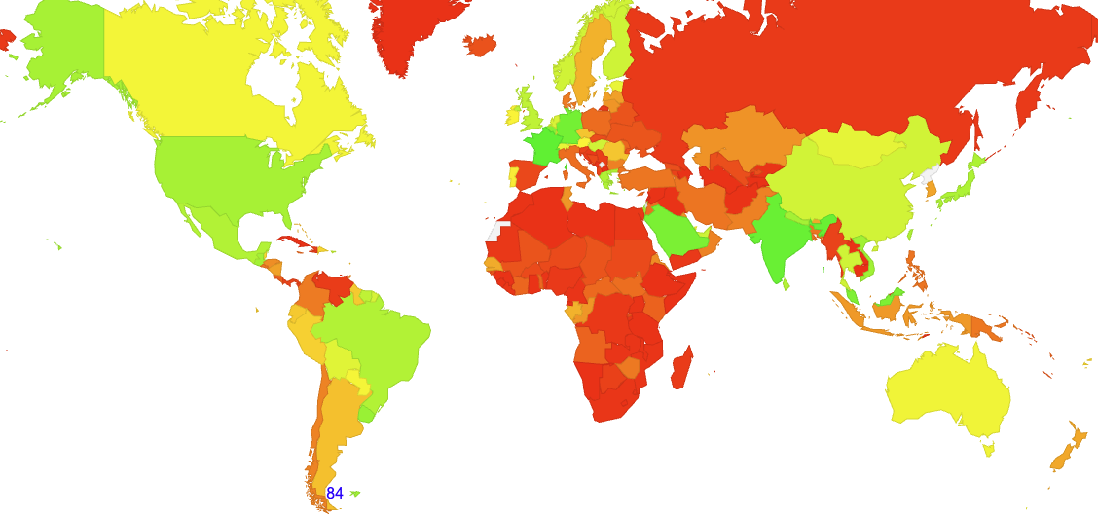
IPv6 Adoption today
0
Not everywhere – not all at once

Slide 43
Will we ever complete this transition?
Or is this the wrong question?

Slide 44
If not IPv6 then what?

Slide 45
Longer Term Trends
Pushing EVERYTHING out of the network and over to the edge!
Transmission infrastructure is becoming an abundant commodity
  Sharing technology (multiplexing) is decreasingly relevant
We have so much network and computing that we no longer have to bring consumers to service delivery points - instead, we are shifting services towards consumers and using the network to replicate servers
With so much computing and storage the application is becoming the service, rather than just a window to a remotely operated service

Slide 46
Do networks matter any more?
We have increasingly stripped out network-centric functionality in out search for lower cost, higher speed, and better agility
We are pushing functions out to the edge and ultimately off “the network” altogether and what is left is just dumb pipes
What defines “the Internet”?
  A common network, a common protocol and a common protocol address pool?
  or
  A disparate collection of services that share common referential mechanisms?

Slide 47
What’s important in a loose confederation of access networks?
Unique endpoint addressing?
  Hardly
Routing?
  Nope!
Names and references?
  That’s all that matters!

Slide 48
Some issues to think about
What matters in such a network?
  Addressing – IPv4 / IPv6 / IPv? Absolute? Relative?
    Is universal unique end-point addressing a 1980’s concept who’s time has come and gone?
  Naming and Name Spaces – DNS evolution?
    Are ”names” a common attribute of the network, or an attribute of a service environment?
  Referential Frameworks?
    In a world of densely replicated service delivery points how does a client rendezvous with the “best” service point? Does the client work it out? Or the network? Or the service?

Slide 49
From Addresses to Names
AN IP address is NO LONGER an endpoint identity - It’s an ephemeral session token to allow the network to distinguish the traffic between various active sessions
Much of what we build upon these days is the name infrastructure (using the DNS)
  It may not have been a deliberate choice, but we’ve been building name-based networks for the past decade or so
  And so far, it’s been working!

Slide 50
Thanks!

