Slide 1
Measuring DNS over IPv6
Geoff Huston AM
APNIC Labs

Slide 2
RFC Recommendations
RFC3901 – September 2004 “DNS IPv6 Transport Operational Guidelines”:
  Every recursive name server SHOULD be either IPv4-only or dual stack
  Every DNS zone SHOULD be served by at least one IPv4-reachable name server
Which is saying as an IPv6 Operational guideline “you better keep IPv4 going”
This RFC actually says very little about IPv6!

Slide 3
Proposed: 3901bis
Current IETF draft proposed to update RFC3901 by saying:
It is RECOMMENDED that are least two NS for a zone are dual stack name servers
Every authoritative DNS zone SHOULD be served by at least one IPv6 reachable authoritative name server
Which is saying as an IPv6 Operational guideline “time to take IPv6 seriously” and NOT saying that servers need to keep IPv4 around– which is largely the opposite of the advice in RFC 3901!

Slide 4
The assumption behind 3901bis
That IPv6 is now a mature and well understood technology, and using IPv6 as the transport for the DNS is as efficient and as fast as using IPv4

Slide 5
The assumption behind 3901bis
That IPv6 is now a mature and well understood technology, and using IPv6 as the transport for the DNS is as efficient and as fast as using IPv4
Is this true in today’s Internet?

Slide 6
IPv6 and the DNS
How widely is the use of IPv6 supported in the Internet’s DNS?
If you placed authoritative servers on an IPv6-only service how many users would be able to reach you?

Slide 7
Measuring the DNS
Is not as straightforward as it might sound…

Slide 8
Measuring DNS Resolver Behaviour
We really don’t understand what a “resolver” is!
  It could be a single platform running an instance of DNS resolver code
  It could be a collection of independent back-end systems with a load distributor front end facing clients
  It could be a hybrid collection where the back ends synchronise each other to emulate a common cache
  It is a stub, recursive, or forwarding resolver, or a hybrid behaviour distributed across multiple resolution systems
  A resolver may have 1 client, or millions of clients, or anything in between
When we talk about DNS Resolvers it’s challenging to understand exactly what we are talking about!

Slide 9
Measuring “DNS Queries”
We don’t understand what “a query” is!
  Which sounds silly, but the distributed resolution process causes a ‘fan out’ of queries as part of the resolution process when a single query may cause a number of ‘discovery’ queries to establish the identity of the authoritative server(s) for the name
  Resolvers all use their own timers for retransmission
  Queries have no “hop count” or “resolver path” attached - there is no context to understand the reason for a query
  Queries appear to have a life of their own!

Slide 10
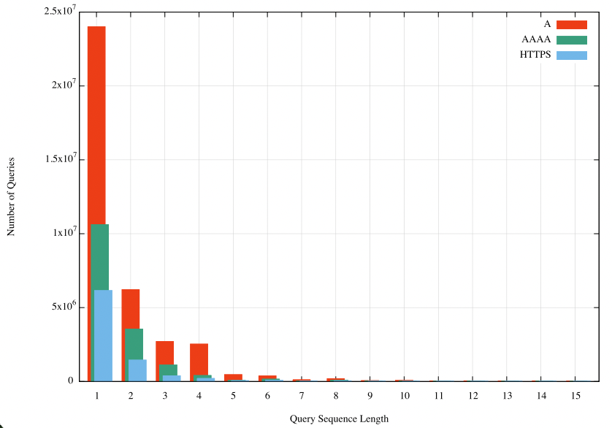
Also, the DNS is noisy!
The DNS cannot use multiple query types in the one DNS transaction – if an application wants to establish the IPv4 address, the IPv6 address, and the application level protocol for service (HTTPS query), then that’s three distinct queries in today’s DNS

Slide 11
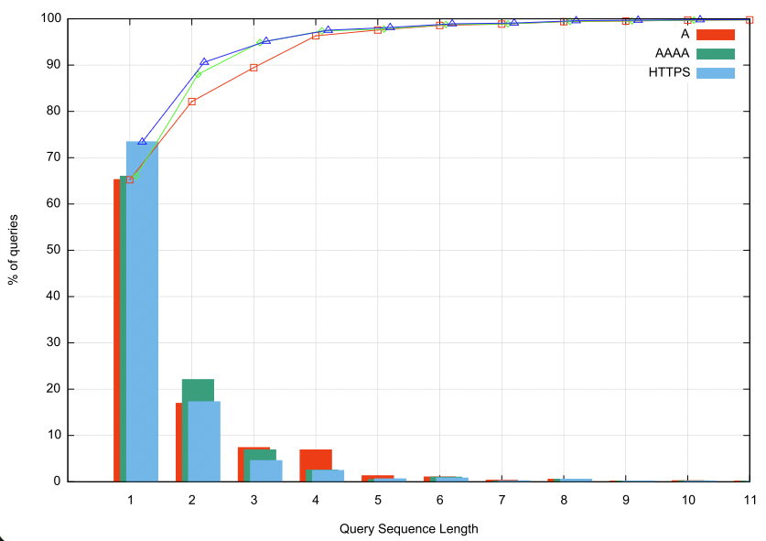
The DNS is VERY noisy!
There are many repeated DNS queries:
  25% - 35% of query name + type are repeated 2 or more times for the A / AAAA / HTTPS query types
The use of UDP transport motivates approaches of rapid-fire query fan-out to compensate for unpredictable response times

Slide 12
APNIC’s DNS Experimental Rig
We use Google’s ad network to “seed” DNS queries
We make parts of the DNS name unique to each measurement
  That way the recursive resolvers have no cached data and are forced to query the authoritative server
We observe the recursive-to-authoritative query process by instrumenting the authoritative server, and match experiment placement records to the server’s DNS logs
Authoritative Server
We insert DNS queries into the stub resolver via ad presentation
DNS
We instrument the DNS Authoritative Server
Stub
Resolver

Slide 13
Back to the measurement question

Slide 14
IPv6 and the DNS
How widely is the use of IPv6 supported in the Internet’s DNS?
If you placed authoritative servers on an IPv6-only service how many users would be able to reach you?

Slide 15
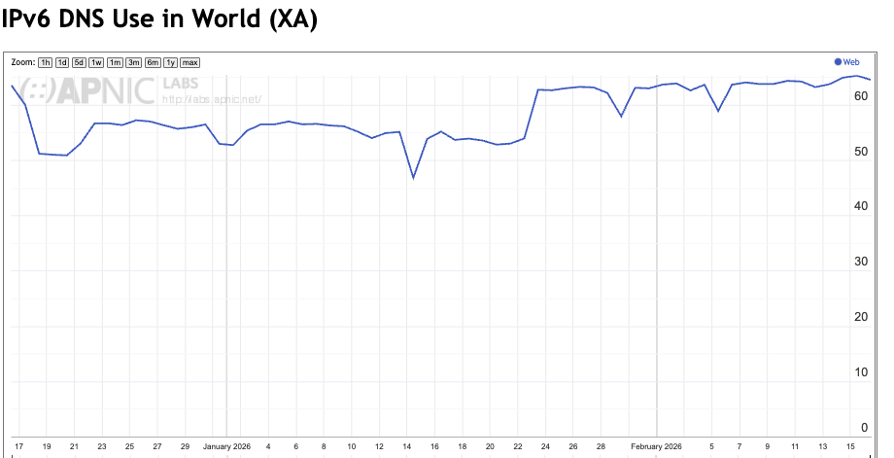
Use of IPv6 Transport in the DNS

Slide 16
How “good” is this measurement?
We place the 1x1 web blot behind a unique DNS name whose only Authoritative Server can only be queried by using IPv6 transport
  The 1x1 blot is itself on a dual stack server and the DNS zone contains both A and AAAA records
  But this DNS resolution is only accessible if the resolver can pose the DNS query over IPv6
So, it looks like a reasonable measurement – right?

Slide 17
But
We are counting the absence of data – i.e. the number of sample points who do not fetch a 1x1 blot
Some users may not even attempt to make the DNS query – the user may terminate the ad script early
Some users may successfully query the DNS over IPv6, yet fail to perform the 1x1 blot fetch
  Should we count those DNS-query-only users as a positive result?
  But what if the DNS result is being filtered by filtering middleware?

Slide 18
A DNS-base Measurement
Can we perform this same measurement of IPv6 capability in the DNS using only the DNS?

Slide 19
A DNS-base Measurement
Can we perform this same measurement of IPv6 capability in the DNS using only the DNS?
  Yes, by using a “glueless delegation”

Slide 20
Glueless Delegation in the DNS
Parent Zone: example.com
Query: a.example.com to example.com server
Resp: Referral, name server nsa.sibling.com
(with no attached glue for this NS name)
…
a NS nsa.sibling.zone.
…

Slide 21
Glueless Delegation in the DNS
IPv6 Only
Parent Zone: example.com
Sibling Zone: sibling.zone
…
a NS nsa.sibling.zone.
…
. NS ns.sibling.zone.
ns AAAA 2001:db8::1
…
nsa AAAA 2001:db8::2
…
Query: nsa.sibling.zone to ns.sibling.zone server
Resp: IP AAAA records for nsa.sibling.com
( the name server is IPv6 only)

Slide 22
Glueless Delegation in the DNS
IPv6 Only
Parent Zone: example.com
Sibling Zone: sibling.zone
. NS ns.sibling.zone.
ns AAAA 2001:db8::1
…
nsa AAAA 2001:db8::2
…
…
a NS nsa.sibling.zone.
…
IPv6-only
Child Zone: a.example.com
. NS nsa.sibling.zone.
…
. A 192.0.2.2
AAAA 2001:db8::2
Query: a.example.com to nsa.sibling.zone server
Resp: IP A/AAAA records for a.example.com

Slide 23
Glueless Delegation in the DNS
IPv6 Only
Parent Zone: example.com
Sibling Zone: sibling.zone
. NS ns.sibling.zone.
ns AAAA 2001:db8::1
…
nsa AAAA 2001:db8::2
…
a NS nsa.sibling.zone.
…
If you can query the child zone, then your DNS resolver environment can make
queries over IPv6 and can receive responses
IPv6-only
Child Zone: a.example.com
. NS nsa.sibling.zone.
…
. A 192.0.2.2
AAAA 2001:db8::2

Slide 24
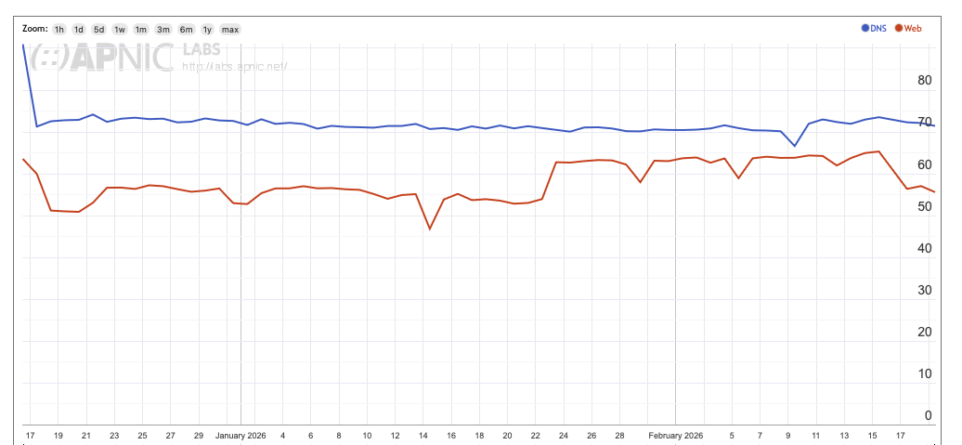
Comparing the two measurements
15%
Why are these two measurements giving different results?

Slide 25
Why are they different?
There is an expectation that the glueless resolution of a name is the DNS does not rely on application behaviour – the entire measurement is undertaken within the DNS’s recursive resolution process, so the client’s stub resolver cannot abort the DNS resolution process.
We expect that the DNS result would be “higher” due to the lossy nature of the application’s DNS to Web fetch transition. The global average of this difference is around 10%.
But averages can hide anomalies…

Slide 26
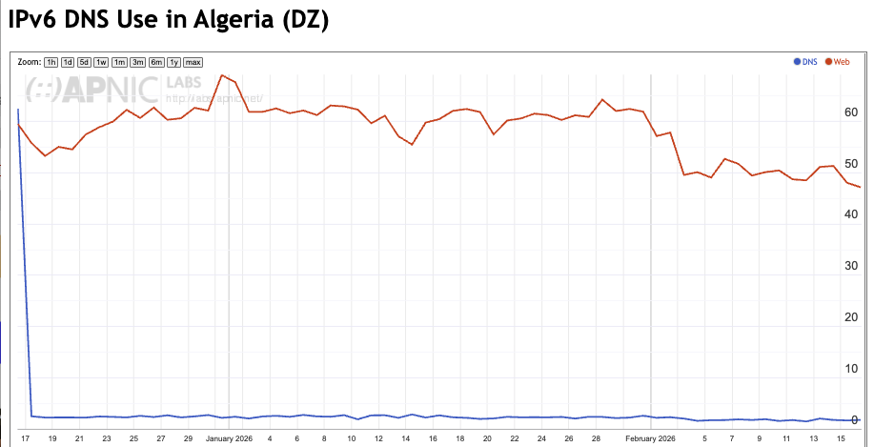
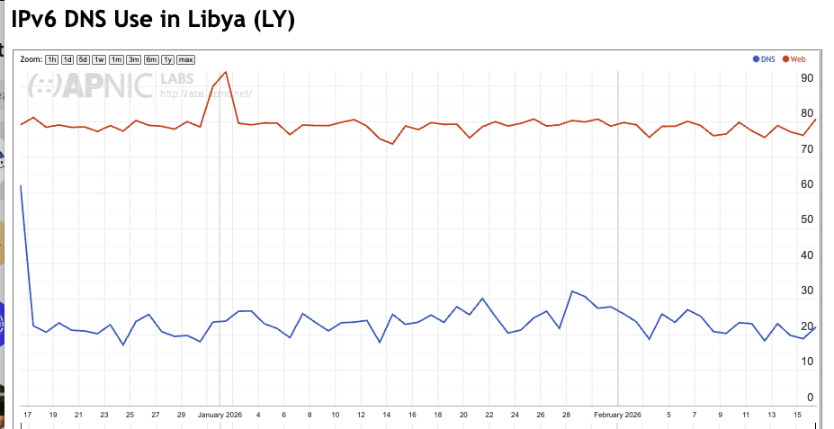
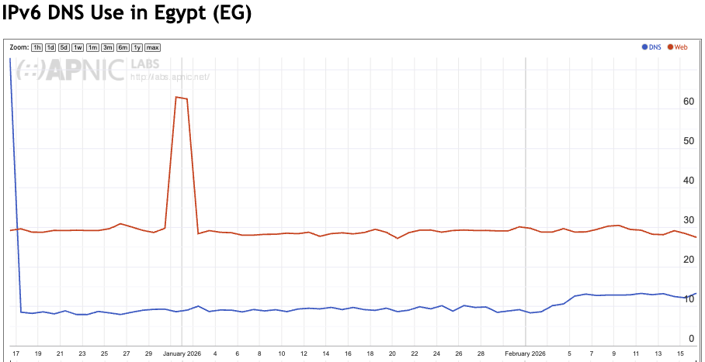
Measurement Anomalies!
Web
Web
-60%
-60%
DNS
DNS
Web
-20%
DNS

Slide 27
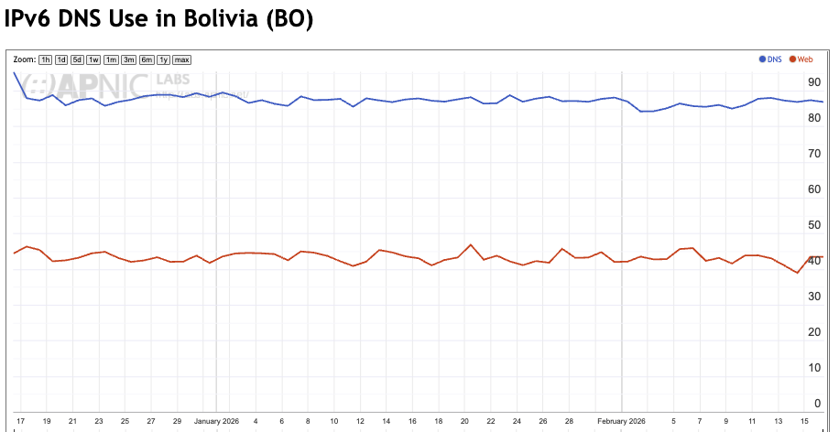
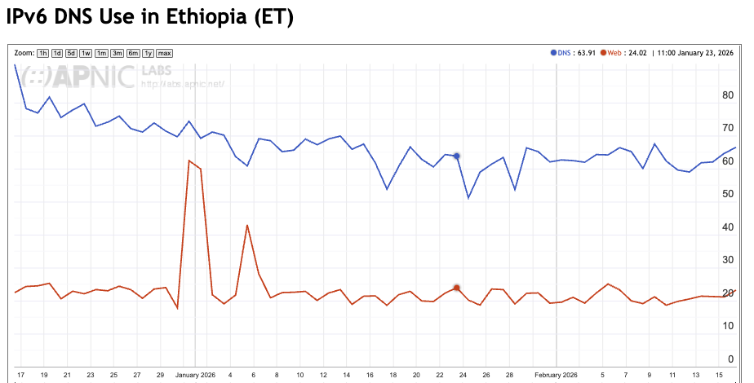
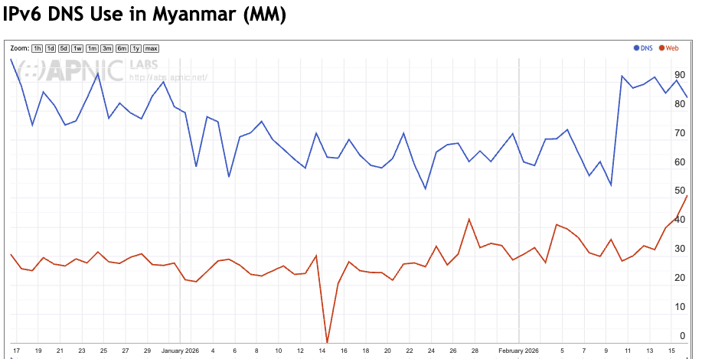
More Anomalies
DNS
50%
DNS
40%
Web
Web
DNS
50%
Web

Slide 28
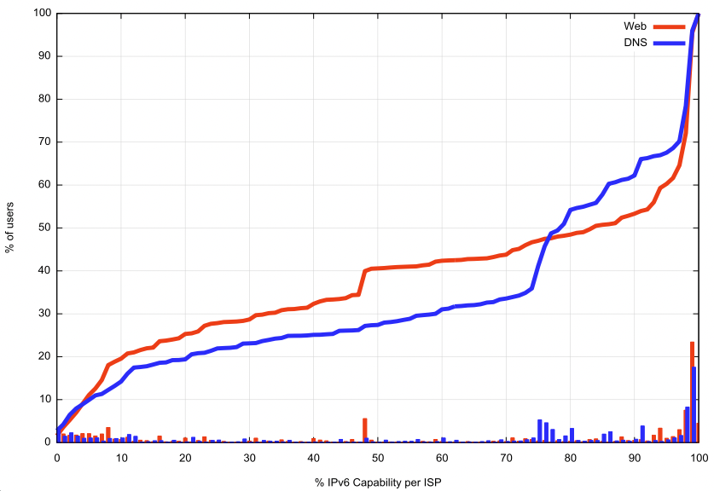
Distribution of Web and DNS Results per Origin AS

Slide 29
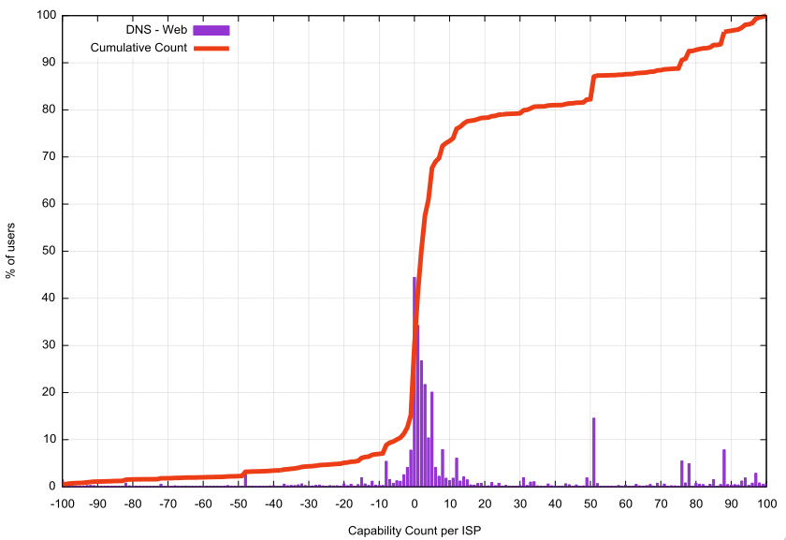
DNS vs Web
Web signal gives a higher result
DNS signal gives a higher result
Web fetch is unreliable
DNS Glueless delegation is blocked

Slide 30
DNS vs Web Measurement
Here the web results differ from the DNS measurements they appear to be between 10% to 20% lower
What if we take the maximum of Web and DNS results?

Slide 31
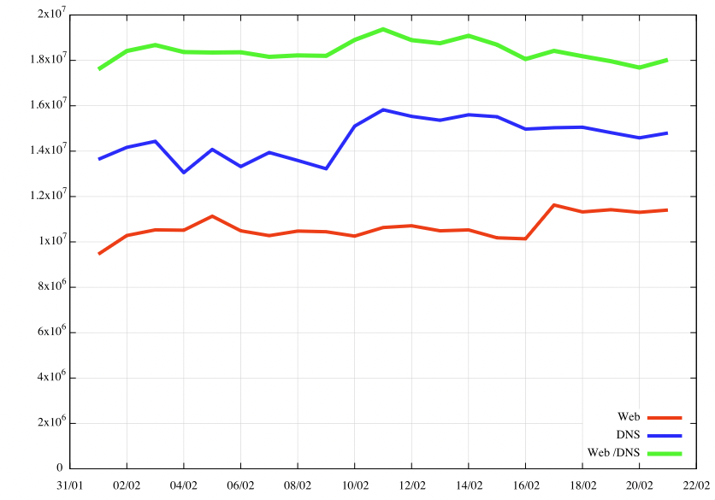
Combined Web and DNS Measurement
Completion Rates:
The DNS measurement has a significantly higher completion rate compared to the Web-based measurement
When combined, one third of the completed DNS measurements did not also complete the Web measurement
+80%
+40%

Slide 32
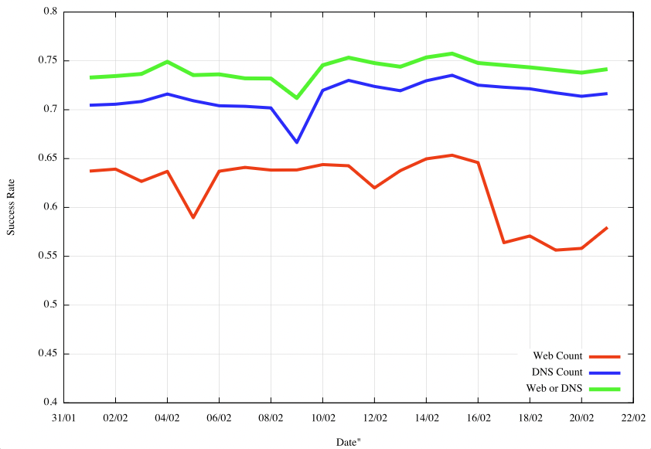
Combined Web and DNS Measurement
Adding the Web measurement to the DNS measurement only adds a further 3% to the overall result
There is a small population of users where the Web fetch indicates a successful query to a IPv6-only server, yet the DNS-only method failed to give an answer
There is a larger population of users where the DNS-only result indicates success, but there is no web object fetch

Slide 33
Observations
The deployed DNS behaves in more complex and obscure ways than a simple stub/recursive/authoritative model of DNS infrastructure might suggest
  Large scale DNS content filtering and DNS monitoring appear to motivate some of this additional DNS behaviour complexity
Nevertheless, for many DNS behaviour measurements, remote observation of the DNS is more effective using techniques of Glueless Delegation over Web object fetching

Slide 34
That’s it!
Questions?

